Slide 1
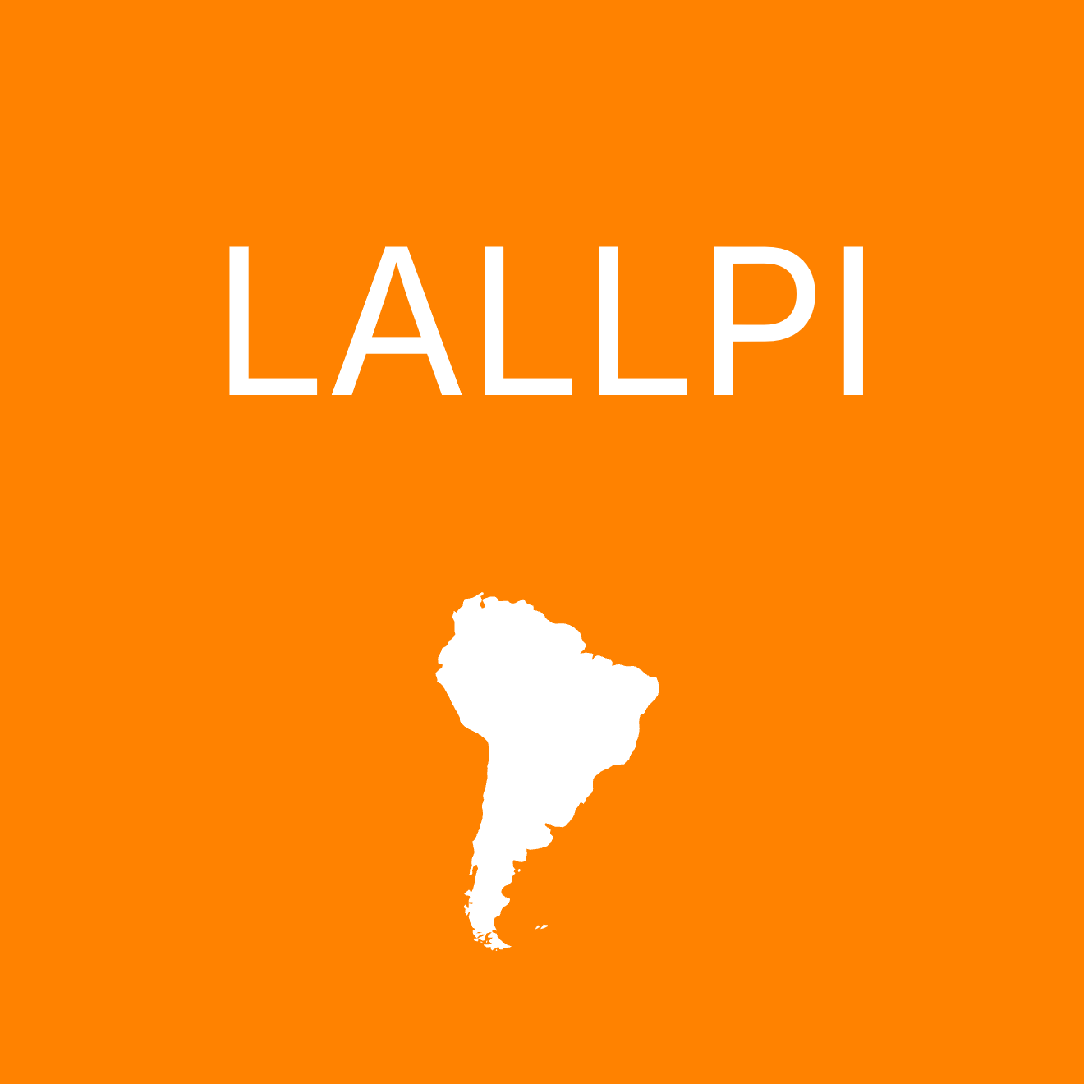
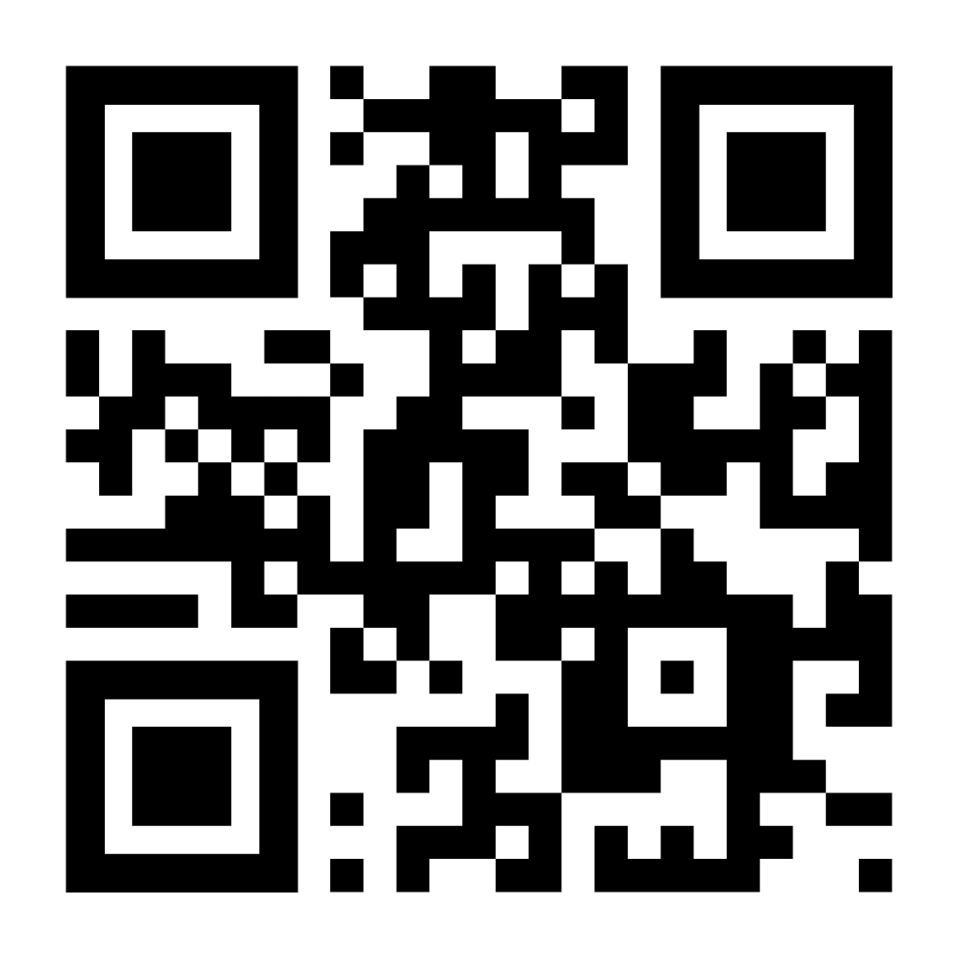
LALLPI
Latin American Left-Leaning Populism Index
Does populist rhetoric become populist policy?
LALLPI doesn’t just track what leaders say – it tracks what they do.
By combining populist rhetoric with actual economic and institutional policy, the index reveals when talk becomes action, and when it doesn’t.
Most populist regimes, 2018
PEP = Economic populism • PIP = Institutional populism
1 Venezuela 79.8 POP | 2 Bolivia 45.5 POP | 3 Nicaragua 40.3 POP | 4 Ecuador 38.4 POP | 5 El Salvador 27.5 POP | 6 Colombia 14.5 POP
PEP 68.6 PIP 91.1 | PEP 31.6 PIP 59.3 | PEP 19.6 PIP 61.3 | PEP 34.0 PIP 42.7 | PEP 17.1 PIP 37.9 | PEP 14.1 PIP 14.8
25 countries • 2000-2020
lallpi.netlify.app
N. Cachanosky | J. P. Bastos | A. Padilla
Center for Free Enterprise
The University of Texas at El Paso

