Slide 1
CAN DOLLARIZATION CONSTRAIN A POPULIST REGIME? THE CASE OF RAFAEL CORREA IN ECUADOR
Nicolás Cachanosky
Metropolitan State University of Denver
Alexander W. Salter
Texas Tech University
Ignacio Savanti
Universidad del CEMA

Slide 2
Introduction
21st Century populism in Latin America literature
What do we know?
Rafael Correa’s presidency (2007 – 2017) is one of the iconic left-leaning populist regimes in the region
He seized significant political power
Empirical work estimates significant economic costs produced by these populist regimes …
… except for Ecuador
Ecuador is the only dollarized economy in the sample
Dollarization is a monetary constitution
Can dollarization constrain (to some degree) a populist regime?

Slide 3
Introduction
Why did Ecuador dollarize its economy?
Serious financial and economic crisis in the later 1990s
No foreseeable alternatives (for instance, a currency board)
Who dollarized
The public (private sector) first [informal dollarization]
Then the government followed [formal dollarization]
Dollarization survived
Correa’s populist regime and an attempt to issue digital currency
The 2008 financial crisis
How can dollarization constrain a populist regime?

Slide 4
What is dollarization
A country adopts a foreign currency
Domestic central bank ceases its operations
Dollarization works as a monetary constitution
Not possible to monetize deficits
Not possible to run domestic monetary policy
The central bank cannot operate as a lender of last resort
Ecuador’s situation is “similar” to that of a US state with respect to the Federal Reserve
Dollarization is a non-reversible reform

Slide 5
Populism in Ecuador
President | Term | Global Populism Database | V-Party
José María Velasco Ibarra | 1968 – 1973 | 1.67 | N/A
Gustavo Noboa | 2000 – 2002 | 0.23 | 0.74
Lucio Gutierrez | 2003 – 2005 | 0.97 | N/A
Alfredo Palacio | 2005 – 2006 | 0.39 | N/A
Rafael Correa | 2007 – 2009 | 1.25 | 0.98
Rafael Correa | 2009 – 2013 | 1.73 | 0.96
Rafael Correa | 2013 – 2017 | 1.53 | 0.96

Slide 6
Ecuador versus other populist regimes
Other populist regimes
Argentina
Bolivia
Nicaragua
Venezuela
Looking at:
Institutional indices: Ecuador performs equal or better than the other populist regimes
Economic indicators: Still to be included… ☹

Slide 7
Dollarization versus Correa
Two examples of how dollarization constrain a populist regime
Through a stricter budget constrain
The failed attempt to issue digital currency

Slide 8

Dollarization as a stricter budget constraint
Let
Government spending: $G$
Taxes: $T$
Government debt: $ΔB$
Monetization: $ΔM$
Other forms of wealth extraction: $X$
Confiscations
Expropriations
Nationalizations

Slide 9
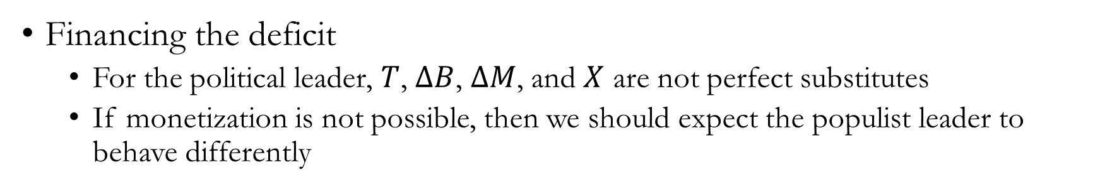
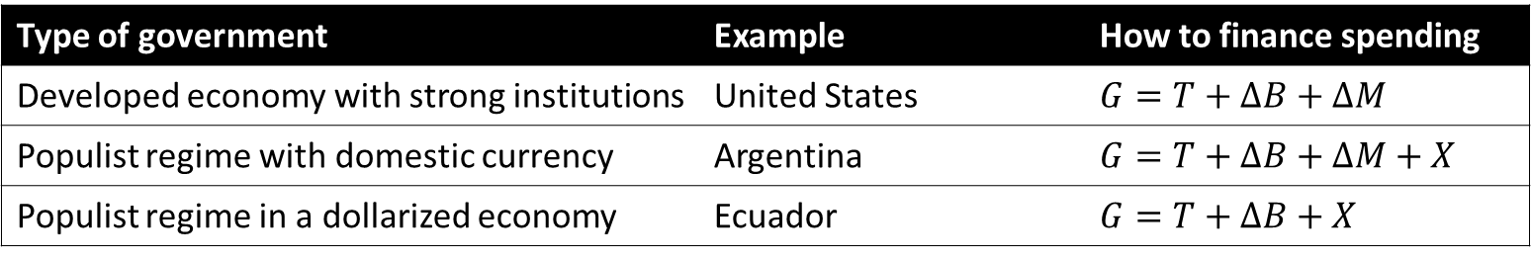
Dollarization as a stricter budget constraint
Type of government | Example | How to finance spending
Developed economy with strong institutions | United States | $$G=T+ΔB+ΔM$$
Populist regime with domestic currency | Argentina | $$G=T+ΔB+ΔM+X$$
Populist regime in a dollarized economy | Ecuador | $$G=T+ΔB+X$$
Financing the deficit
For the political leader, $T$, $ΔB$, $ΔM$, and $X$ are not perfect substitutes
If monetization is not possible, then we should expect the populist leader to behave differently

Slide 10
Dollarization as a stricter budget constraint
Government spending under Correa
Fiscal expenditures (in terms of GDP)
2006: 14.9%
2017: 23.3%
Paid with
Some taxes
Tax (5%) on capital outflows
10% of tax revenues
But mostly with debt
Foreign + Domestic debt in terms of GDP
2006: 26.5%
2017: 41.3%

Slide 11
Dollarization as a stricter budget constraint
Going around the budget constraint
Buy-back debt
Exaggerate populist (anti-market) rhetoric and behavior
Have the price of bonds fall (higher country-risk premium)
Get money from your friend Chávez in Venezuela and buy-back bonds
Default!
Claim some debt is illegitimate because it was issued by past illegitimate governments
Default those bonds
Issue now debt with China (to be paid back in oil)

Slide 12
Dollarization as a stricter budget constraint
Populist turns on populist: Conviction or necessity…?
In 2015 Correa’s popularity starts to decline (so does the growth of the economy)
Oil price start to fall
Cut on public spending
Proposal to impose an inheritance tax of 77.5%
Correa appoints Lenin Moreno to be his successor
Moreno was his Vice President between 2007 and 2013
Moreno wins the presidential elections

Slide 13
Dollarization as a stricter budget constraint
Populist turns on populist: Conviction or necessity…? (cont…)
As long as the economy is growing, there are new resources to distribute among interest groups
Political coalition
Labor unions
Legislators
Judiciary
Armed forces
When the economy stagnates (or worse, falls), the “printing press” is not available to “buy” political loyalty
Interest groups must fight and turn against each other to secure resources from shrinking source

Slide 14
Dollarization as a stricter budget constraint
Populist turns on populist: Conviction or necessity…? (cont…)
Lenin Moreno almost immediately turns against Correa
The market-friendly turn must be credible
Reduce subsidies
Remove some import tariffs
Re-instate limited presidential terms (goodbye Correa for good)
Sign deals with the IMF and the World Bank
Remove political appointees still loyal to Correa
Seems that Moreno’s turn may have been more because of necessity than conviction

Slide 15
Dollarization as a stricter budget constraint
Populist turns on populist: Conviction or necessity…? (cont…)
Other regimes
Argentina: Populism continues with increasing (and very high) inflation rates
Bolivia: Evo Morales’ presidency was interrupted
Nicaragua: Daniel Ortega manages to have low inflation
Venezuela: Populist regime continues with very high inflation rates

Slide 16
Digital currency
Correa: “Dollarization is a monetary suicide”
2014: Digital currency is launched
Issued and stored at the central bank
Managed through a phone app that only state-owned telephone company was allowed to distribute
Prohibit the use of other cryptocurrencies (such as Bitcoin)
Less than three years later, the digital currency is discontinued
Despite tax benefits to users
Expectation versus reality
Expected 500,000 accounts
Open account: 410,000
Active accounts: 205,000

Slide 17
Digital currency
How did the program work?
Central bank issues digital claims to US dollars
It is similar to a commercial bank that holds fractional reserves on US dollar deposits
The success of issuing claims to US dollars depends on the trustworthy of the issues
In this case, Correa by now a well-known populism
Recent default in 2008
Including cease of payments to bonds held by the central bank
Distrust seems to have been rational
The government mandated commercial banks to re-patriate their foreign deposits
The government mandated the central bank to lend US dollars to the treasury

Slide 18
Digital currency
Three previous initiatives to restrict the use of US dollars
2008: Issue of low denominations T-bills intended to be used as currency to make payments
Pay to government contractors
Did not allow to pay taxes in T-bills
Circulation increased when in 2016 government allowed to pay taxes in T-bills
2009: FactoRepo
A B2B “bond points”
Combine invoices of buyers and sellers and credit “bond points” to the net creditor
Use “bond points” for payments
2012: Mobile Payment System
Mobile (digital) money to be issued by the central bank
Private banks pushed-back

Slide 19
Digital currency
Motivations
De-dollarization
Unlikely it would succeed in the short-run
Fiscal resource
The more digital currency circulates, the more of an interest rate free loan the government gets
EMBI+ climbed from 510bp in 2014 to 1000bp in 2015/2016
Retail payments: 10% by bank transfers
More individuals with mobile phones than with bank accounts

Slide 20
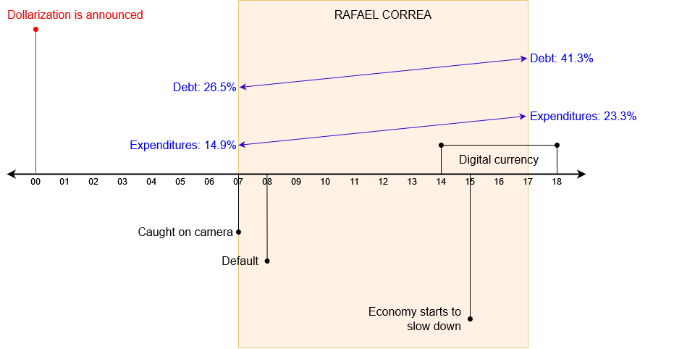
Timeline

Slide 21
Next steps
Things we still want to work on
More background on the process of dollarization
Include economic variables of Ecuador and other populist regimes
More information on the failed attempt to issue the digital currency

Slide 22
Q&A

