Slide 1
ST695_SPD_Analysis

Slide 2
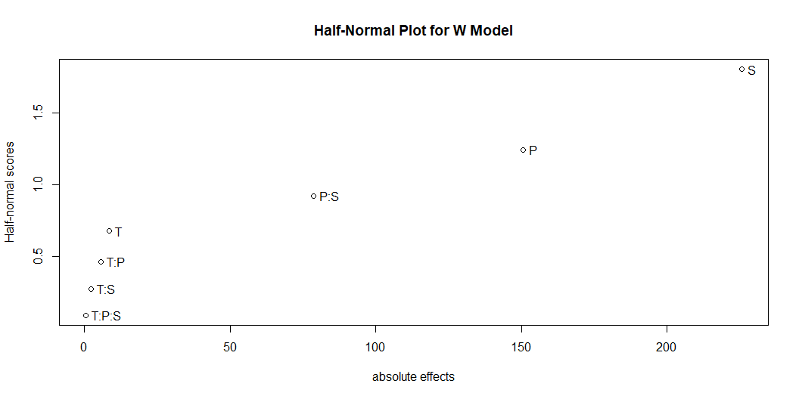
Instantiate Libraries
Import SP PLA Data Set
SP PLA Data Set
T P S D R WP Y_S 1 -1 -1 -1 -1 -1 1 445.5 2 -1 -1 -1 -1 1 1 437.1 3 -1 -1 -1 1 -1 1 198.0 4 -1 -1 -1 1 1 1 151.8 5 -1 -1 1 -1 -1 2 147.0 6 -1 -1 1 -1 1 2 88.5 7 -1 -1 1 1 -1 2 90.0 8 -1 -1 1 1 1 2 74.2 9 -1 1 -1 -1 -1 3 890.0 10 -1 1 -1 -1 1 3 864.9 11 -1 1 -1 1 -1 3 317.2 12 -1 1 -1 1 1 3 249.3 13 -1 1 1 -1 -1 4 299.2 14 -1 1 1 -1 1 4 292.9 15 -1 1 1 1 -1 4 164.2 16 -1 1 1 1 1 4 125.5 17 1 -1 -1 -1 -1 5 434.2 18 1 -1 -1 1 -1 5 231.0 19 1 -1 -1 1 1 5 113.4 20 1 -1 1 -1 -1 6 144.9 21 1 -1 1 -1 1 6 67.5 22 1 -1 1 1 -1 6 73.3 23 1 -1 1 1 1 6 55.8 24 1 1 -1 -1 -1 7 882.6 25 1 1 -1 -1 1 7 891.3 26 1 1 -1 1 -1 7 334.5 27 1 1 -1 1 1 7 207.9 28 1 1 1 -1 -1 8 277.2 29 1 1 1 -1 1 8 274.8 30 1 1 1 1 -1 8 168.6 31 1 1 1 1 1 8 120.3
Method 1 (Ordinary Least Squares)
Call: lm.default(formula = formula_1, data = Ys_data) Residuals: Min 1Q Median 3Q Max -62.225 -26.034 -0.719 27.928 58.100 Coefficients: Estimate Std. Error t value Pr(>|t|) (Intercept) 299.0906 9.0640 32.998 2.03e-15 *** T -3.1156 9.0640 -0.344 0.735815 P 98.4344 9.0640 10.860 1.67e-08 *** S -145.0969 9.0640 -16.008 7.72e-11 *** D -131.9031 9.0640 -14.552 2.97e-10 *** R -19.4969 9.0640 -2.151 0.048181 * T:P 0.2406 9.0640 0.027 0.979171 T:S -3.0781 9.0640 -0.340 0.738867 T:D -0.9719 9.0640 -0.107 0.916033 T:R -2.8156 9.0640 -0.311 0.760350 P:S -37.0906 9.0640 -4.092 0.000962 *** P:D -54.6844 9.0640 -6.033 2.29e-05 *** P:R 0.3344 9.0640 0.037 0.971059 S:D 86.8969 9.0640 9.587 8.68e-08 *** S:R 2.9406 9.0640 0.324 0.750093 D:R -10.4156 9.0640 -1.149 0.268500 --- Signif. codes: 0 '***' 0.001 '**' 0.01 '*' 0.05 '.' 0.1 ' ' 1 Residual standard error: 49.74 on 15 degrees of freedom Multiple R-squared: 0.981, Adjusted R-squared: 0.9619 F-statistic: 51.53 on 15 and 15 DF, p-value: 3.718e-10
Residual Standard Error: 49.74. Error variance estimate: 49.74^2 = 2474.8
The error variance (mean squared error, MSE) is 2474.8 in your model. This value is the estimate of the residual variance from your standard linear model.
Method 2A (Restricted Maximum Likelihood using Satterwaithe)
Linear mixed model fit by REML. t-tests use Satterthwaite's method [ lmerModLmerTest] Formula: formula_2A Data: Ys_data REML criterion at convergence: 214.5 Scaled residuals: Min 1Q Median 3Q Max -1.25093 -0.52338 -0.01445 0.56145 1.16801 Random effects: Groups Name Variance Std.Dev. WP (Intercept) 0 0.00 Residual 2474 49.74 Number of obs: 31, groups: WP, 8 Fixed effects: Estimate Std. Error df t value Pr(>|t|) (Intercept) 299.0906 9.0640 15.0000 32.998 2.03e-15 *** T -3.1156 9.0640 15.0000 -0.344 0.735815 P 98.4344 9.0640 15.0000 10.860 1.67e-08 *** S -145.0969 9.0640 15.0000 -16.008 7.72e-11 *** D -131.9031 9.0640 15.0000 -14.552 2.97e-10 *** R -19.4969 9.0640 15.0000 -2.151 0.048181 * T:P 0.2406 9.0640 15.0000 0.027 0.979171 T:S -3.0781 9.0640 15.0000 -0.340 0.738867 T:D -0.9719 9.0640 15.0000 -0.107 0.916033 T:R -2.8156 9.0640 15.0000 -0.311 0.760350 P:S -37.0906 9.0640 15.0000 -4.092 0.000962 *** P:D -54.6844 9.0640 15.0000 -6.033 2.29e-05 *** P:R 0.3344 9.0640 15.0000 0.037 0.971059 S:D 86.8969 9.0640 15.0000 9.587 8.68e-08 *** S:R 2.9406 9.0640 15.0000 0.324 0.750093 D:R -10.4156 9.0640 15.0000 -1.149 0.268500 --- Signif. codes: 0 '***' 0.001 '**' 0.01 '*' 0.05 '.' 0.1 ' ' 1
optimizer (nloptwrap) convergence code: 0 (OK) boundary (singular) fit: see help('isSingular')
Method 2B (Restricted Maximum Likelihood using Kenward Roger with 2-Way Interactions)
Linear mixed model fit by REML. t-tests use Kenward-Roger's method [ lmerModLmerTest] Formula: formula_2B Data: Ys_data REML criterion at convergence: 214.5 Scaled residuals: Min 1Q Median 3Q Max -1.25093 -0.52338 -0.01445 0.56145 1.16801 Random effects: Groups Name Variance Std.Dev. WP (Intercept) 0 0.00 Residual 2474 49.74 Number of obs: 31, groups: WP, 8 Fixed effects: Estimate Std. Error df t value Pr(>|t|) (Intercept) 299.0906 9.1398 0.9845 32.724 0.0205 * T -3.1156 9.1398 0.9845 -0.341 0.7915 P 98.4344 9.1398 0.9845 10.770 0.0610 . S -145.0969 9.1398 0.9845 -15.875 0.0417 * D -131.9031 9.1398 14.1074 -14.432 7.66e-10 *** R -19.4969 9.1398 14.1074 -2.133 0.0509 . T:P 0.2406 9.1398 0.9845 0.026 0.9833 T:S -3.0781 9.1398 0.9845 -0.337 0.7939 T:D -0.9719 9.1398 14.1074 -0.106 0.9168 T:R -2.8156 9.1398 14.1074 -0.308 0.7625 P:S -37.0906 9.1398 0.9845 -4.058 0.1568 P:D -54.6844 9.1398 14.1074 -5.983 3.25e-05 *** P:R 0.3344 9.1398 14.1074 0.037 0.9713 S:D 86.8969 9.1398 14.1074 9.507 1.63e-07 *** S:R 2.9406 9.1398 14.1074 0.322 0.7524 D:R -10.4156 9.1398 14.1074 -1.140 0.2734 --- Signif. codes: 0 '***' 0.001 '**' 0.01 '*' 0.05 '.' 0.1 ' ' 1
optimizer (nloptwrap) convergence code: 0 (OK) boundary (singular) fit: see help('isSingular')
Method 2C (Restricted Maximum Likelihood using Kenward Roger with 3-Way Interactions)
Linear mixed model fit by REML. t-tests use Kenward-Roger's method [ lmerModLmerTest] Formula: formula_2C Data: Ys_data REML criterion at convergence: 137.1 Scaled residuals: Min 1Q Median 3Q Max -0.9591 -0.2555 -0.1015 0.4184 0.7610 Random effects: Groups Name Variance Std.Dev. WP (Intercept) 0 0.00 Residual 336 18.33 Number of obs: 31, groups: WP, 8 Fixed effects: Estimate Std. Error df t value Pr(>|t|) (Intercept) 297.5107 3.6330 0.9213 81.890 0.010852 * T -4.6955 3.6330 0.9213 -1.292 0.432538 P 100.0143 3.6330 0.9213 27.529 0.029619 * S -143.5170 3.6330 0.9213 -39.503 0.021240 * D -130.3232 3.6330 5.2033 -35.872 1.96e-07 *** R -21.0768 3.6330 5.2033 -5.801 0.001877 ** T:P 1.8205 3.6330 0.9213 0.501 0.709835 T:S -1.4982 3.6330 0.9213 -0.412 0.755503 T:D 0.6080 3.6330 5.2033 0.167 0.873396 T:R -4.3955 3.6330 5.2033 -1.210 0.278407 P:S -38.6705 3.6330 0.9213 -10.644 0.070936 . P:D -56.2643 3.6330 5.2033 -15.487 1.49e-05 *** P:R 1.9143 3.6330 5.2033 0.527 0.619943 S:D 85.3170 3.6330 5.2033 23.484 1.76e-06 *** S:R 4.5205 3.6330 5.2033 1.244 0.266509 D:R -8.8357 3.6330 5.2033 -2.432 0.057291 . T:P:D -0.8455 3.6330 5.2033 -0.233 0.824847 T:P:R 2.4830 3.6330 5.2033 0.683 0.523561 T:S:D 1.0982 3.6330 5.2033 0.302 0.774147 T:S:R 2.7518 3.6330 5.2033 0.757 0.481666 T:D:R -4.4420 3.6330 5.2033 -1.223 0.273934 P:S:D 30.5830 3.6330 5.2033 8.418 0.000319 *** P:S:R 2.6795 3.6330 5.2033 0.738 0.492702 P:D:R -7.1893 3.6330 5.2033 -1.979 0.102495 S:D:R 10.3545 3.6330 5.2033 2.850 0.034231 * --- Signif. codes: 0 '***' 0.001 '**' 0.01 '*' 0.05 '.' 0.1 ' ' 1
optimizer (nloptwrap) convergence code: 0 (OK) boundary (singular) fit: see help('isSingular')
Method 4A ANOVA using Base R
Error: WP Df Sum Sq Mean Sq T 1 2251 2251 P 1 356982 356982 S 1 613959 613959 D 1 23273 23273 T:P 1 2808 2808 T:S 1 9591 9591 P:S 1 23020 23020 Error: Within Df Sum Sq Mean Sq F value Pr(>F) D 1 527529 527529 199.115 1.14e-09 *** R 1 13710 13710 5.175 0.0392 * T:D 1 16 16 0.006 0.9388 T:R 1 685 685 0.259 0.6190 P:D 1 107948 107948 40.745 1.70e-05 *** P:R 1 927 927 0.350 0.5635 S:D 1 226165 226165 85.366 2.47e-07 *** S:R 1 377 377 0.142 0.7116 D:R 1 3290 3290 1.242 0.2839 Residuals 14 37091 2649 --- Signif. codes: 0 '***' 0.001 '**' 0.01 '*' 0.05 '.' 0.1 ' ' 1
Method 4B ANOVA using Letsinger
=== Proposed Method Results (Saturated model: 2-way + T:P:S) ===
Whole-plot error variance (σ²wp): -528.8143
Sub-plot error variance (σ²sp): 2649.362
Total error variance: 2120.548
*** WARNING: Negative whole-plot variance estimate! *** Whole-plot error proportion: -24.9 % Sub-plot error proportion: 124.9 %
=== Reduced Model Fixed Effects ===
Estimate Std. Error t value Pr(>|t|) (Intercept) 298.736957 7.830079 38.1524813 1.349787e-21 T -3.469293 7.830079 -0.4430726 6.620395e-01 P 98.788043 7.830079 12.6164805 1.510049e-11 S -144.743207 7.830079 -18.4855350 6.862177e-15 D -131.549457 7.830079 -16.8005266 4.916830e-14 R -19.850543 7.830079 -2.5351650 1.885784e-02 P:S -37.444293 7.830079 -4.7821091 8.941094e-05 P:D -55.038043 7.830079 -7.0290531 4.715092e-07 S:D 86.543207 7.830079 11.0526602 1.896102e-10
Method 5A Additional Replicates
Method 5B Hierarchical Design
Method 6 QQ Plot Method for S Model
Method 7 Lenth Method for S Model
**2 x 2 Plot of QQ and Lenth Plots for S Model
alpha PSE ME SME 0.050000 4.645312 19.987167 50.026631
alpha PSE ME SME 0.050000 4.317187 13.739217 30.773902
png 2
Import WP Factor PLA Data
WP PLA Data Set
T P S Y_W 1 -1 -1 -1 445.5 2 -1 -1 1 145.8 3 -1 1 -1 914.7 4 -1 1 1 302.1 5 1 -1 -1 434.2 6 1 -1 1 145.8 7 1 1 -1 882.6 8 1 1 1 277.2
Method 6 QQ Plot Method for W Model

Slide 3
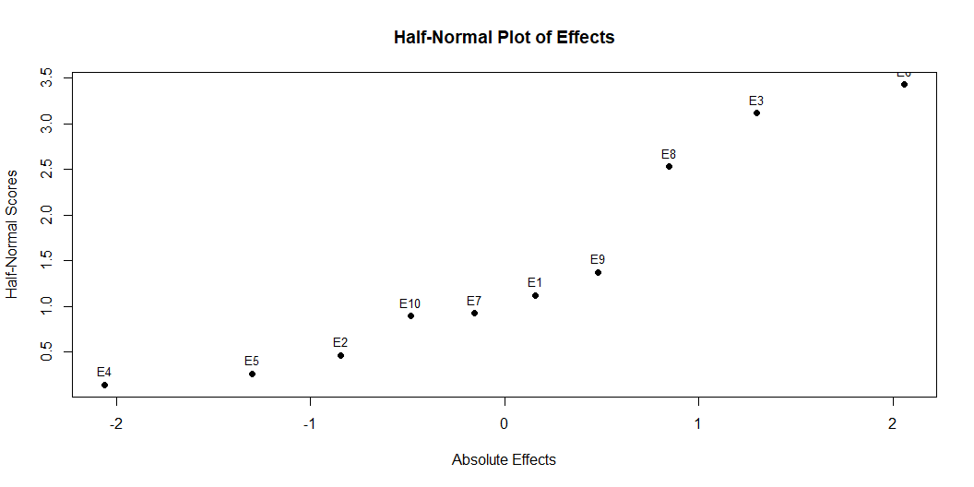

Slide 4
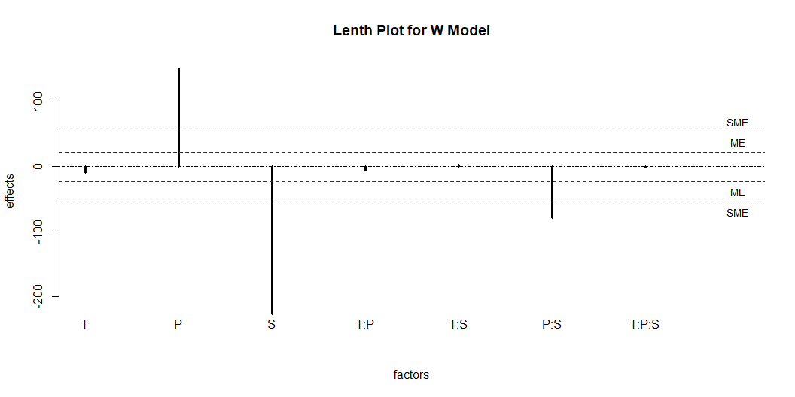
Method 7 Lenth Method for W Model

Slide 5
alpha PSE ME SME 0.05000 6.01875 22.65532 54.21875
Method 8A Sequential Split Plot Method with 2-way Interactions
Linear Model Fit for W Model (OLS)
Call: lm.default(formula = formula_W, data = Yw_data) Residuals: 1 2 3 4 5 6 7 8 0.5125 -0.5125 -0.5125 0.5125 -0.5125 0.5125 0.5125 -0.5125 Coefficients: Estimate Std. Error t value Pr(>|t|) (Intercept) 443.4875 0.5125 865.341 0.000736 *** T -8.5375 0.5125 -16.659 0.038170 * P 150.6625 0.5125 293.976 0.002166 ** S -225.7625 0.5125 -440.512 0.001445 ** T:P -5.7125 0.5125 -11.146 0.056962 . T:S 2.3125 0.5125 4.512 0.138845 P:S -78.7375 0.5125 -153.634 0.004144 ** --- Signif. codes: 0 '***' 0.001 '**' 0.01 '*' 0.05 '.' 0.1 ' ' 1 Residual standard error: 1.45 on 1 degrees of freedom Multiple R-squared: 1, Adjusted R-squared: 1 F-statistic: 5.075e+04 on 6 and 1 DF, p-value: 0.003398
Linear Model Fit for SW1 Model (OLS)
Call: lm.default(formula = formula_SW, data = df_SW) Residuals: Min 1Q Median 3Q Max -220.51 -68.83 37.78 86.55 152.59 Coefficients: Estimate Std. Error t value Pr(>|t|) (Intercept) -145.2415 24.6531 -5.891 7.56e-06 *** D -131.0585 24.6531 -5.316 2.85e-05 *** R -20.3415 24.6531 -0.825 0.41858 `D:R` -9.5710 24.6531 -0.388 0.70176 `T:D` -0.1273 24.6531 -0.005 0.99593 `T:R` -3.6602 24.6531 -0.148 0.88339 `P:D` -55.5290 24.6531 -2.252 0.03512 * `P:R` 1.1790 24.6531 0.048 0.96231 `S:D` 86.0523 24.6531 3.491 0.00218 ** `S:R` 3.7852 24.6531 0.154 0.87944 --- Signif. codes: 0 '***' 0.001 '**' 0.01 '*' 0.05 '.' 0.1 ' ' 1 Residual standard error: 136.4 on 21 degrees of freedom Multiple R-squared: 0.6929, Adjusted R-squared: 0.5613 F-statistic: 5.265 on 9 and 21 DF, p-value: 0.0008274
SSPD Method Model Adequacy Test for Method 8A
Linear Model Fit for SW1 Model (OLS)
Call: lm.default(formula = formula_SW1, data = df_SW1) Residuals: Min 1Q Median 3Q Max -220.51 -68.83 37.78 86.55 152.59 Coefficients: Estimate Std. Error t value Pr(>|t|) (Intercept) -145.2415 24.6531 -5.891 7.56e-06 *** D -131.0585 24.6531 -5.316 2.85e-05 *** R -20.3415 24.6531 -0.825 0.41858 `D:R` -9.5710 24.6531 -0.388 0.70176 `T:D` -0.1273 24.6531 -0.005 0.99593 `T:R` -3.6602 24.6531 -0.148 0.88339 `P:D` -55.5290 24.6531 -2.252 0.03512 * `P:R` 1.1790 24.6531 0.048 0.96231 `S:D` 86.0523 24.6531 3.491 0.00218 ** `S:R` 3.7852 24.6531 0.154 0.87944 --- Signif. codes: 0 '***' 0.001 '**' 0.01 '*' 0.05 '.' 0.1 ' ' 1 Residual standard error: 136.4 on 21 degrees of freedom Multiple R-squared: 0.6929, Adjusted R-squared: 0.5613 F-statistic: 5.265 on 9 and 21 DF, p-value: 0.0008274
Linear Model Fit for SW2 Model (OLS)
Call: lm.default(formula = formula_SW2, data = df_SW2) Residuals: Min 1Q Median 3Q Max -62.737 -25.938 -1.039 27.896 57.588 Coefficients: Estimate Std. Error t value Pr(>|t|) (Intercept) -144.4289 9.0683 -15.927 8.30e-11 *** T 5.3898 9.0683 0.594 0.561130 P -52.1961 9.0683 -5.756 3.80e-05 *** S 80.6977 9.0683 8.899 2.27e-07 *** D -131.8711 9.0683 -14.542 3.01e-10 *** R -19.5289 9.0683 -2.154 0.047953 * T:P 5.9852 9.0683 0.660 0.519256 T:S -5.3586 9.0683 -0.591 0.563377 T:D -0.9398 9.0683 -0.104 0.918828 T:R -2.8477 9.0683 -0.314 0.757829 P:S 41.6148 9.0683 4.589 0.000355 *** P:D -54.7164 9.0683 -6.034 2.29e-05 *** P:R 0.3664 9.0683 0.040 0.968303 S:D 86.8648 9.0683 9.579 8.77e-08 *** S:R 2.9727 9.0683 0.328 0.747589 D:R -10.3836 9.0683 -1.145 0.270134 --- Signif. codes: 0 '***' 0.001 '**' 0.01 '*' 0.05 '.' 0.1 ' ' 1 Residual standard error: 49.77 on 15 degrees of freedom Multiple R-squared: 0.9708, Adjusted R-squared: 0.9416 F-statistic: 33.24 on 15 and 15 DF, p-value: 8.674e-09
Analysis of Variance Table Model 1: Y_SW ~ D + R + `D:R` + `T:D` + `T:R` + `P:D` + `P:R` + `S:D` + `S:R` Model 2: Y_SW ~ (T + P + S + D + R)^2 Res.Df RSS Df Sum of Sq F Pr(>F) 1 21 390667 2 15 37151 6 353517 23.789 7.349e-07 *** --- Signif. codes: 0 '***' 0.001 '**' 0.01 '*' 0.05 '.' 0.1 ' ' 1
Method 8B Sequential Split Plot Method with Three-Way Interactions
Linear Model Fit for W Model (OLS)
Call: lm.default(formula = formula_W, data = Yw_data) Residuals: 1 2 3 4 5 6 7 8 0.5125 -0.5125 -0.5125 0.5125 -0.5125 0.5125 0.5125 -0.5125 Coefficients: Estimate Std. Error t value Pr(>|t|) (Intercept) 443.4875 0.5125 865.341 0.000736 *** T -8.5375 0.5125 -16.659 0.038170 * P 150.6625 0.5125 293.976 0.002166 ** S -225.7625 0.5125 -440.512 0.001445 ** T:P -5.7125 0.5125 -11.146 0.056962 . T:S 2.3125 0.5125 4.512 0.138845 P:S -78.7375 0.5125 -153.634 0.004144 ** --- Signif. codes: 0 '***' 0.001 '**' 0.01 '*' 0.05 '.' 0.1 ' ' 1 Residual standard error: 1.45 on 1 degrees of freedom Multiple R-squared: 1, Adjusted R-squared: 1 F-statistic: 5.075e+04 on 6 and 1 DF, p-value: 0.003398
Linear Model Fit for SW1 Model (OLS)
Call: lm.default(formula = formula_SW, data = df_SW) Residuals: Min 1Q Median 3Q Max -205.91 -74.01 57.06 82.39 110.28 Coefficients: Estimate Std. Error t value Pr(>|t|) (Intercept) -146.6769 31.5293 -4.652 0.000558 *** D -129.6231 31.5293 -4.111 0.001443 ** R -21.7769 31.5293 -0.691 0.502903 `D:R` -8.1356 31.5293 -0.258 0.800754 `T:D` 1.3082 31.5293 0.041 0.967587 `P:D` -56.9644 31.5293 -1.807 0.095929 . `S:D` 84.6168 31.5293 2.684 0.019898 * `T:R` -5.0957 31.5293 -0.162 0.874297 `P:R` 2.6144 31.5293 0.083 0.935282 `S:R` 5.2207 31.5293 0.166 0.871243 `T:D:R` -3.7418 31.5293 -0.119 0.907494 `P:D:R` -7.8894 31.5293 -0.250 0.806646 `S:D:R` 9.6543 31.5293 0.306 0.764699 `T:P:D` -1.5457 31.5293 -0.049 0.961707 `T:S:D` 0.3981 31.5293 0.013 0.990134 `P:S:D` 31.2832 31.5293 0.992 0.340689 `T:P:R` 3.1832 31.5293 0.101 0.921250 `T:S:R` 3.4519 31.5293 0.109 0.914629 `P:S:R` 1.9793 31.5293 0.063 0.950977 --- Signif. codes: 0 '***' 0.001 '**' 0.01 '*' 0.05 '.' 0.1 ' ' 1 Residual standard error: 171.9 on 12 degrees of freedom Multiple R-squared: 0.7214, Adjusted R-squared: 0.3034 F-statistic: 1.726 on 18 and 12 DF, p-value: 0.1688
```

