Slide 1
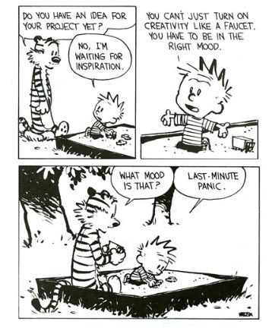
N-th Order Monkeys
Nicolas Canac

Slide 2
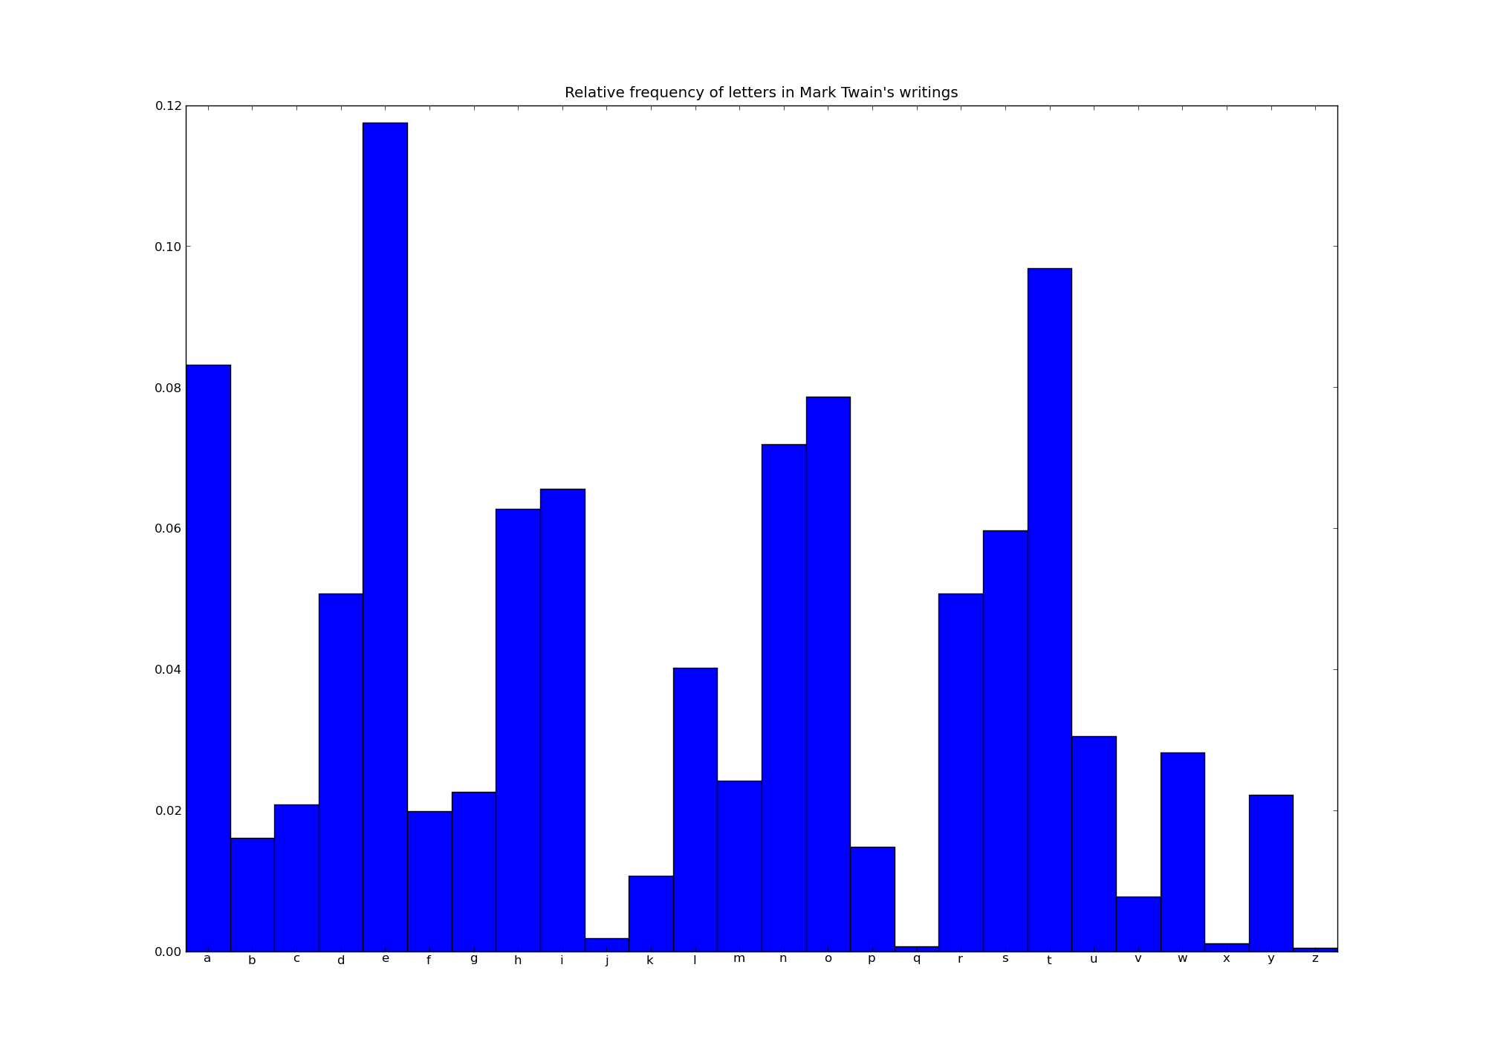

Slide 3
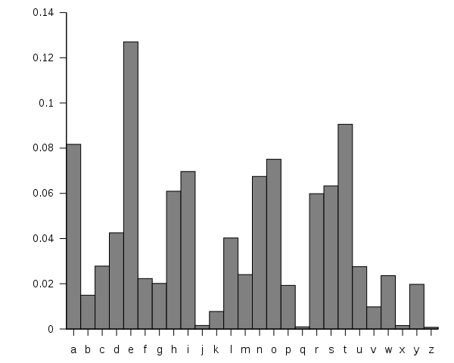
According to Wikipedia...

Slide 4
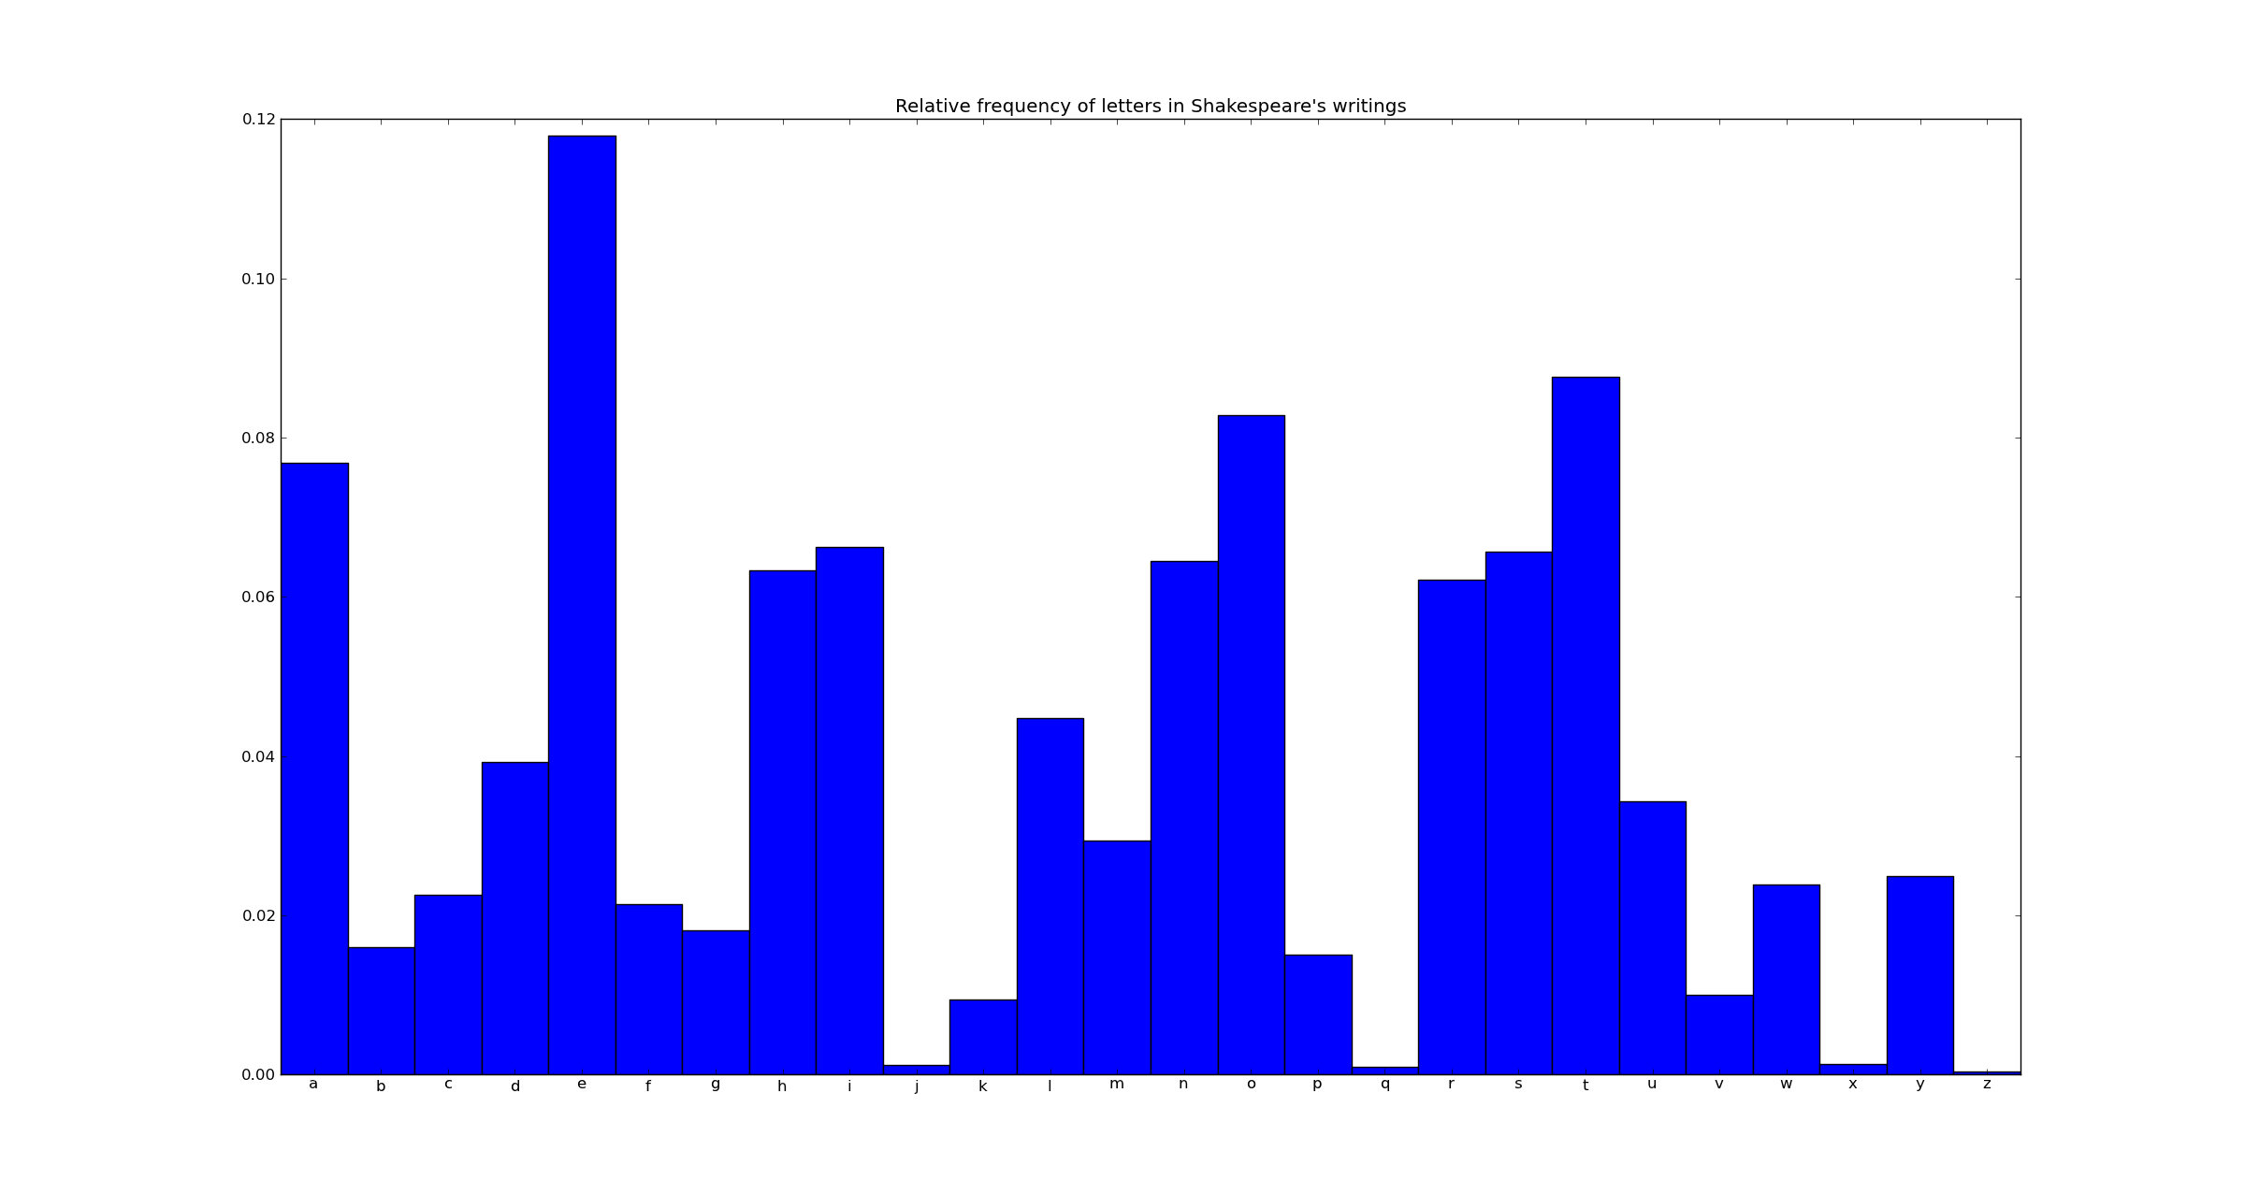

Slide 5
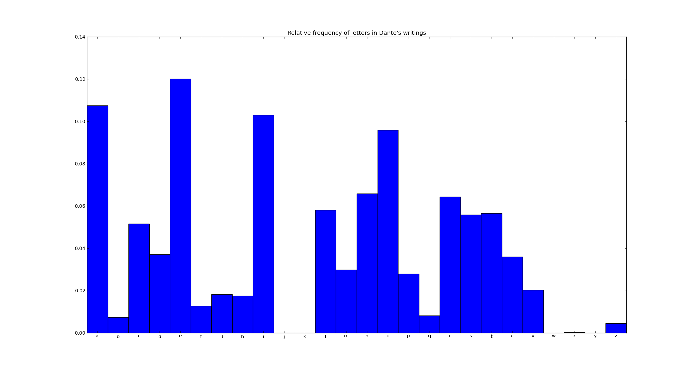

Slide 6
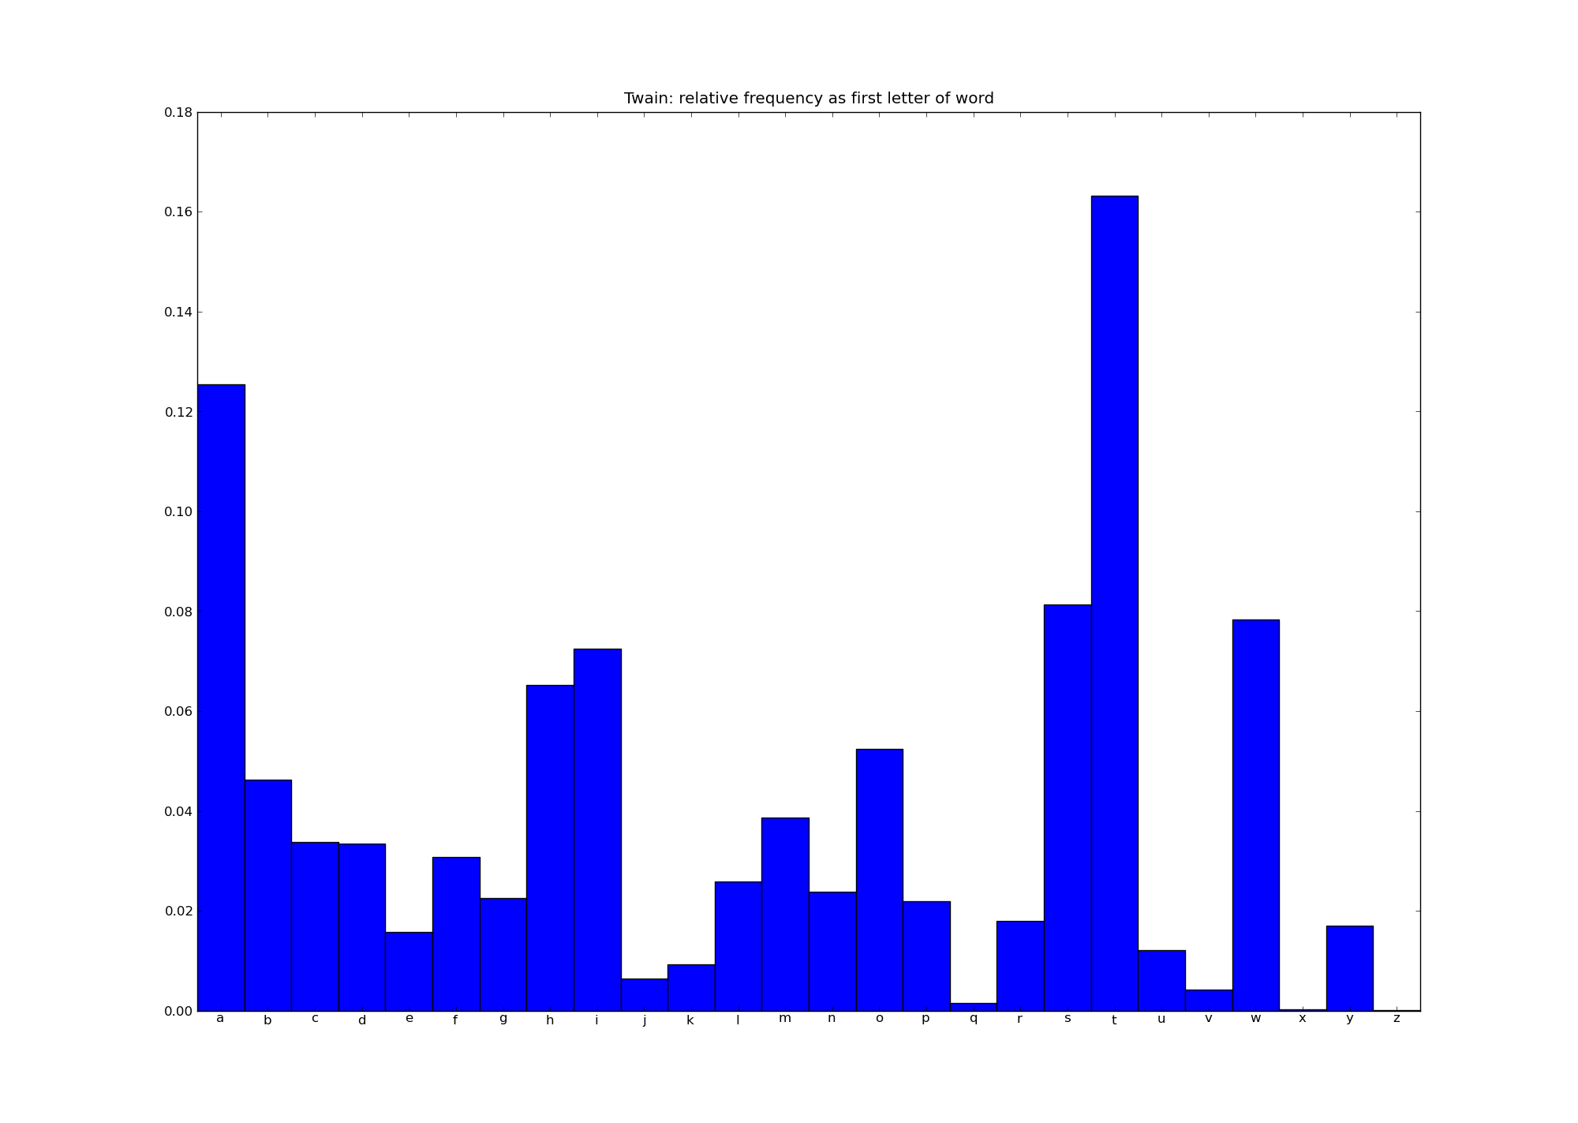

Slide 7
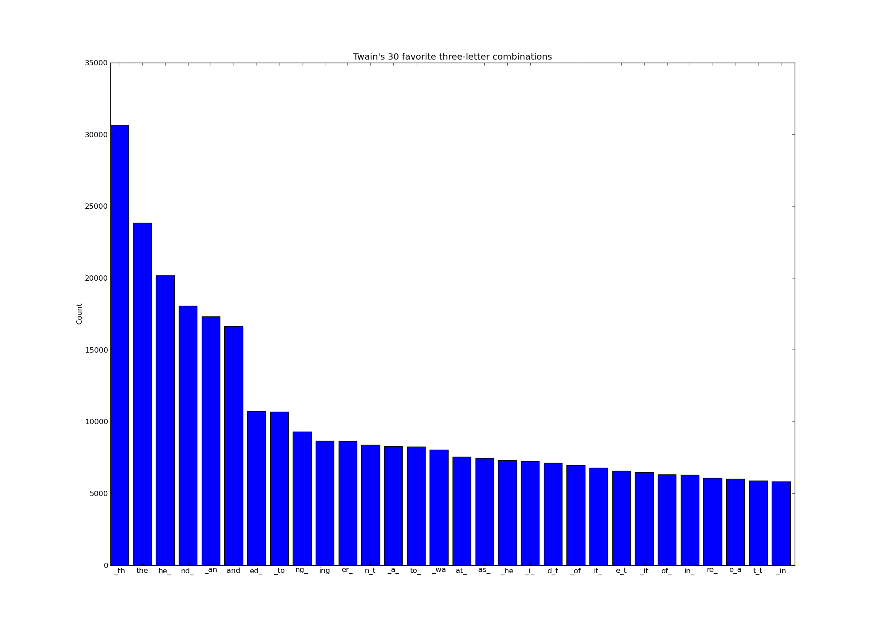

Slide 8
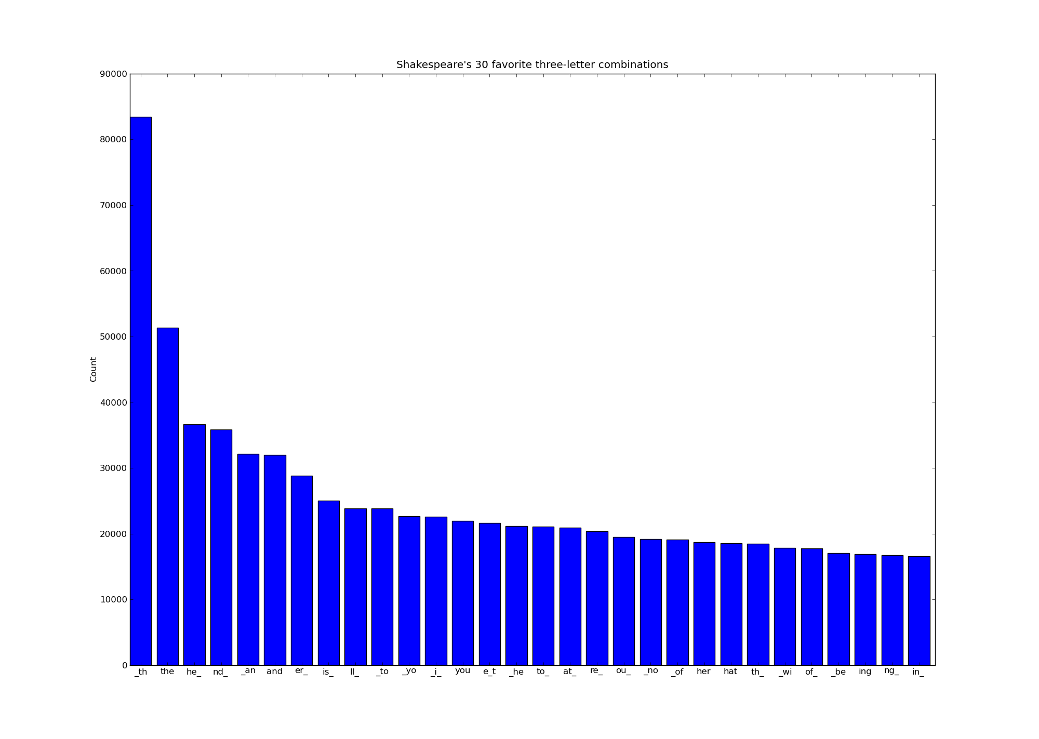

Slide 9
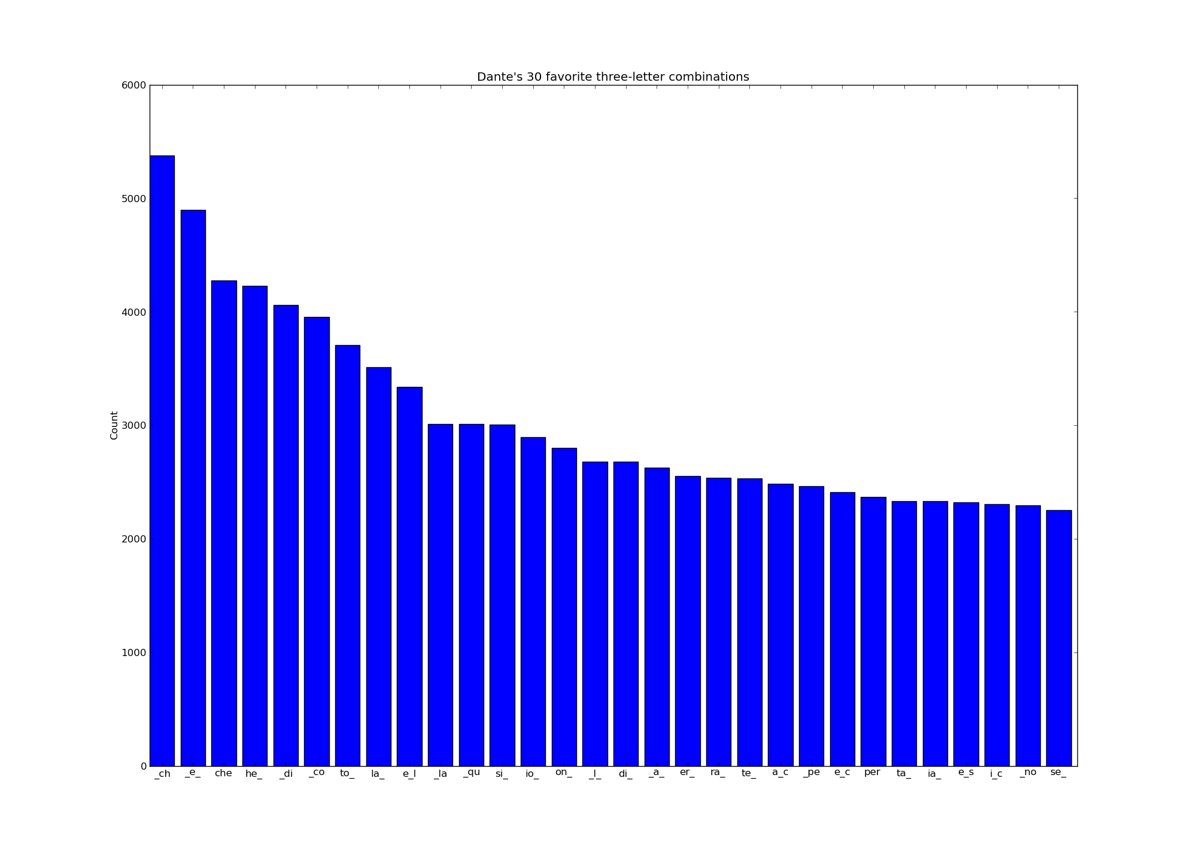

Slide 10
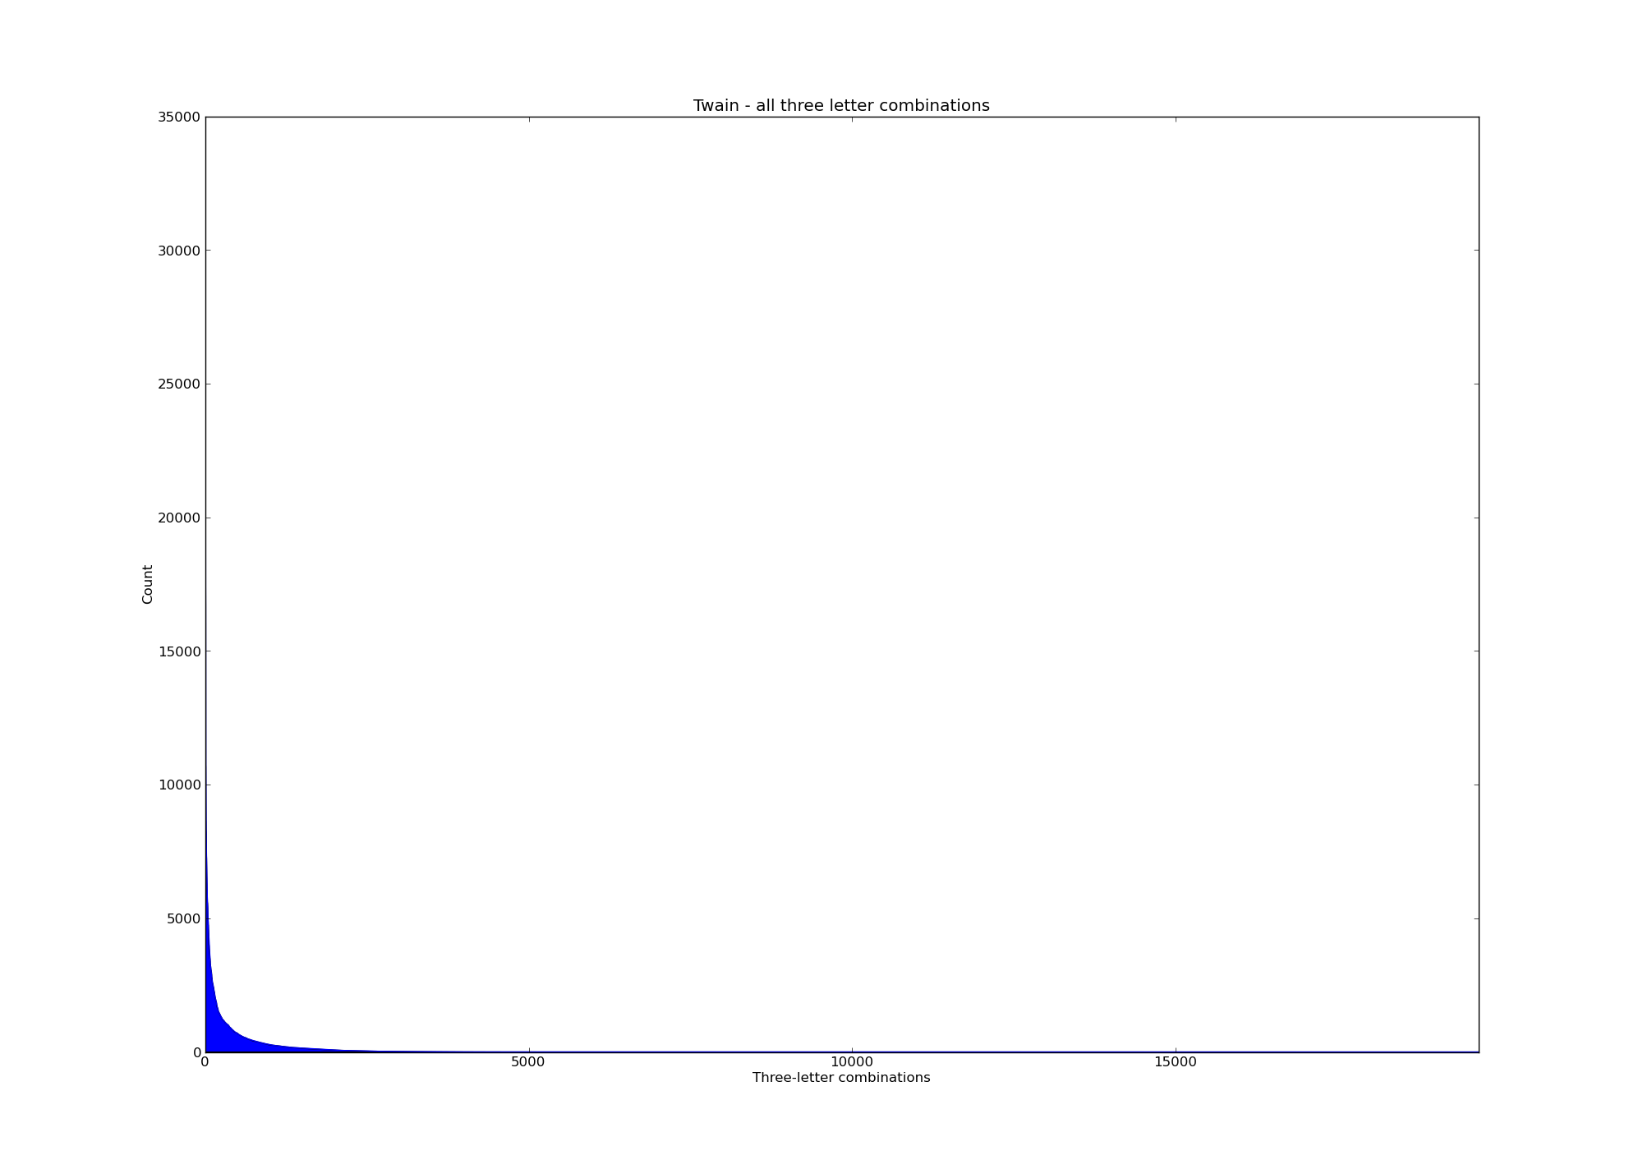

Slide 11
Let's see how this works...

Slide 12
Why stop at 3rd order monkeys?

Slide 13
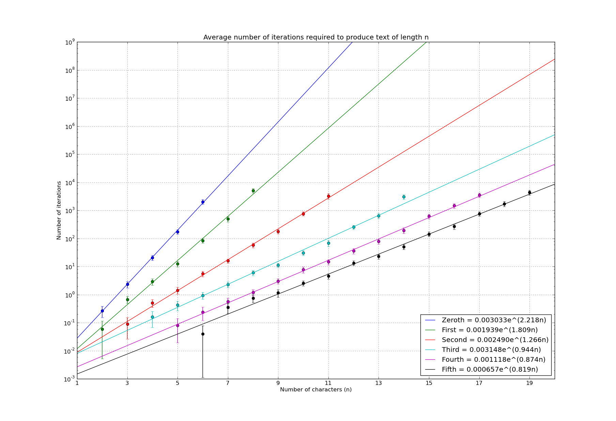

Slide 14
Well, if 4th order monkeys are better than 3rd order monkeys, and 5th order monkeys are better than 4th order monkeys, why stop at 5th order monkeys!?
Answer: memory :'(

Slide 15
Consider...
The average Shakespearean sonnet is approximately 600 characters long. Based on the previous results, it would take a 5th order monkey ~10^210 iterations to reproduce such a string of characters.
Making a few liberal approximations, this would take the world's fastest supercomputer ~10^194 years.
This is what we scientists like to refer to as, “a $%&!ing long time.”
But! It's a marked improvement over our poor friend, the zeroth order monkey, which would take something like ~10^575 iterations.
Impossible > Impossible

Slide 16
Examples – Shakespeare
'and the dauphin and ' found in the writings of shake after 8189 iterations.
'gentleman though the ' found in the writings of shake after 27224 iterations.
'lordship exeunt scene ' found in the writings of shake after 16185 iterations.
'fortunate exeunt scene ' found in the writings of shake after 69455 iterations.
'our grace exeunt scene l' found in the writings of shake after 959117 iterations.
'lus of syracuse thou art ' found in the writings of shake after 327386 iterations.
'y brother gloucester follo' found in the writings of shake after 4003802 iterations.
'and gentlemen what i should' found in the writings of shake after 1215462 iterations.
'e so antipholus of syracuse ' found in the writings of shake after 9296442 iterations.

Slide 17
Examples - Twain
'or there warnt nothi' found in the writings of Mark Twain after 11309 iterations.
'r there was something' found in the writings of Mark Twain after 128884 iterations.
'll right again it was ' found in the writings of Mark Twain after 32399 iterations.
'breakfast and i reckon ' found in the writings of Mark Twain after 826732 iterations.
'three times because of a' found in the writings of Mark Twain after 205125 iterations.
'hing but they couldnt see' found in the writings of Mark Twain after 251001 iterations.
'd i had been sound asleep ' found in the writings of Mark Twain after 327841 iterations.
'think of it and i reckoned ' found in the writings of Mark Twain after 917050 iterations.
'you got to talking about the' found in the writings of Mark Twain after 2968443 iterations.

Slide 18
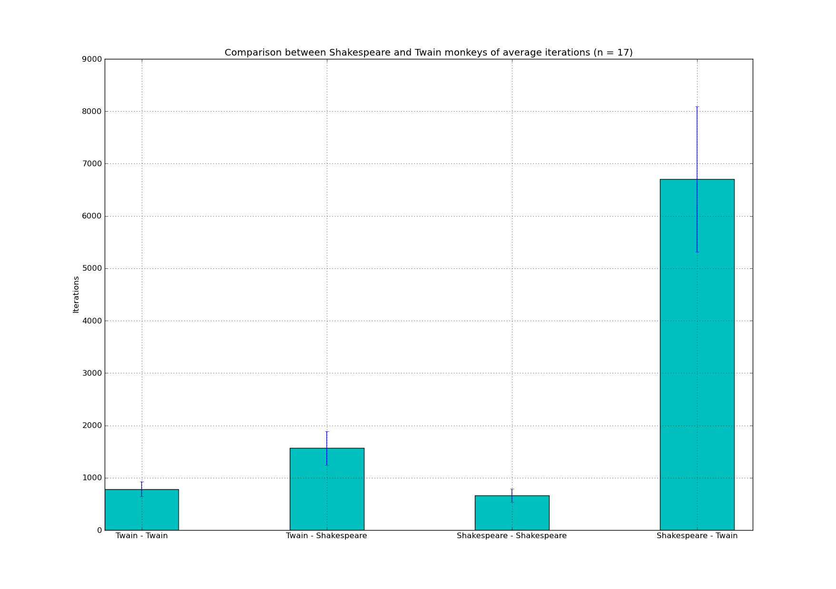

Slide 19
