Slide 1
Day 1: Background, Dataset Overview, & Initial Hypotheses

Slide 2
Background/Motivation
Chest X-Rays are clinical images and diagnostic indicators to check the health of a patient’s heart, lungs, blood vessels, airways, and bones of their chest and spine.¹
Examines numerous characteristics about the inside of one’s body:
Lung condition, heart abnormalities, vascular diseases, calcium deposits, rib abnormalities, postoperative changes
Chest X-Rays are used to diagnose conditions such as²:
Pneumonia → Infection in one or both lungs due to bacteria, viruses, & fungi³
Estimated Global Incidence: 150.7 million cases per year among children 5 years or younger⁴
COPD {Chronic Obstructive Pulmonary Disorder} → Umbrella term utilized to describe chronic emphysema, bronchitis, and/or asthma⁵
Estimated Global Prevalence: 7-19%⁶
Atelectasis → Complete or partial collapse of a lobe of the lung or the entirety of the lung⁷
One of the most common complications after a complex surgery (intubation)
Effusion → An escape of fluid into a body cavity (pleural, peritoneal, pericardial, etc.)⁸
Others (Cardiomegaly, Tuberculosis, Lung Cancer, Heart Failure, and more)⁹
Notes:
https://www.mayoclinic.org/tests-procedures/chest-x-rays/about/pac-20393494#:~:text=Chest%20X%2Drays%20can%20detect,complications%20related%20to%20these%20conditions.
https://www.radiologyinfo.org/en/info.cfm?pg=chestrad
https://www.healthline.com/health/pneumonia
https://www.medscape.com/answers/967822-23537/what-is-the-global-prevalence-of-pneumonia#:~:text=The%20WHO%20Child%20Health%20Epidemiology,enough%20to%20require%20hospital%20admission.
https://www.healthline.com/health/copd-vs-emphysema
https://www.medscape.com/answers/297664-7353/what-is-the-worldwide-prevalence-of-chronic-obstructive-pulmonary-disease-copd#:~:text=The%20exact%20prevalence%20of%20COPD,different%20regions%20of%20the%20world.
https://www.mayoclinic.org/diseases-conditions/atelectasis/symptoms-causes/syc-20369684
https://eclinpath.com/cytology/effusions-2/
https://healthengine.com.au/info/chest-x-ray

Slide 3
Target Task
Given that Chest X-rays serve as an important diagnostic indicator of various pathologies...
What if we could create a model that can serve as an initial screening to predict whether any given patient’s Chest X-ray is abnormal?

Slide 4
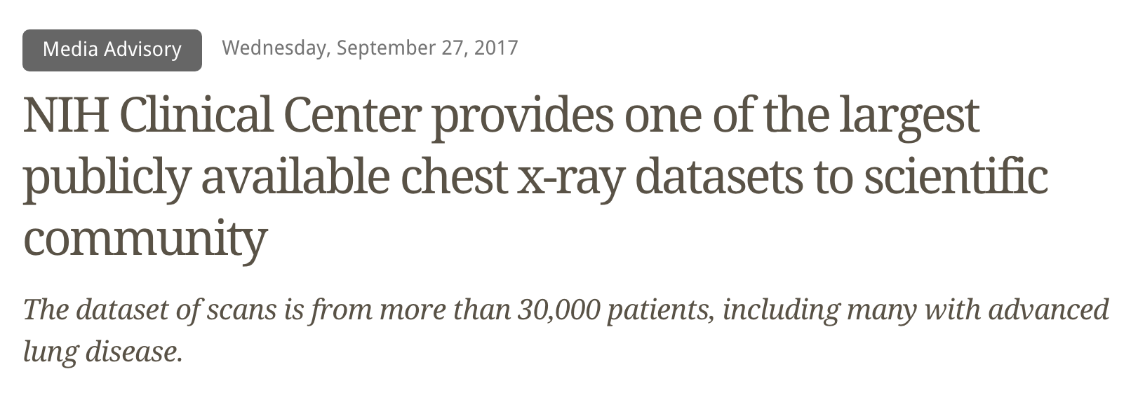
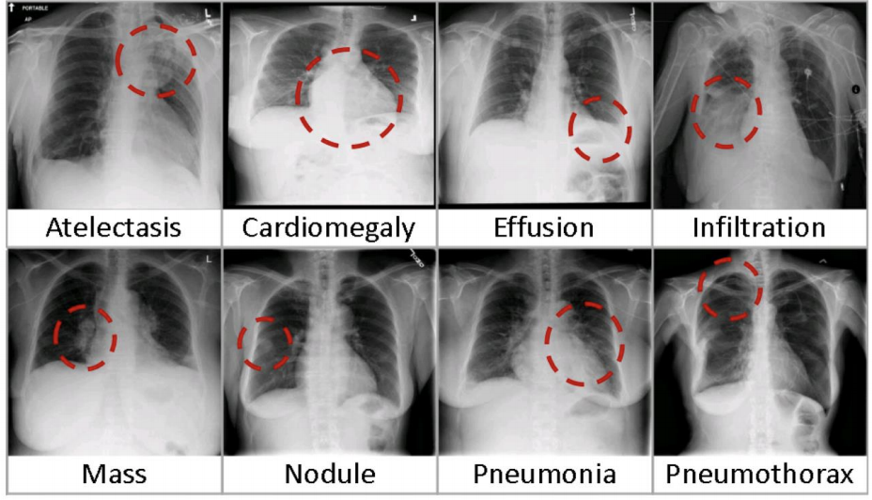
Dataset Overview
This NIH Chest X-ray Dataset is comprised of 112,120 X-ray images with disease labels from 30,805 unique patients
To create these labels, the authors used Natural Language Processing to text-mine disease classifications from the associated radiological reports. The labels are expected to be > 90% accurate and suitable for weakly-supervised learning.
We are using a subset of the data that contains 5606 images
It predicts 15 different labels (14 diseases and one “No findings” label)

Slide 5
Relevant Research
Using the same dataset:
CheXNet: a 121-layer convolutional neural network model created by Stanford students that inputs a chest X-ray image and outputs the probability of pneumonia along with a heatmap localizing the areas of the image most indicative of pneumonia¹
This model was able to achieve radiologist-level pneumonia detection using deep learning
A model that does abnormality classification of chest radiographs using deep convolutional neural networks²
This model achieved with an accuracy of 94.71 ± 0.32%, a sensitivity of 92.20 ± 0.34% and a specificity of 96.34 ± 0.31% for normal versus lung opacity classification
Other datasets:
Using machine learning to accurately classify COVID-19 lung infections based on portable chest X-rays (which are much harder for radiologists to read due to worse image quality)³
the accuracy, sensitivity and specificity were, respectively, 100%, 100%, and 100% for COVID-19 vs normal; 96.34%, 95.35% and 97.44% for COVID-19 vs bacterial pneumonia; and 97.56%, 97.44% and 97.67% for COVID-19 vs non-COVID-19 viral pneumonia
Notes:
1.https://stanfordmlgroup.github.io/projects/chexnet/
2. https://www.nature.com/articles/s41746-020-0273-z
3.https://biomedical-engineering-online.biomedcentral.com/articles/10.1186/s12938-020-00831-x

Slide 6
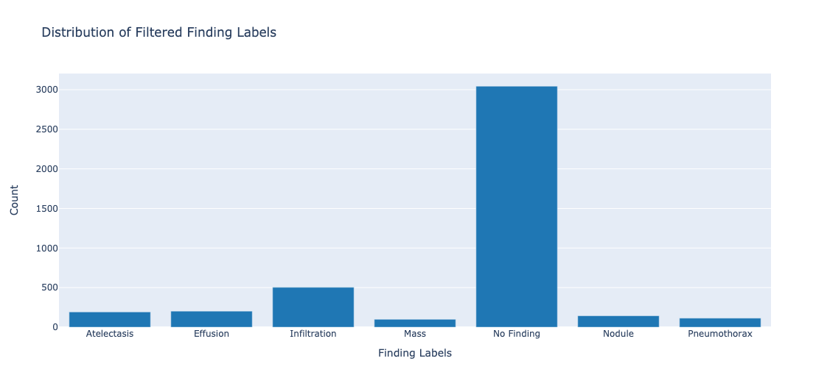
Label Distribution

Slide 7
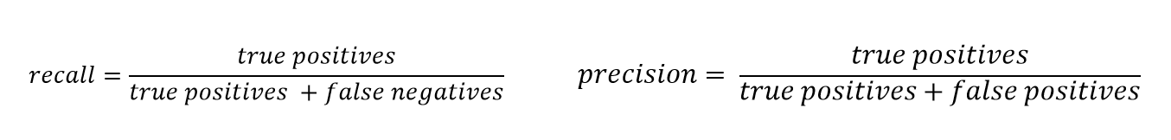
Initial Hypothesis 1
Target data: 7 most frequent classes (out of 15)
Hypothesis 1: Effect of altering (or not altering) class distributions
Null: If a CNN model trained with the original class distribution is compared with a CNN model trained with a balanced class distribution, then the model trained with the balanced class distribution WILL NOT perform better with respect to average Recall of the 7 classes.
Alternative: If a CNN model trained with the original class distribution is compared with a CNN model trained with a balanced class distribution, then the model trained with the balanced class distribution WILL perform better with respect to average Recall of the 7 classes.

Slide 8
Initial Hypothesis 2
Target data: 7 most frequent classes (out of 15)
Hypothesis 2: Recall of best model by individual class
Null: If the best performing CNN model from Hypothesis 1 (original vs. balanced class distribution) is utilized to classify the images on a different testing set, then the recall of each class WILL be equal.
Alternative: If the best performing CNN model from Hypothesis 1 (original vs. balanced class distribution) is utilized to classify the images on a different testing set, then the recall of each class WILL NOT be equal.

Slide 9
Day 2: Exploratory Data Analysis, Finalized Hypotheses, & Initial Model Plan
Authors: Tony, Navya, Kunaal, and Jaya (Group 4)
Date: January 15th, 2021

Slide 10
Dataset Overview
This NIH Chest X-ray Dataset is comprised of 112,120 X-ray images with disease labels from 30,805 unique patients
To create these labels, the authors used Natural Language Processing to text-mine disease classifications from the associated radiological reports. The labels are expected to be > 90% accurate and suitable for weakly-supervised learning.
We are using a subset of the data that contains 5606 images
It predicts 15 different labels (14 diseases and one “No findings” label)

Slide 11
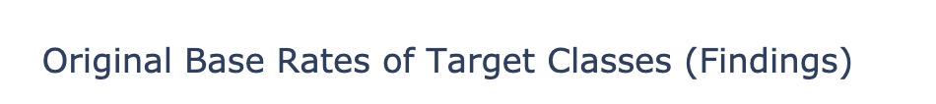
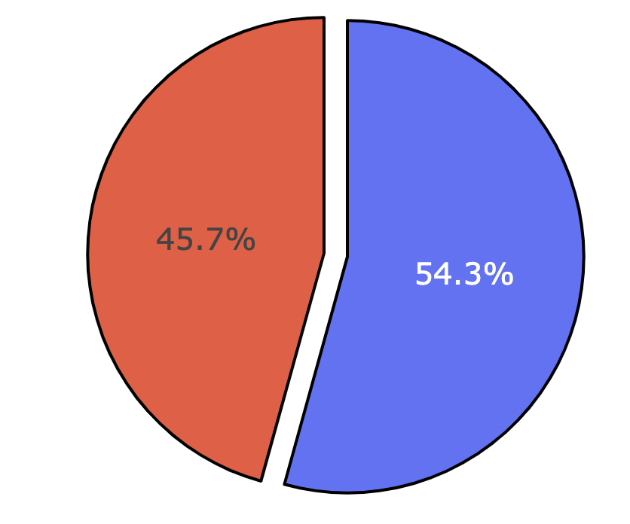
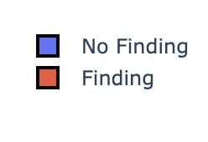
What is the Original Base Rate of Findings vs No Finding?
Findings and No Findings are pretty balanced
However, we are predicting if an X-ray has no, one or multiple abnormalities, and those three classes are not as balanced

Slide 12

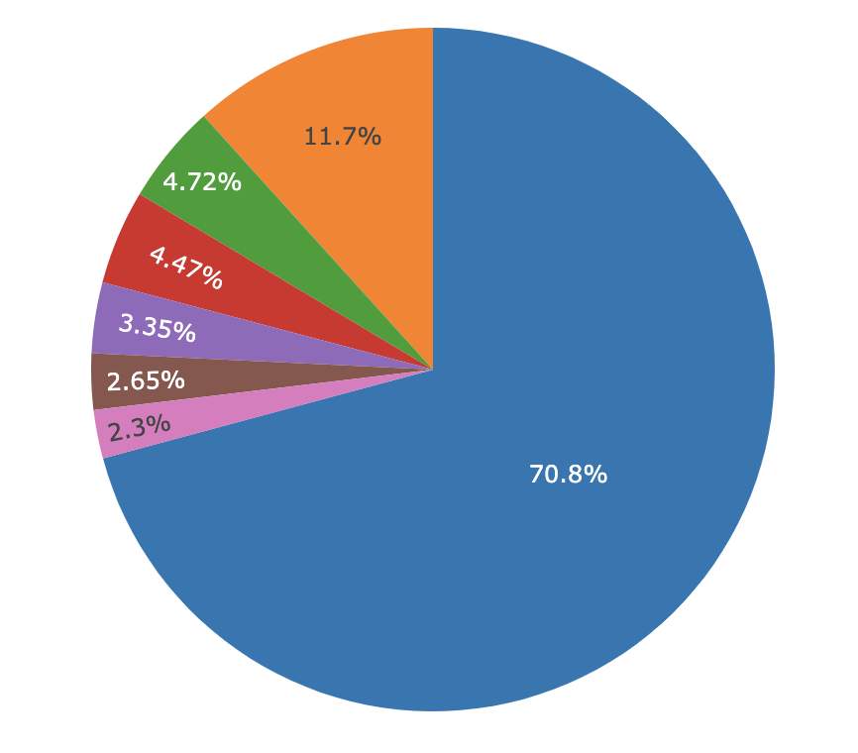
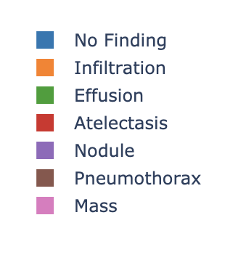
Distribution of the Most Frequent 7 Labels
Originally, we planed to focus on the top 7 labels
However, the data is extremely unbalanced, even in the top 7 levels, which would have made balancing extremely difficult
Therefore, we changed our hypothesis to focus on severity instead

Slide 13
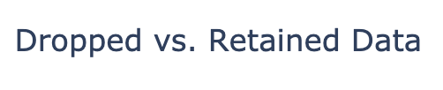
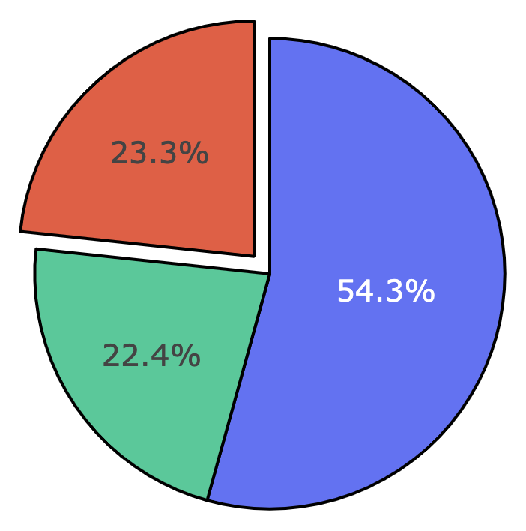
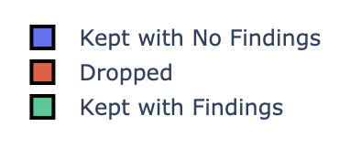
Initial Hypothesis Base Rates
After dropping all the labels below the most frequent 7, we would retain 77% of our xray sample
4299/5606 chest x-rays
Decided to change hypothesis

Slide 14
Updated Hypothesis 1
Target data: No Findings, One Finding, Multiple Findings
Hypothesis 1: Effect of altering (or not altering) class distributions
Null: If a CNN model trained with the original class distribution is compared with a CNN model trained with a balanced class distribution, then the model trained with the balanced class distribution WILL NOT perform better with respect to average Recall of the 3 classes.
Alternative: If a CNN model trained with the original class distribution is compared with a CNN model trained with a balanced class distribution, then the model trained with the balanced class distribution WILL perform better with respect to average Recall of the 3 classes.

Slide 15
Updated Hypothesis 2
Target data: No Findings, One Finding, Multiple Findings
Hypothesis 2: Recall of best model by individual class
Null: If the best performing CNN model from Hypothesis 1 (original vs. balanced class distribution) is utilized to classify the images on a different testing set, then the recall of each class WILL be equal.
Alternative: If the best performing CNN model from Hypothesis 1 (original vs. balanced class distribution) is utilized to classify the images on a different testing set, then the recall of each class WILL NOT be equal.

Slide 16
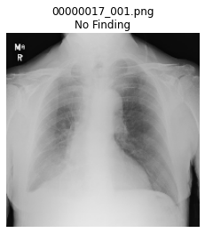
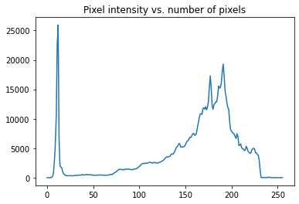
No Finding (Healthy) Class Pixel Intensity
Notes:
https://www.geeksforgeeks.org/opencv-python-program-analyze-image-using-histogram/

Slide 17
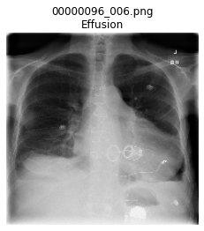
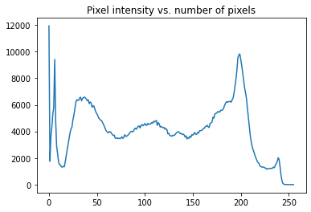
Single Finding Class Pixel Intensity
Notes:
https://www.geeksforgeeks.org/opencv-python-program-analyze-image-using-histogram/

Slide 18
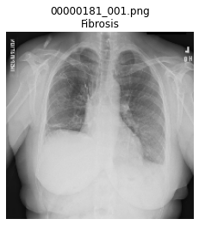
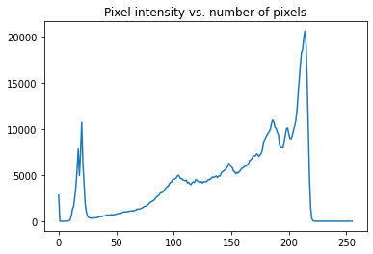
Single Finding Class Pixel Intensity
Notes:
https://www.geeksforgeeks.org/opencv-python-program-analyze-image-using-histogram/

Slide 19
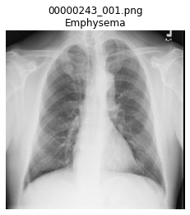
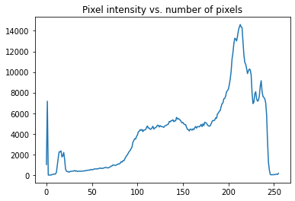
Single Finding Class Pixel Intensity
Notes:
https://www.geeksforgeeks.org/opencv-python-program-analyze-image-using-histogram/

Slide 20
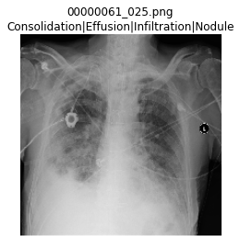
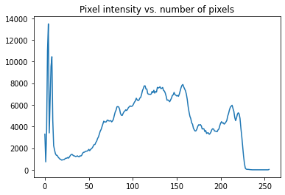
Multiple Findings Class Pixel Intensity
Notes:
https://www.geeksforgeeks.org/opencv-python-program-analyze-image-using-histogram/

Slide 21
Initial Model Plan
Convolutional Neural Network
Pretrained model
VGG-16/VGG-19³ → SOTA CNN Architecture based off of AlexNET
Optimizer: Adam¹
Algorithm/method used to change attributes of the CNN (e.g., learning rate) to reduce the loss
‘adam’ → Adaptive Moment Estimation → Accelerates convergence toward relevant direction and reduces the fluctuation to the irrelevant direction in an SGD algorithm
Advantage(s): Converges Rapidly & corrects for vanishing learning rate & high variance
Disadvantage(s): Computationally Expensive
Loss Function: Categorical Cross Entropy → Explained Later
Sampling:
Model #1: Original class weights/imbalanced label distribution
Model #2: Equal class weights/balanced label distribution
Oversample minority classes (imbalanced learn)
Notes:
https://towardsdatascience.com/optimizers-for-training-neural-network-59450d71caf6
https://www.mathworks.com/help/deeplearning/ref/resnet50.html#:~:text=ResNet%2D50%20is%20a%20convolutional,%2C%20pencil%2C%20and%20many%20animals.
https://neurohive.io/en/popular-networks/vgg16/

Slide 22
Layers in a CNN¹
Input Layer → Hold raw pixel values of the image
Tensor with shape: (# of images, image height, image width, input channels)
Convolutional Layer → Compute the output of neurons that are connected to local regions in the input (i.e., the neuronal receptive field)
Each computes a dot product between weights and a small region they are connected to in the input volume
Since they compute the outputs regionally, allows for a fewer number of overall parameters
Pooling Layer → Reduce the dimensions of the data by combining the outputs of neuron clusters at one layer into a single neuron in the next layer
Decreases the computational power required to process data
Max Pooling and Average Pooling
Dense Layer → Fully connected layers that connect every neuron in one layer to every neuron in the next
Most commonly used layer, as this is essentially the classification layer
Notes:
https://keras.io/api/applications/

Slide 23
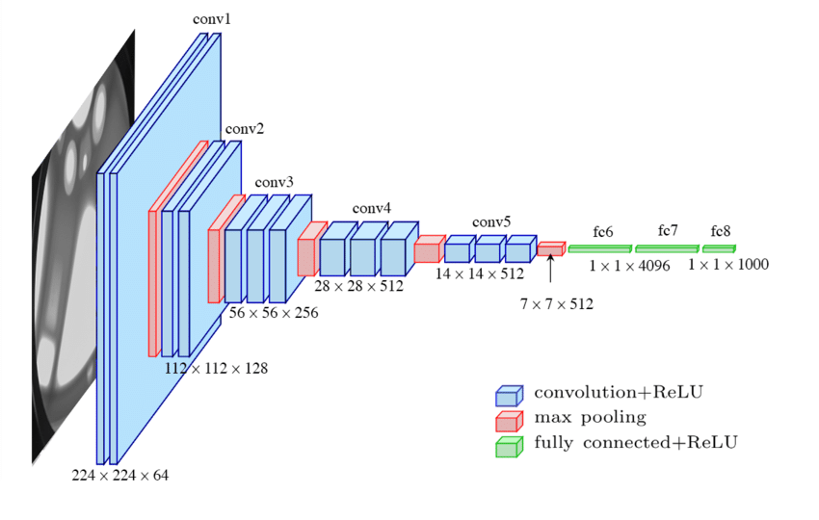
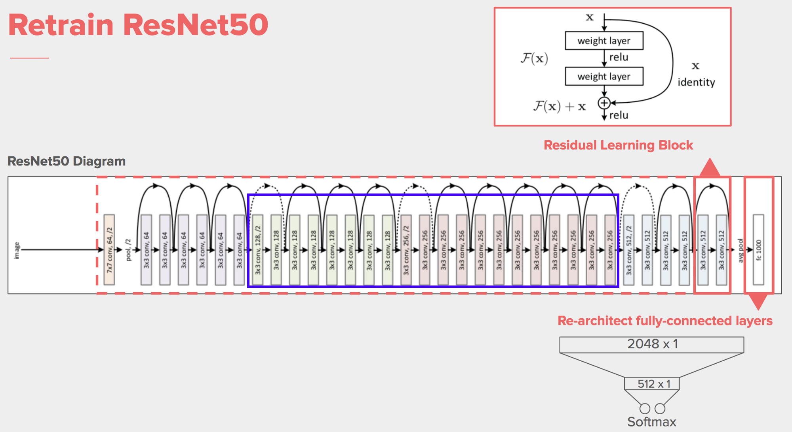
ResNet50 vs VGG-16/VGG-19 Architecture
ResNet50¹
VGG²
Notes:
https://i.stack.imgur.com/5MCjg.png
https://miro.medium.com/max/850/1*_Lg1i7wv1pLpzp2F4MLrvw.png

Slide 24
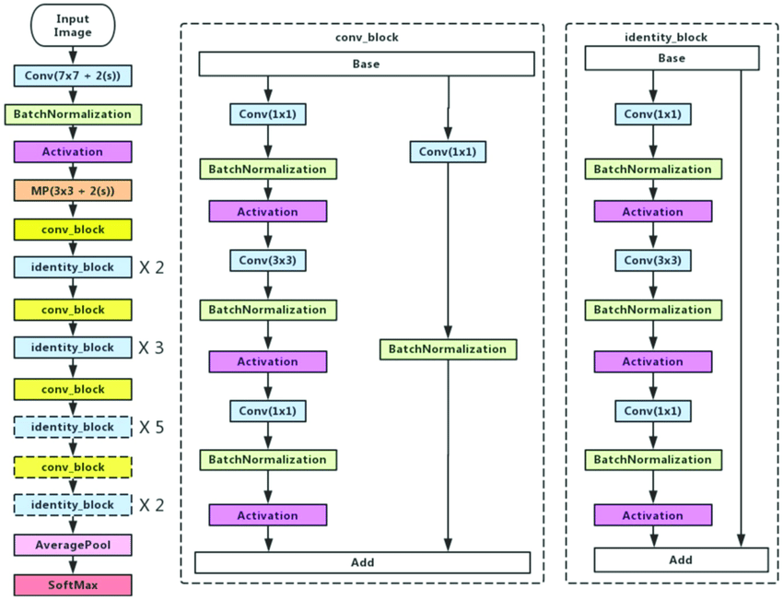
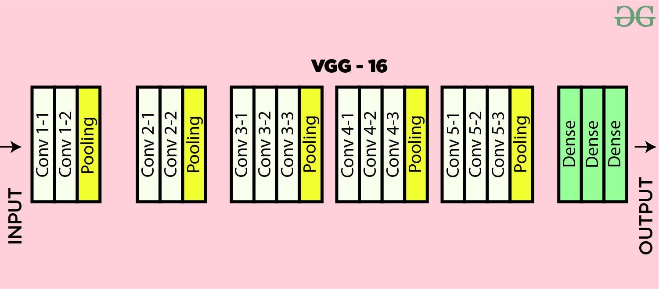
Layers within SOTA CNN Architectures
ResNet-50¹
VGG-16²
Notes:
https://www.researchgate.net/publication/331364877/figure/fig3/AS:741856270901252@1553883726825/Left-ResNet50-architecture-Blocks-with-dotted-line-represents-modules-that-might-be.png
https://media.geeksforgeeks.org/wp-content/uploads/20200219152327/conv-layers-vgg16.jpg

Slide 25
Initial Model Plan (Continued)
Train/Test:
Train (Fit Pre-trained CNN) on 80% data, test on 20% data
Evaluation Metrics:
Recall:
Model is pertaining to the medical field
Having a higher recall means that there are fewer false negatives.
False negatives in the medical field are very dangerous because then a patient with a disease will not be treated for it.
Loss: Categorical cross entropy/Softmax Loss
Categorical cross entropy is a loss function that is used in multi-class classification
An instance can only belong to one out of many possible categories, and the model must decide which one.
It is designed to quantify the difference between two probability distributions.
Notes:
https://peltarion.com/knowledge-center/documentation/modeling-view/build-an-ai-model/loss-functions/categorical-crossentropy

Slide 26
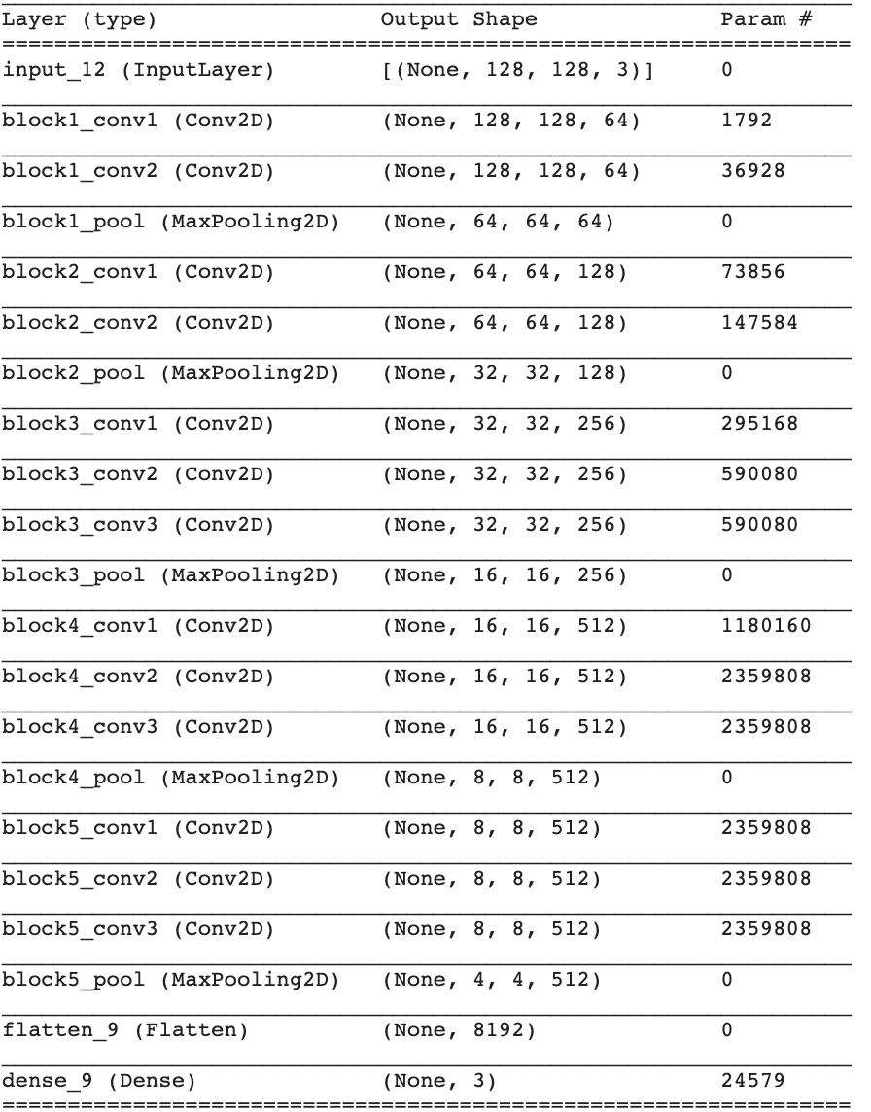
Initial Model Architecture
VGG-16
Input layer takes in resized images
Added + plan to train top layer
Pooling -> Convolutional layers
Configured dense layer
Softmax activation
multi-class classification problem
Output number classes
Early stopping
Validation accuracy
Notes:
https://peltarion.com/knowledge-center/documentation/modeling-view/build-an-ai-model/loss-functions/categorical-crossentropy

Slide 27
Day 3: Results of Model Performance Pre- and Post- Feature Engineering
Authors: Tony, Navya, Kunaal, and Jaya (Group 4)
Date: January 15th, 2021

Slide 28
Dataset Overview
This NIH Chest X-ray Dataset is comprised of 112,120 X-ray images with disease labels from 30,805 patients
Authors used Natural Language Processing to text-mine diagnosis from radiology reports
We are using a subset of the data that contains 5606 images
Subsets of the data were already randomly sampled by NIH and made available
It predicts 15 different classes (14 diseases and one “No findings” class)

Slide 29
Pre-Processing
Images were resized to 128x128 pixels², compared to the original size of 1024x1024 pixels²
Loss of information due to computational limitations
Vectorized the images in the dataset
Allows our images to be run through the subsequent architectures we will create
‘Pickling’ the images in Array Format
Serializes the information so that we don’t have to keep loading the images in
Dangerous!
One-Hot Encoding
Utilized the to_categorical function in the Keras API
For Balanced Models:
Downsampled the larger classes to the frequency of the smallest class

Slide 30
Feature Engineering Overview
Step 0: Running Initial Model with 3 Classes in Response Variable
Step 1: Binary Classification
Step 2: Data Augmentation
Step 3: Trying other CNN Architectures
Step 4: Hypertuning Parameters in Model

Slide 31
Feature Engineering Step 0
Initial MultiClass Classification (3 Classes)

Slide 32
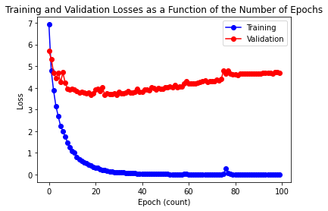
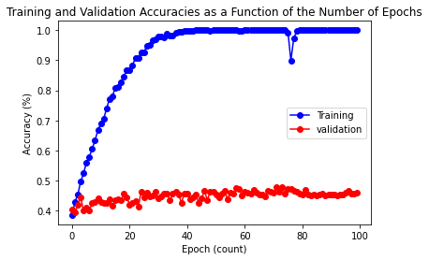
Unbalanced Model - Training/Validation Loss & Accuracy
TESTING ACCURACY: 45.99%

Slide 33
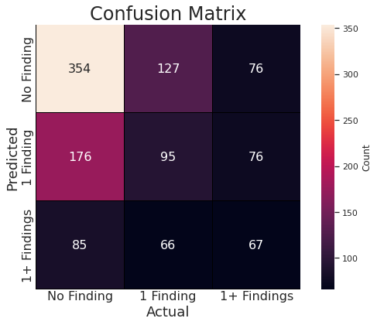
Unbalanced Model - Confusion Matrix

Slide 34
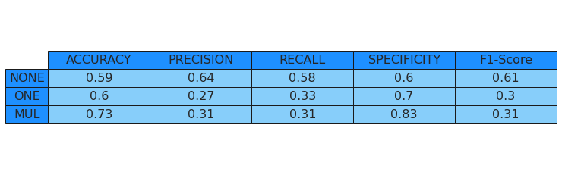
Unbalanced Model - Summary Statistics

Slide 35
Undersampling
In order to create a balanced dataset, we utilized undersampling
Our smallest class is Multiple Findings
We undersampled No Findings and One Finding, so that we only have 980 of all three classes
Classes | Original Count | Sampled Count
No Findings | 3044 | 980
One Finding | 1582 | 980
Multiple Findings | 980 | 980

Slide 36
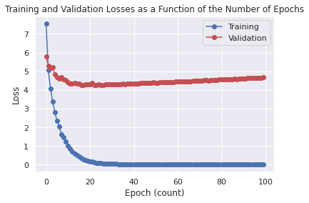
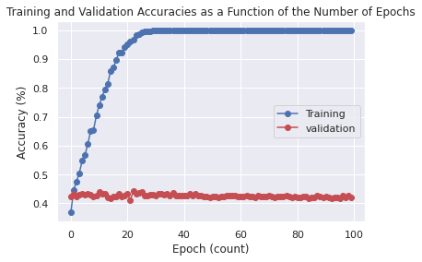
Balanced Model - Training/Validation Loss & Accuracy
TESTING ACCURACY: 42.01%

Slide 37
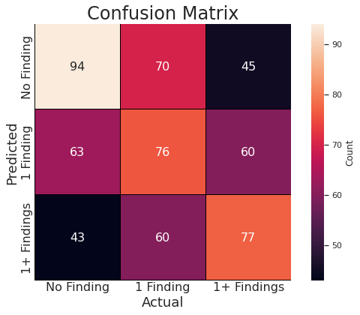
Balanced Model - Confusion Matrix

Slide 38

Balanced Model - Summary Statistics

Slide 39
Imbalanced vs Balanced Model Performance

Slide 40
Imbalanced vs Balanced Model Performance
 | Imbalanced Model |  |  |  | Balanced Model
 | None | One | Multiple | Average | None | One | Multiple | Average
Accuracy | 59% | 60% | 73% | 64.00% | 62% | 57% | 65% | 61.33%
Precision | 64% | 27% | 31% | 40.67% | 45% | 38% | 43% | 42.00%
Recall | 58% | 33% | 31% | 40.67% | 47% | 37% | 42% | 42.00%
Specificity | 60% | 70% | 83% | 71.00% | 70% | 68% | 75% | 71.00%
F-1 Score | 61% | 30% | 31% | 40.67% | 46% | 37% | 42% | 41.67%
Overall Accuracy | 45.99% |  |  |  | 42.01%
 | Imbalanced | Balanced
Average Recall w/ Standard Error | 40.67 ± 8.69% | 42.00 ± 2.89%

Slide 41
Feature Engineering Step 1
Binary Classification

Slide 42

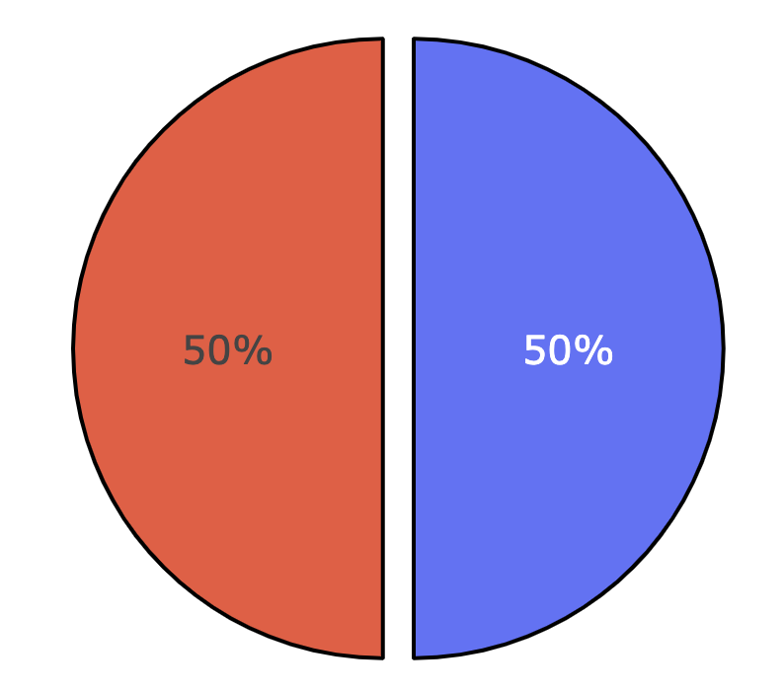
Binary Classification - Hypothesis 1 Visualization

Slide 43
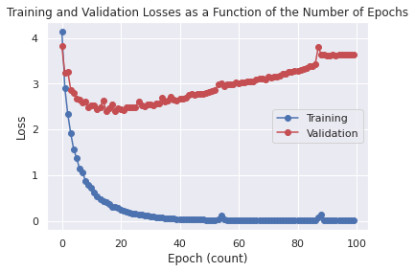
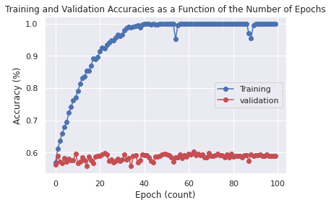
Binary Unbalanced - Training/Validation Loss & Accuracy
TESTING ACCURACY: 58.82%

Slide 44
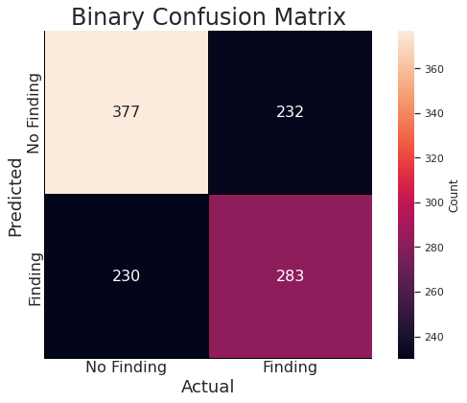
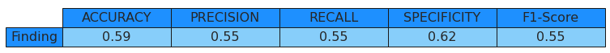
Binary Unbalanced - Confusion Matrix & Summary Statistics

Slide 45
Binary Classification Undersampling
In order to create a balanced dataset, we utilized undersampling
Our smallest class is Finding
We undersampled No Findings such that its count became 2562
Classes | Original Count | Sampled Count
No Findings | 3044 | 2562
Finding | 2562 | 2562

Slide 46
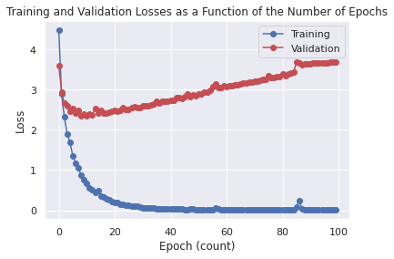
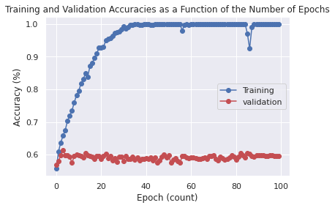
Binary Balanced - Training/Validation Loss & Accuracy
TESTING ACCURACY: 59.61%

Slide 47
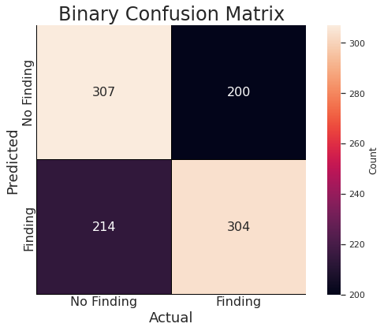

Binary Balanced - Confusion Matrix & Summary Statistics

Slide 48
Imbalanced vs Balanced Binary Model Performance
 | Imbalanced Model | Balanced Model
Accuracy | 59% | 60%
Precision | 55% | 59%
Recall | 55% | 60%
Specificity | 62% | 59%
F-1 Score | 55% | 59%
Overall Accuracy | 58.82% | 59.61%

Slide 49
Feature Engineering Step 2
Data Augmentation on Balanced Models

Slide 50
Data Augmentation
ImageDataGenerator() class in the Keras API
featurewise_center = True
Calculates the mean pixel value across the entire training dataset, then subtracts it from each image
Effect: Centers the distribution of pixel values on zero
featurewise_std_normalization = True
Assumes the distribution of the data inputted is Gaussian
Shifts the distribution to have a mean of zero and a standard deviation of one
Effect: Beneficial for training since dataset sums to zero and the inputs are small values in the rough range of about 3.0 to -3.0 (99.7% of values within 3 standard deviations)

Slide 51
Data Augmentation (Continued)
ImageDataGenerator() class in the Keras API
rotation_range = 20
Value in degrees within which to randomly rotate the images entered
width_shift_range = height_shift_range = 0.2
Ranges (as a fraction of total width or height) within which to randomly translate pictures vertically or horizontally)
horizontal_flip = vertical_flip = True
Randomly flips half of the images vertically and horizontally
zoom_range = 0.2
Randomly zooming inside pictures as much as 20% of original size
fill_mode = ‘nearest’
Strategy used for filling in newly created pixels (post-rotation or width/height shift)

Slide 52
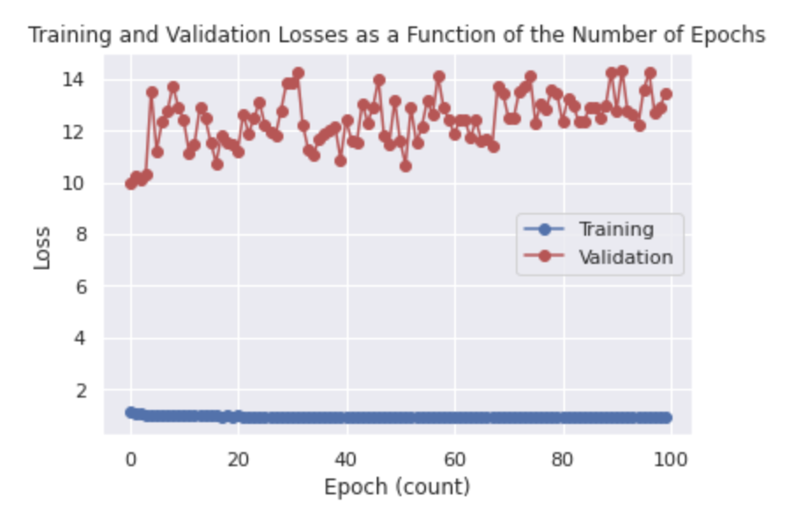
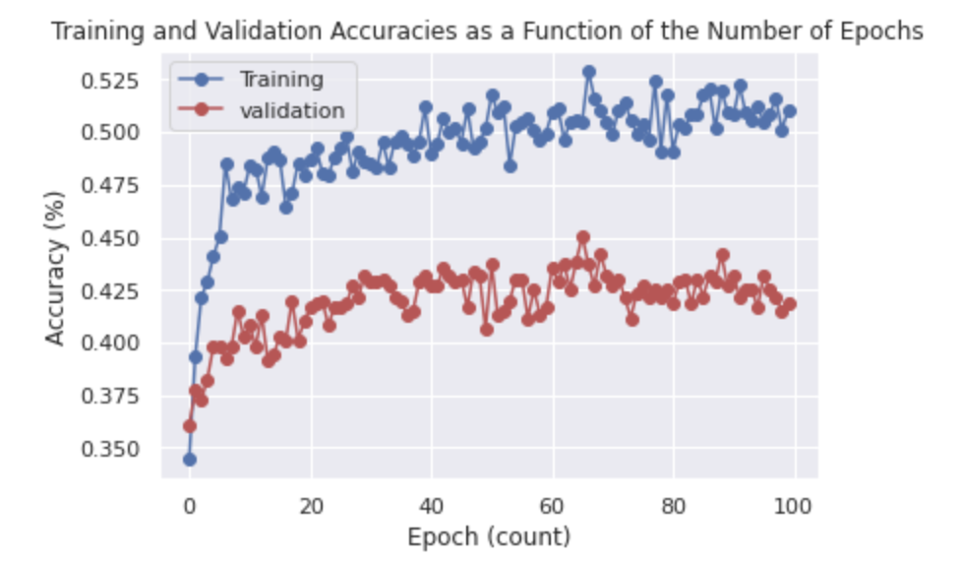
Balanced MultiClass w/ Augmentation - Loss & Accuracy
TESTING ACCURACY: 49.32%

Slide 53
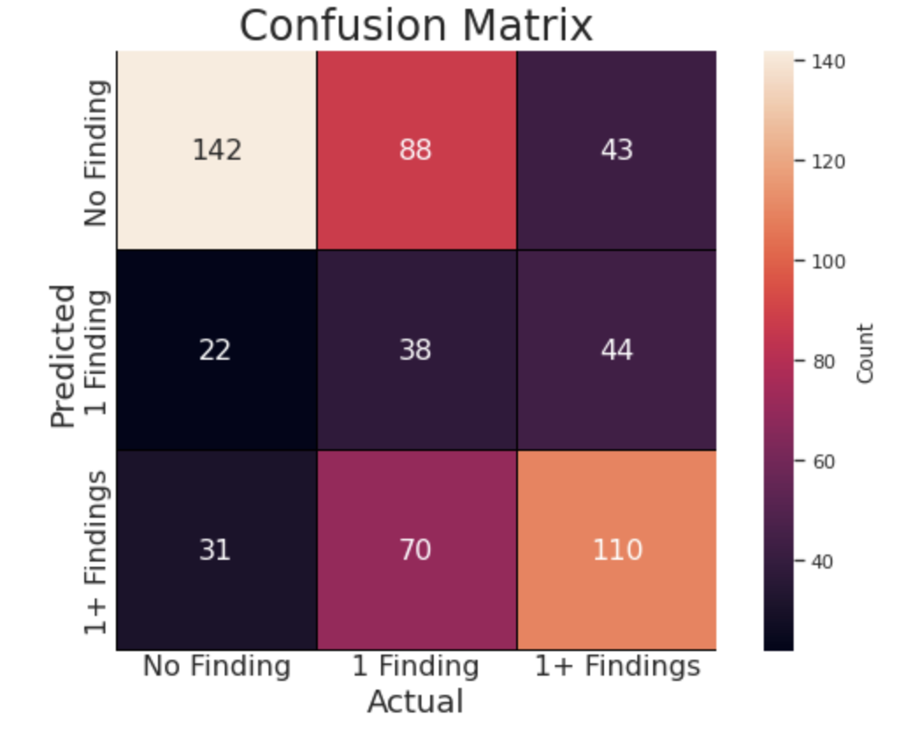
Balanced MultiClass w/ Augmentation - Confusion Matrix

Slide 54
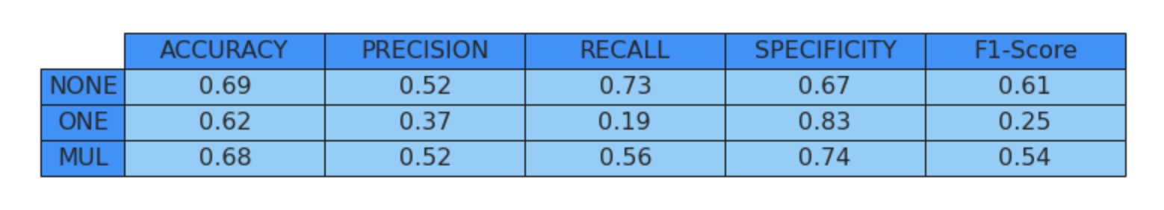
Balanced MultiClass w/ Augmentation- Summary Statistics

Slide 55
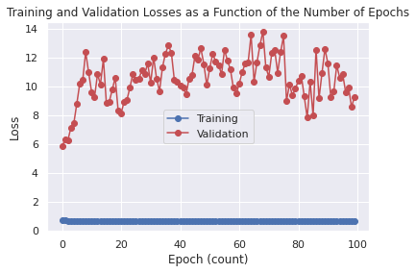
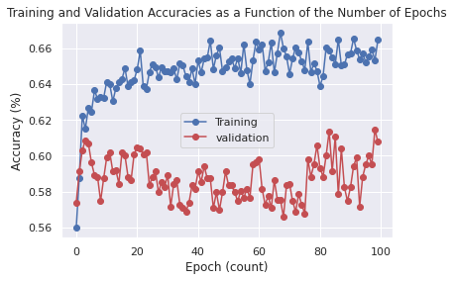
Balanced Binary w/ Augmentation - Loss & Accuracy
TESTING ACCURACY: 60.80%

Slide 56
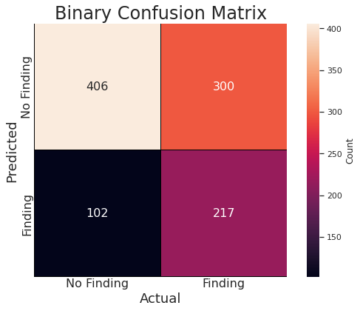

Balanced Binary w/ Augmentation - Confusion Matrix & Statistics

Slide 57
Feature Engineering Summary (Thus Far)
 | Multiclass (None/One/Multiple) |  |  | Binary (No Finding/Finding)
 | Unbalanced | Balanced | Balanced w/ Augmentation | Unbalanced | Balanced | Balanced w/ Augmentation
Accuracy | 64.00% | 61.33% | 66.33% | 59% | 60% | 61.00%
Precision | 40.67% | 42.00% | 47.00% | 55% | 59% | 68.00%
Recall | 40.67% | 42.00% | 49.33% | 55% | 60% | 42.00%
Specificity | 71.00% | 71.00% | 74.67% | 62% | 59% | 80.00%
F1-Score | 40.67% | 41.67% | 46.67% | 55% | 59% | 52.00%
Total Accuracy | 45.99% | 42.01% | 49.32% | 58.82% | 59.61% | 60.80%

Slide 58
Feature Engineering Step 3
Changing the Pretrained CNN Architecture

Slide 59
Comparison of CNN Architectures
 | Balanced Multiclass (None/One/Multiple) |  |  | Balanced Binary (No Finding/Finding)
 | VGG-16 | ResNet-50 | Custom | VGG-16 | ResNet-50 | Custom
Accuracy | 66.33% | 65.33% |  | 61.00% | 62.00%
Precision | 47.00% | 47.33% |  | 68.00% | 62.00%
Recall | 49.33% | 47.33% |  | 42.00% | 66.00%
Specificity | 74.67% | 74.00% |  | 80.00% | 58.00%
F1-Score | 46.67% | 47.00% |  | 52.00% | 64.00%
Total Accuracy | 49.32% | 47.62% |  | 60.80% | 62.05%

Slide 60
Feature Engineering Step 4
Hyperparameter Tuning

Slide 61
Effects of Binary Classification Data Augmentation
Augmentation | Effect on Accuracy | Effect on Recall
Horizontal flip | Positive | Positive
Rotation
Shifts | Positive | Positive

Slide 62


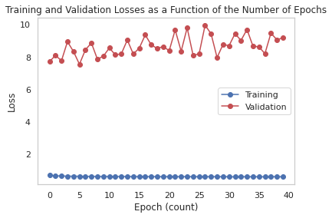



Horizontal Flip Before and After

Slide 63
NIH Chest X-Ray Image Classification
Authors: Tony, Navya, Kunaal, and Jaya (Group 4)
Date: January 15th, 2021

Slide 64
Feature Engineering Concluding Remarks

Slide 65
Next Steps
Normalizing images
Some x-rays have more white around the shoulders and neck than others, hence this would be beneficial to normalize; it will likely improve the accuracy of the model
Hyperparameter Tuning
We plan on tuning the hyperparameters for our model in order to improve the accuracy of our initial model (ie: batch size, activation functions)
Training a new model using different architecture
We want to try using a different pretrained model, ResNet
More widely utilized for medical image classification, although may be more computationally expensive
We may create a custom CNN architecture
Training our own model may help find additional nuances and reduce complexity where it is not needed
Will iteratively test performance on balanced datasets before choosing + running final model

Slide 66
Week 2: NIH Chest X-Ray Image Classification
Authors: Tony, Navya, Kunaal, and Jaya (Group 4)
Course: DS 4002 - Data Science Final Project Course
Professor: Brian Wright
Date: January 15th, 2021

Slide 67
Day 4: Finalized Model Results, Discussion, & Conclusion
Authors: Tony, Navya, Kunaal, and Jaya (Group 4)
Course: DS 4002 - Data Science Final Project Course
Professor: Brian Wright
Date: January 15th, 2021

Slide 68
Background & Motivation
Chest X-rays are used to diagnose conditions such as¹:
Pneumonia → Infection in one or both lungs due to bacteria, viruses, & fungi²
Atelectasis → Collapse of a lobe of the lung or the entirety of the lung³
Effusion → An escape of fluid into a body cavity⁴
Others (Cardiomegaly, Tuberculosis, Lung Cancer, Heart Failure, and more)⁵
Given that Chest X-rays serve as an important diagnostic indicator⁶ of various clinical pathologies…
Can we create a model that can serve as an initial screening to predict whether a given patient’s Chest X-ray is abnormal?
Notes:
https://www.radiologyinfo.org/en/info.cfm?pg=chestrad
https://www.healthline.com/health/pneumonia
https://www.mayoclinic.org/diseases-conditions/atelectasis/symptoms-causes/syc-20369684
https://eclinpath.com/cytology/effusions-2/
https://healthengine.com.au/info/chest-x-ray
https://www.mayoclinic.org/tests-procedures/chest-x-rays/about/pac-20393494#:~:text=Chest%20X%2Drays%20can%20detect,complications%20related%20to%20these%20conditions.

Slide 69
Dataset Overview
This NIH Chest X-ray Dataset
Originally 112,000 X-rays
Using 5,606 subset randomly sampled by the NIH
2 components
X-ray Images
15 classes (14 diseases + Healthy/No finding results)
Disease Classes
Created through using NLP on radiology reports
Expected to be > 90% accurate

Slide 70
What is the original distribution of Findings?
Majority (54%) of patients were not diagnosed with anything
No Finding
140+ unique labels
Predicting individual diagnoses difficult
Very little variation in gender distribution by label

Slide 71



What is the original distribution of Findings?
Majority (54%) of patients were not diagnosed with anything
No Finding
140+ unique labels
Predicting individual diagnoses difficult
Very little variation in gender distribution by label

Slide 72


How do X-rays differ by pixel intensity (brightness)?
0 Finding | 1 Finding | 1+ Finding
Brightness in X-rays =
Fluid
Damage
Abnormalities
Multiple findings X-rays have less distinct peaks
Combination of conditions
X-rays of patients with 0 and 1 finding are similar
Identifying multiple conditions will likely be easier than single
Notes:
Emphasize pixel intensities show patterns
Think of multiple findings as graphs layer over each other creating a composite graph and less clear peaks

Slide 73
Hypothesis 1: Effect of class distribution on model
Target classes:
Binary: No Findings vs. Finding
Multiclass: No Findings, One Finding, & Multiple Findings
Null | A CNN Model trained with a balanced class distribution will possess a lower or equal average class recall relative to a CNN Model trained with the original class distribution.
Alternative | A CNN Model trained with a balanced class distribution will possess a higher average class recall relative to a CNN Model trained with the original class distribution.

Slide 74


Hypothesis 1 Class Balancing Visualization (Multiclass)

Slide 75
Hypothesis 1 Class Balancing Visualization (Binary)

Slide 76
Hypothesis 2: Recall of individual classes
Target model:
Multiclass (Classes = No Findings, One Finding, & Multiple Findings)
Null | If the multiclass model from Hypothesis 1 is utilized to classify images on a testing set, then the recall of each class (No Finding, One Finding, and Multiple Findings) will be equal
Alternative | If the multiclass model is utilized to classify the images on a testing set, then the recall of each class will not be equal

Slide 77
Undersampling
To create balanced models, we performed undersampling
Used less of larger classes
Multiclass Predictor
Binary Predictor
Classes | Original Count | Sampled Count
No Findings | 3044 | 980
One Finding | 1582 | 980
Multiple Findings | 980 | 980
Classes | Original Count | Sampled Count
No Findings | 3044 | 2562
Finding | 2562 | 2562

Slide 78
Effect of Class Distribution on Multiclass Model
 | Imbalanced Distribution Model |  |  |  | Balanced Distribution Model
 | No Finding | One Finding | Multiple Findings | Average | No Finding | One Finding | Multiple Findings | Average
Recall | 54% | 31% | 32% | 39.00% | 44% | 37% | 48% | 43.00%
Specificity | 61% | 68% | 80% | 60.67% | 79% | 65% | 71% | 71.67%
Accuracy | 57% | 57% | 72% | 62.00% | 67% | 56% | 64% | 62.33%
Conclusion: Balancing the unequal class distribution improved multiclass recall

Slide 79
Effect of Class Distribution on Binary Model
 | Imbalanced Model | Balanced Model
Accuracy | 58% | 58%
Recall | 48% | 64%
Specificity | 66% | 51%
Conclusion: Balancing class distribution also improved binary model

Slide 80
Effect of Augmentation on Multiclass Model
Introduced random flipping, zooming, and shifting
 | Multiclass (None/One/Multiple) |  | Binary (No Finding/Finding)
 | Balanced | Balanced w/ Augmentation | Balanced | Balanced w/ Augmentation
Class Accuracy | 62.33% | 64.33% | ---- | ----
Recall | 43.00% | 47.67% | 64.00% | 62.00%
Specificity | 71.67% | 73.33% | 51.00% | 69.00%
F1-Score | 43.00% | 47.00% | 60.00% | 55.00%
Conclusion: Data augmentation improved multiclass classification + recall

Slide 81
Feature Engineering: Data Augmentation
Augmentation Techniques: Random Rotation & Flipping (Horizontally & Vertically)
 | Multiclass (None/One/Multiple) |  | Binary (No Finding/Finding)
 | Balanced | Balanced w/ Augmentation | Balanced | Balanced w/ Augmentation
Class Accuracy | 62.33% | 64.33% | ---- | ----
Recall | 43.00% | 47.67% | 64.00% | 62.00%
Specificity | 71.67% | 73.33% | 51.00% | 69.00%
F1-Score | 43.00% | 47.00% | 60.00% | 55.00%
Total Test Accuracy | 42.01% | 47.12% | 58.00% | 59.61%
Conclusion: Optimize the data augmented models, since the primary endpoint of our hypothesis is multiclass classification and their recall was higher

Slide 82
CNN Layers
Convolutional Pooling Dense
Outputs
Condenses
Extracts

Slide 83
CNN Architectures
ResNet layers these
Convolutional Pooling Dense

Slide 84
CNN Architectures
VGG alternates these
Convolutional Pooling Dense

Slide 85
CNN Architectures
DenseNet layers these
Convolutional Pooling Dense

Slide 86
Performance of CNN Architectures
 | Balanced, Augmented Multiclass (None/One/Multiple) |  |  | Balanced, Augmented Binary (No Finding/Finding)
 | VGG-16 | ResNet-50 | Custom /w DenseNet-121 | VGG-16 | ResNet-50 | Custom w/ DenseNet-121
Class Accuracy | 64.3% | 66.7% | 68% | ---- | ---- | ----
Recall | 47.7% | 48.3% | 53.3% | 69.0% | 72.0% | 94%
Specificity | 73.3% | 74.7% | 76.3% | 69.0% | 58.0% | 21%
Conclusion: Use Custom CNN Architecture /w DenseNet-121, for both multiclass classification and binary classification to test hypotheses.

Slide 87
Feature Engineering: CNN Architectures & Hypertuning
 | Balanced, Augmented Multiclass (None/One/Multiple) |  |  | Balanced, Augmented Binary (No Finding/Finding)
 | VGG-16 | ResNet-50 | Custom /w DenseNet-121 | VGG-16 | ResNet-50 | Custom w/ DenseNet-121
Class Accuracy | 64.3% | 66.7% | 68% | ---- | ---- | ----
Recall | 47.7% | 48.3% | 53.3% | 69.0% | 72.0% | 94%
Specificity | 73.3% | 74.7% | 76.3% | 69.0% | 58.0% | 21%
Total Test Accuracy | 47.1% | 50.0% | 52% | 59.6% | 64.3% | 59%
Conclusion: Use Custom CNN Architecture, based off of SOTA DenseNet-121, for both multiclass classification and binary classification when testing hypotheses.

Slide 88
Effects of Hypertuning & Data Augmentation
Augmentation | Effect on Recall
Epochs | <20 epochs ideal to avoid overfitting
Learning Rate | Low (0.0001) ideal for multiclass; higher (0.01) ideal for binary
Flips | Positive (horizontal and vertical flips)
Rotations | ~10 degrees ideal
Shifts | Between 10 and 20% of the image ideal
Zoom | Between 10 and 20% of the image ideal
Cropping | Negative, over feature engineering

Slide 89

Finalized Model (Post-Feature Engineering)
CNN Architecture:
DenseNet-121
Each layer passes its feature maps to all subsequent layers in the network
Hyperparameters:
Learning Rate → 0.0001
Number of Epochs → 15
Data Augmentation:
Rotation Range → 10
Width Shift Range → 0.2
Height Shift Range → 0.1
Horizontal Flip → True
Vertical Flip → True
Zoom Range → 0.15

Slide 90
Final Multiclass Model Results
 | Imbalanced Model | Balanced Model
No Findings | 0.68 | 0.49
One Finding | 0.34 | 0.38
Multiple Findings | 0.41 | 0.73
Average Recall | 0.48 | 0.53
Hypothesis 1: Rejected; balanced model has higher average recall than imbalanced
Hypothesis 2: Rejected; recall between classes of the balanced model are not equal

Slide 91
Finalized Binary Model Results
 | Imbalanced Model | Balanced Model
Recall | 0.52 | 0.94
Hypothesis 1: Rejected; balanced model has higher average recall
Hypothesis 2: N/A

Slide 92
Finalized Binary Model Results
 | Imbalanced Model | Balanced Model
Recall | 0.52 | 0.94
Conclusion: Predicting severity is easier than individual diagnoses
Single Finding Multiple Finding

Slide 93
Limitations
Computational:
Significantly downsized image data (1024 → 128)
Small subset (~5%)
May not be best representation
Dataset:
NLP Labels
Potential Error Propagation
X-rays may vary significantly
> 140 unique findings
Results:
Low model accuracies
No statistical significance analysis

Slide 94
Future Avenues of Research
Larger sample or all of the dataset
Full sized X-ray images (1024x1024 rather than 128x128)
Alternative techniques for balancing class distribution (stratified samples)
Classify all 14 disease classifications (multiple findings possible)
Narrow approach to one disease classification (ie: pneumonia vs. not)
Ensemble approach
Use other SOTA architectures
InceptionV3, CIFAR-100, MobileNet, & EfficientNet
Other types of medical imaging
CT, MRI, U/S
Introduce noise in images

Slide 95
Conclusion
Looked at feasibility of multiclass/binary classification on medical images
Hypothesis 1: Balanced data gave better average recall for both multiclass + binary
Hypothesis 2: Multiclass model was significantly better for no and multiple findings
Key takeaways: Medical imaging diagnosis via ML might benefit from
Nontraditional CNN architectures (DenseNet)
Limited feature engineering
Key applications:
Screen most at-risk patients
Intervene early, to prevent recurrent diseases
Prevent redundant testing (globally billions of dollars)

Slide 96
Sources
https://www.kaggle.com/nih-chest-xrays/data?select=Data_Entry_2017.csv
https://stanfordmlgroup.github.io/projects/chexnet/
https://www.nature.com/articles/s41746-020-0273-z
https://biomedical-engineering-online.biomedcentral.com/articles/10.1186/s12938-020-00831-x
https://www.mayoclinic.org/tests-procedures/chest-x-rays/about/pac-20393494#:~:text=Chest%20X%2Drays%20can%20detect,complications%20related%20to%20these%20conditions.
https://www.radiologyinfo.org/en/info.cfm?pg=chestrad
https://www.healthline.com/health/pneumonia
https://www.medscape.com/answers/967822-23537/what-is-the-global-prevalence-of-pneumonia#:~:text=The%20WHO%20Child%20Health%20Epidemiology,enough%20to%20require%20hospital%20admission.
https://www.healthline.com/health/copd-vs-emphysema
https://www.medscape.com/answers/297664-7353/what-is-the-worldwide-prevalence-of-chronic-obstructive-pulmonary-disease-copd#:~:text=The%20exact%20prevalence%20of%20COPD,different%20regions%20of%20the%20world.
https://www.mayoclinic.org/diseases-conditions/atelectasis/symptoms-causes/syc-20369684
https://eclinpath.com/cytology/effusions-2/
https://healthengine.com.au/info/chest-x-ray
https://peltarion.com/knowledge-center/documentation/modeling-view/build-an-ai-model/loss-functions/categorical-crossentropy
https://towardsdatascience.com/optimizers-for-training-neural-network-59450d71caf6
https://www.mathworks.com/help/deeplearning/ref/resnet50.html#:~:text=ResNet%2D50%20is%20a%20convolutional,%2C%20pencil%2C%20and%20many%20animals.
https://www.geeksforgeeks.org/opencv-python-program-analyze-image-using-histogram/

