Slide 1
Forensic Chainguard
A Blockchain-Based Chain-of-Custody System Built on Hyperledger Fabric
Group No: 19

Slide 2
Team Members
Kruthi Tirunagari - Blockchain & Security Specialist
Ashish Nadadur Chakravarthi - Blockchain & Smart Contract Developer
Shashank Gadipally - System Administrator
Sree Sai Harshitha Nanjyala - Frontend & Smart Contract Developer
Sri Sai Chetana Reddy Janagan -Testing & Validation

Slide 3
Objective
Build a tamper-proof forensic evidence integrity system using blockchain.
Ensure evidence authenticity from creation → check-in → transfer → removal.
Problem
Evidence must remain unchanged, traceable, and trustworthy. Even minor integrity issues can overturn cases.
Limitations of Traditional Systems
Paper logs & spreadsheets -> easy to alter / lose
Manual handoffs -> uncertain custody
Centralized databases -> single point of failure
No cryptographic verification -> tampering undetectable
Limited transparency -> hard to audit
Custody disputes -> dismissed cases & wrongful convictions

Slide 4
Our Solution
Blockchain-Powered Chain of Custody
Store all evidence actions immutably on Hyperledger Fabric
Enforce access with smart-contract–based roles
Use SHA-256 image hashing for tamper detection
Maintain full event timeline (created → check-in → transfer → remove)
Why Blockchain Helps
Immutability: No one can alter or delete past records
Transparency: All authorized users see complete history
Decentralization: No single authority controls evidence
Cryptographic Proof: Each interaction is digitally signed
Consensus: Multiple parties validate every action
Legal Strength: Forensic chain-of-custody becomes defensible in court

Slide 5
Blockchain Network Architecture
Hyperledger Fabric Network
2 Organizations
Org1 -> Forensic Lab
Org2 -> Prosecutor’s Office / Court
1 Ordering Service -> Orders transactions into blocks
Each org has:
1 peer node
Its own ledger copy
Channel: forensic-chainguard
Shared private ledger for evidence chain-of-custody
Chaincode: chainguard
Handles evidence creation, check-in, transfer, removal
Enforces role-based access

Slide 6
Roles (Application Level)
Business Roles (Enforced by Smart Contract)
Forensic Technician (Custodian):
Create evidence, check in
Evidence Manager (Admin equivalent):
Create, check in, transfer, remove
Viewer / Analyst:
Read-only access

Slide 7
LIVE DEMO!!

Slide 8
THANK YOU!!!
OPEN FOR QUESTIONS

Slide 9
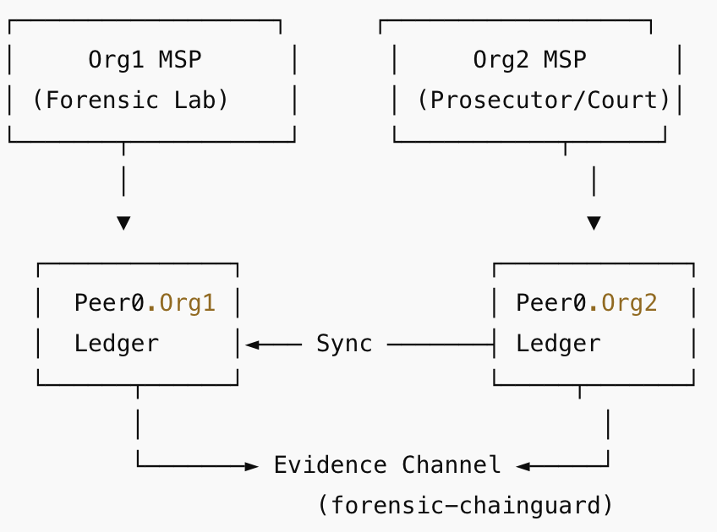
BACKUP

