Slide 1

Regulating the Financial System

Slide 2
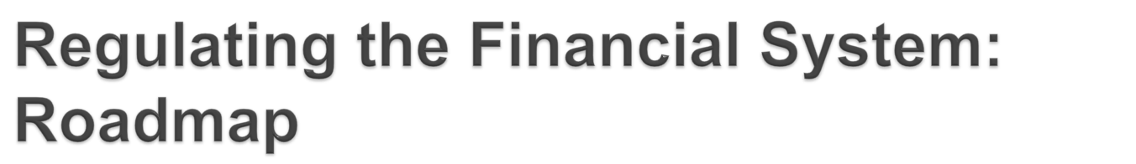
Runs, Panics & Financial Crises
The Government Safety Net
Regulation and Supervision

Slide 3

Sources of Bank Runs:
  Promise depositors withdrawal on demand
  First come, first served
Suppose depositors lose confidence?
Concern over insolvency can lead to illiquidity.
Bank run can be the result of both real and imagined problems

Slide 4

Run on a single bank can turn into a system-wide panic.
Asymmetric information:
Can’t distinguish good from bad banks.
Concern about one bank can create panic about all banks.

Slide 5

Business slowdown = firms find it harder to pay their debts
People lose jobs = cannot make loan payments
As default rates rise, bank assets/capital drop
Banks contract their balance sheets = extend fewer loans
Less loans = less business investment

Slide 6

Depositor protection
  Government is obligated to protect small deposits unable to judge the soundness of financial institutions
Protect customers from exploitation
  Large institutions can raise prices
Ensure financial stability
  System is inherently unstable

Slide 7

We rely heavily on depository institutions (banks) for access to the payments system
If banks disappeared, we would have a difficult time making payments
Furthermore, banks are prone to runs
The result is that banks receive a disproportionate amount of the attention of regulators

Slide 8

Lender of Last Resort
Deposit Insurance
Regulation
Supervision and Examination

Slide 9

The best way to stop a bank failure from turning into a bank panic is to make sure solvent institutions can meet their depositors’ withdrawal demands.

Slide 10

FDIC (Federal Deposit Insurance Corporation)
  Resolves insolvency by:
    Payoff method
    Purchase-and-assumption method

Slide 11

To contain risks created by safety net, the government employ 3 strategies:
  Government Regulation
  Government Supervision
  Formal Examination

Slide 12
Type of Intermediary | Regulators
Commercial Banks | Federal Deposit Insurance Corporation Office of the Comptroller of the Currency (Nationally chartered banks) Federal Reserve System (State-chartered banks that are Federal Reserve members) State authorities (All state-chartered banks)
Savings Banks Savings and Loans | Office of the Comptroller of the Currency (since 2011) Federal Deposit Insurance Corporation State authorities
Credit Unions | National Credit Union Administration State authorities

Slide 13

Restrictions on competition
  Greater competition leads to more risk to survive.
Asset holding restrictions
  Restrict the type of asset banks can hold
  Banks should maintain minimum levels of capital
  US banks cannot hold common stocks
Minimum capital requirements
  Capital acts as buffer, has to be big enough.
Disclosure requirements
  Allows regulators and financial markets to assess quality of the institution

Slide 14

Regular visits from examiners
An elaborate oversight process
Check that loan collateral exists
Evaluate past-due loans to see that banks write them off
Rate banks (CAMELS – Capital Adequacy, Asset Quality, Management, Earnings, Liquidity, and Sensitivity to risk)

Slide 15

Regulators’ goal must be to prevent large-scale catastrophes
Two types of externalities that pose systemic risks:
  Common Exposure – when many institutions have an exposure to the same specific risk factor
  Pro-cyclicality – positive correlation between the value of a good, a service or an economic indicator and the overall state of the economy

Slide 16

Regulatory capital requirements vary with an institution’s contribution to systemic risk
FDIC proposed higher capital requirements for the “largest, most systemically important banking institutions”
Varying capital requirements with business cycle

Slide 17
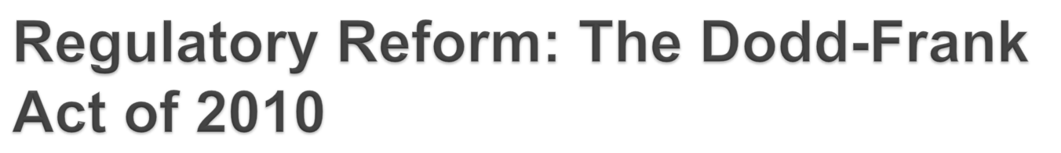
Dodd-Frank Wall Street Reform and Consumer Protection Act
An act to promote the financial stability of the United States by improving accountability and transparency in the financial system, to protect consumers from abusive financial services practices, and for other purposes
Effective July 12, 2010

Slide 18

Strengthening the Financial System
  Encourages transparency and simplification throughout the financial system and improves its resilience
Preventing Crises Through Systemic Risk Management – identity and forestall threats to the system
Ending “Too Big to Fail” and Reducing Moral Hazard
  Eliminates government bailouts of institutions
  Makes it difficult for the Fed to make loans to nonbank intermediaries
  Constrains the FDIC’s guarantee powers
  Requires all SIFIs to have resolution plans (“living wills”) and gives the FDIC new powers to take over SIFIs, even if they are not banks

Slide 19
End of Chapter

