Slide 1


Chapter 12
Depository Institutions:
Banks and Bank Management

Slide 2
Depository Institutions:
The Big Questions
What is a bank?
Where do banks get their funds and what do they do with them?
What are the risks banks face?

Slide 3
Depository Institutions:
Roadmap
Commercial Bank Balance Sheets
Bank Risk

Slide 4
Preliminary:
Financial Institutions
Depository Institutions:
Financial institutions that accept deposits.
Includes banks, savings and loans, savings banks, and credit unions.
We’ll call all of these Banks
Nondepository institutions:
Financial institutions – insurance companies, pension funds, mutual funds and the like – do not accept deposits.

Slide 5
Balance Sheet of Commercial Banks:
Assets, Liabilities, and Capital
The balance sheet identity:
Bank Assets =
Bank Liabilities + Bank Capital
When one side changes, the other side must change as well.

Slide 6
Commercial Bank Assets:
Uses of Funds
Cash (13.1%)
  Reserves = vault cash + deposits at the Fed
  Cash Items in process of collection
  Balances held at other banks
  **Balance Sheet of U.S. Commercial Banks, January 2013

Slide 7
Commercial Bank Assets:
Uses of Funds
Cash (13.1%)
Securities (20.9%)
  U.S. Treasury = 14.3% of assets
  State and Local Government = 6.6% of assets
  These are very liquid.
  They are secondary reserves.
  U.S. Commercial banks are not allowed to purchase stocks.

Slide 8
Commercial Bank Assets:
Uses of Funds
Cash (3.1%)
Securities (22.7%)
Loans (65.6%)
  Commercial and Industrial (C&I)
  Real Estate
  Consumer (auto-loans and credit card loans)
  Interbank (loans made from one bank to another)
  Primary differences among various depository institutions is in the composition of their loan portfolio.

Slide 9
Commercial Bank Liabilities:
Sources of Funds
Checkable Deposits
  Available on Demand
  Include Now accounts, Super-Now,
  Insured Market Rate accounts
  Also known as transactions deposits
  Have declined substantially in importance
  (From 40% in 1970s to nearly 15% in 2013)

Slide 10
Commercial Bank Liabilities:
Sources of Funds
Checkable Deposits
Nontransaction Deposits
  Certificates of Deposit ($100,000 or less)
  Large (> $100,000) are negotiable

Slide 11
Commercial Bank Liabilities:
Sources of Funds
Checkable Deposits
Nontransaction Deposits
Borrowing
  Discount loans for the Fed
  Reserves from other banks in the
  Federal Funds Market (unsecured)
  Repurchase agreements

Slide 12
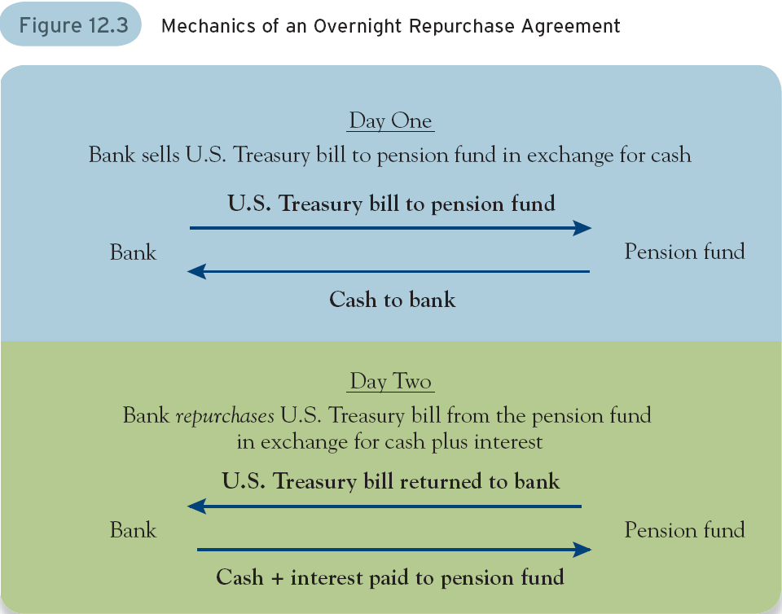

Slide 13

Finding the right bank takes some work
Decide what services you need
Shop around looking for a bank that provides them cheaply
Be sure that your bank is insured

Slide 14
Bank Capital
Assets – Liabilities = Net Worth
This is bank capital.
It is the value of the bank to its owners.
The average debt-to-equity ratio for retail and commercial U.S. banks as of January 2015 is approximately 2.2.

Slide 15
Bank Profitability
Return on Assets (ROA)
Return on Equity (ROE)
ROA =
Net profit after taxes
Total Bank Assets
ROE =
Net profit after taxes
Bank Capital

Slide 16
Bank Profitability
Net Interest Income
Net Interest Income = Interest Income – Interest Expense

Slide 17
Off-Balance-Sheet Activities
Don’t show up as assets or liabilities
Generate income through fees and compensation for risk bearing
Examples:
  Loan Commitments
  Letters of Credit

Slide 18

It is easy to get a payday loan
You need a ID, a phone or utility bill, and a pay stub.
The problem is that they are very expensive.
Payday loans are really a last resort

Slide 19
Sources of Bank Risk
Liquidity Risk
Credit Risk
Interest-Rate Risk
Trading Risk
Foreign Exchange, Sovereign
& Operational Risk

Slide 20
Liquidity Risk
Source:
  Withdrawal from Transaction deposit
  “Take down” of loan commitment
Management
  Asset Adjustment
  Not very appealing: it shrinks the size of the bank
  Liquidity Adjustment
  Issue large denomination CDs

Slide 21
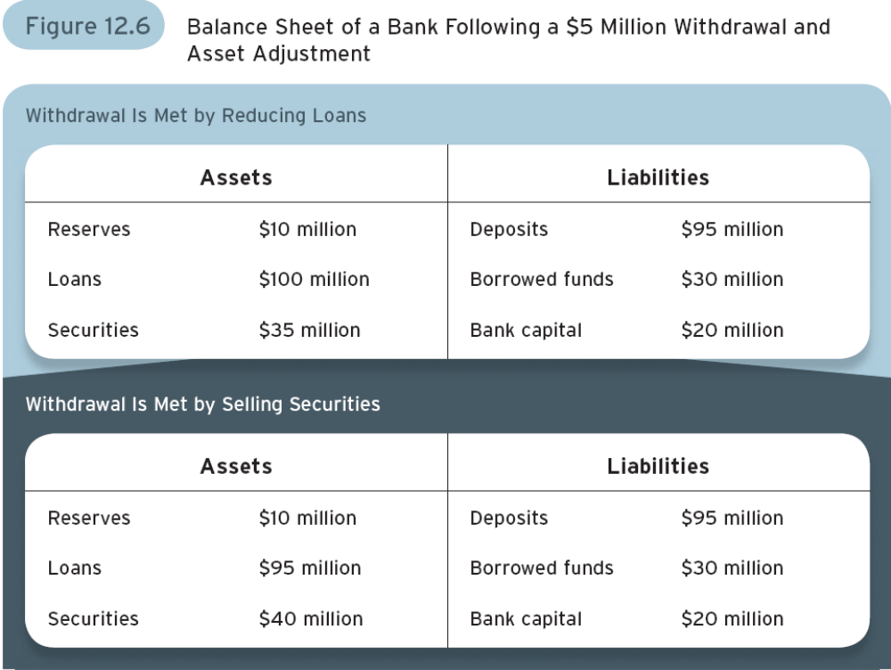

Slide 22
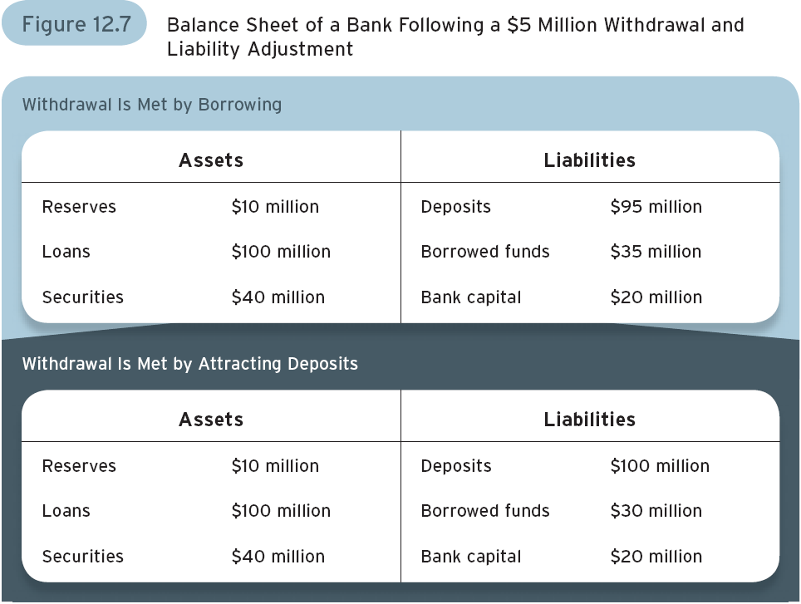

Slide 23
Credit Risk
Source:
Borrower default
Management:
  Diversification
  Credit-risk analysis
  (also addresses information asymmetry)
  Collateral
  Long-term relationship

Slide 24
Interest-Rate Risk:
Source
Banks assets don’t match liabilities
They “borrow short” and “lend long”
Creates a maturity mismatch
When interest rates move, it affects
Revenue from the assets
Costs of the liabilities differently

Slide 25
Interest-Rate Risk:
Source
Classify assets and liabilities into
  Interest-rate sensitive – deposits
  Not interest-rate sensitive – long-term loans
What happens if interest rate rise?
  Deposit costs based on flexible
  short-term interest rates rise
  Loan revenues based on past (fixed)
  long-term interest rates don’t

Slide 26
Interest-Rate Risk:
Management
Change maturity structure of assets to
better match liabilities using instruments like Adjustable Rate Loans
Use derivatives, like swaps
Remember an interest-rate swap turns
fixed-rate into flexible-rate bonds

Slide 27
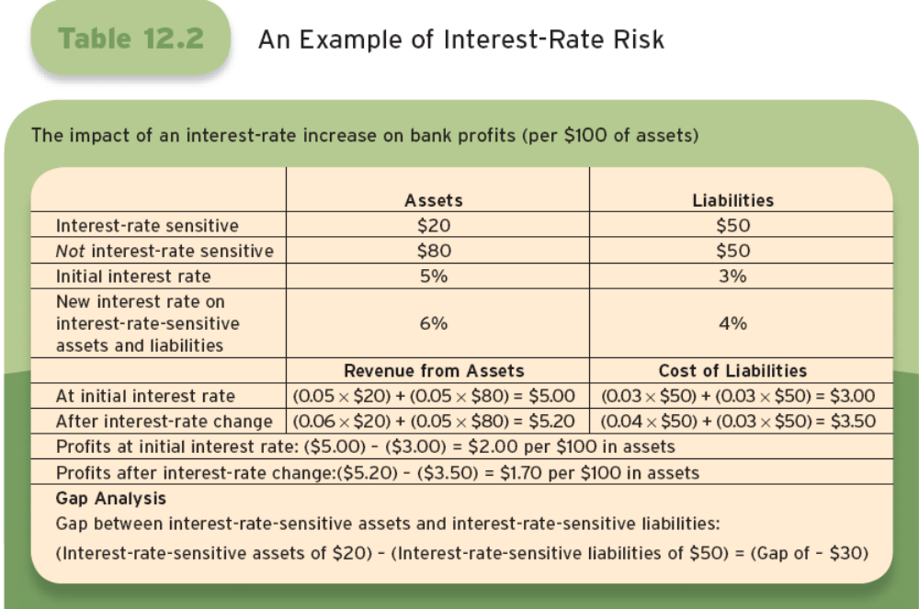

Slide 28
Trading Risk
Source:
  Banks employ traders who use
  bank capital to try and make profits.
  Trading creates risk of losses.
Management:
Statistical models to calculate value-at-risk

Slide 29
Other Risks
Foreign-Exchange Risk
  Make loans in foreign currency
  Exposure to exchange rate fluctuations
Sovereign Risk
  What if a foreign government stands in the way of repayment?
Operational Risk
  Computers might go down
  Buildings may become inaccessible.

Slide 30
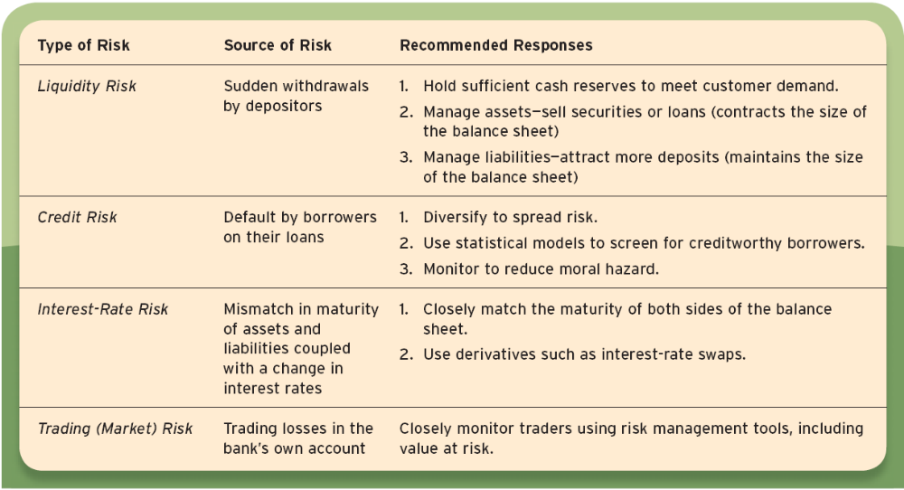
Summary of Sources and Management of Bank Risk

Slide 31






Slide 32


Slide 33
TYPES OF BANKS IN THE PHILIPPINES
Capitalization of 2.8 Billion
Accept or create demand deposit
Receive other deposits and deposits substitute
Service withdrawal
Lending activities
Accept drafts and Letters of Credit

Slide 34
TYPES OF BANKS IN THE PHILIPPINES
Can discount and negotiate Promissory notes, drafts and bills of exchange and other forms of indebtedness
Can invest in allied undertaking
Trading of bonds and securities
Buy and sell foreign exchange (FX) and gold or silver bullion
Trust function
Advisory function

Slide 35

TYPES OF BANKS IN THE PHILIPPINES
Capitalization of 5.4 Billion (BSP Circular 156 Series of 1998)
Shall exercise the powers authorized for a commercial bank
Undertake underwriting activities
Invest in allied and non-allied enterprises as maybe determined by the Monetary Board
Up to 100% equity investment in financial intermediaries other that commercial banks

Slide 37
List of major universal and commercial banks
BDO
MBTC
BPI
LBP
PNB
DBP
CBC
AUB
Standard Chartered Bank
RCBC
Security Bank
UBP
Citibank, N.A.
UCPB
HSBC
East West Bank
Bank of Commerce
Philtrust Bank

Slide 38
List of major universal and commercial banks
Maybank Philippines
PBCom
ANZ
JP Morgan Chase
The Bank of Tokyo-Mitsubishi UFJ, Ltd.
Philippine Veterans Bank
Deutsche Bank
Robinsons Bank
Bangkok Bank
BDO Private Bank
ING Group
Mizuho Bank
CTBC
Bank of America
Korea Exchange Bank
Mega International Commercial Bank
Bank of China
Al-Amanah Islamic Investment Bank of the Philippines

Slide 39
TYPES OF BANKS IN THE PHILIPPINES
Capitalization of 400 Million if its H.O is located in Metro Manila and 64M if it is located outside Metro Manila
Deposit function
Loan function
Exchange function
Trust function
Advisory function

Slide 40
List of thrift banks
BPI Family Savings Bank
Chinabank Savings
City Savings Bank
Citystate Savings Bank
Equicom Savings Bank
First Consolidated Bank
UCPB Savings
HSBC Savings Bank
Malayan Savings Bank
Philippine Business Bank
Postal Bank
PSBank
RCBC Savings Bank
Sterling Bank of Asia

Slide 41
TYPES OF BANKS IN THE PHILIPPINES
CAPITALIZATION
In the cities of Manila, Kalookan, Quezon, Pasay, Mandaluyong and Makati and Municipalities of Malabon, Navotas, San Juan and Parañaque | 32 Million
In the cities of Cebu and Davao | 16 Million
In the first, second and third class cities and first class municipalities | 8 Million
In the fourth, fifth, and sixth class cities and in second, third and fourth class municipalities | 4.8 Million
In the fifth and sixth class municipalities | 3.2 Million

Slide 42
TYPES OF BANKS IN THE PHILIPPINES
Provide channels for funds from urban areas and the government sector for agriculture and individual activities in the countryside
Provide credit to small-scale farmers and enterprises in the rural sector
Receive government support of the farm production program
Deposit function
With MB approval, act as trustee over estates, or properties of farmers or merchants

Slide 43
TYPES OF BANKS IN THE PHILIPPINES
Land Banks of the Philippines
Development Bank of the Philippines
Postal Bank
Al-Amanah Investment Bank of the Philippines

Slide 44






Slide 45
TYPES OF BANK ACCOUNTS
Checking Account: Customers are generally given paper check to carry out day-to-day transaction. Usually no interest is paid on the deposited money.
Savings Account: A type of deposits which is designed to get small savings from the general public. It is usually evidenced by a passbook or record book.

Slide 46
TYPES OF BANK ACCOUNTS
Certificate of Deposit: Requires the customer to deposit a certain amount of money for a fixed period of time. The interest rate given is usually higher that other types of bank accounts.
Money Market Account: A type of deposit account in which money can be deposited to earn higher rate of interest.

Slide 47















Non-bank
Financial Instructions
Securities and Exchange Commission
Investment Houses*
Fund Managers
Financing Companies*
Lending Investors
Investment Companies*
Non-stock Saving and Loan Association
Securities Dealers*
Mutual Building & Loan Associations
Securities Brokers
Private Insurance Companies
Pawnshops
Venture Capital Corporation
Government Non-Bank
Financial Institutions
* With quasi-Banking Functions

Slide 48
Chapter 12
Depository Institutions:
Banks and Bank Management

