Slide 1

Financial Industry Structure

Slide 2

Why are there 6000 banks in the U.S and only 24 in Canada?
Why is the number of U.S. banks falling?
What are the functions and characteristics of nondepository institutions?

Slide 3

Banking Industry Structure
Nondepository Institutions

Slide 4


1863
National Congress Banking Act of 1863
  10% tax on banknotes
  Created a system of federally chartered banks or national banks
  ***Dual Banking System – banks can choose whether to get their charters from the Comptroller of the Currency at the US Treasury or from state officials.

Slide 5
1933
From 1929-1933, more than a third of the U.S. banks failed
Glass-Steagall Act of 1933
  Created the FDIC
  Restricted bank assets to certain approved forms of debt and forbade banks from dealing in securities, providing insurance, or engaging in nondepository institution’ activities

Slide 6
1999
Gramm-Leach Bliley Financial Services Modernization Act
Dodd-Frank Wall Street Reform and Consumer Protection Act of 2010
  Aims to prevent financial crises and new government bailouts of financial intermediaries
  Closer gov’t oversight on SIFIs
2010

Slide 7

Size of Institution (Assets) | Number | % of Total Assets
Less than $100 million | 1,915 | 0.8%
$100 million to $1 billion | 3,596 | 7.9%
$1 billion to $10 billion | 447 | 8.6%
$10 billion or more | 90 | 82.6%
Total | 6,048 | 100%($13.4 trillion)

Slide 8






Slide 9

Pawnshops provide loans to people without access to the traditional financial system.
Because the loans are collateralized, the terms are often reasonable – better than payday loans, for example.

Slide 10
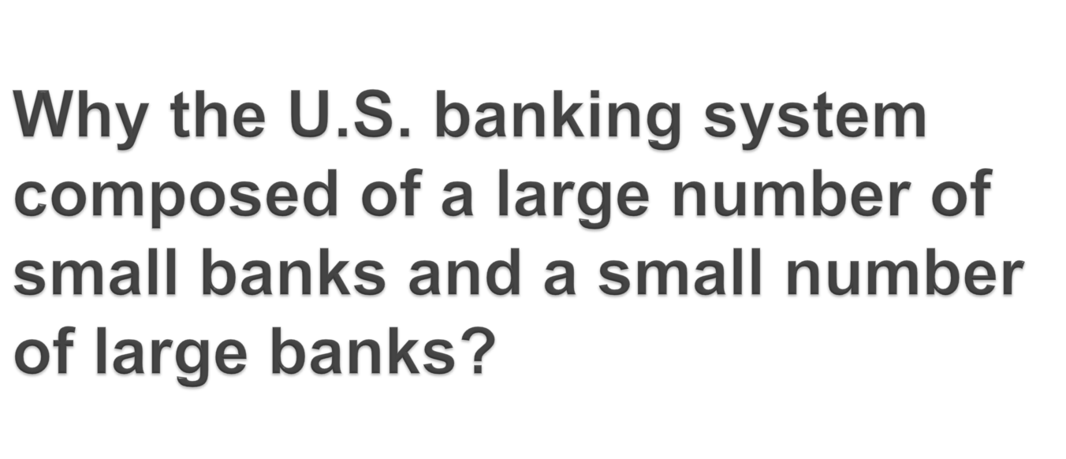


Slide 11

Required nationally chartered banks to meet the branching restrictions of the states where they were located
Produced a fragmented banking system nearly devoid of large institutions
Banks can only receive loans from residents of their own communities

Slide 12

Holding company - created not just as a way to evade branching restrictions but as a way to provide nonbank financial services in more than one state.
The act was established in 1956
Allowed holding companies to do asset management, investment advice, insurance, leasing, collections, and real estate services

Slide 13

Established in 1994
Reversed restrictions put in place by McFadden Act
Banks were allowed to acquire unlimited number of branches nationwide

Slide 14

Foreign branches offering the same services as those in the home country
IBF (international banking facility)
Edge Act corporation
Eurodollars
  dollar deposits in foreign banks.
  The Eurodollar market in London is one of the biggest and most important financial markets in the world.

Slide 15

What will the bank of the future be?
  Financial holding companies
  Universal banks
  Are there scale economies?
  Are there scope economies?

Slide 16

Insurance Companies
Pension Funds
Mutual Funds
Finance Companies
Government-Sponsored Enterprises

Slide 17

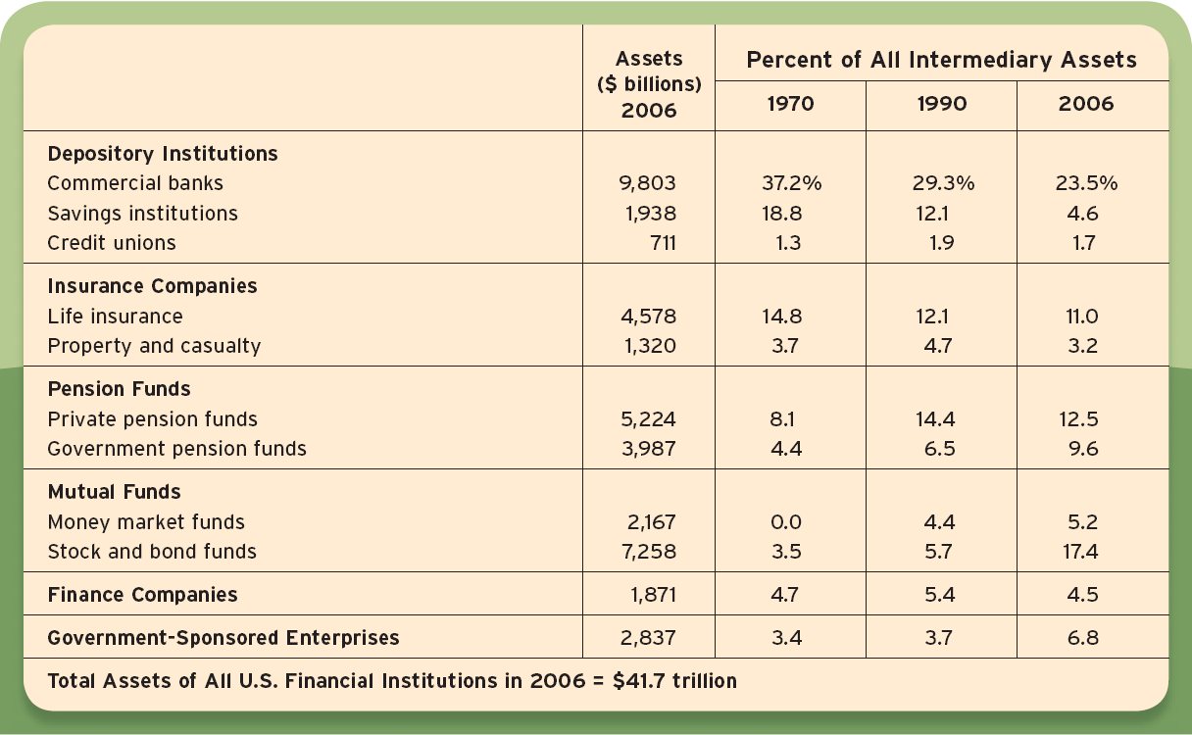

Slide 18

Pooling resources of small savers
Safekeeping and Accounting services
Liquidity services
Diversification services
Information services

Slide 19

The History
  1400:Shipments from London to Italy
  1688: Lloyd’s of London
  Sea voyages were very risky
Two Types
  Property and Casualty
  Life
    Term
    Whole
Reduce risk by spreading it across policies

Slide 20

Allow policyholders to
pool and transfer risk
Screen & monitor to reduce
adverse selection & moral hazard

Slide 21

Life insurance is to support people who need it if something happens to you.
People with children need it
Buy term life insurance, it’s cheaper
You may need as much as 10 x income

Slide 22

Some risks are too big for insurance companies
Reinsurance companies insure insurance companies against really big risks
Catastrophic bonds allow investors to share some of this risk
Cat bonds:
  If there is no catastrophe they pay a high return
  If a specific event (described in the bond) occurs, they pay nothing

Slide 23

Defined contribution
Defined benefit
Purpose: Reduce risk
Same companies offer life insurance
  Pensions pay off if you live
  Life insurance pays off if you die
  The company is hedged

Slide 24

Pay-as-you-go:
Transfers tax revenue to current retirees
Excess revenue is spent by the Treasury
Trust fund is U.S. Treasury securities which would have to be repaid with future tax revenue.
Problems:
  Population is aging so ratio of workers to retirees is falling
  People are living longer so they receive more in benefits.
What is the future?

Slide 25

Annuities are a promise to make payments for
  Fixed period of time
  Or until a person dies
Payments may be adjusted for inflation
When you’re ready to retire you can turn your savings into an annuity

Slide 26

Securities Firms:
  Accounting services
  Custody services
  Access to secondary markets
Investment Banks
  Access to financial markets
  Risk reduction through diversification
  Screen and monitoring
  Research and Advice

Slide 27

Specialize in specific kinds of loans
Screens and monitors borrowers
Raise funds directly in financial markets
Examples:
  Consumer loans
  Mortgages
  Business loans

Slide 28

Created by Congress
Exist to encourage provide access to
  Home ownership through mortgages
  College attendance through loans

Slide 29

Investment partnerships
Partners are required to be wealthy
Very little disclosure
Numerous types

Slide 30
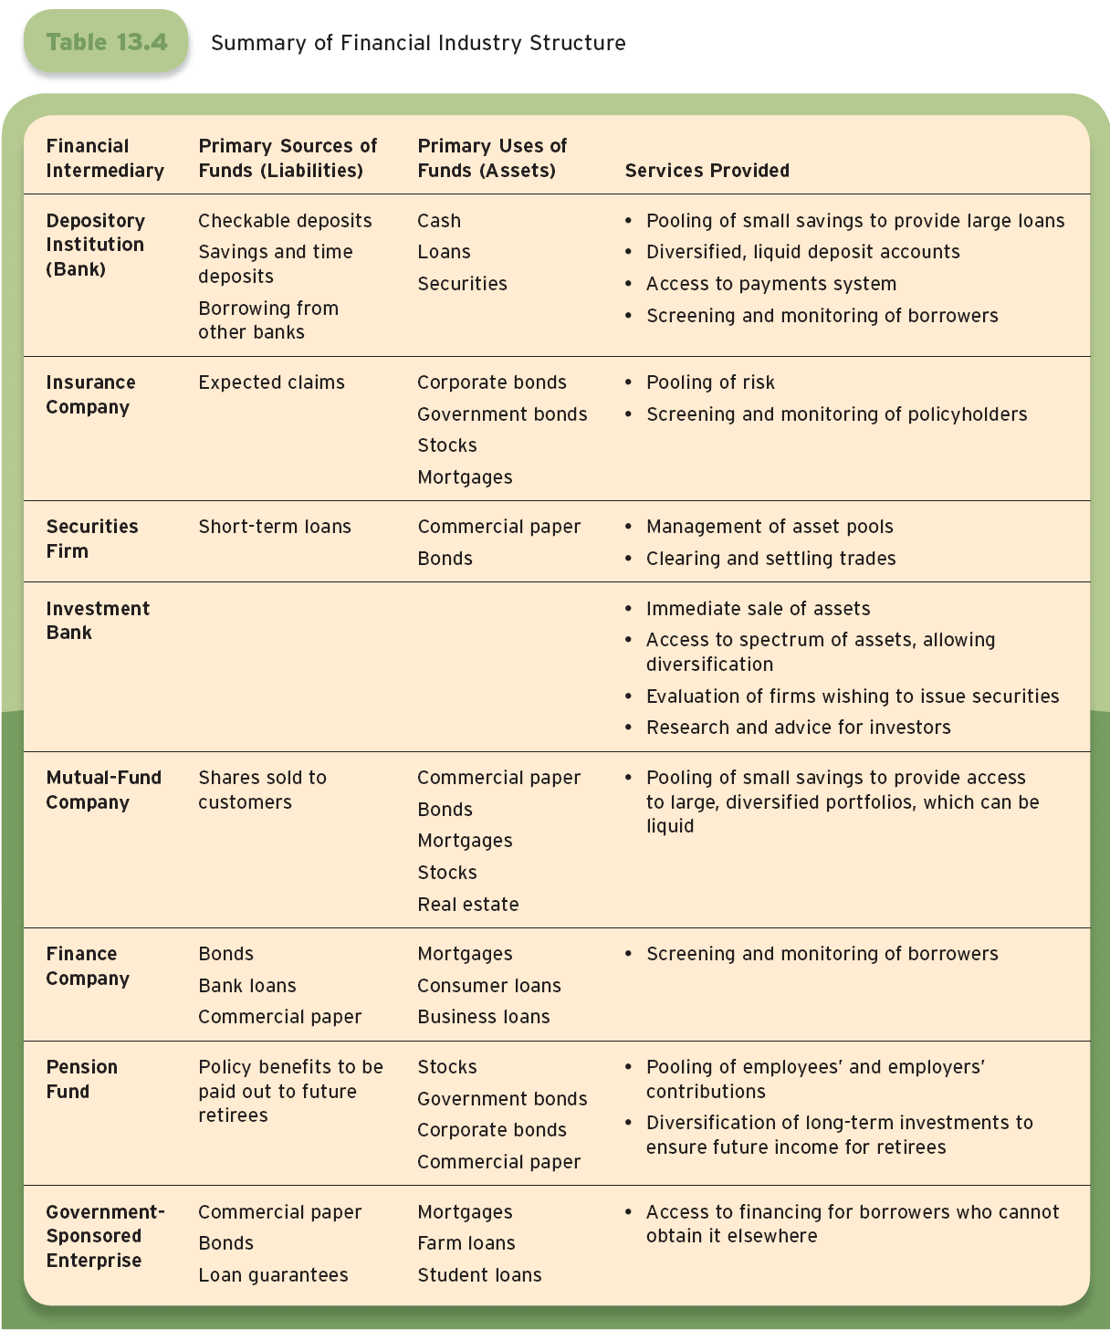

Slide 31
End of Chapter

