Slide 1

ANTI-MONEY LAUNDERING ACT

Slide 2
OBJECTIVES
Define Money Laundering
Identify Illegal activities that are tied to money laundering
List the three stages that are used by criminals to launder money

Slide 3

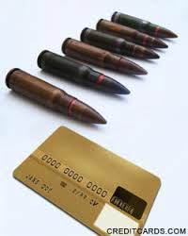
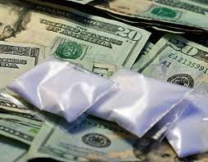
What is Money Laundering?
It is the movement of funds for the purpose of concealing the true source, ownership or use of the funds. It is the process by which criminals attempts to disguise the true origin and ownership of the proceeds of criminal activities.

Slide 4
Criminal Activities
Drug trafficking
Embezzlement
Mail Fraud
Bribery
Arson
Tax evasion
Foreign smuggling and export control violations
Human trafficking
Illegal gambling
Racketeering

Slide 5
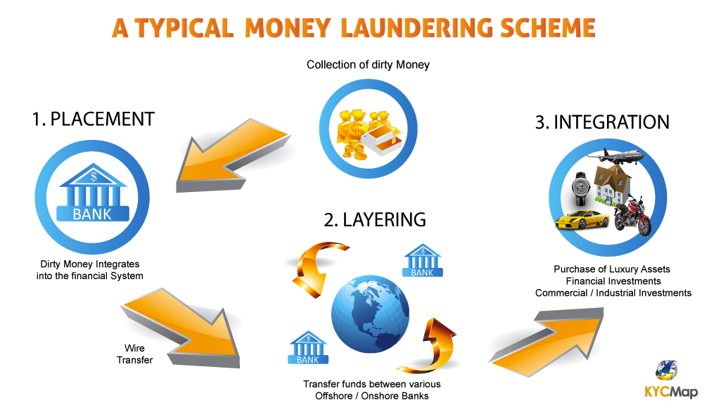
STAGES OF MONEY LAUNDERING

Slide 6
Placement
  This is the introduction of illegal profits into the financial system. This may be accomplished by breaking up large amounts of cash into less conspicuous, smaller sums that are then deposited into a bank account.

Slide 7
Layering
  The money launderer engages in multiple and sometimes complex financial transactions to transfer or move money, in order to make it difficult to identify the source of the funds and obscure the audit trail.

Slide 8
Integration
  In this stage, funds may be converted into apparently legitimate funds through the purchase of real estate, luxury assets or business ventures.

Slide 9
REGULATIONS, SANCTIONS AND MONITORING
ANTI-MONEY LAUNDERING ACT OF 2001
  The Republic Act 9160 or the Anti-Money Laundering Act of 2001 is an act which defines the crime of money laundering and provides penalties therefor and for other purposes.
  Signed into law on Sep 29, 2001 and took effect on Oct 17, 2001

Slide 10
Covered Institutions
Institutions and their subsidiaries supervised or regulated by BSP; and the Insurance Commission
Institutions managing securities or rendering services like investment agent, advisor, or consultant like securities dealers, brokers, salesmen, investment houses
Mutual funds, close-end investment companies, common trust funds, pre-need companies
FX corporations, money changers, money payment, remittance, and transfer companies

Slide 11
AML Council
An agency of the government which was established to perform the following functions:
  To uphold the integrity of the banking industry
  To regulate all banks and institutions under BSP
  To conduct investigations regarding suspicious banking activities
  Implement practices and measures that would greatly reduce the likelihood of money laundering

Slide 12

How to Prevent Money Laundering
Customer Identification
Record Keeping
Reporting

Slide 13
Penalties
Transaction or attempt to transact – 7 to 14 years imprisonment and a fine of not less than PHP 3 million
Failure to act – 7 to 14 years imprisonment and a fine of PHP 1.5 million
Failure to disclose – 6 months to 4 years imprisonment or a fine of not less than PHP 100,000 but not more than PHP 500,000

Slide 14

STAY ALERT!

