Slide 1
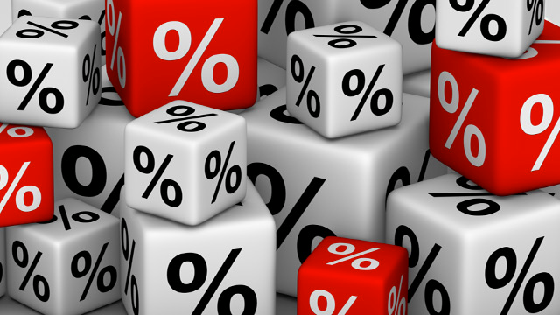
Part II. Chapter 4_Start
Future Value,
Present Value and Interest Rates

Slide 2
Key Points on Interest Rates
Link the present to the future
Tell future reward for lending today, as well as cost of borrowing now and repaying later
Price paid for the use of borrowed money
Expressed as a percentage of the principal over a certain period of time

Slide 3
Valuation of Monetary Payments Now and in the Future
Fundamental to studying financial instruments is the ability to value payments made at different times.
Tools:
Future Value and Present Value

Slide 4
FUTURE VALUE
The value on some future date of an investment made today
Core Principle:
Time has value

Slide 5
HOW TO COMPUTE FV?
FV = Present Value + Interest
The higher the interest rate, the higher the future value

Slide 6
SIMPLE VS COMPOUND INTEREST
Simple – interest charged on the principal only
I = PRT
Compound – interest on principal and on interest earned previously

Slide 7
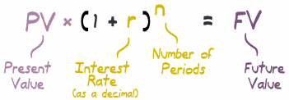


Slide 8
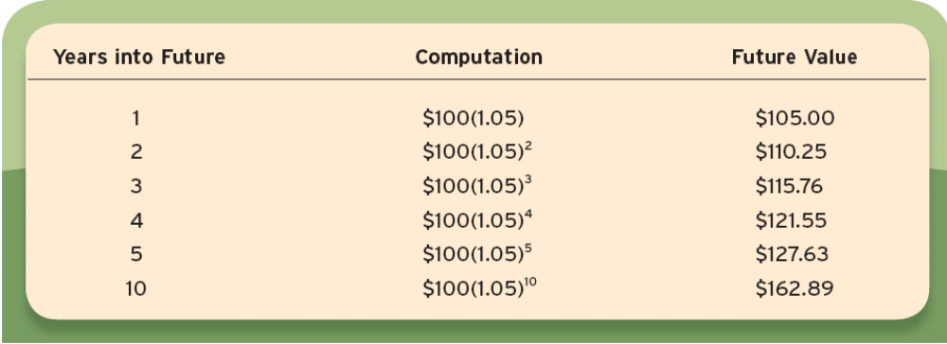
Future Value:
$100 Investment at 5% Annual Interest
After 10 years, $100 as grown to $162.89 – that’s the initial investment of $100 plus interest of $62.89. Ignoring compounding, you would have just multiplied 5 percent times 10 years and gotten $50. The difference of $12.69 comes from compounding.

Slide 9

Invest $100 at 5% annual interest
How until you have $200?
The Rule of 72:
  Divide the annual interest rate into 72
  So 72/5=14.4 years.
  1.05^{14.4} = 2.02

Slide 10
PRESENT VALUE
The value today (in the present) of a payment that is promised to be made in the future
The amount that must be invested today to realize a specific amount on a given future date

Slide 11

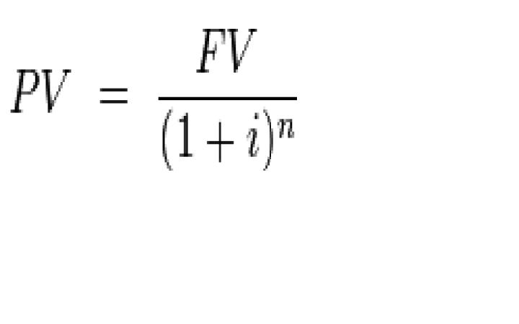

Slide 12
PROPERTIES OF PRESENT VALUE
The higher the future value of payment
The shorter the time until the payment
The lower the interest rate
  THE HIGHER THE PRESENT VALUE

Slide 13
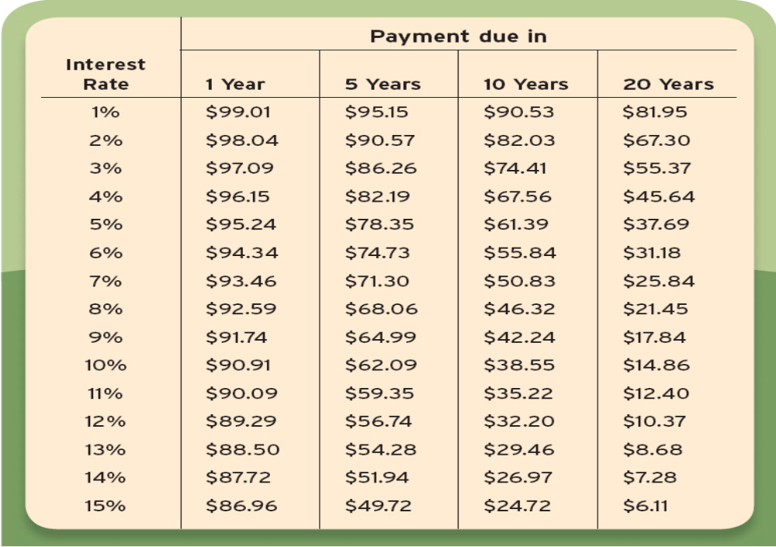
Present Value
of $100 Payment

Slide 14

  The present value of a future payment falls with the interest rate; the further the promised payment payment is to be made, the more the present value falls.

Slide 15
APPLYING PRESENT VALUE
Internal Rate of Return
Valuation of Bonds

Slide 16
INTERNAL RATE OF RETURN (IRR)
Interest rate that equates the present value of an investment with its cost
Is also known as economic rate of return
It compares the profitability of investments

Slide 17
INTERNAL RATE OF RETURN (IRR)...
Is the discount rate at which the net present value becomes zero.
Should only be accepted if it is higher than the target internal rate of return
The higher the IRR, the more viable the investment/project is

Slide 18
Internal Rate of Return:
Example
Balance the cost of the machine against the revenue
$1 million today vs.
$150,000 a year for ten years.
Is the $150,000 revenue enough to make payments on a $1 million loan?

Slide 19
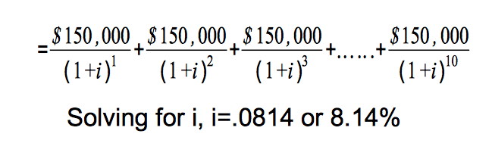
Solve for i

Slide 20
THE BASICS OF BONDS
BOND - is a promise to make a series of payments on specific future dates
Are used by companies, municipalities, states, and sovereign governments to raise money and finance a variety of projects and activities
COUPON PAYMENTS, COUPON RATE, MATURITY DATE, PAR VALUE/FACE VALUE

Slide 21
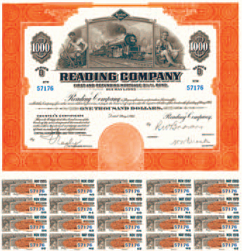
Coupon Bond
$1000 Face Value
50-yr, 3½% coupon bond issued on May 1, 1945.
Coupons

Slide 22
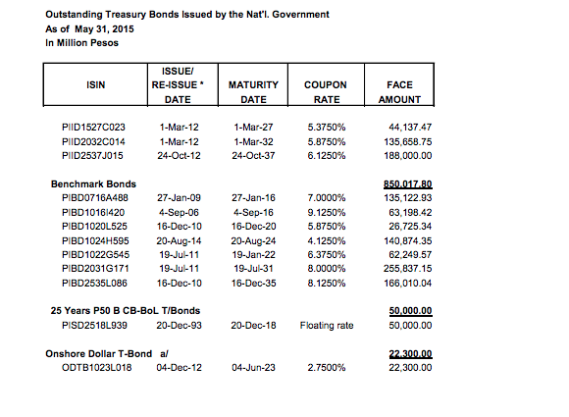
Bond Examples

Slide 23
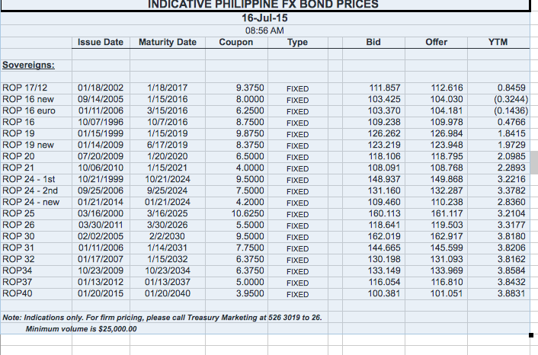
Bond Examples

Slide 24
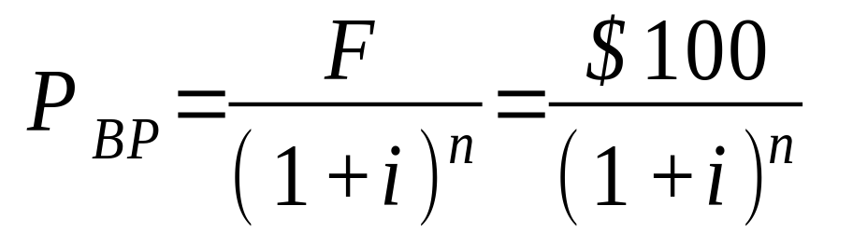
Coupon Bond:
Valuing the Principal
Present value of Bond Principal =
Payment divided by one plus the interest rate raised to n

Slide 25
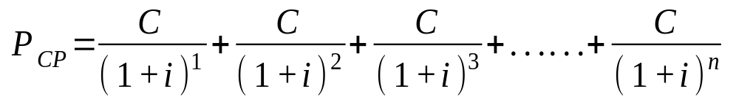
Coupon Bond:
Valuing the Coupon Payments
The longer the payments go on, the higher the value
The higher the interest rate, the lower the present value

Slide 26
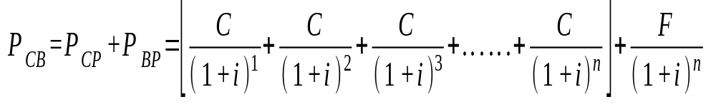
Price of Coupon Bond:
Principal + Coupons
Price of Coupon Bond (P_{CB}) =
Present value of Coupon Payments (P_{CP}) + Present Value of the Principal (P_{BP})

Slide 27
FACTS ON BONDS
The value of the coupon bond rises when the yearly coupon payments rise and interest falls
The lower the interest rate, the higher the bond prices. The higher the interest rate, the lower the bond prices. (PV concept)
The value of the bond varies inversely with the interest rate

Slide 28
Real and Nominal Interest Rates
Borrowers look at inflation-adjusted cost of borrowing, so they care about the resources required to pay
Lenders care about the purchasing power of the payments they received. So, they focus on inflation-adjusted return
Neither cares solely about the number of dollars, they care about what the dollars buy.

Slide 29
Real and Nominal Interest Rates
Nominal Interest Rates (i)
Interest Rates expressed in current dollar terms.
Real Interest Rates (r)
Nominal Interest Rate adjusted for inflation.

Slide 30
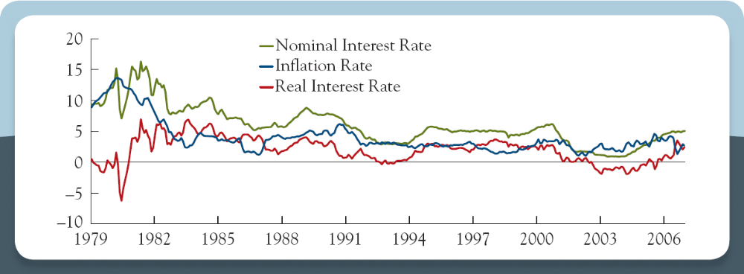
Nominal Interest Rate,
Inflation Rate and Real Interest Rate
Nominal Interest Rate = Real Interest Rate + Expected Inflation

Slide 31
Part II. Chapter 4_End
Future Value,
Present Value and Interest Rates

