Slide 1
Numpy
Handling Arrays in Python
Thanks to all contributors:
Alison Pamment, Sam Pepler, Ag Stephens, Stephen Pascoe, Anabelle Guillory, Graham Parton, Esther Conway,
Wendy Garland, Alan Iwi, Matt Pritchard and Tommy Godfrey.

Slide 2

With special thanks to…
Johnny Lin wrote a great python/atmospheric science book with exercises, examples, presentations, books etc.
It is Python 2 however.
Much of this is borrowed from...
https://www.johnny-lin.com/pyintro/

Slide 3
What is an array?
An array is like a list except:
All elements are of the same type, so operations with arrays are much faster.
Multi-dimensional arrays are more clearly supported.
Array operations are supported

Slide 4
The NumPy package
NumPy is the standard array package in Python. (There are others, but the community has now converged on NumPy).
NumPy is written in C so processing of large arrays is much faster than processing lists.
To utilize NumPy's functions and attributes, you import the package numpy.
Often NumPy is imported as an alias, e.g.:
import numpy as np

Slide 5
Creating arrays
Use the array function on a list:
import numpy as np
a = np.array([[2, 3, -5],[21, -2, 1]])
The array function will match the array type to the contents of the list.

Slide 6
Creating arrays
To force a certain numerical type for the array, set the dtype keyword to a type code:
a = np.array([[2, 3, -5], [21, -2, 1]],
dtype=np.int32)

Slide 7
Typecodes for arrays
Some common typecodes (which are strings):
np.float64: Double precision float
np.float32: Single precision float
np.int8: Byte
np.int64: Long integer (64-bit)

Slide 8
Other ways of creating arrays
To create an array of a given shape filled with zeros, use the zeros function (with dtype being optional):
a = np.zeros((3,2), dtype=np.float64)
To create an 1-D array similar to range, use the arange function (again dtype is optional):
a = np.arange(10)

Slide 9
Array indexing
Like lists, element addresses start with zero, so the first element of 1-D array a is a[0], the second is a[1], etc.
Like lists, you can reference elements starting from the end, e.g., element a[-1] is the last element in a 1-D array.

Slide 10
Array slicing
Element addresses in a range are separated by a colon, e.g.: a[4:8]
The lower limit is inclusive, and the upper limit is exclusive, e.g.: a[1:4] contains second to fourth values of a.
If one of the limits is left out, the range is extended to the end of the range, e.g.: a[:6] contains the first 6 elements of a.
To specify all elements use a colon only: a[:]

Slide 11
Multi-dimensional array indexing
For multi-dimensional arrays, indexing between different dimensions is separated by commas (fastest-varying dimension is last).
e.g. a[4, 2] ← [row, col]
Slicing rules also work as applied for each dimension.
e.g. a[1, :, 4:7]

Slide 12
Multi-dimensional array indexing
Consider the following example:
a = np.array([[2, 3.2, 5.5, -6.4, -2.2, 2.4], [1, 22, 4, 0.1, 5.3, -9], [3, 1, 2.1, 21, 1.1, -2]])
What is a[1,2] equal to? a[1,:]? a[1,1:4]?
a[1, 2] → 4
a[1, :] → array([1, 22, 4, 0.1, 5.3, -9])
a[1, 1:4] → array([22, 4, 0.1])

Slide 13

Interrogating arrays
Numpy has many functions that give info about arrays.
Examples for array "a" (assuming you imported numpy as np):
Shape: np.shape(a)
Rank (number of dimensions): np.ndim(a)
Number of elements: np.size(a) ← don't use len
Maximum: np.max(a) Similarly np.min(a)

Slide 14
Array manipulation
There are many functions to manipulate arrays, e.g.:
Reshape the array: e.g., np.reshape(a, (2,3))
Transpose the array: np.transpose(a)
Flatten to a 1-D array: np.ravel(a)
Concatenate arrays: np.concatenate((a,b))
Repeat array elements: e.g., np.repeat(a, 3)

Slide 15
Arrays as objects
Arrays have methods or attributes, including equivalents of the more commonly used np.……… functions, e.g.:
a.shape ⬄ np.shape(a)
a.max() ⬄ np.max(a)
a.repeat(3) ⬄ np.repeat(a,3) as well as various others, e.g.:
a.dtype ← interrogate data type b = a.astype(np.int32) ← convert data type although much else exists only as np.……… , e.g.
np.average(a) ← a.average doesn't exist

Slide 16
meshgrid
A common task is to generate a pair of arrays which represent the coordinates of our data. When the orthogonal
1d coordinate arrays already exist, numpy's meshgrid function is very useful:
>>> x_g = np.linspace(0, 9, 3)
>>> y_g = np.linspace(-8, 4, 3)
>>> x2d, y2d = np.meshgrid(x_g, y_g)
>>> print(x2d)
[[ 0. 4.5 9. ]
[ 0. 4.5 9. ]
[ 0. 4.5 9. ]]
>>> print(y2d)
[[-8. -8. -8.]
[-2. -2. -2.]
[ 4. 4. 4.]]
X-values for each cell in a grid
Y-values for each cell in a grid

Slide 17
Let's start doing some calculations with arrays

Slide 18
General array operations
Multiply two arrays together, element-by-element:
import numpy as np
a = np.array([[2, 3.2, 5.5, -6.4],
[3, 1, 2.1, 21]])
b = np.array([[4, 1.2, -4, 9.1],
[6, 21, 1.5, -27]])

Slide 19
General array operations
It's a one liner!
product_ab = a * b
c = a + b
Operand shapes are automatically checked for compatibility.
You do not need to know the rank of the arrays ahead of time, so the same line of code works on arrays of any dimension.
This makes them much faster than loops.

Slide 20
Testing inside an array
Often, you will want to do calculations on an array that involves conditions. For example:
You have a 2-D array and you want to double each value when the element is between 5 and 10, and set to zero when it is not.

Slide 21
Testing inside an array
Comparison operators (implemented either as operators or functions) act element-wise, and return a Boolean array. For instance:
answer = a > 5
answer = np.greater(a, 5)
Boolean operators are provided which also act element-wise, e.g.: np.logical_not(a > 3) np.logical_and(a > 3, a < 5)

Slide 22
Testing inside an array
The where function tests any condition and applies operations for true and false cases, as specified, on an element-wise basis.
Our use case can be coded:
condition = np.logical_and(a > 5, a < 10)
answer = np.where(condition, a * 2, 0)

Slide 23
Testing inside an array
The code implements the example we saw previously:
you have a 2-D array a
you want to return an array answer which is:
double each value when the element is > 5 and < 10
zero when it is not
This is both clean and fast.

Slide 24
Additional array functions
Basic mathematical functions: np.sin, np.exp, np.interp, etc.
Basic statistical functions: np.correlate, np.histogram, np.hamming, np.fft, etc.
NumPy has a lot of stuff! For more info, use:
dir(np) and help(np)
help(np.x), where x is the name of a function
dir(a)and help(a), where a is the name of an array

Slide 25
Handling missing values (using masked arrays)

Slide 26
Introducing a masked array
A masked array includes:
a mask of bad values travels with the array.
Those elements deemed bad are treated as if they did not exist. Operations using the array automatically utilise the mask of bad values.
Typically bad values may represent something like a land mask (e.g. sea surface temperature only exists where there is ocean).

Slide 27
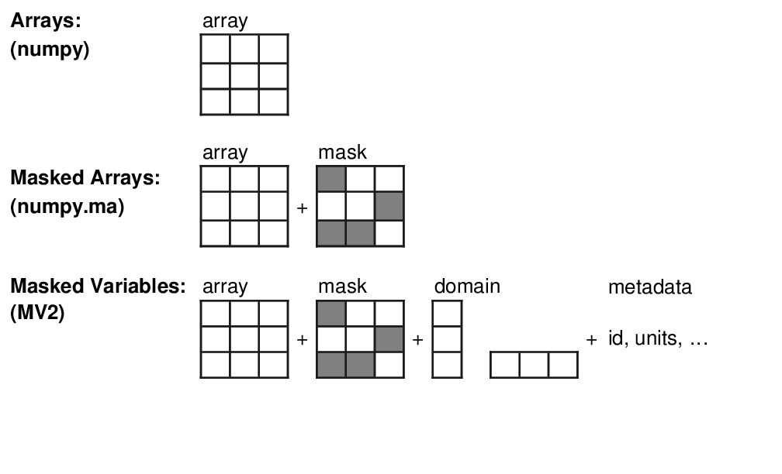
Comparing arrays and masked arrays

Slide 28
Constructing Masked Arrays 1
All functions are part of the numpy.ma submodule. In these examples, assume that I import that submodule with:
import numpy.ma as MA
and NumPy is imported as
import numpy as np

Slide 29
Constructing Masked Arrays 2
Make a masked array by explicitly specifying a
mask (missing values have mask = True):
a = MA.masked_array(
data=[1, 2, 3],
mask=[True, True, False])
>>> a
masked_array(data = [-- -- 3],
mask = [ True True False],
fill_value = 999999) discussed later

Slide 30
Constructing Masked Arrays 3
Make a masked array by masking values greater than a value:
b = MA.masked_greater([1,2,3,4,5],3)
>>> b
masked_array(data = [1, 2, 3, --, --],
mask = [False, False, False, True, True],
fill_value = 999999)

Slide 31
Constructing Masked Arrays 4
Make a masked array by masking values that meet a condition:
data = np.array([1,2,3,4,5])
cond = np.logical_and(data>2, data<5)
c = MA.masked_where(cond, data)
>>> c
masked_array(data = [1, 2, --, --, 5],
mask = [False, False, True, True, False],
fill_value = 999999)

Slide 32
Masked arrays: example operations
(with b and c arrays as constructed in previous slide)
Masked when:
b > 3
c > 2, c < 5
Expression | Values including mask
b | [ 1 2 3 -- --]
c | [ 1 2 -- -- 5]
b * b | [ 1 4 9 -- --]
b + 1 | [ 2 3 4 -- --]
b + c | [ 2 4 -- -- --]

Slide 33
Masked arrays: fill values
An array can be "filled", which replaces masked values with
the fill_value
>>> print(a.filled()) ← or MA.filled(a)
array([999999, 999999, 3]) ← numpy array
Typical use: when writing to a file
You should use a value outside the valid data range
Can override default when creating an array, e.g. MA.masked_array(data=...,mask=..., fill_value=1e30)

Slide 34
Conclusions
NumPy is a powerful array handling package that provides the array handling functionality of IDL, Matlab, Fortran 90 etc.
Array syntax enables you to write more streamlined and flexible code: The same code can handle operations on arrays of arbitrary rank.
Masked arrays extend the functionality by providing support for "bad values".
Other libraries, such as Pandas, netCDF4, cf-python, iris and Xarray all use NumPy.

