Slide 1
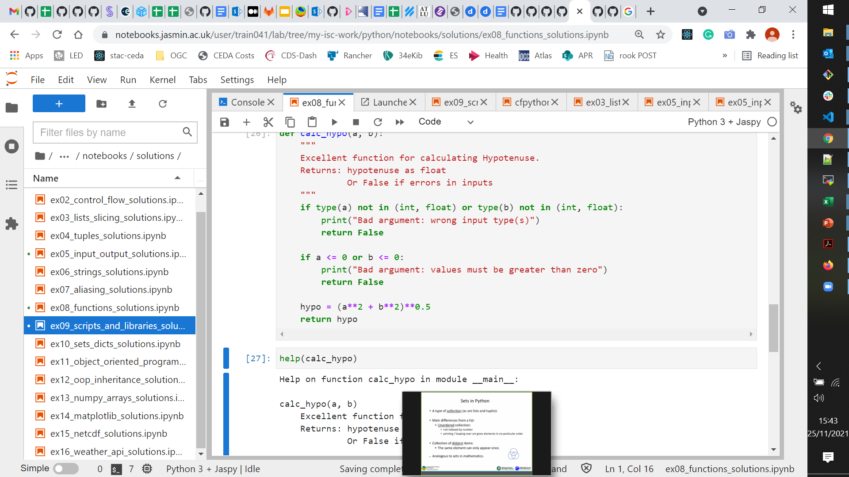



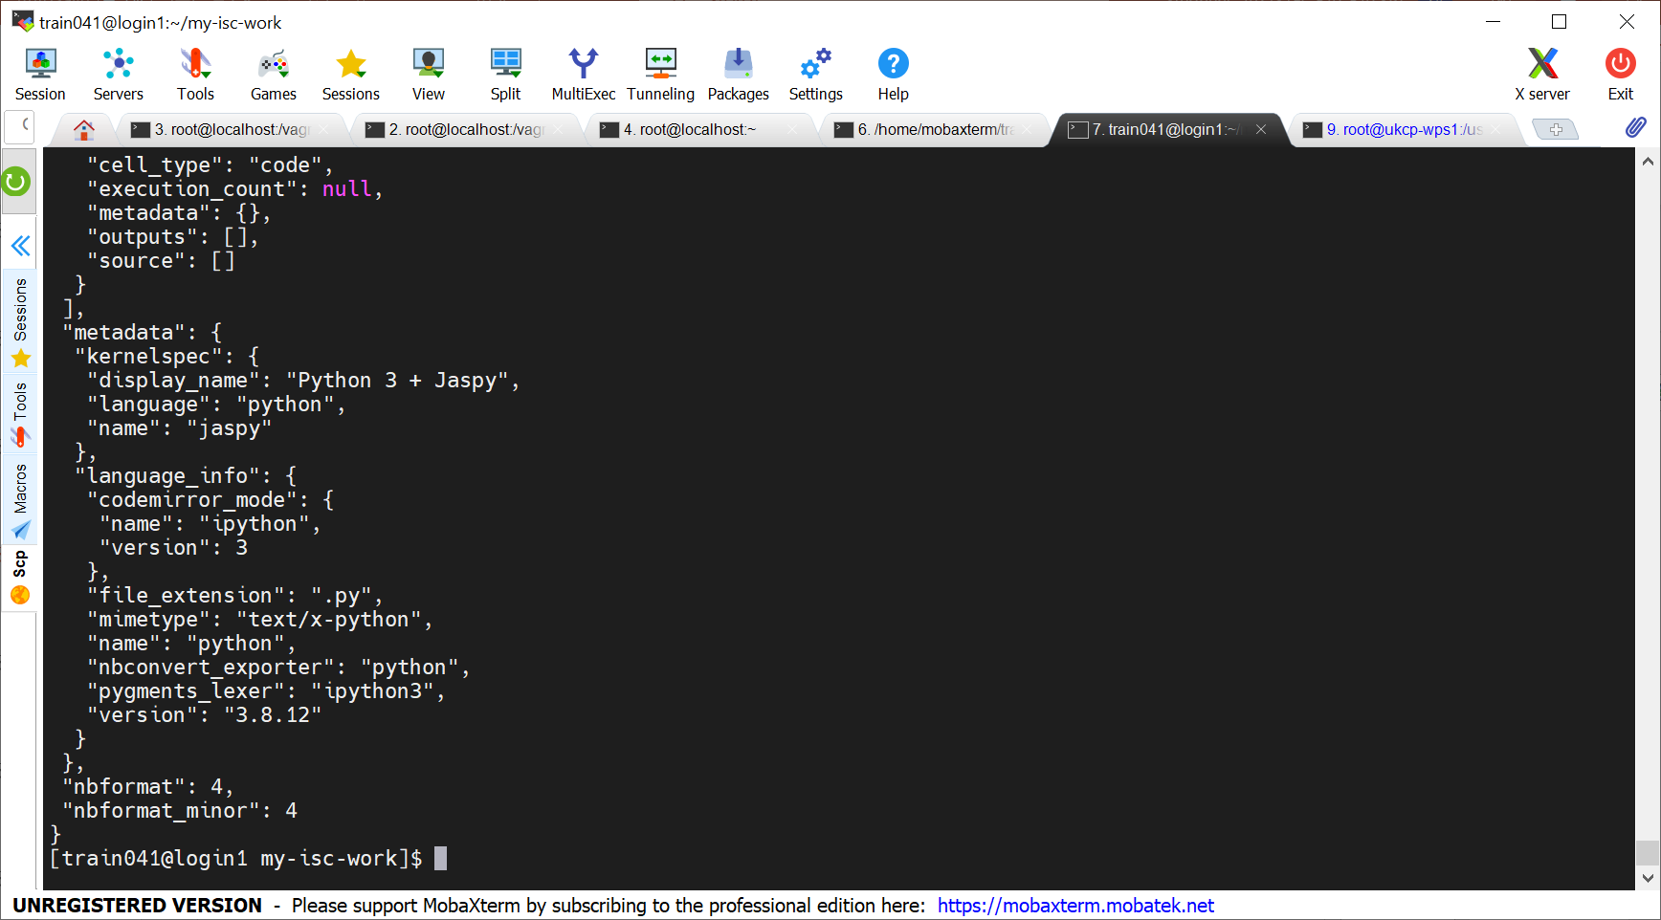

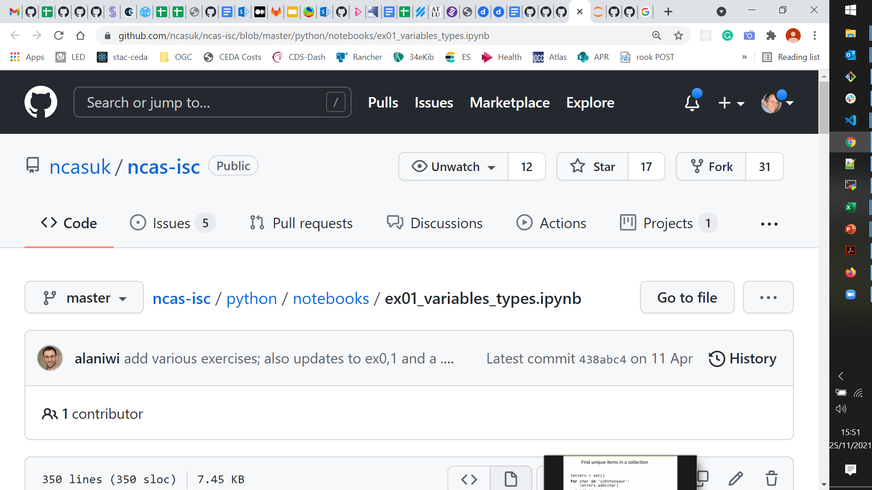
Browser
JASMIN Server(s)
File system
$HOME
Notebook
Run: Jupyter Server
Linux env
"sci" Server(s)
Linux Terminal
Run: Python Edit: file(s)
git clone / git pull
git push
Browser
GitHub Website

