Slide 1


From now on it's:
python2.7

Slide 2

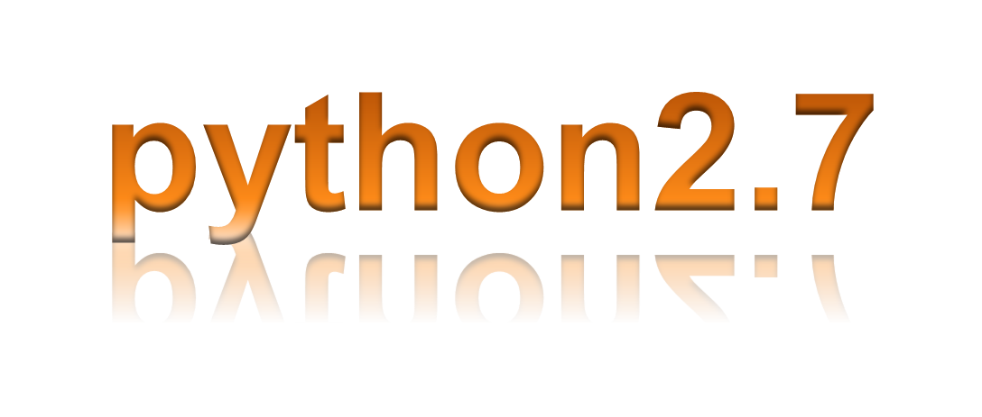

Slide 3
From now on type "python2.7" instead of "python".
This will start the version of python with all the libraries that we require.

