Slide 1

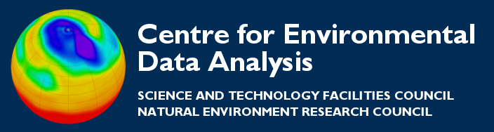
Handling arrays in Python (numpy)
Thanks to all contributors:
Alison Pamment, Sam Pepler, Ag Stephens, Stephen Pascoe, Anabelle Guillory, Graham Parton, Esther Conway, Wendy Garland, Alan Iwi and Matt Pritchard.

Slide 2

With special thanks to…
Johnny Lin writes a great python/atmospheric science blog with exercises, examples, presentations, books etc.
Much of this is borrowed
from...
http://pyaos.johnny-lin.com/?p=1256

Slide 3
What is an array?
An array is like a list except:
  All elements are of the same type, so operations with arrays are much faster.
  Multi-dimensional arrays are more clearly supported.
  Array operations are supported

Slide 4
The NumPy package
NumPy is the standard array package in Python. (There are others, but the community has now converged on NumPy).
NumPy is written in C so processing of large arrays is much faster than processing lists.
To utilize NumPy’s functions and attributes, you import the package numpy.
Often NumPy is imported as an alias, e.g.:
import numpy as np

Slide 5
Creating arrays
Use the array function on a list:
import numpy as np
a = np.array([[2, 3, -5],[21, -2, 1]])

Slide 6
Creating arrays
Use the array function on a list:
import numpy as np
a = np.array([[2, 3, -5],[21, -2, 1]])
The array function will match the array type to the contents of the list.

Slide 7
Creating arrays
To force a certain numerical type for the array, set the dtype keyword to a type code:
a = np.array([[2, 3, -5], [21, -2, 1]],
dtype = np.int32)

Slide 8
Typecodes for arrays
Some common typecodes (which are strings):
np.float64: Double precision float
np.float32: Single precision float
np.int8: Byte
np.int64: Long integer (64-bit)

Slide 9
Other ways of creating arrays
To create an array of a given shape filled with zeros, use the zeros function (with dtype being optional):
a = np.zeros((3,2), dtype=np.float64)
To create an array the same as range, use the arange function (again dtype is optional):
a = np.arange(10)

Slide 10
Array indexing
Like lists, element addresses start with zero, so the first element of 1-D array a is a[0], the second is a[1], etc.
Like lists, you can reference elements starting from the end, e.g., element a[-1] is the last element in a 1-D array.

Slide 11
Array slicing
Element addresses in a range are separated by a colon, e.g.: a[4:8]
The lower limit is inclusive, and the upper limit is exclusive, e.g.: a[1:4] contains second to fourth values of a.
If one of the limits is left out, the range is extended to the end of the range, e.g.: a[:6] contains the first 6 elements of a.
To specify all elements use a colon only: a[:]

Slide 12
Array indexing
For multi-dimensional arrays, indexing between different dimensions is separated by commas.
The fastest varying dimension is the last index. Thus, a 2-D array is indexed [row, col].
Slicing rules also work as applied for each dimension (e.g., a colon selects all elements in that dimension).

Slide 13
Multi-dimensional array indexing
Consider the following example:
a = np.array([[2, 3.2, 5.5, -6.4, -2.2, 2.4],
[1, 22, 4, 0.1, 5.3, -9],
[3, 1, 2.1, 21, 1.1, -2]])
What is a[1,2] equal to? a[1,:]? a[1,1:4]?
a[1,2] → 4
a[1,:] → [1, 22, 4, 0.1, 5.3, -9]
a[1,1:4] → [22, 4, 0.1]

Slide 14


Slide 15

Interrogating arrays
Numpy has many functions
that give info about arrays.
Examples for array “a” (assuming
you imported numpy as np):
  Shape: np.shape(a)
  Rank (number of dimensions): np.ndim(a)
  Number of elements: np.size(a) ← don’t use len
  Maximum: np.max(a) Similarly np.min(a)

Slide 16
Array manipulation
There are many functions to manipulate arrays, e.g.:
Reshape the array: e.g., np.reshape(a, (2,3))
Transpose the array: np.transpose(a)
Flatten to a 1-D array: np.ravel(a)
Concatenate arrays: np.concatenate((a,b))
Repeat array elements: e.g., np.repeat(a, 3)

Slide 17
Arrays as objects
Arrays have methods or attributes, including equivalents of the more commonly used np.……… functions, e.g.:
a.shape ⬄ np.shape(a)
a.max() ⬄ np.max(a)
a.repeat(3) ⬄ np.repeat(a,3)
as well as various others, e.g.:
a.dtype ← interrogate data type
b = a.astype(np.int32) ← convert data type
although much else exists only as np.……… , e.g.
np.average(a) ← a.average doesn’t exist

Slide 18
meshgrid
A common task is to generate a pair of arrays which represent the coordinates of our data. When the orthogonal
1d coordinate arrays already exist, numpy’s meshgrid function is very useful:
>>> x_g = np.linspace(0, 9, 3)
>>> y_g = np.linspace(-8, 4, 3)
>>> x2d, y2d = np.meshgrid(x_g, y_g)
>>> print x2d
[[ 0. 4.5 9. ]
[ 0. 4.5 9. ]
[ 0. 4.5 9. ]]
>>> print y2d
[[-8. -8. -8.]
[-2. -2. -2.]
[ 4. 4. 4.]]
X-values for each cell in a grid
Y-values for each cell in a grid

Slide 19
Let's start doing some calculations with arrays

Slide 20
General array operations:
Method 1 - the OLD way
Multiply two arrays together, element-by-element:
import numpy as np
a = np.array([[2, 3.2, 5.5, -6.4],
[3, 1, 2.1, 21]])
b = np.array([[4, 1.2, -4, 9.1],
[6, 21, 1.5, -27]])
shape_a = a.shape
product_ab = np.zeros(shape_a, dtype=np.float32)
for i in xrange(shape_a[0]):
for j in xrange(shape_a[1]):
product_ab[i, j] = a[i, j] * b[i, j]

Slide 21
General array operations:
Method 1: the OLD way
Note the use of xrange (which is like range, but provides only one element of the list at a time) to create a list of indices.
Loops are relatively slow.
You could also add a line to check that the two arrays have the same shape.

Slide 22
General array operations:
Method 2: array syntax
It's a one liner!
product_ab = a * b
c = a + b
Operand shapes are automatically checked for compatibility.
You do not need to know the rank of the arrays ahead of time, so the same line of code works on arrays of any dimension.
This makes them much faster than loops.

Slide 23
Testing inside an array:
Method 1: the OLD way
Often, you will want to do calculations on an array that involves conditions. For example:
You have a 2-D array a and you want to return an array answer which is double the value when the element in a is greater than 5 and less than 10, and output zero when it is not.
Here’s the code…

Slide 24
Testing inside an array:
Method 1: the OLD way
answer = np.zeros(np.shape(a), dtype=np.float64)
for i in xrange(np.shape(a)[0]):
for j in xrange(np.shape(a)[1]):
if (a[i,j] > 5) and (a[i,j] < 10):
answer[i,j] = a[i,j] * 2
else:
pass # i.e. do nothing

Slide 25
Testing inside an array
Method 2: array syntax
Comparison operators (implemented either as operators or functions) act element-wise, and return a Boolean array. For instance:
answer = a > 5
answer = np.greater(a, 5)
Boolean operators are provided which also act element-wise, e.g.:
np.logical_not(a > 3) np.logical_and(a > 3, a < 5)

Slide 26
Testing inside an array—Method 2 (array syntax) II
The where function tests any condition and applies operations for true and false cases,
as specified, on an element-wise basis.
For instance, consider the following case:
condition = np.logical_and(a > 5, a < 10)
answer = np.where(condition, a * 2, 0)

Slide 27
Testing inside an array—Method 2 (array syntax) II
The above code implements the example we saw previously:
say you have a 2-D array a
you want to return an array answer which is:
  double the value when the element in a is greater than 5 and less than 10
  zero when it is not
and is both cleaner and runs faster.

Slide 28
Additional array functions
Basic mathematical functions: np.sin, np.exp,
np.interp, etc.
Basic statistical functions: np.correlate,
np.histogram, np.hamming, np.fft, etc.
NumPy has a lot of stuff! For more info, use:
  dir(np) and help(np)
  help(np.x), where x is the name of a function
  dir(a)and help(a), where a is the name of an array

Slide 29
Handling missing values
(using masked arrays)

Slide 30
Introducing a masked array
A masked array includes:
a mask of bad values travels with the array.
Those elements deemed bad are treated as if they did not exist. Operations using the array automatically utilise the mask of bad values.
Typically bad values may represent something like a land mask (e.g. sea surface temperature only exists where there is ocean).

Slide 31
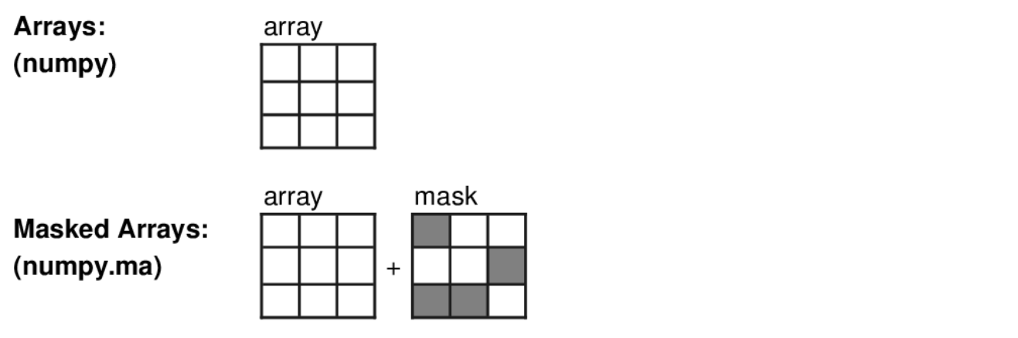
Comparing arrays and masked arrays

Slide 32
Constructing Masked Arrays 1
All functions are part of the numpy.ma submodule.
In these examples, assume that
I import that submodule with:
import numpy.ma as MA
and NumPy is imported as
import numpy as np.

Slide 33
Constructing Masked Arrays 2
Make a masked array by explicitly specifying a mask (missing values
have mask = True):
a = MA.masked_array(
data=[1, 2, 3],
mask=[True, True, False])
>>> a
masked_array(data = [-- -- 3],
mask = [ True True False],
fill_value = 999999) ⬅ discussed later

Slide 34
Constructing Masked arrays 3
Make a masked array by masking values greater than a value:
b = MA.masked_greater([1,2,3,4,5],3)
Make a masked array by masking values that meet a condition:
data = np.array([1,2,3,4,5])
cond = np.logical_and(data>2, data<5)
c = MA.masked_where(cond, data)

Slide 35
Masked arrays:
example operations
(with b and c arrays as constructed in previous slide)
Expression | Values including mask
b | [ 1 2 3 -- --]
c | [ 1 2 -- -- 5]
b * b | [ 1 4 9 -- --]
b + 1 | [ 2 3 4 -- --]
b + c | [ 2 4 -- -- --]

Slide 36
Masked arrays: fill values
An array can be “filled”, which replaces masked values with the fill_value
>>> print a.filled()
array([999999, 999999, 3]) ← numpy array
Typical use: when writing to a file
You should use a value outside the valid data range
Can override default when creating an array, e.g.
MA.masked_array(data=………,mask=………,
fill_value=1e30)

Slide 37
Conclusions
NumPy is a powerful array handling package that provides the array handling functionality of IDL, Matlab, Fortran 90 etc.
Array syntax enables you to write more streamlined and flexible code: The same code can handle operations on arrays of arbitrary rank.
Masked arrays extend the functionality by providing support for "bad values".

