Slide 1

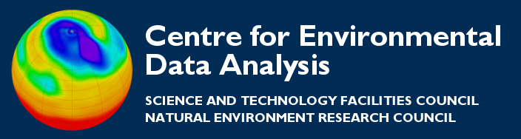
Python Errors and Exceptions
CEDA

Slide 2
Errors
Computer programmes break. It’s a fact of life.
There are (at least) two distinguishable kinds of errors:
syntax errors and exceptions.

Slide 3
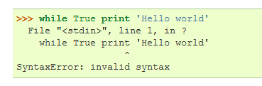
Syntax Errors
Syntax errors, or parsing errors, are very common when learning:
The arrow tells you where the error was located
Notes:
Syntax errors, also known as parsing errors, are perhaps the most common kind of complaint you get while you are still learning Python:
>>>
>>> while True print 'Hello world'
File "<stdin>", line 1, in ?
while True print 'Hello world'
^
SyntaxError: invalid syntax
The parser repeats the offending line and displays a little ‘arrow’ pointing at the earliest point in the line where the error was detected. The error is caused by (or at least detected at) the token preceding the arrow: in the example, the error is detected at the keyword print, since a colon (':') is missing before it. File name and line number are printed so you know where to look in case the input came from a script.

Slide 4
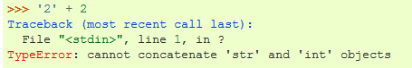
Exceptions
Even if a statement or expression is syntactically correct, it may cause an error on execution.
Errors detected during execution are called exceptions and are not unconditionally fatal.
You can catch an exception and decide how to handle it.

Slide 5
Types of exception
Exceptions come in different types, and the type is printed as part of the message, e.g.:
  ZeroDivisionError
  NameError
  TypeError
And you can define your own exceptions, e.g.:
    MyAppBadUserInputError

Slide 6
Catching exceptions
You can catch errors and decide how to handle them using: try / except
try:
result = runMyClimateModel(experiment)
except:
# It failed, so do something sensible
emailMe(“No results I’m afraid!”)
print “It’s not a good model”
By handling errors appropriately you can change the flow of your programme accordingly.

Slide 7
Raising exceptions
You can even trigger your own exceptions using: raise
if validate(input) == False:
raise Exception(“Bad input provided”)
# Programme will stop here unless this
# exception is caught
else:
print “Great input”
...processing input here...

Slide 8
An example please
In this example, I have written some code to read the content from a number of simple text files. Each file should contain a numeric code.
There are two exceptions that I am interested in:
  File does not have content
  Contents of the file cannot be converted to an integer.

Slide 9
An example continued
def readIntFromFile(fname):
"Returns an integer from a file. "
with open(fname) as f:
my_int = int(f.read(10))
return my_int
Notes:
def readIntFromFile(fname):
if fname == "c": I_AM_BAD_SYNTAX
f = open(fname)
i = int(f.read(10))
f.close()
return i
for f in ("a", "b", "c"):
try:
print readIntFromFile(f)
except IOError:
print "There is nothing in file: %s" % f
except ValueError:
print "The contents is not an integer: %s" % f
except Exception, err:
raise
~

Slide 10
An example continued
for f in ("a.txt", "b.txt", "c.txt"):
try:
print readIntFromFile(f)
except IOError:
print "There is nothing in file: %s" % f
except ValueError:
print "The contents is not an integer: %s" % f
except Exception, err:
print "Really unexpected error: %s" % err
# But the script keeps processing all the good files!
Notes:
def readIntFromFile(fname):
if fname == "c": I_AM_BAD_SYNTAX
f = open(fname)
i = int(f.read(10))
f.close()
return i
for f in ("a", "b", "c"):
try:
print readIntFromFile(f)
except IOError:
print "There is nothing in file: %s" % f
except ValueError:
print "The contents is not an integer: %s" % f
except Exception, err:
raise
~

Slide 11
Further Reading
Much of this presentation was taken from the python documentation pages:
https://docs.python.org/2/tutorial/errors.html

