Slide 1

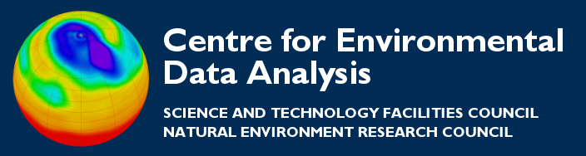
Overview of NetCDF
Thanks to all contributors:
Alison Pamment, the Unidata team.

Slide 2
What is NetCDF?
NetCDF is more than just a file format. In the simple view, netCDF is a:
  Data model
  File format
  Application programming interface (API)
  Library implementing the API
Together the data model, file format, and APIs support the creation, access, and sharing of scientific data.

Slide 3
What is netCDF, really?
In the real world, things are more complicated. NetCDF evolves to keep up with needs of its users, and is actually:
Two data models:
  Classic model (for netCDF-1, netCDF-2, netCDF-3)
  Enhanced model (for netCDF-4)
Four file formats:
  Classic format and 64-bit offset format variant
  NetCDF-4 format and netCDF-4 classic model format variant
Two independent flavours of APIs:
  C-based (C, F90, F77, C++, Python, Perl, Ruby, Matlab, ...)
  Java-based

Slide 4
However, we only use one of these
Most scientists, most of the time, will only interact with one of these - so the story isn't so complex after all.

Slide 5
NetCDF Features
Several characteristics make netCDF useful for storing and accessing scientific data.
Self-Describing: A netCDF file may include metadata as well as data: names of variables, data locations in time and space, units of measure, and other useful information.
Portable: Data written on one platform can be read on other platforms.
Direct-access: A small subset of a large dataset may be accessed efficiently, without first reading through all the preceding data.
Appendable: Data may be appended to a netCDF file without copying the dataset or redefining its structure.

Slide 6
NetCDF Features
Networkable: The netCDF library provides client access to structured data on remote servers through OPeNDAP protocols.
Extensible: Adding new dimensions, variables, or attributes to netCDF files does not require changes to existing programs that read the files.
Sharable: One writer and multiple readers may simultaneously access the same netCDF file. With parallel netCDF, multiple writers may efficiently and concurrently write into the same netCDF file.
Archivable: Access to all earlier forms of netCDF data will be supported by current and future versions of the software.

Slide 7
NetCDF’s niche
The netCDF niche is array-oriented scientific data.
It also has a large user community to foster:
  Support in third-party applications
  Third-party APIs for many programming and scripting languages
  Community conventions, such as Climate and Forecast (CF) metadata conventions
  Standards for interoperability

Slide 8
Installing NetCDF
Download an appropriate release from:
http://www.unidata.ucar.edu/downloads/netcdf/index.jsp
(If you want python-netCDF to work you will need the NetCDF libraries written in C).
To install, see the installation guide at:
http://www.unidata.ucar.edu/software/netcdf/docs/netcdf-install/
However, you should be able to pick up binary and RPM distributions for most computing environments.

Slide 9
Acknowledgement
The material presented here was primarily taken from the Unidata NetCDF workshop notes at:
http://www.unidata.ucar.edu/software/netcdf/workshops/2012

