Slide 1

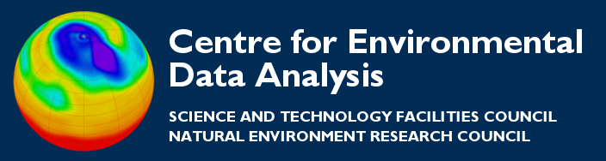
cf-python and cfplot

Slide 2
What is cf-python?
cf-python is an implementation of the CF data model that:
Reads CF-netCDF and PP format files, aggregating contents into as few multi-dimensional fields as possible.
Writes fields to CF-netCDF files on disk.
Creates, deletes and modifies field data and metadata.
Subsets fields by conditions on their metadata.
Subspaces a field to create a new field.
Enables arithmetic/comparison operations with fields.
Calculates statistics on field data.

Slide 3
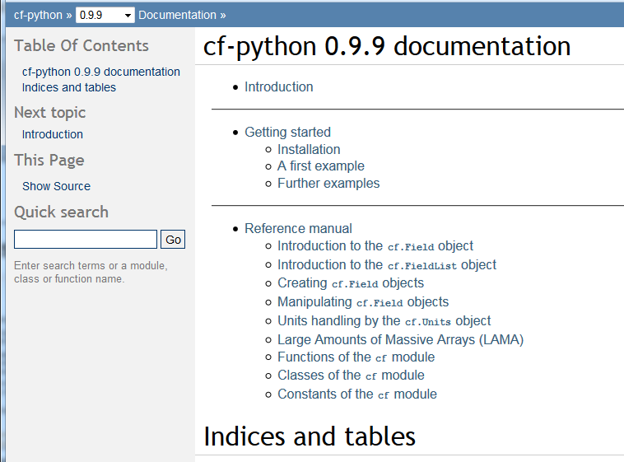
Documentation
http://cfpython.bitbucket.org/docs/0.9.9/

Slide 4
Main concept - the "field"
The cf package allows a data array and its associated metadata to be contained and manipulated as a single entity called a field, which is stored in a cf.Field object.

Slide 5
Some example functionality
Here we will highlight some example cf-python functionality that goes beyond that provided by lower level packages:
Reading data from multiple files:
>>> import cf
>>> f = cf.read('~/file.nc')
>>> f = cf.read('file[1-9a-c].nc')
>>> f = cf.read('dir*/*.pp')
>>> f = cf.read(['file1.nc', 'file2.nc',
'file3*.nc'])

Slide 6
Selecting from a field
Fields may be selected with the match and select methods. These methods take conditions on field CF properties, attributes and coordinates as inputs:
>>> f
[<CF Field: x_wind(grid_latitude(110), grid_longitude(106)) m s-1>,
<CF Field: air_temperature(time(12), grid_latitude(73), grid_longitude(96)) K>]
>>> f.match('temperature', regex=True)
[False, True]
>>> g = f.select('air_temperature', cvalue={'longitude': 0})
>>> g
[<CF Field: air_temperature(time(12), grid_latitude(73), grid_longitude(96)) K>]

Slide 7
Functions of the cf module
The cf module provides a variety of functions, including:
  I/O: read, write, open_files
  Aggregation: aggregate
  Statistics: collapse
  Comparison: eq, gt, lt, ...
    For climatologies: djf, mam, jja, son
  Date-time: dt, Y, M, D

Slide 8
Command-line tools
cfplot provides some useful command-line utilities:
The cfdump tool generates text representations on standard output of the CF fields contained in the input files.
The cfa tool creates aggregated CF datasets - it creates and writes to disk the CF fields contained in the input files.
For usage instructions, use the -h option to display the manual pages:

Slide 9
cfa example
cfa can read multiple files and aggregate the contents into a single output file, e.g.:
cfa -o out.nc file1.nc file2.nc
cfa -o out.nc file[1-9].nc
cfa -f NETCDF3_CLASSIC -o out.nc data1/*.nc
data2/*.nc
cfa -o out.nc
http://test.opendap.org/dap/coads_climat ology.nc file*.nc # remote file(s)

Slide 10
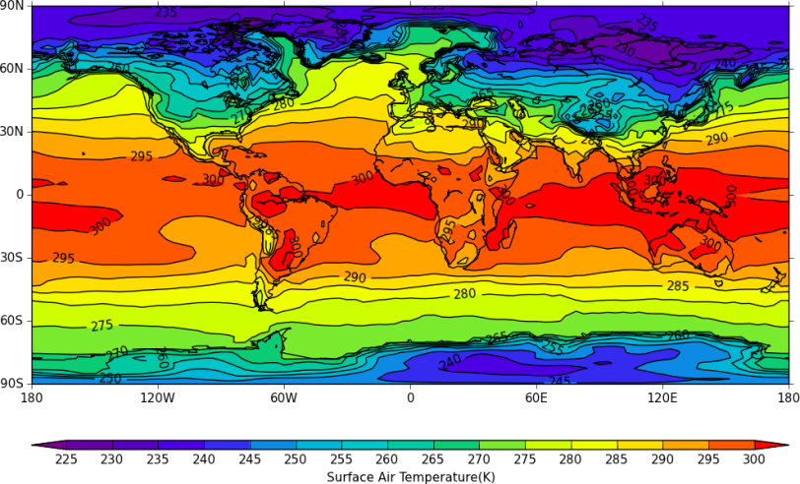
Plotting with cfplot
cfplot is a set of Python routines for making the common contour and vector plots that climate researchers use. The data to make a contour plot can be passed to cfplot using cf-python as per the following example.
import cf, cfplot as cfp
f = cf.read('/opt/graphics/cfplot_data/tas_A1.nc')[0]
cfp.con(f.subspace(time=15))

Slide 11
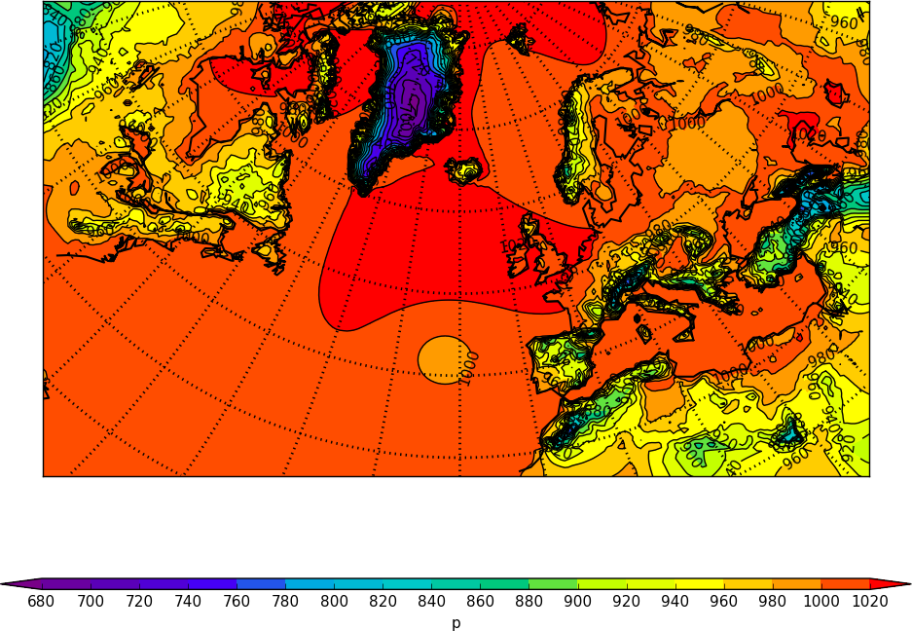
Plotting with cfplot
Plotting rotated pole data.
import cf, cfplot as cfp
f = cf.read('/opt/graphics/cfplot_data/rgp.nc')[0]
cfp.con(f)

Slide 12
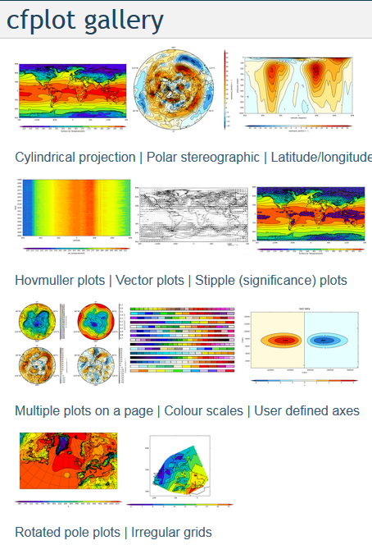
And more
See: http://climate.ncas.ac.uk/~andy/cfplot_sphinx/_build/html/gallery.html

Slide 13
Further reading
cf-python documentation (current version):
http://cfpython.bitbucket.org/docs/0.9.9/index.html
cfa command-line utility:
http://www.met.reading.ac.uk/~david/cfa.1
cfdump command-line utility:
http://www.met.reading.ac.uk/~david/cfdump.1
cfplot:
http://climate.ncas.ac.uk/~andy/cfplot_sphinx/_build/html/

