Slide 1


Some common text formats
(at CEDA)

Slide 2
What is a good text format?
A good text format should:
be well-described following a clear format specification
contain appropriate metadata to enable:
  scientific understanding
  Interpretation and usage

Slide 3
Text formats at CEDA
At CEDA we have adopted two such formats over the years:
NASA Ames
  A set of well-described sub-formats to handle 1-dimensional to 4-dimensional data
BADC-CSV
  A simple comma-separated format aimed at facilitating data preparation, submission and usage.

Slide 4
NASA Ames format: Overview
An ASCII (text) format developed in late 1980s to facilitate the data exchange between the participants and allow shared use of a minimised amount of software to analyse and display different datasets.
Developed with the requirements:
portable - readable on any machine by any language;
self-describing - the data had to include a header containing all the information needed to read, understand and interpret;
readable by humans - to retain the benefit of its self-description.
NASA Ames is well suited to field campaigns involving several teams that need to share their observations.
Notes:
REVIEW: Split the original slide into 3 because it was very crowded and text was probably too small to read
REVIEW: Added notes here to use as script for presenter
“SST” is a commonly used abbreviation for sea surface temperature. Anomalies are the difference in the value of a quantity observed or modelled at a particular instant in time from the longer term mean value for that quantity. The “bin” file extension allows you to guess that your colleague wrote a binary file (i.e. encoded according to his computer’s internal way of storing data) but you have no computer program to easily read the data.
Your colleague wrote the data file using a program written in the FORTRAN language. He tells you to write a FORTRAN program on your own machine that expects to read in an integer (whole number) value which gives the year in which the data were measured, followed by twelve floating point numbers (a floating point number is the name given to the way computers store numbers containing decimal points) giving the temperature values for each month of the year, and finally another floating point number containing the annual mean temperature.

Slide 5
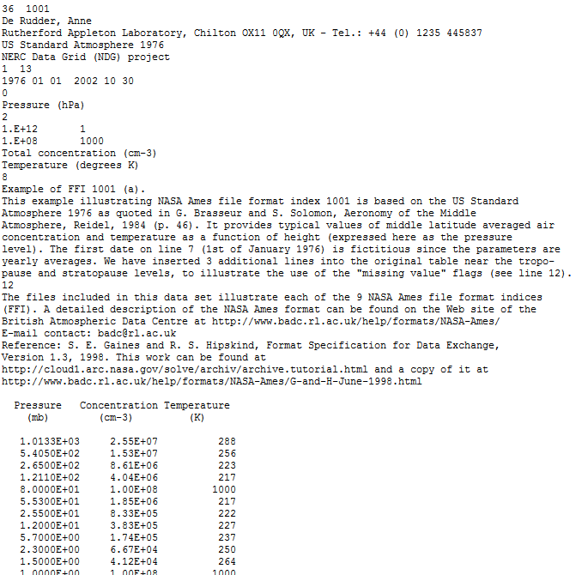
Example NASA Ames file
Header section
Data section

Slide 6
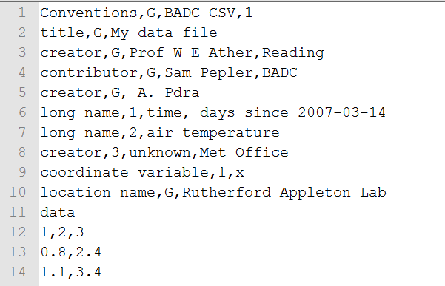
BADC-CSV format: Overview
Developed as a simplified alternative to NASA-Ames.
A record-based format (multiple records allowed).
Each record has a short simple header and a data section.
Format is very simple to read/write/interpret.
Notes:
REVIEW: Split the original slide into 3 because it was very crowded and text was probably too small to read
REVIEW: Added notes here to use as script for presenter
“SST” is a commonly used abbreviation for sea surface temperature. Anomalies are the difference in the value of a quantity observed or modelled at a particular instant in time from the longer term mean value for that quantity. The “bin” file extension allows you to guess that your colleague wrote a binary file (i.e. encoded according to his computer’s internal way of storing data) but you have no computer program to easily read the data.
Your colleague wrote the data file using a program written in the FORTRAN language. He tells you to write a FORTRAN program on your own machine that expects to read in an integer (whole number) value which gives the year in which the data were measured, followed by twelve floating point numbers (a floating point number is the name given to the way computers store numbers containing decimal points) giving the temperature values for each month of the year, and finally another floating point number containing the annual mean temperature.

Slide 7
More info
NASA Ames Specification:
http://cedadocs.badc.rl.ac.uk/73/3/G-and-H-June-1998.html
NASA Ames Overview:
https://badc.nerc.ac.uk/help/formats/NASA-Ames/
BADC-CSV Format:
http://www.ceda.ac.uk/help/users-guide/file-formats/badc-csv/
Notes:
REVIEW: Split the original slide into 3 because it was very crowded and text was probably too small to read
REVIEW: Added notes here to use as script for presenter
“SST” is a commonly used abbreviation for sea surface temperature. Anomalies are the difference in the value of a quantity observed or modelled at a particular instant in time from the longer term mean value for that quantity. The “bin” file extension allows you to guess that your colleague wrote a binary file (i.e. encoded according to his computer’s internal way of storing data) but you have no computer program to easily read the data.
Your colleague wrote the data file using a program written in the FORTRAN language. He tells you to write a FORTRAN program on your own machine that expects to read in an integer (whole number) value which gives the year in which the data were measured, followed by twelve floating point numbers (a floating point number is the name given to the way computers store numbers containing decimal points) giving the temperature values for each month of the year, and finally another floating point number containing the annual mean temperature.

