Slide 1

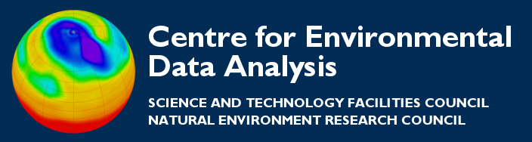
ncgen and ncdump to create/export NetCDF,
and CDL
Thanks to:
Eduardo Damasio Da Costa

Slide 2

ncdump and ncgen
Used together, ncdump and ncgen can accomplish simple netCDF manipulations with little or no programming.
ncdump and ncgen are reverse operations:

Slide 3
CDL (network Common Data form Language)
CDL provides a means for NetCDF ↔ ASCII translation. It is a simple text-based language that can be directly converted to NetCDF.
It has two main utilities:
1. ncdump (from NetCDF to ASCII)
  to get overview of NetCDF file contents
2. ncgen (from ASCII to NetCDF)
  to create NetCDF files

Slide 4
ncdump
For quick glimpse at file’s “metadata”
To view header info:
  ncdump -h myfile.nc
To view header info plus values of coordinate variables:
  ncdump -c myfile.nc
To output data values in ascii form:
  ncdump –v varname myfile.nc

Slide 5
An easy way to view NetCDF: CDL
CDL is a human-readable notation for netCDF objects and data.
netcdf example { // example of CDL notation
dimensions:
  lon = 3 ;
  lat = 8 ;
variables:
  float rh(lon, lat) ;
  rh:units = "percent" ;
    rh:long_name = "Relative humidity" ;
    // global attributes
    :title = "Simple example, lacks some conventions" ;
    data:
    rh =
    2, 3, 5, 7, 11, 13, 17, 19,
    23, 29, 31, 37, 41, 43, 47,
    53, 59, 61, 67, 71, 73, 79, 83, 89 ;
    }
Let's zoom in…

Slide 6
netcdf example { // example of CDL notation
dimensions:
  lon = 3 ;
  lat = 8 ;
variables:
  float rh(lon, lat) ;
  rh:units = "percent" ;
    rh:long_name = "Relative humidity" ;
    // global attributes
    :title = "Simple example, lacks some conventions" ;
    data:
    rh =
    2, 3, 5, 7, 11, 13, 17, 19,
    23, 29, 31, 37, 41, 43, 47,
    53, 59, 61, 67, 71, 73, 79, 83, 89 ;
    }

Slide 7
netcdf example { // example of CDL notation
dimensions:
  lon = 3 ;
  lat = 8 ;
variables:
  float rh(lon, lat) ;
  rh:units = "percent" ;
    rh:long_name = "Relative humidity" ;
    // global attributes
    :title = "Simple example, lacks some conventions" ;
    data:
    rh =
    2, 3, 5, 7, 11, 13, 17, 19,
    23, 29, 31, 37, 41, 43, 47,
    53, 59, 61, 67, 71, 73, 79, 83, 89 ;
    }
This example specifies a netCDF dataset with:
2 dimensions (lon and lat)
1 variable (rh)
2 variable attributes (units and long_name)
1 global attribute (title), and 24 data values for the variable.

Slide 8
NCL example: explained
Only one variable, but multiple variables are allowed.
CDL comments follow "//" symbols. They are not part of netCDF data and will not be recorded in a transformation.
You can use the ncdump utility to get the CDL form of a binary netCDF file.
You can use the ncgen utility to generate a binary netCDF file from CDL.
This simple example neglects some recommended best practices for netCDF data.

Slide 9
Writing a NetCDF file with ncgen
ncgen can be used to:
Generate a NetCDF file
  ncgen -o mydata.nc mydata.cdl
Generate code that will produce a NetCDF file
  Fortran:
  ncgen -f mydata.cdl > mydata.f
  C:
  ncgen -c mydata.cdl > mydata.c

Slide 10
Further information
NetCDF:
  http://www.unidata.ucar.edu/software/netcdf/
CDL:
  http://www.unidata.ucar.edu/software/netcdf/docs/cdl_syntax.html
Best practices to writing NetCDF files:
http://www.unidata.ucar.edu/software/netcdf/docs/BestPractices.html

