Slide 1

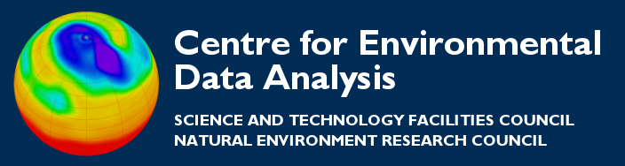
Checking CF-compliance:
The CF Checker
Thanks to all contributors:
Alison Pamment, Stephen Pascoe, Ros Hatcher.

Slide 2
What is the CF-Checker?
The tool cf-checker will check the metadata of a NetCDF file for compliance with the CF conventions. It is very good practice to check your files for compliance at regular intervals as fixing problems early is much easier than letting small errors persist.
$ cf-checker data/test.nc

Slide 3
Running the CF-checker
Let’s check the file we have created for compliance.
CHECKING NetCDF FILE: data/test.nc
=====================
Using CF Checker Version 2.0.5 Checking against CF Version CF-1.6
Using Standard Name Table Version 26 (2013-11-08T06:09:34Z) Using Area Type Table Version 2 (10 July 2013)
WARNING (2.6.1): No ’Conventions’ attribute present
------------------
Checking variable: latitude
------------------
WARNING (3): No standard_name or long_name attribute specified ERROR (3.1): Invalid units: degrees north
------------------
Checking variable: level
------------------
WARNING (3): No standard_name or long_name attribute specified

Slide 4
Running the CF-checker
------------------
Checking variable: temp
------------------
WARNING (3): No standard_name or long_name attribute specified
------------------
Checking variable: longitude
------------------
WARNING (3): No standard_name or long_name attribute specified ERROR (3.1): Invalid units: degrees east
------------------
Checking variable: time
------------------

Slide 5
Using the online version(s)
You can use the CF-checker online at:
http://puma.nerc.ac.uk/cgi-bin/cf-checker.pl

Slide 6
Further reading
Online CF-checker:
http://puma.nerc.ac.uk/cgi-bin/cf-checker.pl
CF-checker code:
https://github.com/cedadev/cf-checker

