Slide 1
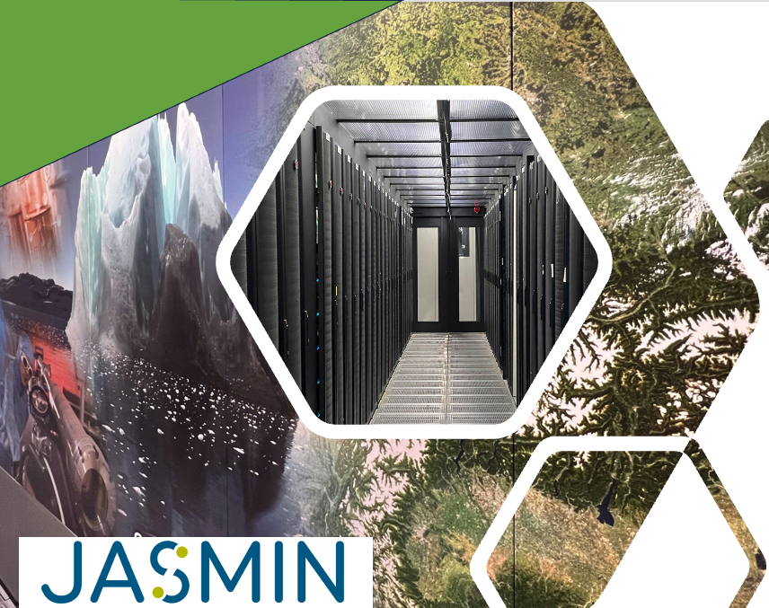

Net Zero & DRI
Notes:
raising awareness of Net Zero DRI goals and some first suggestions of how to work towards them.

Slide 2
Net Zero - what is it?
Definition:
Net zero refers to achieving a balance between the amount of greenhouse gas emissions produced and the amount removed from the atmosphere, resulting in no net increase in emissions.
Importance
Mitigating climate change is a global priority, and digital research infrastructure users can play a crucial role.
Digital technology and internet are responsible for around 4% of global carbon emissions

Slide 3
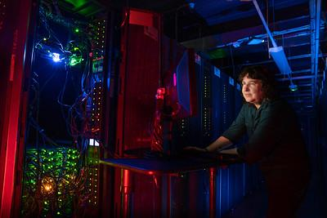
What is digital research infrastructure (DRI)?
The building blocks of the digital research infrastructure system include:
Large scale computer facilities, including high-throughput, high-performance, and cloud computing
Data storage facilities, repositories, stewardship and security
Software and shared code libraries
Mechanisms for access, such as networks and user authentication systems
People: the users, and the experts who develop and maintain these powerful resources

Slide 4
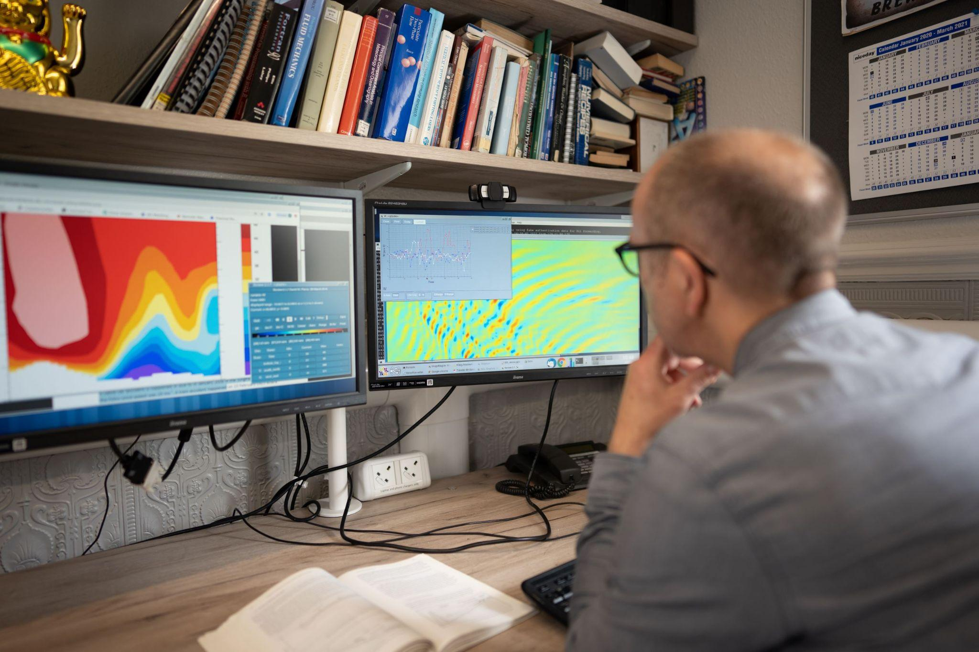
Key areas contributing to digital research infrastructure emissions
Embodied carbon in equipment
Manufacture of hardware (including the footprint of extracting raw materials)
Emissions associated with the use of electricity to power computer equipment
Energy for power distribution and cooling storage

Slide 5
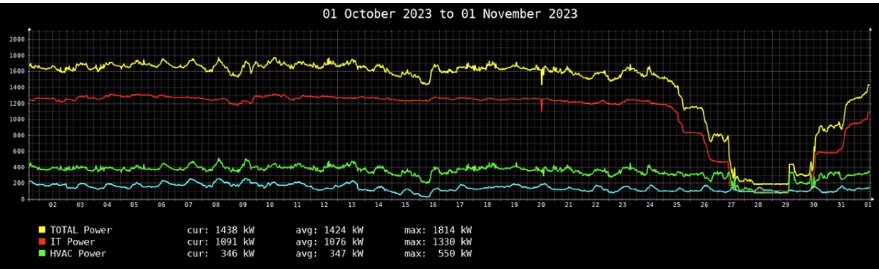
An example - power usage in the JASMIN building

Slide 6
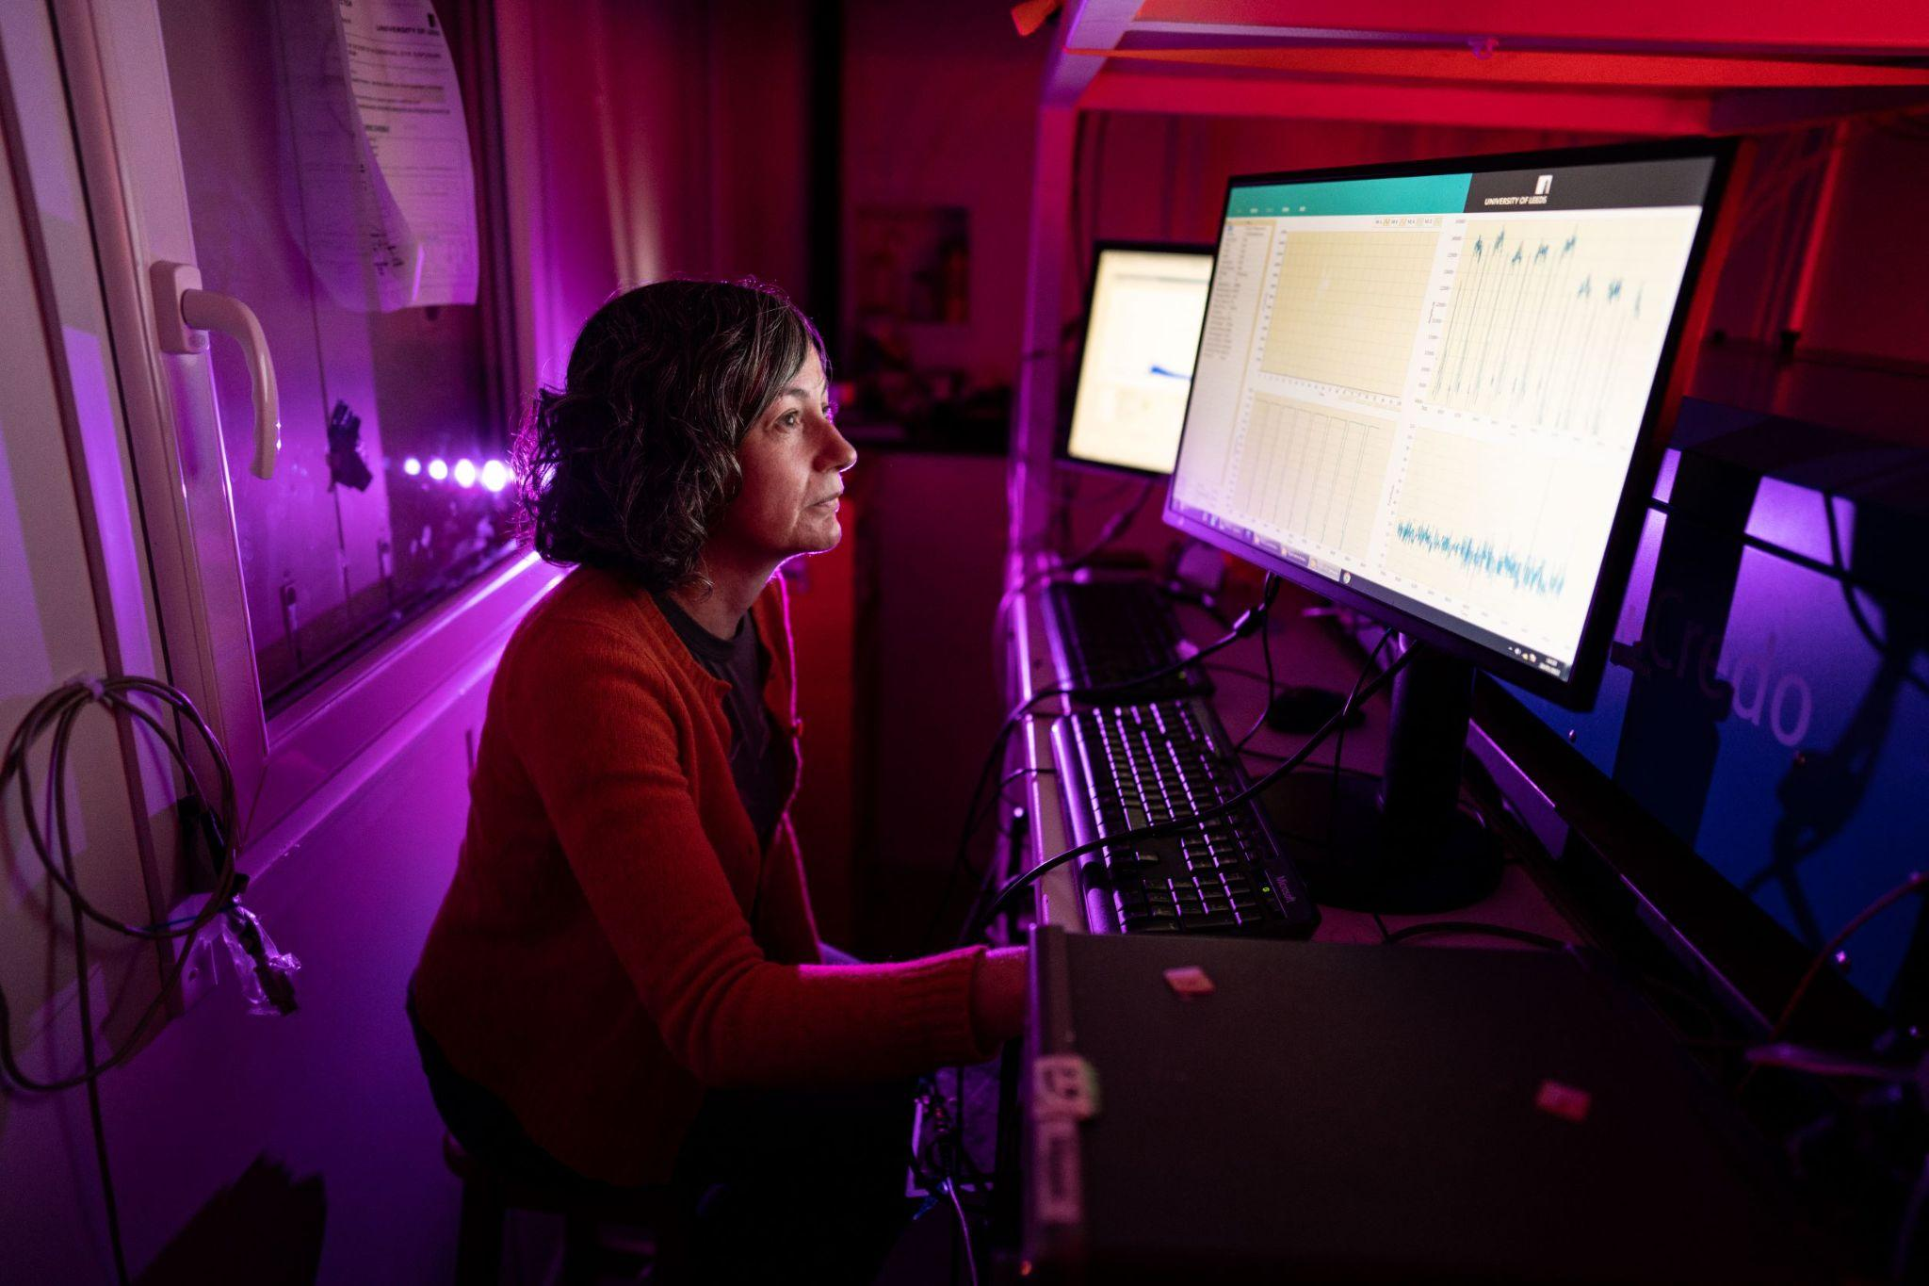
Actions you can take
Reduce Energy Consumption
Optimise server utilisation
Ensure efficient use of computational resources to minimise energy waste.
Implement power-saving features
Configure hardware and software to reduce energy consumption during idle periods.

Slide 7
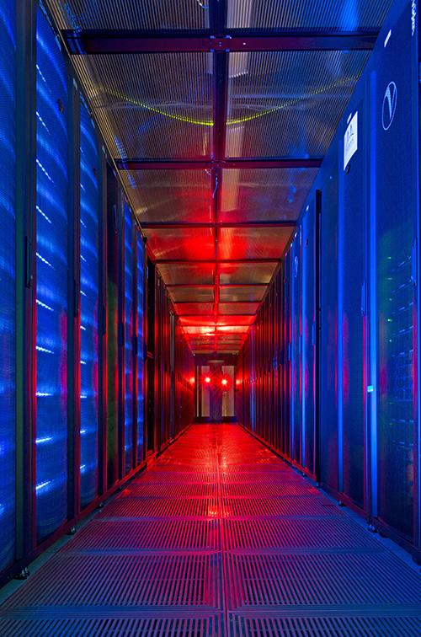
Efficient data storage and usage
Don’t make multiple copies of big data!
Provide links to where the data are stored rather than attaching multiple copies to emails
A JASMIN Group Workspace (GWS) can be used to collaborate with co-workers
Think about what data really need to be stored in the long-term (Data Management Planning)
Tape storage is more energy efficient than disk storage
When processing - subset your data

Slide 8

Actions you can take
Green Software Development
Code efficiency
Write energy-efficient code to reduce computational demands.
Sustainable algorithms
Develop and use algorithms that minimise energy and resource consumption.
Green Software Engineers – a profession for the future?

