Slide 1

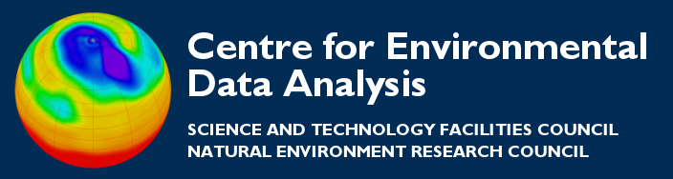
Visualisation in python
(with Matplotlib)
Thanks to all contributors:
Ag Stephens, Stephen Pascoe.

Slide 2
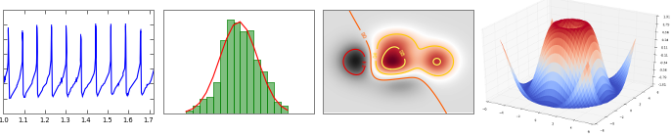
Introducing Matplotlib
Matplotlib is a python 2D plotting library which produces publication quality figures in a variety of hardcopy formats and interactive environments across platforms. Matplotlib can be used in python scripts, the python shell, web application servers, and six graphical user interface toolkits.

Slide 3
Introducing Matplotlib
Matplotlib enables you to generate plots, histograms, power spectra, bar charts, error charts, scatterplots, etc, with just a few lines of code.
For simple plotting the "pyplot" interface provides a MATLAB-like interface.
You also have full control of line styles, font properties, axes properties, etc, via an object oriented interface or via a set of functions familiar to MATLAB users.

Slide 4
Recommending Matplotlib
As with all open source Python tools there are other options and approaches available.
However, Matplotlib, like NumPy, has become the clear leader in its particular niche.
If you want to do (high quality) visualisation in Python – use Matplotlib!

Slide 5
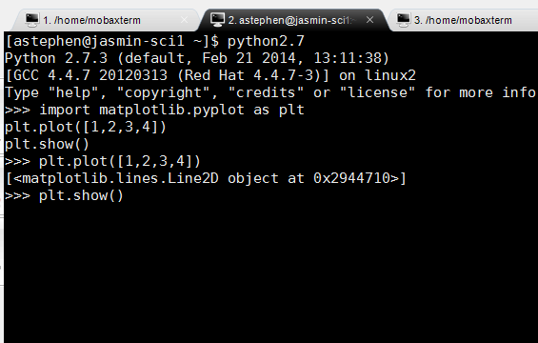
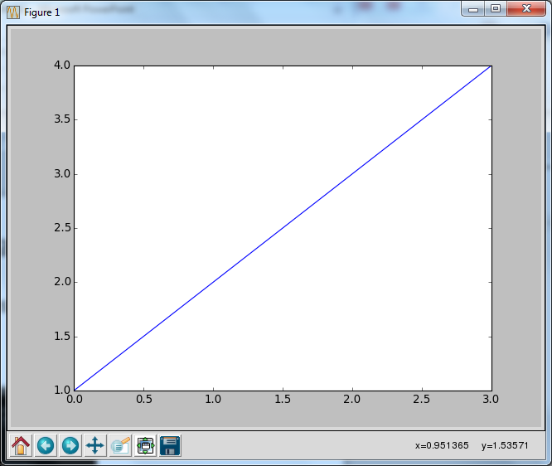
Using Matplotlib Interactively
Matplotlib has it's own interactive plotting window:

Slide 6
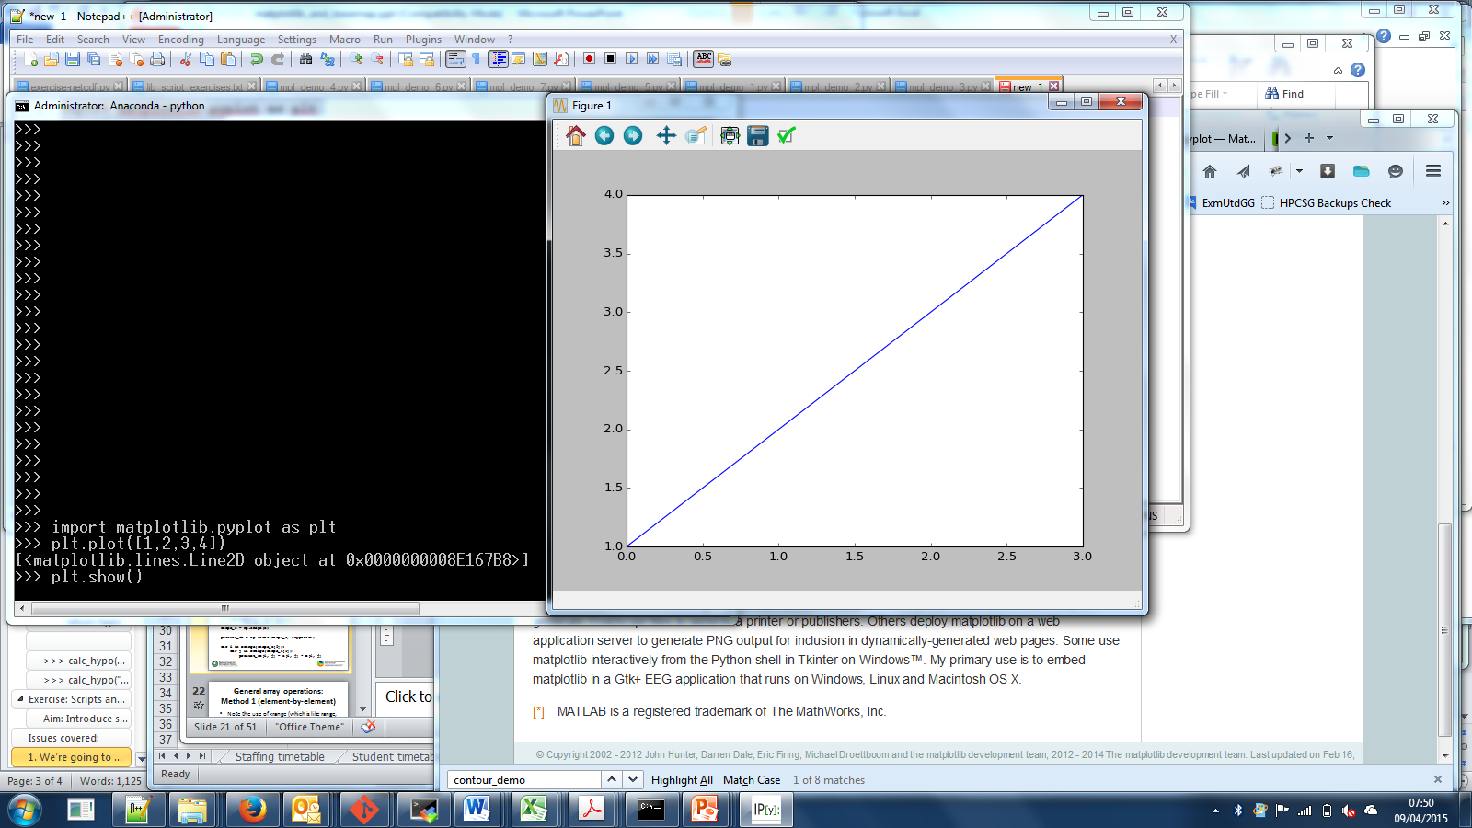
Using Matplotlib Interactively
The buttons allow you to:
Re-set the image
Move between different plots in this session
Scroll around the current plot
Zoom in to specified region
View whole plot
Save the plot

Slide 7
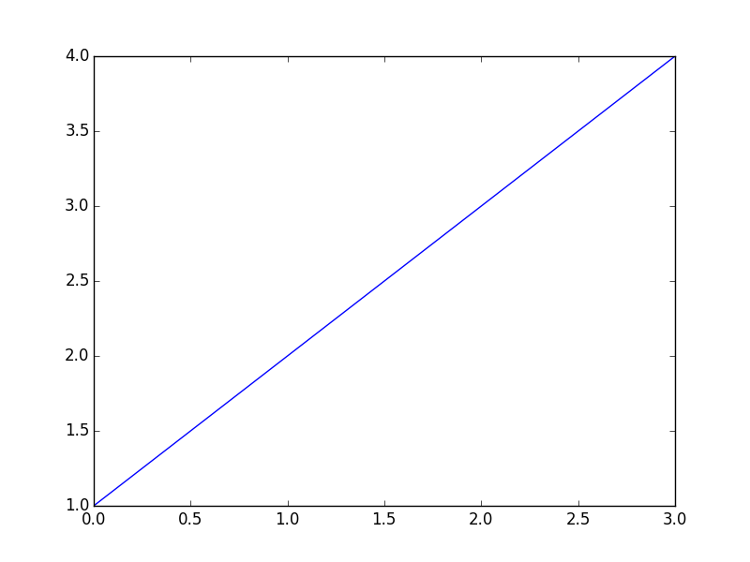
The first plot: A simple line graph
import matplotlib.pyplot as plt
plt.plot([1,2,3,4])
plt.show()
Defaults are used for things you do not specify (such as the x-axis values).

Slide 8


Before we go any further…
!!!This slide is important!!!
In the environment you are working with it is useful to be able to work in Python without closing your interactive window. Here's how you do it:
>>> import matplotlib.pyplot as plt # The standard import
>>> plt.plot(range(5)) # Generate a plot
>>> plt.pause(1) # Show plot but refocus
# on python shell
# Now you can continue to modify the plot in python
>>> plt.clf() # Clears the figure
>>> plt.pause(1) # Updates (clears) canvas
>>> plt.plot([1, 10, 3, 4, 9]) # Plot something different
>>> plt.pause(1) # Show the plot in the
# window.
!!!This slide is important…if a bit of a kludge!!!

Slide 9
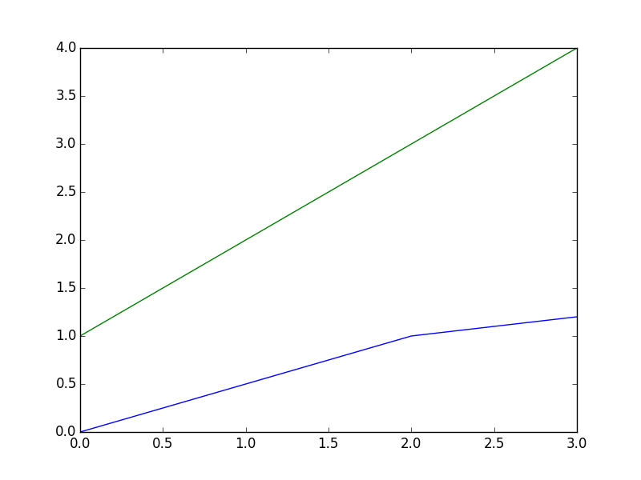
Two lines
plt.plot([0,0.5,1,1.2])
plt.plot([1,2,3,4])
plt.show()
Assume we have always run:
import matplotlib.pyplot as plt

Slide 10
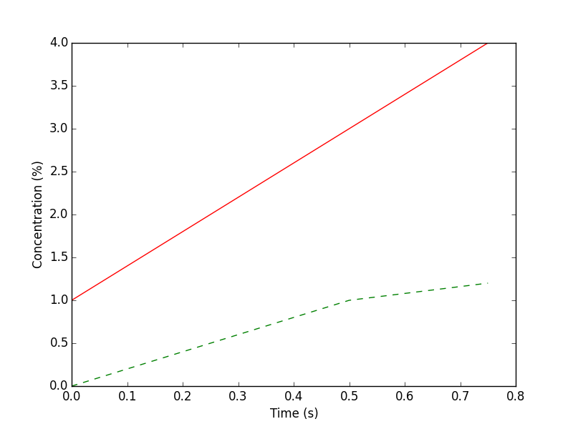
Two lines formatted – with axes
times = [0, 0.25, 0.5, 0.75]
plt.plot(times, [0,0.5,1,1.2], 'g--',
times, [1, 2, 3, 4], 'r')
plt.ylabel('Concentration (%)')
plt.xlabel('Time (s)')
plt.show()

Slide 11
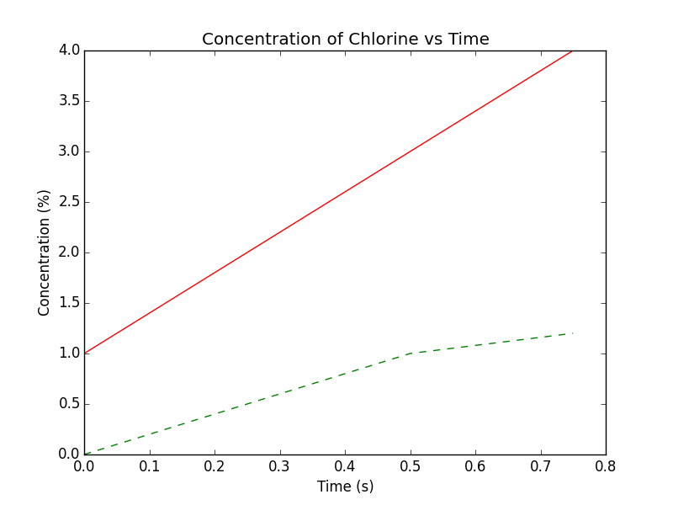
Add a title
times = [0, 0.25, 0.5, 0.75]
plt.plot(times, [0,0.5,1,1.2], 'g--',
times, [1, 2, 3, 4], 'r')
plt.title('Concentration of Chlorine vs Time')
plt.ylabel('Concentration (%)')
plt.xlabel('Time (s)')
plt.show()

Slide 12
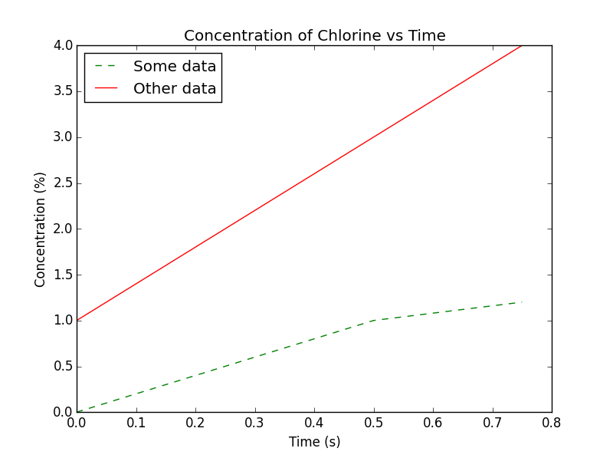
Add a legend
times = [0, 0.25, 0.5, 0.75]
plt.plot(times, [0,0.5,1,1.2], 'g--', label = "Some data")
plt.plot(times, [1, 2, 3, 4], 'r', label = "Other data")
plt.title('Concentration of Chlorine vs Time')
plt.ylabel('Concentration (%)')
plt.xlabel('Time (s)')
plt.legend()
plt.show()

Slide 13
Saving an image: savefig
To save an image use:
plt.savefig("myplot.png")
Optional arguments include:
  dpi: resolution
  orientation: "portrait" or "landscape"
  format: "png", "pdf", "ps", "eps" or "svg"
  And more…

Slide 14
plt.figure – To plot multiple figures and change size
To draw multiple plots from the same session:
  plt.figure()
  plt.plot(range(5))
  plt.figure(figsize = (10, 10)) # size in inches
  plt.plot(range(100))
  plt.show() # shows both figures
plt.figure: returns a new figure so you can interact with them independently, e.g.:
  f1 = plt.figure()
  f2 = plt.figure()

Slide 16
Histogram – prepare the data
import numpy as np
import matplotlib.pyplot as plt
mu, sigma = 100, 15
x = mu + sigma * np.random.randn(10000)
The above code will be assumed for all the following histogram examples.

Slide 17
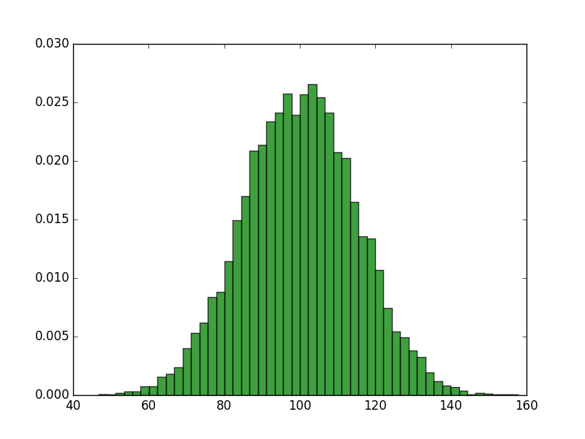
Histogram - basic
n, bins, patches = plt.hist(x, 50, normed=1,
facecolor='g', alpha=0.75)
plt.axis([40, 160, 0, 0.03])
plt.show()

Slide 18
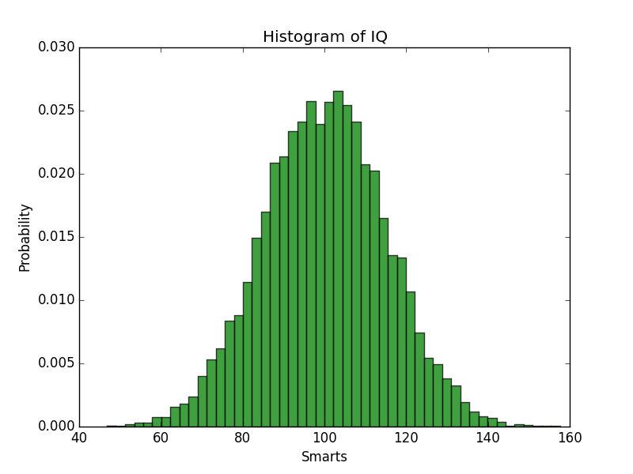
Histogram – annotated
n, bins, patches = plt.hist(x, 50, normed=1,
facecolor='g', alpha=0.75)
plt.xlabel('Smarts')
plt.ylabel('Probability')
plt.title('Histogram of IQ')
plt.axis([40, 160, 0, 0.03])
plt.show()

Slide 19
Multiple plots – prepare data
import numpy as np
import matplotlib.pyplot as plt
x1 = np.linspace(0.0, 5.0)
x2 = np.linspace(0.0, 2.0)
y1 = np.cos(2 * np.pi * x1) * np.exp(-x1)
y2 = np.cos(2 * np.pi * x2)
The above code will be assumed for all the following multiple plot examples.

Slide 20
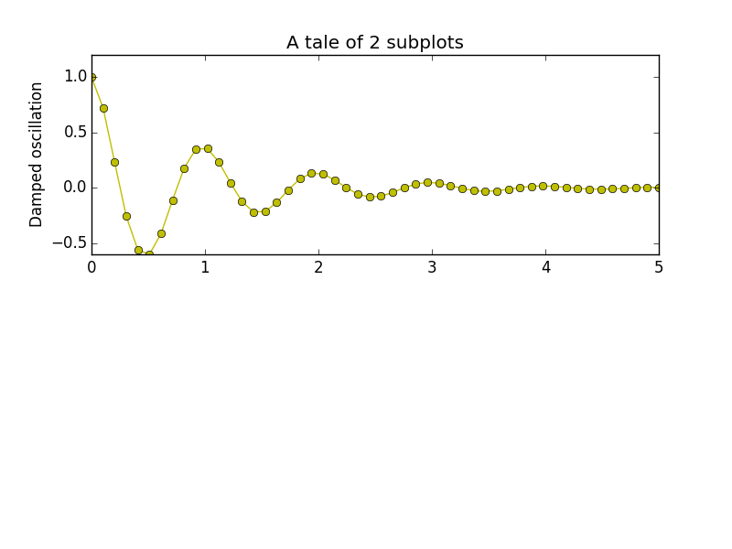
Multiple plots (using subplot)
plt.subplot(2, 1, 1)
plt.plot(x1, y1, 'yo-')
plt.title('A tale of 2 subplots')
plt.ylabel('Damped oscillation')
The "subplot" function is defined as:
subplot(nrows, ncols, plot_number)
Here we define: 2 rows, 1 column and we add the first plot.

Slide 21
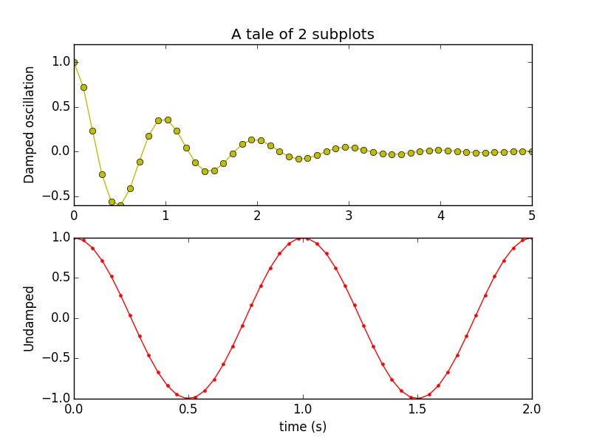
Multiple plots (using subplot)
plt.subplot(2, 1, 1)
plt.plot(x1, y1, 'yo-')
plt.title('A tale of 2 subplots')
plt.ylabel('Damped oscillation')
plt.subplot(2, 1, 2)
plt.plot(x2, y2, 'r.-')
plt.xlabel('time (s)')
plt.ylabel('Undamped')
plt.show()
Now we have added the second plot.

Slide 22
Multiple axes on one plot (1)
import numpy as np
import matplotlib.pyplot as plt
fig, ax1 = plt.subplots()
t = np.arange(0.01, 10.0, 0.01)
s1 = np.exp(t)
ax1.plot(t, s1, 'b-')
ax1.set_xlabel('time (s)')
# Make the y-axis label and tick labels match the line color.
ax1.set_ylabel('exp', color='b')
for tl in ax1.get_yticklabels():
tl.set_color('b')
...

Slide 23
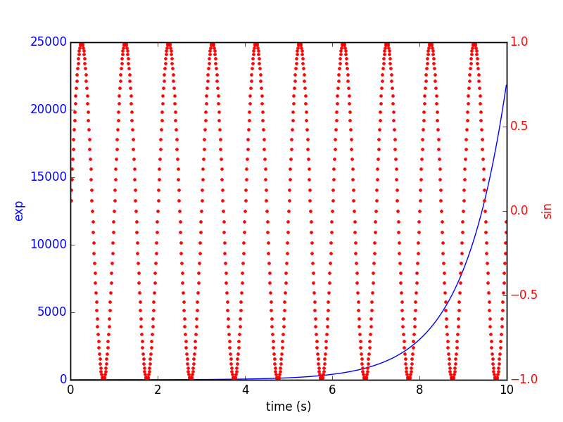
Multiple axes on one plot (2)
...
ax2 = ax1.twinx()
s2 = np.sin(2*np.pi*t)
ax2.plot(t, s2, 'r.')
ax2.set_ylabel('sin', color='r')
for tl in ax2.get_yticklabels():
tl.set_color('r')
plt.show()

Slide 25
Contour plot – prepare data
import matplotlib
import numpy as np
import matplotlib.cm as cm
import matplotlib.mlab as mlab
import matplotlib.pyplot as plt
matplotlib.rcParams['xtick.direction'] = 'out'
matplotlib.rcParams['ytick.direction'] = 'out'
delta = 0.025
x = np.arange(-3.0, 3.0, delta)
y = np.arange(-2.0, 2.0, delta)
X, Y = np.meshgrid(x, y)
Z1 = mlab.bivariate_normal(X, Y, 1.0, 1.0, 0.0, 0.0)
Z2 = mlab.bivariate_normal(X, Y, 1.5, 0.5, 1, 1)
# difference of Gaussians
Z = 10.0 * (Z2 - Z1)
Assume this code applies to all contour examples.

Slide 26
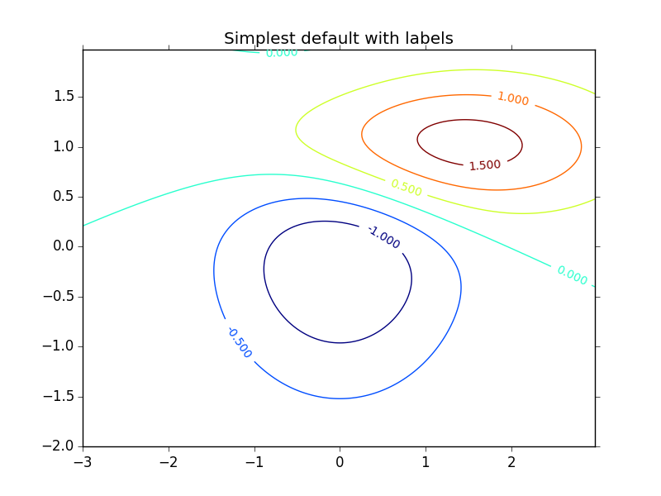
Contour plot – default colours
CS = plt.contour(X, Y, Z)
plt.clabel(CS, inline=1, fontsize=10)
plt.title('Simplest default with labels')
plt.show()

Slide 27
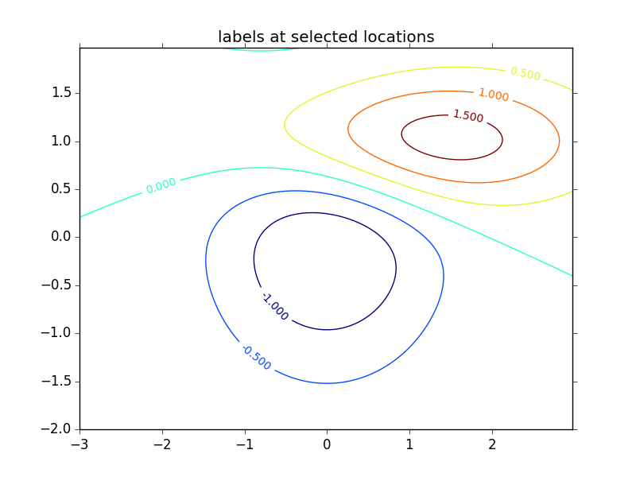
Contour plot – control labels
CS = plt.contour(X, Y, Z)
manual_locations = [(-1, -1.4), (-0.62, -0.7), (-2, 0.5),
(1.7, 1.2), (2.0, 1.4), (2.4, 1.7)]
plt.clabel(CS, inline=1, fontsize=10,
manual=manual_locations)
plt.title('labels at selected locations')
plt.show()

Slide 28
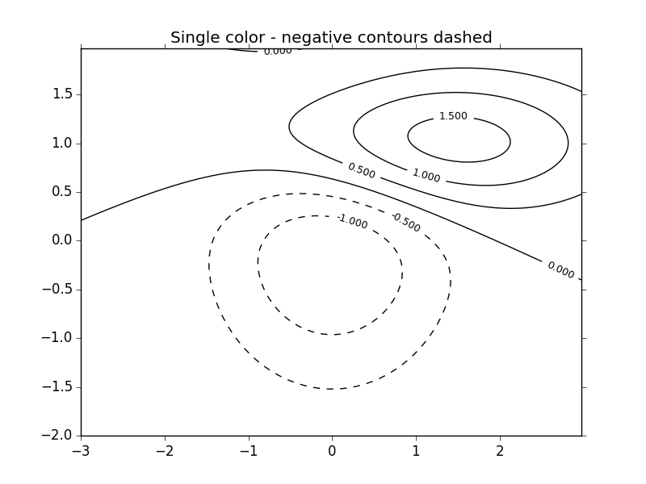
Contour plot – with negative values
# This time negative contours will be dashed by default
CS = plt.contour(X, Y, Z, 6, colors='k')
plt.clabel(CS, fontsize=9, inline=1)
plt.title('Single color - negative contours dashed')
plt.show()

Slide 29
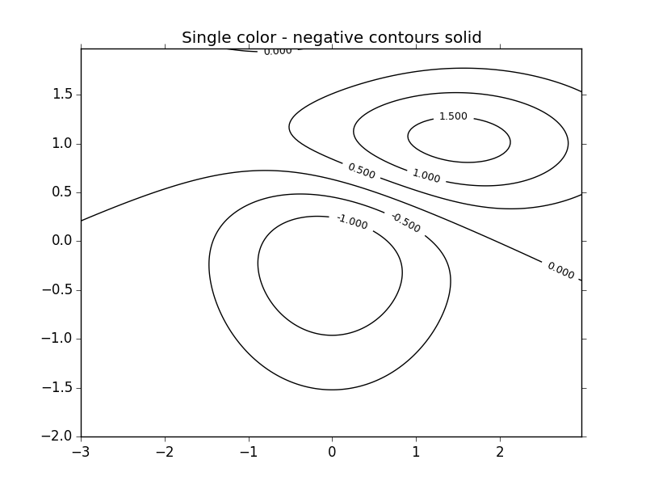
Contour plot - set negative line style
# Override negative contours – use solid lines
matplotlib.rcParams['contour.negative_linestyle'] = 'solid'
CS = plt.contour(X, Y, Z, 6, colors='k')
plt.clabel(CS, fontsize=9, inline=1)
plt.title('Single color - negative contours solid')
plt.show()

Slide 30
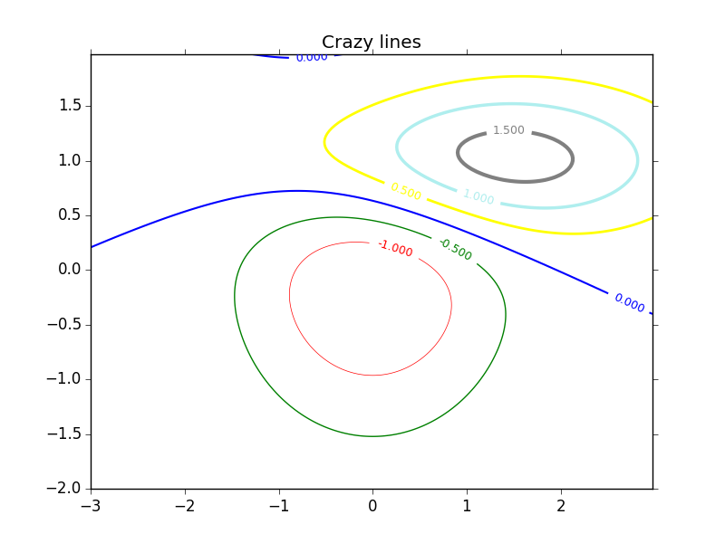
Contour plot – specify colours
CS = plt.contour(X, Y, Z, 6, linewidths=np.arange(.5, 4, .5),
colors=('r', 'green', 'blue', (1, 1, 0),
'#afeeee', '0.5'))
plt.clabel(CS, fontsize=9, inline=1)
plt.title('Crazy lines')
plt.show()

Slide 31
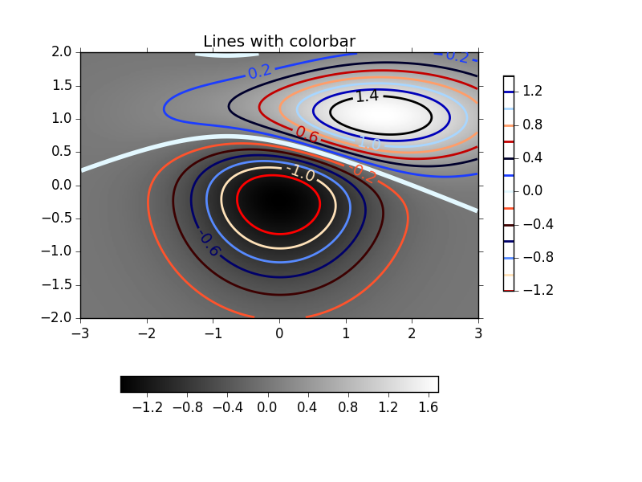
Contour plot - smart
And you can keep going…

Slide 32
Introducing Basemap
The matplotlib basemap toolkit is a library for plotting 2D data on maps in Python.
It is similar in functionality to the MATLAB mapping toolbox.
Basemap does not do any plotting on its own, but provides the facilities to transform coordinates to one of 25 different map projections.
Matplotlib is then used to plot contours, images, vectors, lines or points in the transformed coordinates. Shoreline, river and political boundary datasets are provided, along with methods for plotting them.

Slide 33
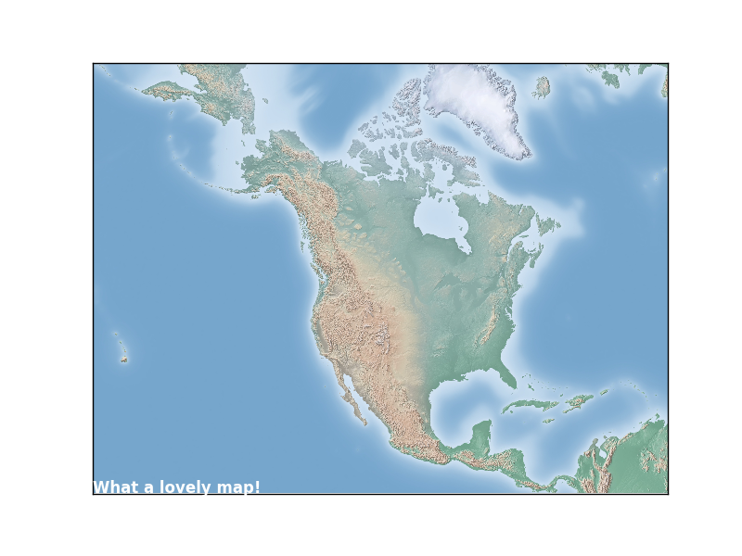
Plotting maps – using Basemap
from mpl_toolkits.basemap import Basemap
import matplotlib.pyplot as plt
m = Basemap(width=12000000,height=9000000,projection='lcc',
resolution=None,lat_1=45.,lat_2=55,lat_0=50,lon_0=-107.)
m.shadedrelief()
plt.text(0.2, 0.2, "What a lovely map!", color="white",
weight="bold")
plt.show()
http://matplotlib.org/basemap/users/geography.html

Slide 34
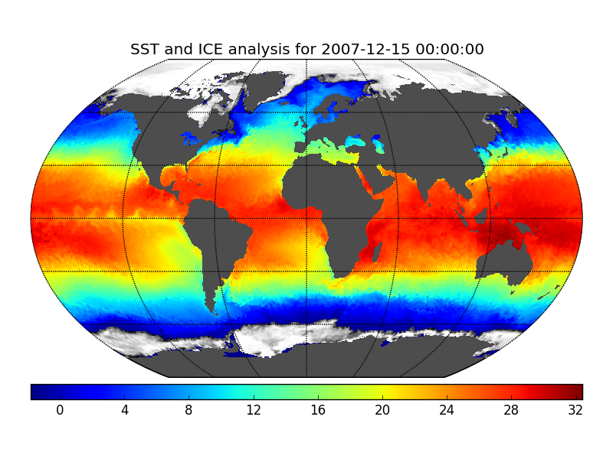
Plotting maps – and data
With about 30 lines of code you can extract Sea Surface Temperature and Ice from a file and plot on a required projection:
http://matplotlib.org/basemap/users/examples.html

Slide 35
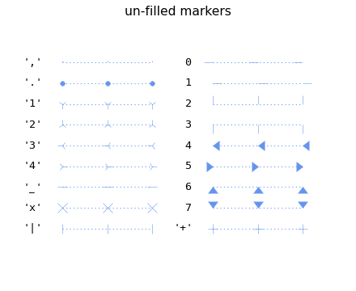
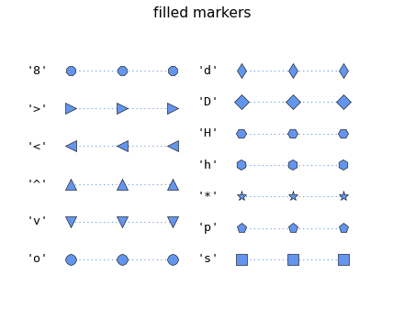
Useful features: Markers
http://matplotlib.org/examples/lines_bars_and_markers/marker_reference.html

Slide 36
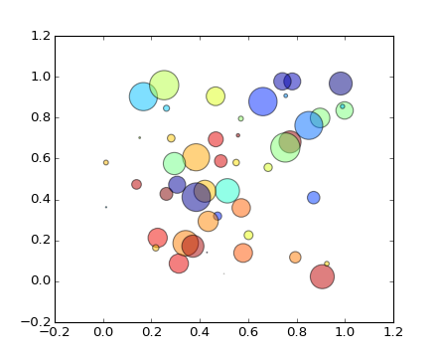
Useful features: Scatter plots
http://matplotlib.org/examples/shapes_and_collections/scatter_demo.html

Slide 37
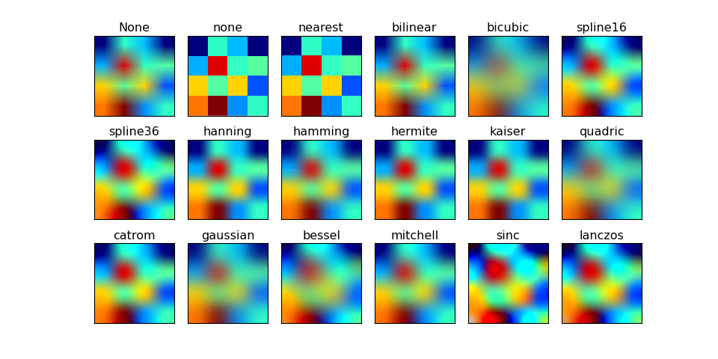
Useful features: Interpolation
http://matplotlib.org/examples/images_contours_and_fields/interpolation_methods.html

Slide 38
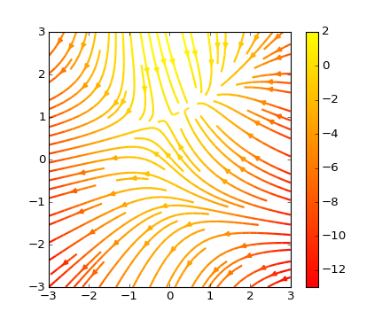
Useful features: Stream plot
http://matplotlib.org/examples/images_contours_and_fields/streamplot_demo_features.html

Slide 39
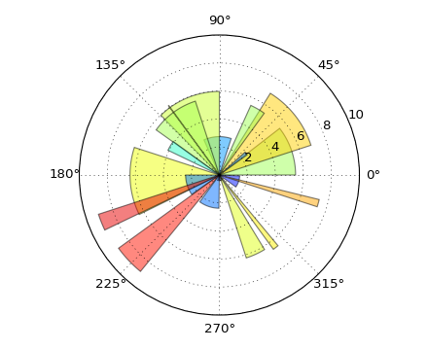
Useful features: Polar bar
http://matplotlib.org/examples/pie_and_polar_charts/polar_bar_demo.html

Slide 40
One last word: the OOP interface
We have demonstrated Matplotlib using the "pylab" interface (which aims to mimic that of MATLAB).
You can interact with Matplotlib using its OOP interface (known as the Matplotlib API). This is a different interface to the same functionality.
Over time you may wish to use the OOP interface for complex plotting applications.

Slide 41
More info
Matplotlib:
  http://matplotlib.org
Matplotlib gallery:
  http://matplotlib.org/gallery.html
Pyplot reference:
  http://matplotlib.org/api/pyplot_summary.html
Basemap toolkit (for map plotting):
  http://matplotlib.org/basemap/
Books, videos and tutorials:
  http://matplotlib.org/1.4.3/resources/

