Slide 1


Sets in Python
Thanks to all contributors:
Alan Iwi, Ag Stephens

Slide 2
Sets in Python
A type of collection (as are lists and tuples).
Main differences from a list:
  Unordered collection:
    not indexed by number
    printing / looping over set gives elements in no particular order
Collection of distinct items:
  The same element can only appear once.
Analogous to sets in mathematics.

Slide 3
Why use sets? An example.
Suppose we have meteorological data at various measurement sites.
We want to ask questions such as:
  which sites have both wind and temperature data?
  which sites have either wind or temperature data?
We can store information in sets, e.g.:
  the set of sites that have wind data
  the set of sites that have temperature data
Answer these questions intuitively and efficiently using Python set operations like intersection or union.

Slide 4
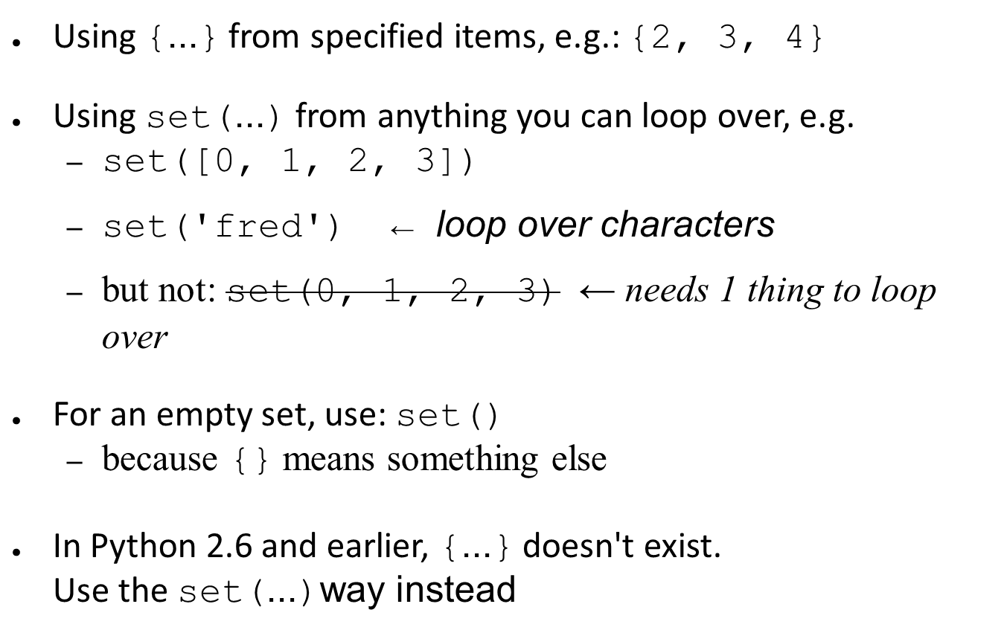
How to construct sets in python

Slide 5
Sets are mutable
>>> a = {10, 11, 12}
>>> a.add(13)
>>> a.remove(11)
>>> print a
set([10, 12, 13]) ← NB not ordered
>>> a.clear() ← remove all items

Slide 6
Find unique items in a collection
letters = set()
for char in 'ichthyosaur':
letters.add(char)
print letters
set(['a', 'c', 'i', 'h', 'o', 's', 'r', 'u', 't', 'y'])
Note ‘h’ only appears once, and no particular order
or simply:
letters = set('ichthyosaur')

Slide 7
Set operations
len(a) gives the number of elements
Many operations on two sets exist
  comparisons
  combinations
  many operators have equivalent methods
  see following slides

Slide 8
Set comparisons
return True or False
a <= b a.issubset(b)
a >= b a.issuperset(b)
a < b strict subset
a > b strict superset
a == b identical

Slide 9
Set combinations
returning a new set
a = { 2, 3 }
b = { 3, 4 }
a | b a.union(b) {2, 3, 4}
a & b a.intersection(b) {3}
a - b a.difference(b) {2}
a ^ b a.symmetric_difference(b) {2, 4}

Slide 10
Set operators vs methods
operators act on two sets
the equivalent methods act on anything you can loop over
set1 = { 2, 3 }
set2 = { 3, 4 }
set1 – set2 gives {2}
tup = ( 3, 4 )
set1 – tup fails with a TypeError
set1.difference(tup) gives {2}

