Slide 1
Great Lakes Meteorological Real-Time Coastal Observation Network (ReCON)

Slide 2
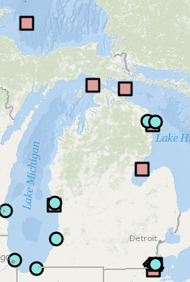
GLERL ReCON Infrastructure
Blue circles are meteorological stations that host webcams of interest, however not every station’s webcams are operational at this time
Red squares are ReCON buoy locations
On the western end of Lake Erie there are also 4 Nutrient Monitoring Buoys

Slide 3
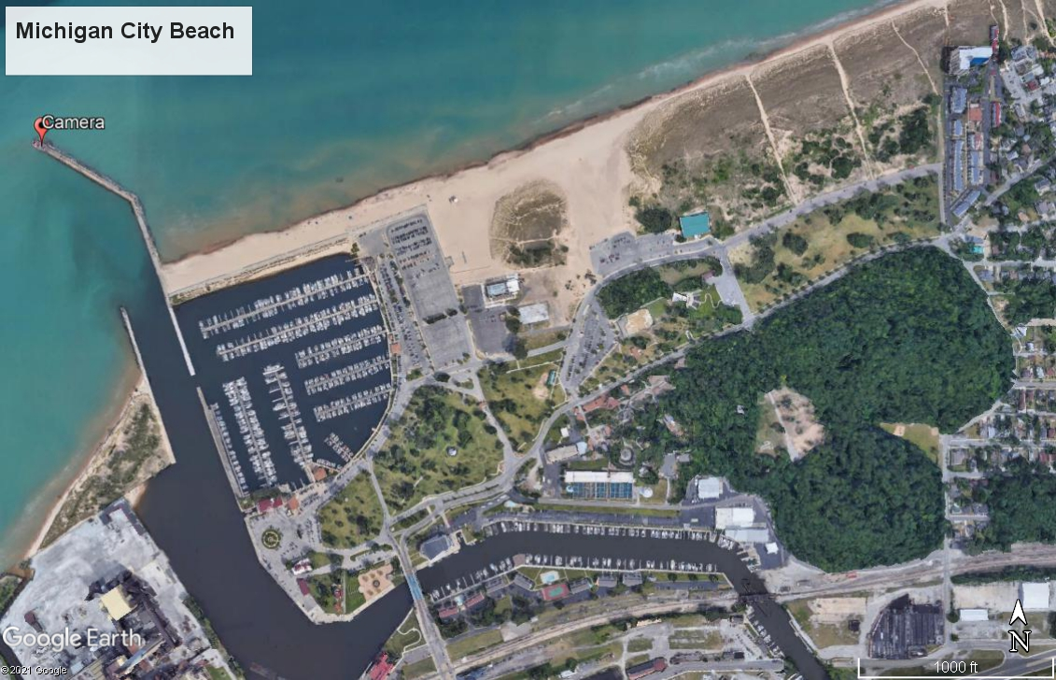

Slide 4
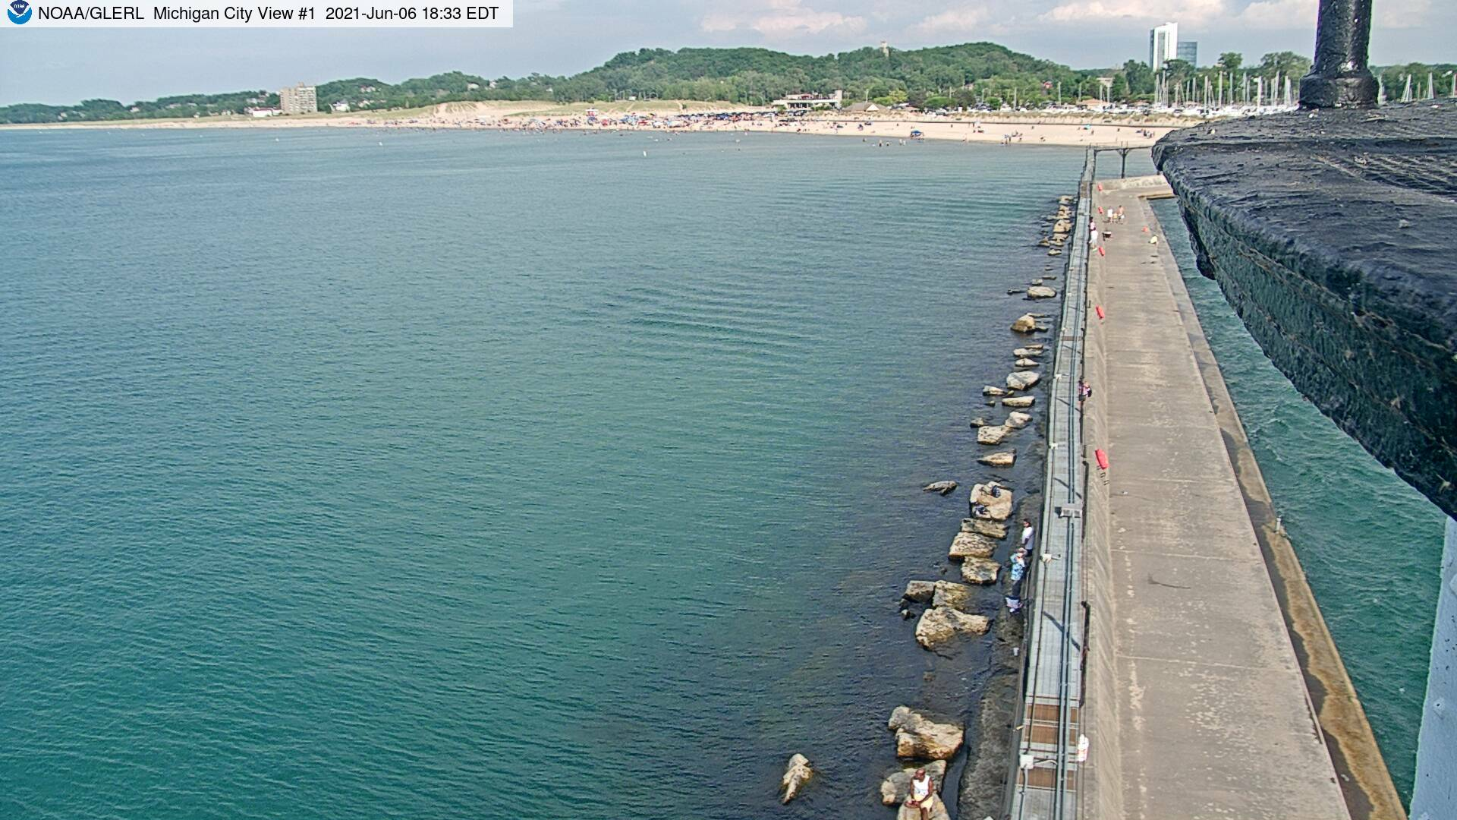
Michigan City, IN Webcam
View #1 shows coastline from a lighthouse at the end of a pier looking back east to the beach.
Pros: large extent of shoreline shown
Cons: The camera is about 310 meters from the closest point on the beach.

Slide 5
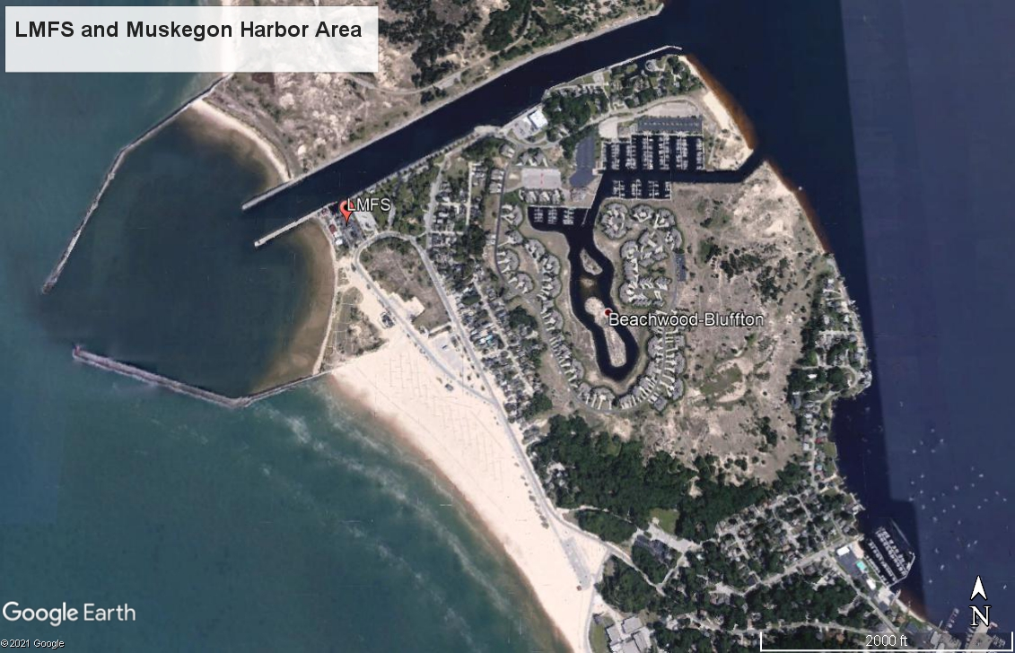

Slide 6
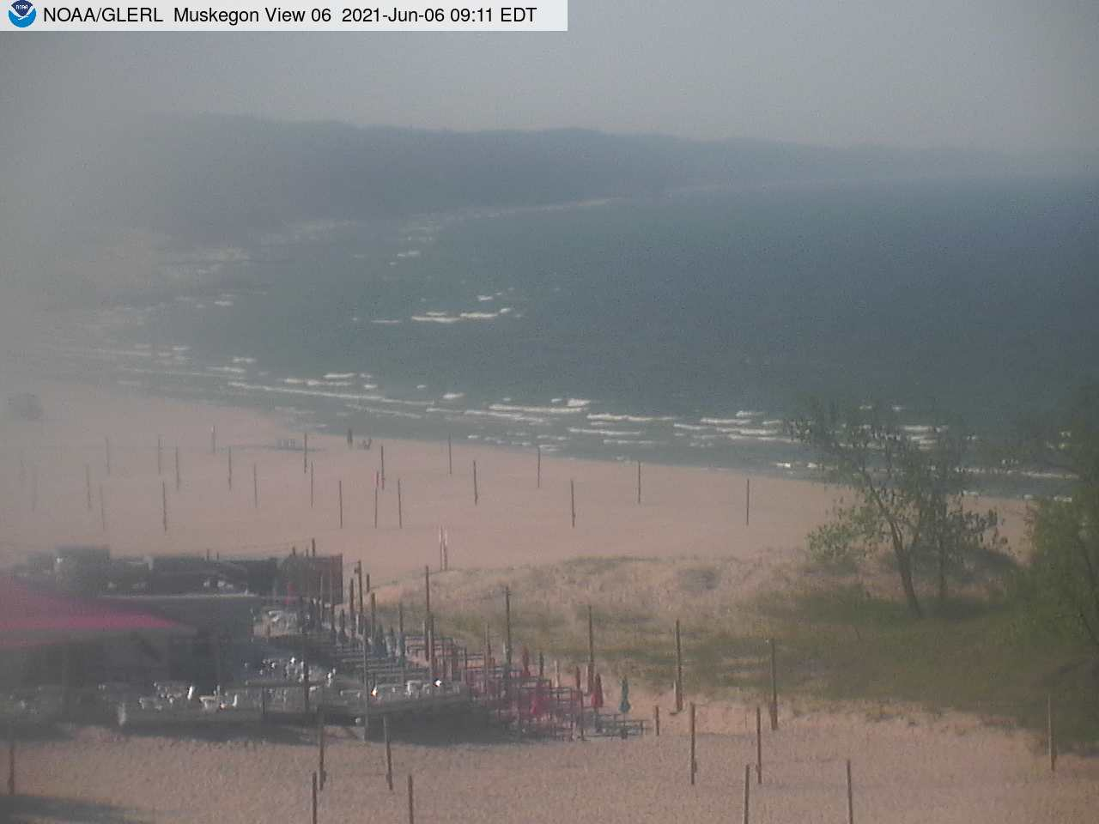
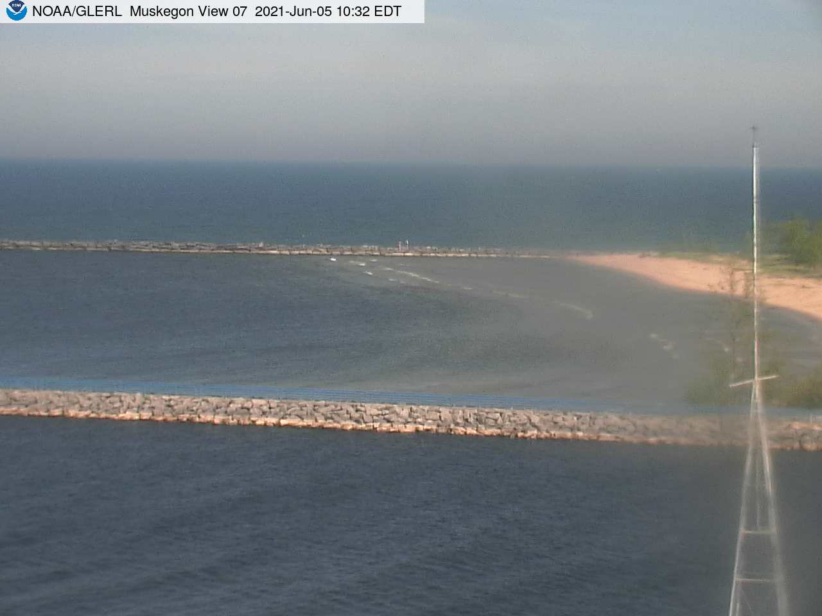
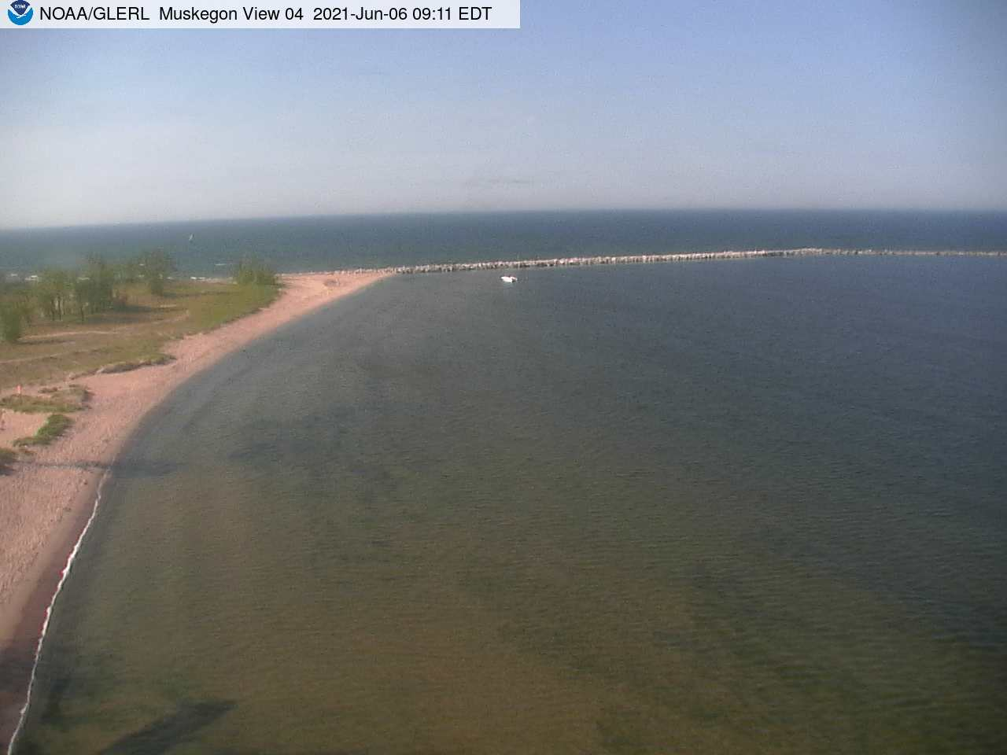
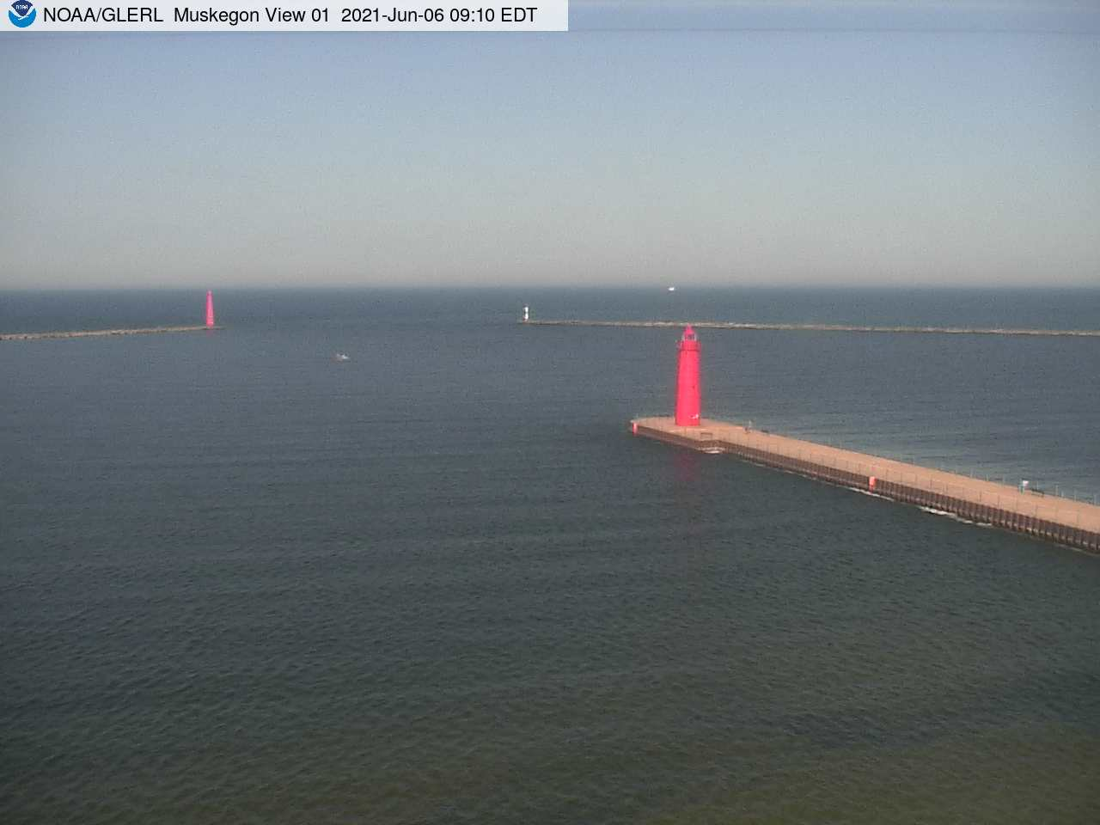
Muskegon Webcam
Shows beach north of LMFS
Shows a zoomed in view of a beach south of Muskegon harbor
Shows harbor beach to the south of LMFS
Shows Muskegon harbor

