Slide 1
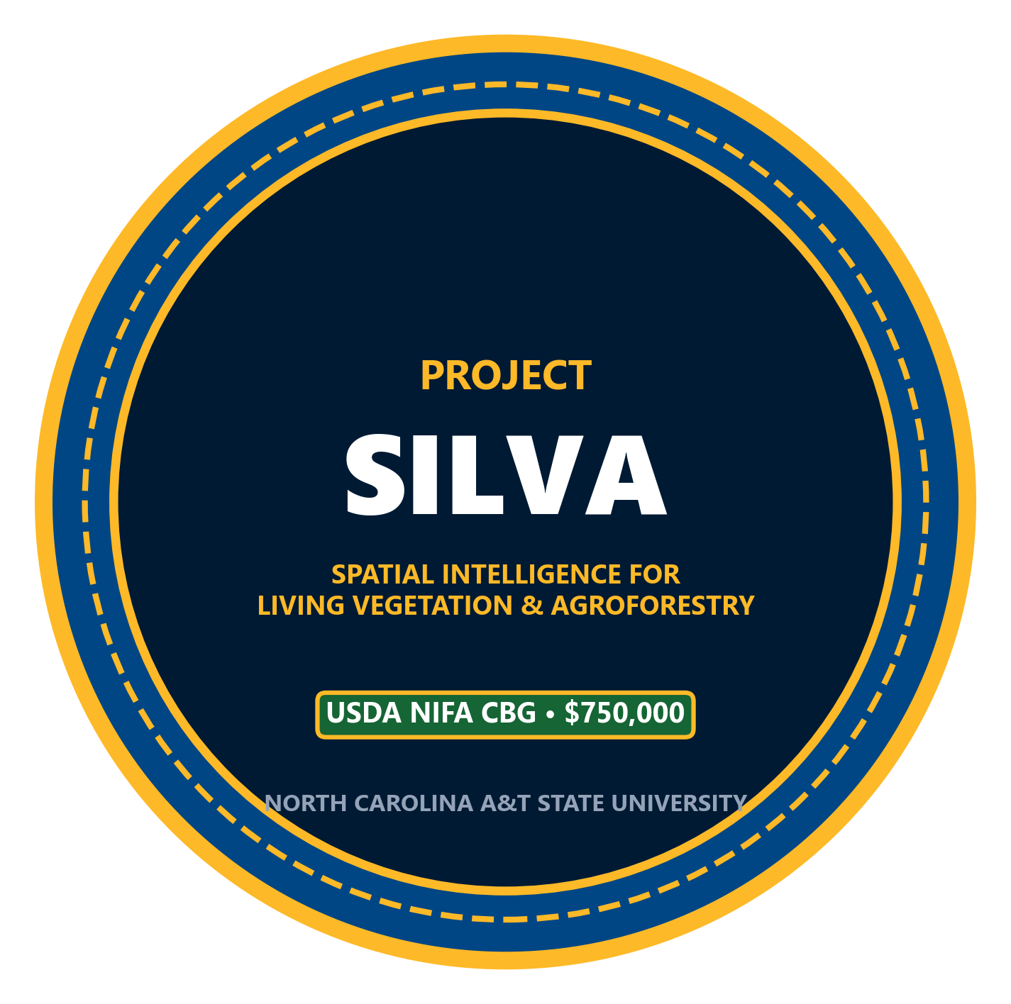

PROJECT SILVA
Spatial Intelligence for Living Vegetation & Agroforestry
USDA NIFA 1890 Capacity Building Grants Program | $750,000 Integrated Track
North Carolina Agricultural and Technical State University
College of Agriculture & Environmental Sciences (CAES)
Notes:
Good morning colleagues, department leadership, and collaborators. Today I am presenting Project SILVA—our $750,000 capacity-building initiative for North Carolina A&T under the USDA NIFA 1890 Integrated Track. SILVA stands for Spatial Intelligence for Living Vegetation and Agroforestry. This initiative unites eleven investigators across three academic colleges—Agriculture, Engineering, and Science and Technology—along with Cooperative Extension. Project SILVA creates permanent digital, biological, and curricular capacity for our university while fully protecting our faculty's teaching and research workload.

Slide 2
Executive Vision: Sustainable Land-Grant Capacity
Direct Alignment with CAES Priorities under Dean Dr. Gregory Goins & Chair Dr. Niroj Aryal
THE $750,000 INTEGRATED TRACK
ENDURING CAPACITY VS. ROUTINE OPERATION
BREAKING INTERDISCIPLINARY SILOS
• Maximum Allowable Funding: Single-function projects cap at $300k–$600k; Integrated projects award up to $750,000 over 36 months.
• Tri-Partite Mandate: Simultaneously executes Teaching ($350k), Research ($225k), and Extension ($175k).
• Reviewer-First Simplicity: Focused on core land-grant capacity rather than sprawling, untrackable municipal programs.
• Protected Budget: Caps faculty summer salary at 32% ($240k), preserving 68% ($510k) for physical hardware, student stipends, field plots, and university overhead.
• Federal Red Line: USDA panels strictly disqualify proposals funding everyday classroom supplies or temporary research consumables.
• Physical & Computing Assets: Establishes a permanent GPU Spatial Design Center and living agroforestry field infrastructure.
• First 4+1 HBCU MLA Pathway: Lays the structural foundation for the Nation's First Accelerated 4+1 Master of Landscape Architecture (BSLA + MLA) at an HBCU.
• Institutionalized Longevity: Generates recurring graduate tuition revenue, permanent computing licenses, and 15–20 year agroforestry plots.
• Three Academic Colleges: Unites CAES (Agriculture), COE (Engineering), and CoST (Science & Technology) with Cooperative Extension.
• Dean & Chair Leadership: Structured to support CAES administrative goals under Dean Dr. Gregory Goins, faculty tenure velocity, and student workforce placement.
• University F&A Recovery: Fully accounts for NC A&T's ~45% MTDC indirect cost rate, generating ~$125k in overhead revenue back to DOR, CAES, and NRED.
• Verified Credentials: Fully funds examination fees for 45+ students as USDA NRCS Planners, SITES APs, and ABCD Community Leaders.
Notes:
As Chair Dr. Aryal and Dr. Omon emphasized during our strategic discussions, federal review panels immediately disqualify proposals that merely request routine classroom supplies or temporary operating consumables. Project SILVA is designed strictly around USDA's statutory definition of Capacity Building. We are pursuing the full $750,000 allowable under the Integrated track because our scope spans three colleges and all three Land-Grant missions. Crucially, we preserve 68% ($510,000) of the budget for permanent physical infrastructure, computing workstations, living field plots, student stipends, and over $125,000 in statutory university indirect cost recovery for the Division of Research and CAES, while capping faculty summer salary at 32%. This directly aligns with CAES strategic goals under Dean Dr. Gregory Goins and Chair Dr. Niroj Aryal, building enduring institutional capital for North Carolina A&T.

Slide 3
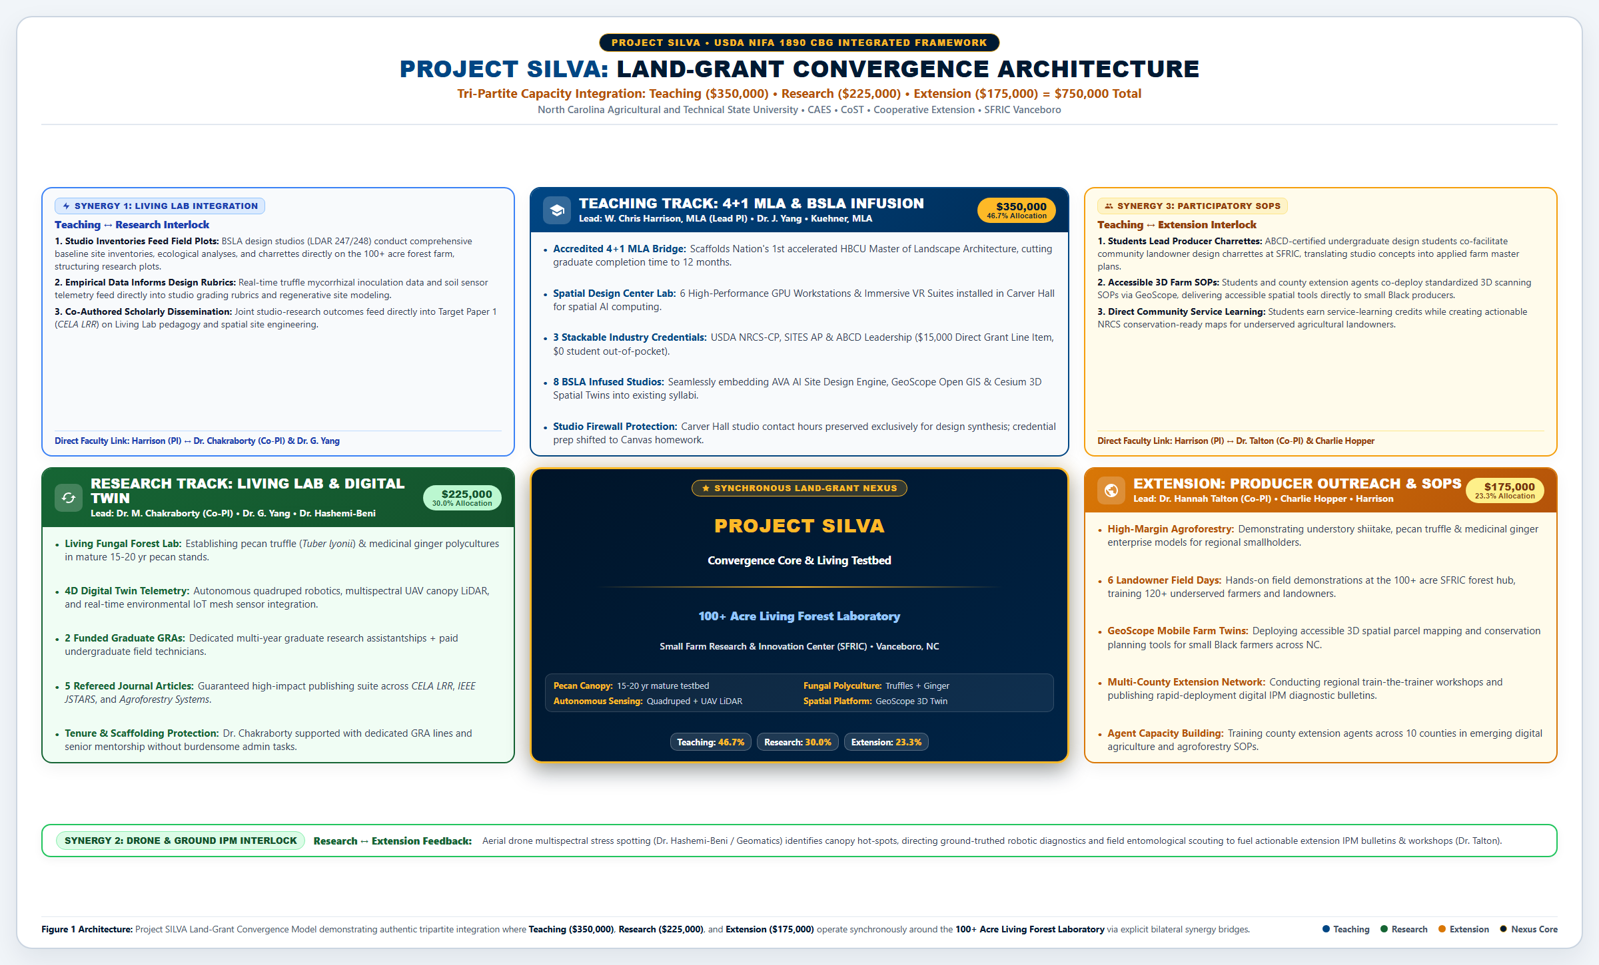
The Integrated Tri-Partite Land-Grant Model
Figure 1: Bilateral Synergies Across Teaching, Research, and Extension
PROJECT SILVA CONVERGENCE ARCHITECTURE
BILATERAL SYNERGIES & CONVERGENCE MECHANISMS
• Synergy 1 (Teaching ↔ Research): BSLA design studio baseline inventories directly structure field research plots; real-time sensor and truffle mycorrhizal telemetry stream into studio grading rubrics.
• Synergy 2 (Research ↔ Extension): Aerial drone multispectral canopy stress spotting directs ground-truthed robotic diagnostics and field entomology to fuel rapid-deployment grower IPM bulletins.
• Synergy 3 (Teaching ↔ Extension): ABCD-certified undergraduate students lead community landowner design charrettes at SFRIC; students and county agents co-deploy 3D farm scanning SOPs via GeoScope.
• Central Testbed Convergence: The 100+ acre SFRIC Living Forest Lab serves as the shared physical testbed uniting all three tracks.
Notes:
Here is our core convergence architecture. Rather than running three isolated programs, Project SILVA is structured around three mutually reinforcing pillars that converge at our SFRIC living testbed. At the apex, our Teaching Track infuses spatial computing into the curriculum while strictly protecting studio contact hours. On the left, our Research Track establishes an active agroforestry living lab without placing administrative burdens on our faculty. On the right, our Extension Track builds direct technical capacity for ten county agents. Three bilateral synergy interlocks connect these tracks: studio site baseline data feeds directly into field research plots; aerial drone stress spotting directs ground-truthed robotic diagnostics to fuel producer IPM bulletins; and community design charrettes empower our students to co-deploy digital farm twins with local landowners.

Slide 4
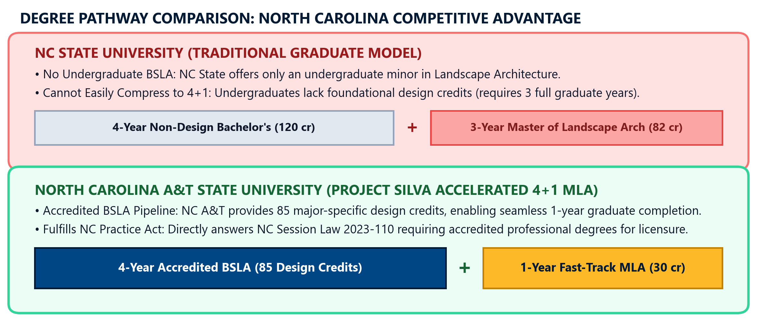
The Graduate Degree Bridge: Accelerated 4+1 MLA
Scaffolding the Nation's First Accelerated Landscape Architecture Degree at an HBCU
DEGREE BRIDGE & CURRICULAR SCAFFOLDING
ACCELERATED 4+1 MLA TIMELINE & COURSE MAPPING
• Nation's First 4+1 HBCU MLA: Seamless pipeline from undergraduate BSLA to Master of Landscape Architecture (MLA) in 5 total years.
• Two New Approved Graduate Courses: Formally establishes LDAR 612 (Resilient Site Systems & SITES AP) and LDAR 624 (Community Spatial Practice & ABCD).
• Graduate Credit Banking: Seniors take up to 12 graduate credit hours in Year 4 that count toward both BSLA electives and MLA core requirements.
• Talent Retention: Prevents predatory out-of-state recruitment of NC A&T design graduates by providing an elite in-house professional pathway.
• Institutional Longevity: Creates a self-funding graduate enrollment pipeline generating recurring departmental tuition revenue.
Notes:
Our primary educational milestone is laying the operational foundation for the Nation's First Accelerated 4+1 Master of Landscape Architecture degree at an HBCU. Today, our top undergraduate talent is routinely recruited away to external graduate programs. Project SILVA establishes two approved graduate courses—LDAR 612 in resilient site systems and LDAR 624 in community spatial practice. Qualified undergraduate seniors can complete up to twelve graduate credit hours during their fourth year, allowing them to transition seamlessly into a one-year accelerated Master's program. This degree bridge creates a permanent talent pipeline, expands graduate enrollment, and generates recurring tuition revenue for our department long after the grant period concludes.

Slide 5
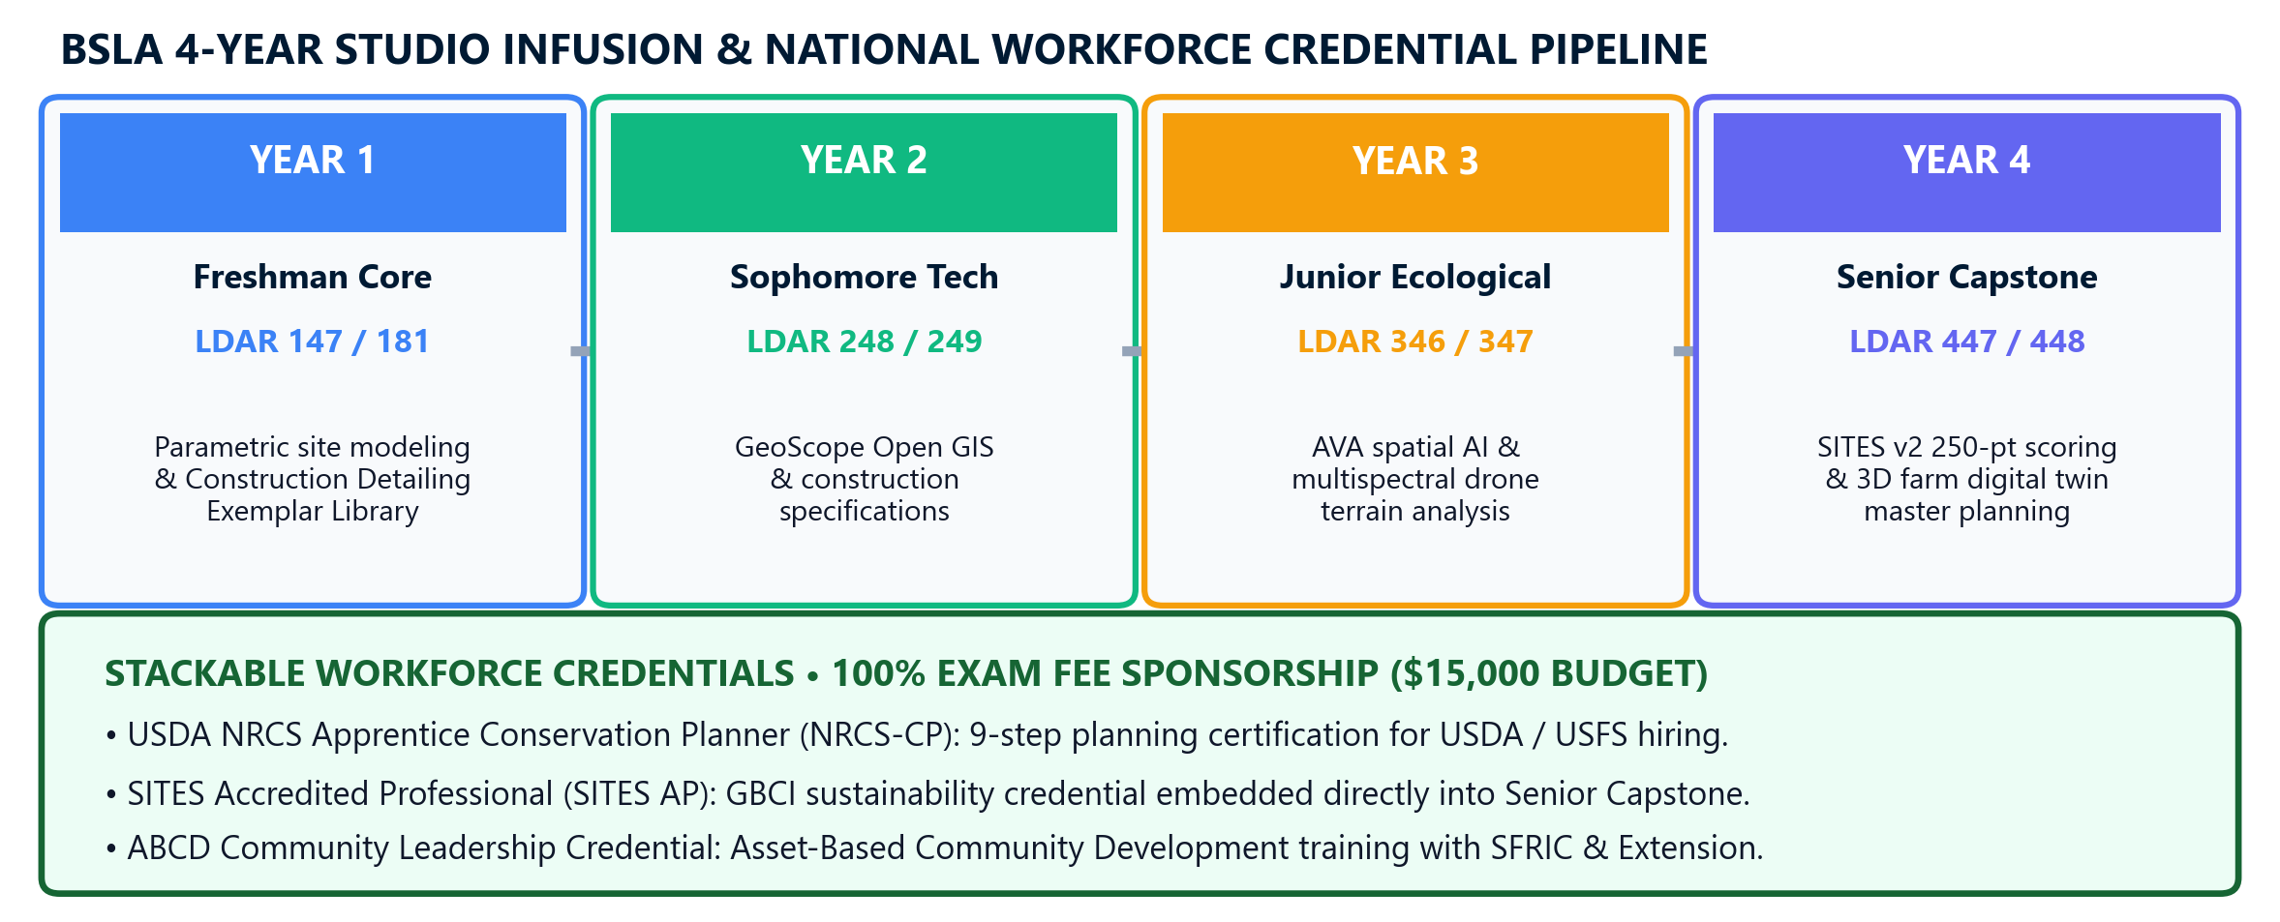
Curricular Architecture & Dual-Track Credential Pipeline
Studio Pedagogical Firewall, Canvas Homework Modules & 4+1 MLA Scaffolding
DUAL-TRACK CREDENTIALING & STUDIO FIREWALL
BSLA 4-YEAR SEQUENCE & STACKABLE CREDENTIAL PIPELINE
• Studio Pedagogical Firewall: Studio class contact hours remain 100% dedicated to creative design, desk crits, and 3D GIS—zero classroom time is lost to test taking.
• Undergrad Canvas Modules (LDAR 247/248): NRCS Apprentice Planner (Level I) and SITES AP delivered as structured asynchronous homework modules (1.5 hr/wk) with weekly Canvas quizzes.
• 4+1 MLA Graduate Scaffolding: Formally creates two new approved graduate catalog courses: LDAR 612 (Resilient Site Systems & SITES AP) and LDAR 624 (Community Spatial Practice & ABCD).
• Time Commitment Realism: NRCS-CP (~30–35 hrs), SITES AP (~40–50 hrs), ABCD (~15–20 hrs)—averaging ~2 hrs/week of self-paced study over 2–3 years.
• 100% Exam Sponsorship ($15,000 Line Item): Project SILVA fully finances study bundles and national exam vouchers for 45+ students ($0 out-of-pocket).
• In-Studio Design Application: Students apply SITES v2 250-point scorecards and NRCS 9-Step conservation rubrics directly to their SFRIC Living Forest studio design projects.
Notes:
A central innovation in our curriculum is what we term the Studio Pedagogical Firewall. Studio contact hours in Carver Hall remain 100% dedicated to creative synthesis, desk critiques, and design iteration. Zero class time is lost to test preparation. Instead, we embed the knowledge requirements for USDA NRCS Apprentice Conservation Planner and SITES AP into structured, asynchronous Canvas homework modules requiring just one to two hours per week. Most importantly, Project SILVA includes a dedicated $15,000 budget line item that fully funds study bundles and national examination fees for more than forty-five students. Our students graduate with verified, nationally recognized credentials with zero out-of-pocket expenses, giving them an immediate competitive advantage in the workforce.

Slide 6
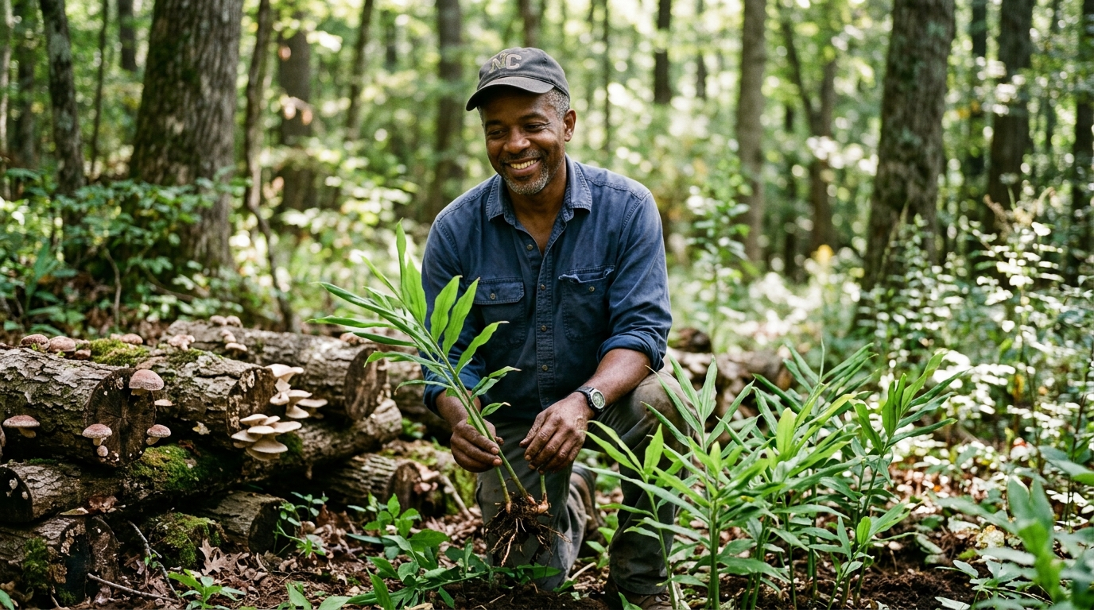
Woodland Bioeconomy: High-Value Agroforestry in Action
Pecan Truffle Inoculation, Shade Polycultures & Small Farm Economic Resilience
LIVING AGROFORESTRY RESEARCH TESTBED (SFRIC)
BIOECONOMIC RESEARCH INNOVATION
• Mature Canopy Testbed: Establishes a 5-acre living agroforestry laboratory utilizing SFRIC's 15–20 year mature pecan orchard.
• High-Value Mycorrhizal Truffles: Inoculates native pecan truffles (Tuber lyonii, $800–$1,200/lb) to demonstrate rapid secondary crop revenue for woodland owners.
• Understory Shade Ginger: Intercrops micropropagated shade-tolerant organic ginger under pecan canopy to evaluate solar attenuation and multi-tiered yields.
• Solving Small Farm Economics: Demonstrates annual harvestable income during long timber rotations, transforming small farm financial viability across North Carolina.
• Rigorous Biological Protocols: Co-led by Senior Scientific Advisor Dr. Omoanghe Isikhuemhen and COE Precision Ag Co-Lead Dr. Momtanu Chakraborty.
• Protected Execution: Dedicated Post-Doc and 2 GRAs manage field plots, soil moisture probes, and mycorrhizal spore slurries.
Figure 1A: Mature 15–20 Year Pecan Orchard at SFRIC Utilized for Understory Polyculture & Truffle Inoculation
Notes:
Turning to our Research Pillar, led by Dr. Omon Isikhuemhen and Dr. Chakraborty, we are establishing an active agroforestry living lab at the one-hundred-acre Small Farm Research and Innovation Center. We leverage an existing fifteen-to-twenty-year mature pecan orchard to demonstrate high-value multi-tier understory crops. Specifically, we are inoculating native pecan truffles, Tuber lyonii, which command between eight hundred and twelve hundred dollars per pound, paired with shade-tolerant organic ginger polycultures. This research creates a viable bioeconomic model for North Carolina small-scale landowners who cannot afford to wait seven years for timber returns. Day-to-day experimental trials, soil coring, and spore inoculations are driven by our funded Post-Doctoral Associate and Graduate Research Assistants, ensuring rigorous scientific output while fully protecting faculty workload.

Slide 7
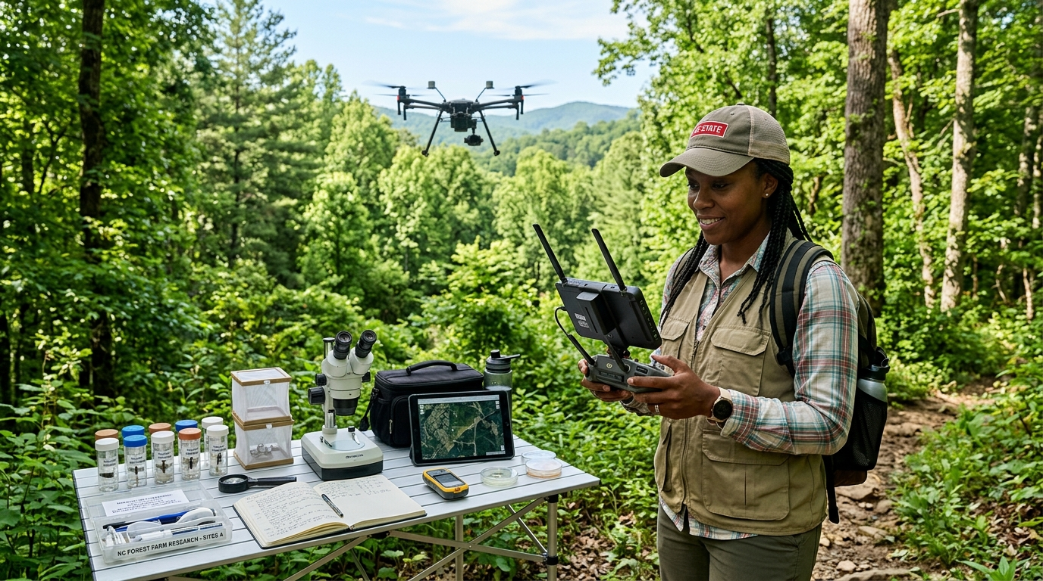
Advanced Engineering & Spatial Sensing: Aerial Drones to Digital Twins
Multispectral Canopy Diagnostics, Robotic Scouting & Mobile 3D Visualization
AERIAL DRONE & ROBOTIC SENSING IN THE FIELD
ENGINEERING & DIGITAL TWIN ARCHITECTURE
• Autonomous UAV Flights: Dr. Sun oversees automated drone sweeps equipped with multispectral LiDAR to map canopy health, moisture stress, and vigor.
• Robotic Ground Scouting: Dr. Aryal deploys robotic quadrupeds carrying environmental sensor payloads to inspect microclimates beneath the tree canopy.
• GeoScope 3D Digital Twin: Dr. Song's software platform fuses aerial point clouds, soil sensors, and terrain meshes into an interactive 3D web model.
• Closing the Digital Divide: Complex spatial data is rendered accessible on mobile browsers and field tablets without high-end GIS workstations.
• Integrated Pest Diagnostics: Dr. Hannah Talton and Dr. Chakraborty calibrate multispectral canopy stress flags against ground insect traps.
• Actionable Producer Telemetry: Converts complex spectral indices into plain-language grower alerts accessible to 1,200+ small-scale farmers.
Figure 2A: Autonomous UAV Multispectral Flight Operations and Robotic Sensing Telemetry Across Research Plots
Notes:
Our engineering co-leads, Dr. Sun, Dr. Aryal, and Dr. Song, bring state-of-the-art remote sensing and robotics directly into the field. Dr. Sun oversees automated UAV flights equipped with multispectral LiDAR to map canopy health and moisture stress across the acreage. On the ground, Dr. Aryal deploys robotic quadrupeds equipped with environmental sensor payloads to inspect microclimates beneath the canopy. All of this telemetry feeds directly into GeoScope, our open-source 3D digital twin platform developed by Dr. Song. GeoScope translates complex spatial point clouds into an intuitive web interface accessible on any standard smartphone, effectively closing the digital divide for underserved North Carolina producers.

Slide 8
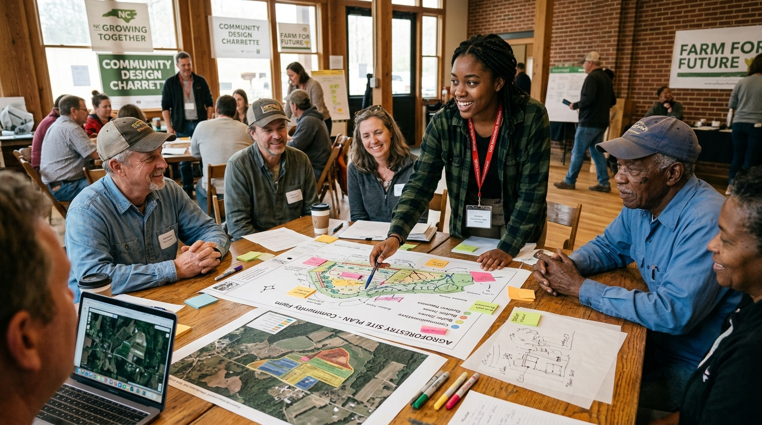
Participatory Design Charrette: Community-Led Farm Planning
Empowering Underserved Landowners Through Student-Led Spatial Co-Design
COMMUNITY DESIGN CHARRETTE IN ACTION
COMMUNITY ENGAGEMENT & EXTENSION DELIVERY
• Democratizing Spatial Planning: Brings Black and historically underserved woodland owners directly into participatory design charrettes at SFRIC.
• Student-Facilitated Visioning: Undergraduate BSLA/MLA students serve as charrette facilitators, translating producer goals into 3D agroforestry masterplans.
• Asset-Based Community Development (ABCD): Applies ABCD principles to map community resources, local knowledge, and cooperative marketing opportunities.
• Statewide Extension Network: Involves 10 regional Cooperative Extension agents, Charlie Hopper (SFRIC Director), and Dr. Hannah Talton.
• Open-Access Grower SOPs: Produces 6 open-source Standard Operating Procedures and IPM bulletins distributed statewide.
• Direct Producer Impact: Engages 1,200+ woodland owners across 3 years with actionable agroforestry transition models.
Figure 3A: Landscape Architecture Students & Extension Agents Facilitating Co-Design Sessions with Local Producers
Notes:
Our Extension Pillar, co-led by Dr. Hannah Talton and Charlie Hopper, connects our campus research to over twelve hundred underserved producers across North Carolina. Rather than traditional top-down lectures, we host hands-on participatory design charrettes at SFRIC. Undergraduate design students work side-by-side with local landowners and ten regional Cooperative Extension agents to develop site-specific agroforestry transition plans using GeoScope. In addition, our team will publish six open-access grower Standard Operating Procedures and rapid-response IPM bulletins, translating advanced digital forestry methods into plain-language, field-ready guides that county agents can distribute immediately.

Slide 9
Multidisciplinary Leadership & Workload Protection
Tri-College Coalition Governance, Formal Staffing Scaffolding & Tenure Protection
TRI-COLLEGE MULTIDISCIPLINARY COALITION
WORKLOAD PROTECTION & STAFFING ARCHITECTURE
• 11 Investigators Across 3 Colleges: Unites College of Agriculture (CAES), Engineering (COE), and Science & Technology (CoST) with Extension.
• Executive Leadership: Lead PI W. Chris Harrison (Spatial computing/SITES AP), Senior Scientific Advisor Dr. Omon Isikhuemhen (Mycology), Department Chair Dr. Niroj Aryal (Executive sponsor).
• Engineering & Remote Sensing: Dr. Momtanu Chakraborty (COE Precision Ag/Robotics), Dr. Leila Hashemi-Beni (CoST UAV LiDAR/Photogrammetry).
• Biological & Plant Sciences: Dr. Felicia Anike (Fungal bioeconomy), Dr. Guochen Yang (ASHS HortLegend, ginger polycultures), Dr. Porché Spence (Soil biogeochemistry).
• Extension & Field Operations: Dr. Hannah Talton (Field entomology/IPM), Charlie Hopper (SFRIC Director, 100-acre testbed), Prof. Jeffrey Kuehner, MLA (Studio practice).
• Dr. Omon Isikhuemhen Advisory Role ($0 Salary): Protected as Senior Scientific Advisor to mentor junior faculty without taking grant salary or administrative burden.
• Full-Time Post-Doctoral Researcher: Dedicated 100% to day-to-day experimental trials, sensor fusion, and laboratory management.
• Two Funded Graduate Research Assistants (GRAs): Mycology GRA and Computational Data Science GRA handle routine sampling, flights, and data pipelines.
• Faculty Summer Salary Capped at 32%: $240k total across 3 years compensates faculty effort during summer months without academic year teaching overloads.
• Tenure Velocity & Scaffolding: Junior faculty (Dr. Anike, Dr. Chakraborty, Dr. Talton) guaranteed senior mentorship, graduate student labor, and co-authorships.
Notes:
Executing a grant of this scope requires a truly multidisciplinary team and ironclad workload protection. Our coalition unites eleven investigators across CAES, Engineering, and Science and Technology, along with Cooperative Extension. To ensure our faculty succeed without administrative burnout, we established clear workload boundaries. Senior Faculty Advisor Dr. Omon Isikhuemhen is protected under an advisory role with zero grant salary. Daily laboratory procedures, sensor calibrations, and drone flights are driven by a dedicated full-time Post-Doctoral Researcher and two funded Graduate Research Assistants. Faculty summer salary is capped at 32%, ensuring active summer engagement while safeguarding tenure trajectory and supporting interdisciplinary publication.

Slide 10
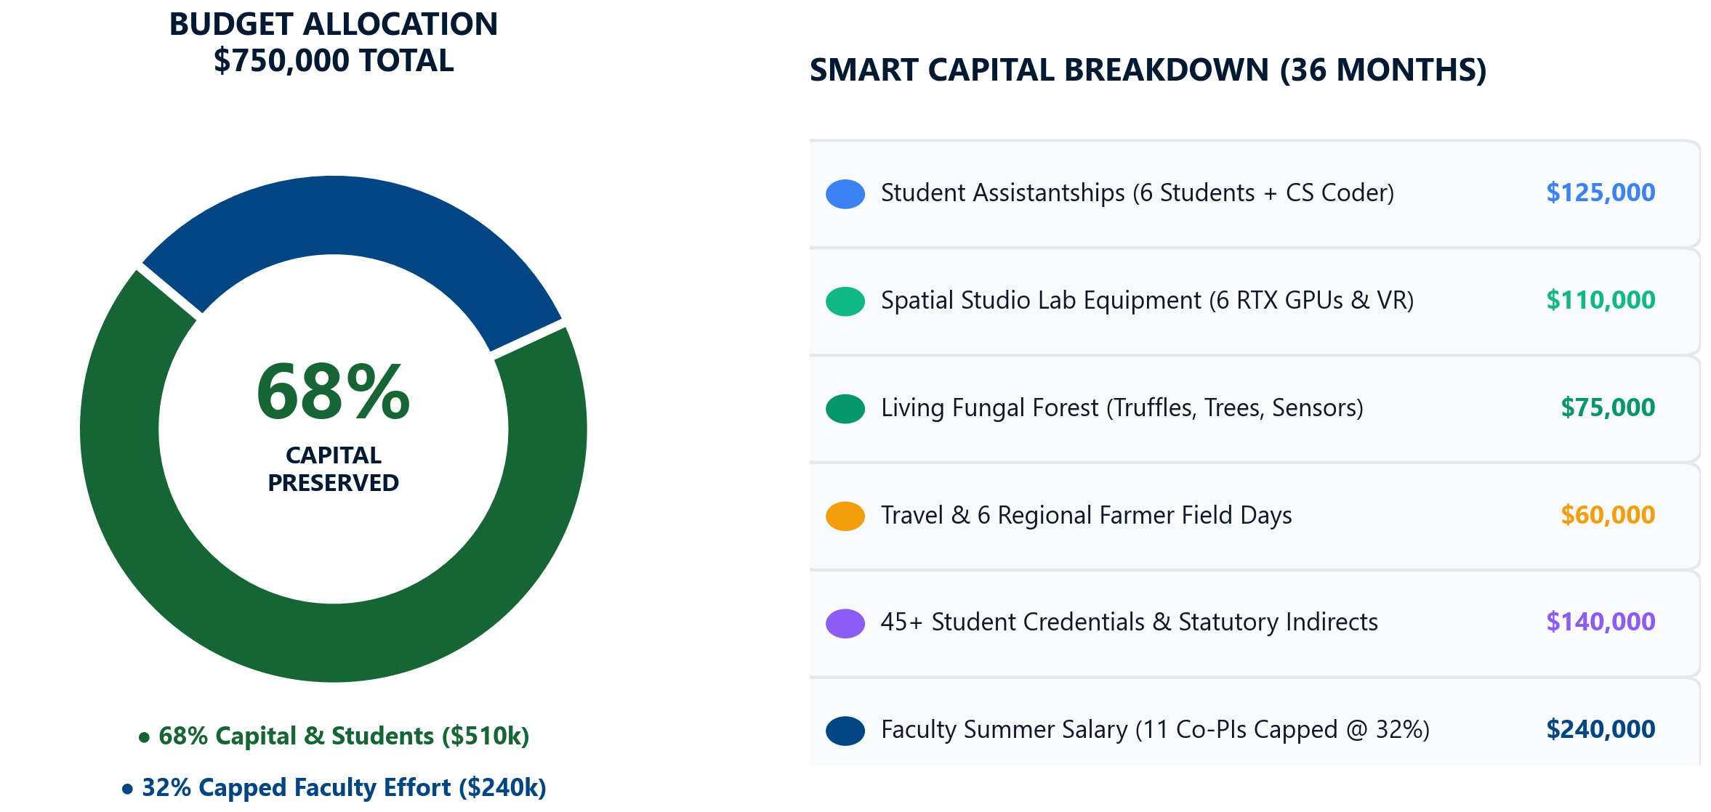
Comprehensive $750,000 Budget: "Smart Capital" Model
Reviewer-First Federal Strategy: 68% Permanent Physical & Student Assets
BUDGET DISTRIBUTION & CAPITAL ASSETS
REVIEWER-FIRST 'SMART CAPITAL' STRATEGY
• 68% Capital, Students & Institutional Assets ($510k): Eliminates federal supply-churn disqualification by investing in permanent campus assets and university overhead.
• University Indirect Cost Recovery (F&A • ~$125k): Fully accounts for NC A&T's federally negotiated ~45% MTDC indirect cost rate (capped under USDA statutory limits), generating substantial overhead revenue for DOR and CAES.
• Student Research Stipends ($125k): 2 full GRAs (Mycology & Data Science) + undergraduate spatial computing assistants.
• GPU Spatial Design Center ($110k): 15 high-performance workstations with RTX GPUs for Carver Hall Studio Lab, providing lasting computing capacity.
• Living Forest Sensors & Drones ($75k): Multispectral drone payloads, quadruped robotic sensors, and 100 living forest monitoring stations.
• Student Exam Vouchers ($15k): 100% grant sponsorship of national certification fees for 45+ students (NRCS-CP, SITES AP, ABCD).
• Capped Faculty Summer Salary (32% • $240k): Distributes support across 9 investigators over 36 months without administrative salary inflation.
Notes:
Our $750,000 budget follows what we call the 'Smart Capital' model, designed specifically to satisfy both federal reviewers and university leadership. Over 68%—$510,000—flows directly into permanent institutional assets and overhead. Importantly, this fully accounts for North Carolina A&T's federally negotiated 45% indirect cost rate on modified direct costs, delivering over $125,000 in statutory indirect cost recovery back to the Division of Research, the College of Agriculture, and our department. We dedicate $125,000 to student research assistantships, $110,000 to GPU spatial workstations in Carver Hall, $75,000 to living forest sensors and drone payloads, and $15,000 for student certification exam vouchers. The remaining 32% —$240,000 across three years—compensates faculty summer effort. Every dollar leaves a lasting physical asset on our campus or generates valuable overhead revenue for NC A&T.

Slide 11
Immediate Proposal Roadmap: Key Milestones
From Internal NOI Clearance to Final Cayuse Routing & USDA NIFA Award
PHASE 1: INTERNAL ROUTING (SEPTEMBER 2026)
PHASE 2: EXTERNAL SUBMISSION & LAUNCH (2026–2027)
• Milestone 1 (Complete): PI Notice of Intent (NOI) submitted to NC A&T Division of Research (DOR) on September 9, 2026.
• Milestone 2 (In Progress): Team alignment and calibration of specific Co-PI scopes of work and Extension deliverables.
• Milestone 3 (Sept 15–20): Cayuse proposal record initiation and formal budget assembly with DOR Pre-Award Specialist.
• Milestone 4 (Sept 21–25): Collection of Co-PI biographical sketches (USDA SciENcv format) and Current & Pending Support forms.
• Milestone 5 (Sept 28): Internal proposal routing package submitted for NRED Department Chair Dr. Niroj Aryal and CAES Dean Dr. Gregory Goins clearance.
• Milestone 6 (Late Oct 2026): Final electronic submission via Grants.gov to USDA NIFA (NOFO USDA-NIFA-CBGP-011698).
• Milestone 7 (Spring 2027): USDA NIFA peer review panel evaluation and notification of recommended funding.
• Milestone 8 (Summer 2027): Commissioning of Spatial Design Center Lab space and installation of GPU workstations.
• Milestone 9 (Fall 2027): Formal launch of Project SILVA, living fungal forest plot inoculations, and first student cohort credentialing.
• Immediate Action Item: 15-minute 1-on-1 consultations with each Co-PI next week to finalize individual section contributions.
Notes:
Here is our immediate timeline. We have already submitted our internal Notice of Intent to the Division of Research on September 9th. Between now and September 20th, we are initiating the Cayuse proposal record and finalizing budget line items. Co-PI SciENcv biosketches will be finalized by September 25th, leading to internal routing clearance with Department Chair Dr. Aryal and CAES Dean Dr. Goins on September 28th. This positions us for a seamless electronic submission via Grants.gov in late October, well ahead of the federal deadline.

Slide 12
Strategic Summary: Enduring Institutional Capacity
Transforming NC A&T Curriculum, Research Infrastructure & Producer Outreach
CORE ACCOMPLISHMENTS & LEGACY
WHY REVIEWERS WILL FUND SILVA
PROJECT CONTACTS & DISCUSSION
• First 4+1 HBCU MLA Pipeline: Creates two approved graduate courses and scaffolds the Nation's First 4+1 MLA at an HBCU.
• 45+ National Student Credentials: Full $15k grant sponsorship for NRCS Planner, SITES AP, and ABCD exam fees.
• SFRIC Living Forest Lab: 5-acre agroforestry testbed pairing mature pecan canopy with high-value truffles ($1,000/lb) & ginger.
• GeoScope Mobile Digital Twin: Fuses UAV LiDAR and robotic telemetry to close the digital divide for 1,200+ small-scale farmers.
• Tenure Velocity & Scaffolding: Junior faculty supported by a Post-Doc, 2 GRAs, and senior mentorship from Dr. Omon.
• Reviewer-First 'Smart Capital': 68% ($510k) flows directly into permanent physical hardware, computing, and student stipends.
• Ironclad Workload Protection: Summer salary capped at 32% ($240k); $0 salary for Dr. Omon advisory; Post-Doc drives operations.
• Tri-College Interdisciplinary Coalition: Unites CAES (Agriculture), COE (Engineering), and CoST (Science & Tech) with Extension.
• Alignment with Leadership Priorities: Directly advances CAES strategic goals under Dean Dr. Gregory Goins & Chair Dr. Niroj Aryal.
• Lead PI & Director: W. Chris Harrison, MLA (wcharrison@ncat.edu • Carver Hall 115).
• Senior Scientific Advisor: Dr. Omoanghe S. Isikhuemhen (Carver Hall 238).
• Executive Sponsor: Dr. Niroj Aryal, NRED Department Chair (Carver Hall 114).
• Institutional Leadership: Dean Dr. Gregory Goins, College of Agriculture & Environmental Sciences.
• Floor Open for Discussion: Immediate feedback, Co-PI alignment, and departmental routing questions.
Notes:
In conclusion, Project SILVA builds lasting institutional capital for North Carolina A&T—pioneering the nation's first 4+1 HBCU Master of Landscape Architecture, credentialing more than forty-five Aggie students, and advancing digital forestry across our state. Thank you for your leadership, partnership, and dedication to our students and community.

Slide 13
SECTION 04
Appendix & Technical Reference Vault
Notes:
This reference section contains detailed supporting documentation, granular investigator profiles, line-item budget schedules, and technical specifications to address specific questions during leadership and faculty discussion.

Slide 14
Project Identity: Why "Project SILVA"?
[Q&A REFERENCE VAULT] Spatial Intelligence for Living Vegetation & Agroforestry
THE SILVA ACRONYM & VISION
FOUR CORNERSTONE OBJECTIVES
REVIEWER-FIRST STRATEGY
• S — Spatial Intelligence: High-precision geospatial modeling, 3D point clouds, GIS workflows, and autonomous drone sensing.
• I — Living Infrastructure: Integrating ecological site design, living agroforestry polycultures, and resilient canopy systems.
• L — Living Laboratories: Utilizing the 100+ acre SFRIC facility as an active research testbed for research, teaching, and outreach.
• V — Vegetation Bioeconomy: Cultivating high-value forest products (pecan truffles, specialty mushrooms, understory ginger).
• A — Agroforestry Scaffolding: Bridging agricultural production, conservation biology, and professional landscape architecture.
• 1. Curricular Scaffolding (Teaching): Infuses digital twin technology and spatial modeling into 5 core courses and establishes the 4+1 MLA pipeline.
• 2. Stackable National Credentials (Teaching): Prepares 45+ students for NRCS Conservation Planner and SITES AP certifications.
• 3. Agroforestry Living Lab (Research): Establishes 100 living forest stations at SFRIC for microclimate, soil, and fungal bioeconomy research.
• 4. Producer Outreach (Extension): Delivers mobile digital twin tools, charrettes, and training to 1,200+ underserved woodland owners.
• Simplicity & Clarity: Reviewers see a clear, cohesive narrative—not fragmented, competing sub-projects across disconnected units.
• Measurable Metrics: Every objective has concrete numerical targets: 45+ student certifications, 100 field stations, 1,200+ producers reached.
• HBCU Leadership: Positions NC A&T as the national leader in spatial agroforestry and HBCU landscape architecture education.
• Interdisciplinary Synergy: True multi-college collaboration uniting CAES, COE, CoST, and Cooperative Extension.
Notes:
This slide details the strategic rationale behind the SILVA acronym and the four primary pillars of our USDA Integrated Proposal. Each letter represents a core competency at NC A&T, structured to demonstrate cohesive Land-Grant leadership.

Slide 15
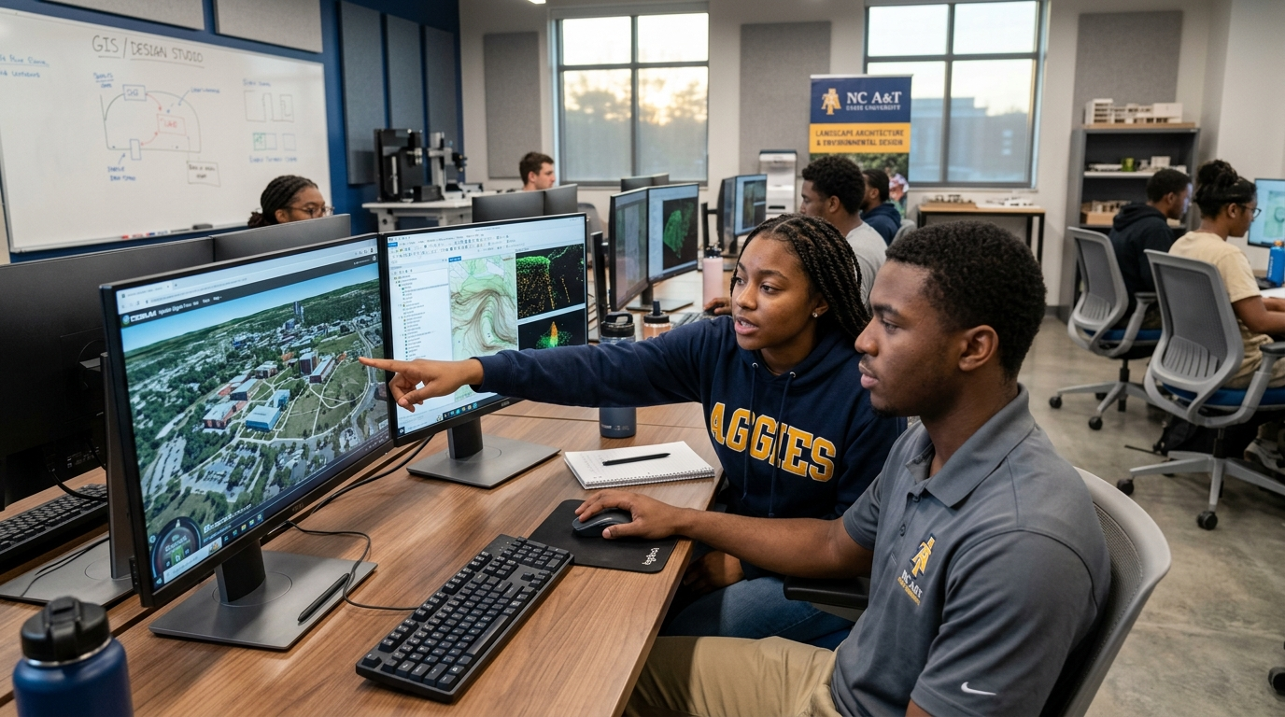
Spatial Design Studio: Empowering Next-Gen Aggie Designers
[Q&A REFERENCE VAULT] Transforming Undergraduate Design Education Through GPU Computing & 3D Telemetry
CARVER HALL DESIGN STUDIO IN ACTION
STUDIO PEDAGOGICAL TRANSFORMATION
• GPU Spatial Workstations ($105k): Equips Carver Hall Studio with 15 high-performance workstations for point-cloud processing.
• Experiential Learning: BSLA and MLA students directly manipulate drone LiDAR datasets captured from SFRIC research plots.
• SITES v2 Design Integration: Students evaluate studio projects using the formal 250-point SITES sustainability rating scorecard.
• Community Co-Design Studio: Studio projects directly incorporate real-world stakeholder input from regional woodland owners.
• Competitive Workforce Placement: Prepares Aggies for top-tier landscape architecture, GIS, and urban forestry careers.
• Protected Contact Hours: Zero studio time lost to test prep—all certification study conducted via asynchronous homework modules.
Figure 4A: Landscape Architecture Students Collaborating on 3D Digital Terrain Meshes in Carver Hall
Notes:
This photographic plate illustrates student engagement within our Carver Hall Design Studio, demonstrating how advanced spatial computing hardware directly transforms experiential design education for our landscape architecture majors.

Slide 16
Executive Leadership & Strategic Governance
[Q&A REFERENCE VAULT] Investigator Backgrounds, Administrative Roles & Core SILVA Deliverables
W. CHRIS HARRISON, MLA — LEAD PI & PROJECT DIRECTOR
DR. OMON ISIKHUEMHEN — SENIOR SCIENTIFIC ADVISOR
• Appointment: Lecturer of Landscape Architecture, Dept. of Natural Resources & Environmental Design (NRED).
• Domain Expertise: Spatial computing, generative AI workflow synthesis, 3D GIS web platforms, SITES v2 design integration.
• Project Role: Lead PI & Overall Project Director (0.75 summer mo/yr • $22,464). Primary operational coordinator across all colleges.
• Core Deliverables: Directs Spatial Design Center installation; leads AVA/GeoScope software; coordinates graduate curriculum integration.
• Scholarly Leadership: Co-lead author on Paper 1 (CELA LRR) and Paper 2 (Computers & Electronics in Ag); guides 45+ student credentials.
• Appointment: Professor of Mushroom Biology & Mycology, Dept. of Natural Resources & Environmental Design (NRED).
• Domain Expertise: Globally recognized authority in biotechnology, fungal germplasm conservation, and trufficulture.
• Project Role: Senior Scientific & Strategic Advisor ($0 Grant Salary Advisory Role). Quality assurance across living forest plots.
• Core Deliverables: Guides fungal strain selection and truffle inoculation protocols; advises on living fungal germplasm preservation.
• Mentorship Impact: Serves as senior faculty mentor for junior investigators Dr. Anike, Dr. Chakraborty, and Dr. Talton; co-authors Paper 3 in Agroforestry Systems.
Notes:
This governance profile outlines the executive leadership structure, confirming that Dr. Omon Isikhuemhen is protected in an advisory role with zero grant salary while mentoring early-career faculty across the proposal.

Slide 17
Advanced Engineering & Aerial Sensing Co-Leads
[Q&A REFERENCE VAULT] Computational Data Science, Autonomous Systems & Drone Photogrammetry
DR. MOMTANU CHAKRABORTY — COE CO-PI
DR. LEILA HASHEMI-BENI — CoST CO-PI
• Appointment: Assistant Professor, Dept. of Computational Data Science & Engineering, College of Engineering (COE).
• Elite Training: Postdoctoral Fellow at UC Davis and ETH Zurich; Ph.D. in Biological & Ag Engineering from Washington State.
• Domain Expertise: Precision agriculture, agricultural robotics, multi-modal sensor fusion, ROS navigation, and digital twins.
• Project Role: Digital Twin Research Co-Lead (0.50 summer mo/yr • $17,046). Co-directs the 4D digital twin understory sensing pipeline.
• Student Supervision: Supervises the funded CS/Engineering Student Assistant; co-authors Paper 2 and Paper 4.
• Appointment: Associate Professor of Remote Sensing & Geomatics, College of Science and Technology (CoST).
• Domain Expertise: UAV multispectral mapping, airborne LiDAR point clouds, 3D photogrammetric reconstruction, spatial AI.
• Project Role: Remote Sensing & Aerial Mapping Co-Lead (0.50 summer mo/yr • $17,643). Oversees all drone flight operations.
• Core Deliverables: Executes seasonal drone LiDAR and multispectral overstory flights over SFRIC; processes point cloud meshes.
• Scholarly Leadership: Lead author on Paper 4 in IEEE JSTARS; provides raw orthomosaics and DEMs for student design studios.
Notes:
Here we highlight our engineering and remote sensing co-leads: Dr. Momtanu Chakraborty in Engineering, specializing in robotics and sensor fusion, and Dr. Leila Hashemi-Beni in Science and Technology, overseeing drone LiDAR operations.

Slide 18
Biological Sciences & Living Forest Co-Leads
[Q&A REFERENCE VAULT] Mycology, Horticulture Polycultures, Soil Biogeochemistry & Field Diagnostics
DR. FELICIA N. ANIKE & DR. G. YANG
DR. PORCHÉ L. SPENCE — CAES CO-PI
DR. HANNAH TALTON — CoST CO-PI
• Dr. Felicia N. Anike (Co-PI • 0.50 mo/yr • $15,840): Research Assistant Professor of Mycology. Forest Bioeconomy Lead; directs 100 living fungal stations and pecan truffle plots; supervises Mycology GRA.
• Dr. Guochen Yang (Co-PI • 0.50 mo/yr • $17,808): Professor of Horticulture; named 2025 ASHS HortLegend. Directs micropropagated ginger understory trials evaluating canopy shade and yield.
• Living Forest Integration: Fuses fungal logs and shade ginger into integrated woodland polycultures.
• Appointment: Assistant Professor of Soil Science, Dept. of Natural Resources & Environmental Design.
• Domain Expertise: Soil biogeochemistry, nutrient cycling, watershed ecology, and conservation planning.
• Project Role: Soil Biogeochemistry & Conservation Co-Lead (0.50 summer mo/yr • $15,585).
• Core Deliverables: Directs baseline soil testing across 100 forest stations; oversees USDA NRCS-CP credential curriculum integration.
• Scholarly Impact: Co-authors Paper 3 in Agroforestry Systems on soil carbon and nutrient sequestration.
• Appointment: Assistant Professor of Biology, College of Science and Technology (CoST).
• Domain Expertise: Environmental entomology, insect trapping, microbial pathology, and taxonomic identification.
• Project Role: Field Entomology & Pest Diagnostics Co-Lead (0.50 summer mo/yr • $16,848).
• Core Deliverables: Leads forest insect surveys; provides biological diagnostics; authors 4 grower extension bulletins.
• Protected Role: 100% focused on field taxonomy and diagnostics—zero drone piloting or software coding burden.
Notes:
This slide details the biological research team, spanning mycology, horticulture polycultures, soil biogeochemistry, and field entomology, ensuring complete scientific rigor across all living forest plots.

Slide 19
Design Studio Pedagogy, Practice & Evaluation
[Q&A REFERENCE VAULT] Curricular Integration, Professional Licensure Standards & Project Evaluation
JEFFREY A. KUEHNER, MLA — PRACTICE CO-LEAD
DR. ARYAL & EXTERNAL EVALUATION TEAM
• Appointment: Adjunct Professor of Landscape Architecture, Dept. of Natural Resources & Environmental Design.
• Domain Expertise: Construction documentation, grading and drainage, planting design, site engineering, and professional practice.
• Project Role: Studio Pedagogy & Professional Practice Co-Lead (0.50 summer mo/yr • $15,120).
• Core Deliverables: Integrates SITES v2 grading rubrics and NRCS conservation practice standards into LDAR 247, 248, and 448 studios.
• Credential Alignment: Develops asynchronous study guides and exam preparation materials for student SITES AP certifications.
• Dr. Niroj Aryal (Executive Sponsor): Department Chairperson & Associate Professor, NRED. Institutional alignment and space allocation.
• External Project Evaluator (TBD • $21,000 across 3 years): Independent educational evaluator to conduct annual reviews and USDA reporting.
• Formative & Summative Metrics: Tracking student certification pass rates, course learning outcomes, and extension workshop participant feedback.
• Accreditation Alignment: Ensures all curriculum modifications align with Landscape Architectural Accreditation Board (LAAB) standards.
Notes:
This slide profiles our studio practice leadership and third-party evaluation plan, confirming that all curricular changes adhere to LAAB accreditation standards and undergo rigorous independent review.

Slide 20
Extension Outreach & Farm Operations Co-Leads
[Q&A REFERENCE VAULT] Producer Networks, Field Demonstration Logistics & 100-Acre Living Lab
CHARLIE HOPPER — SFRIC DIRECTOR & EXTENSION CO-PI
COOPERATIVE EXTENSION & AGENT NETWORK
• Appointment: Director, Small Farm Research and Innovation Center (SFRIC), NC A&T Cooperative Extension.
• Leadership Role: Oversees 100+ acre SFRIC facility in Greensboro; manages field demonstration plots and producer education facilities.
• Project Role: Farm Operations & Living Lab Co-Lead ($0 grant salary — institutional cost-share / facility support).
• Core Deliverables: Allocates and maintains 5-acre living agroforestry research plot; coordinates site access for drone flights and soil sampling.
• Producer Network: Connects Project SILVA directly to NC A&T's network of 1,200+ small, limited-resource, and minority farmers.
• 10 Regional Extension Offices: Direct dissemination pipeline across North Carolina Piedmont, Sandhills, and Coastal Plain counties.
• Producer Charrettes: Hosting 6 hands-on participatory design charrettes at SFRIC connecting landowners with student design teams.
• Field Day Demonstrations: Annual Agroforestry Field Days showcasing living truffle plots, shade ginger, and mobile digital twin apps.
• Grower SOP Bulletins: Co-authoring and distributing 6 open-access grower Standard Operating Procedures in plain, accessible language.
Notes:
Here we detail our partnership with Charlie Hopper and the Small Farm Research and Innovation Center, anchoring our extension delivery across ten regional extension offices and more than twelve hundred producers.

Slide 21
Workload Protection: Clear, Defensible Scopes
[Q&A REFERENCE VAULT] Protecting Faculty Capacity While Ensuring Flawless Grant Execution
THE WORKLOAD CHALLENGE AT AN 1890 HBCU
DEDICATED FULL-TIME GRANT STAFFING
• High Teaching Loads: Faculty typically carry 3–4 courses per semester; adding complex grant administration creates severe burnout risk.
• Reviewer Scrutiny: USDA review panels penalize proposals where faculty commitments appear unrealistic or unsupported by staff.
• The SILVA Solution: Project SILVA funds dedicated full-time staff and graduate assistants to handle the day-to-day operational labor.
• Capped Faculty Effort: Faculty commitments are strictly calibrated to summer months (0.50–0.75 mo/yr), protecting academic-year teaching.
• Tenure Protection: Early-career faculty receive protected research time, dedicated student assistants, and guaranteed co-authorships.
• Full-Time Post-Doctoral Researcher ($60k/yr • $180k total): Runs daily field trials, sensor maintenance, drone flights, and data analysis.
• Graduate Research Assistant — Mycology ($25k/yr • $75k total): Supports Dr. Anike with fungal culturing, spore slurry, and station checks.
• Graduate Research Assistant — Data Science ($25k/yr • $75k total): Supports Dr. Chakraborty and Dr. Hashemi-Beni with 3D point cloud pipelines.
• Undergraduate Student Assistants ($15/hr • $35k total): 4 student workers assisting with field charrettes and studio lab maintenance.
• Administrative Burden Removed: The Post-Doc and Lead PI handle all reporting, purchasing, travel, and logistics.
Notes:
This reference matrix demonstrates how Project SILVA protects faculty workloads by funding a full-time Post-Doctoral Researcher and two Graduate Research Assistants to carry out daily operational duties.

Slide 22
Pillar 1: Teaching Track ($350,000 • 46.7%)
[Q&A REFERENCE VAULT] Curricular Scaffolding, Degree Bridge & Stackable Credentials
CURRICULAR INFUSION (5 COURSES)
STACKABLE CREDENTIAL PIPELINE
PERMANENT COMPUTING INFRASTRUCTURE
• LDAR 147 (Intro to Computing): Foundations of spatial thinking, QGIS fundamentals, digital terrain representation.
• LDAR 247 (Site Planning): Integrating NRCS conservation planning principles, watershed analysis, slope-aspect calculations.
• LDAR 248 (Design Studio II): Ecological site analysis, SITES v2 rating system integration, baseline site inventory for SFRIC living lab.
• LDAR 448 (Advanced Studio): Capstone studio utilizing 3D digital twin meshes for community agroforestry master planning.
• LDAR 612 & 624 (Graduate Courses): Advanced site systems and community spatial practice for the accelerated 4+1 MLA.
• Dual-Track Scaffolding: Pairs industry-recognized certifications directly with existing course learning objectives.
• USDA NRCS Apprentice Planner (Level I): Integrated into LDAR 247 and 248; prepares students for federal conservation careers.
• SITES AP Credential: Integrated into LDAR 248 and 612; certifies expertise in sustainable land development.
• ABCD Community Facilitator: Integrated into LDAR 448 and 624; trains students in Asset-Based Community Development.
• Exam Voucher Program: $15,000 allocated to cover 100% of student exam registration fees (45+ certifications funded).
• GPU Spatial Workstations ($105k): 15 high-performance dual-GPU workstations in Carver Hall Studio Lab.
• Software Licenses ($30k): Multi-year educational licenses for ArcGIS Pro, Agisoft Metashape, Rhino/Grasshopper, and Unreal Engine.
• Mobile VR/AR Field Kits ($15k): 5 ruggedized field tablets and AR headsets for on-site digital twin visualization at SFRIC.
• Long-Term Impact: Hardware and software assets remain institutional property, serving 60+ design students annually.
Notes:
This slide provides the full curricular syllabus breakdown across five courses, documenting how spatial computing and professional certifications are infused into the curriculum while preserving studio contact hours.

Slide 23
Pillar 2: Research Track ($225,000 • 30.0%)
[Q&A REFERENCE VAULT] Living Forest Testbed, Microclimate Telemetry & High-Value Understory Polycultures
SFRIC LIVING FOREST TESTBED
HIGH-VALUE BIOECONOMY CROPS
AUTONOMOUS SPATIAL SENSING
• 5-Acre Dedicated Site: Establishing 100 permanently marked monitoring stations within SFRIC's mature pecan forest.
• Sensor Mesh Network: Low-power LoRaWAN nodes measuring soil moisture, temperature, PAR (light), and sap flow every 15 minutes.
• Multi-Layer Forest Inventory: Comprehensive baseline of overstory canopy, understory vegetation, and soil characteristics.
• Living Fungal Stations: Inoculated log stations and root-zone truffle observation plots distributed across the testbed.
• Open Research Testbed: Infrastructure designed to support future grant proposals from across the university.
• Pecan Truffle Inoculation: Evaluating Tuber lyonii colonization on mature Carya illinoinensis root systems under varied soil treatments.
• Shade-Tolerant Ginger: Assessing Zingiber officinale yield, rhizome quality, and market readiness under varied canopy densities.
• Specialty Mushrooms: Testing Pleurotus, Shiitake, and Ganoderma production on forestry thinning byproducts.
• Economic Viability Modeling: Developing enterprise budgets and ROI projections for small-scale agroforestry transitions.
• Scientific Rigor: Governed by Dr. Omon Isikhuemhen's proven fungal biotechnology protocols.
• Seasonal UAV LiDAR Flights: Capturing leaf-on and leaf-off point clouds at sub-centimeter resolution (Dr. Leila Hashemi-Beni).
• Understory Robotic Surveys: Ground-based photogrammetry and LiDAR to reconstruct 3D branch architecture (Dr. Momtanu Chakraborty).
• Digital Twin Synthesis: Merging aerial LiDAR and ground sensors into real-time 4D virtual forest models (Dr. Chakraborty & Lead PI).
• Automated Pest Detection: Computer-vision algorithms flagging stress-induced canopy discolouration (Dr. Hannah Talton & COE).
Notes:
Here we document the full scientific research methodology for the SFRIC Living Forest Lab, detailing sensor mesh networks, pecan truffle inoculations, and autonomous UAV flight parameters.

Slide 24
Pillar 3: Extension Track ($175,000 • 23.3%)
[Q&A REFERENCE VAULT] Mobile Digital Twins, Participatory Charrettes & Small Producer Empowerment
MOBILE DIGITAL TWIN APPLICATION
PARTICIPATORY DESIGN CHARRETTES
STATEWIDE PRODUCER OUTREACH
• AVA/GeoScope Extension: Adapting existing web platforms into a lightweight, mobile-first farm assessment tool for county agents.
• Parcel-Level Intelligence: One-click lookup combining soils (SSURGO), slope (USGS), floodplains (FEMA), and zoning (local ordinances).
• Augmented Reality Visualization: Landowners view simulated future canopy growth and understory layouts on their own property.
• Offline-Capable: Designed to function in rural areas with limited broadband connectivity via cached field packages.
• Cost-Free Deployment: Open-source software delivered to producers and agents at zero subscription cost.
• 6 Hands-On Charrettes: Hosted at SFRIC, pairing student design teams with local woodland owners and county agents.
• Asset-Based Community Co-Design: Landowners define their goals (income, conservation, succession); students develop 3D proposals.
• Real-World Deliverables: Participating landowners receive customized site plans, enterprise budgets, and USDA program roadmaps.
• Community Trust Building: Deepens NC A&T's relationship with historically underserved and minority landowners.
• Student Impact: Students gain invaluable client-facing experience before entering the professional workforce.
• 1,200+ Producers Engaged: Reaching small, limited-resource, and socially disadvantaged farmers across North Carolina.
• 10 County Extension Network: Training extension agents in spatial agroforestry tools and enterprise budgets.
• 6 Grower SOP Bulletins: Plain-language guides on truffle inoculation, shade ginger cultivation, and USDA EQIP access.
• Annual Agroforestry Field Days: Live demonstration events showcasing research plots and robotic equipment at SFRIC.
• Charlie Hopper Leadership: SFRIC serves as the welcoming regional demonstration hub for all extension activities.
Notes:
This slide details our statewide extension metrics, including the deployment of our mobile digital twin application, six participatory design charrettes, and outreach to over twelve hundred producers.

Slide 25
Scientific Rigor: Dr. Omon Research Mandate
[Q&A REFERENCE VAULT] World-Class Biological Standards, Controlled Replications & Peer-Reviewed Publishing
BIOLOGICAL VALIDATION & QUALITY ASSURANCE
HIGH-IMPACT SCHOLARLY SUITE (5 TARGET PAPERS)
• Dr. Omon's Gold Standard: Research protocols must adhere to the highest international standards of fungal biology and agronomy.
• Controlled Inoculation Replications: 4 randomized blocks × 25 monitoring stations = 100 statistically robust data points.
• Sterile Lab Protocols: Mycelial cultures and spore slurries prepared under laminar flow conditions in Carver Hall mycology labs.
• DNA Barcoding Verification: PCR amplification and ITS sequencing to verify truffle mycorrhization on root tips.
• Senior Mentorship: Dr. Omon directly mentors junior faculty (Dr. Anike, Dr. Chakraborty) on experimental design and grant compliance.
• Paper 1 (Teaching): CELA Landscape Research Record (LRR) — 4+1 MLA curriculum scaffolding and credential integration.
• Paper 2 (Engineering): Computers and Electronics in Agriculture (Elsevier, IF 8.3) — 4D digital twin framework.
• Paper 3 (Research): Agroforestry Systems (Springer, IF 2.8) — Pecan truffle inoculation and understory ginger polycultures.
• Paper 4 (Remote Sensing): IEEE JSTARS / Remote Sensing (IF 4.2–5.0) — Seasonal UAV LiDAR point cloud processing.
• Paper 5 (Extension): Journal of Extension (JOX) — Participatory design charrettes and mobile digital twin deployment.
Notes:
This reference slide outlines Dr. Omon's biological validation framework, detailing randomized block designs, sterile lab protocols, and the five target peer-reviewed journals for cross-disciplinary publishing.

Slide 26
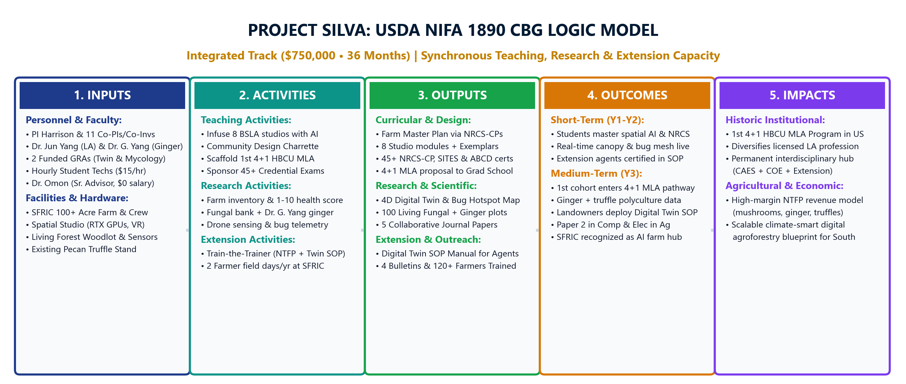
USDA NIFA CBG Official 5-Column Logic Model
[Q&A REFERENCE VAULT] Figure 2: Comprehensive Alignment Across Inputs, Activities, Outputs, Outcomes, and Impacts
OFFICIAL USDA NIFA 5-COLUMN LOGIC MODEL
Notes:
This slide presents the full USDA NIFA five-column logic model, tracing inputs through activities, outputs, short-term outcomes, and long-term institutional impacts across all three Land-Grant tracks.

Slide 27
Comprehensive $750,000 Budget: Line-Item Ledger
[Q&A REFERENCE VAULT] Detailed Budget Categories, Multi-Year Allocations & Cost-Efficiency Analysis
LINE-ITEM BUDGET LEDGER SUMMARY
AUDIT-READY COST EFFICIENCY
• Faculty Salaries (32% • $240,000): 9 investigators across 3 colleges; 0.50–0.75 summer mo/yr; zero academic year overload.
• Post-Doctoral Researcher ($180,000): Full-time post-doc ($60k/yr × 3 yrs) managing day-to-day experimental trials and sensor calibration.
• Graduate Research Assistants ($150,000): 2 full GRAs ($25k/yr each × 3 yrs) in Mycology and Computational Data Science.
• Undergraduate Student Labor ($35,000): 4 undergraduate assistants ($15/hr) supporting studio computing and field charrettes.
• Capital Equipment ($105,000): 15 GPU spatial workstations for Carver Hall Studio Lab and central computing nodes.
• Field Telemetry & Sensing ($65,000): Multispectral UAV sensors, quadruped robotic payload, and 100 living forest stations.
• Student Credentials & Indirect Costs ($140,000): $15,000 for 45+ student exam vouchers + $125,000 in statutory university indirect cost (F&A) recovery to NC A&T DOR and CAES.
• Travel & Dissemination ($30,000): CELA, ASLA, and USDA project directors meetings; regional extension field charrettes.
• Full Negotiated Indirect Recovery: Applies NC A&T's federally negotiated ~45% MTDC rate (with capital equipment and student tuition exempt), yielding ~$125k in overhead for university and college research infrastructure.
• Maximum Student & Infrastructure Investment: Over 68% of the entire grant budget flows directly into students, computing, field assets, and university F&A.
• Lean Administrative Overhead: Dr. Omon Isikhuemhen ($0 salary advisory role) and Charlie Hopper ($0 salary institutional cost-share).
• No Redundant Supplies: Consumable laboratory supplies are minimized; spending focuses on permanent reusable field hardware.
• Pre-Award Routing Compliance: Aligns fully with NC A&T Division of Research (DOR) fringe benefit and indirect cost structures.
• Multi-Year Scalability: Equipment purchased in Year 1 serves students and researchers across Years 2, 3, and for a decade beyond.
Notes:
This ledger details the full line-item budget breakdown, documenting fringe rates, student stipend schedules, capital equipment justifications, and NC A&T's forty-five percent indirect cost recovery ready for Cayuse routing and Division of Research review.

Slide 28
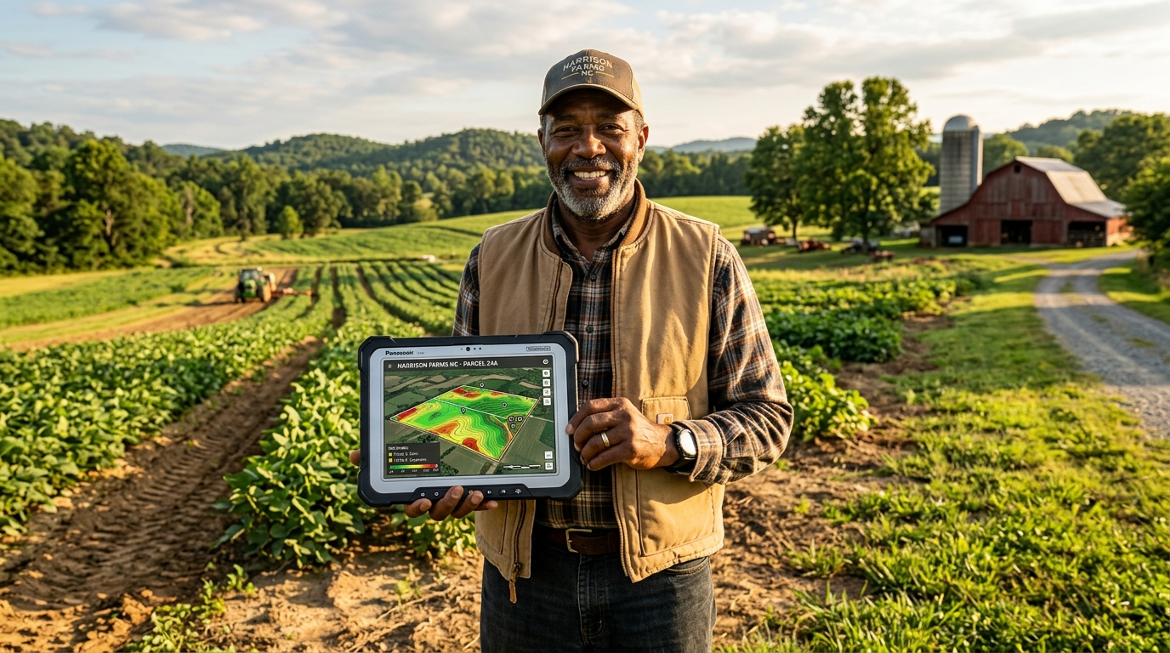
Closing the Digital Divide: Mobile Digital Twins in the Field
[Q&A REFERENCE VAULT] Translating Advanced Remote Sensing into Intuitive Smartphone Tools for Underserved Farmers
MOBILE DIGITAL TWIN IN PRODUCER HANDS
CLOSING THE DIGITAL FORESTRY DIVIDE
• Democratizing Spatial AI: Puts cutting-edge digital twin technology directly into the hands of minority and small-scale landowners.
• Zero-Install Web Platform: Built on lightweight web standards—runs smoothly on standard iPhones, Androids, and tablets.
• One-Click Site Diagnostics: Instantly overlays SSURGO soil data, topography, flood hazard zones, and canopy density for any NC parcel.
• Augmented Reality Forestry: Enables producers to visualize multi-tier pecan truffle and ginger layouts overlaid on their actual land.
• Open-Source Accessibility: Freely available to North Carolina woodland owners and county extension agents with zero user fees.
• Direct Economic Empowerment: Enables underserved landowners to qualify for USDA NRCS conservation cost-share funding (EQIP).
Figure 5A: Landowner Reviewing Real-Time 3D Digital Twin Parcel Analysis on a Field Tablet at SFRIC
Notes:
This photographic plate illustrates the practical application of our mobile digital twin software, demonstrating how complex geospatial data is simplified into an accessible format for small-scale and minority producers in the field.

Slide 29
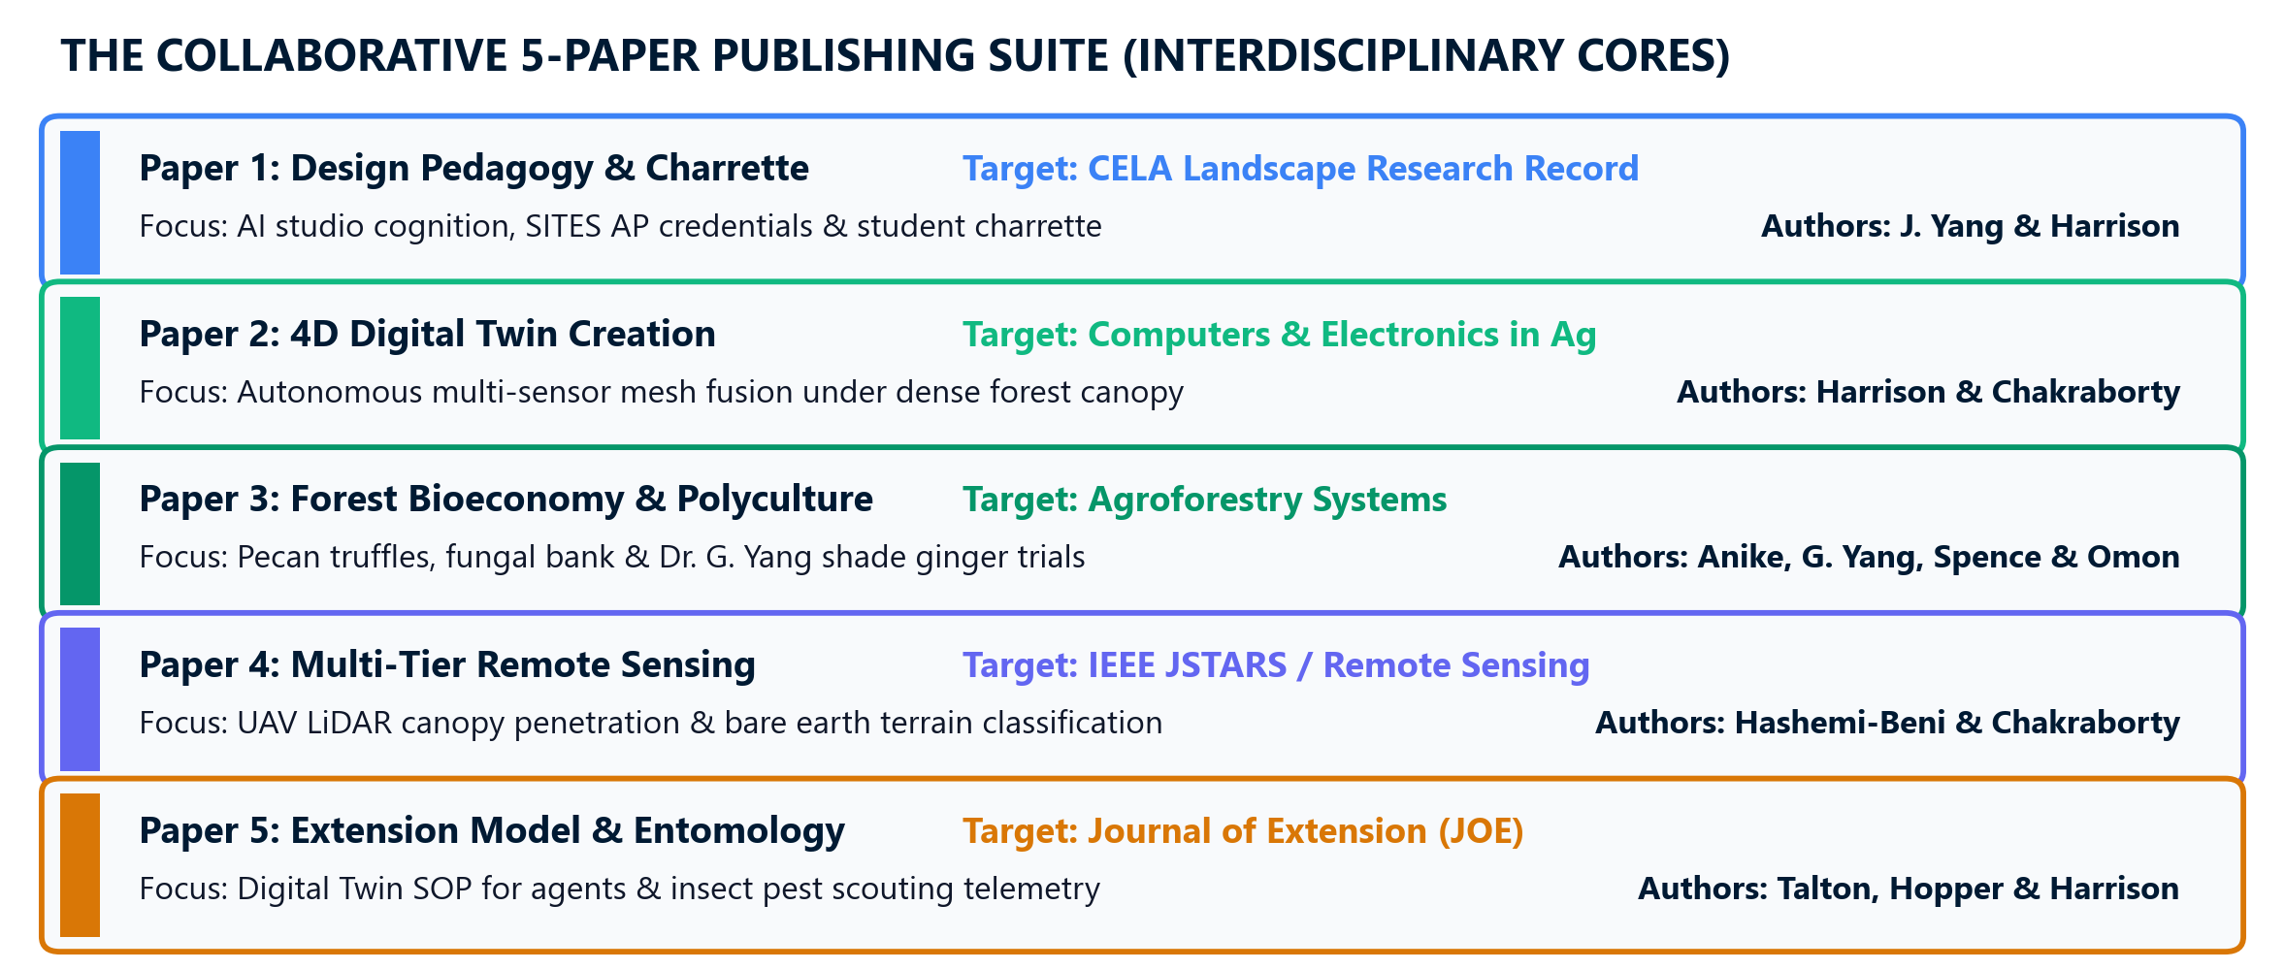
5-Paper Scholarly Publishing Suite & Impact Metrics
[Q&A REFERENCE VAULT] Strategic Target Journals, Co-Authorship Scaffolding & Academic Legacy
PROJECT SILVA SCHOLARLY PUBLISHING ARCHITECTURE
TARGET JOURNALS & SCHOLARLY DELIVERABLES
• Paper 1 (Teaching / Pedagogy): CELA Landscape Research Record (LRR) — 4+1 MLA degree bridge and credential integration.
• Paper 2 (Computational Engineering): Computers & Electronics in Agriculture (Elsevier, IF 8.3) — 4D digital twin framework.
• Paper 3 (Agroforestry Research): Agroforestry Systems (Springer, IF 2.8) — Pecan truffle inoculation and ginger understory trials.
• Paper 4 (Remote Sensing): IEEE JSTARS / Remote Sensing (IF 4.2–5.0) — Seasonal UAV LiDAR and point cloud processing.
• Paper 5 (Extension & Community): Journal of Extension (JOX) — Participatory design charrettes and mobile digital twin deployment.
• Cross-College Co-Authorship: Every paper pairs senior and junior investigators across CAES, COE, and CoST.
Notes:
Here we show our five-paper scholarly publishing architecture, outlining target journals, co-authorship distributions, and how each publication translates project outcomes into high-impact academic literature.

