Slide 1
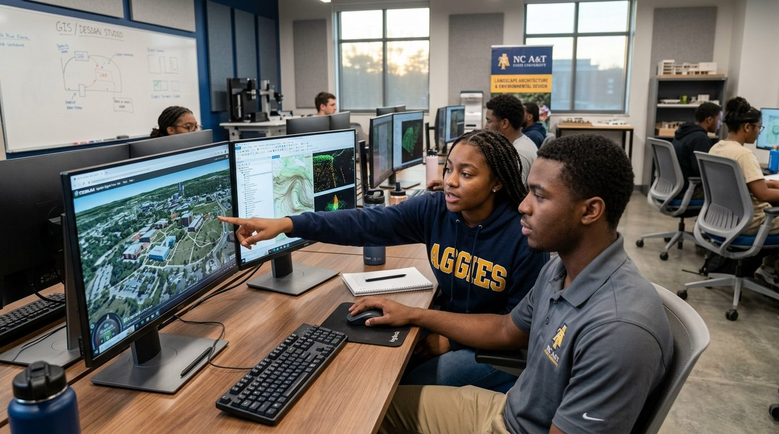
NC A&T LANDSCAPE ARCHITECTURE
Design the world around you.
Bachelor of Science in Landscape Architecture
College of Agriculture & Environmental Sciences
Notes:
Hi everyone! We're students in the Landscape Architecture program at North Carolina A&T State University. Today we want to show you a career where you get to design the places people live, play and grow, and why A&T is the place to learn it.

Slide 2
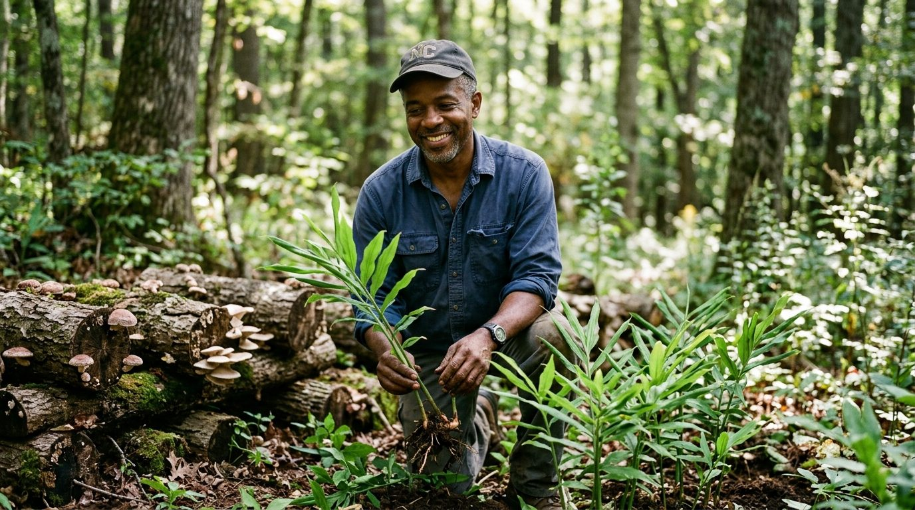
WHAT IS IT?
What is landscape architecture?
The art and science of designing outdoor places, so they work for people and for nature.
Part artist. Part scientist. Part engineer. All about people.
Notes:
So what is landscape architecture? It's the art and science of designing outdoor places. Every park you've played in, every campus quad, every greenway and plaza was designed by someone. Landscape architects blend art, nature, engineering and people to make those places work.

Slide 3
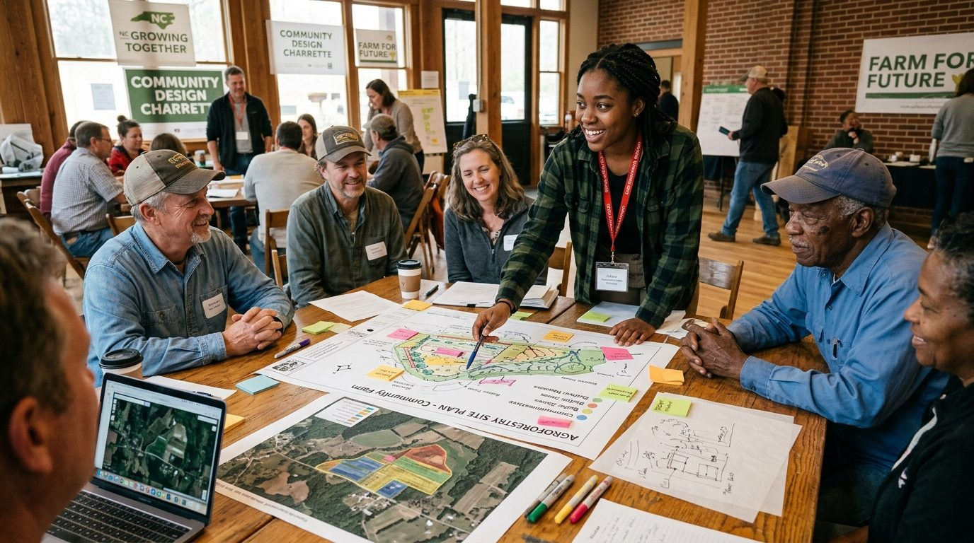
What could you design?
Parks & playgrounds
Campuses & plazas
Green streets & trails
Stormwater & wetlands
Farms & food landscapes
Whole neighborhoods
Notes:
Here's what landscape architects actually design: parks and playgrounds, college campuses, green streets and trails, stormwater wetlands that clean our water, farms and food landscapes, and even entire neighborhoods. If it's outside, a landscape architect probably shaped it.

Slide 4

OUR STORY
Five decades of firsts
1976
1989
1992
2008
2024
2026
Program founded by Dr. Charles A. Fountain
Perry Howard named program director
First accredited LA program at an HBCU
Howard becomes first African American ASLA president
Accreditation renewed; Howard receives the ASLA Medal
New High-Tech, High-Touch curriculum launches
Notes:
Our program has a proud history. It was founded in 1976 by Dr. Charles Fountain. In 1989, Perry Howard became director, and in 1992 we became the first accredited landscape architecture program at any HBCU. Professor Howard went on to become the first African American president of the American Society of Landscape Architects in 2008, and he received the ASLA Medal in 2024. That same year our accreditation was renewed, and in 2026 we launched a brand-new curriculum.

Slide 5

1 of 1
The only accredited undergraduate landscape architecture program at any HBCU in the nation.
Notes:
And here's what makes A&T special: we are the only accredited undergraduate landscape architecture program at any HBCU in the entire country. One of one. If you want this degree at an HBCU, this is the place.

Slide 6
STUDIO LIFE
Where ideas become designs
Sketch, model, critique, repeat
Learn in a cohort with your class year
Small studios: about 15 students per instructor
A faculty lead for every class year
Notes:
Most of our learning happens in studio. That's where we sketch, build models, design on the computer and present our ideas to classmates and professors. Each class year moves through the program together as a cohort, with its own faculty lead, so you're never on your own.

Slide 7
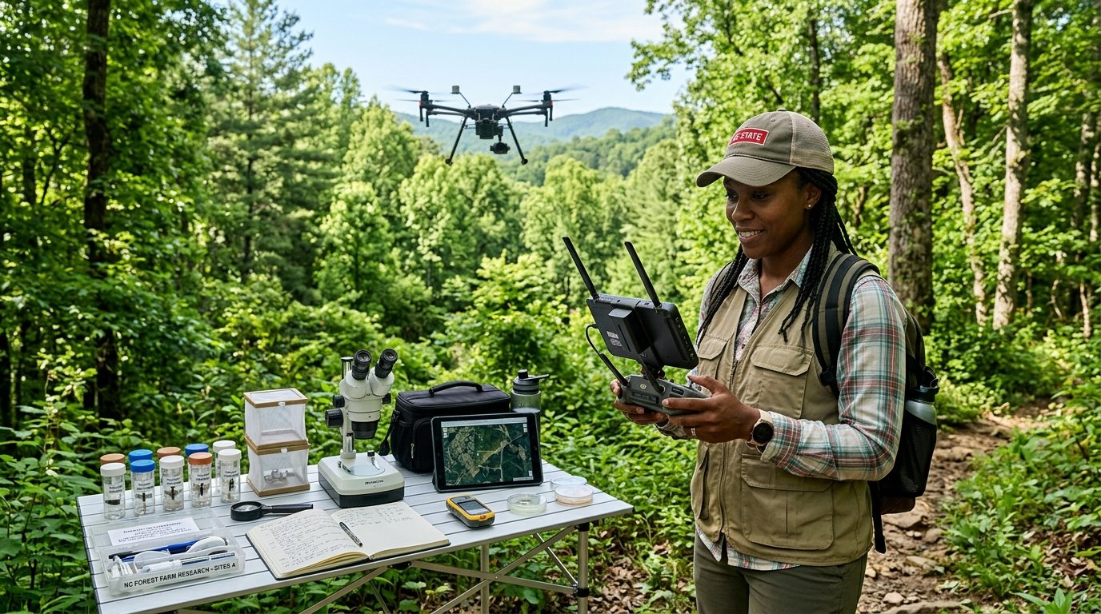
TOOLS YOU'LL USE
High-tech. High-touch.
Hand drawing & model making
AutoCAD Civil 3D, SketchUp, Adobe CC, Land F/X
GIS mapping & drone surveys
3D digital twins & AI site analysis
Notes:
You'll learn by hand and by computer. We start with drawing and sketching, then add the same software professionals use: AutoCAD Civil 3D, SketchUp, Adobe Creative Cloud and Land F/X. You'll also work with GIS mapping, drones and 3D digital twins, and even AI tools for site analysis.

Slide 8
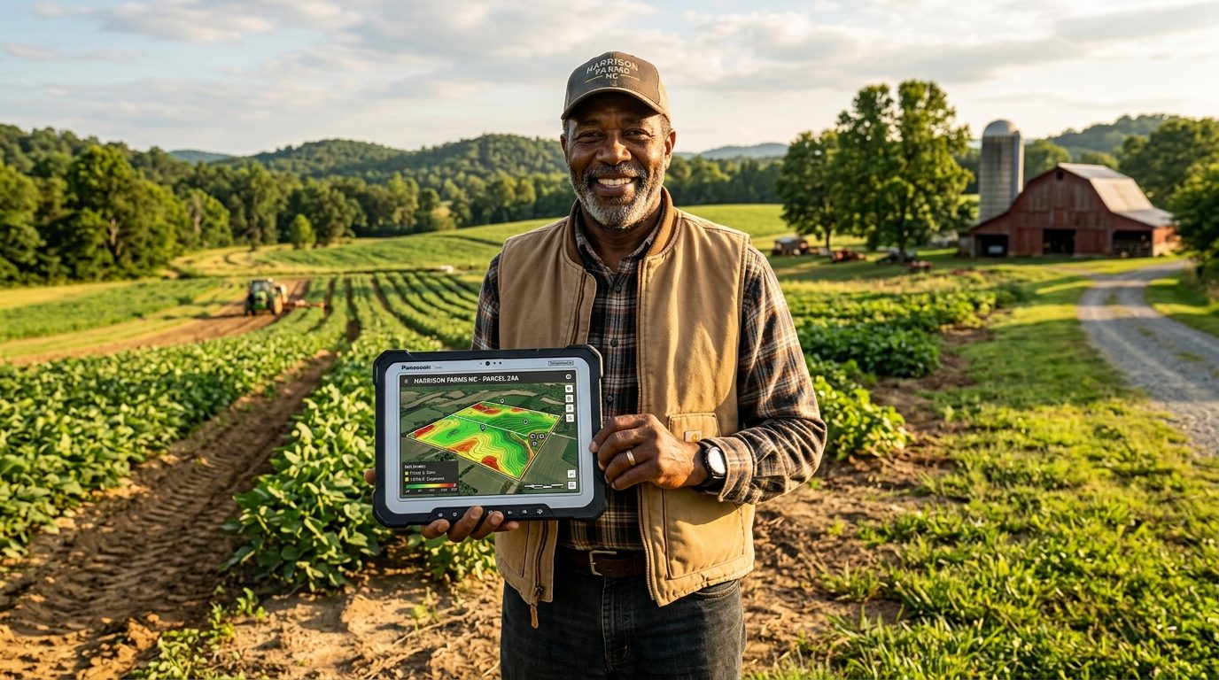
Our classroom has 1,000+ acres
492-acre living field lab • 667-acre University Farm & Research Park
Notes:
Our classroom doesn't stop at the studio door. A&T has a 492-acre Small Farm living field lab and a 667-acre University Farm and research park right here in Greensboro. We study real soil, real water and real forests, and design for real places.

Slide 9
REAL PROJECTS
Design with the community
Lead design workshops with neighbors and farmers
Turn people's ideas into real plans
Serve communities across North Carolina
Notes:
Landscape architecture is about people. Our students lead community design workshops called charrettes, where we listen to neighbors and farmers and turn their ideas into plans. You'll work on real projects for real communities across North Carolina.

Slide 10

CAREERS
Where this degree can take you
Design firms
City & county planning
State DOT
National Park Service
USDA & conservation
Developers & builders
Campus planning
Start your own firm
A licensed profession in all 50 states.
Notes:
Where can this degree take you? Our graduates work at design firms, for cities and counties, for the state DOT, for the National Park Service and USDA, for developers, and some start their own firms. Landscape architecture is a licensed profession in all 50 states, just like architecture or engineering.

Slide 11
YOUR PATH
Two ways in
High school students
Community college students
Take art, drafting/CAD, biology & geometry
Sketch the places around you
Apply to A&T: BS in Landscape Architecture
Transfer into our studio sequence
7 transfer students joined us this fall
Talk to us early so your credits line up
Notes:
So how do you get here? If you're in high school, take art, drafting or CAD, biology or environmental science, and geometry, and start sketching the places around you. Apply to A&T and choose landscape architecture. If you're at a community college, you can transfer in. This fall alone, seven transfer students joined us. Talk to us early so your credits line up.

Slide 12
WHY A&T
Aggies Do.
The nation's largest HBCU
The only accredited BSLA at an HBCU
Small studios, faculty who know you
Real land, real projects, real communities
Scholarships, including NCASLA
Notes:
Why A&T? You'll join the nation's largest HBCU, learn in small studios from faculty who know your name, design on real land, and graduate into a profession that needs your voice. And yes, there are scholarships, including the NC chapter of ASLA's scholarship for landscape architecture students.

Slide 13
LET'S CONNECT
Come design with us.
Dallas C. Bretzman, M.S., ASLA
Program Coordinator, Landscape Architecture
[add email] • Carver Hall, NC A&T
Visit a studio. Ask about scholarships. Apply.
Notes:
Thanks for listening! If you want to learn more, visit our studios in Carver Hall, follow the program, or reach out to our program coordinator, Dallas Bretzman. We'd love to see you in studio. Aggie Pride!

