Slide 1

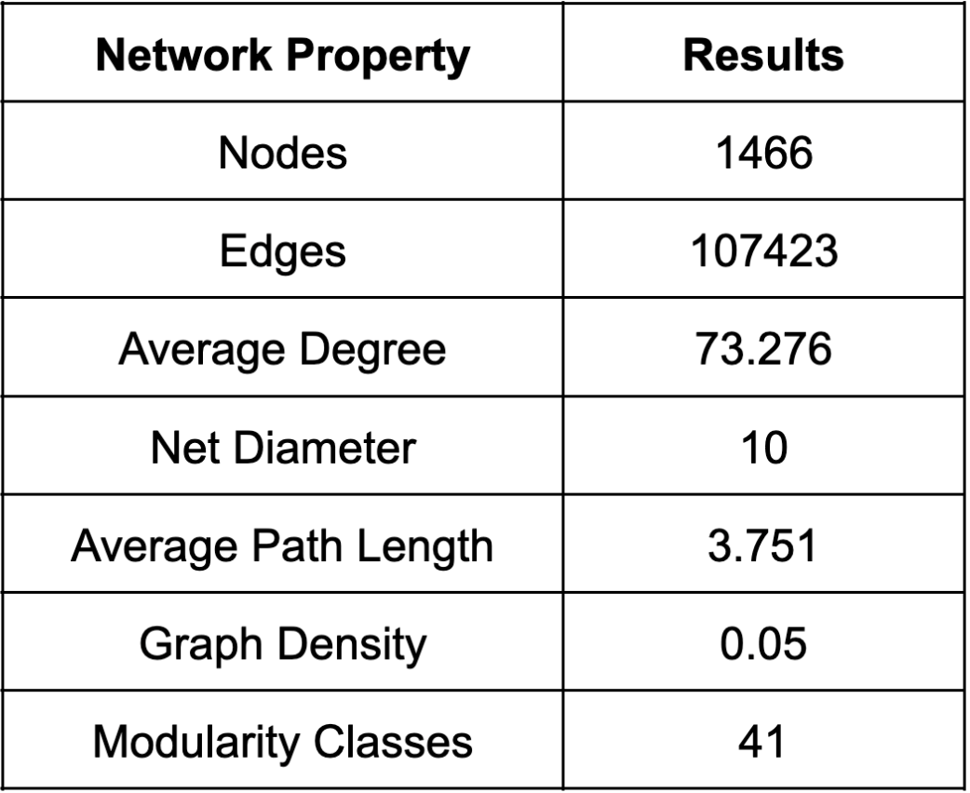
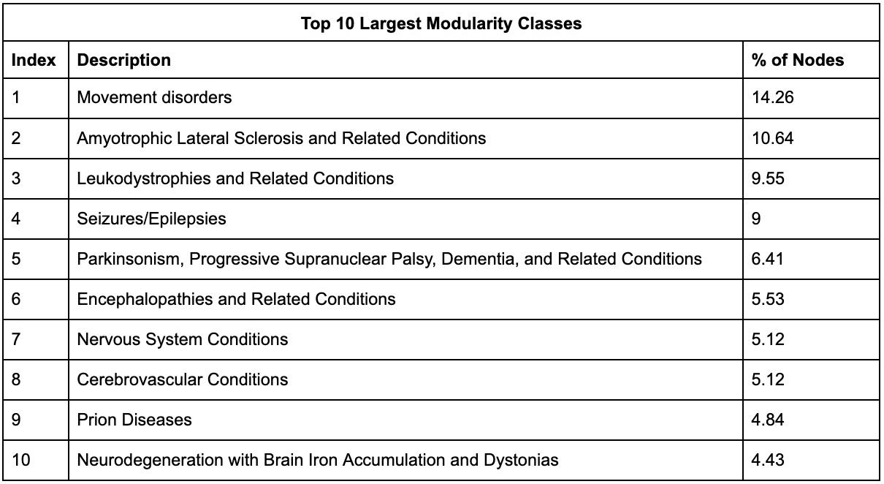
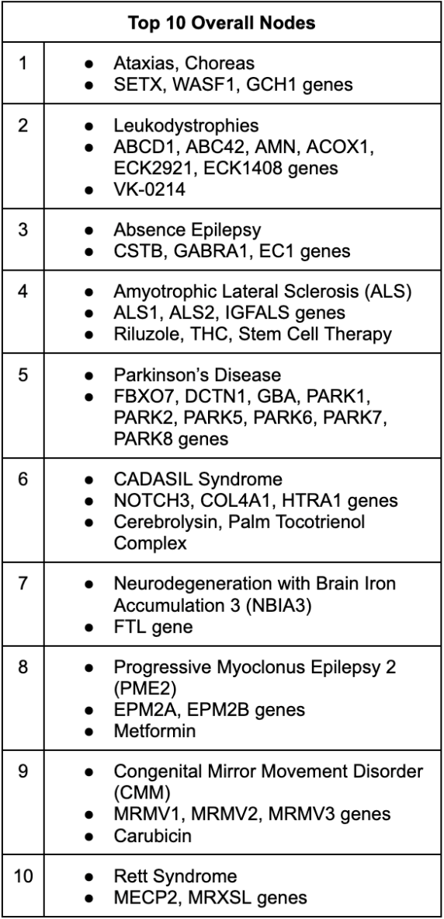
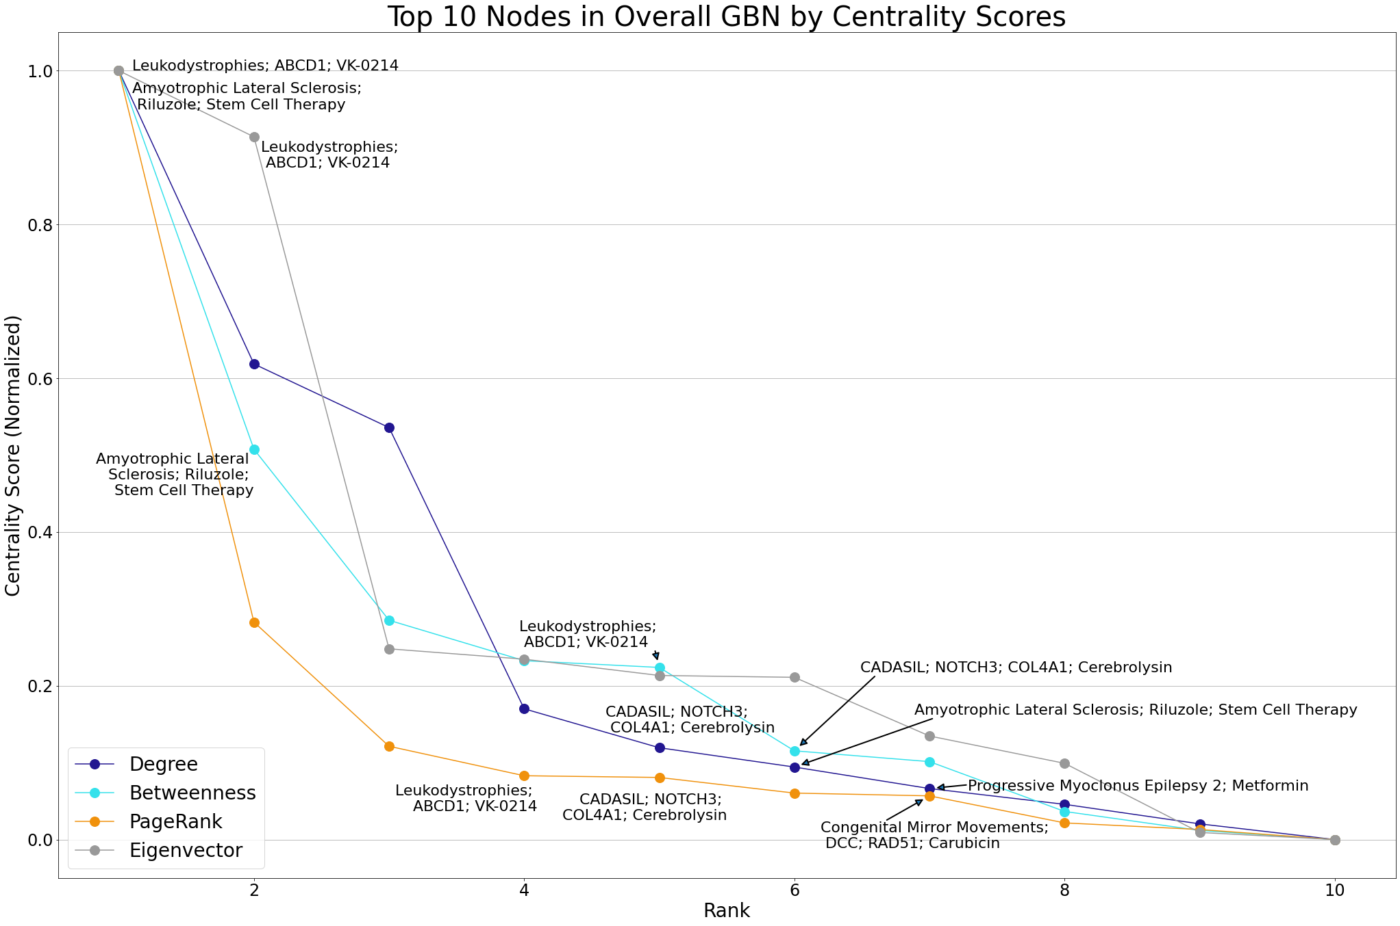
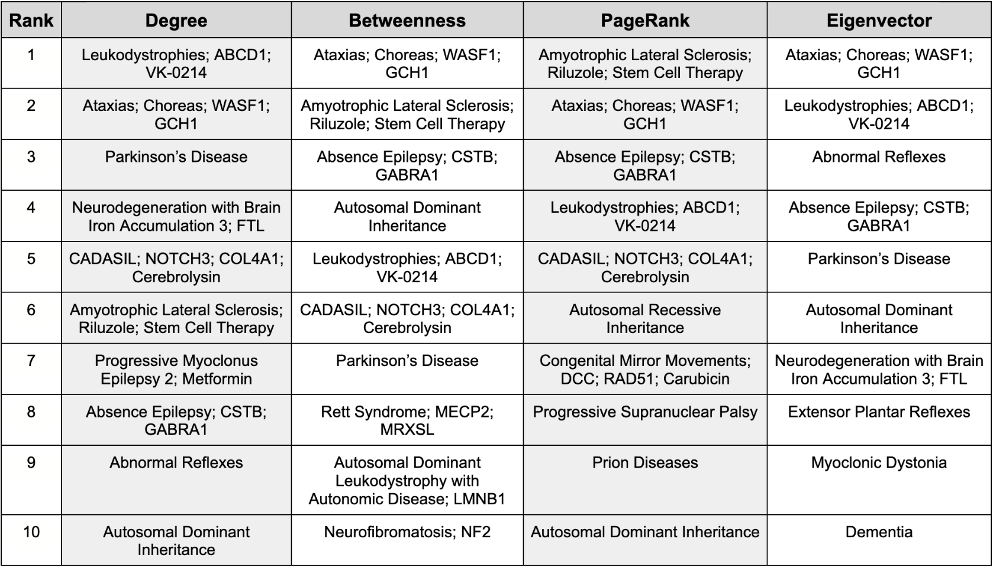
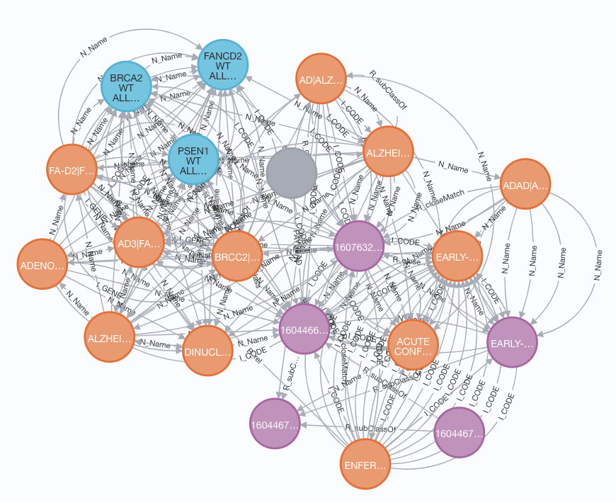




Network Analysis-Based Drug Repositioning for Glioblastoma
Erin McGowan¹, Qian Zhu¹
¹Division of Preclinical Innovation, National Center for Advancing Translational Sciences, National Institutes of Health, Bethesda, MD 20850
Abstract
Results
Glioblastoma is a malignant (cancerous) brain tumor that develops from specific types of brain cells called astrocytes and oligodendrocytes. Glioblastoma are often very aggressive and grow into surrounding brain tissue.¹
Currently treatment options for glioblastoma are extremely limited and rely on surgery and chemotherapy rather than less potentially less invasive drug therapies².
We present a preliminary, network analysis-based approach to drug repositioning candidate discovery for glioblastoma, an approach chosen due to the ability of drug repositioning to dramatically reduce research costs and shorten the drug development timeline.
We have developed a Glioblastoma-Based Network (GBN) by integrating information extracted from the NCATS GARD Knowledge Graph (NGKG)³.
A variety of network analysis measures, namely degree, closeness, betweenness, PageRank, and eigenvector centrality, have been calculated to identify high-influence nodes in the GBN that could shed insight on potential drug repositioning candidates for glioblastoma.
We substantiate our findings with evidence from PubMed⁴, and suggest further experimental evaluation for the top candidates.
Table 1. GBN network properties.
Table 2. Descriptions of the 10 largest modularity classes.
Methods
Begin with the NCATS GARD Knowledge Graph (NGKG)³, which contains data related to diseases, genes, phenotypes, drugs/treatments, etc.
“N_Name”
(synonyms)
gene
disease
“R_subclassOf”
“I_GENE”
disease subtype
“R_closeMatch”
drug
“I_CODE”
(synonyms)
Fig 1. One of the 92 disease-based subgraphs of NGKG³ (Familial Alzheimer Disease).
Extract subgraphs from NGKG³, each containing one of the 92 diseases in the glioblastoma cluster and all nodes connected to it by a path length of up to length 3. Take the union of these subgraphs to create GBN.
Fig 2. The top 10 most influential nodes in the overall GBN by degree, betweenness, eigenvector, and PageRank centralities. Nodes highlighted in the conclusion section are labeled on plot.
Table 3. The top 10 overall most influential nodes in the GBN.
Conclusions
Future Directions
Merge duplicates, resulting in nodes that contain very closely related diseases, genes, proteins, and treatments/drugs/compounds.
Overall | Top 10 nodes all contain central nervous system (brain or neurodegenerative) conditions Many nodes in top 10 are genetic disorders, several are X-linked
Gene | Novel COL4A1 gene variant recently found to be associated with glioblastoma⁵ NOTCH3 is a prognostic factor that promotes glioma cell proliferation, migration, and invasion⁶ RAD51 expression levels are inversely correlated with glioblastoma patient survival⁷
Drug | Metformin (PME2) reduces the proliferation rate of tumor-initiating cell-enriched cultures isolated from glioblastomas⁸ Riluzole (ALS) pretreatment sensitizes glioma to radiation therapy and has synergistic effects with select other drugs when used to treat glioblastoma⁹ Stem cell transplantation has shown potential for treating neuron and glial cell damage from glioblastoma¹⁰ VK-0214 (currently in Phase I clinical trial as treatment for X-ALD) and could potentially be a novel candidate for glioblastoma treatment¹¹
Experimental validation of Metformin, Riluzole, VK-0214, and stem cell transplants for glioblastoma
While our method of merging duplicate nodes allowed us to treat very closely related conditions, genes, and treatments as one entity, parsing these could provide more granular insights
Other methods of analyzing the GBN (different centrality measures, perturbation)
Identify top 10 high-influence nodes in GBN by 5 centrality measures (degree, closeness, betweenness, PageRank, and eigenvector centrality).
Divide graph into modularity classes and identify top 10 high-influence nodes in each modularity class by centrality measures.
Rank top 10 most influential nodes and substantiate connection to glioblastoma using PubMed⁴.
References
Acknowledgements
¹ Glioblastoma, https://rarediseases.info.nih.gov/diseases/2491/glioblastoma
²Fisher, J. P., & Adamson, D. C. (2021). Current FDA-Approved Therapies for High-Grade Malignant Gliomas. Biomedicines, 9(3), 324. https://doi.org/10.3390/biomedicines9030324
³Zhu Q, Nguyen DT, Grishagin I, Southall N, Sid E, Paiser A, An Integrative Knowledge Graph for Rare Diseases, derived from the Genetic and Rare Diseases Information Center (GARD), J Biomed Semant 11, 13 (2020).
⁴U.S. National Library of Medicine. (n.d.). PubMed. National Center for Biotechnology Information. Retrieved July 21, 2022, from https://pubmed.ncbi.nlm.nih.gov/.
⁵Muto, K., Miyamoto, R., Terasawa, Y. et al. A novel COL4A1 variant associated with recurrent epistaxis and glioblastoma. Hum Genome Var 8, 18 (2021). https://doi.org/10.1038/s41439-021-00150-0
⁶Alqudah, M. A., Agarwal, S., Al-Keilani, M. S., Sibenaller, Z. A., Ryken, T. C., & Assem, M. (2013). NOTCH3 is a prognostic factor that promotes glioma cell proliferation, migration and invasion via activation of CCND1 and EGFR. PloS one, 8(10), e77299. https://doi.org/10.1371/journal.pone.0077299
⁷Morrison, C., Weterings, E., Mahadevan, D., Sanan, A., Weinand, M., & Stea, B. (2021). Expression Levels of RAD51 Inversely Correlate with Survival of Glioblastoma Patients. Cancers, 13(21), 5358. https://doi.org/10.3390/cancers13215358
⁸Würth, R., Pattarozzi, A., Gatti, M., Bajetto, A., Corsaro, A., Parodi, A., Sirito, R., Massollo, M., Marini, C., Zona, G., Fenoglio, D., Sambuceti, G., Filaci, G., Daga, A., Barbieri, F., & Florio, T. (2013). Metformin selectively affects human glioblastoma tumor-initiating cell viability: A role for metformin-induced inhibition of Akt. Cell cycle (Georgetown, Tex.), 12(1), 145–156. https://doi.org/10.4161/cc.23050
⁹Blyufer, A., Lhamo, S., Tam, C., Tariq, I., Thavornwatanayong, T., & Mahajan, S. S. (2021). Riluzole: A neuroprotective drug with potential as a novel anti‑cancer agent (Review). International journal of oncology, 59(5), 95. https://doi.org/10.3892/ijo.2021.5275
¹⁰Ebrahimi, T., Abasi, M., Seifar, F., Eyvazi, S., Hejazi, M. S., Tarhriz, V., & Montazersaheb, S. (2021). Transplantation of Stem Cells as a Potential Therapeutic Strategy in Neurodegenerative Disorders. Current stem cell research & therapy, 16(2), 133–144. https://doi.org/10.2174/1574888X15666200628141314
¹¹A study to assess the pharmacodynamics of VK0214 in male subjects with amn - full text view. Full Text View - ClinicalTrials.gov. (n.d.). Retrieved July 21, 2022, from https://clinicaltrials.gov/ct2/show/NCT04973657
This project was supported by the Division of Preclinical Innovation at the National Center for Advancing Translational Sciences (NCATS) and was conducted while one of the authors, Erin McGowan, was a Data Science Fellow through Coding it Forward. Special thanks to Jaleal Sanjak for sharing the glioblastoma-based rare disease cluster and Iyanuoluwa Odebode for valuable suggestions on network analysis.

