Slide 1
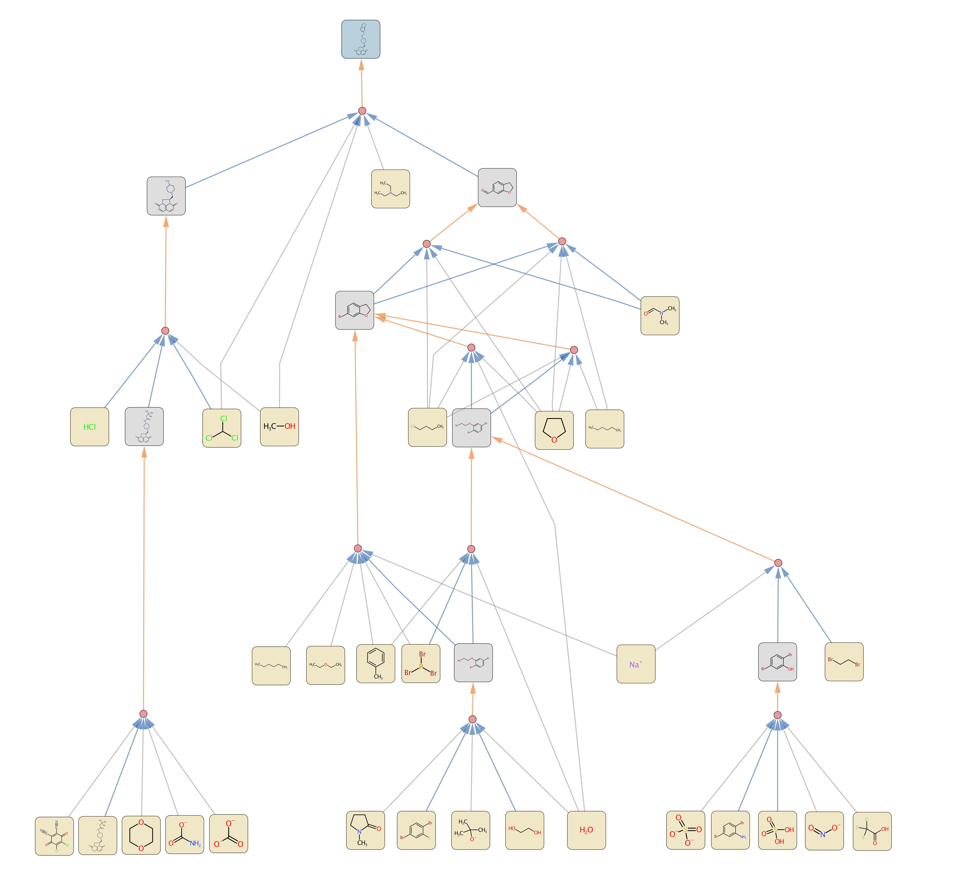
NaOH

Slide 2
NaOH

