Slide 1
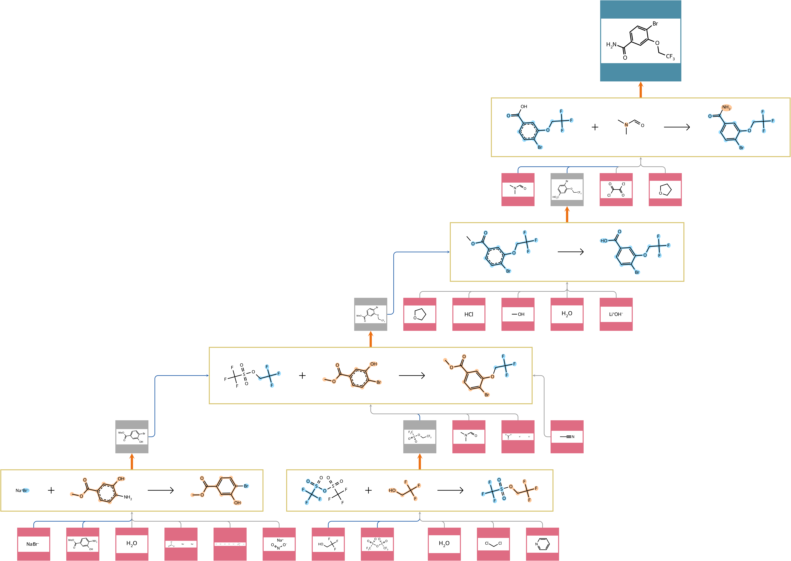
Route 1
62.29%
71.26%
60.34%
65.50%
71.86%
BOYA Aggregated Yield: 18.36%
Average Yield of Reactions: 66.25%
Badowski Aggregated Yield Score: 1.0304

Slide 2
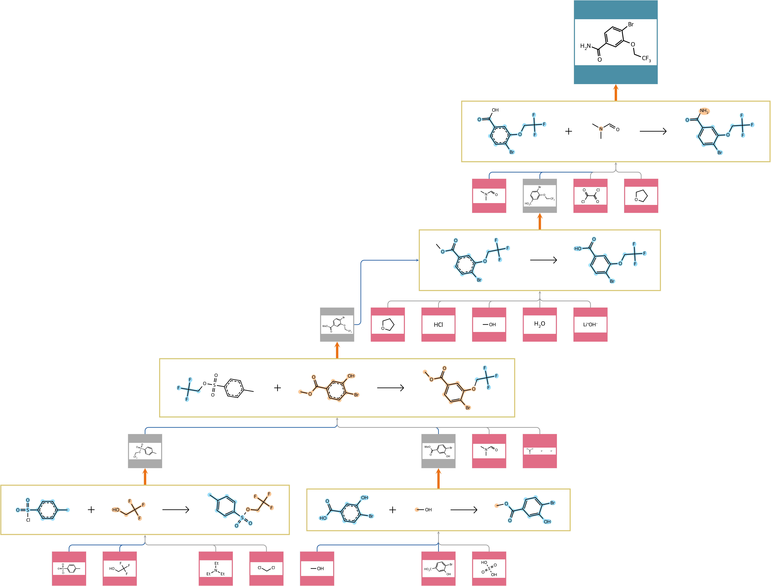
Route 3
62.29%
71.26%
65.42%
76.61%
68.98%
MW: 98.07 g/mol
BOYA Aggregated Yield: 21.08%
Average Yield of Reactions: 68.91%
Badowski Aggregated Yield Score: 1.0292

Slide 3

Route 4
62.29%
71.26%
65.42%
76.61%
71.70%
MW: 118.96 g/mol
BOYA Aggregated Yield: 21.51%
Average Yield of Reactions: 69.46%
Badowski Aggregated Yield Score: 1.0290

