Slide 1

Winning the Space Race with Data Science
Nicholas Chew
6th December 2023

Slide 2

Outline
Executive Summary
Introduction
Methodology
Results
Conclusion
Appendix

Slide 3
Executive Summary
Summary of methodologies
Data collection through API
Data Collection through Web Scraping
Data Wrangling with Python
Exploratory Data Analysis
Create visualization analytics dashboard with Folium and Plotly Dash
Predictive Analysis – test multi models if the first stage of F9 will land succesfully
Summary of all results
Using K-nearest neighbour with one of the best accuracy models, we can predict that only 41% of all first stage flight will successfully land

Slide 4
Introduction
Project background
In this project, we want to predict if the Falcon 9 first stage will land successfully (problem).
SpaceX advertises Falcon 9 rocket launches on its website, with a cost of 62 million dollars; other providers cost upward of 165 million dollars each, much of the savings is because SpaceX can reuse the first stage. Therefore, if we can determine if the first stage will land, we can determine the cost of a launch. This information can be used if an alternate company wants to bid against SpaceX for a rocket launch

Slide 5

Methodology

Slide 6
Methodology
Executive Summary
Data collection methodology:
Data was collected through API from SpaceX’s site and Wikipedia through web scrapping
Perform data wrangling
Data was grouped through primary category including ‘Class’, ‘Booster Version’, ‘Orbit’, and ‘Launch Site’ with a count of its success/failures.
Any columns with null values were dropped.
Performed exploratory data analysis (EDA) using visualization and SQL
Performed interactive visual analytics using Folium and Plotly Dash
Performed predictive analysis using classification models
In the predictive analysis using classification models, we employed several methodologies to evaluate and select the best-performing model. We utilized techniques such as cross-validation, hyperparameter tuning, and careful experimentation with different machine learning methods to assess their performance and identify the most effective approach for the given task. This involved creating various classification models, such as logistic regression, support vector machines, decision trees, and k-nearest neighbors, and then using GridSearchCV to find the best parameters for each model. By leveraging these methodologies, we were able to determine the most suitable model for the predictive analysis, ensuring robust performance and reliable predictions for the given problem.

Slide 7
Data Collection – SpaceX API
There were two approaches in data collection with the first being an API call to https://api.spacexdata.com/v4/launches/past.
This link contains spaceX launches data, including rocket specifications and its success. The following flow chart on the right shows the process in which the API was called and data was cleaned.
Github link to notebook
Import libraries and define auxiliary functions
Convert the data received into a new list → assign to a new dataframe
Filter for only Falcon9 data
Remove null values from the data
Read content of SpaceX url containing data of launches and success/failure
decode the response content as a Json using .json() and turn it into a Pandas dataframe using .json_normalize()
use the API again to get information about the launches using the IDs given for each launch. Specifically we will be using columns rocket, payloads, launchpad, and cores.
Export to csv to be used

Slide 8
Data Collection - Scraping
The second approach in data collection involves ‘scrapping’ data from SpaceX’s Wikipedia page in the form of html code.
This approach uses the ‘BeautifulSoup’ library.
This link contains spaceX launches data, including rocket specifications and its success. The following flow chart on the right shows the process in which the API was called and data was cleaned.
Github link to notebook
Import libraries and define auxiliary functions
Loop through all ‘th’ element to get the column name to create a list of column names
Create a data frame by parsing the launch HTML tables
‘Get’ content of Wikipedia page containing data of launches and success/failure
Export to csv to be used
Parse the html content through Beautiful Soup html parser and verify if the right content was parsed using soup.title
Extract all column/variable names from the HTML table header

Slide 9
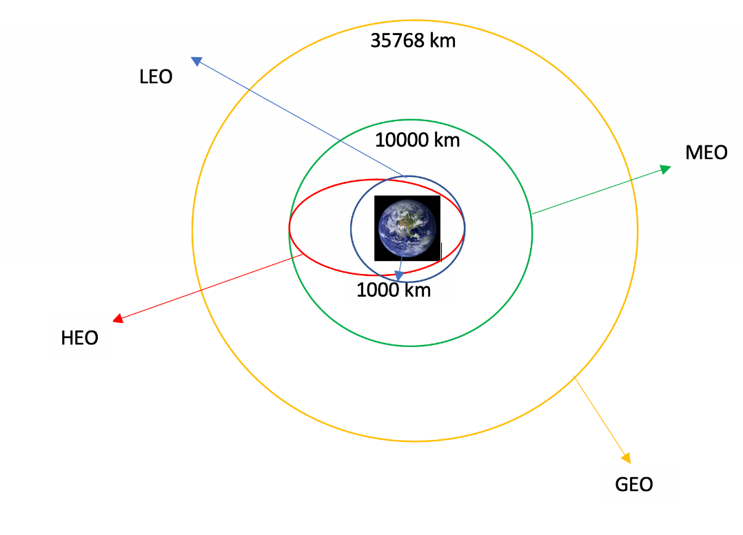
Data Wrangling
In data wrangling, we prepare the data through exploring the data before transforming it into a workable flat file.
Github link to notebook
Define auxiliary functions
Export data to .csv to be used
Read the csv prepared from the earlier data collection process
Creating a landing outcome label from the Outcome column
Identify data types of each columns
Calculate number and occurrence of mission outcomes of the orbit
Calculate number of launches on each site
Calculate number and occurrence of each orbit

Slide 10
EDA with Data Visualization
Chart 1: A categorical chart was plotted to explore the relationship between flight number, launch site, and mission success
Chart 2: A categorical chart was plotted to explore the relationship between pay load mass (kg), launch site, and mission success
Chart 3: A bar chart was plotted to explore the relationship between orbit and success rate
Chart 4: A categorical chart was plotted to explore the relationship between orbit, flight number, and mission success
Chart 5: A categorical chart was plotted to explore the relationship between Orbit, pay load mass (kg), and mission success
Chart 6: A line chart was plotted to explore the relationship between success rate and year (time series).
GitHub link to notebook

Slide 11
EDA with SQL
Display the names of the unique launch sites in the space mission
Display 5 records where launch sites begin with the string 'CCA’
Display the total payload mass carried by boosters launched by NASA (CRS)
Display average payload mass carried by booster version F9 v1.1
List the date when the first succesful landing outcome in ground pad was acheived.
List the names of the boosters which have success in drone ship and have payload mass greater than 4000 but less than 6000
List the total number of successful and failure mission outcomes
List the names of the booster_versions which have carried the maximum payload mass. Use a subquery
List the records which will display the month names, failure landing_outcomes in drone ship ,booster versions, launch_site for the months in year 2015
Rank the count of landing outcomes (such as Failure (drone ship) or Success (ground pad)) between the date 2010-06-04 and 2017-03-20, in descending order.
Github notebook link

Slide 12
Build an Interactive Map with Folium
Markers were added to launch sites on the global map to show the locations of launch sites.
Markers within launch sites were added to indicate count of missions, and success/failure of missions. Green represents success missions, Red represents failed missions.
Proximity lines were added to show the distance between launch sites and important locations/landmarks.
Github notebook link

Slide 13
Predictive Analysis (Classification)
Data was split to test and train data
Create GridSearchCV object with cv=10 for optimization purposes
Apply GridSearchCV to different analysis methodology, including logistic regression, SVC, Decision Tree, and KNN
Calculate accuracy on test data
Assess confusion matrix for all outcome
Github notebook link

Slide 14
Insights drawn from EDA

Slide 15
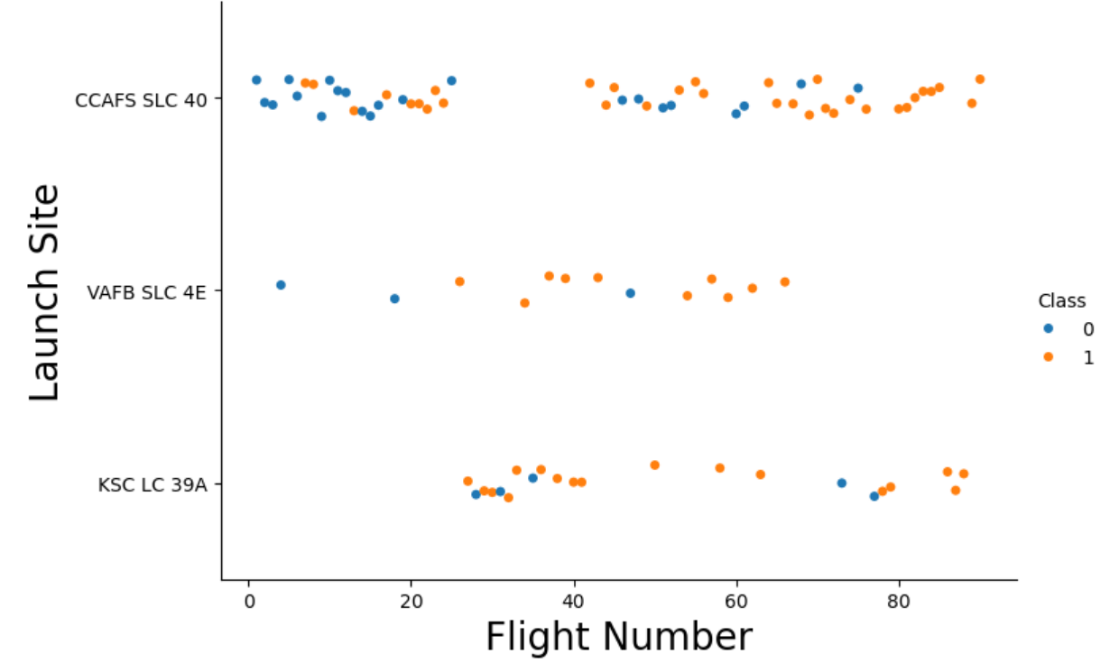
Flight Number vs. Launch Site
In this chart, it shows that launch site looks to make a difference to mission success.
Specifically, CCAFS SLC 40 has almost a 40-60 success rate, whilst the other two sites shows a higher success rate.

Slide 16
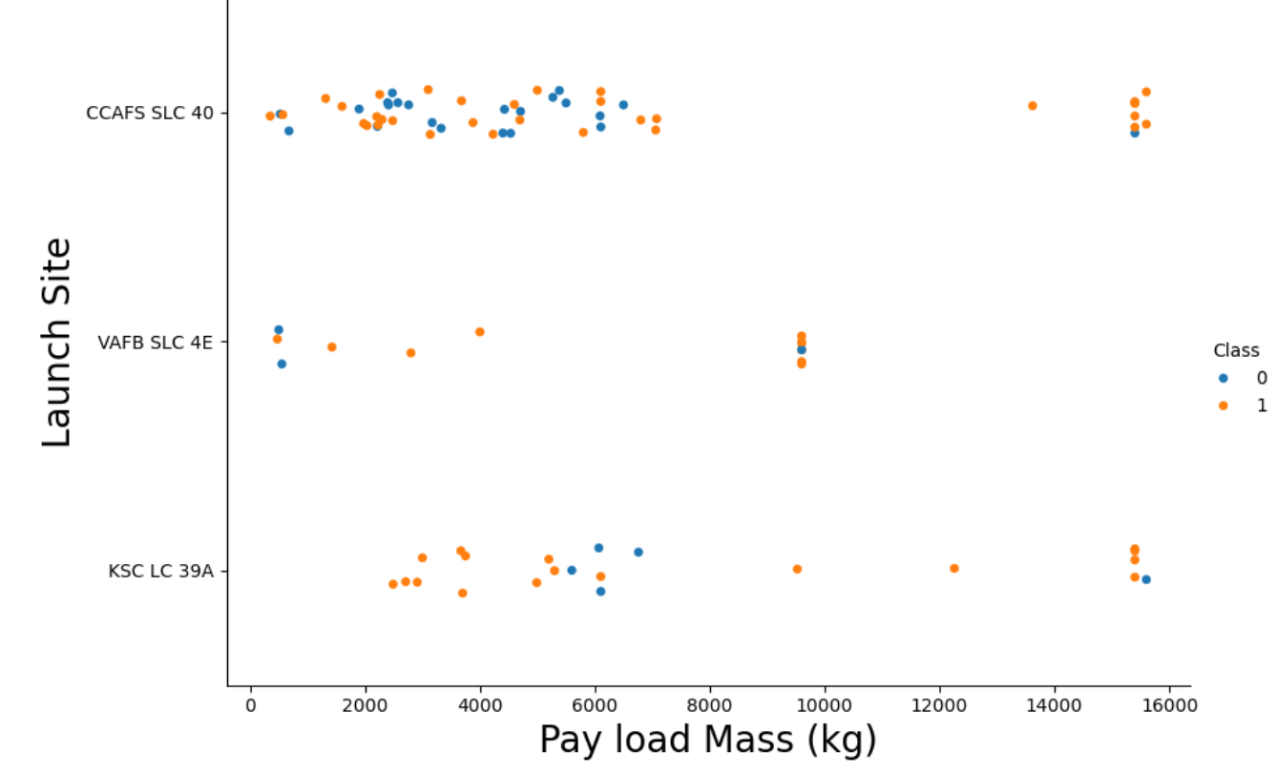
Payload vs. Launch Site
At CCAFS SLC40 launch site, pay load mass doesn’t look to have an impact to mission success. It looks to have an almost equal success/failure rate. It looks to have a higher success rate at 16000 kg payload though.
At VAFB SLC 4E launch site, success rate looks to be higher between 1800 t0 4500 pay load
At KSC LC 39A launch site, success rate looks higher below 6000 pay load mass, and failure was higher at around 6000 pay load.

Slide 17
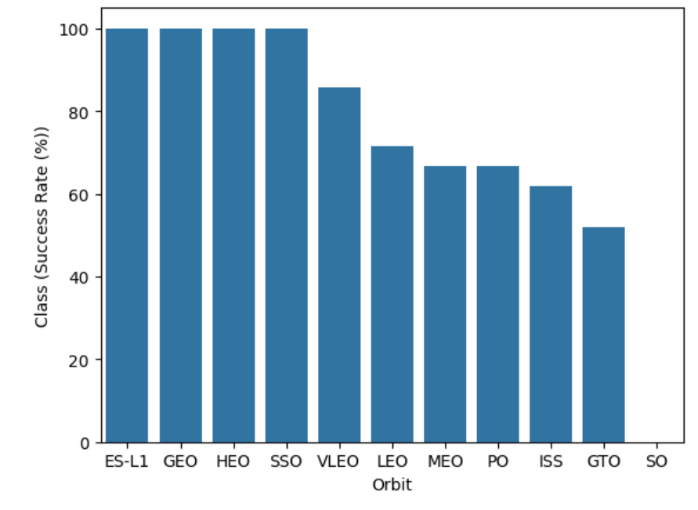
Success Rate vs. Orbit Type
The bar chart shows a notable differences in Orbit type vs success rate.
ES-L1, GEO, HEO, and SSO had 100% success rate.
Followed by VLEO at 83%.
All other orbit types have <80% success rate.

Slide 18
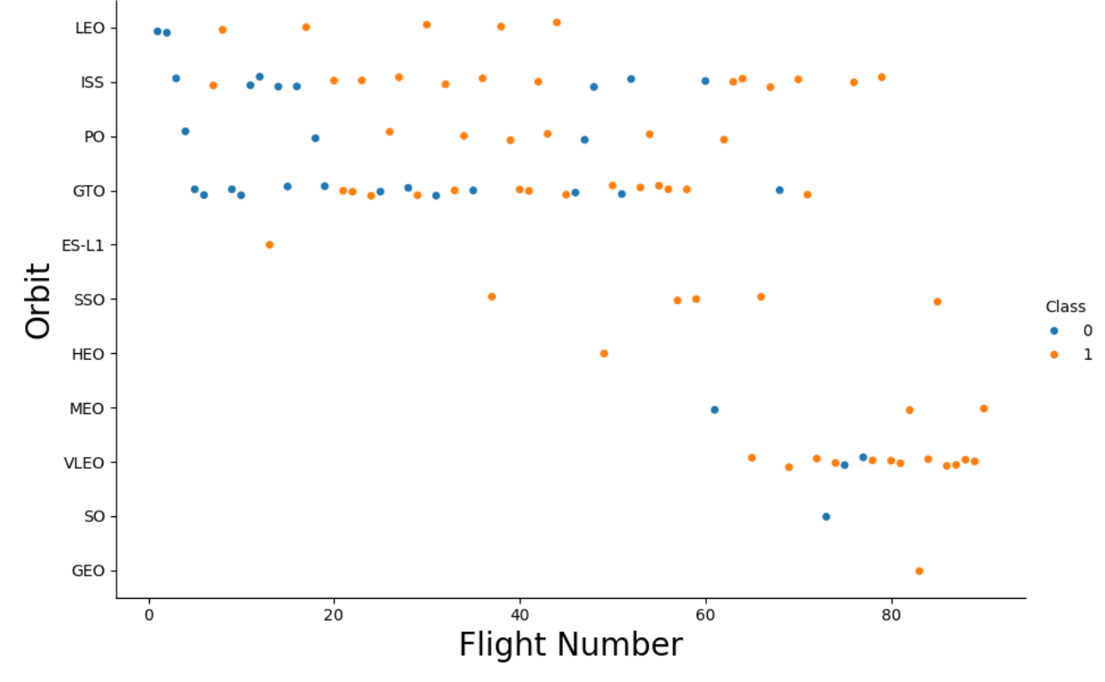
Flight Number vs. Orbit Type

Slide 19
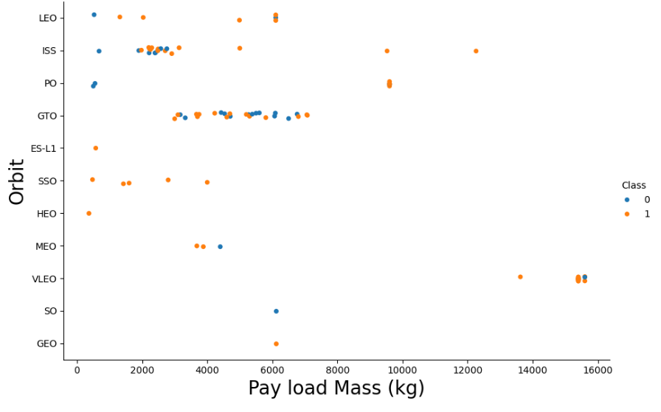
Payload vs. Orbit Type

Slide 20
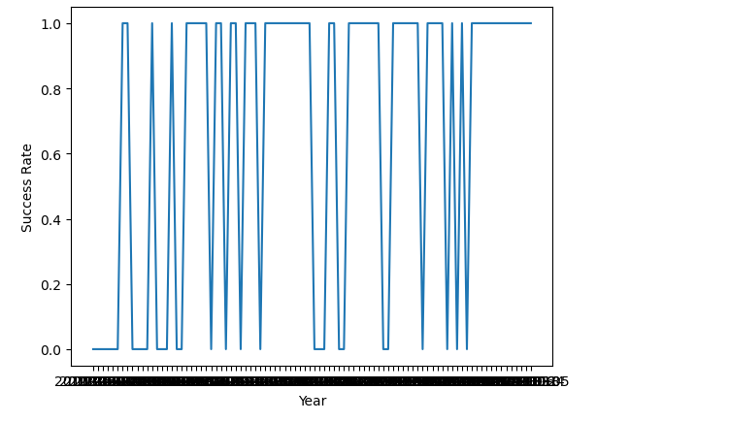
Launch Success Yearly Trend

Slide 21

All Launch Site Names
There were 4 unique launch sites in the dataset

Slide 22
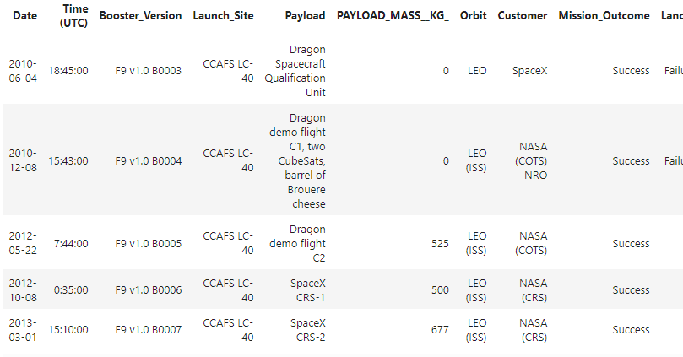
Launch Site Names Begin with 'CCA'
Following are 5 records where launch sites begin with `CCA`

Slide 23
Total Payload Mass
Total payload mass was 999,80kg

Slide 24
Average Payload Mass by F9 v1.1
The average payload mass by F9 v1.1 booster was 2534.67kg

Slide 25
First Successful Ground Landing Date
The first successful ground landing date was 22nd July 2018

Slide 26
Successful Drone Ship Landing with Payload between 4000 and 6000
Following are the names of boosters which have successfully landed on drone ship and had payload mass greater than 4000 but less than 6000
F9 v1.1
F9 v1.1 B1011
F9 v1.1 B1014
F9 v1.1 B1016
F9 FT B1020
F9 FT B1022
F9 FT B1026
F9 FT B1030
F9 FT B1021.2
F9 FT B1032.1
F9 B4 B1040.1
F9 FT B1031.2
F9 B4 B1043.1
F9 FT B1032.2
F9 B4 B1040.2
F9 B5 B1046.2
F9 B5 B1047.2
F9 B5 B1046.3
F9 B5B1054
F9 B5 B1048.3
F9 B5 B1051.2
F9 B5B1060.1
F9 B5 B1058.2
F9 B5B1062.1

Slide 27
Total Number of Successful and Failure Mission Outcomes
Following is a table showing the number of successful and failure mission outcomes
Mission_Outcome | COUNT (Mission_Outcome)
Failure (in flight) | 1
Success | 98
Success | 1
Success (payload status unclear) | 1

Slide 28
Boosters Carried Maximum Payload
Following are the names of the booster which have carried the maximum payload mass
F9 B5 B1048.4
F9 B5 B1049.4
F9 B5 B1051.3
F9 B5 B1056.4
F9 B5 B1048.5
F9 B5 B1051.4
F9 B5 B1049.5
F9 B5 B1060.2
F9 B5 B1058.3
F9 B5 B1051.6
F9 B5 B1060.3
F9 B5 B1049.7

Slide 29
2015 Launch Records
Following is a list of the failed landing_outcomes in drone ship, their booster versions, and launch site names for in year 2015
month | Date | Booster_Version | Launch_Site | Landing _Outcome
01 | 10-01-2015 | F9 v1.1 B1012 | CCAFS LC-40 | Failure (drone ship)
04 | 14-04-2015 | F9 v1.1 B1015 | CCAFS LC-40 | Failure (drone ship)

Slide 30
Rank Landing Outcomes Between 2010-06-04 and 2017-03-20
Following is the rank of the count of landing outcomes (such as Failure (drone ship) or Success (ground pad)) between the date 2010-06-04 and 2017-03-20, in descending order
Landing_Outcome | qty
No attempt | 10
Success (drone ship) | 5
Failure (drone ship) | 5
Success (ground pad) | 3
Controlled (ocean) | 3
Uncontrolled (ocean) | 2
Failure (parachute) | 2
Precluded (drone ship) | 1

Slide 31
Launch site proximity analysis

Slide 32
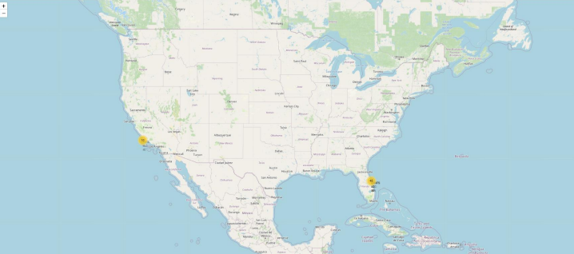
Launch Sites
This is a map of the United States of America pinpointing the launch sites of SpaceX
The pinpoints locations are marked in Yellow

Slide 33
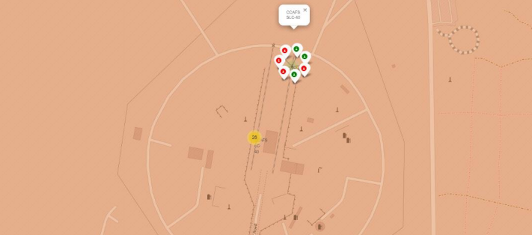
Launch Outcomes
In the launch site map below, green markers represent successful launches whilst red markers represent unsuccessful launches
For the following launch site CCAFS SLC-40, it has a 3 out of 7 success rate

Slide 34
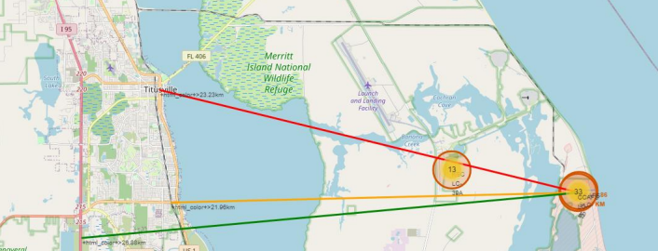
Distance to Proximities
The launch site of CCAFS SLC-40 is:
23.23km from the nearest city
21.96km from the nearest railway
26.88 km from the nearest highway

Slide 35
Build a dashboard with Plotly Dash

Slide 36
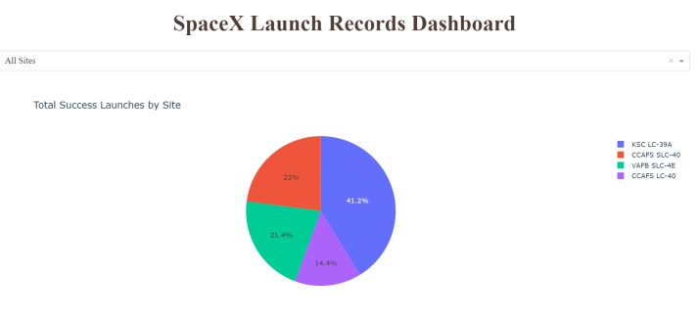
Total Launch Success by Site
Launch site KSC LC-39A has the highest success rate among other launch sites at 41.2%

Slide 37
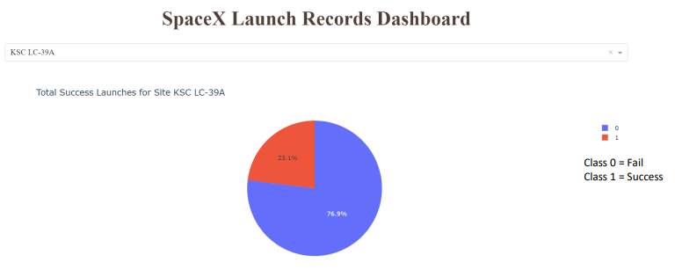
Launch Success (KSC LC-29A)
On its own launch site, its success rate was 76.9%

Slide 38
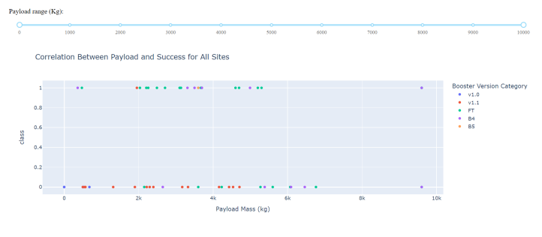
Payload Mass and Success
This dashboard shows a scatter plot exploring the relationship between payload mass and success rate.
The chart shows that payloads between 2,000kg and 5,000kg have the highest success rate.

Slide 39
Predictive Analyses
(Classification)

Slide 40
Classification Accuracy

Slide 41
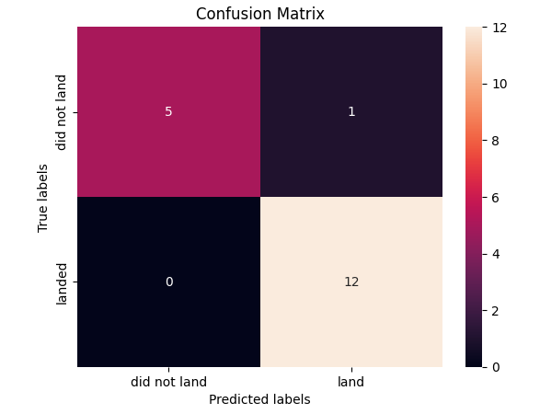
Confusion Matrix
This is a confusion matrix of K-nearest neighbour with test accuracy of 94.4% (cv = 10)

Slide 42
Conclusions
KSC LC-39A has the highest success rate among all launch sites with a 100% success rate for launches less than 5,000 kg.
Orbits ES-L1, HEO, SSO, and GEO have a 100% mission success rate.
On Payload Mass, the higher the payload mass, the higher the success rate.
Launch success increased over time. This shows that SpaceX learns from its mistake and constantly make correction to its rockets to increase its success rate.
The models in predictive analyses had similar accuracy, we can choose between Log Regression, Support Vector Machine, and KNN with all having a test accuracy of 94.4%

Slide 43

Thank You

