Slide 1
Enhanced Search Capabilities and Ease of Use of NCBI SRA Data on the Cloud
Adam Stine

Slide 2
Yes/No Question
I have used a cloud platform like AWS or GCP in the past?

Slide 3
Why do I want to use the cloud?
Speed – High Performance Computing (HPC) resources may not be available to you normally or access may be limited.
Cost – Buying and supporting computing and storage resources can be costly and time consuming.
Features – New features and opportunities for automation are available using the cloud providers.
Gap Filling – You can keep using all the existing on-site resources while using cloud resources to test or for short term needs.

Slide 4

STRIDES
The NIH STRIDES Initiative is a partnership with commercial cloud providers to make accessing compute and storage resources easier for biomedical researchers.
Any NIH Institute, Center or Office (ICO) or NIH-funded researcher is eligible to take part in the STRIDES Initiative.
Researchers with NIH grants or at institutions with NIH funding may want to check the STRIDES website to learn if they are eligible for discounts or credits for one of the cloud providers. https://cloud.nih.gov

Slide 5


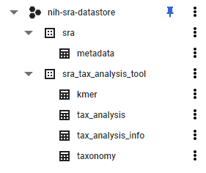
What is BigQuery?
BigQuery is the Google Cloud Data Warehouse product.
SRA maintains a copy of submission metadata in BigQuery.
This allows SQL queries to search the metadata in ways that are hard or impossible with the NCBI Entrez search engine.
https://cloud.google.com/bigquery/docs/how-to

Slide 6
Yes/No Question
I feel comfortable writing basic queries in SQL.

Slide 7
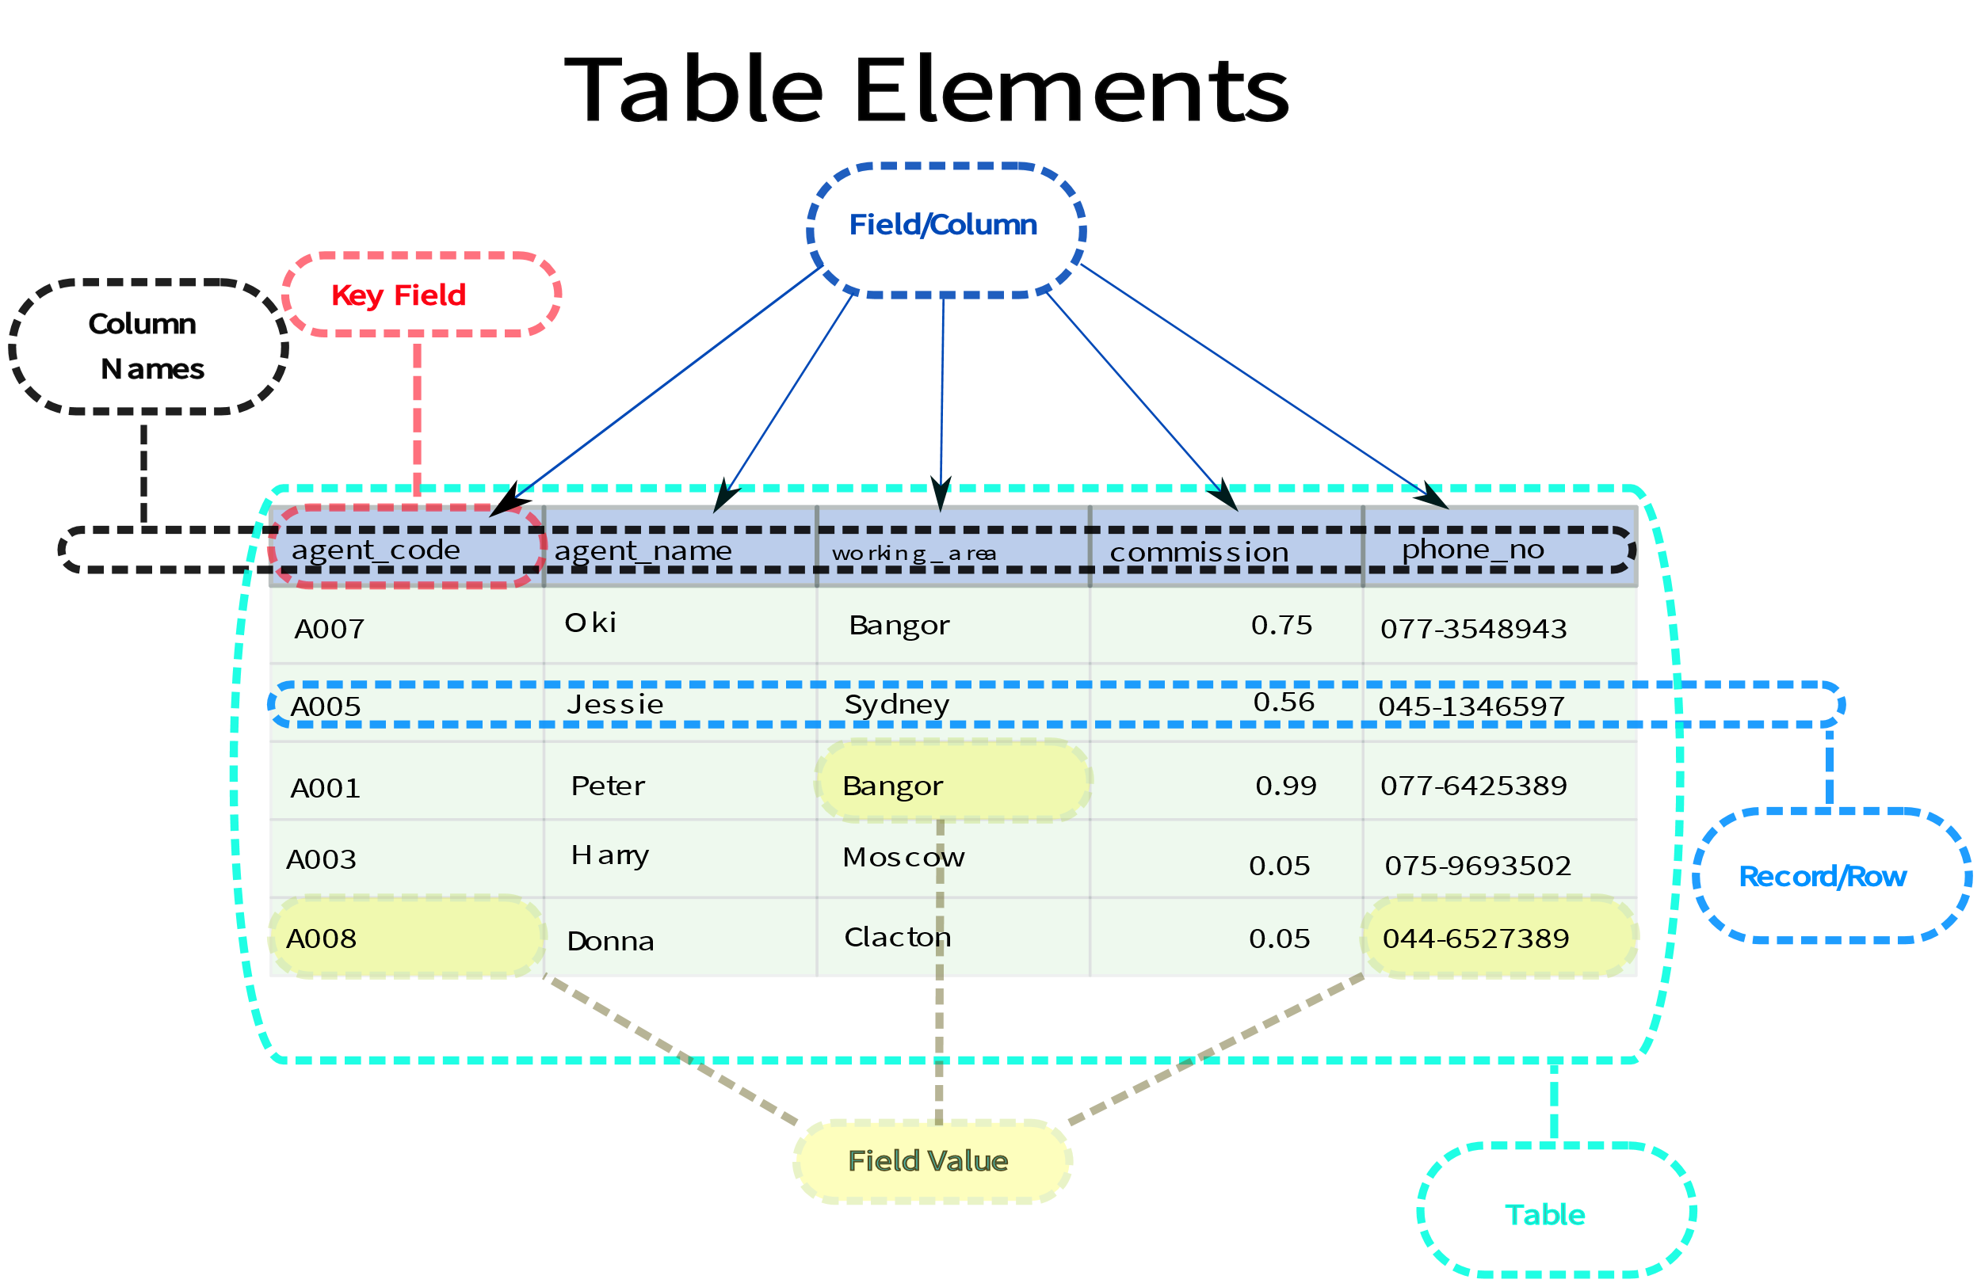
What is a Database?
A database is a structured way to store information electronically.
There are many forms of database they commonly have tables, columns, and records.
Databases are similar to a spreadsheet with more features.

Slide 8
Simple SQL Queries
A very basic overview of SQL queries.
SELECT – command to extract data from a table.
FROM – specify which tables to extract data from
WHERE – filters the data
ORDER BY – order the results by specified column(s)
https://cloud.google.com/bigquery/docs/reference/standard-sql/query-syntax

Slide 9

Searching in BigQuery
Here is an example search for the SRA Data.
This query will search in the metadata table that is part of the SRA dataset contained in the nih-sra-datastore project.
The query will look for all (Select *) records with ‘Homo sapiens’ in the organism column.

Slide 10
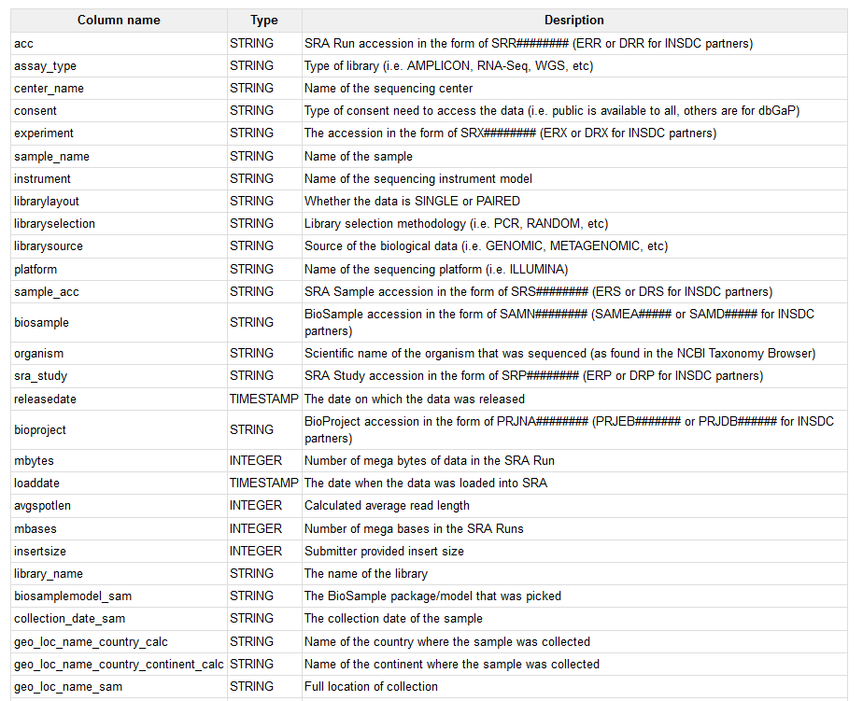
What Columns are in the Database?
The SRA documentation page includes:
Available Tables List
Column Descriptions
Additional Example Queries
https://www.ncbi.nlm.nih.gov/sra/docs/sra-cloud-based-examples/

Slide 11
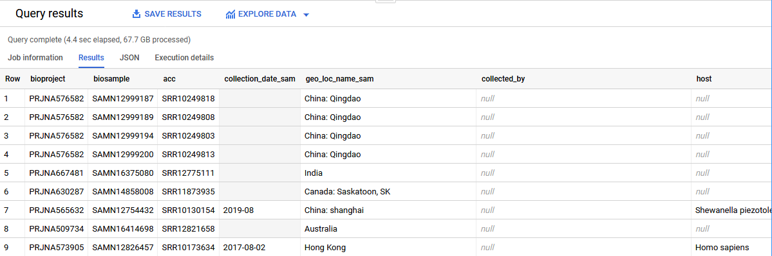
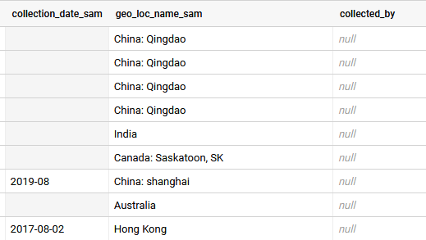
Submitter Provided Metadata
Note that some of this metadata might not have been provided by the submitter so the presence of certain metadata on one record does not imply it will be present on all records.

Slide 12
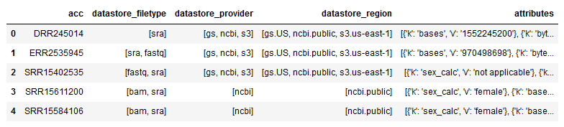
BigQuery Arrays
Arrays are a feature of BigQuery that allows for storage of multiple values in a single field or a data structure.
SRA Metadata uses both arrays and key-value pair structs to store metadata in records.

Slide 13
BigQuery Charges
Our first example query will read through the full metadata table (~20 GB) to get a result.
https://cloud.google.com/bigquery/pricing
Our example is an on-demand query which currently costs $5.00 per TB searched.
This query would be ~$0.10 to run but the first 1 TB each month is free.
BigQuery Sandbox available for existing GCP users.
https://cloud.google.com/bigquery/docs/sandbox

Slide 14
Addition BigQuery Webinars
We have an “NCBI Minute” webinar on using BigQuery https://www.youtube.com/watch?v=DkNz-RCCm-M
NCBI Cloud Data & Tools YouTube playlist https://www.youtube.com/playlist?list=PLH-TjWpFfWrt5MNqU7Jvsk73QefO3ADwD
A video from Google that looks at nested data in BigQuery https://www.youtube.com/watch?v=STo98QUKDS8

Slide 15
Additional Resources
Additional Examples for SRA Searches in BigQuery https://www.ncbi.nlm.nih.gov/sra/docs/sra-bigquery-examples/
STAT Description https://www.ncbi.nlm.nih.gov/sra/docs/sra-taxonomy-analysis-tool/
The NIH STRIDES training website https://cloud.nih.gov/training/
Google Quickstart for BigQuery https://cloud.google.com/bigquery/docs/quickstarts/quickstart-web-ui

Slide 16
Thank You
Adelaide Rhodes
Ravinder Eskandary
Chris O’Sullivan
Jon Trow
Yuriy Skripchenko
Michael Kimelman
Vadim Zalunin

