Slide 1
Intro and Getting Started
Adam Stine

Slide 2

Adam Stine
Sequence Read Archive curator since 2009
Database Support
Sequencing Data ETL
Upload/Download Support
Mostly that means I use SQL, Unix (Bash), XML, Python, and some common packages like samtools
Teaching Cloud access

Slide 3
Workshop Flow
Please try to watch the slide presentations and live demos as they occur. We will give time and breaks for experimenting on your own.
There will be some question prompts we’d like you to answer during the presentations.
We’ll answer questions when we hit logical pauses or the end of the slides.

Slide 4
Overview
Initial Google Cloud Setup
Make a Project
Billing and Spending Alerts
Service Account Credentials

Slide 5
Initial Setup
Much of this will depend on whether you are running a personally administered account or an institutional account.
We’ll cover some basics today to get you started but the cloud documentation from the service provider will be a more complete resource.
You can experiment with your own Google Cloud account by entering the necessary billing information and taking advantage of the free credits provided to you by Google.

Slide 6
Yes/No Question
I have a personal Google Cloud Platform account already.

Slide 7
Create a Project
There are multiple optional layers of resource hierarchy in Google Cloud but Project is the most basic.
Projects enable billing, managing permission for resources, adding and removing collaborators, and more.
A project is required to use Google Cloud resources.

Slide 8
Projects
You won’t be making a new project in this workshop but you will need to create one if you plan to use a personal GCP account in the future.
This guide in the GCP documentation should help you create and manage projects if you need to. https://cloud.google.com/resource-manager/docs/creating-managing-projects

Slide 9
Set Spending Alerts
Cost is a frequent concern when moving from local to cloud.
It is certainly possible to generate large bills when using cloud services from the major providers but there are quite a few trial credits and “free tier” services that allow for learning and experimenting with very low expense.
GCP billing has tools to set alerts for various spending levels either projected or actual costs spent to prevent surprises.
There is also a robust monitoring system to track spending

Slide 10
Billing
The Billing section of the console provides many views and tools to manage and track spending.
For institutional accounts some of these features may not be available to you.
The Billing Overview is a good place to start to talk about costs.

Slide 11
Billing Overview
The Overview page shows current and projected usage for the billing period.
For personal accounts like the one shown it also provides information about the remaining trial credit.
We can set some spending alerts by clicking Budgets & alerts on the menu.

Slide 12
Budgets & Alerts
From this page we can create a budget and use it to send us alerts at certain milestones or if we are spending at a faster monthly rate than previously.

Slide 13
Create a Budget
We can create a budget that tracks one or more of our Projects as well as one or more of the GCP services.
This can provide very granular tracking to optimize spending.
Or it can simply ensure you don’t spend too much money without being alerted.

Slide 14
Simple Budget Alert
A simple budget sets a target spending limit.
Then we can trigger alerts to email when certain thresholds are hit, for example 50% of the budget.

Slide 15
API Credentials
Sometimes APIs in GCP will need you to provide billing credentials in order to charge usage to your project.
This is going to be mentioned later when installing the SRA Toolkit.
GCP handles this with a JSON file containing billing project information.

Slide 16
Get JSON Credentials for API
A description of how to make credentials needed for Google or AWS can be found here.
https://github.com/ncbi/sra-tools/wiki/04.-Cloud-Credentials
For the examples in this workshop we have taken care of the credential requirements for the toolkit. On your own account you will need to generate and use a cloud credential file when installing the toolkit.

Slide 17
Review
Projects are a fundamental part of GCP.
Budgets allow you to track spending and set alerts to prevent unexpected expenses.
Applications may require credentials to bill your service account. For the SRA Toolkit this takes the form of a JSON file that can be downloaded from the GCP Console.

Slide 18
Additional Resources
GCP Intro Video https://www.youtube.com/watch?v=4D3X6Xl5c_Y
GCP Documentation Page https://cloud.google.com/docs
GCP Billing Documentation https://cloud.google.com/billing/docs/how-to
GCP Service Accounts https://cloud.google.com/iam/docs/creating-managing-service-accounts

Slide 19
Searching with BigQuery
Adam Stine

Slide 20
Overview
What is BigQuery?
Pinning Data in the Console
Search SRA Metadata
Taxonomy Searches of SRA

Slide 21
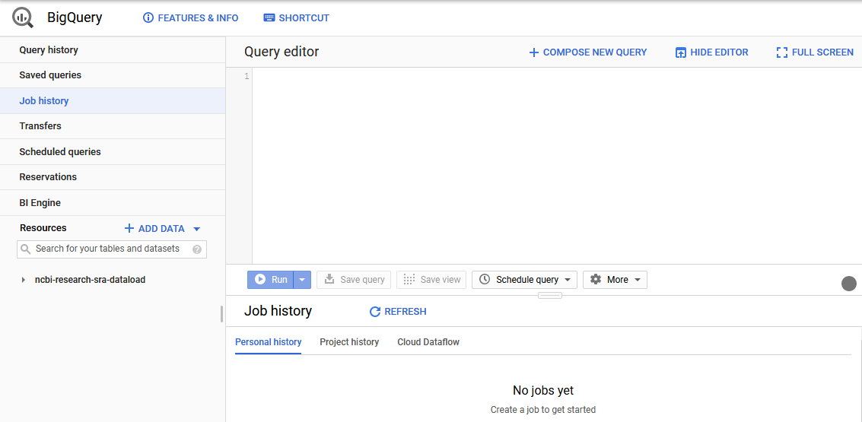
What is BigQuery?
BigQuery is the Google Cloud Data Warehouse product.
It supports features like queries, access control, and data management.
The Sequence Read Archive (SRA) maintains a copy of the sequence metadata from submissions in BigQuery
This allows SQL queries to search the metadata in ways that are hard or impossible with the NCBI Entrez search engine.
https://cloud.google.com/bigquery/docs/how-to

Slide 22
Intro to BigQuery
You can either use the ‘bq’ client from Google in a virtual machine or the GCP console in a web browser.
For this seminar I will show you how you would setup a query in the GCP console.
We will be using JupyterNotebooks to make it easier for a large number of people to access at once.

Slide 23
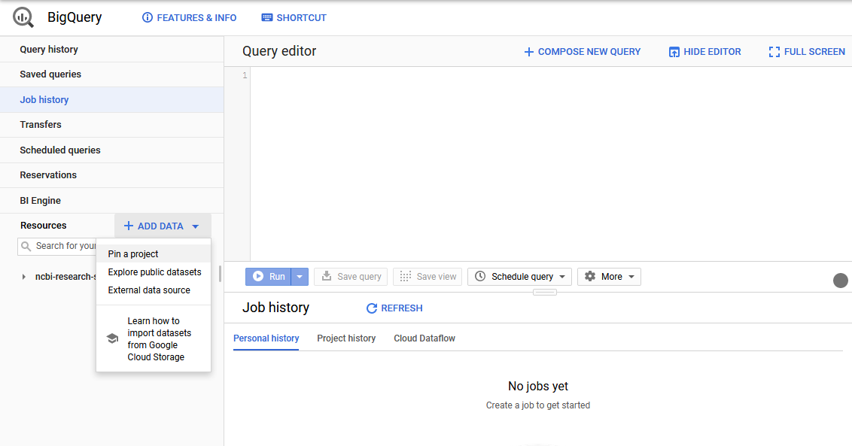
Adding Data
We can add the public SRA data set to our BigQuery project.
Click + ADD DATA on the left side of the console.
In the menu that appears click Pin a project.

Slide 24
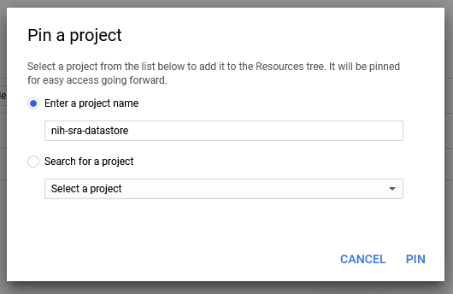
Adding Data
Enter nih-sra-datastore in the project name box.
Click PIN.
This will pin the public metadata datastore to your BigQuery console.

Slide 25
Yes/No Question
I feel comfortable writing basic queries in SQL.

Slide 26
Simple SQL Queries
A very basic overview of SQL queries.
SELECT – command to extract data from a table.
FROM – specify which tables to extract data from
WHERE – filters the data
ORDER BY – order the results by specified column(s)
https://cloud.google.com/bigquery/docs/reference/standard-sql/query-syntax

Slide 27
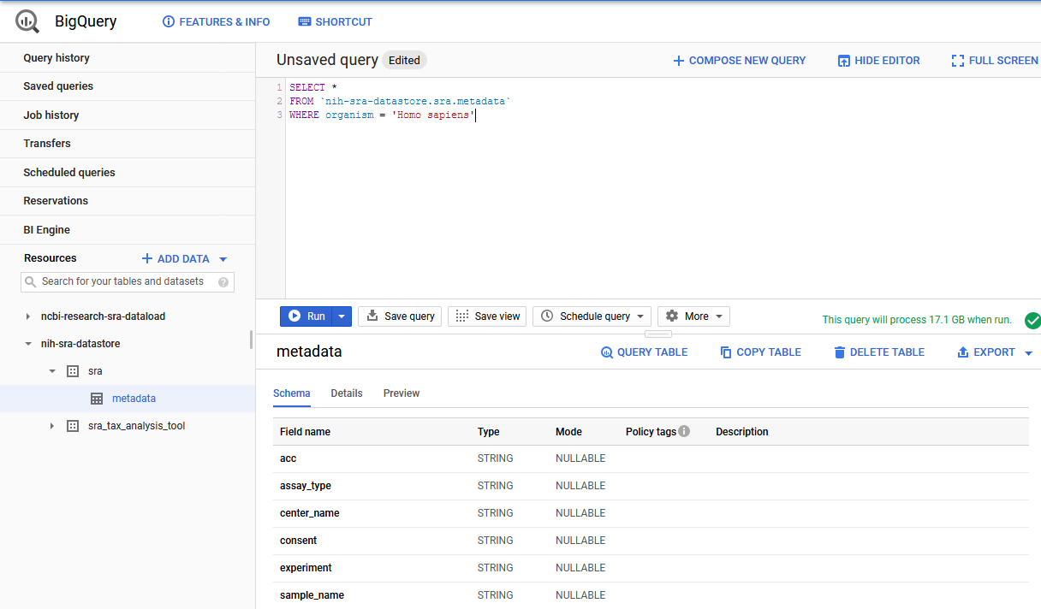
Searching in BigQuery
Here is an example search for the SRA Data.
SELECT * FROM `nih-sra-datastore.sra.metadata` WHERE organism = ‘Homo sapiens’
This query will search in the metadata table that is part of the SRA dataset contained in the nih-sra-datastore project.
The query will look for all (Select *) records with ‘Homo sapiens’ in the organism column.

Slide 28
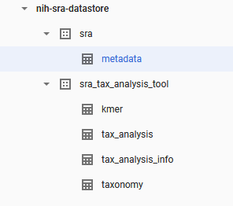
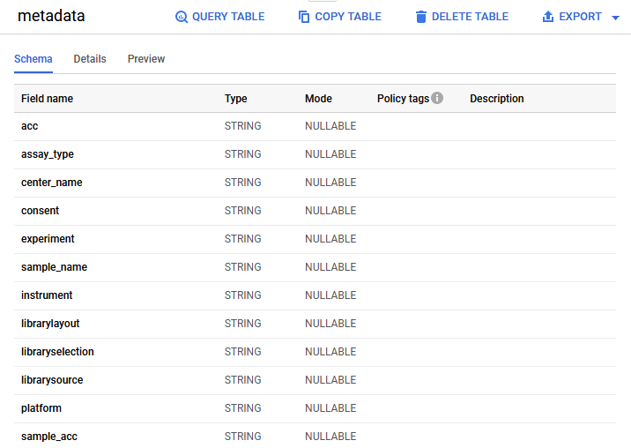
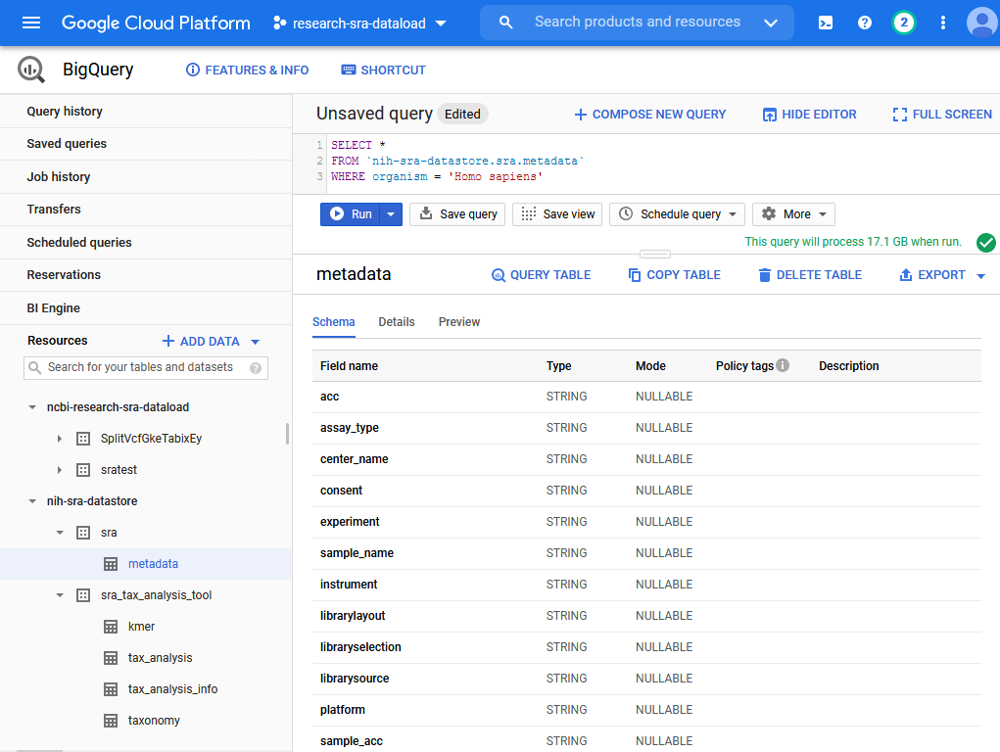
Console Previews and Info
The console has some very useful features we can explore.
We can look through the tables available to query in the pinned dataset.
By clicking on a single table we can view the columns and data type of those columns.

Slide 29
Documentation of SRA Cloud Metadata
The SRA documentation page includes:
Available Tables List
Text descriptions of the contents of the columns
Additional example queries
https://www.ncbi.nlm.nih.gov/sra/docs/sra-cloud-based-examples/

Slide 30
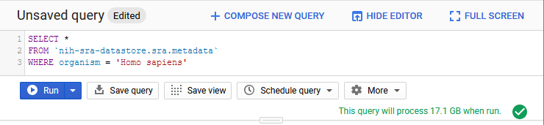
BigQuery Charges
We also get a preview of how much data will be searched.
Our example query will look through 17.1 GB of data to get a result.
This is one of the ways you generate cost in BigQuery
https://cloud.google.com/bigquery/pricing
Our example is an on-demand query which currently costs $5.00 per TB searched.
This query would be ~$0.10 to run
The first 1 TB each month is free.

Slide 31

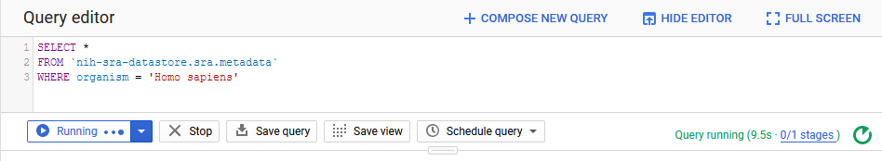
Running a Query
Click RUN to run the query.
While the query is running the console will show live updates on the status of the query.
Once the query finishes the results will display in the lower right portion of the console.

Slide 32
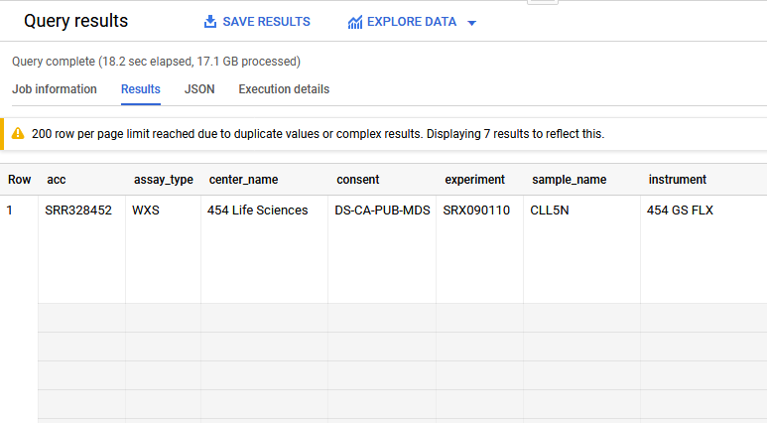
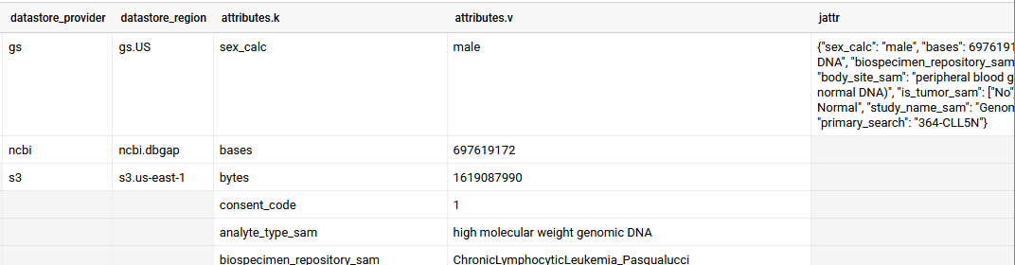
BigQuery Arrays
You might expect to see one record per row on the results but BigQuery supports an array feature for multi-value fields.
Scrolling to the right on this record we can find several columns that have multiple lines for this one record.
We won’t go into depth on the data structure in these columns but it is an important feature of BigQuery

Slide 33
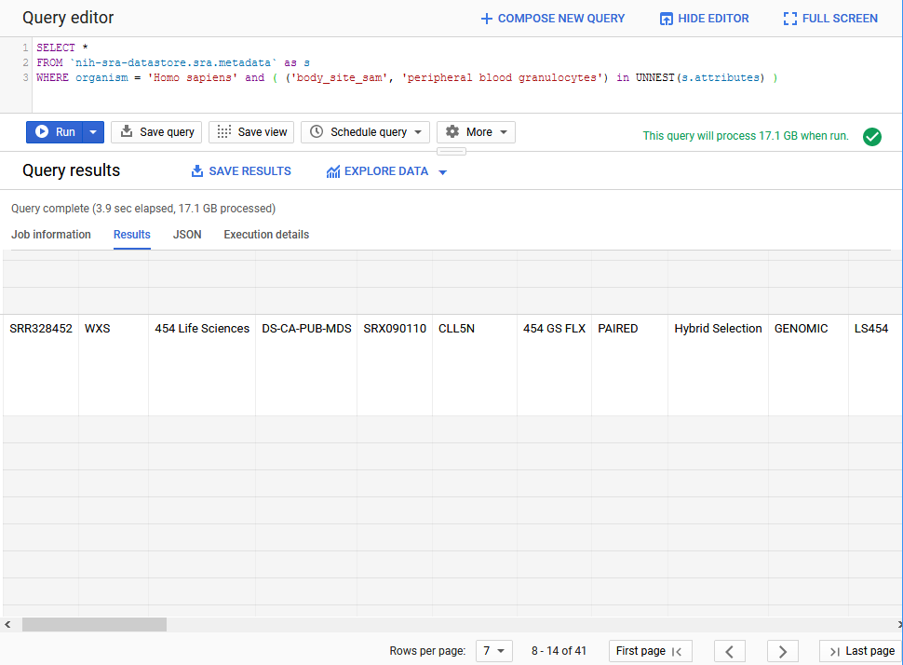
Unnesting Arrays
Here is an example search that will filter for a value in one of those columns.
SELECT *
FROM `nih-sra-datastore.sra.metadata` as s
WHERE organism = 'Homo sapiens' and ( ('body_site_sam', 'peripheral blood granulocytes') in UNNEST(s.attributes) )
The unnest function is allowing us to search the key ‘body_side_sam’ and find only records with the value ‘peripheral blood granulocytes’

Slide 34
Taxonomy Data
In addition to metadata from the SRA database, there is also the sra_tax_analysis_tool dataset.
There are four tables in this dataset:
tax_analysis_info: a summary table for the results of the STAT tool
tax_analysis: use the taxonomy analysis table to locate any number of runs based on kmer hits to a particular organism or branch in a taxonomic tree.
taxonomy: NCBI Taxonomy database where you can locate the taxid based on organism names.
kmer: contains kmers mapped to a particular organism and allows you to continue exploring organismal content further. You can use kmer tables in your downstream analysis by building custom kmer libraries.

Slide 35
Searching in BigQuery
We can join the metadata and the taxonomy data and to search for sequence data in SRA that is from the coronaviridae family.
SELECT m.bioproject, m.biosample, m.acc, m.collection_date_sam, m.geo_loc_name_sam,
(select v from unnest(m.attributes) where k = 'collected_by_sam') as collected_by,
(select v from unnest(m.attributes) where k = 'host_sam') as host
FROM `nih-sra-datastore.sra.metadata` m , `nih-sra-datastore.sra_tax_analysis_tool.tax_analysis` tax
WHERE m.acc = tax.acc
and tax.name = 'Coronaviridae'

Slide 36
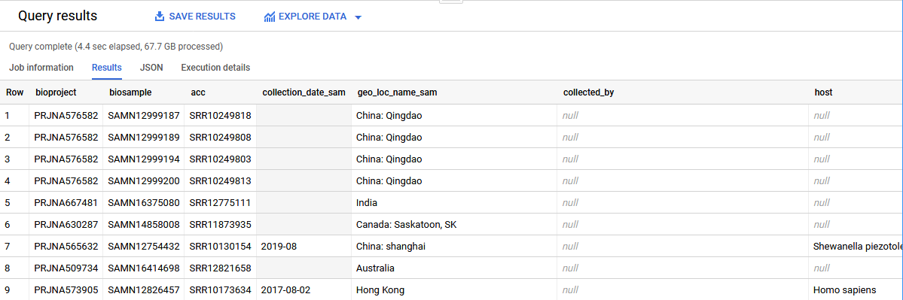
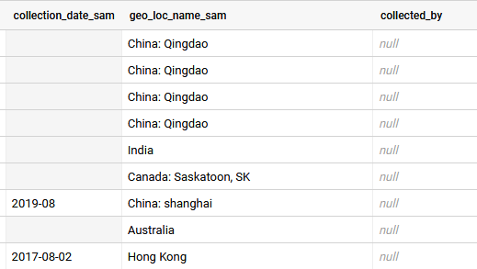
Searching in BigQuery
This query includes the project, sample, and run accessions for all the data we found. It also shows submitter supplied metadata for date, location, host, and collected by fields.
Note that some of this metadata might not have been provided by the submitter so the presence of certain metadata on one record does not imply it will be present on all records.
Keep that in mind when writing queries.

Slide 37
Searching in BigQuery
The last query was part of this NCBI Minute webinar on using BigQuery
https://www.youtube.com/watch?v=DkNz-RCCm-M
The NCBI YouTube channel has additional videos on many topics that range in length from a few minutes to over an hour long.
https://www.youtube.com/channel/UCvJHVo5xGSKejBbBj0A5AyQ

Slide 38
Review
BigQuery allows for SQL searches of large data sets quickly.
BigQuery can be used to search the publicly accessible SRA metadata using SQL searches.
SRA has generated taxonomy data using the SRA Taxonomy Analysis Tool (STAT) that can be used to find the organism content of runs in SRA.

Slide 39
Additional Resources
STAT Description https://www.ncbi.nlm.nih.gov/sra/docs/sra-taxonomy-analysis-tool/
Additional Examples for SRA Searches in BigQuery https://www.ncbi.nlm.nih.gov/sra/docs/sra-bigquery-examples/
Google Quickstart for BigQuery https://cloud.google.com/bigquery/docs/quickstarts/quickstart-web-ui
A video from Google that looks at nested data in BigQuery https://www.youtube.com/watch?v=STo98QUKDS8

