Slide 1
The Best Way to Find Data
in NIH’s Sequence Read Archive
On the Cloud

Slide 2

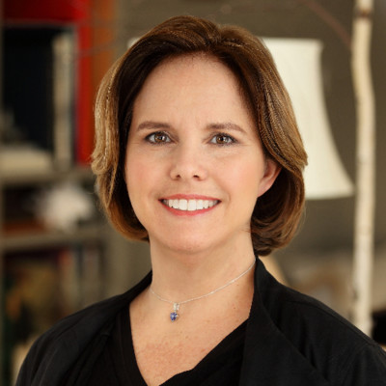
Today’s Presenters
Adam Stine, M.S.
Adelaide Rhodes, Ph.D.
Sequence Read Archive Curator since 2009
Cloud Subject Matter Expert for NCBI Outreach

Slide 3
Today’s Agenda
Introductory Slides
Lecture: Getting Started with GCP BigQuery
How to Log In
Hands-On Activity/Demo in GCP BigQuery
Hands-On Activity/Demo in AWS Athena

Slide 4
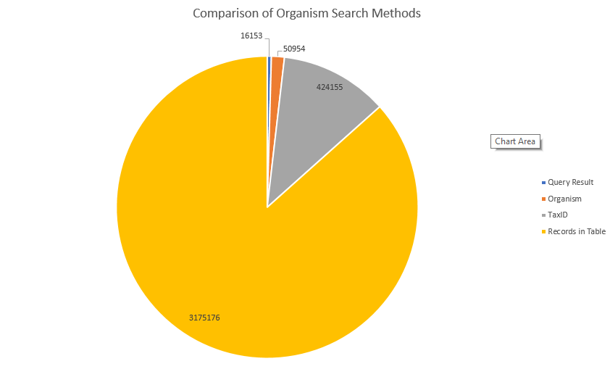
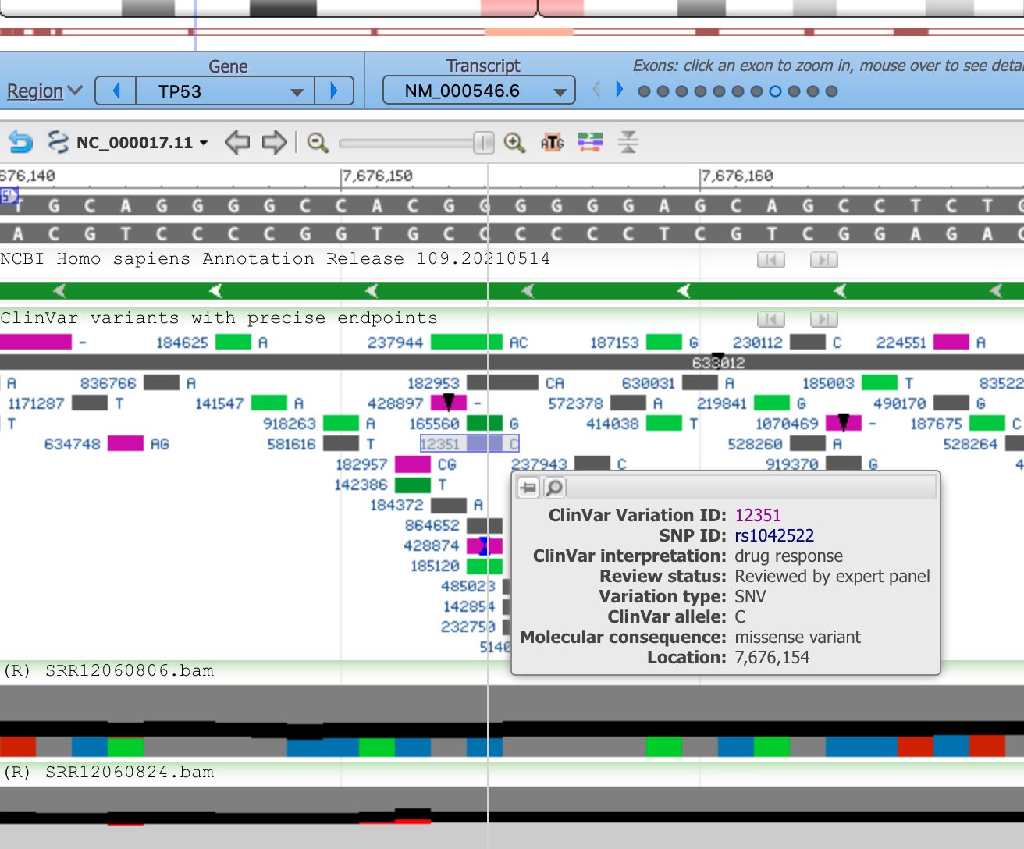
Rationale for Learning SQL for SRA
Searching for SRA Data using Queries is More Targeted
Speeds up Analysis of ~15 Million Records
SRA Data Can be Streamed Directly Into Bioinformatics Workflows
Supports High Throughput Data Discovery by Increasing Interoperability, Scalability and Reproducibility

Slide 5
Learning Outcomes
Familiarity with SQL Language
Insight into how SRA Metadata is Organized in the Cloud
How to get started on your own SRA Queries

Slide 6

Resources
Email The Helpdesk: info@ncbi.nlm.nih.gov
Webinar Series on YouTube www.youtube.com/ncbinlm
NCBI Insights Blog www.ncbiinsights.ncbi.nlm.nih.gov
Social Media

