Slide 1
Title
Adam Stine

Slide 2

Adam Stine
Sequence Read Archive curator since 2009
Database Support
Sequencing Data ETL
Upload/Download Support
Mostly that means I use SQL, Unix (Bash), XML, Python, and some common packages like samtools
Teaching Cloud access

Slide 3
Workshop Flow
Please try to watch the slide presentations and live demos as they occur. We will give time and breaks for experimenting on your own.
There will be some question prompts we’d like you to answer during the presentations.
We’ll answer questions when we hit logical pauses or the end of the slides.

Slide 4
Overview
STRIDES and Cloud Introduction
BigQuery
Examples using Jupyter Notebook
Arrays and why they are important

Slide 5
STRIDES
The NIH STRIDES Initiative is a partnership with commercial cloud providers to make accessing compute and storage resources easier for biomedical researchers.
Any NIH Institute, Center or Office (ICO) or NIH-funded researcher is eligible to take part in the STRIDES Initiative.
The STRIDES website provides information on enrollment to gain access to discounts and funding through STRIDES as well as training and educational resources.
https://cloud.nih.gov

Slide 6
Yes/No Question
I have used a cloud platform like AWS or GCP in the past?

Slide 7
Why do I want to use the cloud?
Speed – High Performance Computing (HPC) resources may not be available to you normally or access may be limited.
Cost – Buying and supporting computing and storage resources can be more costly and time-consuming than expected.
Features – New features and opportunities for automation are available using the cloud providers.

Slide 8
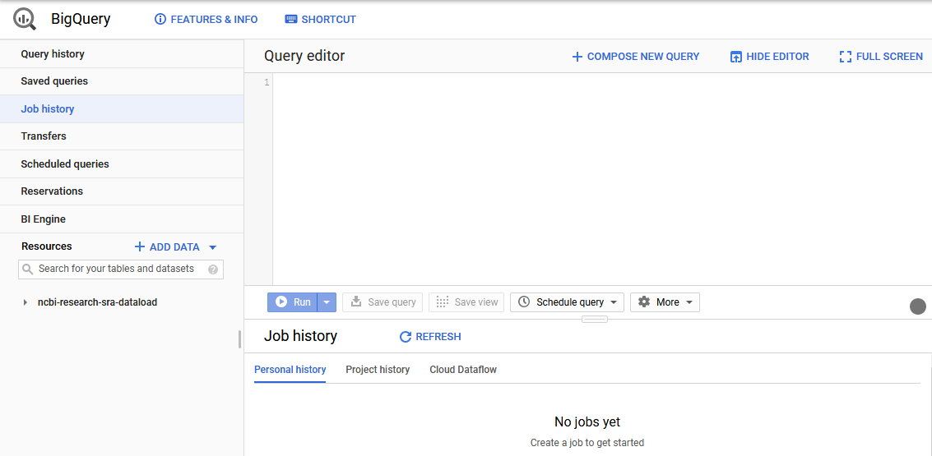
What is BigQuery?
BigQuery is the Google Cloud Data Warehouse product.
It supports features like queries, access control, and data management.
The Sequence Read Archive (SRA) maintains a copy of submissions metadata in BigQuery.
This allows SQL queries to search the metadata in ways that are hard or impossible with the NCBI Entrez search engine.
https://cloud.google.com/bigquery/docs/how-to

Slide 9
Intro to BigQuery
You can either use the ‘bq’ client from Google in a virtual machine or the GCP console in a web browser.
For this seminar I will show you how you would setup a query in the GCP console.
We will be using JupyterNotebooks to make demonstration easier.

Slide 10
Yes/No Question
I feel comfortable writing basic queries in SQL.

Slide 11
Simple SQL Queries
A very basic overview of SQL queries.
SELECT – command to extract data from a table.
FROM – specify which tables to extract data from
WHERE – filters the data
ORDER BY – order the results by specified column(s)
https://cloud.google.com/bigquery/docs/reference/standard-sql/query-syntax

Slide 12

Searching in BigQuery
Here is an example search for the SRA Data.
This query will search in the metadata table that is part of the SRA dataset contained in the nih-sra-datastore project.
The query will look for all (Select *) records with ‘Homo sapiens’ in the organism column.

Slide 13
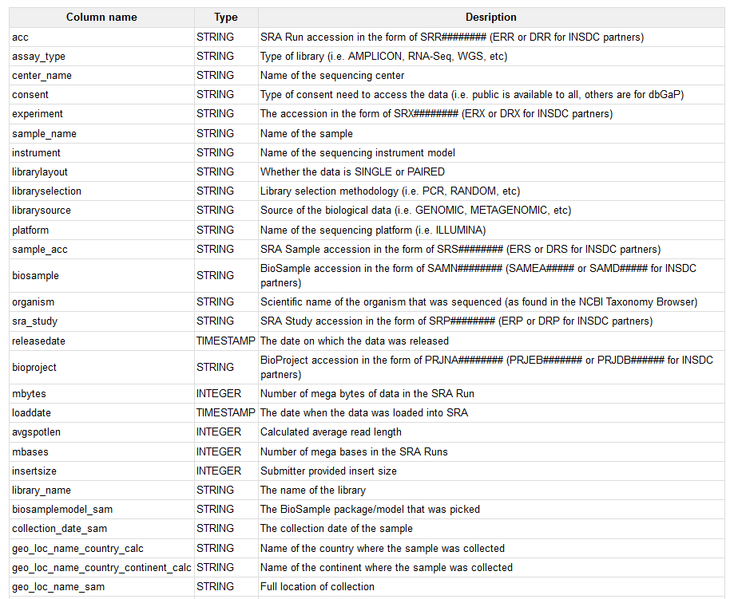
What Columns are in the Database?
The SRA documentation page includes:
Available Tables List
Column Descriptions
Additional Example Queries
https://www.ncbi.nlm.nih.gov/sra/docs/sra-cloud-based-examples/

Slide 14
BigQuery Charges
Our example query will look through ~20 GB of data to get a result.
This is one of the ways you generate cost in BigQuery
https://cloud.google.com/bigquery/pricing
Our example is an on-demand query which currently costs $5.00 per TB searched.
This query would be ~$0.10 to run
The first 1 TB each month is free.

Slide 15
BigQuery Arrays
Arrays are a feature of BigQuery that allows for storage and search of key-value pairs.
SRA Metadata also uses key-value pairs to store additional metadata on records.

Slide 16
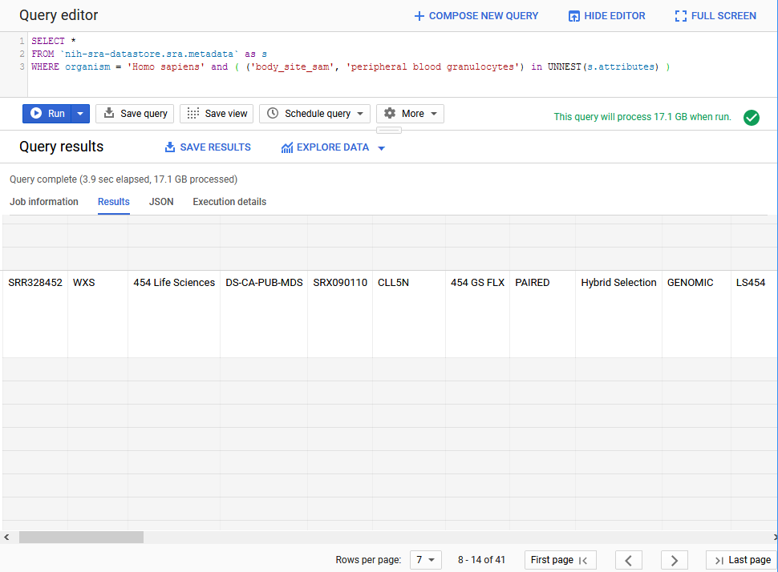
Unnesting Arrays
Here is a search that will filter for an array value.
SELECT *
FROM `nih-sra-datastore.sra.metadata` as s
WHERE organism = 'Homo sapiens' and ( ('body_site_sam', 'peripheral blood granulocytes') in UNNEST(s.attributes) )
The unnest function is allowing us to search the key ‘body_side_sam’ and find only records with the value ‘peripheral blood granulocytes’

Slide 17
Taxonomy Data
In addition to metadata from the SRA database, there is also the sra_tax_analysis_tool dataset.
There are four tables in this dataset:
tax_analysis_info: a summary table for the results of the STAT tool
tax_analysis: use the taxonomy analysis table to locate any number of runs based on kmer hits to a particular organism or branch in a taxonomic tree.
taxonomy: NCBI Taxonomy database where you can locate the taxid based on organism names.
kmer: contains kmers mapped to a particular organism and allows you to continue exploring organismal content further. You can use kmer tables in your downstream analysis by building custom kmer libraries.

Slide 18
Searching Taxonomy in BigQuery
We can join the metadata and the taxonomy data and to search for sequence data in SRA that is from the coronaviridae family.
SELECT m.bioproject, m.biosample, m.acc, m.collection_date_sam, m.geo_loc_name_sam,
(select v from unnest(m.attributes) where k = 'collected_by_sam') as collected_by,
(select v from unnest(m.attributes) where k = 'host_sam') as host
FROM `nih-sra-datastore.sra.metadata` m , `nih-sra-datastore.sra_tax_analysis_tool.tax_analysis` tax
WHERE m.acc = tax.acc
and tax.name = 'Coronaviridae'

Slide 19
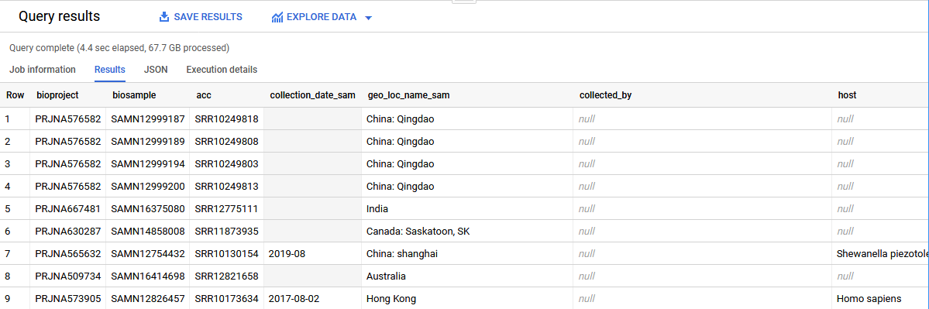
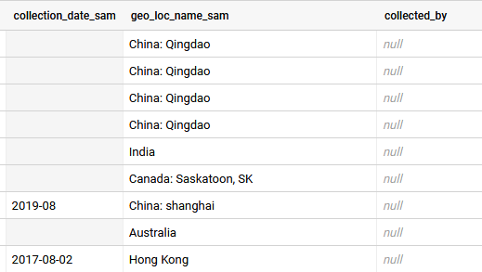
Searching in BigQuery
This query includes the project, sample, and run accessions for all the data we found. It also shows submitter supplied metadata for date, location, host, and collected by fields.
Note that some of this metadata might not have been provided by the submitter so the presence of certain metadata on one record does not imply it will be present on all records.
Keep that in mind when writing queries.

Slide 20
Searching in BigQuery
The last query was part of this NCBI Minute webinar on using BigQuery
https://www.youtube.com/watch?v=DkNz-RCCm-M
The NCBI YouTube channel has additional videos on many topics that range in length from a few minutes to over an hour long.
https://www.youtube.com/channel/UCvJHVo5xGSKejBbBj0A5AyQ

Slide 21
Review
BigQuery allows for SQL searches of large data sets quickly.
BigQuery can be used to search the publicly accessible SRA metadata using SQL searches.
SRA has generated taxonomy data using the SRA Taxonomy Analysis Tool (STAT) that can be used to find the organism content of runs in SRA.

Slide 22
Additional Resources
https://cloud.nih.gov/training/

Slide 23
Additional Resources
STAT Description https://www.ncbi.nlm.nih.gov/sra/docs/sra-taxonomy-analysis-tool/
Additional Examples for SRA Searches in BigQuery https://www.ncbi.nlm.nih.gov/sra/docs/sra-bigquery-examples/
Google Quickstart for BigQuery https://cloud.google.com/bigquery/docs/quickstarts/quickstart-web-ui
A video from Google that looks at nested data in BigQuery https://www.youtube.com/watch?v=STo98QUKDS8

