Slide 1
For each variant type:
Start with: sequence, start position, stop position, number of bases deleted, number of bases inserted, repeat subunit literal sequence, repeat count, strand (for adjacencies), mobile element family, etc
Assign each datapoint to a field
Try to merge field usage into a common, minimal item set
Examine relationship between proposed SPDIR expression and VRS
Assign an appropriate prefix value based on agreed 'minimal item set'

Slide 2
outer_start | start | inner_start | inner_stop | stop | outer_stop
9,999,750 | 10,000,000 | 10,000,250 | 10,004,750 | 10,005,000 | 10,005,250
NC_000007.14
NC_000014.9
pre | S | P | D | I | R
SPDIR expression:
::::

Slide 3
Simple deletion
Sequence (chromosome) | NC_000007.14
Position (range?) | 10,000,000 (10,000,000-10,005,000)
Length (or Stop position) | 5,000 (or 10,005,000)
What happened | deleted, lost
pre | S | P | D | I | R
va | NC_000007.14 | 10,000,000 | 5,000
va | NC_000007.14 | 10,000,000 - 10,005,000 | del
SPDIR expression:
va.NC_000007.14:10000000:5000:-
va.NC_000007.14:10000000-10005000:del:-

Slide 4
 | pre | S | P | D | I | R
Simple deletion |  | NC_000007.14 | 10000000
Simple insertion |  | NC_000007.14 | 10000000 | - | 6612
Simple inversion |  | NC_000007.14 | 10000000
CopyNumberChange | cx | NC_000007.14 | 10000000
CopyNumberCount | cc | NC_000007.14 | 10000000
Adjacency |  | NC_000007.14 | 10000000 | NC_000014.9 | 23000751
Simple inversion |  | NC_000007.14 | 10000000-10005000
Simple duplication (tandem) |  | NC_000007.14 | 10000000
Array-based deletion |  | NC_000007.14 | 10000000
Array-based duplication |  | NC_000007.14 | 10000000
Repeat (>50bp) |  | NC_000007.14 | 10000000 |  |  | [17]

Slide 5
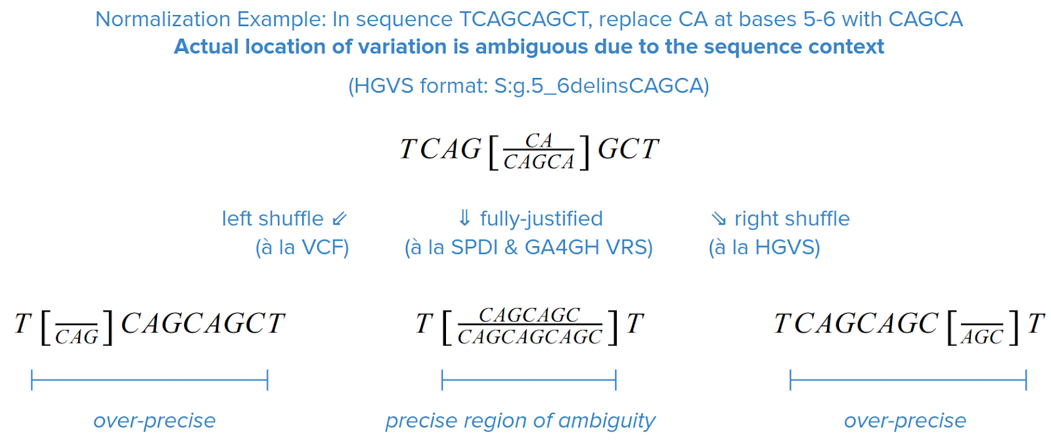

Fully-Justified Normalization Captures Region of Shuffling Ambiguity
Holmes, J.B., Moyer, E., Phan, L., Maglott, D. & Kattman, B. L.
SPDI: Data Model for Variants and Applications at NCBI.
bioRxiv 537449 (2019). doi:10.1101/537449
Slide prepared by Reece Hart
Notes:
Narration target: ~0:35 | Allow 0:06 for slide transition
This slide shows why normalization matters in repeats. The same sequence change can be written at several nearby positions and still produce the same final sequence. Fully justified normalization captures that whole region of equivalent placement. The goal is for equivalent descriptions to converge without asserting more precision than the evidence supports.
[6-second transition — not spoken]

Slide 6
What would SV repeats look like if we do not include literal sequence?
ref:
TCAGCAGCAGCAGCAGCAGCAGCAGCAGCAGCAGCAGCAGCAGCAGCAGCAGCAGCAGCAT
sample:
TCAGCAGCAGCAGCAGCAGCAGCAGCAGCAT
CAGCAGCAGCAGCAGCAGCAGCAGCAGCAGCAGCAGCAGCAGCAGCAGCAGCAGCAGCA
T
T
CAGCAGCAGCAGCAGCAGCAGCAGCAGCAGCAGCA
reference:
T[CAG]₁₉CAT
sample:
T[CAG]₁₁CAT
[CAG]₁₉CA
T
T
[CAG]₁₁CA
NC_000007.14:12664553:[CAG]₁₉CA:[CAG]₁₁CA

Slide 7
Topics for Discussion/Resolution
Repeats (mononucleotide-to-microsatellite)
  Repeat subunit sequence (length can be derived)
  Number of repeats in reference (floating point)
  Normalization (compare Reece's example to a SV equivalent - how does this inform?)
  What do the answers say about: name/usage of 'R' field, problem of overspecificity, etc.
Ranges
Imprecision

Slide 8
Simple insertion
Sequence (chromosome) | NC_000007.14
Position | 10,000,000
What happened | sequence was inserted
Length | 6112
What is the inserted seq? | (LINE1 insertion)
pre | S | P | D | I | R
SPDIR expression:
1
2

Slide 9
Simple duplication
Sequence (chromosome) | NC_000007.14
Position (range?) | 10,000,000 (10,000,000-10,005,000)
Length (or Stop position)
What happened
pre | S | P | D | I | R
SPDIR expression:
1
2

Slide 10
CopyNumberChange
Sequence (chromosome) | NC_000007.14
Position (range?) | 10,000,000 (10,000,000-10,005,000)
Length (or Stop position)
What happened
pre | S | P | D | I | R
SPDIR expression:
1
2

Slide 11
CopyNumberCount
Sequence (chromosome) | NC_000007.14
Position (range?) | 10,000,000 (10,000,000-10,005,000)
Length (or Stop position)
What happened
pre | S | P | D | I | R
SPDIR expression:
1
2

Slide 12
Adjacency
Sequence (chromosome) | NC_000007.14
Position (range?) | 10,000,000 (10,000,000-10,005,000)
Length (or Stop position)
What happened
pre | S | P | D | I | R
SPDIR expression:
1
2

Slide 13
Simple inversion
Sequence (chromosome) | NC_000007.14
Position (range?) | 10,000,000 (10,000,000-10,005,000)
Length (or Stop position)
What happened
pre | S | P | D | I | R
SPDIR expression:
1
2

Slide 14
Deletion (array or read-depth based)
Sequence (chromosome) | NC_000007.14
Position (range?) | 10,000,000 (10,000,000-10,005,000)
Length (or Stop position)
What happened
pre | S | P | D | I | R
SPDIR expression:
1
2

