Slide 1
ASM BIG 2026 NCBI Workshop
NCBI Pathogen Detection
Arjun Prasad
October 11, 2026

Slide 2





NCBI Pathogen Detection Pipeline
NCBI Pathogen Pipeline
BioProject
BioSamples
NCBI
Public Health Agencies
SRA
Basic researchers
GenBank
Clinical sources
Reports

Slide 3
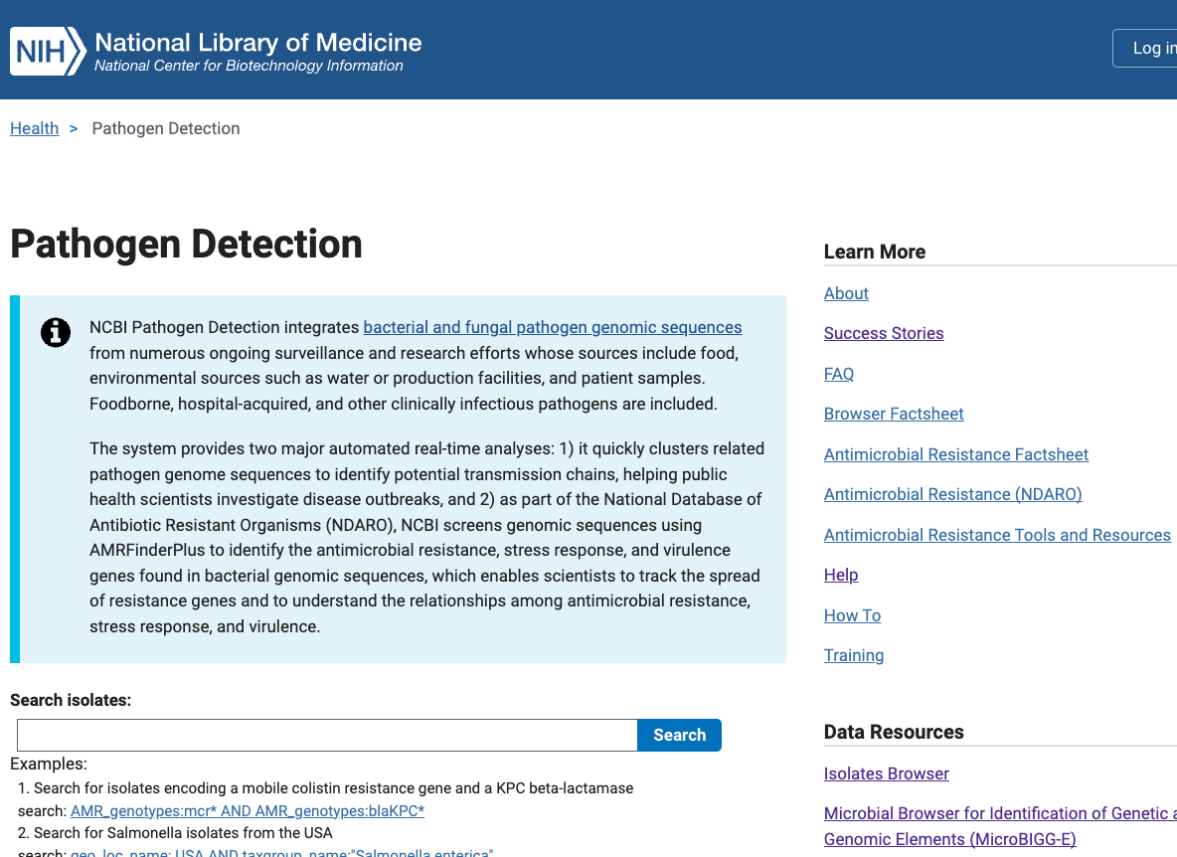
NCBI Pathogen Detection
https://www.ncbi.nlm.nih.gov/pathogens/
All public data
Generated by submitters
Currently 2.9 million assemblies
New genomes added and analyzed
daily
>100 pathogenic taxa

Slide 4
Pathogen Detection Analysis Goals
Are these isolates clonally related?
What is the anti-microbial resistance, stress response, and virulence gene repertoire of this isolate?
Notes:
The Pathogen Detection pipeline was initiated as part of this effort. There are effectively two main analytical goals of the pipeline: 1) the first is to identify if the isolates are clonally related to aid in the identification of food sources making people sick, and the second is to identify the genetic elements contributing to pathogenicity including antimicrobial resistance genes, stress response genes that contribute to environmental persistence, and virulence genes such as toxins. The results are presented in an easy-to-use web interface and I will give a brief demonstration in a few minutes of that for the first point.

Slide 5
Pathogen Detection Analysis Goals
Are these isolates clonally related?
What is the anti-microbial resistance, stress response, and virulence gene repertoire of this isolate?
Notes:
The Pathogen Detection pipeline was initiated as part of this effort. There are effectively two main analytical goals of the pipeline: 1) the first is to identify if the isolates are clonally related to aid in the identification of food sources making people sick, and the second is to identify the genetic elements contributing to pathogenicity including antimicrobial resistance genes, stress response genes that contribute to environmental persistence, and virulence genes such as toxins. The results are presented in an easy-to-use web interface and I will give a brief demonstration in a few minutes of that for the first point.

Slide 6
Pathogen Detection Pipeline
SRA
Assembly
Annotation
GenBank
Clustering
AMRFinderPlus
Trees
Goal <24 hours

Slide 7
Web browsers
Pathogen Detection Isolate Browser
Every row is an assembled isolate, possibly with AMR, virulence, and/or stress response genes and AST data
Reference Gene Catalog
Every row is a reference gene or point mutation
1,000 X N
1, 000,000 X N
Reference Gene Hierarchy
Every row is a node in our hierarchy
Download genomes
MicroBIGG-E (Microbial Browser for Identification of Genetic and Genomic Elements)
Every row is an AMR, virulence, and/or stress response genes with method, type, subtype, class, subclass, and supporting evidence
1000 X N
Reference HMM Catalog
Every row is an HMM
10, 000,000 X N
100 X N
Download genes, genes + flanks, contigs

Slide 8
Web browsers
Pathogen Detection Isolate Browser
Every row is an assembled isolate, possibly with AMR, virulence, and/or stress response genes and AST data
Reference Gene Catalog
Every row is a reference gene or point mutation
1,000 X N
1, 000,000 X N
Reference Gene Hierarchy
Every row is a node in our hierarchy
Download genomes
MicroBIGG-E (Microbial Browser for Identification of Genetic and Genomic Elements)
Every row is an AMR, virulence, and/or stress response genes with method, type, subtype, class, subclass, and supporting evidence
1000 X N
Reference HMM Catalog
Every row is an HMM
10, 000,000 X N
100 X N
Download genes, genes + flanks, contigs

