Slide 1


NATIONAL CENTER FOR BIOTECHNOLOGY INFORMATION • USER RESEARCH INITIATIVE
Help Shape the Future of NCBI Data Submission & Discovery!
Modernized Sequence Infrastructure
We need your input!
NCBI is building a modernized infrastructure to make submitting and discovering sequence data faster, easier, and more reliable. We are exploring natural-language search, automated sequence quality scoring, and an improved submission workflow.
Whether you submit sequence data, perform bioinformatic analyses, or search NCBI databases for research, your feedback is valuable and will guide the future of our tools.
Natural-Language Search
Automated Quality Scoring
Improved Submission Workflow
If you are interested in participating, please contact us at
prism@ncbi.nlm.nih.gov

Slide 2
ASM BIG 2026 NCBI Workshop
NCBI Pathogen Detection
Arjun Prasad
October 11, 2026

Slide 3





NCBI Pathogen Detection Pipeline
NCBI Pathogen Pipeline
BioProject
BioSamples
NCBI
Public Health Agencies
SRA
Basic researchers
GenBank
Clinical sources
Reports

Slide 4
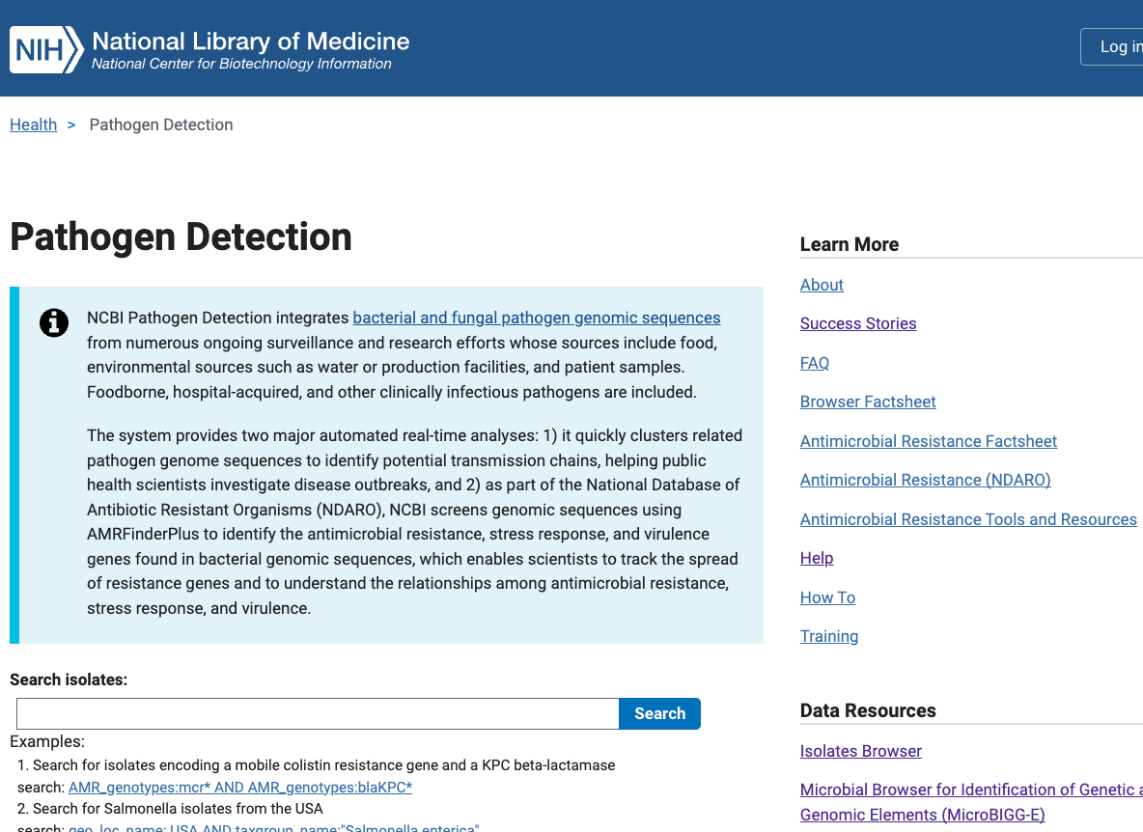
NCBI Pathogen Detection
https://www.ncbi.nlm.nih.gov/pathogens/
All public data
Generated by submitters
Currently 2.9 million assemblies
New genomes added and analyzed
daily
>100 pathogenic taxa

Slide 5
Pathogen Detection Analysis Goals
Are these isolates clonally related?
What is the anti-microbial resistance, stress response, and virulence gene repertoire of this isolate?
Notes:
The Pathogen Detection pipeline was initiated as part of this effort. There are effectively two main analytical goals of the pipeline: 1) the first is to identify if the isolates are clonally related to aid in the identification of food sources making people sick, and the second is to identify the genetic elements contributing to pathogenicity including antimicrobial resistance genes, stress response genes that contribute to environmental persistence, and virulence genes such as toxins. The results are presented in an easy-to-use web interface and I will give a brief demonstration in a few minutes of that for the first point.

Slide 6
Pathogen Detection Analysis Goals
Are these isolates clonally related?
What is the anti-microbial resistance, stress response, and virulence gene repertoire of this isolate?
Notes:
The Pathogen Detection pipeline was initiated as part of this effort. There are effectively two main analytical goals of the pipeline: 1) the first is to identify if the isolates are clonally related to aid in the identification of food sources making people sick, and the second is to identify the genetic elements contributing to pathogenicity including antimicrobial resistance genes, stress response genes that contribute to environmental persistence, and virulence genes such as toxins. The results are presented in an easy-to-use web interface and I will give a brief demonstration in a few minutes of that for the first point.

Slide 7
Pathogen Detection Pipeline
SRA
Assembly
Annotation
GenBank
Clustering
AMRFinderPlus
Trees
Goal <24 hours

Slide 8
Understanding the Min-same / Min-diff Fields
Clinical
Clinical
Clinical
Clinical
Clinical
Clinical
Environmental
Clinical
3
3
2
2
1
1
1
1
1
1
1
1
Min-same: 2, Min-diff: NA
Min-same: 4, Min-diff: 2
Calculated once, does not change unless SNP cluster changes
Notes:
Min-same and min-diff shown diagrammatically. On the left the min-same is 2 and there is no opposite type, so no min-diff. On the right by replacing a clinical with an environmental, the min-same moves to 4 and min-diff is now two.

Slide 9
Web browsers
Pathogen Detection Isolate Browser
Every row is an assembled isolate, possibly with AMR, virulence, and/or stress response genes and AST data
Reference Gene Catalog
Every row is a reference gene or point mutation
1,000 X N
1, 000,000 X N
Reference Gene Hierarchy
Every row is a node in our hierarchy
Download genomes
MicroBIGG-E (Microbial Browser for Identification of Genetic and Genomic Elements)
Every row is an AMR, virulence, and/or stress response genes with method, type, subtype, class, subclass, and supporting evidence
1000 X N
Reference HMM Catalog
Every row is an HMM
10, 000,000 X N
100 X N
Download genes, genes + flanks, contigs

Slide 10
Web browsers
Pathogen Detection Isolate Browser
Every row is an assembled isolate, possibly with AMR, virulence, and/or stress response genes and AST data
Reference Gene Catalog
Every row is a reference gene or point mutation
1,000 X N
1, 000,000 X N
Reference Gene Hierarchy
Every row is a node in our hierarchy
Download genomes
MicroBIGG-E (Microbial Browser for Identification of Genetic and Genomic Elements)
Every row is an AMR, virulence, and/or stress response genes with method, type, subtype, class, subclass, and supporting evidence
1000 X N
Reference HMM Catalog
Every row is an HMM
10, 000,000 X N
100 X N
Download genes, genes + flanks, contigs

Slide 11


To Exercise 1
Outbreak investigation
Follow evidence from case to possible source
https://github.com/ncbi/workshop-asm-big-2026/blob/main/outbreak/README.md
Notes:
Link target: https://github.com/ncbi/workshop-asm-big-2026/tree/main/amr#exercise-1-explore-carbapenem-resistance-in-eye-drop-isolates
Image theme: Public-health outbreak investigation
Generated image prompt: Top-down documentary photograph of public-health investigators reviewing a case map, specimen tubes, and sealed product samples.
Generated with the built-in image generation tool.

Slide 13
Pathogen Detection Analysis Goals
Are these isolates clonally related?
What is the anti-microbial resistance, stress response, and virulence gene repertoire of this isolate?
Notes:
The Pathogen Detection pipeline was initiated as part of this effort. There are effectively two main analytical goals of the pipeline: 1) the first is to identify if the isolates are clonally related to aid in the identification of food sources making people sick, and the second is to identify the genetic elements contributing to pathogenicity including antimicrobial resistance genes, stress response genes that contribute to environmental persistence, and virulence genes such as toxins. The results are presented in an easy-to-use web interface and I will give a brief demonstration in a few minutes of that for the first point.

Slide 14
AMRFinderPlus Uses a Curated Database, HMMs and BLAST to Identify AMR genes
Report on
resistance genes
- integrated into Pathogen Detection Isolate Browser for >2.9 million pathogen isolates
Proteins
Nucleotide
HMMs and
BLAST
Available at:
https://github.com/ncbi/amr/wiki
AMR
database
”Plus” contains:
1,034 virulence factor proteins
259 acid, biocide, metal, and heat resistance proteins
Optional for users
8,545 resistance proteins
784 HMMs
114 drug classes
~70% beta-lactamases
AMRFinderPlus now finds point mutations
1,618 resistance mutations and 26 disrupted genes for 32 taxa
Database: 2026-05-15.1
https://github.com/ncbi/amr/wiki/Curated-organisms

Slide 15
Reference databases
Data used by AMRFinderPlus to identify genes and point mutations
Reference Gene Catalog
Every row is a reference gene or point mutation
1,000 X N
Download reference sequences
Reference Gene Hierarchy
Every row is a node in our hierarchy
1000 X N
Reference HMM Catalog
Every row is an HMM
100 X N
Notes:
The prediction tool, the reference sets, and the results of the predictions are made available in various data formats including easy-to-use web browwsers. There are over 1 million pathogen isolates, and over 10 million predicted genes and point mutations found in these pathogens. Together these comprise the National Database of Antibiotic Resistant Organisms. (The NIH/NLM/NCBI NDARO is a collaborative, cross-agency, centralized hub for researchers to access AMR data to facilitate real-time surveillance of pathogenic organisms, which currently contains genomic data for nearly one million pathogen isolates collected from publicly available information. Many of these isolate entries include integrated antibiotic susceptibility phenotypic data, antibiotic resistance genotypic data, and detailed information on the sequences encoding resistance genes found in these isolates.) The NIAID funded PATRIC resource uses NDARO as one of its data sources.

Slide 16
Analysis results
Pathogen Detection Isolate Browser
Every row is an assembled isolate
1,000,000 X N
Download genomes
MicroBIGG-E (Microbial Browser for Identification of Genetic and Genomic Elements)
Every row is an AMR, virulence, and/or stress response genes with method, type, subtype, class, subclass, and supporting evidence
AST Browser
Submitted Antibiotic Susceptibility test results
100,000 X N
10,000,000 X N
Download phenotypes
Download genes,
genes + flanks, contigs
MicroBIGG-E Map
Graphic display of MicroBIGG-E data

Slide 17
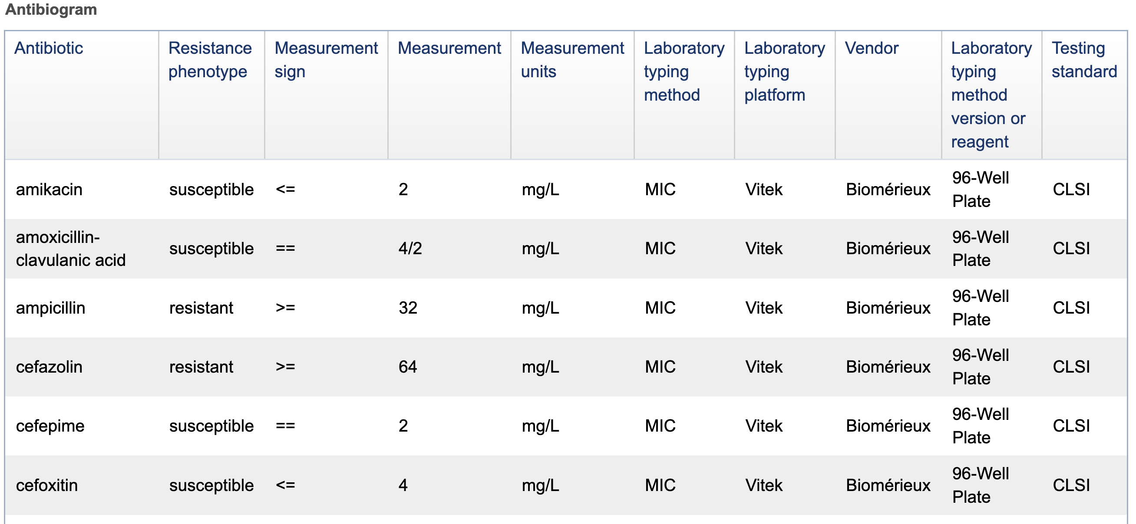
AST data from BioSample
If you have AST data and want to submit them, contact pd-help@ncbi.nlm.nih.gov

Slide 18
Understanding AMRFinderPlus: Class and Subclass
Class represents broad class of drugs to which resistance can be conferred; e.g., "AMINOGLYCOSIDE"
Subclass has more specificity and can include groups of drugs or individual antibiotics; e.g., "AMIKACIN/TOBRAMYCIN"
Beta-lactamase resistance (BETA-LACTAM) is divided into 3 subclasses:
  BETA-LACTAM: unknown/unclear resistance OR resistance to penicillins
  CEPHALOSPORINS: resistance to 2nd generation (or newer) cephalosporins
  CARBAPENEMS: resistance to some (or all carbapenems)
Note: many virulence genes will lack values for these fields

Slide 19
To Exercise 2
Antibiotic resistance
Explore resistance genotypes and phenotypes
https://github.com/ncbi/workshop-asm-big-2026/blob/main/amr/README.md
Notes:
Link target: https://github.com/ncbi/workshop-asm-big-2026/tree/main/amr#exercise-1-explore-carbapenem-resistance-in-eye-drop-isolates
Image theme: Public-health outbreak investigation
Generated image prompt: Top-down documentary photograph of public-health investigators reviewing a case map, specimen tubes, and sealed product samples.
Generated with the built-in image generation tool.

Slide 21
Plasmids and antimicrobial resistance in hospital metagenomes
https://github.com/ncbi/workshop-asm-big-2026/blob/main/metagenomics/README.md

Slide 22
Metagenomics
Culture-independent, untargeted sequencing of total genomic DNA recovered directly from a mixed sample
Shotgun metagenomics is when you don’t target a particular gene or set of genes, but just sequence everything randomly

Slide 23
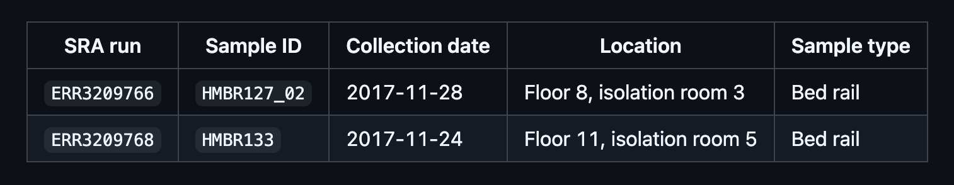
Chng et al. (2020), Cartography of opportunistic pathogens and antibiotic resistance genes in a tertiary hospital environment.
Sampled various hospital surfaces and sequenced enriched cultures.
We will focus on three of the plasmids from two sequencing runs on two samples.

Slide 24
Exercise overview
Prepare the targets and reads. Download published plasmid sequences, select three targets, and obtain and filter reads from two metagenomes.
Explore the sample composition. Use STAT and its Krona display to examine the taxa represented in a metagenomic sample.
Assemble and compare sequences. Run SAUTE and use BLAST to compare the assemblies with the plasmid targets.
Investigate resistance genes and related genomes. Run AMRFinderPlus, search Pebblescout, and follow a match into Pathogen Detection.

Slide 25
To Exercise 3
Metagenomics
Some tools to explore metagenomic data
https://github.com/ncbi/workshop-asm-big-2026/blob/main/metagenomics/README.md
Notes:
Link target: https://github.com/ncbi/workshop-asm-big-2026/tree/main/amr#exercise-1-explore-carbapenem-resistance-in-eye-drop-isolates
Image theme: Public-health outbreak investigation
Generated image prompt: Top-down documentary photograph of public-health investigators reviewing a case map, specimen tubes, and sealed product samples.
Generated with the built-in image generation tool.

Slide 26
Acknowledgements
Richa Agarwala
Victor Ananiev
Azat Badretdin
Slava Brover
Joshua Cherry
Jinna Choi
Vyacheslav Chetvernin
Pavan Chilamakuri
Robert Cohen
DeAnne Cravaritis
Michael DiCuccio
Olga Ermoleava
Boris Fedorov
Mike Feldgarden
Lewis Geer
Renata Geer
Dan Haft
Lianyi Han
Avi Kimchi
Michel Kimelman
William Klimke
Alex Kotliarov
Valerii Lashmanov
Aleksandr Morgulis
Eyal Moses
Chris O'Sullivan
Arjun Prasad
Edward Rice
Kirill Rotmistrovskyy
Alejandro A. Schaffer
Nadya Serova
Sergey Shiryev
Martin Shumway
Oleg Shutov
Douglas Slotta
Alexandre Souvorov
Tatiana Tatusova
Francoise Thibaud-Nissen
Igor Tolstoy
Ed Wachtel
Lukas Wagner
Jay Worley
Hlavina Wratko
Chunlin Xiao
Alexander Zasypkin
Eugene Yaschenko
Mingzhang Yang
David Lipman
James Ostell
Kim Pruitt
Stephen Sherry
ASM
APHL
BWH
CDC
FDA/CFSAN
FDA/CVM
GenFS
USDA-FSIS
PHAC/CFIA
PHE/FERA
NIAID
Wadsworth/MDH
pd-help@ncbi.nlm.nih.gov
This |work was supported by the National Center for Biotechnology Information of the National Library of Medicine (NLM) and the National Institute of Allergy and Infectious Diseases (NIAID), National Institutes of Health (NIH), and the Human Foods Program (HFP), Food and Drug Administration (FDA). The contributions of the NIH author(s) are considered Works of the United States Government. The findings and conclusions presented in this paper are those of the author(s) and do not necessarily reflect the views of the NIH or the U.S. Department of Health and Human Services.

