Slide 1
Magento 2 Presentation

Slide 2
Content
1. Structure Folder
2. Structure Module
3. Create module simple
4. Event, plugin, preference

Slide 3
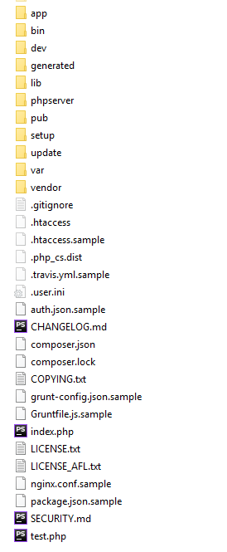
1. Structure Folder
app: - /code: Module
- /design: Theme
- /etc: config.php, env.php, di.xml …
bin: Run command line.
dev: Test script.
generated: - Interceptor.php (Plugin)
- Factory.php
- Proxy.php
lib: The directory contains several libraries packed separately from the Magento core.
pub: - media: image, videos …
- static: build css, js
setup: Setup magento.
var: - cache: cache, view_preprocessed, page_cache
- /export:
- /log: debug.log, system.log, exception.log …
- /report
vendor: Core magento

Slide 4
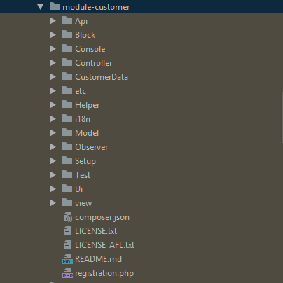
2. Structure Module
Api: API
Block: Create function use for phtml file.
Console: Define cli
Controller: Url redirection
CustomerData: Local Storage -> mage-cache-storage
etc: contain file xml (module.xml, di.xml, event.xml …)
Helper: Common function
i18n: Translate
Model: ResourceModel connect database
Observer: Event Magento
Setup: Install and Upgrade Data or Schema
Test: Function test
Ui: Define component .
registration: Register module

Slide 5
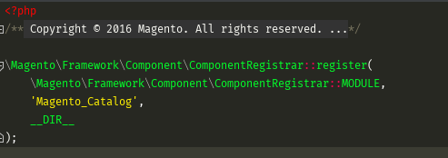
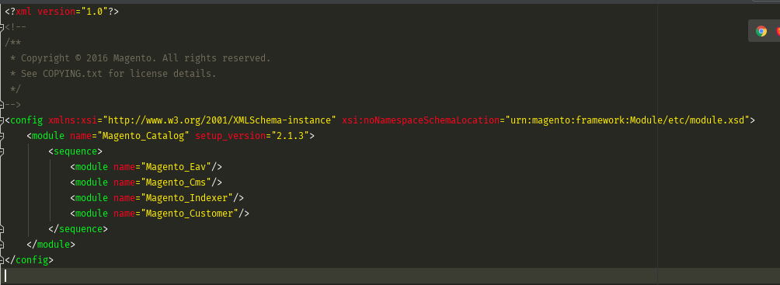
3. Create Simple Module
registration.php
Module Name: Magento_Catalog.
sequence: Dependency module (Magento_Eav …)
version: 2.1.3
module.xml

