Slide 1
Harvey Nash Scrum Process NHI HUYNH-PQA, CSM

Slide 2
Outline
Scrum Framework
Harvey Nash Scrum Process and template
Q&A, Examination

Slide 3
You will learn
The Why of Scrum
The What of Scrum
The How of Scrum:
Scrum Roles
Sprinting
Reports
Apply Harvey Nash Scrum process

Slide 4
Scrum Principal

Slide 5
Why is Scrum?
Penny Game
2 teams, each team has 5 members, 5 supervisers, 1 PO, 1 User
Circle life: 10 paths, 5 paths, 2 paths, 1 path
Rule: measure effort each circle
What things do you realize?
Smaller batches produce faster cycle times
Water Fall has Plan driven approach
Scrum has Value driven approach

Slide 6
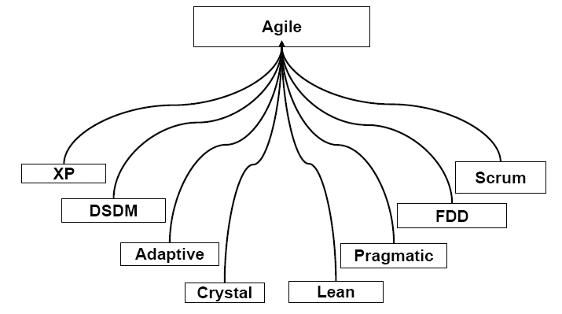
What is Scrum?
Scrum is:
A framework for product
Development in Complex and
Chaotic
An Empirical process
Notes:
Chaotic: kei’otik: lộn xộn
Empirical: kinh nghiem chu nghia

Slide 7
The Foundations of Scrum
Cross functional team
Single works stream
Time boxing
(Re)Defining Done
Progressive elaboration
Self Organization
Notes:
Cross functional team: major resource
Single works stream: sprint, user story (Stream: luồng, dòng)
Time boxing: how many stuff you can do in sprint → Velocity
(Re)Defining Done: Done or Not done. There is no 80% complete
Progressive elaboration: xây dung su tien bo: Retrospective, increase velocity
Self Organization: why? → avoid bottle neck, depend on somebody → Gioi han cua Self Organization? → in sprint

Slide 8
Three pillars of Scrum
Transparency: the progress of the work and the team is visible to all.
Inspection: frequent opportunities to review the current state of the work and how the team is using Scrum.
Adaptation: to follow inspection, it is critical to make changes and adapt to the new ideas, information, and current environment of the work

Slide 9
Scrum Overview

Slide 10
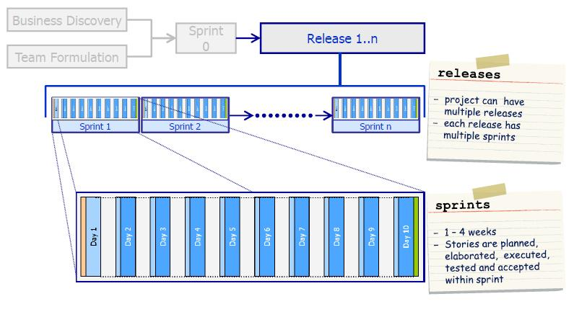
Project Road Map

Slide 11
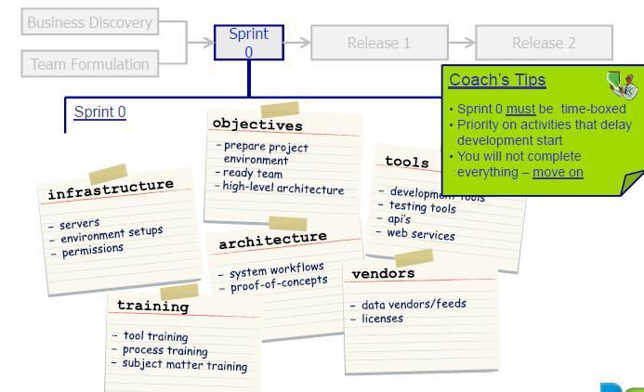
To Start Up
Sprint 0: To “setup” a project or product, to do non-functional work
Notes:
Key things:
Objectives
Tools
Architecture
Training….

Slide 12
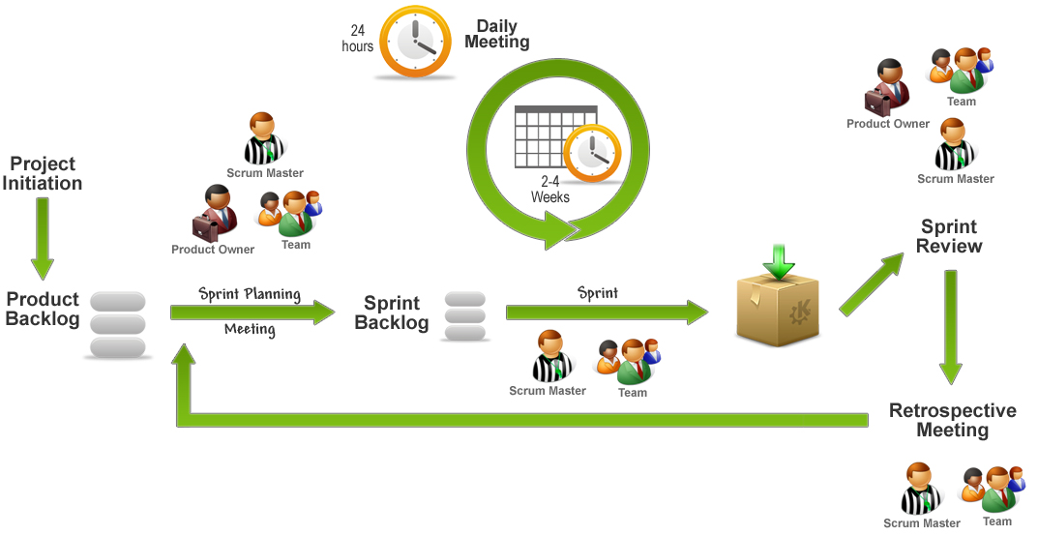
Sprint Overview

Slide 13
3 most important things in Scrum
3 Roles:
Product Owner
Scrum Master
Scrum Team
4 Events:
Planning meeting
Daily meeting
Sprint review meeting
Retrospective meeting
3 Artifacts:
Product backlog (store User Story with priority)
Sprint log
Reports (Burndown Charts)

Slide 14








Scrum Roles
Product Owner
Scrum Master
Scrum Team
Stakeholders & Users
Security Clasification: Internal
Notes:
PO: What to build
Team: How to build
Scrum master: facility: make sure team build fast and stable

Slide 15
How do Scum work?
Based on 4 events:
Planning meeting: Sprint goal + tasks
1st stage:
Present the highest priority Product Backlog.
Review and clarify each item→ user story points
Break each story into tasks and clearly defined acceptance criteria (Define sprint goal)
2nd stage:
Estimate for each task : each task should be <=16hrs
Commitment to complete the tasks.
Update to sprint backlog

Slide 16
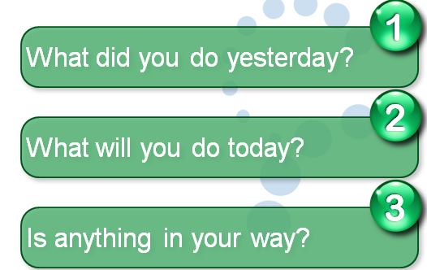
How do Scrum work?
2. Daily meeting:

Slide 17



How do Scrum work?
3. Sprint review meeting: Show
“Done” Story
Incomplete Story
Accept/Reject
Put in Product Backlog
Scrum Team
Product Owner
Demo
Inform
Security Classification: Internal
Notes:
What will be happened if Scrum Team can’t complete Story? → Don’t move to next Sprint

Slide 18
How do Scrum work?
4. Retrospective meeting: 3 questions
What went well during the last sprint?
What could be improved in the next sprint?
Action need

Slide 19
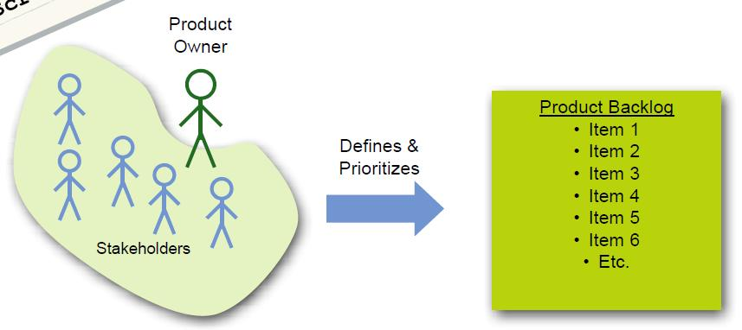

Artifact: The Product Backlog
→ Things you get
Backlog Item | Estimate | Priority
As a Conference Room Coordinator I want to allow a Guest to make a reservation in the system so that we can book their request for a conference room in our system. | Large (4 –6) | 1

Slide 20
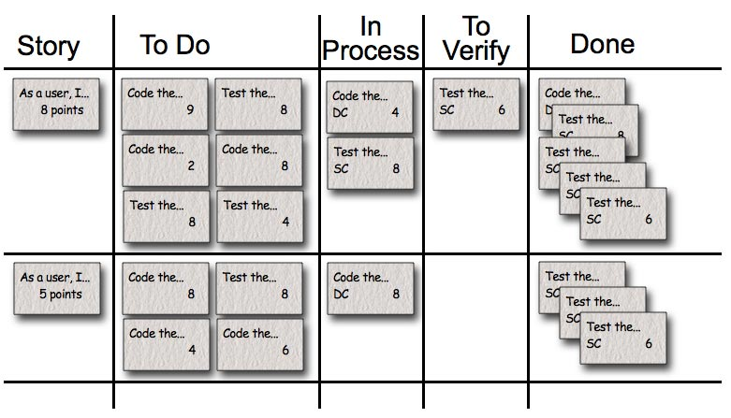
Artifact: Sprint log, Task Board
→ Things you do
https://jira.harveynash.vn/secure/Dashboard.jspa

Slide 21
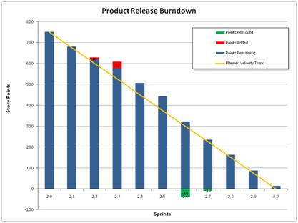
Report: Release Burndown Chart
0 hrs.
Notes:
Release burndown :
Show: sum total of estimated work remaining in Product Backlog for the current Release and current burn rate
Used to : manage Release
Owner: product owner

Slide 22
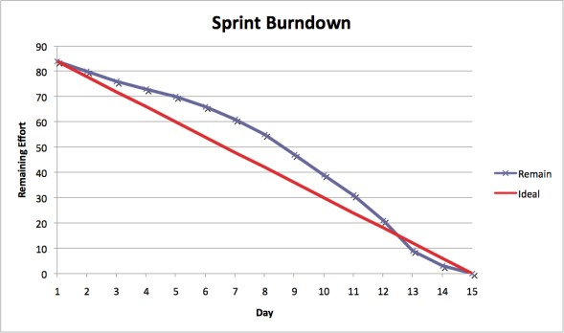
Report: Sprint Burndown Chart
Notes:
Sprint burndown:
Show: sum total of estimated tasks remaining in the Sprint Log and current burn
Used to: manage sprint
Owner: Team

Slide 23
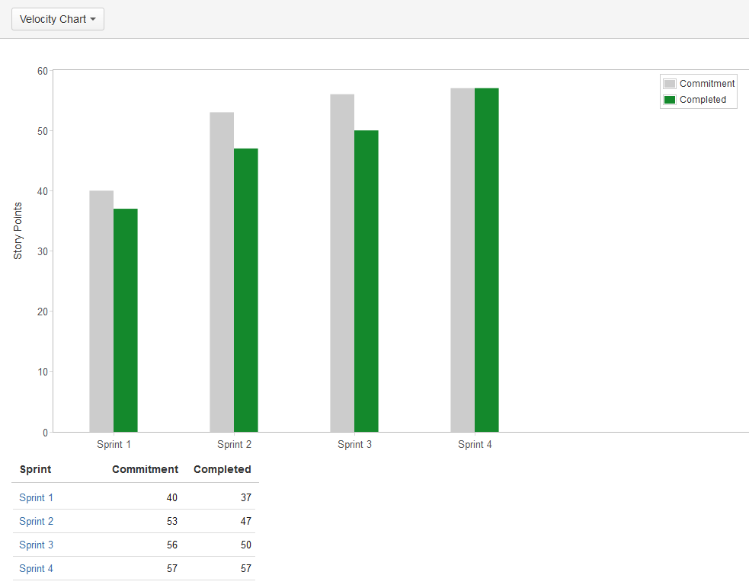
Report: Velocity Chart
Notes:
Velocity chart:
Show: Historical rate of project delivery
Used to: assess impact of impediment removal
Owner: Scrum Master

Slide 24
Harvey Nash Scrum Process

Slide 25
How HvN Scrum is difference?
3 Roles:
Product Owner
Scrum Master
Scrum Team → BA, TA, Dev, QC
4 Events: including management processes
Planning meeting
Daily meeting
Sprint review meeting
Retrospective meeting
3 Artifacts: Output from standard processes
Product backlog (store User Story with priority)
Sprint log
Reports (Burndown Charts)

Slide 26
HvN Scrum Process Characteristics
Belong to Harvey Nash Software Development Process Standard
Combine Scrum framework and CMMI best practice to:
Suitable for Harvey Nash
Add the best value to org and customer

Slide 27
Criteria for Harvey Nash Scrum Approach
Project type is not fixed price. It should be ODC, T&M
Client and Project team members have good awareness on SCRUM.
Product Owner, Scrum master, Scrum Team are clearly defined.
Product Owner is Client (or representative ) and make sure they have time to stay with development team for queries and explanation on stories. (It should be at least 2 hours/day)
Development team are self-organising

Slide 28




HvN Scrum Roles
Project Manager
Business Analyst
Product Owner
Scrum Master
Developer
Architect
The Team
Stakeholders & Users
Project Director
Tester

Slide 29
HvN Scrum Rule
Sprint duration is never extended
The Product Owner is one person
SAD must be done at sprint 0
Processes (such as Project Monitoring and Control, Coding, Testing process...) in Scrum project are referred to standard processes
Design note must be provided for user stories

Slide 30
HvN Scrum: How to work
Items | Definition of Done
Sprint 0 | Project team is trained about Scrum Process.
 | All committed work products in approved tailoring sheet have to be completed according to SLA.
 | SAD is ready
 | Coding Convention and Code review checklist must be approved in case client doesn’t require using their standard Development, testing environment and testing device are ready.
 | All agreement, commitments have to be transferred to project team members.
 | All dependencies impact on Sprint 1 back log are resolved.
 | Requirement for Sprint 1 is approved by PO.
 | Build script, build guide is developed

Slide 31
HvN Scrum: How to work
Items | Definition of Done
A US/PBI | US is provided or approved by Product Owner.
 | US is transferred and understood by the team.
 | Tasks for US are identified and estimated by the team.
 | Design note is provided for US if required
 | Code is completed and passed code review with zero open defect.
 | Unit tests are completed and passed.
 | Acceptance criteria of user story are passed.
 | Test cases are generated as approach which mentioned in test strategy.
 | All cases of the test case have been are executed and passed
A Successful Sprint | All committed US/PBI are done.
 | There are no Critical and Major bugs.
 | Unit test has to cover at least 70% of the source code.

Slide 32
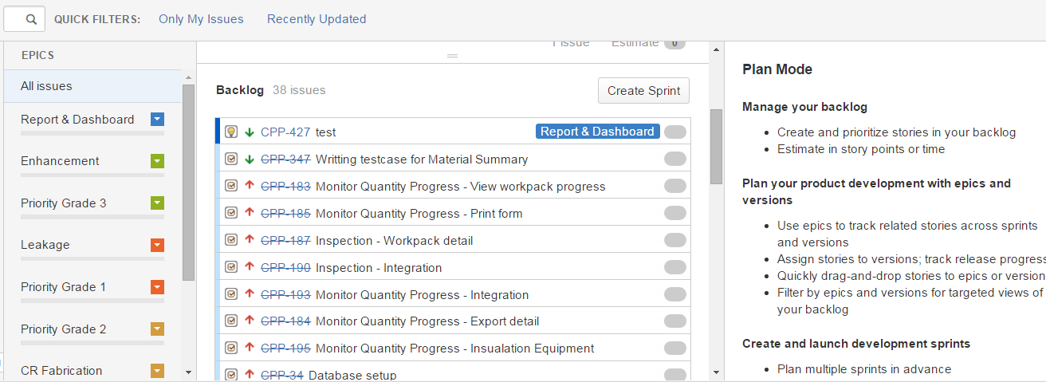
HvN Scrum tool
Product Backlog: https://jira.harveynash.vn

Slide 33
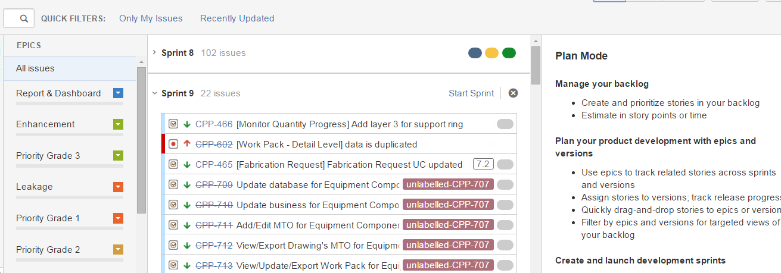
HvN Scrum Tool
Sprint Log: https://jira.harveynash.vn

Slide 34
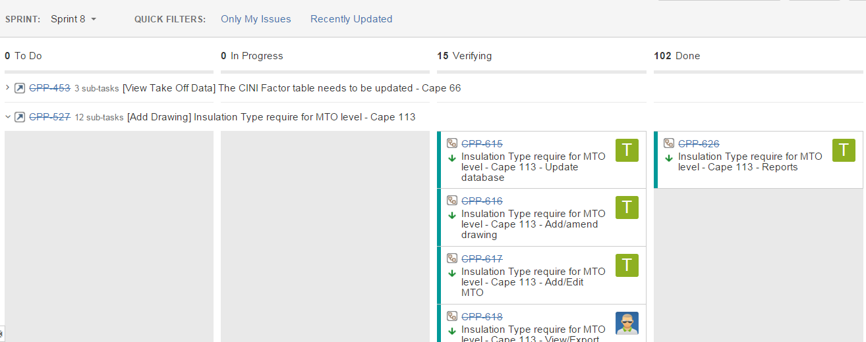
HvN Scrum Tool
Task Board: https://jira.harveynash.vn

Slide 35
Q&A

