Slide 1

Rule of Project
Chau Thanh Nhan 11-22-2016

Slide 2
Agenda
Why?
Mail
Redmine
Pull/Push GIT
SCM Flow
Mean of “Done”
Report

Slide 3
Why?
Shared the project information
No conflict
Support and work together

Slide 4
Mail
Subject Mail
Add prefix [projectname]
Could add prefix [recevied name] after projectname
Ex: Subject: [MagentoProject][Nhan]Setup Environment
Mail Meeting
Use meeting template to invite
Must have Invite, Time, Location
Must have Agenda of meeting
Content Mail
Should explain detail.

Slide 5
Redmine
Member don’t create task without parent task
Task MUST have category and target version

Slide 6
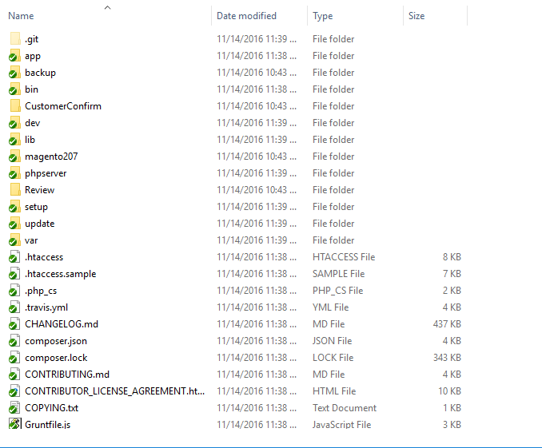
Pull/push Git
Should use TortoiseGIT
Get latest version of source code
Should use SSH(don’t use http)
Pull Time: 08:30
Push Time: 16:30

Slide 7
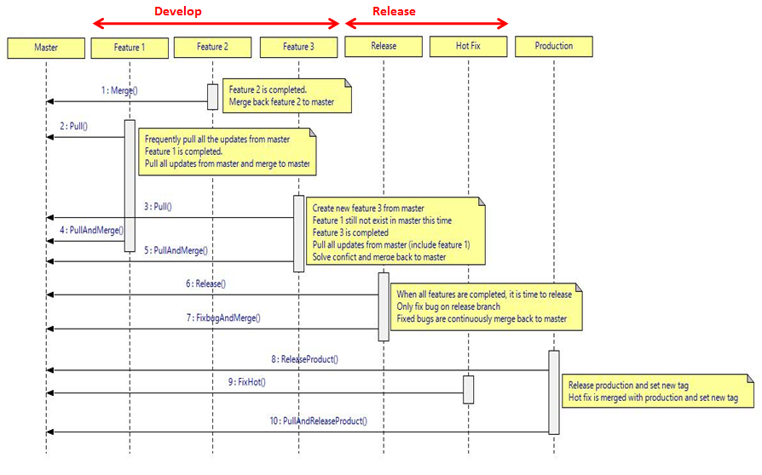
SCM Flow
Develop
All Member
Master
Configuration Controller
Release
Configuration Controller
Product
Configuration Controller
Configuration Controller is assigned by Leader

Slide 8
MEAN OF “DONE”
Task is done after is confirmed from Leader.
Coding Task is done if is passed coding, unit test, review.

Slide 9
Report
Daily Report
Get Plan/Start Date/ Due Date/ Progress from Redmine
If task is late, we need to input the problem
Do input/report the sub tasks which is created by yourself
Use Daily Report Template
Log Time
Input Log time redmine everyday
Weekly Report
Collect problems, efforts, Plan

Slide 10
The end
Thank You

