Slide 1

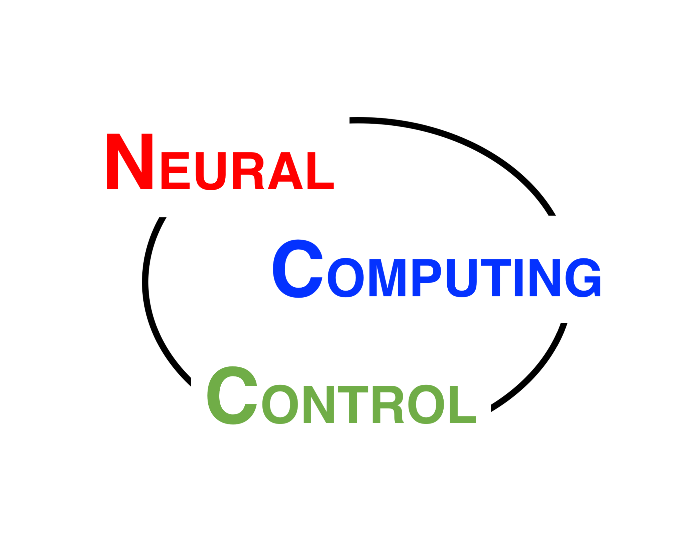
Tips for graduate students A kick-off course
神经计算与控制
NCC lab
Quanying Liu
Sep 27, 2019
liuqy@sustech.edu.cn
Office: SUSTech, Taizhou Building, Room 310
Note: The comics used in the slides are from http://phdcomics.com/comics/
I will remove them if there is any copy right issues.

Slide 2
First of all
Congratulations for joining SUSTech graduate program!

Slide 3
知识改变命运
Your life has been changed…
Notes:
知识改变命运

Slide 4
Your daily life will involve:
Wake up. Courses. Lunch. Courses. Dinner. Homework. Sleep.
Read papers. Read papers. Read papers…
Run experiments. Run experiments. Run experiments …
Analyze data. Analyze data. Analyze data. Analyze data …
Write manuscript. Write manuscript. Write manuscript…
Sell your ideas to others…

Slide 5
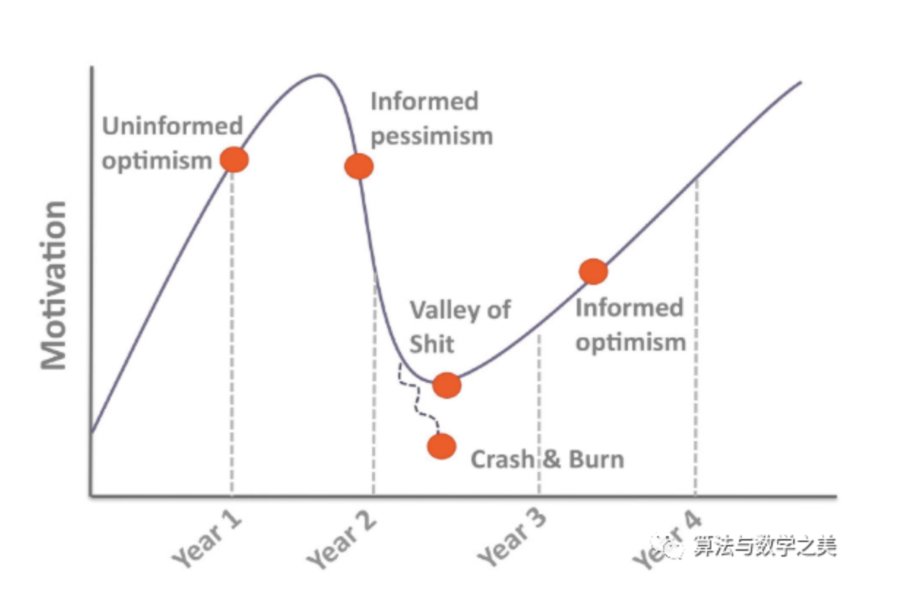
Be self-motivated and realistic
But keep your dream.
莫名的乐观
知情的悲观
情绪的谷底
(可能的)奔溃
知情的乐观

Slide 6
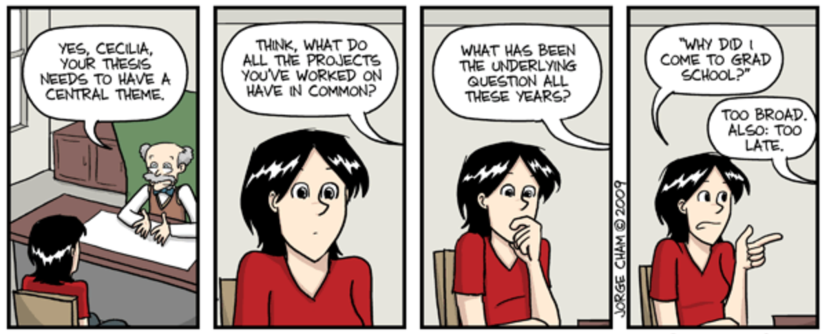
Think ahead to your thesis.

Slide 7
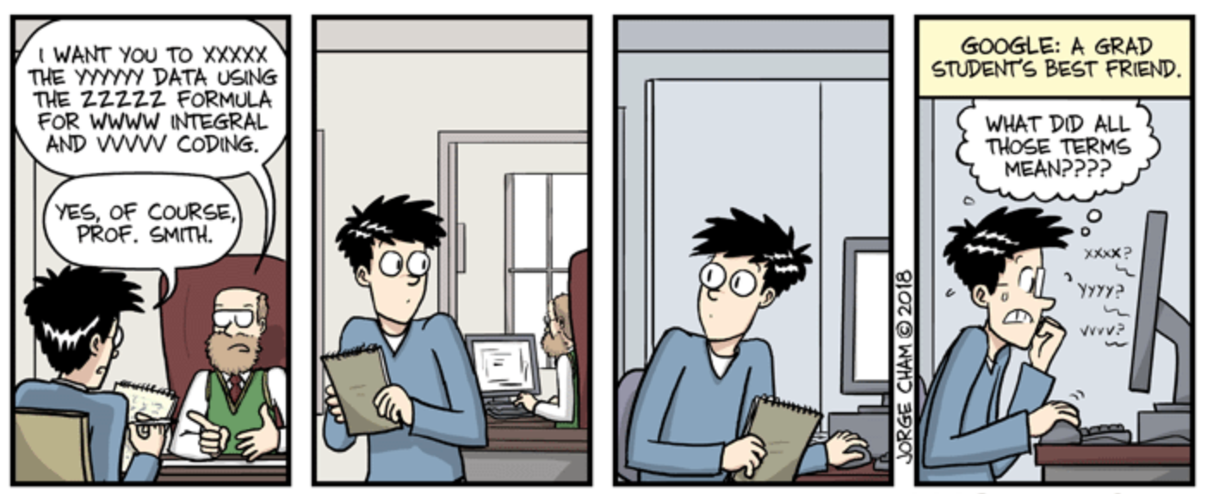
Communications are important.

Slide 8
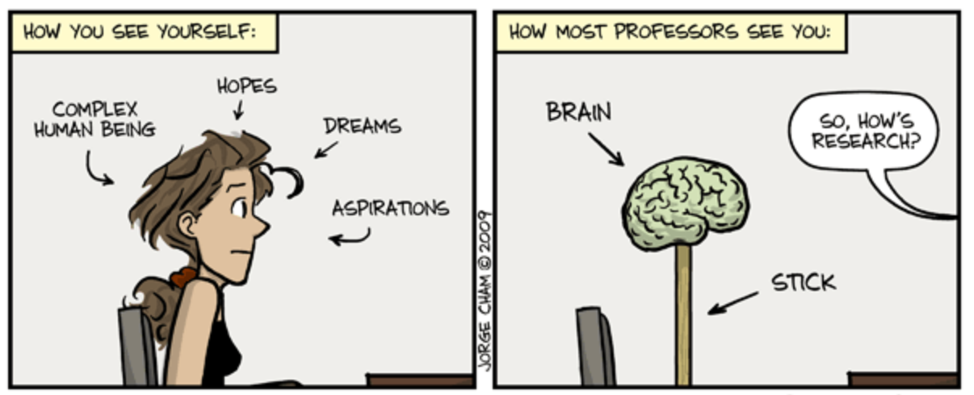
You and your professor may have different pictures on you.

Slide 9
What will you do in the summer (holiday)?
SUMMER
Students, Under-Managed, Mainly Evade Research
Sweltering Unproductive Months, Manuscript Expectations Reduced
‘So-so, Unexceptional, Mediocre’ – Mean Editorial Reviewer
Short-term Undergraduate Minions Make Experiments Relaxing

Slide 10
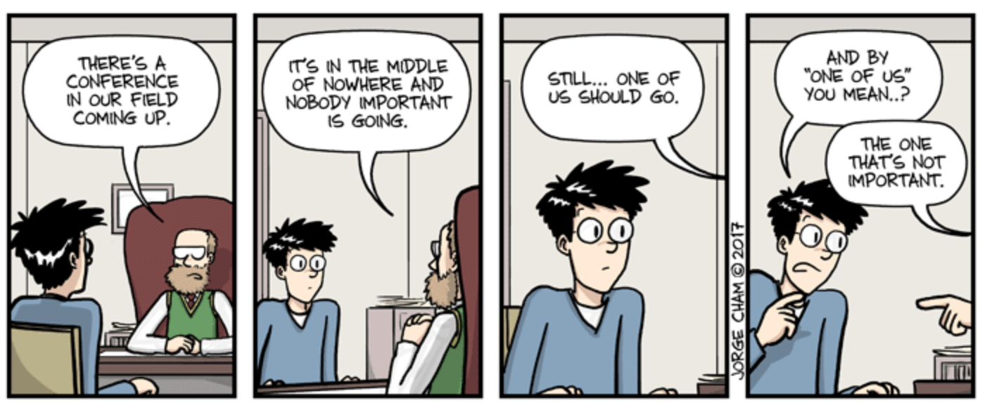
Attend some (top) conferences.

Slide 11
Understand your professor.
A professor’s life is tough.

Slide 12
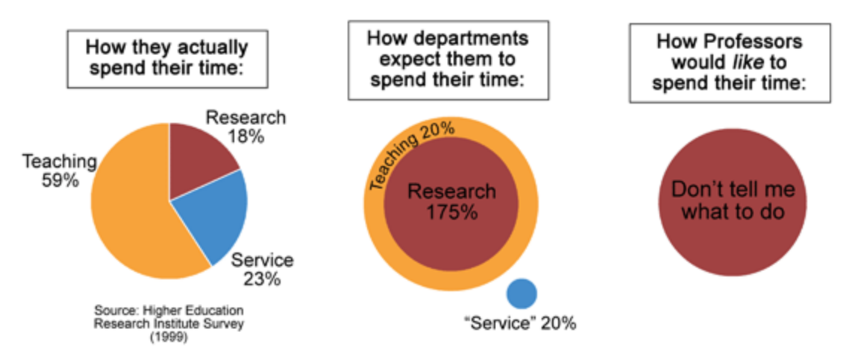
As a professor, 200% of workloads are very common.

Slide 13
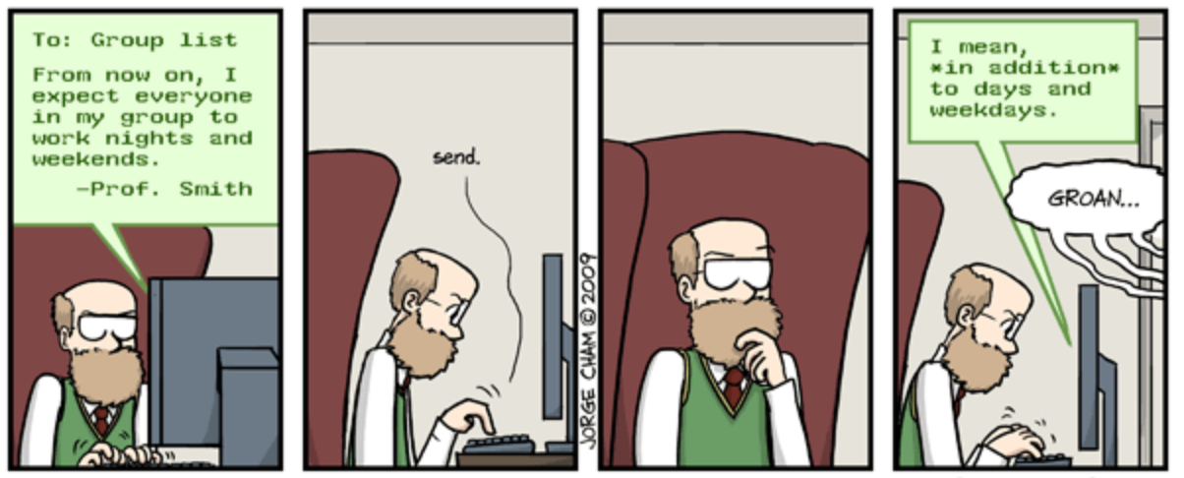
Therefore, your professor may also expect you 200% of workloads.

Slide 14
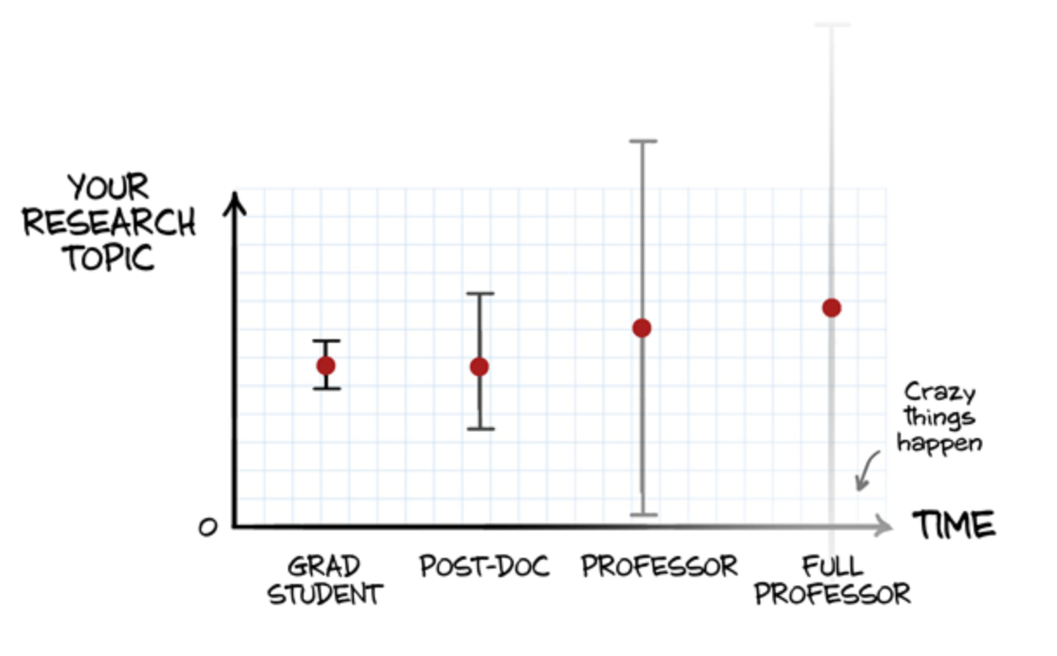
To choose a research topic, something need be cautious…

Slide 15
How to stay in academia?
Get a PhD position
Get a postdoc position
Get another postdoc position
…
Get a tenure-track assistant professor position
Get tenured!
Publish in CNS

Slide 16
Keep your curiosity.
Be proud of yourself.
Be happy.

Slide 17
Life is long.

Slide 18
Enjoy your life at SUSTech.

