Slide 1
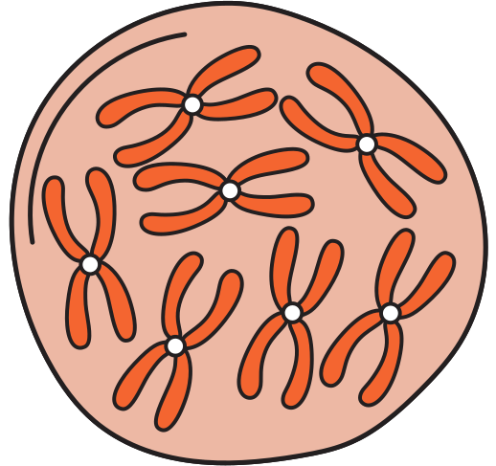
DNA:
BIOMARKERR
DISCOVERT
Nadeen Ali - 22110361

Slide 2

OUR PROBLEM?
Stomach adenocarcinoma (or just simply a type of stomach cancer, the most common)
THE DATA WE FOUND?
From LinkedOmics, using RNA-Seq (gene expressions), Mutation Data (statuses as 0s and 1s), and Clinical data (basic clinical features)
All datasets include the same patients!

Slide 3
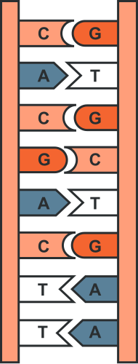
CLEANED DATA?
Ensured datasets’ rows = patients (samples) and cols = features (genes or clinical data)
Filtered low quality data based on a threshold (why have genes that are lowly expressed/mutated)
Check for null values and dropped any if found
Concatenated all 3 datasets to find the common samples (patients)!

Slide 4
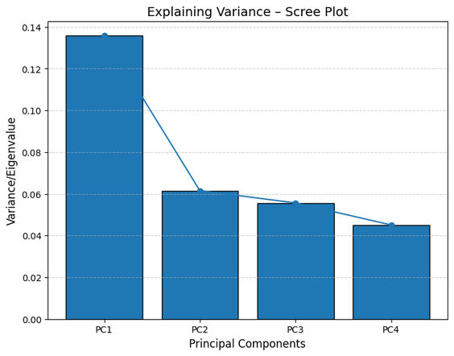
OUTLIERS?
Used PCA, TSNE & UMAP (both with PCA)
very low explaining variance
no outliers detected
no strong groups detected (slight clusters, just not strong enough)

Slide 5
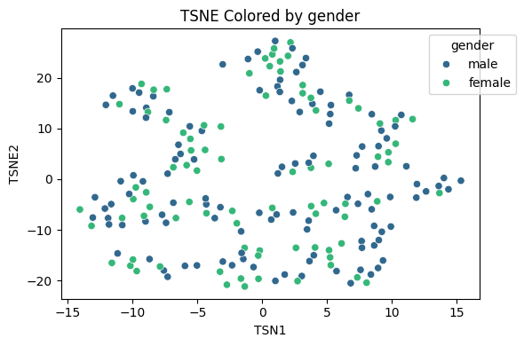
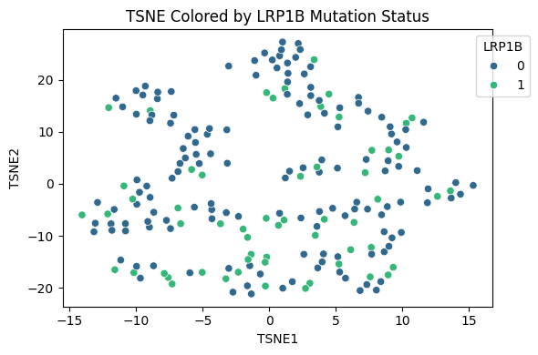
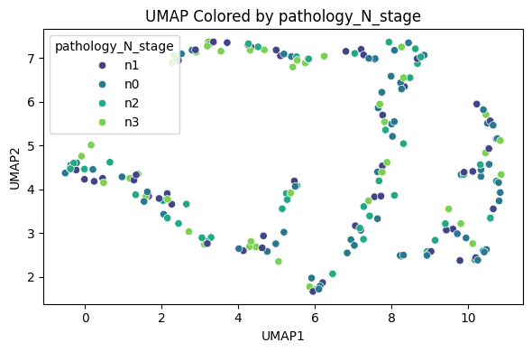
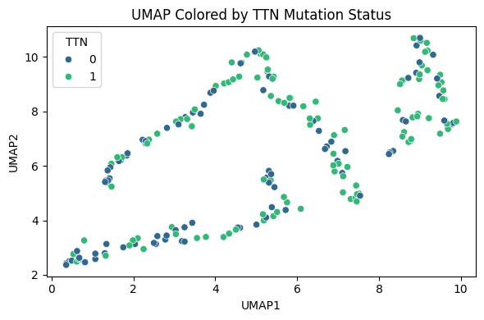
OUTLIERS?
Plots had similar patterns/structure (variables not strong enough to drive expression?)
Conclusion: no strong outliers or groups - do not remove ANY DATA

Slide 6
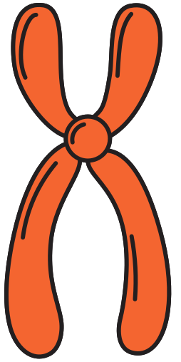
NOW WHAT?
MOFA OBJECT CREATION
WHAT FOR?
TO INTEGRATE MULTI-OMICS
DATA (RNA-SEQ & MUT) FOR DEEPER ANALYSIS

Slide 7
THE IMPORTANT PART
DOWNSTREAM ANALYSIS

Slide 8
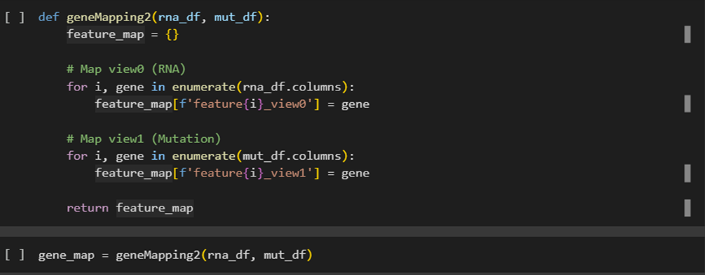
WHERE ARE THE GENE NAMES?
MOFA did not pick up gene names during training - plots will not have gene names :(
Created a function to map feature names to gene names!

Slide 9
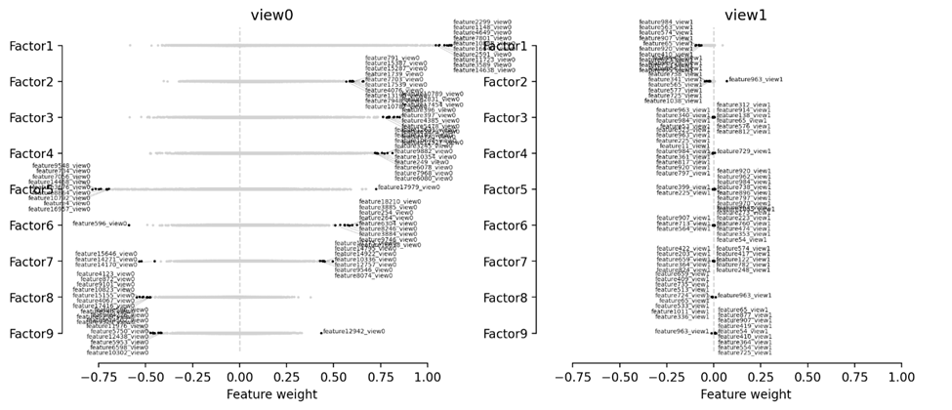
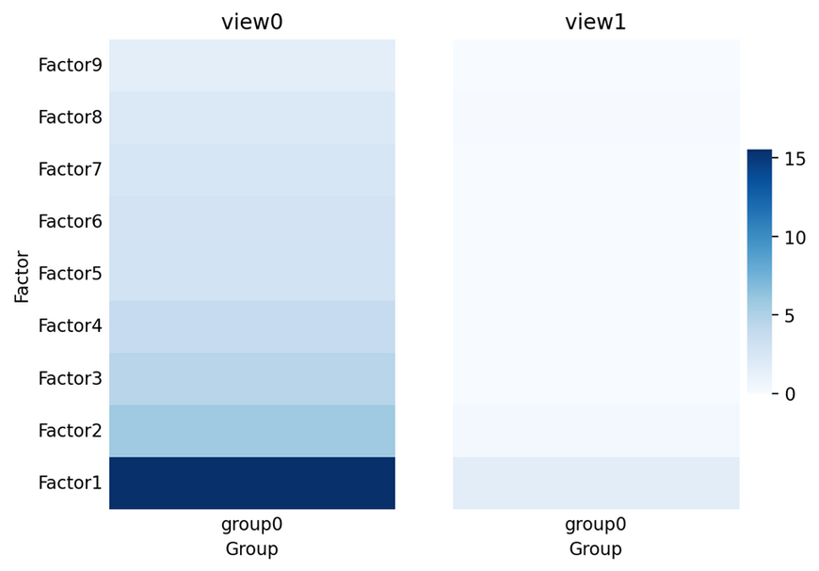
WEAK MUT DATA (VIEW1)?
Rna view (view0) sees strong features from factors 1 – 4 mainly (our focus it seems)
-Mutation view (view1) is quite weak without strong features on any factors

Slide 10
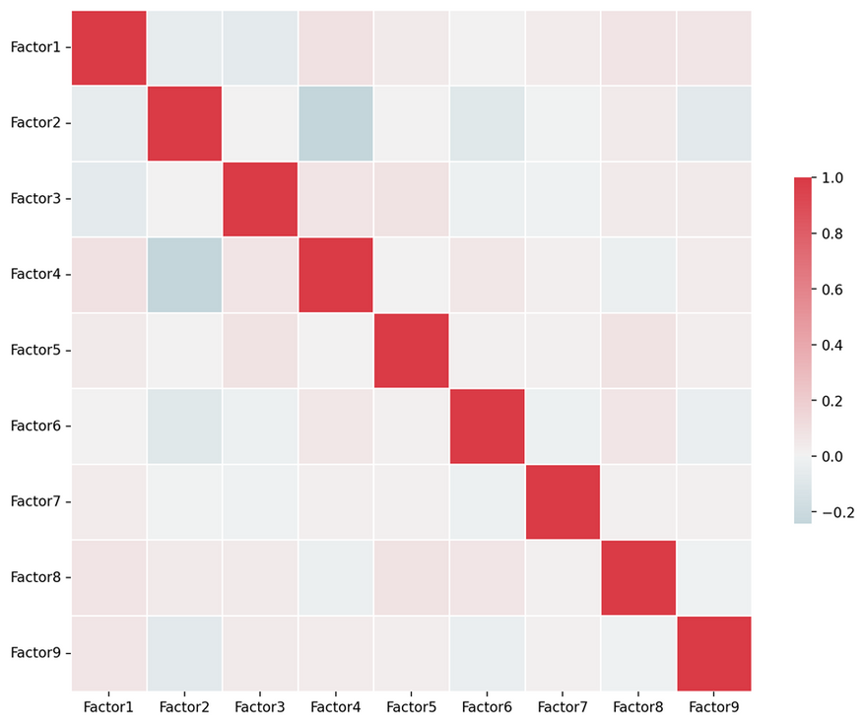
FACTOR OVERLAP?
No, weak overlap.
No need to drop any factors for now
Each of the factors show distinct biological
information (no redundancy in data or genes)

Slide 11
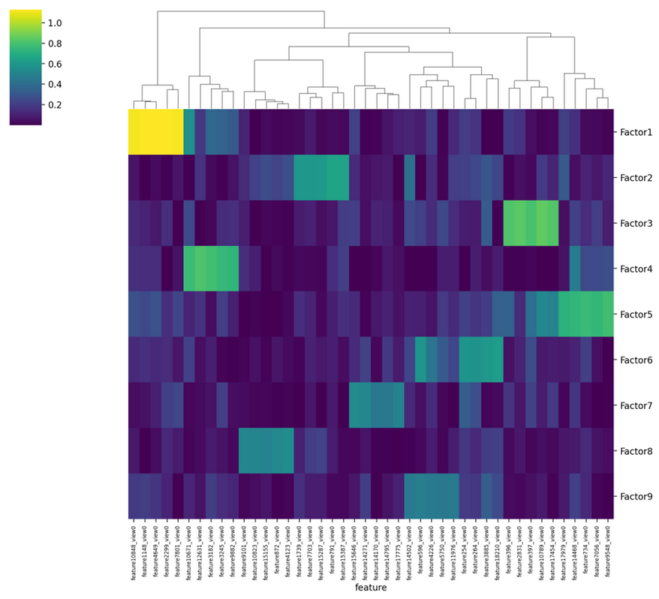
DRIVING FACTORS & FEATURES?
Again, no overlap bewtween factors (no sharing features)
Order of seemingly strongest relationships based on brightness:
Factor 1 - Factor 3 - Factor 4 - Factor 5 - Factor 2 - remaining are weak.
Factor 5 a new focus added? Potentially

Slide 12
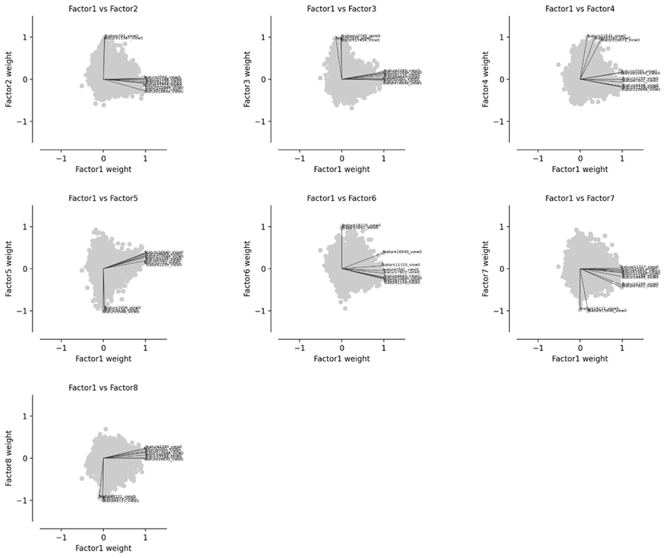
FACTOR 1 VS. FACTORS - FEAUTRE DENSITY
Compares the density and direction of 2 factors’ features. But many factors: which do we compare? Based on variance explained!
Quite strong clusters in factors 2 – 5 vs. factor
No clusters, greater sparsity in factors 6 - 9 (expected)
So, we focus on factors 1 - 5 (as previously thought
oFactor 1 vs. 2 - 5 very orthogonal (unique bio info, we will see later)

Slide 13
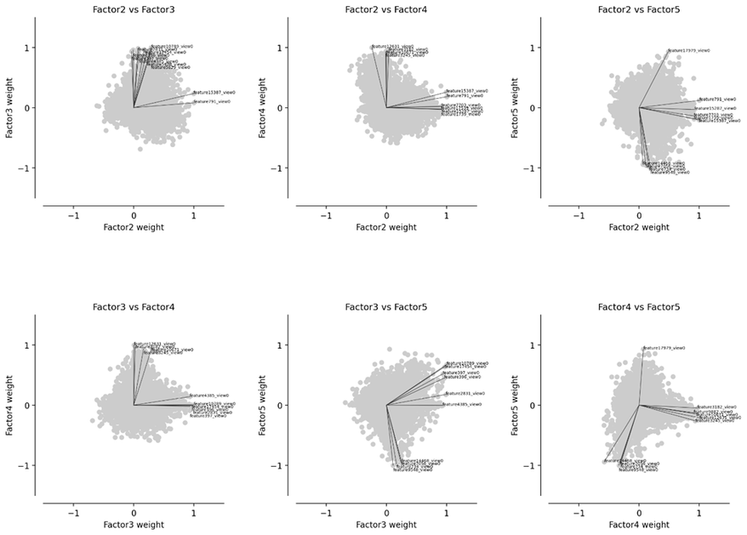
REST OF STRONG FACTORS VS. EACH OTHER
No strong overlap between factors: great sign of no redundancy
ut we do see some overlap in factor 5 comparisons...
So, we ignore factor 5 as factors 1 - 4 have strong signals already
Thus, going back to our original focus of factors 1 – 4
Conclusion: high correlation in heatmap is not always good and enough

Slide 14
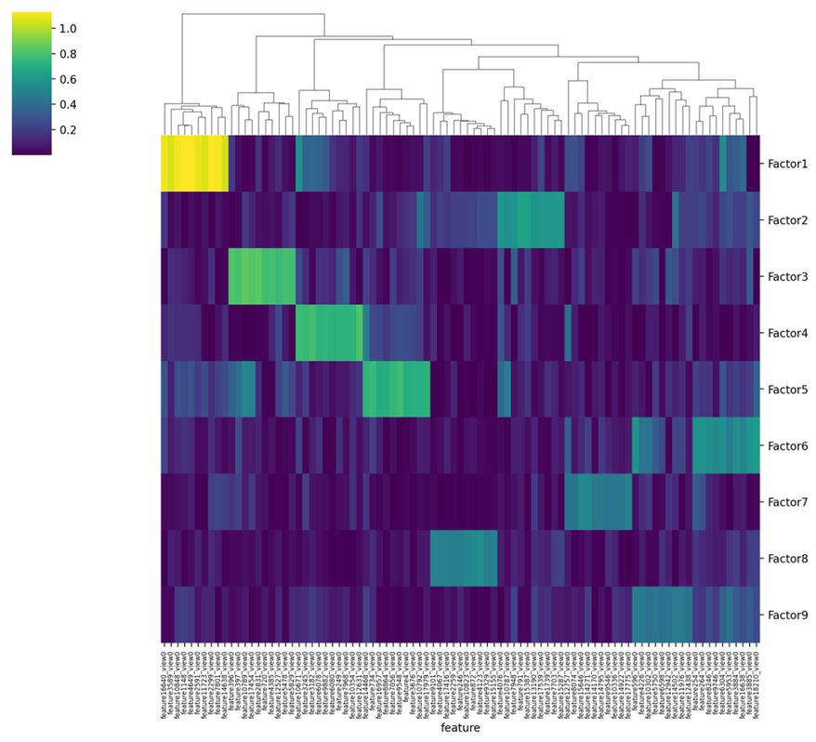
HEATMAP FOR 10 FEATURES
After finding our focus factors, we reuse the heatmap but with highest 10 features for each factor now
Factor 1: MYH11, ATP1A2, DES, C2orf40, HSPB6, THBS4, CHRDL1, C7, OGN, SCRG1
Factor 2: ATP5G2, HPN, SLC34A2, APOA1, SLC5A5, CREB3L3, MUC15, IGF2BP1, PROC, TTR, C12orf56
Factor 3: AGR2, CAPN8, AGR3, MUC17, TSPAN8, ANXA10, CYP2C18, PIGR, ERN2, FAM3D
Factor 4: MS4A1, PLA2G2D, CD19, CD79A, LY9, FCRL3, FCRL5, ADAM6, IGJ, MGC29506, S100A2

Slide 15
FACTOR ANALYSIS
ONTOLOGIES
FROM:
GO BIOLOGICAL PROCESS 2025
GO CELLULAR COMPONENTS
GO MOLECULAR FUNCTIONS

Slide 16
FACTOR 1 - MUSCLE & ION TRANSPORT
Related to muscle contraction, heart function, and ion transport
Genes involved in cell movement and signal balance
Suggests stomach cancer affects tissue motion and tumor growth

Slide 17
FACTOR 2 - PROTEIN & IMMUNE SUPPRESSION
Enriched in negative regulation and protein transport
Genes found in Golgi and vesicles
Tumor may suppress immune signals and alter protein pathways to grow

Slide 18
FACTOR 3 - STRESS & IMMUNE INTERACTION
Linked to unfolded protein response, RNA activity, and immune regulation
Genes active in cell stress and immune control
Suggests tumor adapts to harsh conditions and alters immune environment

Slide 19
FACTOR 4 - B CELLS & INFLAMMATION
Genes linked to B cell activation and immune signaling
Enriched in immune zones like endosomes and membrane rafts
Suggests strong immune-related processes in the tumor context

Slide 20
FACTOR SUMMARY
FACTOR 1: TUMOR IMPACTS MUSCLE FUNCTION AND ION REGULATION
FACTOR 2: DISRUPTED PROTEIN TRANSPORT AND SUPPRESSED IMMUNITY
FACTOR 3: TUMOR SHOWS STRESS RESPONSE AND IMMUNE INTERFERENCE
FACTOR 4: STRONG IMMUNE ACTIVITY, ESPECIALLY B CELLS

Slide 21
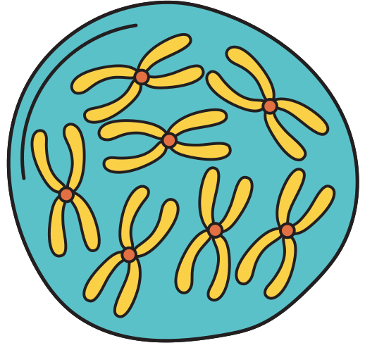
IMPROVEMENTS?
YES, OF COURSE...
ADD MORE OMICS (E.G., PROTEOMICS, METHYLATION)
INTEGRATE CLINICAL DATA AS A THIRD VIEW
APPLY CLUSTERING OR CLASSIFICATION TO DISCOVER PATIENT SUBTYPES

Slide 22
THANK
YOU!
Nadeen Ali

