Slide 1
iote2e Internet of Things End to End
Pete Zybrick
pzybrick@mdsol.com
pzybrick@gmail.com
https://github.com/petezybrick

Slide 2
"As soon as you get to that space where you actually have something to play with and something tangible, that's when the real learning happens. Get out of Keynote, get out of PowerPoint, and just start building and start showing it off to people.“
Jack Dorsey, Twitter

Slide 3
Objectives
Demonstrate Variety of Use Cases on Common Architecture
Understand the Basics of the Architecture
Realize Benefits and Complexities
Give me feedback!

Slide 4
Overview: Use Cases
MyHomeGreenhouse.com
A greenhouse in your backyard that is remotely managed
Sensor data is streamed from all greenhouses, actuators are instructed to perform tasks (i.e. turn on water, turn off fan)
Dynamic Clinical Trial
A clinical trial for a blood pressure medication
Number of Pills Dispensed Changes over course of Trial
YourPersonalizedMedicine.com using Open mHealth and Apple HK
Patient Device submits various measures (blood pressure, blood glucose, etc.)
Dashboard for your doctor and you, view history and real time values
Big Data Black Box
Stream Flight Status data for Airframe and Engines
Dashboard for airline chief mechanic, view history and real time values

Slide 5
Sequence
Review: Raspberry Pi Configuration
Demo: MyHomeGreenhouse.com
Review Architecture and Development/Demo Environment
Demo: Dynamic Clinical Trial
Demo: YourPersonalizedMedicine.com
Overview: Simulating Flight Status
Demo: Big Data Black Box
Q and A

Slide 6
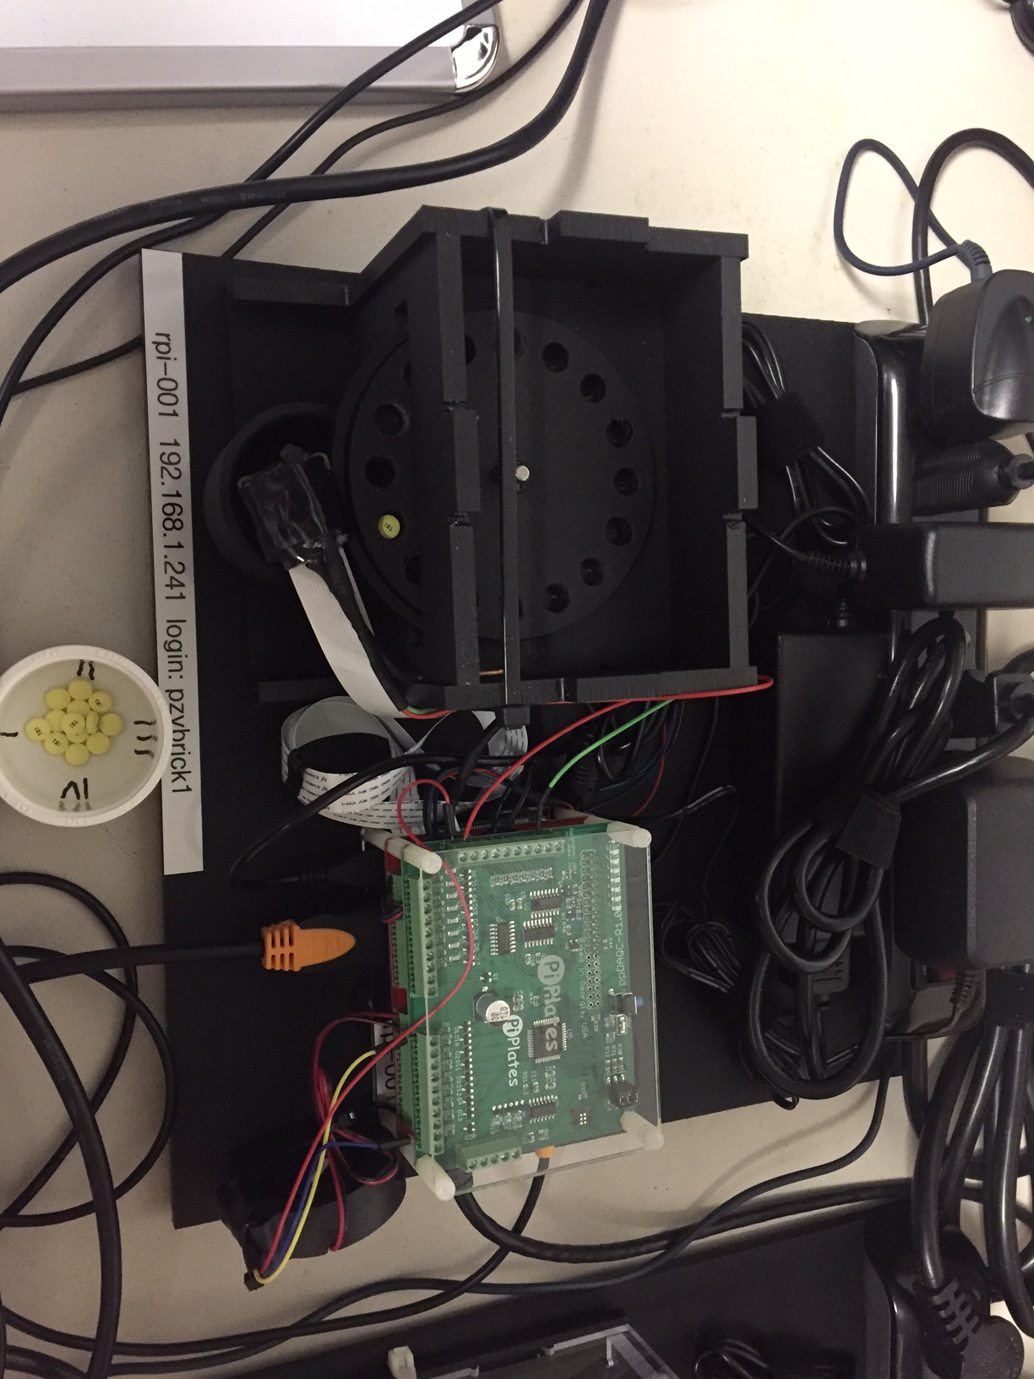
Review: Raspberry Pi Configuration
Raspberry Pi – ubuntu 16.04
Data Acquisition Board
Motor Control Board
Pill Dispenser
Stepper Motor
Camera
LED
Temperature Sensor
Fan
Dispenser Cup
Alignment Cup

Slide 7
Background: MyHomeGreenhouse.com
A greenhouse in your backyard that is remotely managed
Sensor data is streamed from all greenhouses, actuators are instructed to perform tasks (i.e. turn on water, turn off fan)

Slide 8
Demo: MyHomeGreenhouse.com
Temperature Sensor, blow dryer represents heat source
Laptop fan represents fan in a greenhouse
Review: Simple Rules
Iote2eRequest’s are sent every 2 seconds with the current temp
Speed Layer processes Rules
If Temp >= 50C and Fan Off, then create Iote2eResult with fan=on
If Temp <= 35C and Fan On, then create Iote2eResult with fan=off
Batch Layer writes blocks of rows to database
Display temperature graphs in Zeppelin
Display real time temperature in browser using Rickshaw, WebSockets and Ignite

Slide 9
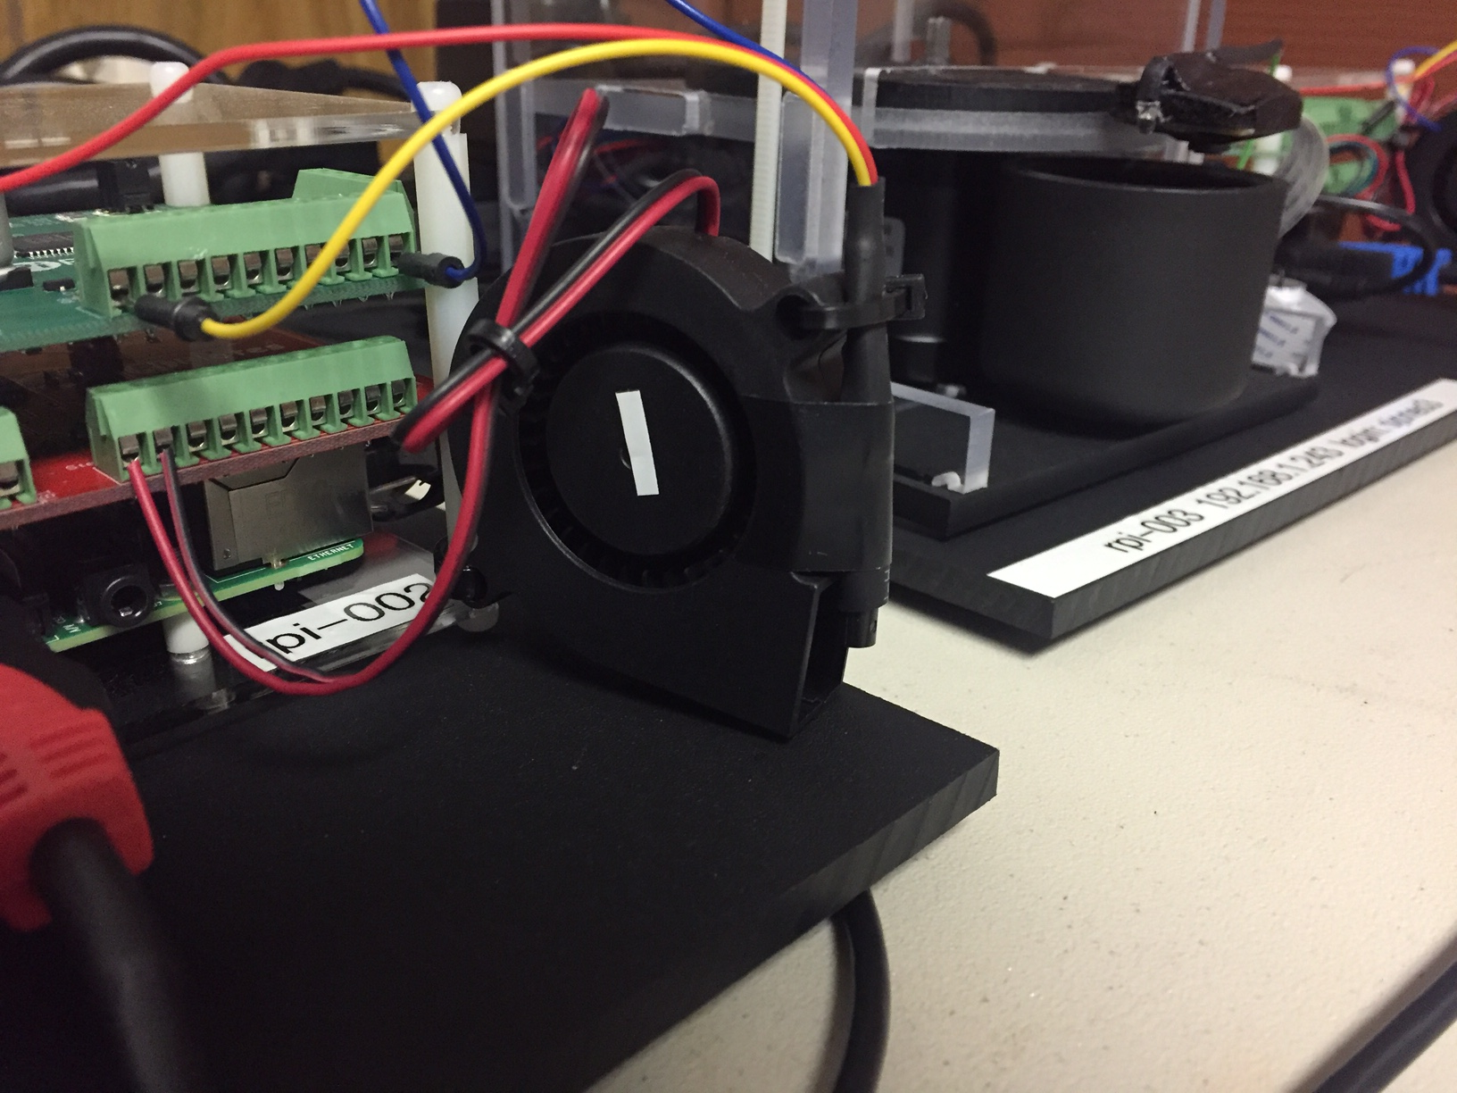
Temperature Sensor and Fan
Laptop Fan
Temperature Sensor

Slide 10
Architecture Overview

Slide 11
Lambda Architecture
Cluster of Containers
Speed
Near Real Time
Rules Processor
Immediate Action
Inbound Messages
Batch
Aggregation over Duration
Windowed Computations
Write to Database

Slide 12
High Level Architecture
WebSockets via Browser
Apache Ignite
ignite0
ignite1
ignite2
Chrome
Apache Spark Streaming
Apache Kafka
Raspberry Pi’s
master
zk1
zk2
zk3
rpi-001
ws1
worker1
MySQL
kafka1
worker2
kafka2
rpi-002
worker3
kafka3
worker4
worker5
rpi-003
Apache Cassandra
cassandra1
cassandra2
cassandra3

Slide 13
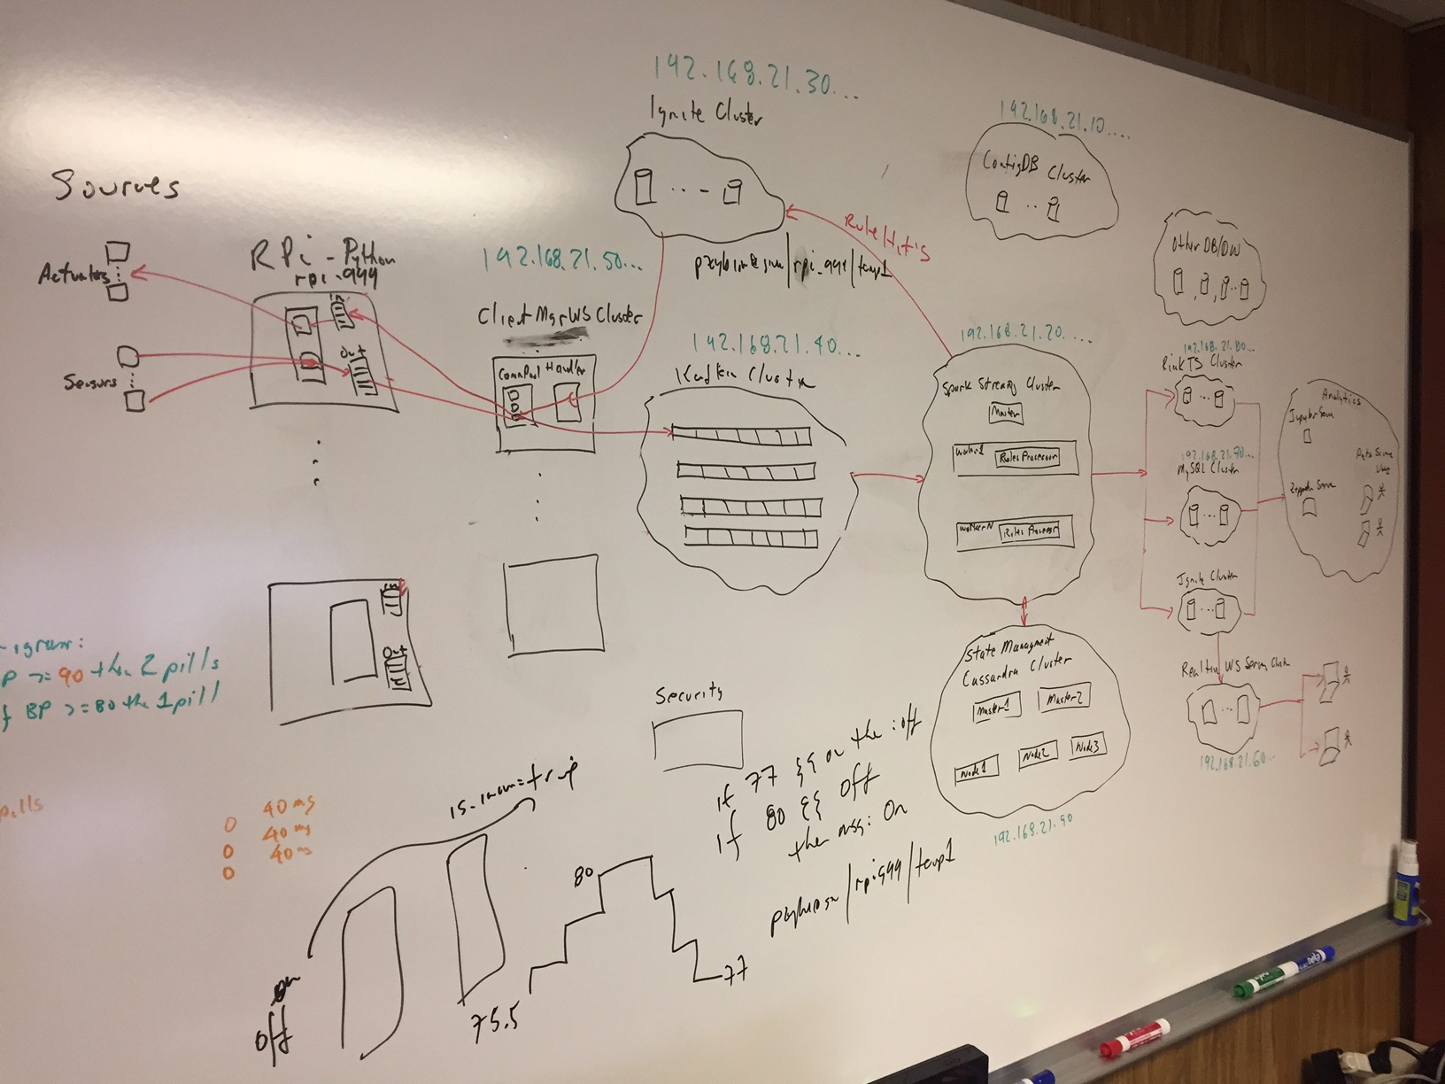
Whiteboard in Home Office

Slide 14
Development/Demo Environment
Win7
Chrome
Tableau
ubuntu 14.04
Docker
Network: iote2enet
24 ubuntu 14.04 Containers
3x Cassandra
3x Ignite
6x Kafka (3x zk, 3x kafka)
1x KafkaManager
6x SparkStreaming
1x Zeppelin
1x WebSockets Server (jetty)
1x MySQL
2x DemoMgr (just ubuntu)
Other Notes
Fixed IP’s
Ports opened in Docker
docker-compose Files
All share /iote2e-shared
Raspberry Pi’s
ubuntu 16.04
rpi-001
rpi-002
rpi-003

Slide 15
High Level Process Flow (too technical?)
Client connects to WebSocket server
Register remote key filter with Ignite cluster, i.e. “rpi-001|temperature”
Source creates an Iote2eRequest in Avro, i.e. contains “temp=35.0”
Iote2eRequest sent to WebSocket server, sends to Kafka cluster
SparkStreaming
Speed Driver (window=200ms)
Process Rule(s) against the inbound Iote2eRequest
If Rule Hit
Create Iote2eResult, push to Ignite with Key, i.e. “rpi-001|temperature” to turn on the fan
WebSocket server gets the Iote2eResult from Ignite remote filter, writes back to source RPi
Python on Rpi processes the Iote2eResult, i.e. to turn the fan on for rpi-001
Batch Driver (window=10s)
Write accumulated data to database

Slide 16
Background: Dynamic Clinical Trial
A clinical trial for a blood pressure medication
A Pill Dispenser is installed in the home of each Subject
Each pill is 40mg, and the number of pills dispensed is based on criteria determined by the team managing the trial
This criteria can change change the number of pills dispensed/subject over the course of the study and must be tracked
When pills are dispensed, the number of pills dispensed must be verified programmatically and receipt confirmed by the subject

Slide 17
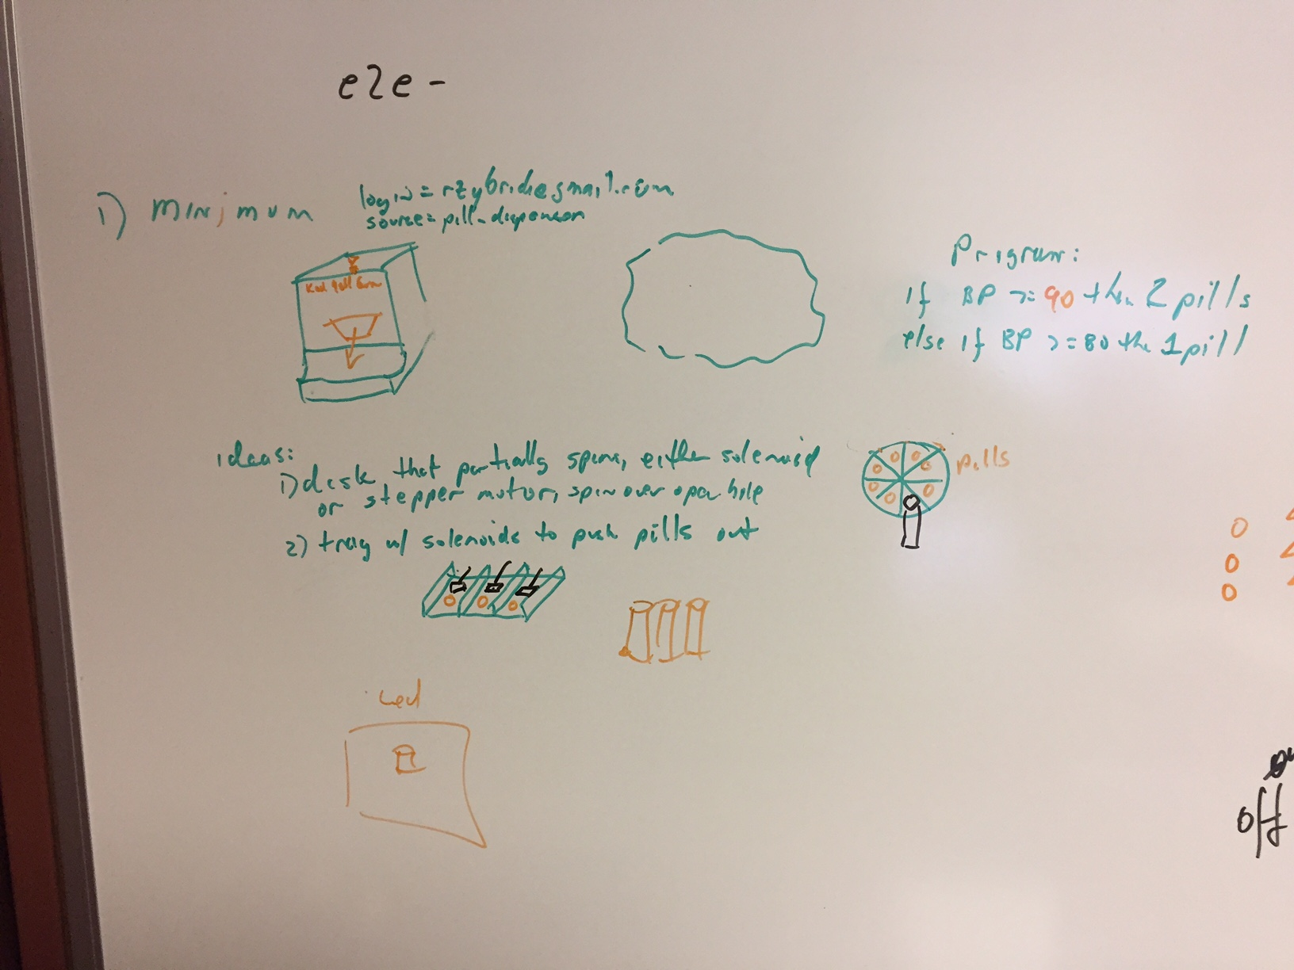
Evolution of a Pill Dispenser Design

Slide 18
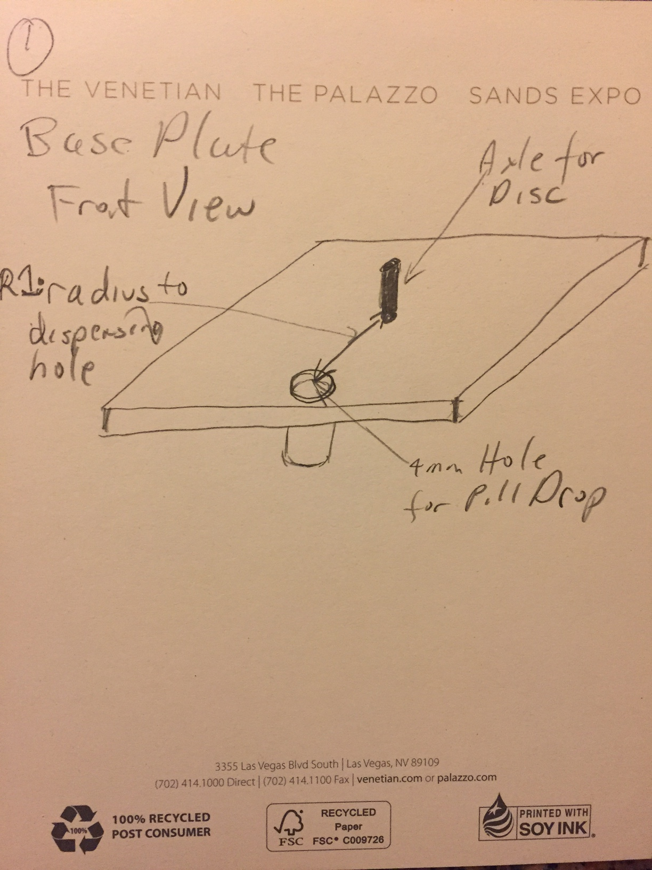
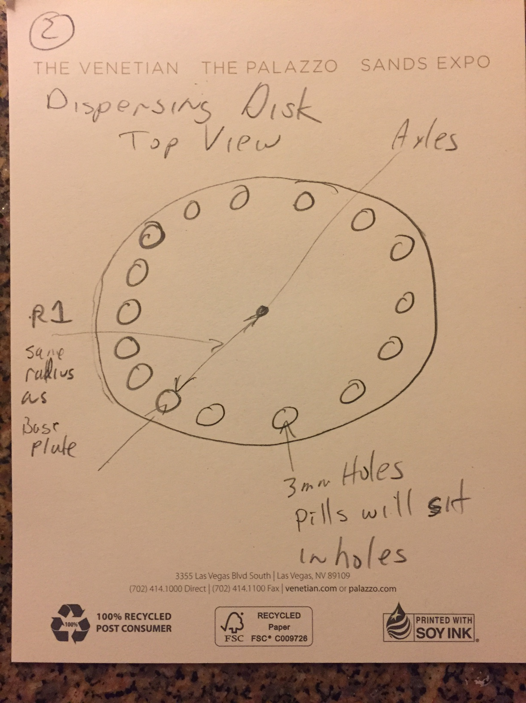
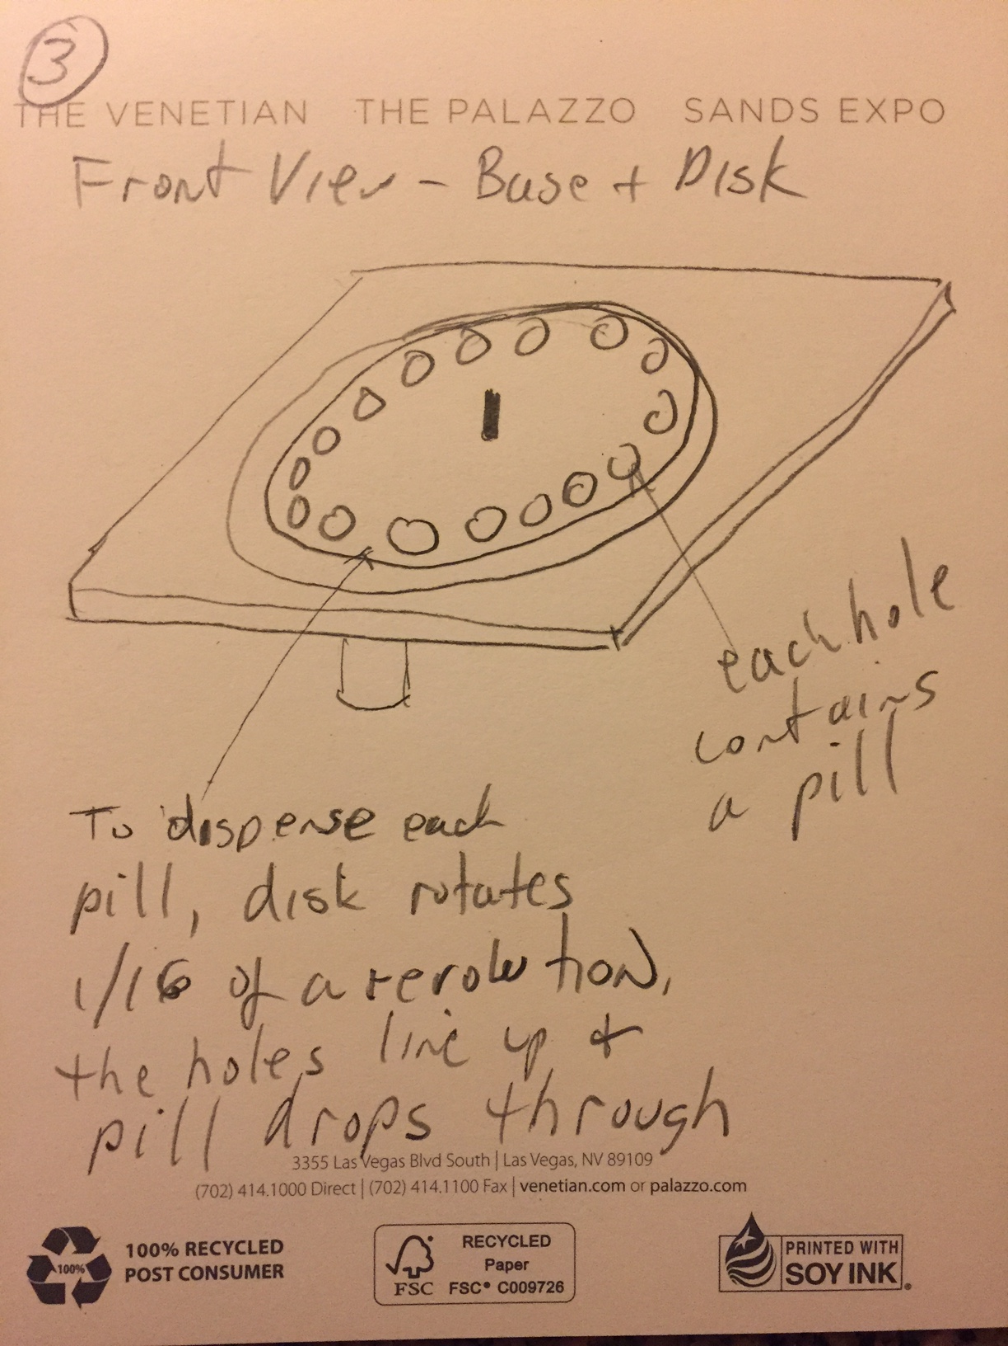
Evolution of a Pill Dispenser Design

Slide 19
Demo: Dynamic Clinical Trial
Designed a basic pill dispenser, my son Rob then enhanced it, he put the design in SolidWorks and machined the parts
3x Raspberry Pi's (each mapped to a specific Subject)
Python code on the Pi drives the pill dispenser
After dispensed,
LED lights the dispensed pills and camera takes picture
Sends back to SparkStreaming cluster for image processing to count the number of pills
If the count matches, then blink Green LED on the Pi, else blink Red on the Pi.
Subject then presses button to confirm
All of these actions are tracked in a database table

Slide 20
Background: YourPersonalizedMedicine.com
Patient Device submits various measures (blood pressure, blood glucose, etc.)
Scalably support ever increasing number of patients
Dashboard for your doctor and you, can view history and real time values
If a criteria is exceeded (i.e. diastolic > 100) then send an email to your doctor, with dashboard link embedded in the email.

Slide 21
Demo: YourPersonalizedMedicine.com
Simulator for patients sends Open mHealth/HK schema compliant JSON once per second for each of the following Open mHealth/HK Schemas:
BloodGlucose, BloodPressure, BodyTemperature, HeartRate, HKWorkout, RespiratoryRate
Speed Layer checks if Diastolic BP exceeds 100 and sends email
Batch Layer writes blocks of rows to database
Tableau dashboard with 2 sheets: embedded near realtime display and filterable historical data

Slide 22
Background: Big Data Black Box
Stream Flight Status data for Airframe and Engines
Scalably support ever increasing number of flights
Dashboard for airline chief mechanic, view your history and real time values
If a criteria is exceeded (i.e. oil pressure > 90) then send an email to that airlines chief mechanic, with dashboard link embedded in the email.

Slide 23
Demo: Big Data Black Box
Simulator for Flights, in this case 3 flights (JFK-MUC, LAX-JFK, SFO-NRT) with 120 waypoints, one waypoint per second
Review: How the Simulator works (too technical?)
AirframeStatus and EngineStatus measures sent
Speed Layer checks if Oil Pressure exceeds 90 on any Engine and sends email
Batch Layer writes blocks of rows to database
Two Tableau dashboards
2 sheets: Embedded Near RealTime display and filterable historical data
1 sheet: World Map, filterable by Flight, mouse over displays flight status at any given waypoint

Slide 24
Feedback
Demo then Architecture Overview – good approach?
What should be emphasized for Business/Management?
What should be emphasized for Technical?
More historical data or does the point get across?
Would an Animation on the Process Flow help?
Next Steps
Documentation
Basic install guide
Install on some developer workstations, get temperature simulation running

