Slide 1
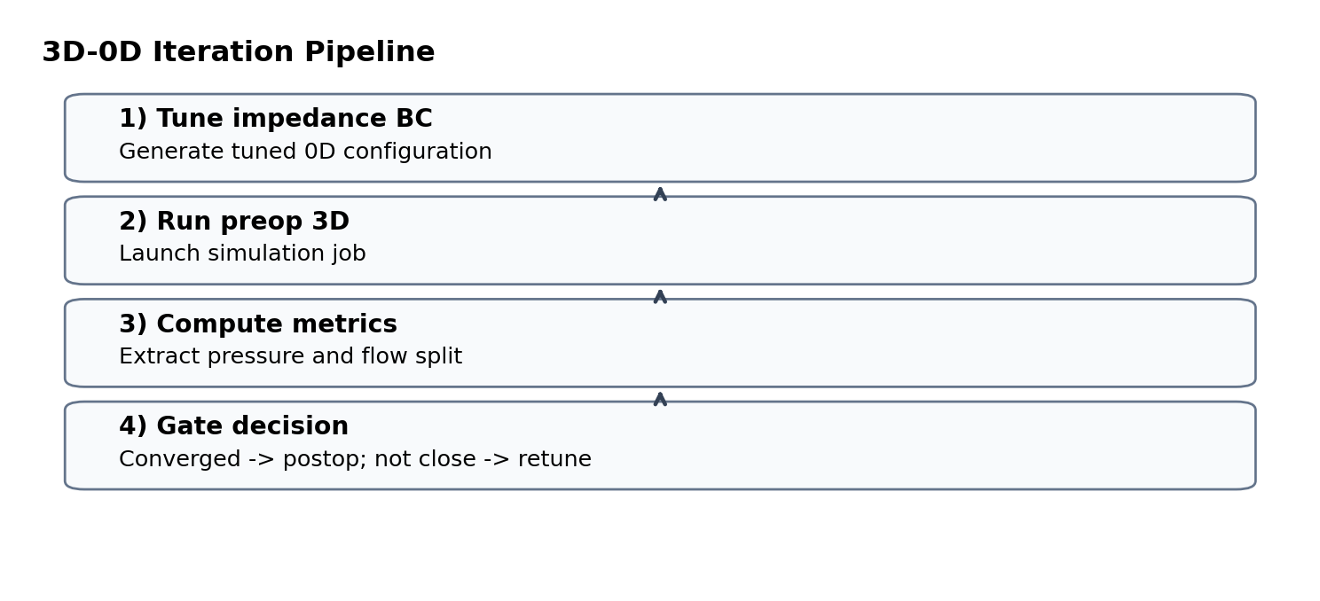
Impedance BC Implementation Review
MASTER-focused check: localized solver impact, BC behavior, and workflow implications
This revision focuses on:
Structural impact against master
What changed inside IMPEDANCE BC
Why minimal support hooks were added
What this means for 3D-0D and full 0D runs
Top line: no broad solver rewrite was introduced.

Slide 2
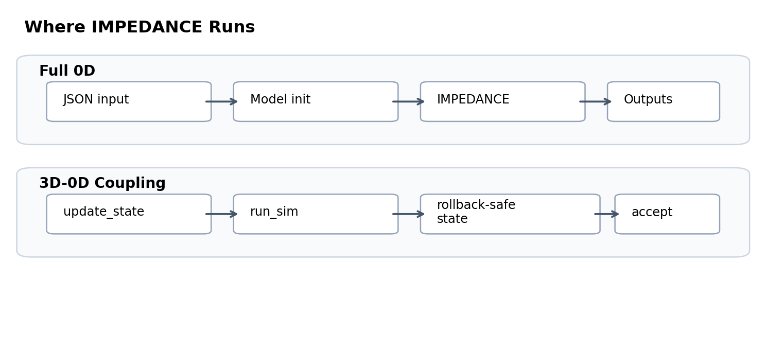
Architecture Context
The same IMPEDANCE logic is used in both full 0D and coupled 3D-0D workflows
Full 0D: standard model execution path
3D-0D: retry loop needs rollback-safe internal state
Shared IMPEDANCE runtime rules across both modes

Slide 3
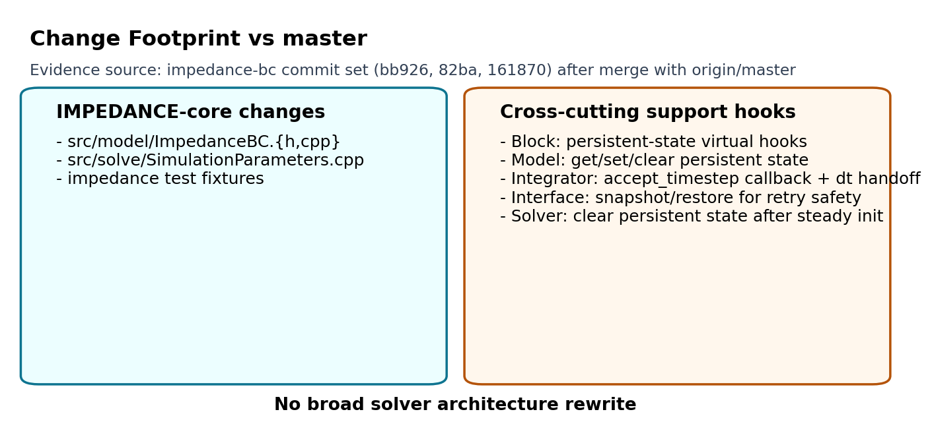
Structural Footprint vs master
Changes are concentrated in IMPEDANCE logic plus a small set of support hooks
Core additions stay inside IMPEDANCE BC and its config wiring
Support hooks are limited to state snapshot/restore and timestep acceptance
No solver loop redesign or global architecture change
Notes:
Comparison method note: master history in this local clone has missing objects, so this footprint is anchored to the impedance-bc commit set around the master merge (bb926fa9, 82ba416d, 161870a5).

Slide 4
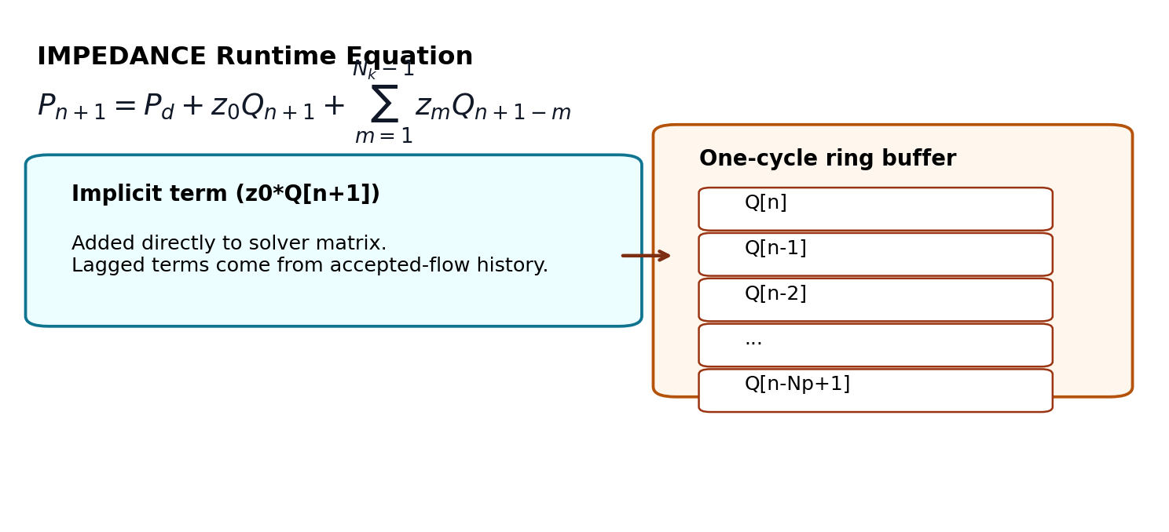
How IMPEDANCE BC Works
Pressure is computed from current flow plus accepted one-cycle flow history
Key runtime behaviors
Implicit current-flow term enters matrix
Lagged terms use accepted history only
Startup follows one-cycle warm-up semantics
Supports exact or truncated kernel mode

Slide 5
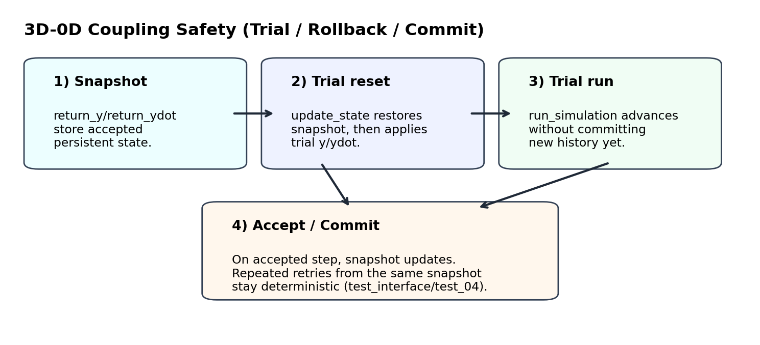
Support Hooks Outside IMPEDANCE
Small cross-cutting additions were made to keep coupling retries safe and deterministic
Interface snapshots accepted persistent state
update_state restores snapshot before each trial
Integrator calls accept_timestep only on accepted steps
Steady-init path clears dt-dependent persistent memory
Why: preserve deterministic retries and avoid stale-memory carryover.

Slide 6
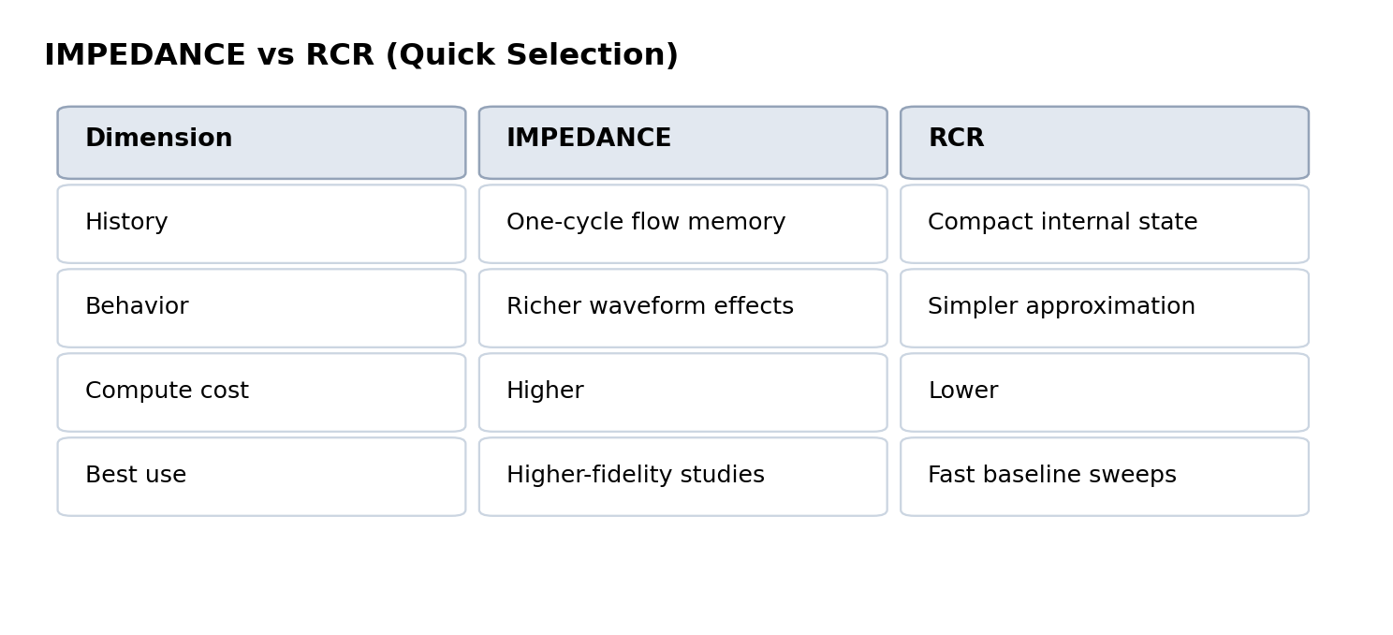
IMPEDANCE vs RCR
Both remain supported; choice depends on fidelity needs and runtime budget
IMPEDANCE: richer waveform behavior with memory
RCR: faster baseline model with simpler dynamics
Select model type based on study objective
Comparison is behavioral and use-case driven.

Slide 7
Practical Implications
Impact summary for coupled 3D-0D tuning loops and standard full 0D execution
3D-0D
Retry loops remain deterministic
State rollback is explicit and controlled
Accept/commit boundary is clearer
Full 0D
Configuration remains straightforward
Validation checks catch kernel and timestep inconsistencies
Reproducibility improves through explicit persistent-state handling

Slide 8
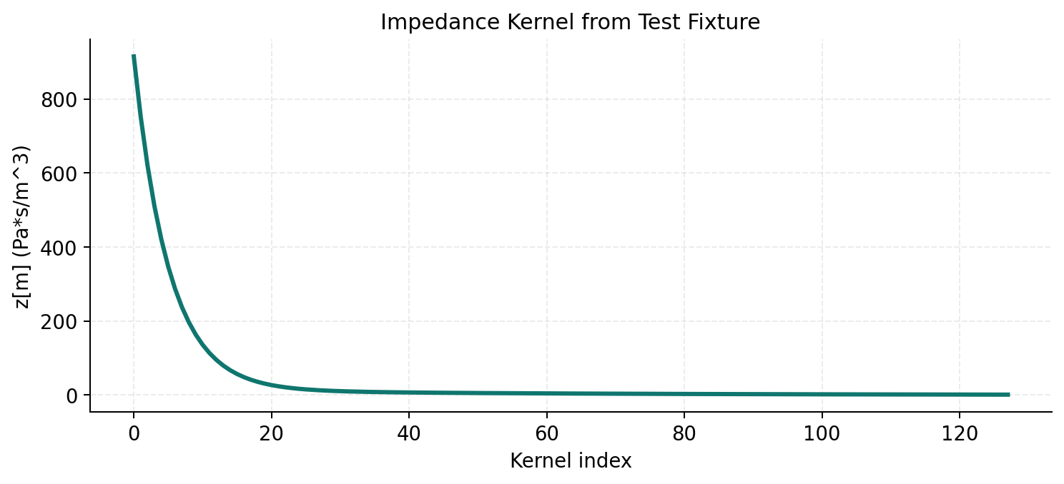
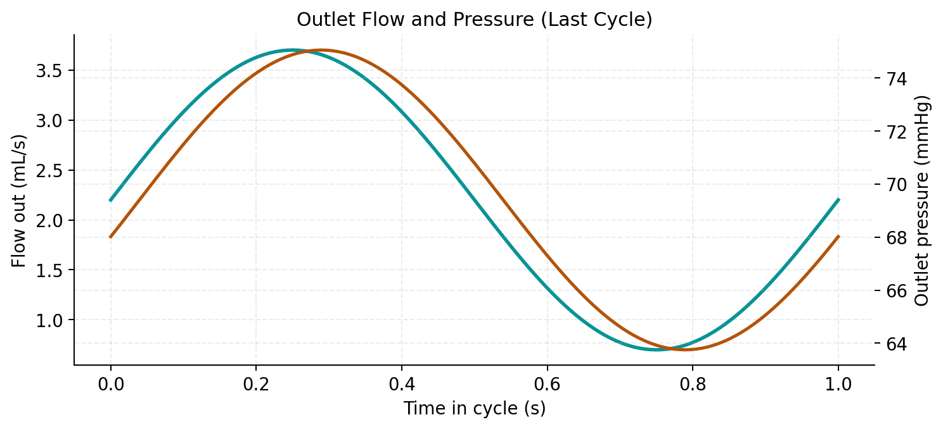
Evidence and Takeaway
Tests and fixtures support the implementation claims and runtime behavior
Impedance fixture validates kernel and waveform behavior
Interface test_04 validates retry determinism and commit effect
Overall result: targeted implementation with stable coupling behavior

