Slide 1
Simulating Microvascular Adaptation
after Pulmonary Artery Stenting
A patient-specific pipeline for structured-tree boundary condition tuning
and mechanobiological adaptation · Tetralogy of Fallot stent cohort
Nick Dorn · Marsden Lab, Stanford University
Pipeline reference deck · October 2026
Notes:
Title slide. Deck synced 22 Oct 2026 to svzt-agent 389c580, svZeroDTrees 1b01fc9.

Slide 2
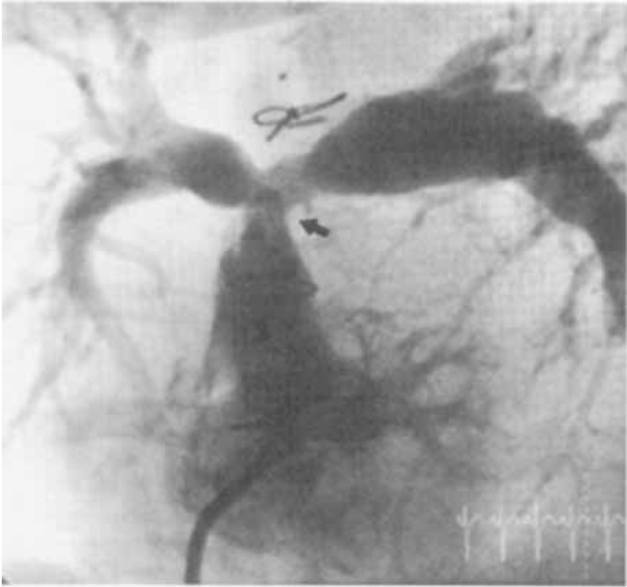
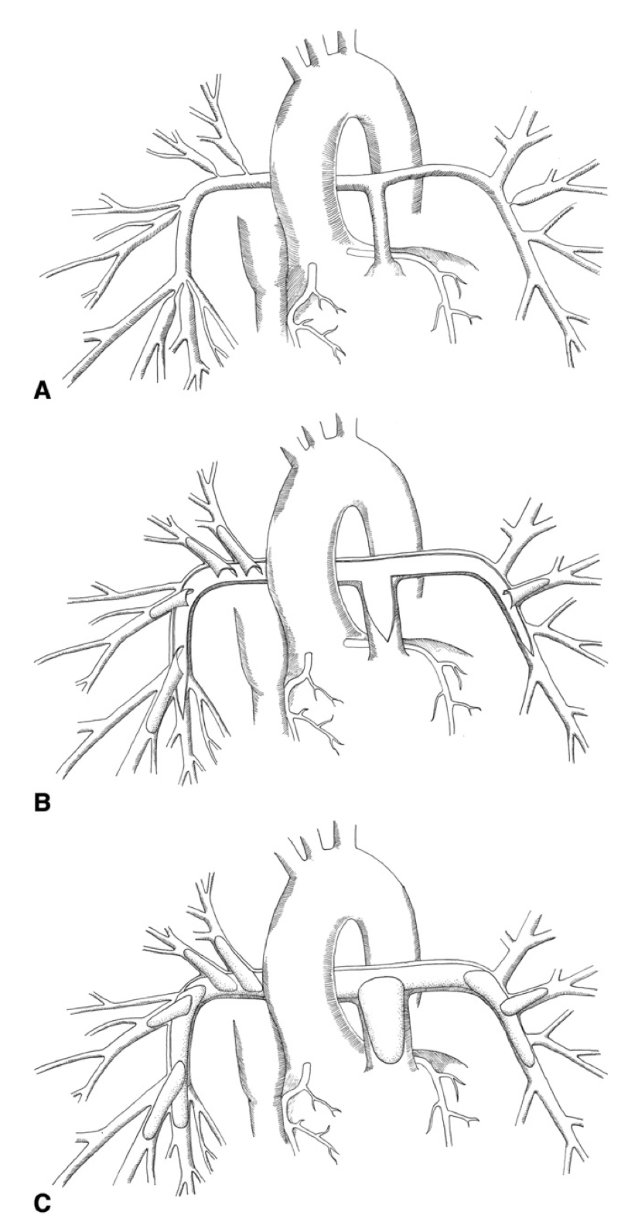
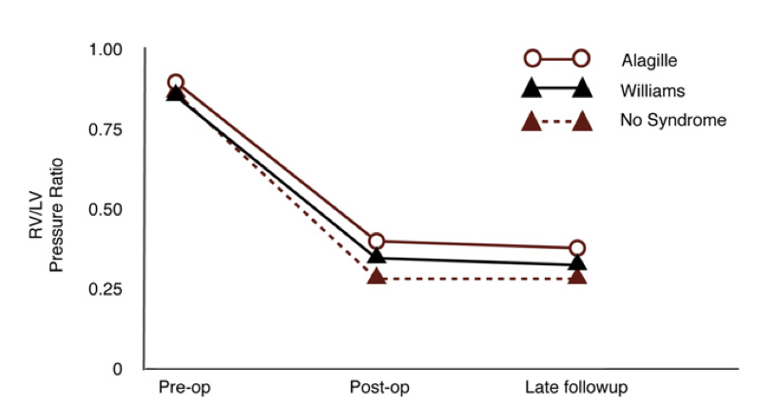
Branch pulmonary artery stenosis persists after Tetralogy of Fallot repair
• Stenosis of the branch and peripheral PAs raises pulmonary vascular resistance and loads the right ventricle
• Managed with balloon angioplasty, stenting, or surgical patch reconstruction: often over repeated catheterizations
• Goal of intervention is to lower RV pressure and rebalance perfusion between the lungs
Angiographic appearance of branch PA stenosis
The hard question is not whether a lesion can be opened, but how the lung responds afterward.
Surgical reconstruction
RV/LV pressure ratio through follow-up
Figures: Monge et al., J Thorac Cardiovasc Surg (2013); Bacha & Kreutzer, J Interv Cardiol (2001).
Notes:
Kept slide. Spot-checked 22 Oct 2026 against svzt-agent 389c580, svZeroDTrees 1b01fc9 and svz config; sources as in the footnote.

Slide 3
Treatment planning needs a prediction, not a description
What the clinician decides
What CFD can give today
What is actually measured later
• Which lesion(s) to treat
• Stent diameter and length
• Proximal vs. extensive coverage
• Acute pressure and flow immediately after the geometric change
• Local wall shear stress and pressure gradients
• Post-op catheter pressures
• Post-op lung perfusion split
• Both reflect a remodelled distal bed
The gap: an acute simulation cannot reach the measured outcome
• Opening a proximal stenosis raises flow to the downstream bed, which raises wall shear stress in every distal arteriole
• Those arterioles dilate to restore their homeostatic shear and stress state, lowering downstream resistance further
• The flow split and pressures that get measured weeks to months later are the adapted state, not the acute one
So the boundary condition itself has to be able to remodel.
Notes:
Kept slide. Spot-checked 22 Oct 2026 against svzt-agent 389c580, svZeroDTrees 1b01fc9 and svz config; sources as in the footnote.

Slide 4
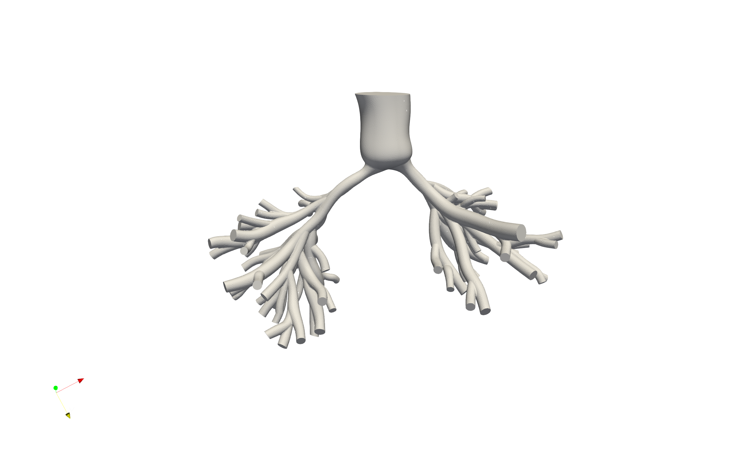
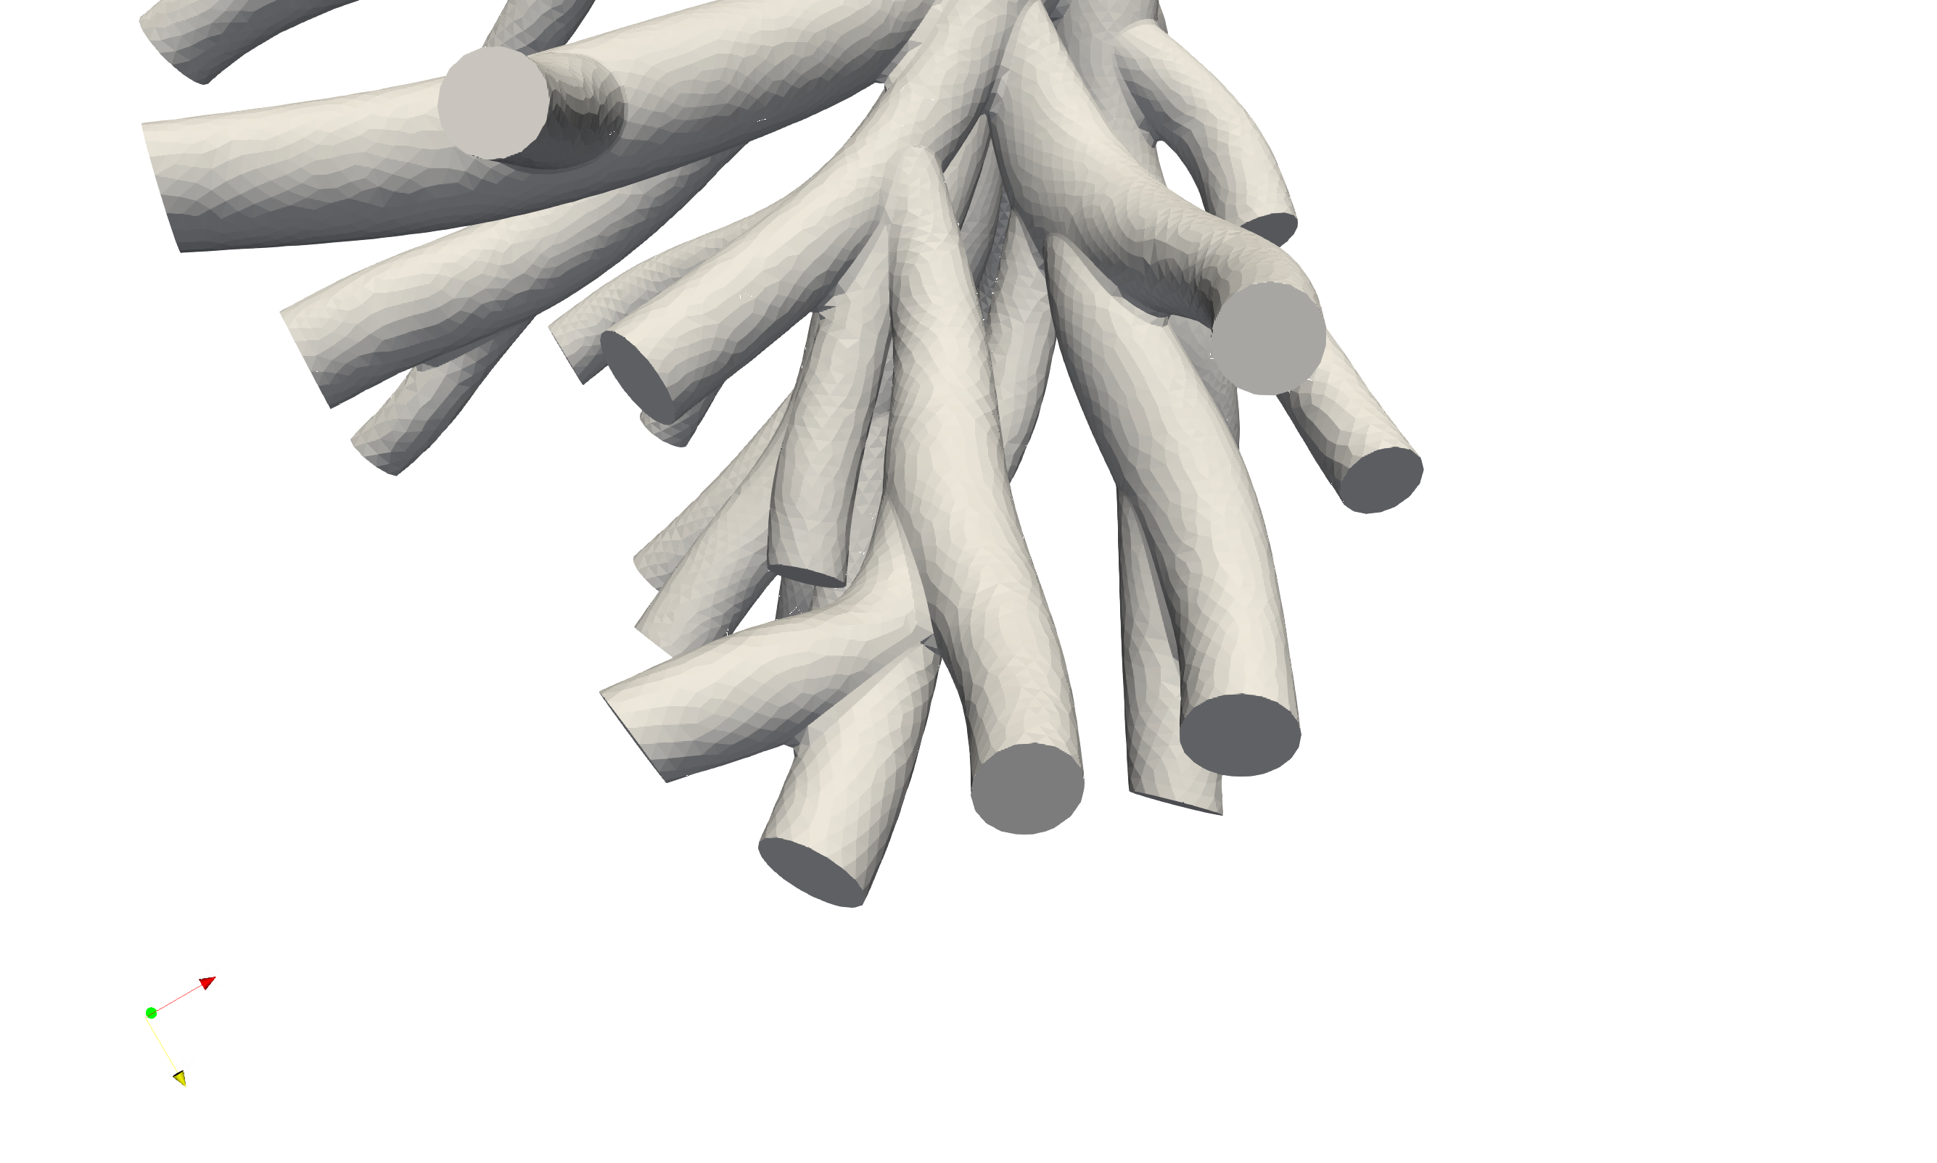
The boundary condition problem
Conventional outlet BCs
• Resistance or RCR fitted once to the pre-operative state
• A single lumped number per outlet
• No internal structure, so nothing to remodel
• Post-op flow redistribution can only come from the 3D geometry change
Segmentation resolves vessels to roughly 1 mm; everything distal is boundary condition
Requirements for an adaptive boundary condition
Physiological
Dynamic
Adaptable
• Morphometry of the real arteriolar bed
• Terminates at capillary scale
• Full impedance, not just resistance
• Compatible with pulsatile 3D coupling
• Per-vessel state that responds to flow
• Driven by mechanobiological stimuli
Notes:
Kept slide. Spot-checked 22 Oct 2026 against svzt-agent 389c580, svZeroDTrees 1b01fc9 and svz config; sources as in the footnote.

Slide 5
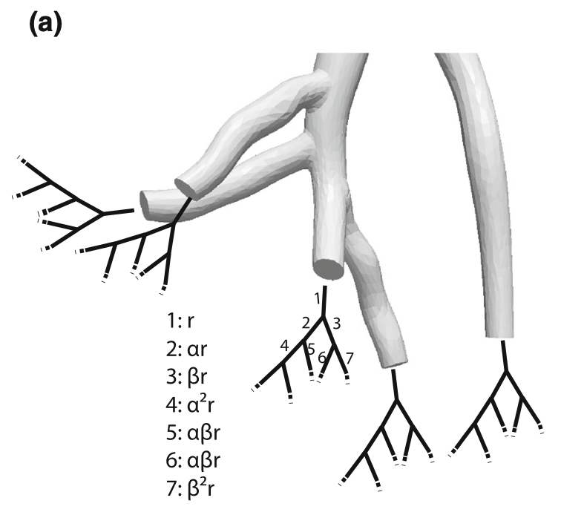
Structured-tree boundary conditions
What the tree buys us
• Impedance is computed recursively from the vessel network, giving a physically grounded pulsatile BC
• Every vessel carries its own radius, thickness, flow and pressure: the state that adaptation acts on
Cost of the choice
• Tree morphometry introduces parameters that must be identified per patient
• Impedance evaluation is expensive, so tuning happens against a reduced-order surrogate
A self-similar binary tree is appended at each 3D outlet
Structured trees turn the outlet BC from a fitted constant into a model that can be perturbed.
The rest of this deck walks the seven pipeline stages that build, tune, apply and adapt these boundary conditions.
Tree construction and impedance formulation after Olufsen, Ann Biomed Eng (1999, 2000).
Notes:
Kept slide. Spot-checked 22 Oct 2026 against svzt-agent 389c580, svZeroDTrees 1b01fc9 and svz config; sources as in the footnote.

Slide 6
The pipeline
1 Inputs
2 BC Tuning
3 Pre-op Sim
4 Post-op Sim
5 Adaptation
6 Adapted Sim
7 Metrics
Imaging, segmentation, cath and perfusion targets
Trees fit to cath and perfusion; protocol v1 frozen
Deformable-wall 3D CFD (CMM)
SDF virtual stent, pre-op BCs kept
M2 update of per-cap trees; rebuild planned
3D rerun with the adapted trees
Split and pressures vs post-op data
Validated
Completed
In development
In development
In development
Planned
Planned
Development workstreams
Problem | Current fix | Status
3D pulse too wide (TST-STAN-1, -2, -3) | E-law wall correction, iteration 3 (23 Oct) | Done
0D model did not match the corrected wall | Matched 0D refit, R then proximal C (all five, 26 Oct) | Done
TST-STAN-2 split +0.037 after v1 | Resistance side; check for a missing lobe on the angiogram | Open
Simulated post-op splits overshoot | Check stent diameters against angiography | Open
Stage status per PIPELINE_BRIEF stage table, with Stage 2 completed 25 Oct 2026 (pre-op protocol v1 frozen).
Notes:
Pipeline overview. Stage status: 1 validated; 2 to 5 in development; 6 and 7 planned (Stage 3 changed from validated on 22 Oct: damping rollout 21 Oct, no pre-op iteration selected under the current BCs). Workstreams from the 21 Oct deck, updated against svzt-agent 389c580, svZeroDTrees 1b01fc9 and svz config (damping in config/patients.yaml). Updated 25 Oct 2026: Stage 2 completed (svz docs/preop_protocol_v1/README.md (frozen 25 Oct 2026)); workstreams: E-law wall correction done for all five (pulse -2.6 to +0.6 mmHg); matching 0D refit in development (uncommitted svzt-agent workflows/wall_correction.py); TST-STAN-2 split error +0.037 after v1.

Slide 7
Cohort progress across the pipeline
1 Inputs
2 BC Tuning
3 Pre-op Sim
4 Post-op Sim
5 Adaptation
6 Adapted Sim
7 Metrics
Stage | TST-STAN-1 | TST-STAN-2 | TST-STAN-3 | TST-STAN-5 | TST-STAN-9
1 Model finalized | Done | Done | Done | Done | Done
2 BCs tuned | Done (v1) | Done (v1) | Done (v1) | Done (v1) | Done (v1)
3 Pre-op 3D | Iter. 3 done | Iter. 3 done | Iter. 3 done | Iter. 3 done | Iter. 3 done
4 Post-op 3D | Earlier BCs | Incomplete | Earlier BCs | Incomplete | Earlier BCs
5 Adaptation (0D) | Tested, earlier BCs | Not started | Not started | Not started | Tested, earlier BCs
6 Adapted 3D | Not started | Not started | Not started | Not started | Not started
7 Metrics | Partial, earlier BCs | Not started | Partial, earlier BCs | Not started | Partial, earlier BCs
Pre-op tuning is done for all five under protocol v1; Stages 4 to 7 still hold earlier-BC results.
Status as of 26 Oct 2026: protocol v1 (svz docs/preop_protocol_v1); matched 0D refit and pre-op hand-off done for all five. Row 3: tuning mesh, boundary-layer runs pending. Rows 4 to 7 from the May to June runs.
Notes:
Cohort progress matrix (state slide), updated 25 Oct 2026. Rows 2 and 3: svz docs/preop_protocol_v1/README.md (frozen 25 Oct 2026): all five ran iterations 1 and 2 (tst-stan-1-20261023, tst-stan-{2,3,5,9}-20261021) and the wall-correction step (_checks/elaw_iter3_20261023/*). Row 3 stays in-development colour because Stage 3 is in development (boundary-layer mesh runs pending). Rows 4 to 7 carried over unchanged (May to June runs on earlier BCs). 26 Oct 2026: matched 0D refit and pre-op hand-off completed for all five (svz runs/tst-stan-*/manifest.yaml wall_correction_runs (status completed 26 Oct 2026) and wall_correction/iter-02/calibration/results/calibration_summary.json).

Slide 8
Inputs & Dataset
STAGE 1 OF 7
Patient imaging, segmentation, catheter and perfusion targets, and the prescribed inflow waveform.
1
Inputs
2
BC Tuning
3
Pre-op Sim
4
Post-op Sim
5
Adaptation
6
Adapted Sim
7
Metrics

Slide 9
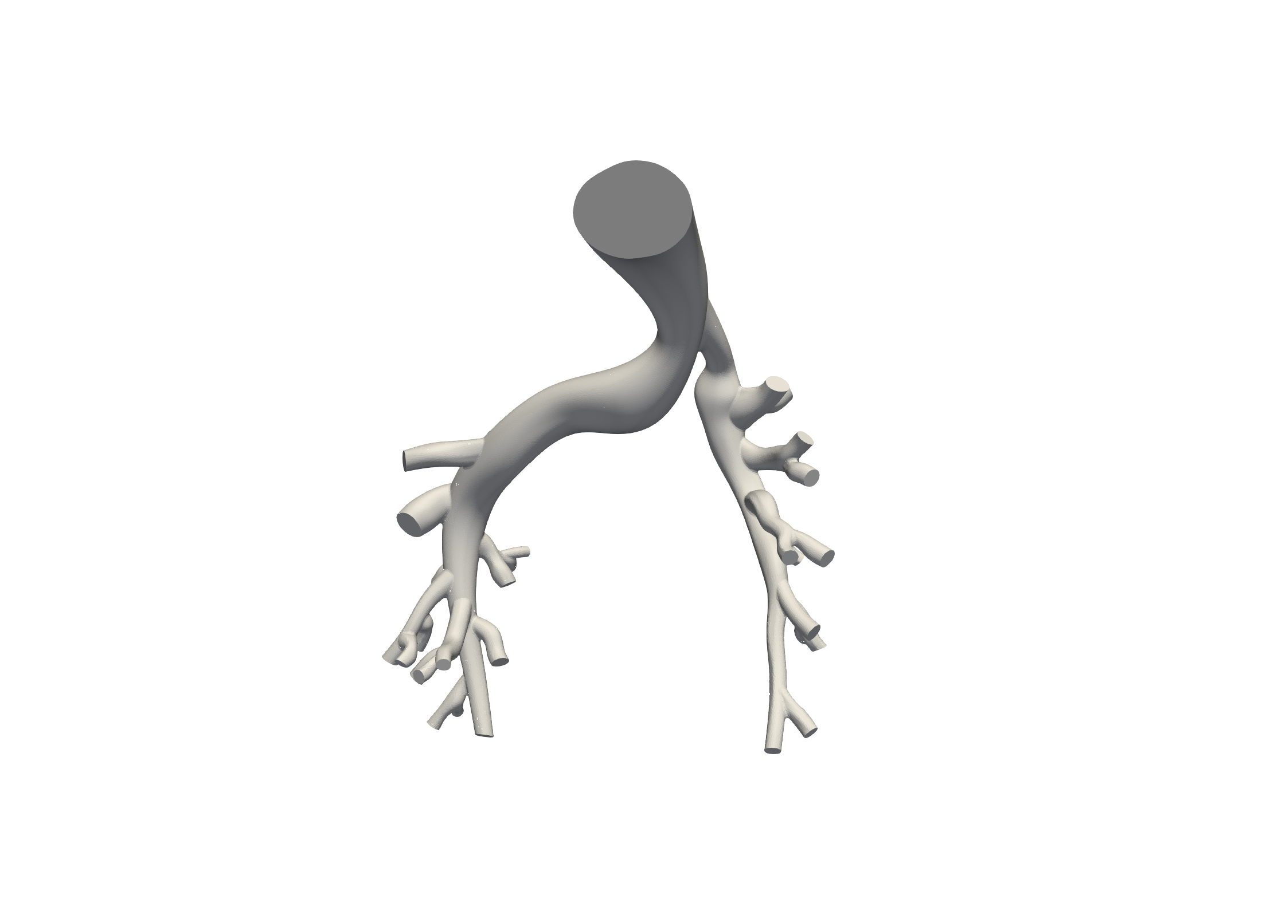
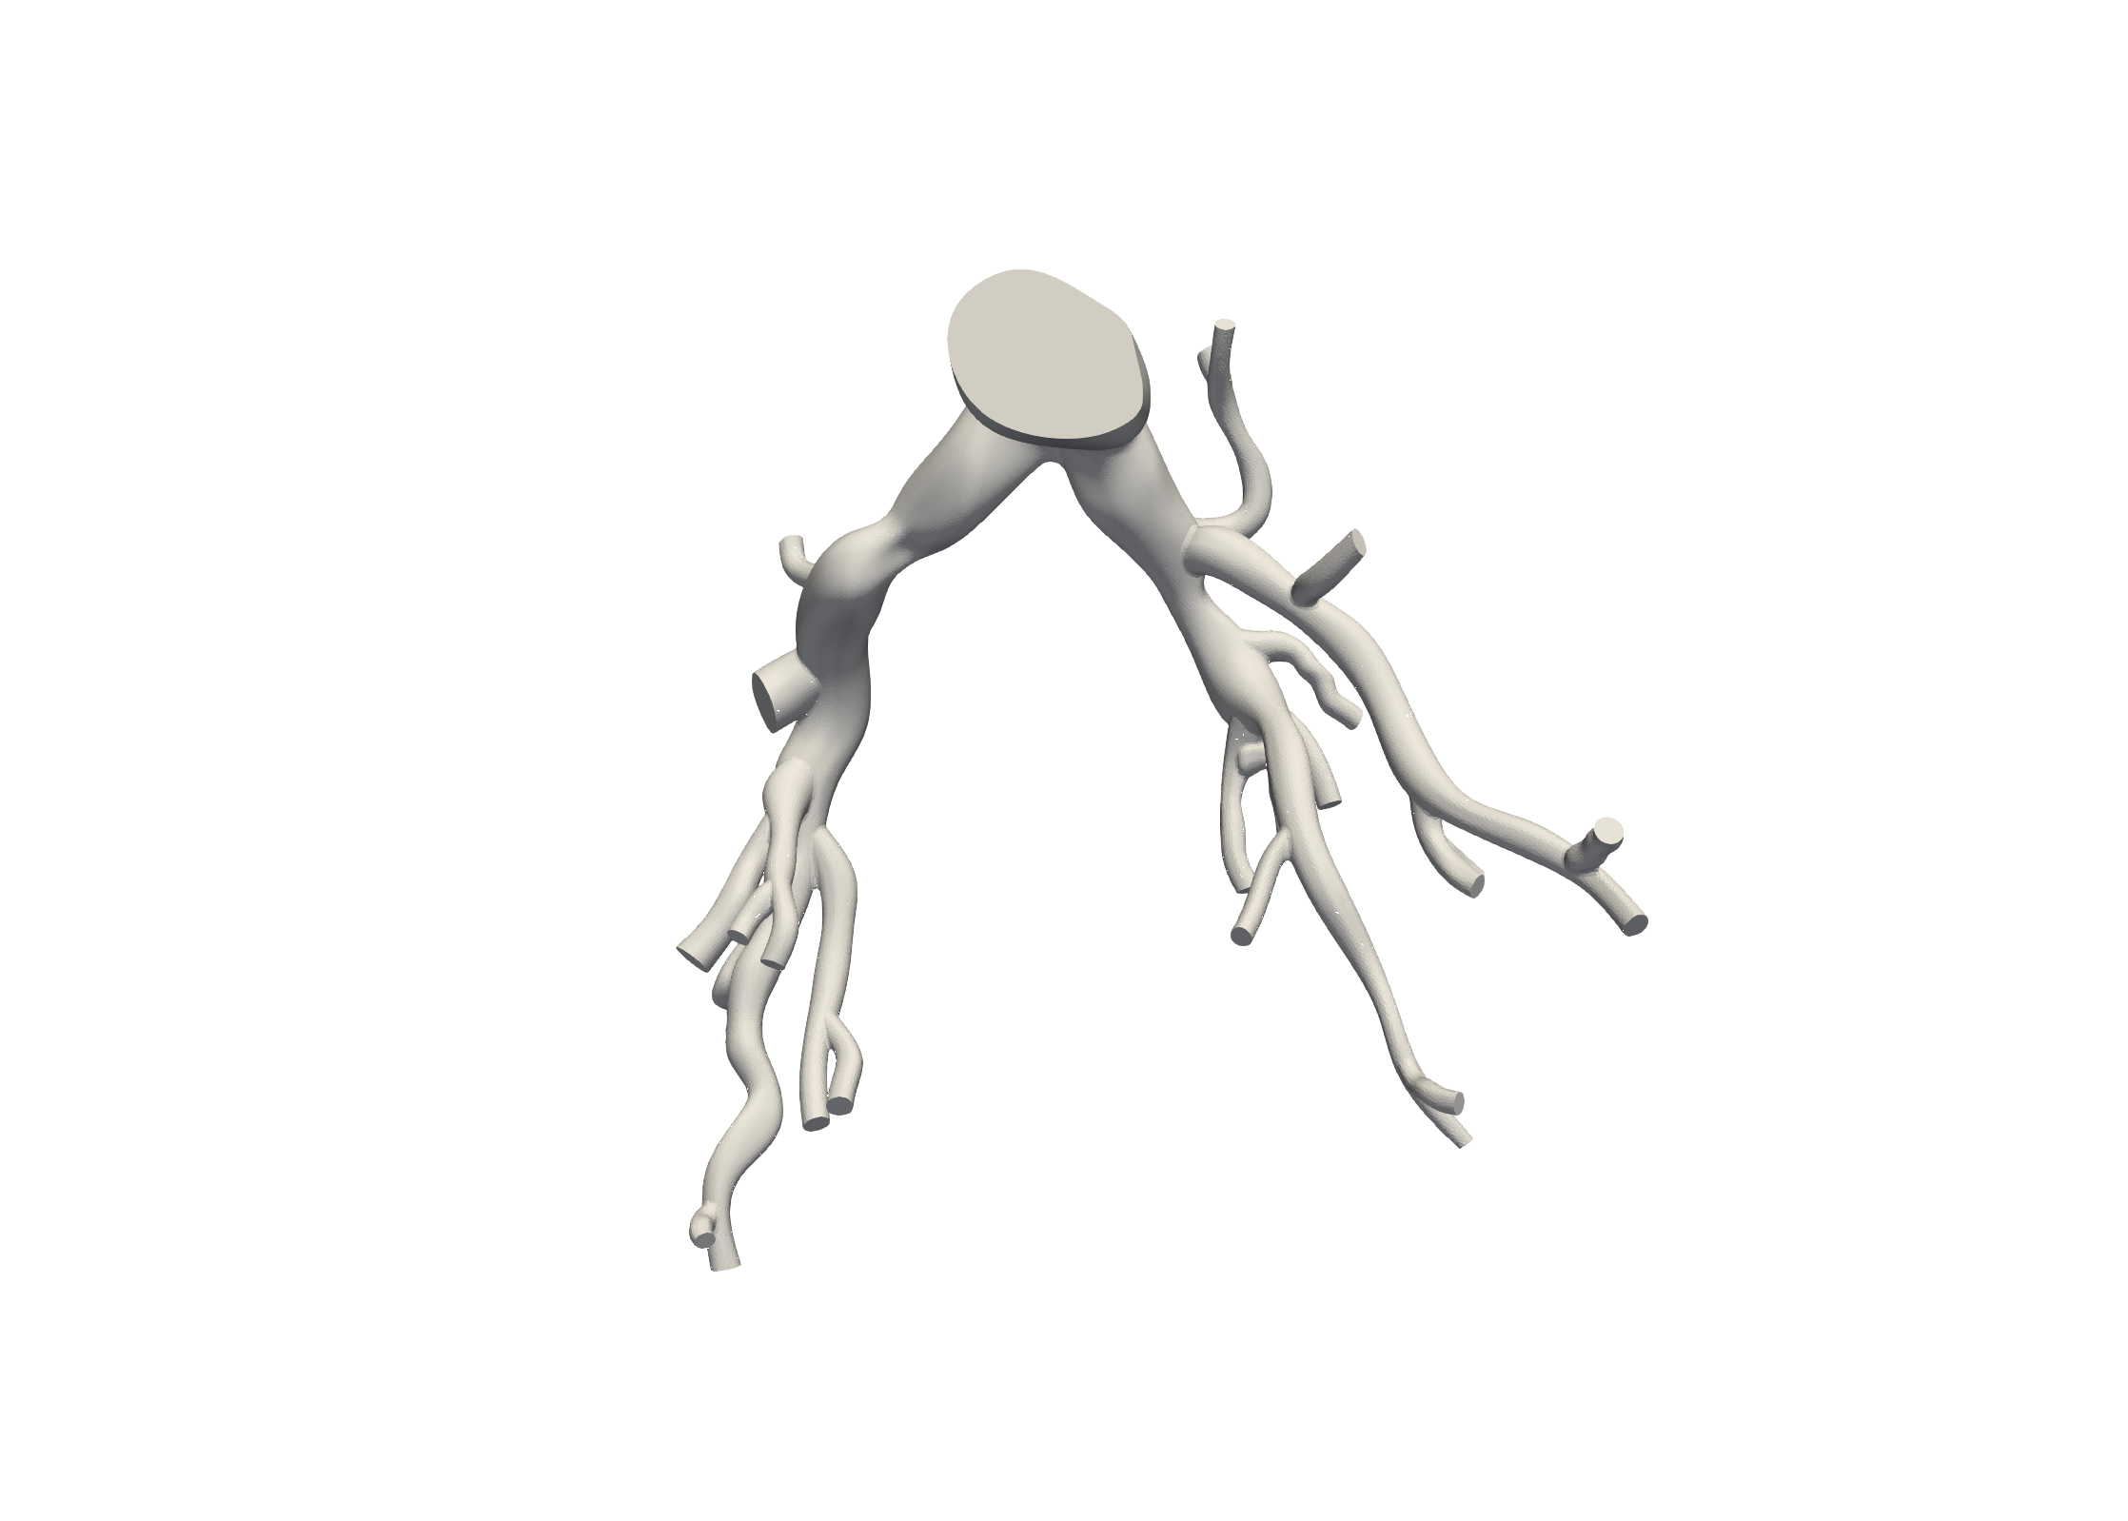
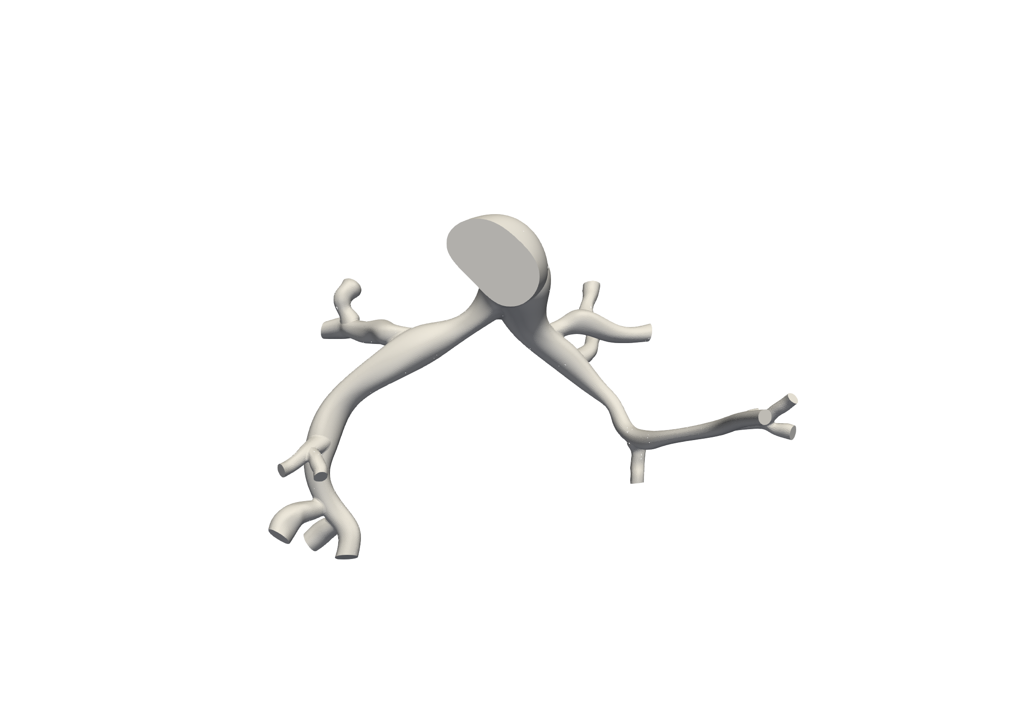
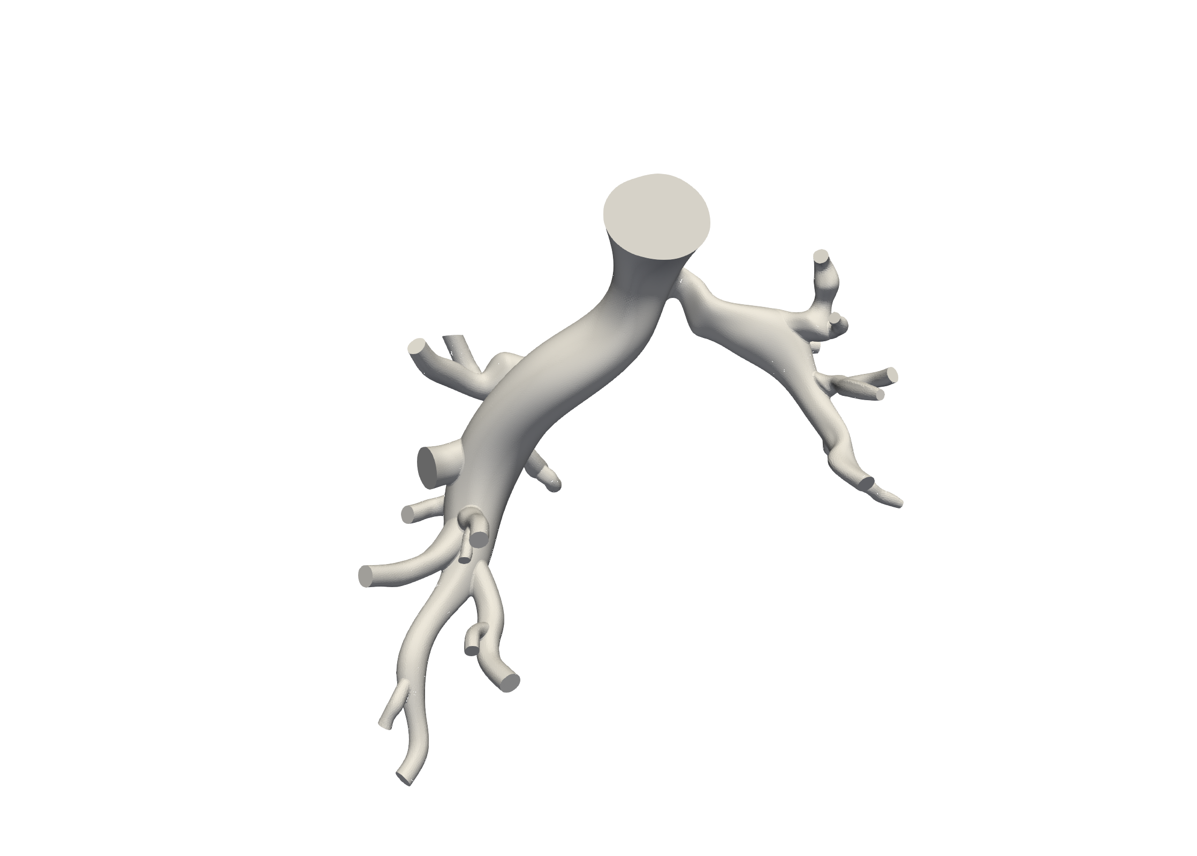
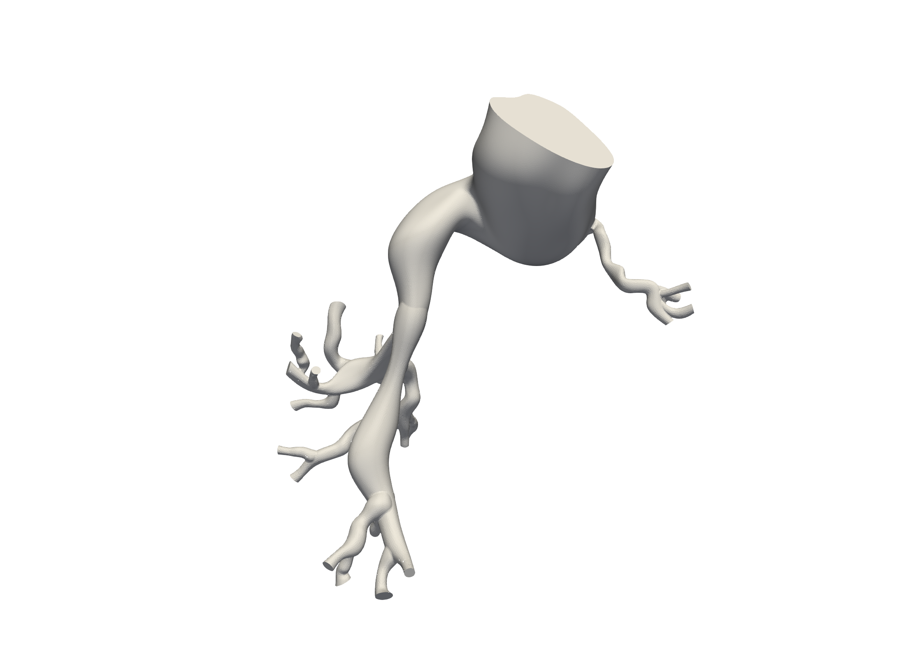
Five Tetralogy of Fallot stent patients
1 Inputs
2 BC Tuning
3 Pre-op Sim
4 Post-op Sim
5 Adaptation
6 Adapted Sim
7 Metrics
VALIDATED
Patient | Age / Sex | Weight · BSA | Lesion | Intervention (from cath report) | PV regurg.
TST-STAN-1 | 2 yr · M | 8.9 kg · 0.39 m² | LPA stenosis | Formula 8 × 16 mm stent, LPA | Yes
TST-STAN-2 | 1 yr · M | 8.4 kg · n/a | RPA stenosis | Visi-Pro 10 × 17 mm stent, RPA | No
TST-STAN-3 | 21 yr · F | 62.2 kg · 1.56 m² | RPA stenosis | Visi-Pro 10 × 27 mm stent, RPA | No
TST-STAN-5 | 4 yr · M | 14.3 kg · 0.62 m² | LPA stenosis | Visi-Pro 10 × 17 mm stent, post-dilated 9 mm | Yes
TST-STAN-9 | 2 yr · M | 14 kg · 0.57 m² | Bilateral branch | RPA 7 × 20 mm balloon; LPA 5 × 15 mm Herculink stent | No
TST-STAN-1
TST-STAN-2
TST-STAN-3
TST-STAN-5
TST-STAN-9
Two regurgitant (1, 5) and three non-regurgitant (2, 3, 9): the split that determines inflow assignment.
Notes:
Kept slide. Spot-checked 22 Oct 2026 against svzt-agent 389c580, svZeroDTrees 1b01fc9 and svz config; sources as in the footnote.

Slide 10
Did scaling only the 3D mesh bias TST-STAN-1 and -9?
1 Inputs
2 BC Tuning
3 Pre-op Sim
4 Post-op Sim
5 Adaptation
6 Adapted Sim
7 Metrics
VALIDATED
Before
14 Oct
3D mesh
scaled by s
Centerline
unscaled
0D seed
unscaled
Answer
Yes
Runs for these two patients before 14 Oct are biased:
TST-STAN-1 s = 1.147
TST-STAN-9 s = 1.425
s: mesh scale factor (true anatomy = mesh × s). R resistance, L inertance, C compliance.
Since
14 Oct
3D mesh
scaled by s
Centerline
scaled by s
0D seed
R s⁻³, L s⁻¹, C s³
What the mismatch did
The 0D models were smaller than the 3D domain, and svSlicer flows came out too small by a factor s².
Since 14 Oct, the mesh, centerline and 0D seed are scaled together, so 0D and 3D describe the same PA.
svzt-agent docs/PATIENT_DATA_CONTRACT.md (Mesh Scale Factor); svzt-agent 545ac09, a838e57, 505adfd (14 Oct), 96b65c2 (15 Oct).
Notes:
Question slide for the newest Stage 1 change (mesh scaling, 14 Oct 2026).
Source: svzt-agent docs/PATIENT_DATA_CONTRACT.md, section Mesh Scale Factor: 'Before 2026-10-14 only the 3D solver applied s, which made svSlicer flows s^-2 too small and the 0D models smaller than the 3D domain (TST-STAN-1 s=1.147, TST-STAN-9 s=1.425).' Seed scaling: lengths x s, areas x s^2, R_poiseuille s^-3, L s^-1, C s^3 (constant Eh/r).
Commits: svzt-agent 545ac09, a838e57, 505adfd (14 Oct), 96b65c2 (15 Oct); svZeroDTrees 7264ff9, 2b97be9 (14 Oct), b7ae42a (15 Oct). Checked 22 Oct 2026.

Slide 11
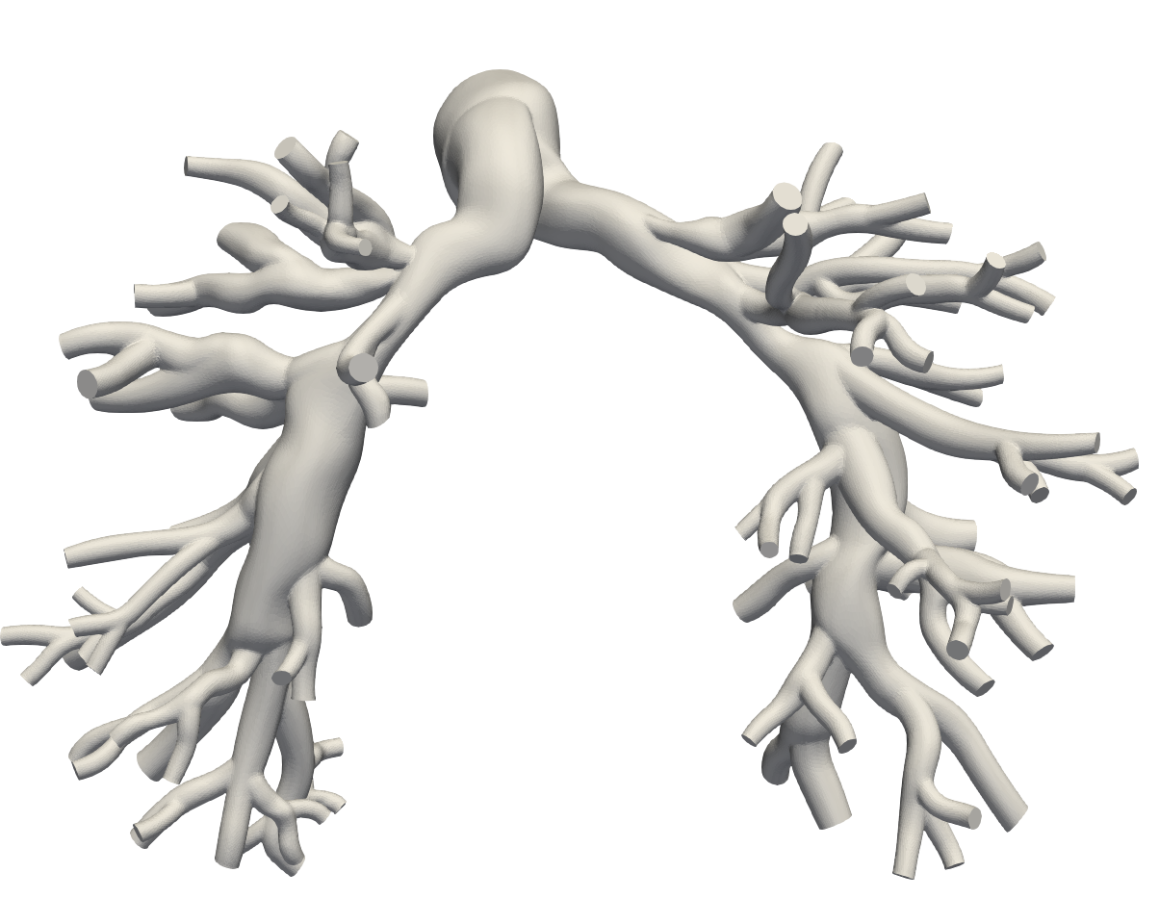
Imaging and segmentation
1 Inputs
2 BC Tuning
3 Pre-op Sim
4 Post-op Sim
5 Adaptation
6 Adapted Sim
7 Metrics
VALIDATED
Source imaging
• TST-STAN-1, -2, -9: pre-operative CT angiography
• TST-STAN-3, -5: pre-operative cardiac MR
• Pre-op imaging to catheterization interval ranges 8 to 84 weeks
Segmentation
• Manual 2D segmentation along centerline pathlines in SimVascular
• Lofted and unioned to a solid model, then meshed with TetGen
• Resolves MPA through lobar and early segmental branches
Representative segmented pulmonary artery model with outlet caps
Manual segmentation is the pipeline's main human-time cost and the main source of inter-model variability.
Notes:
Kept slide. Spot-checked 22 Oct 2026 against svzt-agent 389c580, svZeroDTrees 1b01fc9 and svz config; sources as in the footnote.

Slide 12
Clinical targets
1 Inputs
2 BC Tuning
3 Pre-op Sim
4 Post-op Sim
5 Adaptation
6 Adapted Sim
7 Metrics
VALIDATED
Catheter and lung perfusion measurements define both the tuning targets (pre-op) and the validation data (post-op).
Patient | Pre-op MPA (sys/dia/mean) | Post-op MPA | Pre-op LPS R / L | Post-op LPS R / L
TST-STAN-1 | 38 / 10 / 23 mmHg | 25 / 8 / 15 mmHg | 71.3 / 28.7 % | 55.5 / 44.5 %
TST-STAN-2 | 44 / 14 / 26 mmHg | 39 / 16 / 26 mmHg | 76.2 / 23.8 % | 77.2 / 22.8 %
TST-STAN-3 | 67 / 9 / 32 mmHg | 64 / 10 / 30 mmHg | 44.6 / 55.4 % | 46.8 / 53.2 %
TST-STAN-5 | 34 / 3 / 16 mmHg | 30 / 8 / 17 mmHg | 87.0 / 13.0 % | 63.1 / 36.9 %
TST-STAN-9 | 29 / 5 / 15 mmHg | 27 / 8 / 16 mmHg | 90.3 / 9.7 % | 82.9 / 17.1 %
Used as tuning targets (Stage 2)
Held back for validation (Stage 7)
• Pre-op MPA systolic, diastolic and mean pressure
• Pre-op RPA flow split from lung perfusion scan
• PCWP or PA diastolic sets the tree outlet pressure Pd, per patient
• Post-op MPA pressures at catheterization
• Post-op RPA / LPA perfusion split
Post-op data never enters tuning: it is the endpoint the adapted simulation must reproduce.
Notes:
Kept slide. Spot-checked 22 Oct 2026 against svzt-agent 389c580, svZeroDTrees 1b01fc9 and svz config; sources as in the footnote.

Slide 13
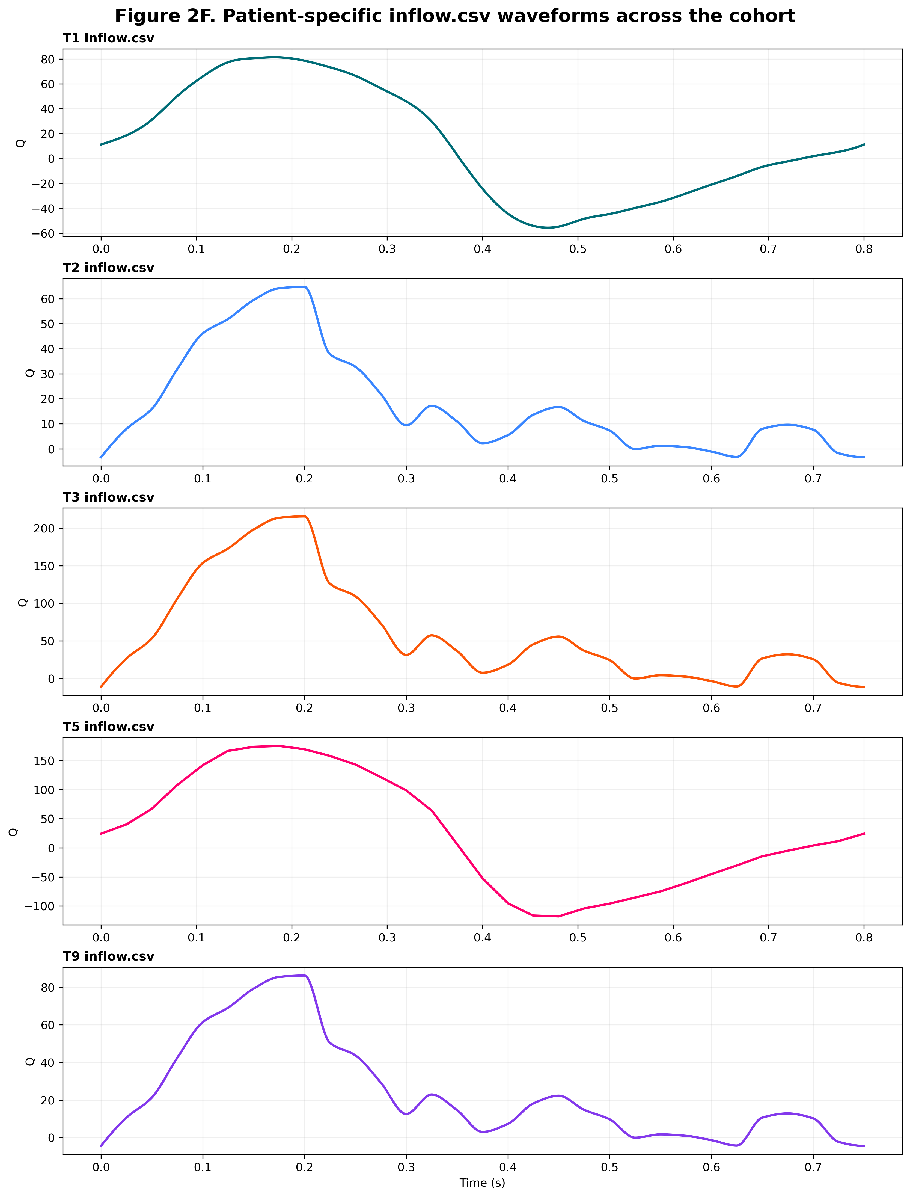
Inflow waveform assignment
1 Inputs
2 BC Tuning
3 Pre-op Sim
4 Post-op Sim
5 Adaptation
6 Adapted Sim
7 Metrics
VALIDATED
Not every patient has phase-contrast flow data, so waveform shape is assigned by pulmonary valve regurgitation class and then rescaled.
Regurgitant class
• TST-STAN-1 and TST-STAN-5
• Waveform shape taken from TST-STAN-5 and applied to TST-STAN-1
• Retains the retrograde diastolic component
Non-regurgitant class
• TST-STAN-2, TST-STAN-3 and TST-STAN-9
• Waveform shape taken from TST-STAN-3 and applied to TST-STAN-2 and -9
• Strictly forward flow through the cycle
Patient-specific inflow waveforms across the cohort
Every assigned waveform is rescaled so that its cycle-mean matches the patient's measured cardiac output.
Notes:
Kept slide. Spot-checked 22 Oct 2026 against svzt-agent 389c580, svZeroDTrees 1b01fc9 and svz config; sources as in the footnote.

Slide 14
Mesh and temporal discretization
1 Inputs
2 BC Tuning
3 Pre-op Sim
4 Post-op Sim
5 Adaptation
6 Adapted Sim
7 Metrics
VALIDATED
Discretization settings
Why two mesh configurations
Mesh edge size | ≈ 0.035 cm, isotropic tetrahedral
Boundary layer | Off during tuning, on for final runs
Timesteps per cycle | 2000, every patient (dt = period / 2000)
Timestep size | 4×10⁻⁴ s (0.8 s cycle) or 3.75×10⁻⁴ s (0.75 s)
Cycles: tuning | 3 (6000 steps), metrics from the last
Cycles: final | 3
Solver | svMultiPhysics
• Tuning needs many 3D evaluations, so the boundary layer is dropped to keep each outer iteration affordable
• Final pre-op, post-op and adapted runs use the boundary-layer mesh for wall shear stress fidelity
Open question to document
IN DEVELOPMENT
• Boundary-layer meshes change the computed pressure drop, so tuned parameters are strictly valid for the mesh they were tuned on
• Worth quantifying the shift for the paper
Discretization is settled; the tuning-mesh to final-mesh consistency check is not.
Notes:
Discretization. dt 4e-4 for every patient (svz config/patients.yaml); 6000 steps (svz config/defaults.yaml: 'Two cycles were not periodic (2026-10-08)'); metrics from the last cycle. Earlier deck listed dt 3e-4 to 5e-4 and 2 tuning cycles. Code default in svzt-agent 389c580 config/models.py:472-473 is n_tsteps 4000, dt 5e-4 (overridden by the workspace). Boundary-layer question open (PIPELINE_BRIEF; Sep 2026 correction withdrawn 22 Oct). Corrected 25 Oct 2026: the v1 svFSIplus.xml inputs (svz runs/*/wall_correction/iter-02/inputs/{iter-01,iter-02,adopted}/svFSIplus.xml) all use Number_of_time_steps 6000 with Time_step_size 4e-4 (TST-STAN-1, -5; 0.8 s cycle) or 3.75e-4 (TST-STAN-2, -3, -9; 0.75 s cycle), i.e. 2000 steps per cycle and 3 cycles. svz config defaults.yaml comment: dt = period/2000, so 6000 steps = 3 cycles. The per-patient dt 0.0004 in patients.yaml is not what the 0.75 s patients ran.

Slide 15
Path to publication: Stage 1
1 Inputs
2 BC Tuning
3 Pre-op Sim
4 Post-op Sim
5 Adaptation
6 Adapted Sim
7 Metrics
VALIDATED
Action item | Status | What it gates
Scale mesh, centerline and 0D seed together (TST-STAN-1, -9) | Done (14 Oct) | Valid 0D/3D comparison for 1 and 9
Quantify how the boundary-layer mesh shifts the tuned parameters | Open | Final runs in Stages 3, 4 and 6
TST-STAN-5 flow source: catheter 2.79 vs MRI net 1.55 L/min | Open | TST-STAN-5 targets
Confirm each patient's inflow waveform before tuning | Open | Every tuning run
Check whether TST-STAN-2 needs a missing lobe re-segmented | Open | TST-STAN-2 flow split
Stage 1 is validated; the open checks decide whether the final meshes and the TST-STAN-5 targets hold.
Items from PIPELINE_BRIEF open items and svzt-agent docs/TUNING_MODEL.md section 8 items 6 and 7 (389c580).
Notes:
Path to publication, Stage 1. Sources: svzt-agent 389c580 docs/TUNING_MODEL.md section 8 item 6 (inflow provenance) and item 7 (TST-STAN-5 cath 2.79 vs MRI 1.55 L/min); docs/PATIENT_DATA_CONTRACT.md (mesh scaling, commits 545ac09, a838e57, 505adfd). Boundary-layer item: PIPELINE_BRIEF Discretization (Sep 2026 correction withdrawn 22 Oct). Missing-lobe item from the 21 Oct pipeline slide workstreams.

Slide 16
Boundary Condition Tuning
STAGE 2 OF 7
Identifying structured-tree parameters that reproduce the pre-operative catheter and perfusion measurements.
1
Inputs
2
BC Tuning
3
Pre-op Sim
4
Post-op Sim
5
Adaptation
6
Adapted Sim
7
Metrics

Slide 17
What the measurements require from the distal bed
1 Inputs
2 BC Tuning
3 Pre-op Sim
4 Post-op Sim
5 Adaptation
6 Adapted Sim
7 Metrics
COMPLETED
Phase 0 · lumped Rp–C–Rd model driven by the measured inflow: 54% regurgitant (44.5 mL forward, 23.9 mL back per beat), Pd = 7 mmHg
Best lumped fit vs fixed compliance C
Impedance budget in front of the compliance (dyn·s/cm⁵)
Allowed by the measured pulse pressure
≤ 140
Rigid seed + literature-stiffness trees
≈ 250–300
Earlier fit (k₃ = 0)
≈ 130
seed proximal R ≈ 122
tree-root impedance ρc/A
its 115–185 range
Consequence
With Rp ≈ 250–300 a Windkessel predicts 46–51 / −9 to −14 mmHg, the pattern every literature-stiffness case produced. k₃ = 0 fits only because it removes the root impedance.
C ≥ ~1 mL/mmHg is required; above that the three pressures cannot tell values apart, so C is bounded below but not identified.
The trees must supply ≳ 1 mL/mmHg of compliance with ≤ ~140 dyn·s/cm⁵ of impedance in front of it.
Pulse pressure 31 mmHg ÷ inflow swing ≈ 290 mL/s ≈ 140 dyn·s/cm⁵. Root impedance: 23 roots in parallel. C fixed, Rp and Rd refit at each point. REPORT.md Phase 0; FINDINGS.md finding 1.
Notes:
Phase 0 diagnostics before any tree tuning. A lumped Rp-C-Rd model driven by the measured TST-STAN-5 inflow fits 34/3/16 exactly once C is at least about 1 mL/mmHg; above that the three pressure targets cannot distinguish C values (profile flat to 3 mL/mmHg). The regurgitant inflow (54% backflow) makes the pulse pressure very sensitive to whatever impedance sits in front of the compliance: at most ~140 dyn s/cm^5. The calibrated seed already has ~122, and control-range tree roots add 115-185 of characteristic impedance, so literature stiffness overshoots the budget. k3 = 0 trees have root impedance of ~8, which is why they fit.
Kept slide. Spot-checked 22 Oct 2026 against svzt-agent 389c580, svZeroDTrees 1b01fc9 and svz config; sources as in the footnote.

Slide 18
Can proximal and tree stiffness be tuned apart?
1 Inputs
2 BC Tuning
3 Pre-op Sim
4 Post-op Sim
5 Adaptation
6 Adapted Sim
7 Metrics
COMPLETED
TST-STAN-3 profile over k₃ (proximal Eh/r and ξ, η refit)
Eh/r = s · 5×10⁴ k₃ = s · 10⁵
one multiplier s ∈ [0.5, 20], log-scaled, s = 1 at the literature point
Options tested (TST-STAN-3)
(a) both free, k₃ ≤ 1.6×10⁶
✗ REJECTED
7.89
adds a direction the data cannot resolve (sd ≈ 1.2 decades)
(b) one cohort k₃ = 4×10⁵
✗ REJECTED
13.6
TST-STAN-3 wants 7.5×10⁵, TST-STAN-5 wanted 5×10⁴
■ old k₃ range [5×10⁴, 4×10⁵]: Δχ² 46 ■ above 8×10⁵: flat, Δχ² 0.7
(c) tied s, k₃ ref 10⁵
✓ ADOPTED
−0.99
corr(log Eh/r, log k₃): same signature on sys and dia
0.44–0.49
mL/mmHg total C along the flat valley; the prox/tree split is free
8.18
s = 7.48: Eh/r 3.7×10⁵, k₃ 7.5×10⁵; within 0.3 of (a)
Answer: No. corr(log Eh/r, log k₃) = −0.99, so one multiplier s sets both (default since 16 Oct; ξ floor now 2.1).
examples/adaptation/tst3-stiffness-identifiability/FINDINGS.md: iter-02 seed, shared conductance-matched trees, local periodic solves. svZeroDTrees 1b01fc9, svzt-agent be312f9 (16 Oct 2026).
Notes:
TST-STAN-3 study of whether the proximal wall Eh/r and the tree k3 can be tuned together. Within the old k3 range they are separable but k3 runs to its upper bound (chi2 falls 46 from 5e4 to 4e5). Above about 8e5, where the data want to be, the valley is flat: only total compliance (~0.45 mL/mmHg) is identified, and the two stiffnesses act on systolic and diastolic with correlation -0.99. Freeing both (a) adds an unresolvable direction; one cohort k3 (b) cannot fit both TST-STAN-3 and TST-STAN-5. The adopted option (c) tunes one multiplier s with Eh/r = s x 5e4 and k3 = s x 1e5; it fits within 0.3 chi2 of (a). s can go below 1 so softer patients such as TST-STAN-5 can fit.
Kept slide. Spot-checked 22 Oct 2026 against svzt-agent 389c580, svZeroDTrees 1b01fc9 and svz config; sources as in the footnote.

Slide 19
Protocol v1: two tuning iterations, then a wall fix
1 Inputs
2 BC Tuning
3 Pre-op Sim
4 Post-op Sim
5 Adaptation
6 Adapted Sim
7 Metrics
COMPLETED
learnedZeroD seed
ML-predicted R, C, L; scaled with the mesh
Centerline BC mapping
each 3D cap to its 0D outlet, one tree per cap
Full-PA impedance tuning
χ² fit of ξ, η per side and s; per-cap polish
3D CMM simulation
3 cycles; wall E from s; Rule A damping
Completed
Completed
Completed
Completed
iteration 2, then stop
Wall correction (iter. 3)
E-law 3D rerun, then matched 0D refit; to post-op
Seed promotion
calibrated iteration 1 seeds iteration 2
svZeroDCalibrator
R only; promoted only if no worse
Centerline postprocess
svSlicer: last-cycle MPA metrics, RPA split
Completed
Completed
Completed
Completed
Frozen 25 Oct 2026: all five patients ran these steps identically on Sherlock. Any change starts a v2.
Two iterations refit the 0D model to 3D; one wall correction then fixes the 3D pulse, no 0D retune.
svz docs/preop_protocol_v1/README.md (frozen 25 Oct 2026), steps 1 to 7; svzt-agent docs/TUNING_MODEL.md §10 (389c580 + local edits).
Notes:
Method slide, Stage 2: pre-op BC tuning protocol v1, frozen 25 Oct 2026. Steps from svz docs/preop_protocol_v1/README.md: (1) learnedZeroD seed, mesh, centerline and 0D seed scaled together for TST-STAN-1 (x1.147) and -9 (x1.425); (2) svZeroDTrees full_pa impedance tuning, likelihood objective sigma 2 mmHg / 0.02, maxfev 200, per-cap polish maxfev 100, periodic scoring (>= 6 cycles, drift < 0.1 mmHg); (3) svMultiPhysics CMM, E*h = s*wall_ehr*r_eff, h 0.2 cm, nu 0.5, 3 cycles (6000 steps, dt = period/2000), Dirichlet inflow, Robin stiffness 1000, Rule A damping; (4) svSlicer postprocess; (5) svZeroDCalibrator R only, target_focused, improvement-only gate; (6) iteration 2 from the calibrated seed, runs stop after iteration 2; (7) wall-correction step: iteration-2 3D rerun with iteration-2 BCs and the E-law wall, the reported pre-op result. Code used by the v1 runs (protocol README, Code and inputs): svzt-agent non-editable install of 16 Oct 2026 (HEAD 389c580 plus local edits, archived as code/svztagent_installed_20261016.tar.gz); svZeroDTrees 4f11755 on Sherlock (local clone HEAD 1b01fc9); svZeroDSolver 573da36; svMultiPhysics 626b002. 26 Oct 2026: the svzt-agent port of step 7 (svzt run wall-correction, uncommitted) adopted the v1 iteration-3 3D runs and published a matched 0D model (R, then one proximal C multiplier) for all five; the pre-op hand-off (converged_preop_iteration) now carries E3, damping and the matched 0D model to post-op and adaptation. svz runs/tst-stan-*/manifest.yaml wall_correction_runs (status completed 26 Oct 2026) and wall_correction/iter-02/calibration/results/calibration_summary.json.

Slide 20
Fixed and tuned parameters
1 Inputs
2 BC Tuning
3 Pre-op Sim
4 Post-op Sim
5 Adaptation
6 Adapted Sim
7 Metrics
COMPLETED
Fixed from literature or patient data
Tuned: 5 parameters, 4 targets
k₁ | 2.6×10⁵ dyn/cm² | pulmonary small arteries (Colebank 2021)
k₂ | −14 cm⁻¹ | not identifiable from pressures (Paun 2020)
Stiffness refs | Eh/r 5×10⁴, k₃ 1×10⁵ | literature point at s = 1 (Krenz & Dawson; Colebank)
l_rr | 10 | morphometric range 7–13; free l_rr not identifiable
d_min | 0.01 cm | r_min 50 µm: pre-capillary arterioles
Tree diameter | measured cap d | s = 1.0, one tree per cap
Outlet Pd | per-patient policy | PCWP- or diastolic-based
max_nodes | 1,000,000 | truncation flagged, not excluded
ξ LPA, RPA
[2.1, 3.0]
2.1
floor lowered from 2.33 (16 Oct)
3.0
η LPA, RPA
[0.3, 1.0]
0.3
1.0 = symmetric
1.0
s stiffness multiplier
[0.5, 20], log
0.5
Eh/r = s·5×10⁴, k₃ = s·10⁵
20
○ s = 1: the literature point and the initial guess
Removed: free k₃ ∈ [5×10⁴, 4×10⁵] with Eh/r fixed at 5×10⁴; tuned k₂; L2 penalty on θ
One multiplier now moves both stiffnesses; the tree shape parameters carry the resistance.
Frozen in pre-op protocol v1 (svz docs/preop_protocol_v1, 25 Oct 2026); svz defaults since 16 Oct (svzt-agent docs/TUNING_MODEL.md §2, §8 item 9).
Notes:
Parameters as of the 16 Oct cohort default. Fixed: pulmonary k1, k2, lrr 10, d_min, measured cap diameters, outlet policy, 1M nodes, and the two stiffness reference values (proximal Eh/r 5e4, tree k3 1e5) that s multiplies. Tuned: xi and eta per side and the stiffness multiplier s in [0.5, 20], log-scaled, initialized at 1. The xi floor moved from Uylings' theoretical 2.33 to the lowest measured pulmonary value 2.1. Removed: the free k3 with a fixed proximal wall.
Kept slide. Spot-checked 22 Oct 2026 against svzt-agent 389c580, svZeroDTrees 1b01fc9 and svz config; sources as in the footnote. Checked 25 Oct 2026 against svz docs/preop_protocol_v1/config/defaults.yaml (the config every v1 run used): free xi [2.1, 3.0], eta_sym [0.3, 1.0], stiffness_scale [0.5, 20] log; fixed lrr 10, d_min 0.01, k1 2.6e5, k2 -14; wall_ehr 5e4, tied_k3_ref 1e5. Code used by the v1 runs (protocol README, Code and inputs): svzt-agent non-editable install of 16 Oct 2026 (HEAD 389c580 plus local edits, archived as code/svztagent_installed_20261016.tar.gz); svZeroDTrees 4f11755 on Sherlock (local clone HEAD 1b01fc9); svZeroDSolver 573da36; svMultiPhysics 626b002.

Slide 21
Inner loop: shared fit, then a per-cap polish
1 Inputs
2 BC Tuning
3 Pre-op Sim
4 Post-op Sim
5 Adaptation
6 Adapted Sim
7 Metrics
COMPLETED
Shared stage
1 conductance-matched tree per side · ~7 s / eval
Per-cap polish
23 exported trees · maxfev 100 · ~65 s / eval
Published scoring
the exported model, simulated once
tuning_diagnostics.json
fit, bounds, compliance, periodicity
Shared vs per-cap objective trees, same start (TST-STAN-5)
Stopping, scoring and robustness
shared
per-cap
Bounds-normalized Nelder–Mead
stop on target (1σ), stall or maxfev
Published χ²
17.26
17.22
1
Optimizer vs published gap
2.57 mmHg
0.05 mmHg
2
Scored on a periodic cycle (15 Oct)
≥ 6 cycles, doubling to 24, until Δmean < 0.1 mmHg
Time per evaluation
6.9 s
64.5 s
3
2 cold-start cycles were biased
TST-STAN-3: 42.8/7.6/25.3 vs 46.3/15.4/28.7 periodic
Wall time (stall stop)
19 min
73 min
4
7 / 8 Sobol starts agree
χ² 17.2–17.6 on TST-STAN-5
Runs tuned before 15 Oct scored a transient: their 0D–3D diastolic gap is that artifact, not model mismatch.
polish {maxfev: 100}; periodic_evaluation defaults (not exposed by svzt-agent yet). svZeroDTrees ce00806; OPTION1.md §3–3b; svzt-agent TUNING_MODEL.md §6.
Notes:
Two-stage inner loop as before. New since 15 Oct: every full-PA objective evaluation, the per-cap polish and the published scoring run the 0D model until the MPA pressure is periodic (at least 6 cycles, doubling up to 24, until the mean changes by less than 0.1 mmHg). The learnedZeroD seed's 2 cycles were a cold-start transient: TST-STAN-3 iter-2 scored 42.8/7.6/25.3 against 46.3/15.4/28.7 periodic and 48/15.5/28 in 3D. tuning_diagnostics.json records periodicity.
Kept slide. Spot-checked 22 Oct 2026 against svzt-agent 389c580, svZeroDTrees 1b01fc9 and svz config; sources as in the footnote.

Slide 22
svZeroDCalibrator refits the full 0D model to 3D
1 Inputs
2 BC Tuning
3 Pre-op Sim
4 Post-op Sim
5 Adaptation
6 Adapted Sim
7 Metrics
COMPLETED
3D centerline
last cycle P, Q
QC checks
units, lineage
Calibrate ×2
fixed point
Replay
stable in solver
Target gates
pressure, split
Default fit: vessel R_poiseuille; junction coefficients selectable
fail nothing published
prior seed kept, diagnostic reports retained
pass publish calibrated_full_pa_zerod.json
svzt-agent promotes it as the next seed
Pressure RMSE vs 3D (mmHg), impedance outlet BCs
Gates (improvement-only since 7 Oct)
≤ 0.05
MPA waveform NRMSE: reported only
≤ 0.02
RPA split error: reported only
≥ prior
promotion: score no worse than the uncalibrated seed
TST-STAN-5 (archived 0D-representation comparison): RMSE over systolic, diastolic and mean MPA pressure. Gate-passing output is the only seed accepted for the next full-PA iteration.
Notes:
Postprocess publishes a last-cycle centerline time series with a descriptor that records the SHA-256 of the tuned 0D model it came from, so calibration cannot use data from another iteration. The standard pysvzerod.calibrate API is the only optimizer; it is run twice to confirm a fixed point, then the normalized model is replayed for stability before target gates are evaluated. svzt-agent chains postprocess and calibration with afterok and does the compare-and-set promotion.
Gate updated 22 Oct 2026: improvement-only promotion (svzt-agent c13a227, workflows/calibrate.py:355; svZeroDTrees 7d3cef9). Absolute tolerances are reported only.

Slide 23
Cohort setup: outlet pressure policy per patient
1 Inputs
2 BC Tuning
3 Pre-op Sim
4 Post-op Sim
5 Adaptation
6 Adapted Sim
7 Metrics
COMPLETED
Resolved outlet pressure vs catheter targets (mmHg)
Regurgitant · TST-STAN-1, -5
Pd = PCWP + 0.332 (mPAP − PCWP)
Empirically fitted: χ² 33.5 → 17.3 vs Pd = PCWP. Not Dong et al.'s partition, which puts 33.2% of PVR in the arteries.
No regurgitation · TST-STAN-2, -3, -9 (default)
Pd = PA diastolic − 2 mmHg
Keeps diastole reachable without backflow; needs no PCWP. 0.332 would be infeasible for -2 (needs < 0.29) and -3 (< 0.12).
Tested, not adopted: leaf resistance
Pd = PCWP with capillary + venous R at the tree leaves (pulsatile form of the partition): χ² 50.6 (share 0.668), ~145 (0.90) vs 17.2. Kept available for non-PR patients.
With regurgitation (PR), backflow lets MPA pressure fall below Pd, so Pd may sit above the diastolic target.
All five ran protocol v1 under this policy (tst-stan-*-20261021; TST-STAN-1: -20261023).
Targets from 'Clinical targets'. svzt-agent TUNING_MODEL.md §3, §8.8; svZeroDTrees docs/pulmonary_tuning_model.md §2.3. Pd must be finite, ≥ 0 and below mean pressure, checked before any tree is built.
Notes:
Per-patient outlet-pressure policy, selected by the clinical regurgitation grade. Regurgitant patients (TST-STAN-1, -5) use the precapillary_fraction rule, Pd = PCWP + 0.332 (mPAP - PCWP): 12.98 and 9.99 mmHg. It is an empirically fitted outlet pressure, not Dong et al. 2021's partition (corrected 6 Oct). Non-regurgitant patients (TST-STAN-2, -3, -9) use diastolic_offset, Pd = PA diastolic - 2 mmHg: 12.0, 7.0 and 3.0 mmHg. The pulsatile form of the partition (outlet at PCWP plus a leaf resistance) was tested on TST-STAN-5 and not adopted. Run status: tst-stan-5-20261006b, tst-stan-1-20261006 and tst-stan-9-20261006 were started on 6 Oct; no TST-STAN-2 or -3 run under the new model is recorded in the repos.

Slide 24
Does one wall rule close the 3D pulse in all five?
1 Inputs
2 BC Tuning
3 Pre-op Sim
4 Post-op Sim
5 Adaptation
6 Adapted Sim
7 Metrics
COMPLETED
3D compliance falls more slowly than 1/E
Pulse pressure follows PP × C₃D = constant
Rule: C* = K / PP_{target}, E₃ = E₂ · (C₃D / C*)^{1/α}, α = 0.55
K = PP × C₃D = 20.3 to 21.4 mL across all four runs; four-point fit gives α = 0.62
Answer: Yes
α fixed on TST-STAN-3; all five pulses then within −2.6 to +0.6 mmHg
Fitted on TST-STAN-3 alone, the law closed the pulse in the four out-of-sample patients too.
TST-STAN-3 3D runs (N. Dorn, 23-24 Oct 2026): tst-stan-3-20261021 iter-01, iter-02, ρ tests A, B, and _checks/elaw_iter3_20261023 (iteration-2 BCs, Rule A damping 7695). Fit uses the first four runs only. C₃D = slope of stored volume vs MPA pressure, last cycle. Fit C = 5.43·E^(−0.62) (E in kPa); the rule's α = 0.55 (two-point) under-predicts the pulse drop, so it errs high.
Notes:
Question slide for the newest Stage 2 change (the wall-correction step of protocol v1). Charts: TST-STAN-3 3D runs tst-stan-3-20261021 iter-01, iter-02, rho tests A and B, and _checks/elaw_iter3_20261023/tst-stan-3 (iteration-2 BCs, Rule A damping 7695). E law (protocol README): lambda = (PP_target / PP_3D,iter2)^(1/alpha), alpha = 0.55, lambda >= 0.5, E3 = lambda * E2. alpha was fixed in advance from TST-STAN-3 (in-sample); TST-STAN-1, -2, -5, -9 are out-of-sample. Result: iteration-3 pulse minus target -2.6 (1), -1.6 (2), +0.6 (3), -0.6 (5), -0.5 (9) mmHg. Measured alpha iteration 2 -> 3: 0.84, 0.66, 0.52, 0.66, 0.61, so the softer walls were slightly over-corrected. K = PP x C3D constant within 2% in all five. Sources: svz docs/preop_protocol_v1/README.md (frozen 25 Oct 2026); results/elaw_compare.json, elaw_compare_stan1.json. Code used by the v1 runs (protocol README, Code and inputs): svzt-agent non-editable install of 16 Oct 2026 (HEAD 389c580 plus local edits, archived as code/svztagent_installed_20261016.tar.gz); svZeroDTrees 4f11755 on Sherlock (local clone HEAD 1b01fc9); svZeroDSolver 573da36; svMultiPhysics 626b002.

Slide 25
Final pre-op fit: every pressure within 2.6 mmHg
1 Inputs
2 BC Tuning
3 Pre-op Sim
4 Post-op Sim
5 Adaptation
6 Adapted Sim
7 Metrics
COMPLETED
3D minus catheter pressure (mmHg); gridlines every 1σ
RPA split minus perfusion
mmHg, split | TST-STAN-1 | TST-STAN-2 | TST-STAN-3 | TST-STAN-5 | TST-STAN-9
Clinical | 38 / 10 / 23, 0.71 | 44 / 14 / 26, 0.76 | 67 / 9 / 32, 0.45 | 34 / 3 / 16, 0.87 | 29 / 5 / 15, 0.90
3D, iter. 3 | 36.0 / 10.6 / 20.9, 0.69 | 42.2 / 13.9 / 25.0, 0.80 | 67.2 / 8.6 / 29.7, 0.45 | 33.9 / 3.5 / 15.8, 0.89 | 28.6 / 5.1 / 14.5, 0.88
Every pressure within 2.6 mmHg and every split within 0.037; what remains is resistance, not wall.
Iteration-3 (wall-corrected) 3D vs pre-op catheter and perfusion targets. svz docs/preop_protocol_v1/README.md (frozen 25 Oct 2026), Results; results/elaw_compare*.json. σ = 2 mmHg, 0.02.
Notes:
Result slide, Stage 2 (new 25 Oct 2026). Iteration-3 (wall-correction step) 3D vs pre-op targets, protocol v1. sys/dia/mean (PP), split; error sys/dia/mean; PP error; split error; E3, damping: TST-STAN-1 36.0/10.6/20.9 (25.4), 0.689; -2.0/+0.6/-2.1; -2.6; -0.021; 7.9 kPa, 3456. TST-STAN-2 42.2/13.9/25.0 (28.4), 0.799; -1.8/-0.1/-1.0; -1.6; +0.037; 11.5 kPa, 4438. TST-STAN-3 67.2/8.6/29.7 (58.6), 0.448; +0.2/-0.4/-2.3; +0.6; +0.002; 81.1 kPa, 7695. TST-STAN-5 33.9/3.5/15.8 (30.4), 0.890; -0.1/+0.5/-0.2; -0.6; +0.020; 8.4 kPa, 3488. TST-STAN-9 28.6/5.1/14.5 (23.5), 0.883; -0.4/+0.1/-0.5; -0.5; -0.020; 152.7 kPa, 5792. All within 10% except TST-STAN-5 diastolic (+17%, 0.5 mmHg on 3): report absolute errors as the headline. Remaining errors are resistance-side (TST-STAN-2 split, TST-STAN-1 and -3 mean). Cycle 2 to 3 change <= 0.75 mmHg in every run. Runs: tst-stan-1-20261023, tst-stan-{2,3,5,9}-20261021 (iterations 1-2) and _checks/elaw_iter3_20261023/* (wall correction), runs_root /scratch/users/ndorn/svzt_runs on Sherlock (scratch, purged: archive before relying long term). Chart values computed from svz docs/preop_protocol_v1/results/elaw_compare.json and elaw_compare_stan1.json (iter3 block). Code used by the v1 runs (protocol README, Code and inputs): svzt-agent non-editable install of 16 Oct 2026 (HEAD 389c580 plus local edits, archived as code/svztagent_installed_20261016.tar.gz); svZeroDTrees 4f11755 on Sherlock (local clone HEAD 1b01fc9); svZeroDSolver 573da36; svMultiPhysics 626b002.

Slide 26
Matched 0D refit published for all five
1 Inputs
2 BC Tuning
3 Pre-op Sim
4 Post-op Sim
5 Adaptation
6 Adapted Sim
7 Metrics
COMPLETED
Calibration score vs the corrected 3D run (lower is better)
Patient | Proximal C × | 0D − 3D pulse
TST-STAN-1 | 1.13 | −0.04
TST-STAN-2 | 0.99 | +0.03
TST-STAN-3 | 0.82 | 0.00
TST-STAN-5 | 1.00 | −0.02
TST-STAN-9 | 0.93 | 0.00
Pulse in mmHg. All five published; beating the tuned model is advisory here, and only TST-STAN-2 did.
All five matched 0D models are published and handed to post-op; the score improved only for TST-STAN-2.
svz runs/tst-stan-*/manifest.yaml wall_correction_runs (status completed 26 Oct 2026) and wall_correction/iter-02/calibration/results/calibration_summary.json. Iteration-1 and -2 gates: svz docs/preop_protocol_v1/README.md.
Notes:
Stage 2 calibration slide, updated 26 Oct 2026 to lead with the wall-correction matched 0D refit (svzt run wall-correction, mode adopted, uncommitted svzt-agent src/svztagent/workflows/wall_correction.py on 389c580). Each refit takes the iteration-2 tuned 0D model and the wall-corrected 3D run (_checks/elaw_iter3_20261023/*), fits vessel R, then one multiplier on proximal C (calibration_compliance_fit.json). All five completed and published calibrated_full_pa_zerod.json; svzt then recorded converged_preop_iteration (selection_kind wall_correction, threed_overrides E3 and damping) at 05:26 to 05:27 UTC 26 Oct. TST-STAN-5 completed on its third attempt (calibration job 49585669); the two earlier attempts failed the proximal compliance fit before target evaluation. Per patient (1, 2, 3, 5, 9): C scale 1.133, 0.988, 0.821, 1.003, 0.931; 3D pulse 25.10, 28.44, 58.73, 32.03, 23.54 mmHg, fitted 0D pulse 25.06, 28.47, 58.73, 32.02, 23.54; composite score tuned -> matched 5.197 -> 5.532, 2.008 -> 0.369, 1.479 -> 2.226, 8.386 -> 8.589, 0.919 -> 1.188; pressure NRMSE 0.117, 0.030, 0.064, 0.133, 0.054 (0.05 tolerance reported only); split error 0.002, 0.002, 0.015, 0.025, 0.003. baseline_policy is advisory (required false), so a worse composite does not block publishing. Earlier content of this slide (iteration-1 seeds, score uncalibrated -> calibrated): TST-STAN-1 6.911 -> 6.072; -2 21.523 -> 2.233; -3 9.261 -> 2.373; -5 10.497 -> 7.201; -9 24.931 -> 2.237; all five promoted. Iteration 2: only TST-STAN-9 promoted (protocol README).

Slide 27
What changed: hand-picked iteration to protocol v1
1 Inputs
2 BC Tuning
3 Pre-op Sim
4 Post-op Sim
5 Adaptation
6 Adapted Sim
7 Metrics
COMPLETED
Previous: iterate, pick by hand
Current: protocol v1
Iter. 1
Iter. 2
… up to
iter. 5
Pick by
hand
Why does the 3D pulse stay wide after iteration 2?
Iter. 1
Iter. 2
E-law
wall
Reported
pre-op
iteration count and choice vary by patient
fixed: iteration 3 is the 3D rerun, not a retune
Up to 5 iterations; the operator picked one (svzt preop select). The 3D pulse stayed up to 8 mmHg wide, and a ρ wall test overshot TST-STAN-3.
Two iterations, then one E-law wall correction with no 0D retune. Same steps for all five patients.
3D wall held only 60 to 75% of the 0D compliance; R-only calibration cannot fix that.
3D pulse minus catheter: iteration 2 +0.9 to +8.1 mmHg, iteration 3 −2.6 to +0.6. Earlier step (archived): RRI to full branched 0D.
A fixed protocol gives every patient the same steps, and the wall correction closes the pulse.
svz docs/preop_protocol_v1/README.md (frozen 25 Oct 2026); svzt-agent docs/TUNING_MODEL.md §10 (local edits on 389c580); slide 'Does one wall rule close the 3D pulse in all five?'.
Notes:
What changed and why, Stage 2 (new 25 Oct 2026). Previous: up to max_iterations = 5 outer-loop iterations, the pre-op iteration picked by hand with svzt preop select (3D convergence gate set aside 6 Oct); the 3D pulse was fixed by Rule A damping only (21 Oct), and a rho wall correction (E x 0D/3D compliance ratio) tested on TST-STAN-3 left the pulse 5 to 7 mmHg too narrow (archived slide 'rho test on TST-STAN-3: the correction overshoots'). Trigger: after iteration 2 the 3D pulse was +6.7 (1), +8.1 (2), +7.8 (3), +0.9 (5), +3.7 (9) mmHg wide; the iteration-2 3D deformable wall gave only about 60-75% of the 0D proximal compliance, which R-only calibration cannot change (svzt-agent docs/TUNING_MODEL.md section 10, uncommitted). Current: protocol v1 (svz docs/preop_protocol_v1/README.md (frozen 25 Oct 2026)): two iterations, then the E-law wall-correction step on the iteration-2 BCs, iteration-3 pulse -2.6 to +0.6 mmHg. Earlier step one further back (two-branch RRI to full branched 0D) is archived. In development: svzt run wall-correction (uncommitted svzt-agent workflows/wall_correction.py) ports the step into the orchestrator and also refits the 0D model (R, then one proximal C multiplier) to the corrected 3D run; all five completed and published on 26 Oct 2026 (svz runs/tst-stan-*/manifest.yaml wall_correction_runs (status completed 26 Oct 2026) and wall_correction/iter-02/calibration/results/calibration_summary.json). Code used by the v1 runs (protocol README, Code and inputs): svzt-agent non-editable install of 16 Oct 2026 (HEAD 389c580 plus local edits, archived as code/svztagent_installed_20261016.tar.gz); svZeroDTrees 4f11755 on Sherlock (local clone HEAD 1b01fc9); svZeroDSolver 573da36; svMultiPhysics 626b002.

Slide 28
Path to publication: Stage 2
1 Inputs
2 BC Tuning
3 Pre-op Sim
4 Post-op Sim
5 Adaptation
6 Adapted Sim
7 Metrics
COMPLETED
Action item | Status | What it gates
Freeze the pre-op protocol (v1): all five run identically | Done (25 Oct) | Stages 3 to 7
Archive v1 run directories off Sherlock scratch (purged) | Open | Every reported pre-op number
Matched 0D refit for the corrected wall (all five) | Done (26 Oct) | Post-op and adaptation 0D models
Resistance-side misses: TST-STAN-2 split, -1 and -3 mean | Open | Limitations in the paper
α = 0.55 over-corrects softer walls (measured 0.52 to 0.84) | Open | E law in a v2
Check parameters at bounds in the final tuning diagnostics | Open | Tied model for the cohort
Commit the svzt-agent wall-correction workflow | Open | Reproducible v2 runs
Pre-op tuning is done; what is left is archiving, a code commit and limitations to report.
svz docs/preop_protocol_v1/README.md (frozen 25 Oct 2026) (Known limitations, Runs); svzt-agent docs/TUNING_MODEL.md §10.
Notes:
Path to publication, Stage 2, updated 25 Oct 2026 after protocol v1 froze. Done: protocol v1 (svz docs/preop_protocol_v1/README.md (frozen 25 Oct 2026)). Open: run directories live under /scratch/users/ndorn/svzt_runs (purged; README says archive before relying long term). In progress: svzt run wall-correction (uncommitted svzt-agent src/svztagent/workflows/wall_correction.py, core/wall_correction.py, docs/TUNING_MODEL.md section 10); README: the v1 step ran outside svzt-agent via scripts/elaw_iter3_setup.py and does not refit the 0D proximal compliance. Residual misses: TST-STAN-2 split +0.037, TST-STAN-1 mean -2.1, TST-STAN-3 mean -2.3 (README: resistance side, not the wall). Measured alpha 0.84, 0.66, 0.52, 0.66, 0.61. Parameters at bounds: not checked here, the final tuning_diagnostics.json files are on scratch, not synced locally. Removed rows: re-tune under tied multiplier (done), TST-STAN-2 infeasibility (now 0.037 split error, within 2 sigma), TST-STAN-5 diastolic 3.8 sigma (now +0.5 mmHg), calibrated seeds above tolerance (iteration-2 gates no longer affect the result), copy 0D scores (superseded by the 3D result). Code used by the v1 runs (protocol README, Code and inputs): svzt-agent non-editable install of 16 Oct 2026 (HEAD 389c580 plus local edits, archived as code/svztagent_installed_20261016.tar.gz); svZeroDTrees 4f11755 on Sherlock (local clone HEAD 1b01fc9); svZeroDSolver 573da36; svMultiPhysics 626b002. 26 Oct 2026: matched 0D refit completed for all five (svz runs/tst-stan-*/manifest.yaml wall_correction_runs (status completed 26 Oct 2026) and wall_correction/iter-02/calibration/results/calibration_summary.json); the workflow files are still untracked in svzt-agent (src/svztagent/workflows/wall_correction.py, core/wall_correction.py, tests/test_wall_correction.py), so a commit row replaces the chi-squared gate row (moot while v1 fixes 2 iterations). Matched composite scores beat the tuned model only for TST-STAN-2 (advisory check).

Slide 29
Pre-operative Simulation
STAGE 3 OF 7
Deformable-wall 3D CFD with the tuned structured-tree impedance boundary conditions.
1
Inputs
2
BC Tuning
3
Pre-op Sim
4
Post-op Sim
5
Adaptation
6
Adapted Sim
7
Metrics

Slide 30
Pre-op 3D is the baseline for every later stage
1 Inputs
2 BC Tuning
3 Pre-op Sim
4 Post-op Sim
5 Adaptation
6 Adapted Sim
7 Metrics
IN DEVELOPMENT
Post-op 3D
Stage 4
Held fixed in all three
wall E, damping, 0D model, coupler, outlet mapping
Pre-op 3D run
deformable wall (CMM)
Tuned BCs
Stage 2
Adapted 3D
Stage 6
Catheter + perfusion
pre-op targets
The pre-op run checks the tuned BCs against the catheter in 3D, where they will actually be used.
If the pre-op 3D run misses the catheter, every post-op and adapted comparison inherits the miss.
svzt-agent docs/TUNING_MODEL.md section 8 item 1; docs/ARCHITECTURE.md (preop select, run postop, run adapt).
Notes:
Motivation, Stage 3. E and damping held fixed across a patient's pre-op, post-op and adapted runs; post-op and adaptation use the selected pre-op iteration's E (svzt-agent 389c580 docs/TUNING_MODEL.md section 8 item 1, commit 0dad632). Explicit workflows preop select / run postop / run adapt: docs/ARCHITECTURE.md (389c580).

Slide 31
Does scaled damping narrow the 3D pulse pressure?
1 Inputs
2 BC Tuning
3 Pre-op Sim
4 Post-op Sim
5 Adaptation
6 Adapted Sim
7 Metrics
IN DEVELOPMENT
c = 10⁴ · √( K / K_STAN-3 ), K = E h / (0.75 r²)
K from each patient's iteration-1 tuned wall; keeps TST-STAN-3's stable damping ratio
Wall time constant τ = c / K at c = 10⁴ (ms)
TST-STAN-5 3D test, iteration-1 BCs (mmHg)
Too much damping on soft PA walls removed 20–55% of the wall's dynamic compliance at the first three harmonics, so the 3D pulse pressure came out too wide
0.895
RPA split (target 0.87)
≈ 2×
effective wall compliance; run stable
Answer: partly. TST-STAN-5's pulse is now within 1 mmHg; TST-STAN-1, -2 and -3 stay 8 to 22 mmHg too wide.
TST-STAN-5 test 20 Oct; all five rerun 21 Oct (tst-stan-*-20261021). Damping per patient in svz config/patients.yaml; Robin stiffness unchanged (1000).
Notes:
Stiffness-scaled damping for the CMM Robin tissue-support damping. c = 1e4 was tuned for aortic walls, where tau = c/K is about 14 ms. The softer PA walls gave tau of 89-123 ms for TST-STAN-1 and -5, which removed 20-55% of the wall's dynamic compliance at the first three harmonics and widened the 3D pulse pressure. TST-STAN-3 (tau about 16 ms) was stable, and some damping is still needed for stability. The rule sets c = 1e4 x sqrt(K / K_STAN-3), K = Eh / (0.75 r^2) from each patient's iteration-1 tuned wall, which keeps TST-STAN-3's damping ratio. Test: TST-STAN-5 at c = 3650 with its iteration-1 BCs was stable and gave 34.8/2.8/15.8, split 0.895 (targets 34/3/16, 0.87); at c = 1e4 it gave 38.2/-1.9/15.9. Effective compliance roughly doubled. Rollout: TST-STAN-1, -2 and -9 rerun on 21 Oct as tst-stan-{1,2,9}-20261021; TST-STAN-5 keeps the test run as its iteration-1 result.

Slide 32
Deformable-wall formulation
1 Inputs
2 BC Tuning
3 Pre-op Sim
4 Post-op Sim
5 Adaptation
6 Adapted Sim
7 Metrics
IN DEVELOPMENT
All three simulation stages: pre-operative, post-operative and adapted: use the same coupled momentum method setup.
Wall and solver settings
Why a uniform modulus
Solver | svMultiPhysics, CMM
Wall model | Coupled momentum, linear elastic
Elastic modulus | matched to 0D C, then E-law corrected: 7.9 to 153 kPa
External support | Robin boundary condition
Robin stiffness | 1000.0
Robin damping | Rule A, c₁ √(E / E₁): 3,456 to 7,695 at iteration 3
Fluid | Incompressible Newtonian blood
• Patient-specific wall stiffness is not measurable from the available imaging
• E starts matched to the tuned 0D proximal compliance; the E law then corrects it from the 3D pulse
• Robin support supplies tethering without requiring a surrounding tissue mesh
Candidate refinement
PLANNED
• Regionally varying modulus, or stiffer wall in the stented segment
• Would need a defensible source for the values
E and damping are fixed per patient across stages, so stage differences are not wall effects.
Notes:
Deformable-wall formulation. svMultiPhysics CMM; E = match_proximal_compliance (svzt-agent 0dad632, TUNING_MODEL.md section 8 item 1); Robin stiffness 1000 (config/models.py:408); damping per patient from svz config/patients.yaml (TST-STAN-1 4300, -2 8000, -3 10000 default, -5 3650, -9 6200). svzt-agent 389c580, svZeroDTrees 1b01fc9. Updated 25 Oct 2026 for protocol v1 (svz docs/preop_protocol_v1/README.md (frozen 25 Oct 2026)): reported pre-op runs use the E-law wall E3 = lambda * E2 (7.9, 11.5, 81.1, 8.4, 152.7 kPa for TST-STAN-1, -2, -3, -5, -9; h = 0.2 cm, nu = 0.5) and Rule A damping c1*sqrt(E3/E1) = 3456, 4438, 7695, 3488, 5792 (c1 = 4300, 8000, 1e4, 3650, 6200 in iterations 1 and 2).

Slide 33
Wall correction closed the 3D pulse in all five
1 Inputs
2 BC Tuning
3 Pre-op Sim
4 Post-op Sim
5 Adaptation
6 Adapted Sim
7 Metrics
IN DEVELOPMENT
3D minus catheter pulse pressure (mmHg)
Patient | E₃ (kPa) | Mean | RPA split
TST-STAN-1 | 7.9 | 20.9 / 23 | 0.69 / 0.71
TST-STAN-2 | 11.5 | 25.0 / 26 | 0.80 / 0.76
TST-STAN-3 | 81.1 | 29.7 / 32 | 0.45 / 0.45
TST-STAN-5 | 8.4 | 15.8 / 16 | 0.89 / 0.87
TST-STAN-9 | 152.7 | 14.5 / 15 | 0.88 / 0.90
Iteration 3, model / catheter. E₃: corrected wall modulus. Mean in mmHg.
Catheter values from the clinical targets slide.
Iteration 1 ran up to 22 mmHg wide; after the wall correction every pulse is within 2.6 mmHg.
Pulse pressure = systolic − diastolic. Iterations 1, 2: svz runs/tst-stan-* iteration_decision.json; iteration 3: svz docs/preop_protocol_v1/README.md (frozen 25 Oct 2026), results/elaw_compare*.json.
Notes:
Result slide, Stage 3, updated 25 Oct 2026. 3D minus catheter pulse pressure (mmHg). Iteration 1 (Rule A damping, tied multiplier): svz runs/tst-stan-1-20261023 and tst-stan-{2,3,5,9}-20261021 iterations/iter-01/results/iteration_decision.json: 42.22/6.31 (+7.9), 62.50/11.82 (+20.7), 88.37/7.98 (+22.4), 34.76/2.82 (+0.9), 30.93/4.92 (+2.0). Iteration 2: wall_correction/iter-02/inputs/iter-02/iteration_decision.json and elaw_compare iter2: PP 34.74 (+6.7), 38.11 (+8.1), 65.82 (+7.8), 31.88 (+0.9), 27.66 (+3.7). Iteration 3 (E-law wall, iteration-2 BCs, no 0D retune): PP 25.4 (-2.6), 28.4 (-1.6), 58.6 (+0.6), 30.4 (-0.6), 23.5 (-0.5); targets PP 28, 30, 58, 31, 24. Table: iteration-3 E3 (kPa), Rule A damping, mean and RPA split vs catheter/perfusion. Runs on the tuning mesh (no boundary layer). Replaced the 'Before: c = 1e4' series (pre-20 Oct runs). Code: svzt-agent 389c580 + local edits (install 16 Oct), svZeroDTrees 4f11755 (Sherlock), svZeroDSolver 573da36, svMultiPhysics 626b002.

Slide 34
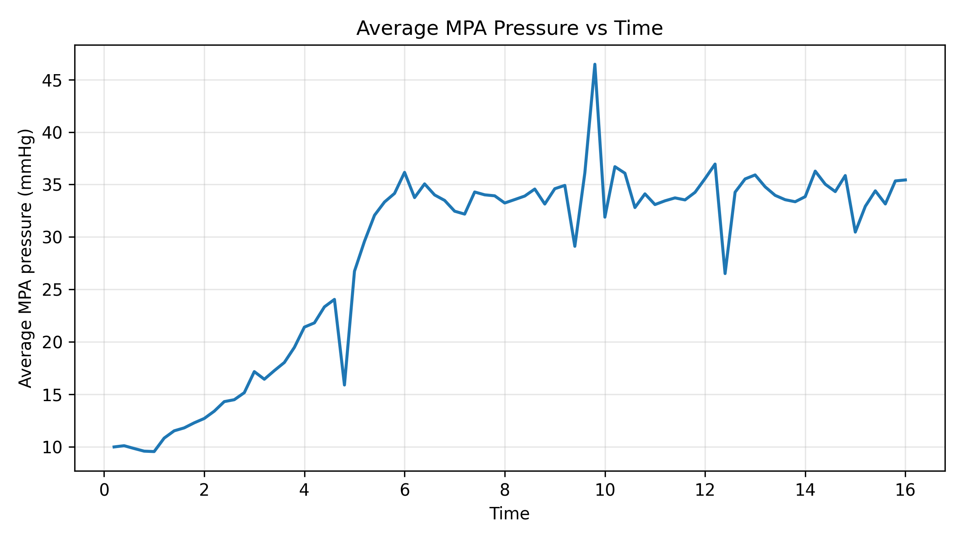
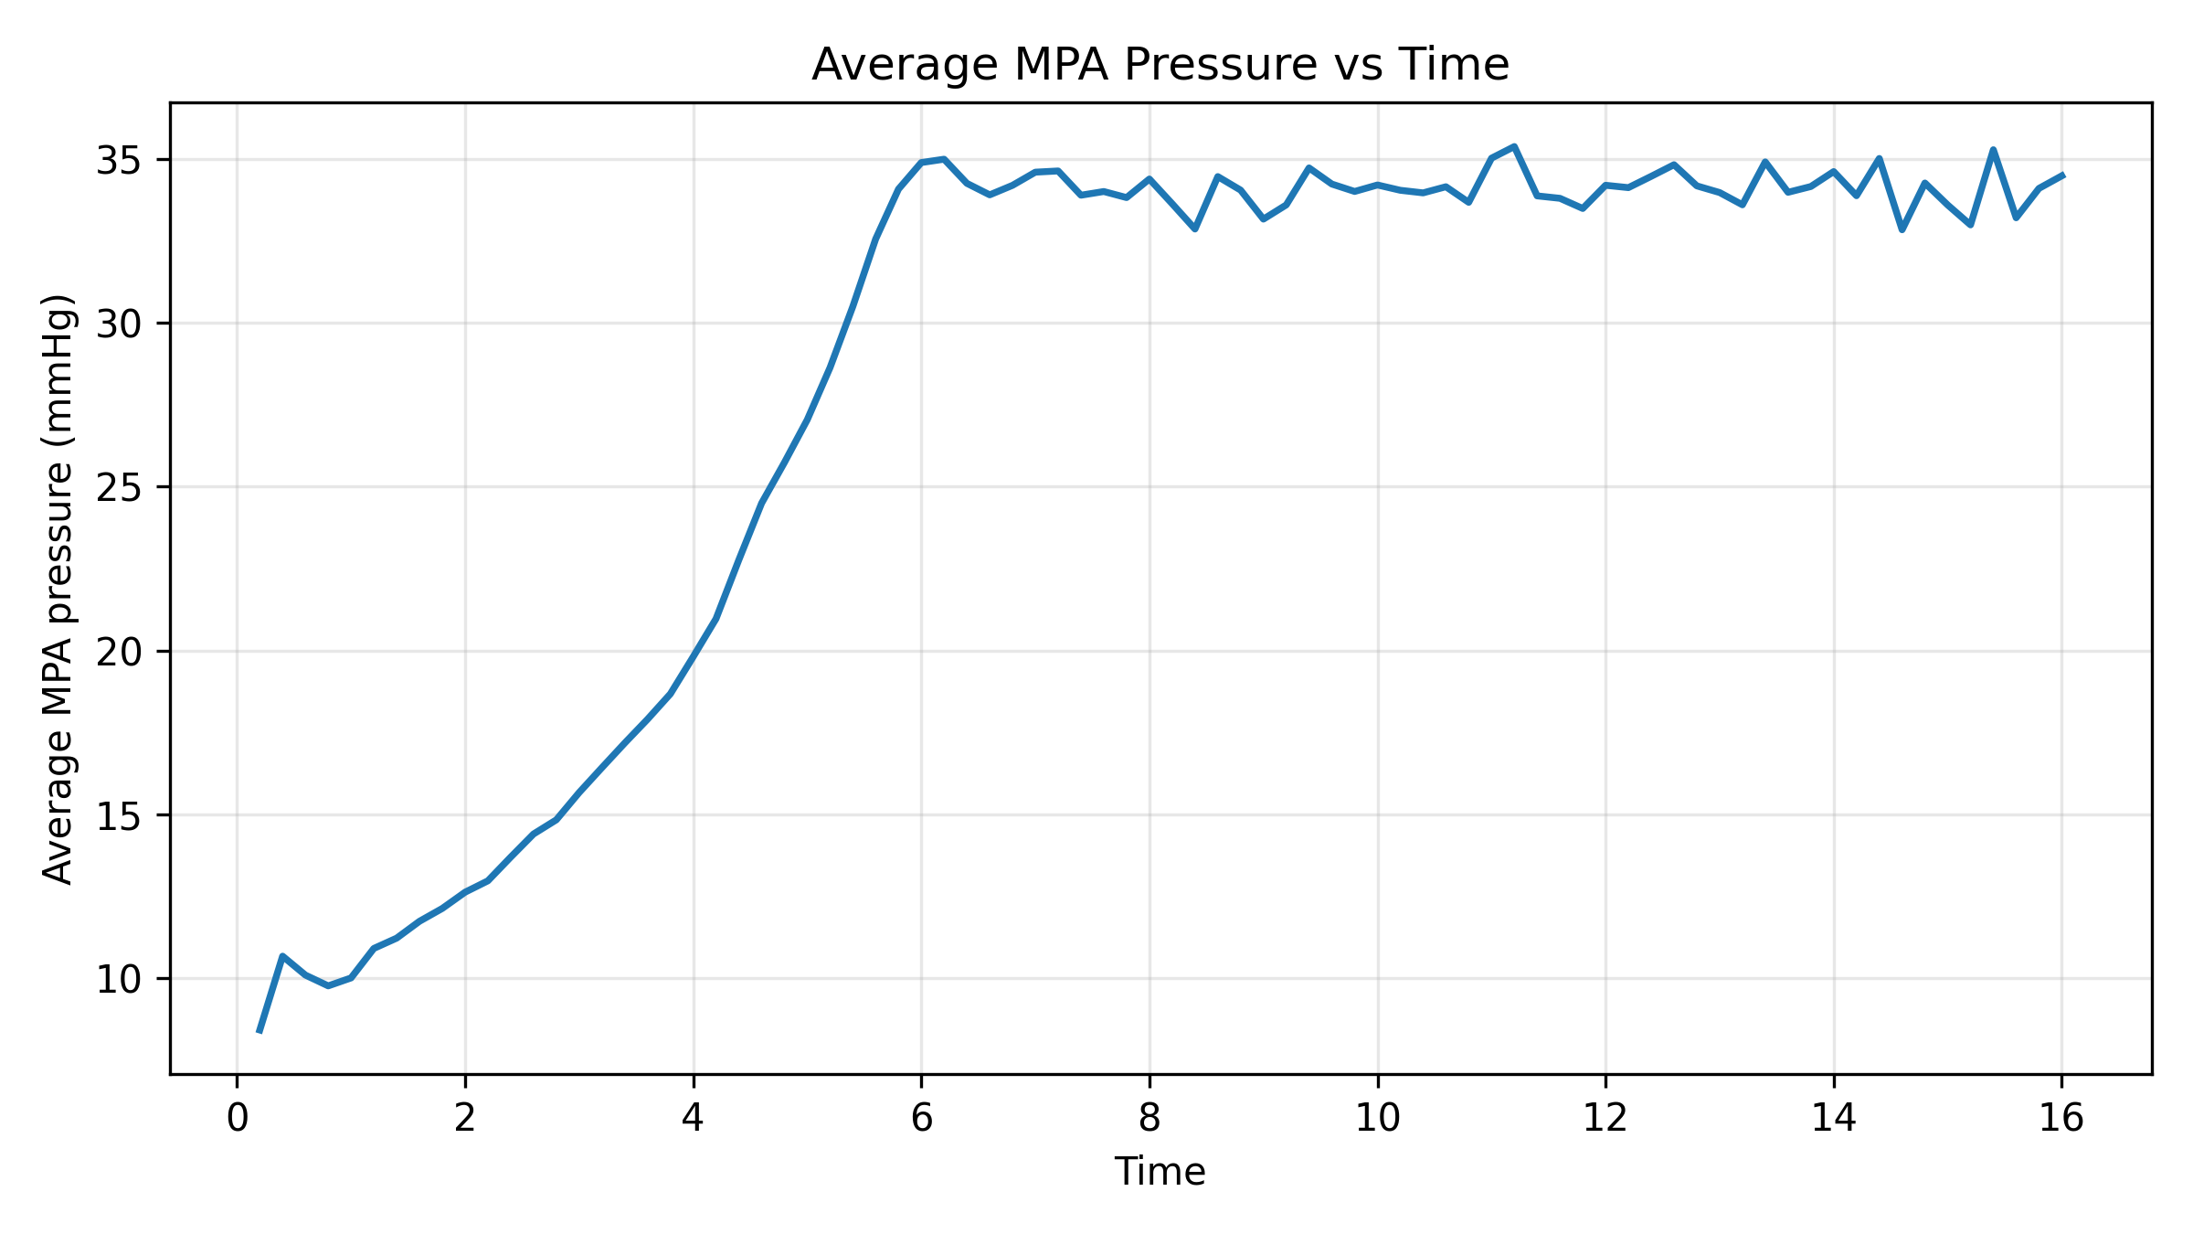
Why the pipeline moved to deformable walls
1 Inputs
2 BC Tuning
3 Pre-op Sim
4 Post-op Sim
5 Adaptation
6 Adapted Sim
7 Metrics
IN DEVELOPMENT
• Rigid-wall simulations produced a systolic pressure drop across the model large enough that no boundary condition could satisfy both systolic and diastolic targets
• Poiseuille scaling gives an inverse fourth-power dependence on radius, so even modest systolic distension should reduce viscous dissipation substantially
Rigid wall: MPA pressure
CMM deformable wall: MPA pressure
Deformable wall lowered the modelled systolic pressure drop and is now the pipeline default, not a side study.
Comparison performed on TST-STAN-5; rigid case 19.4 mmHg vs. CMM 16 mmHg at matched inflow.
Notes:
Kept slide. Spot-checked 22 Oct 2026 against svzt-agent 389c580, svZeroDTrees 1b01fc9 and svz config; sources as in the footnote.

Slide 35
Path to publication: Stage 3
1 Inputs
2 BC Tuning
3 Pre-op Sim
4 Post-op Sim
5 Adaptation
6 Adapted Sim
7 Metrics
IN DEVELOPMENT
Action item | Status | What it gates
Roll out stiffness-scaled damping (Rule A) | Done (21 Oct) | 3D pulse pressure
Close the 3D pulse in all five (E-law wall, iteration 3) | Done (23 Oct) | Stage 3 validation
Pre-op hand-off carries iteration-3 E, damping and matched 0D | Done (26 Oct) | Stage 4 post-op runs
Final runs on the boundary-layer mesh; check tuned BCs transfer | Open | Publication numbers
Wall E is effective (8 to 153 kPa at h = 0.2 cm): compare with distensibility | Open | Wall claims in the paper
Wall Eh/r = 5×10⁴ moves ~120% of proximal volume (TST-STAN-5) | Open | CMM small-strain validity
Stage 3 needs the boundary-layer runs and the tuned-BC transfer check before it is validated.
svz docs/preop_protocol_v1/README.md (frozen 25 Oct 2026) (Known limitations); svzt-agent docs/TUNING_MODEL.md §10; svz config/patients.yaml (c₁).
Notes:
Path to publication, Stage 3, updated 25 Oct 2026. Done: Rule A damping 21 Oct; E-law wall-correction step 23 Oct (svz docs/preop_protocol_v1/README.md (frozen 25 Oct 2026)), pulses within -2.6 to +0.6 mmHg. Open: whether post-op runs take the iteration-3 E and damping is not stated in the repos (TUNING_MODEL.md section 8 item 1 says post-op uses the selected pre-op iteration's E; the wall-correction step is outside svzt-agent in v1). Boundary-layer transfer check: README Known limitations. Effective wall E: README Known limitations. Removed: 'pulse still 8 to 22 mmHg too wide' (closed), 'svzt preop select' (v1 reports iteration 3), '3D/0D volume correction' (superseded by the E law). Repo state: svzt-agent 389c580 (+ local edits), svZeroDTrees 4f11755 on Sherlock. 26 Oct 2026: svzt wall-correction-status recorded converged_preop_iteration (selection_kind wall_correction) for all five with threed_overrides {elasticity_modulus: E3, damping}; postop.py and adapt.py apply them via apply_preop_threed_overrides (uncommitted svzt-agent edits on 389c580). Resolves the earlier open item.

Slide 36
Post-operative Simulation
STAGE 4 OF 7
Virtual stenting of the segmented anatomy, simulated with the pre-operative boundary conditions unchanged.
1
Inputs
2
BC Tuning
3
Pre-op Sim
4
Post-op Sim
5
Adaptation
6
Adapted Sim
7
Metrics

Slide 37
Fixed BCs isolate what the stent itself changes
1 Inputs
2 BC Tuning
3 Pre-op Sim
4 Post-op Sim
5 Adaptation
6 Adapted Sim
7 Metrics
IN DEVELOPMENT
Pre-op geometry
Acute change
from geometry only
SDFStent
virtual stenting
Post-op geometry
3D run
same BCs
Stent size, length
cath report
Unchanged from the selected pre-op iteration
calibrated 0D model, coupler surfaces, outlet mapping, wall E and damping
Any acute change in pressure or flow split comes from the stent geometry, not the boundary conditions.
PIPELINE_BRIEF post-operative geometry; svzt-agent docs/PATIENT_DATA_CONTRACT.md (post-op mesh input), docs/TUNING_MODEL.md section 8 item 1.
Notes:
Motivation, Stage 4. Post-op BCs are unchanged from the selected pre-op iteration: same calibrated full-PA 0D model, coupler surfaces, outlet mapping, E and damping (PIPELINE_BRIEF; svzt-agent 389c580 docs/TUNING_MODEL.md section 8 item 1). SDFStent is not in either repo; the post-op mesh is a patient input (svzt-agent docs/PATIENT_DATA_CONTRACT.md:19-46).

Slide 38
Do nominal stent sizes overshoot the post-op split?
1 Inputs
2 BC Tuning
3 Pre-op Sim
4 Post-op Sim
5 Adaptation
6 Adapted Sim
7 Metrics
IN DEVELOPMENT
Resistance of the stented segment vs the nominal stent
Answer
Open
Some simulated post-op splits exceed the measured ones (May runs, earlier BCs).
Deployed stents may open to about 0.8× nominal; to be checked on the post-op angiograms.
Poiseuille flow: resistance scales with diameter⁻⁴, so a 20% narrower stent has 2.4× the resistance.
Simulated stents use the nominal size from the cath report; if real stents open less, the model overshoots.
Illustration only: R ∝ d⁻⁴ for the stented segment alone. Stent sizes from the catheterization report (cohort slide). Open item from PIPELINE_BRIEF.
Notes:
Question slide, Stage 4. Open item (PIPELINE_BRIEF): simulated stent diameters may overshoot the post-op split; check against angiography (~0.8x nominal?). Evidence of overshoot: archived slide 'Patient-specific adaptation tests' and the roadmap (May to June runs, earlier BCs). Chart values are (1/x)^4 for x = 1.0, 0.9, 0.8: 1.00, 1.52, 2.44, Poiseuille only, not a simulation. Post-op runs: svz runs/tst-stan-*-20260507 etc. (postop submitted 15 to 26 May 2026). Repo state: svzt-agent 389c580, svZeroDTrees 1b01fc9.

Slide 39
Virtual stenting with signed distance fields
1 Inputs
2 BC Tuning
3 Pre-op Sim
4 Post-op Sim
5 Adaptation
6 Adapted Sim
7 Metrics
IN DEVELOPMENT
Method
FIGURE PLACEHOLDER
SDFStent method figure
Drop in the schematic from the SDFStent manuscript
• The stented segment is imposed as a signed distance field on the segmented lumen
• Stent diameter and length are read directly from the catheterization report
• Produces a watertight post-operative solid without re-segmentation
Why it matters for this pipeline
• The post-operative geometry is reproducible and traceable to the clinical record
• The same procedure will support hypothetical stent sizes for treatment planning
Post-op BCs are the tuned pre-op ones, unchanged: only the geometry differs.
SDFStent: manuscript on arXiv, accepted for publication.
Notes:
Kept slide. Spot-checked 22 Oct 2026 against svzt-agent 389c580, svZeroDTrees 1b01fc9 and svz config; sources as in the footnote.

Slide 40
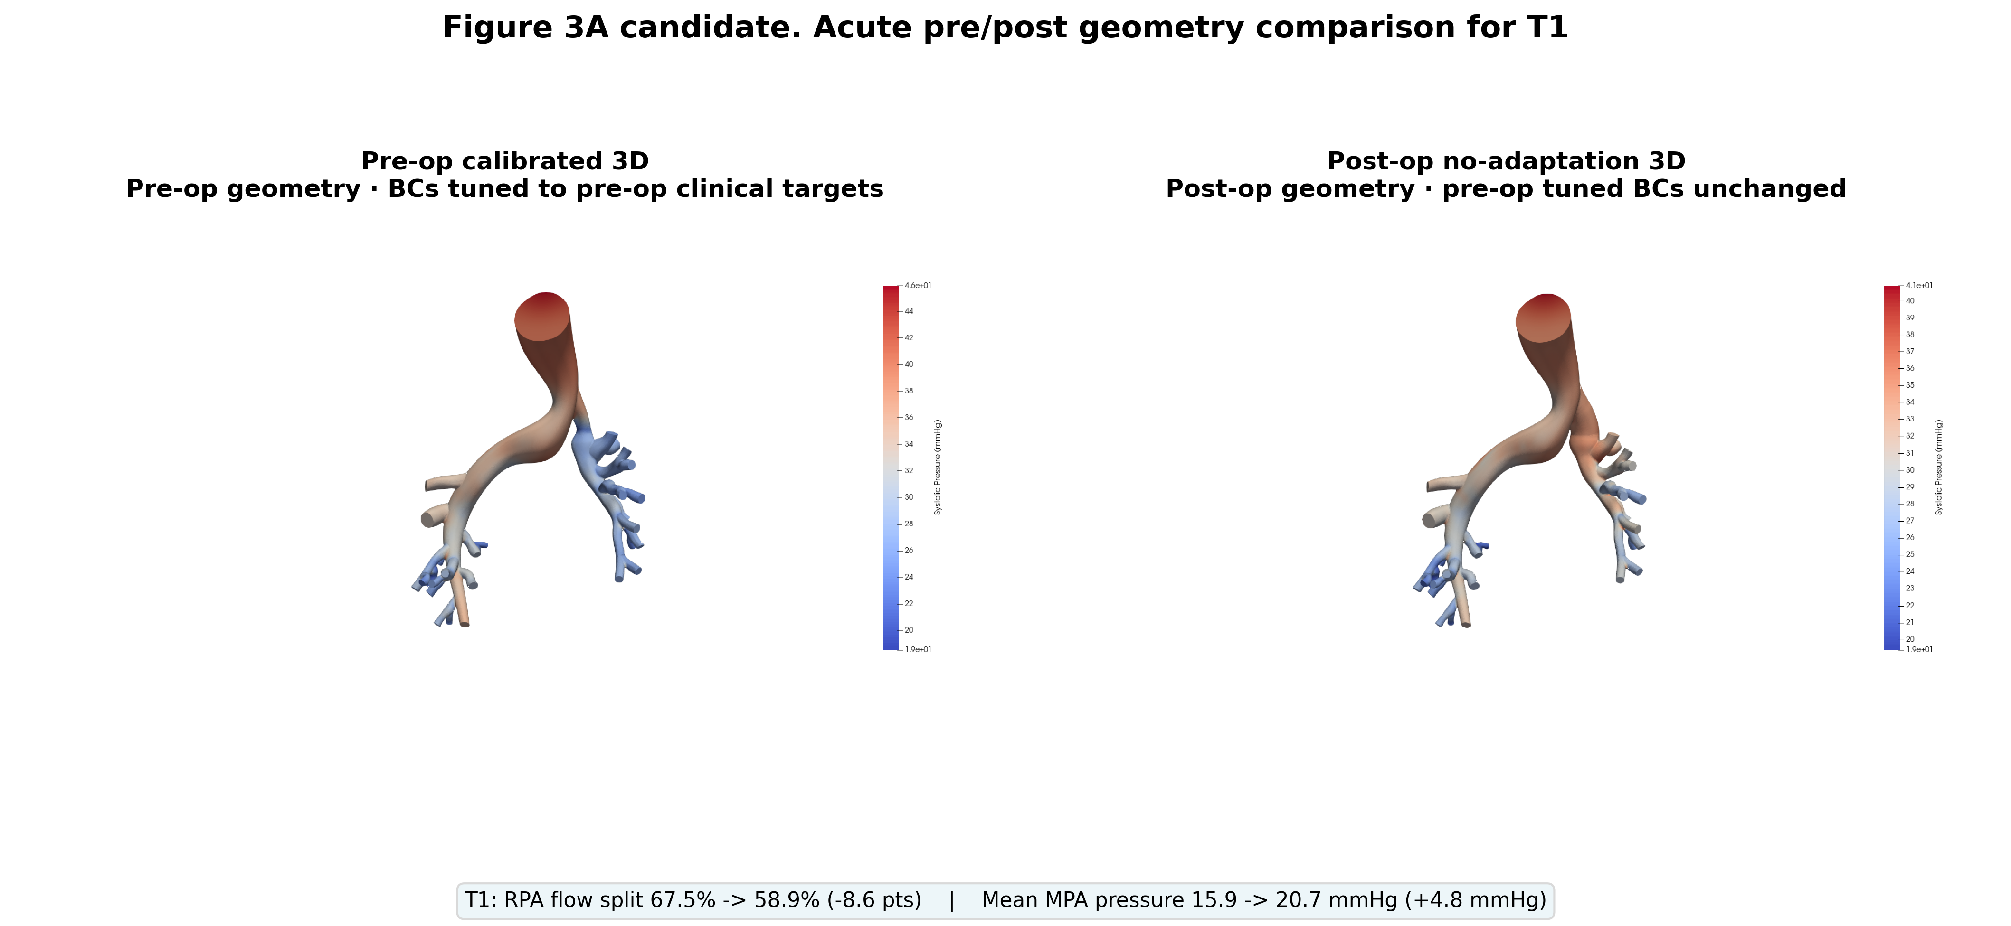
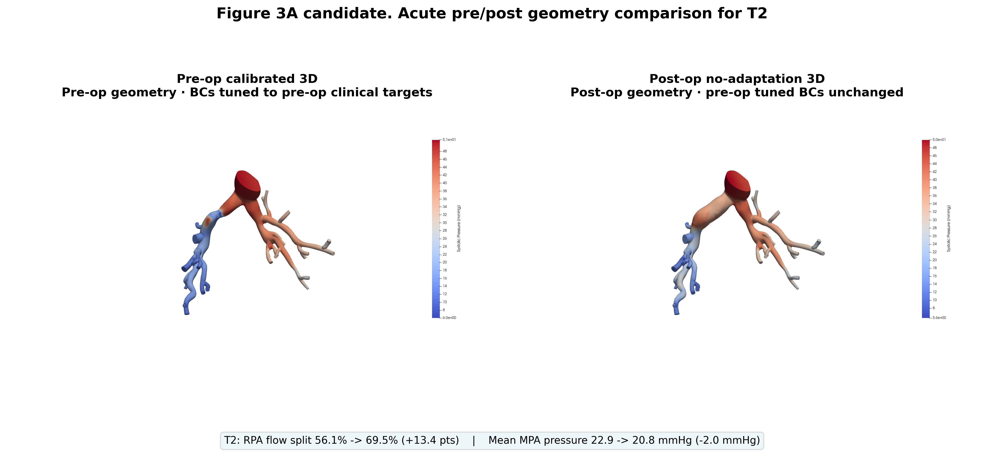
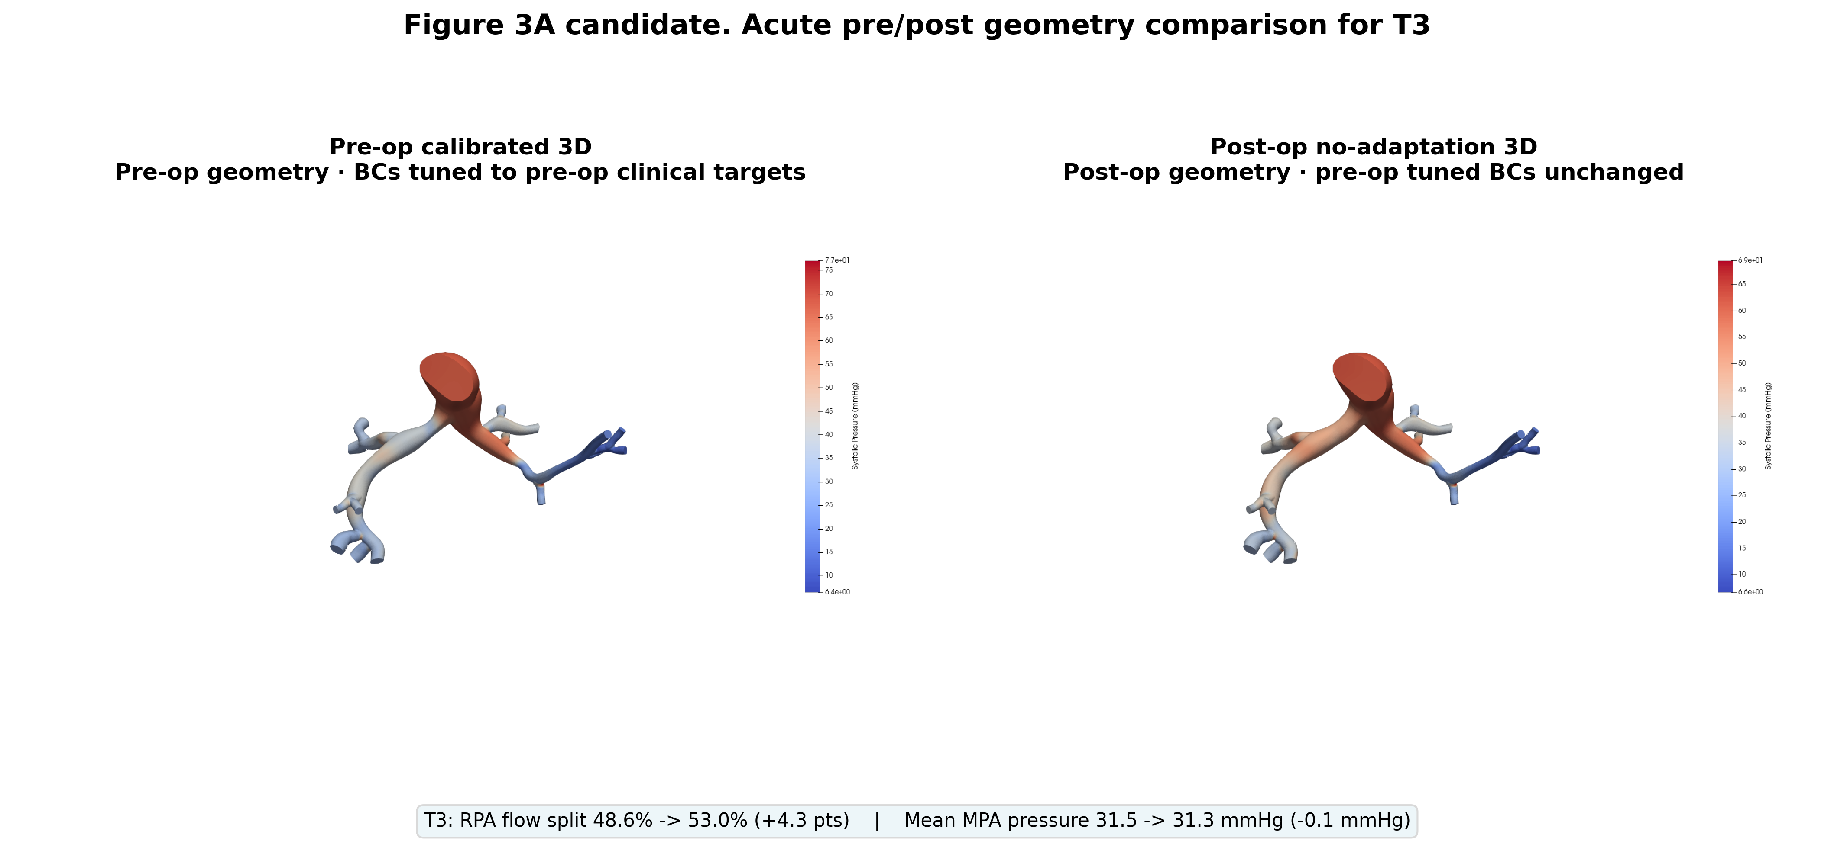
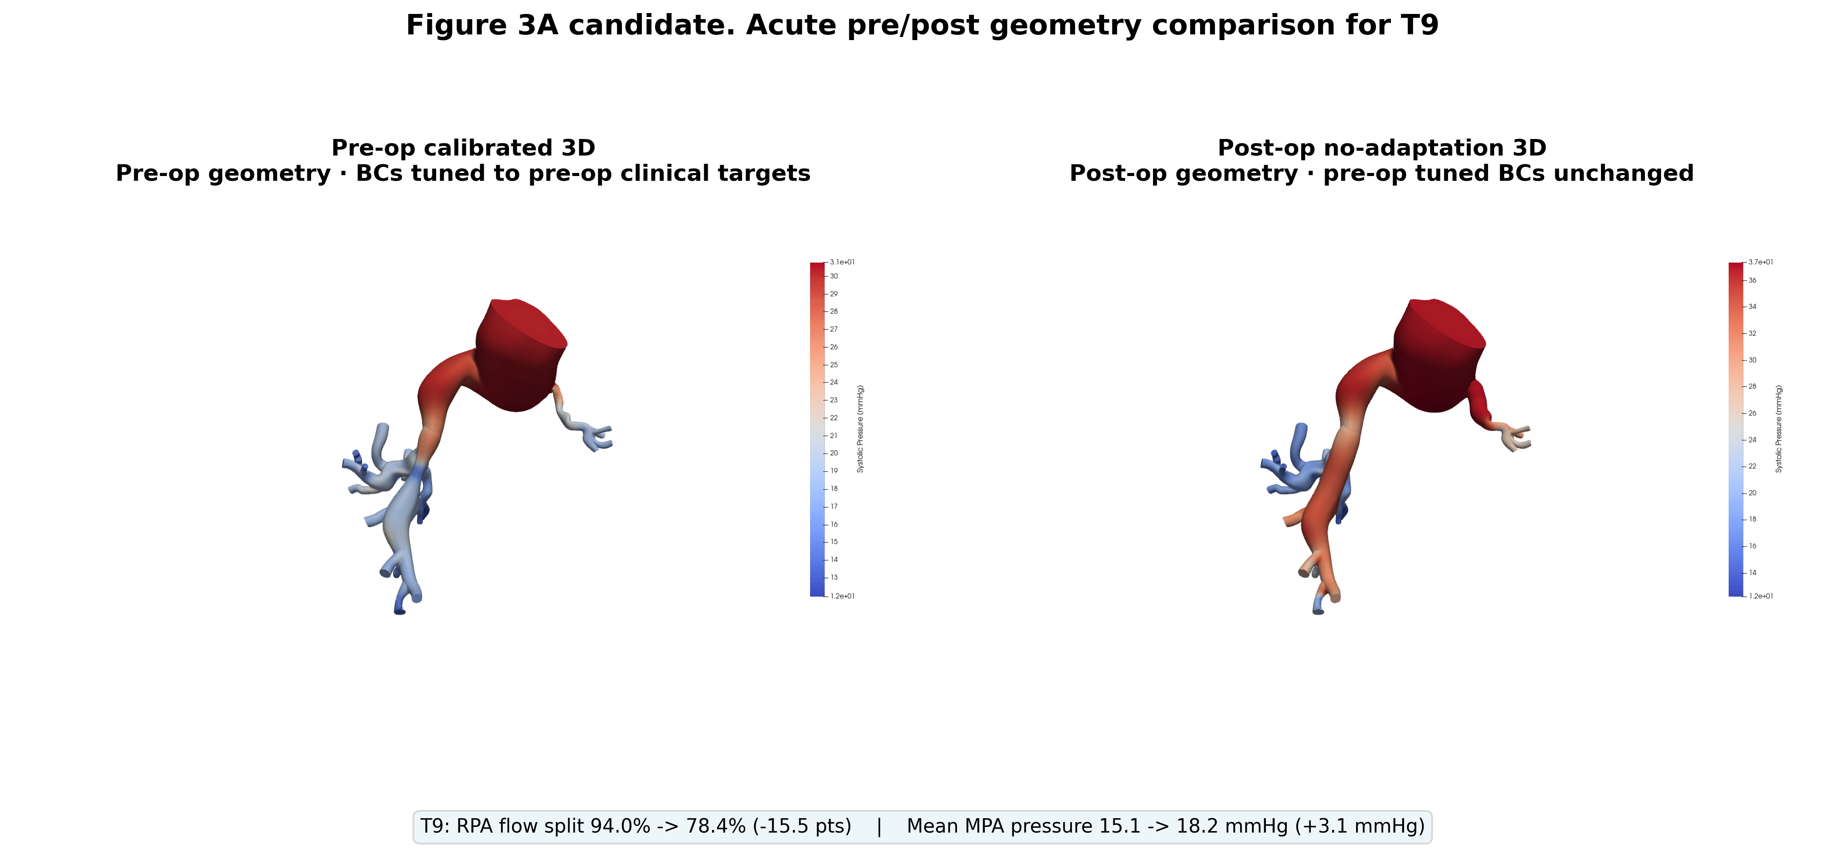
Acute post-operative response
1 Inputs
2 BC Tuning
3 Pre-op Sim
4 Post-op Sim
5 Adaptation
6 Adapted Sim
7 Metrics
IN DEVELOPMENT
TST-STAN-1
TST-STAN-2
TST-STAN-3
TST-STAN-9
Pre-operative calibrated geometry (left of each pair) and the virtually stented geometry with boundary conditions held fixed (right).
What this isolates
What it cannot reach
• The pressure and flow change attributable purely to the geometric intervention
• The measured post-operative flow split, which reflects a remodelled distal bed
This acute state is the perturbation that drives Stage 5.
Renders from the May 2026 runs on the earlier BCs; not yet rerun under the tied model.
Notes:
Kept slide. Spot-checked 22 Oct 2026 against svzt-agent 389c580, svZeroDTrees 1b01fc9 and svz config; sources as in the footnote.

Slide 41
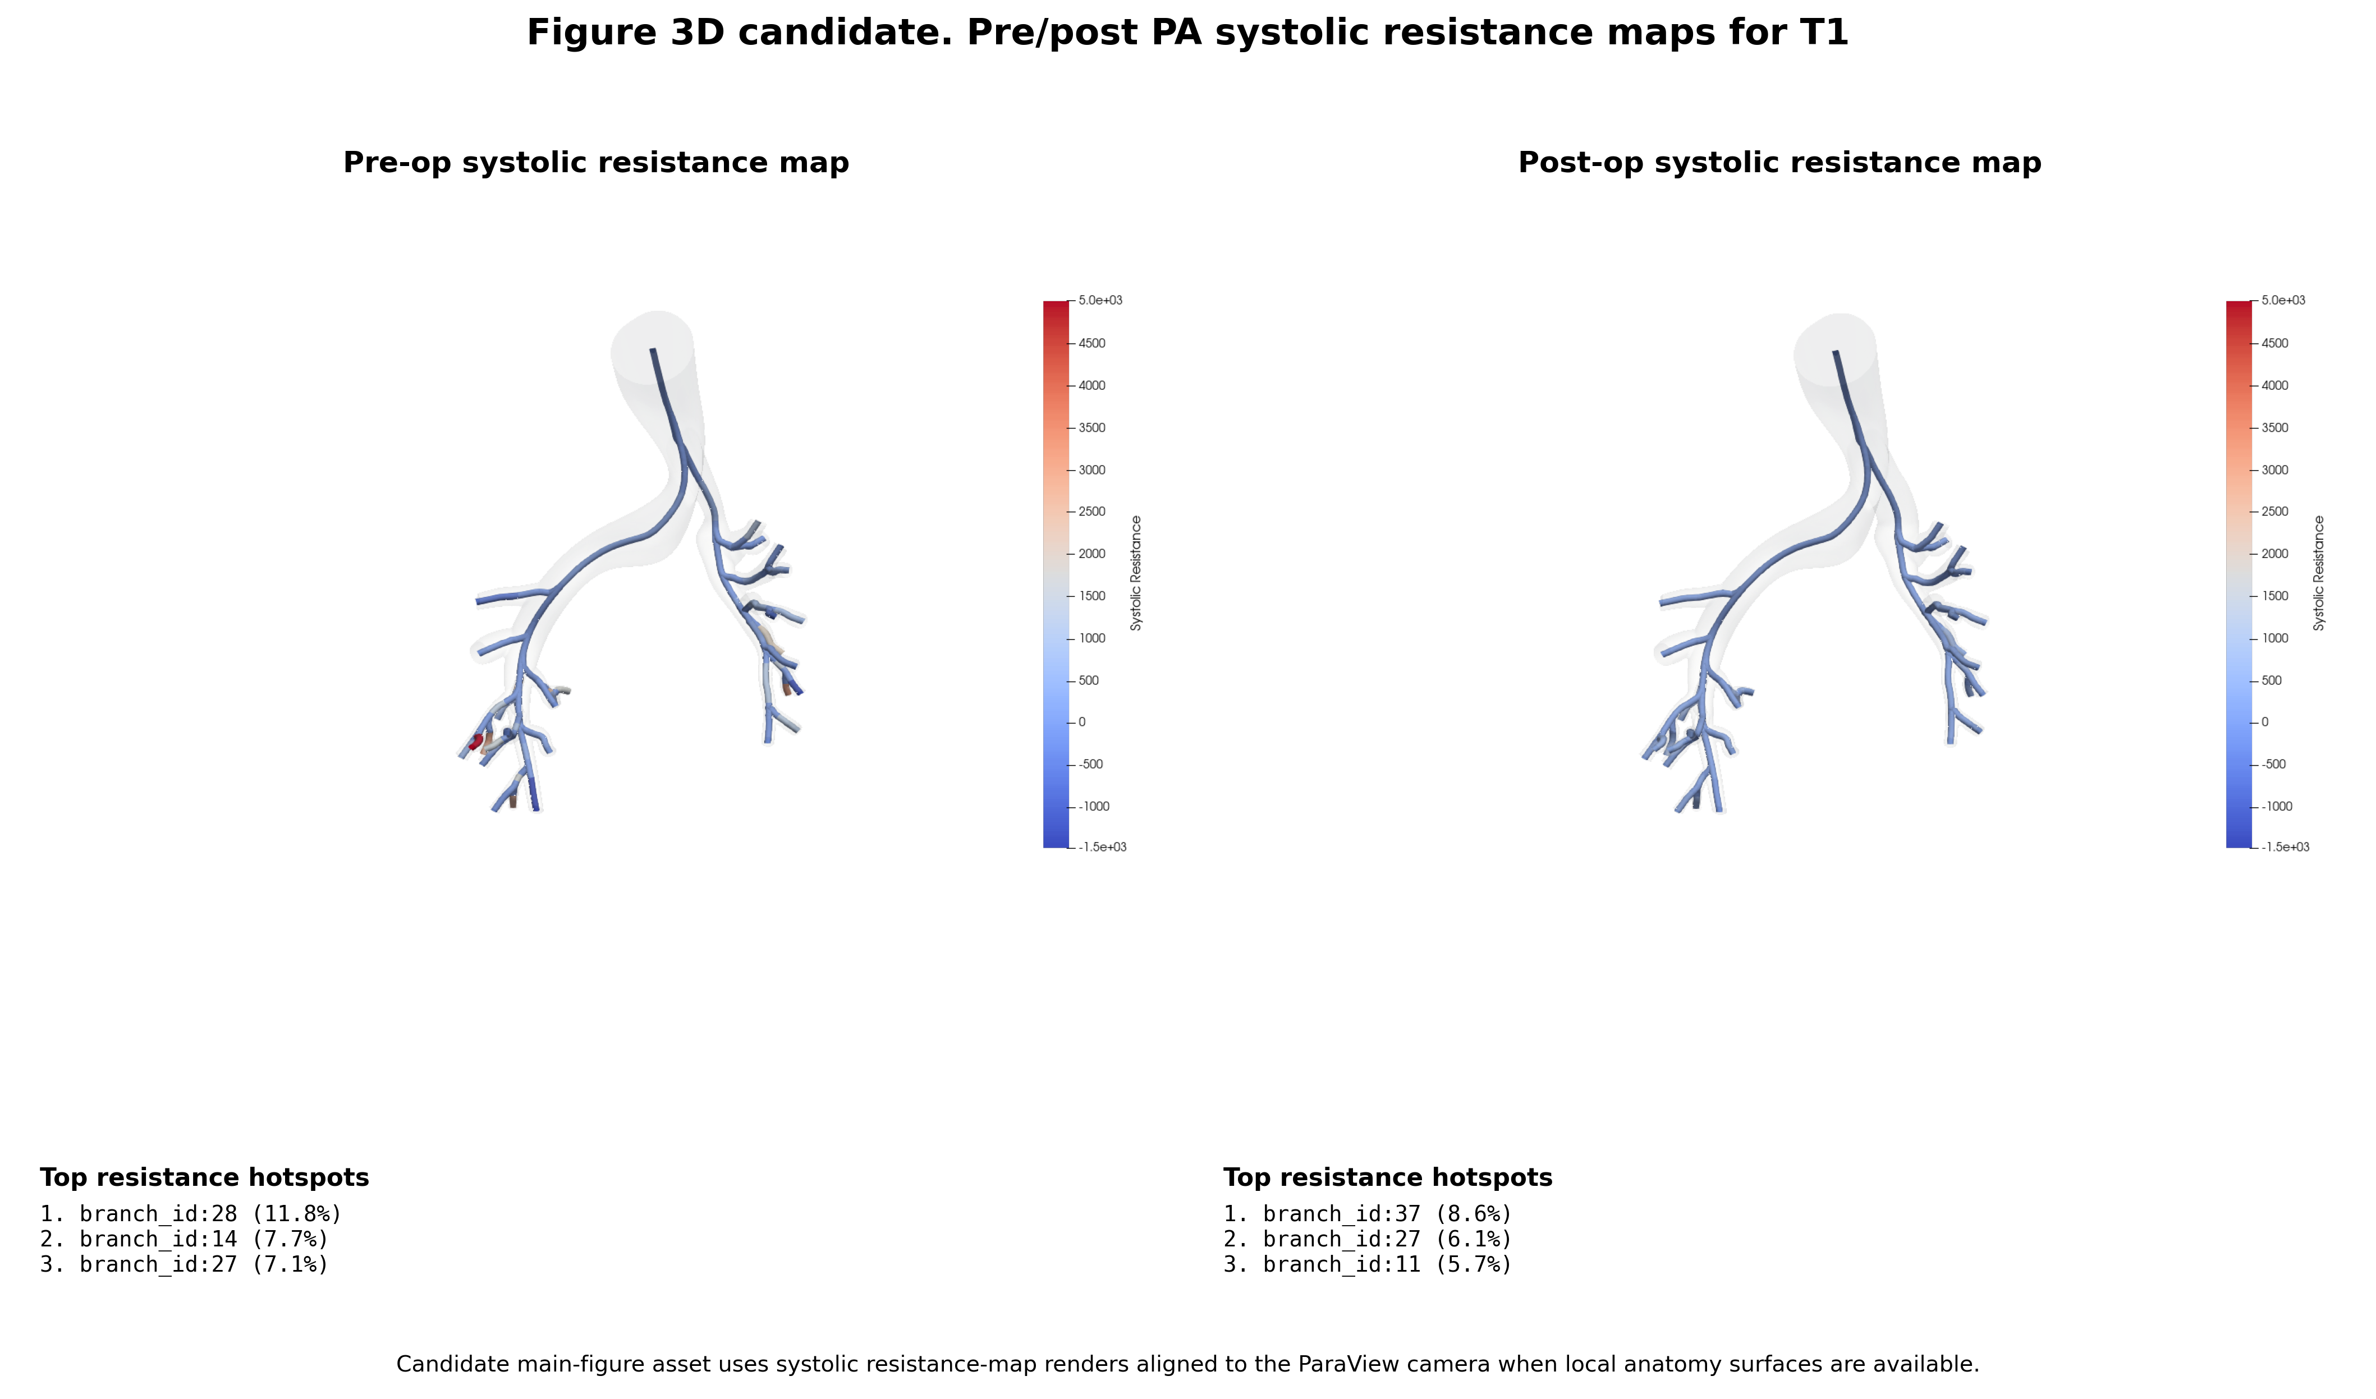
Pre- and post-operative resistance maps
1 Inputs
2 BC Tuning
3 Pre-op Sim
4 Post-op Sim
5 Adaptation
6 Adapted Sim
7 Metrics
IN DEVELOPMENT
TST-STAN-1
TST-STAN-2
TST-STAN-3
TST-STAN-9
• Systolic resistance is mapped along the tree so the intervention's effect can be localized rather than read only at the MPA
• The pre- to post-operative change in branch resistance is what the Stage 5 territory update uses
Resistance maps are the bridge between the 3D result and the adaptation driver.
Renders from the May 2026 runs on the earlier BCs; not yet rerun under the tied model.
Notes:
Kept slide. Spot-checked 22 Oct 2026 against svzt-agent 389c580, svZeroDTrees 1b01fc9 and svz config; sources as in the footnote.

Slide 42
Path to publication: Stage 4
1 Inputs
2 BC Tuning
3 Pre-op Sim
4 Post-op Sim
5 Adaptation
6 Adapted Sim
7 Metrics
IN DEVELOPMENT
Action item | Status | What it gates
Post-op runs under the current BCs (latest are May, earlier BCs) | Open | Stage 5 inputs
Check stent diameters against post-op angiography | Open | Post-op flow split
Confirm the post-op coupler pairs BCs to the mapped caps | Open | Stage 5 adaptation run
Boundary-layer meshes for the post-op geometries | Open | Final post-op numbers
SDFStent method figure for this deck | Open | Stage 4 method slide
Stage 4 waits on a selected pre-op iteration; the stent-size check can run in parallel.
svz runs (postop submitted 15 to 26 May 2026, none since); svzt-agent docs/TUNING_MODEL.md section 8 item 5; PIPELINE_BRIEF open items.
Notes:
Path to publication, Stage 4. No postop_run in any Oct 2026 run manifest (svz runs/tst-stan-*-2026100x to -20261021). Coupler pairing check: svzt-agent 389c580 docs/TUNING_MODEL.md section 8 item 5; svZeroDTrees docs/interface.md says generate_threed_coupler follows the outlet mapping (b582e96, c0f58de), confirm on the first patient. Boundary-layer post-op meshes: prerequisite on the Stage 6 slide.

Slide 43
Microvascular Adaptation
STAGE 5 OF 7
Integrating the structured trees to a new homeostatic state under the post-operative hemodynamic perturbation.
1
Inputs
2
BC Tuning
3
Pre-op Sim
4
Post-op Sim
5
Adaptation
6
Adapted Sim
7
Metrics

Slide 44
The mechanobiological premise
1 Inputs
2 BC Tuning
3 Pre-op Sim
4 Post-op Sim
5 Adaptation
6 Adapted Sim
7 Metrics
IN DEVELOPMENT
Stenosis relieved
Shear rises
Vessels dilate
Resistance falls
Flow to the downstream bed increases
τ = 4μQ / πr³ exceeds its homeostatic value
Radius increases to restore basal shear
Flow split shifts further toward the treated side
• Wall stress provides a second stimulus: σ = P r / h, which drives wall thickness as well as radius
• Adapting both r and h gives a system with a stable fixed point, which pure shear-driven adaptation lacks
• Prior work (Yang et al. 2016) showed adaptive boundary conditions reduce error against lung perfusion data relative to fixed BCs
The adapted state, not the acute state, is what the post-operative catheter and perfusion study measure.
Kamiya et al., AJP Heart (1980); Pries et al., AJP Heart (1992); Yang et al., Biomech Model Mechanobiol (2016).
Notes:
Kept slide. Spot-checked 22 Oct 2026 against svzt-agent 389c580, svZeroDTrees 1b01fc9 and svz config; sources as in the footnote.

Slide 45
Do gains fitted on some patients predict the rest?
1 Inputs
2 BC Tuning
3 Pre-op Sim
4 Post-op Sim
5 Adaptation
6 Adapted Sim
7 Metrics
IN DEVELOPMENT
Patient A
Answer
Open
No adaptation run uses the current BCs yet.
Which patients fit the gains and which are held out is not decided.
Patient D
Gains
fitted once
Patient B
Patient E
Patient C
Gains: how strongly the trees respond to changes in flow (shear) and pressure (wall stress).
Post-op scan + cath
Only agreement on held-out patients makes the adapted result a prediction rather than a calibration.
PIPELINE_BRIEF adaptation (unchanged intent); svZeroDTrees docs/interface.md (wss_gain, ims_gain, compliance_gain).
Notes:
Question slide, Stage 5. Intent unchanged (PIPELINE_BRIEF): gains should generalize across patients (fit on some, validate on held-out). Patient letters are placeholders, not an assignment. Gain names from svZeroDTrees 1b01fc9 docs/interface.md (adaptation parameter_set: wss_gain, ims_gain, compliance_gain). Latest adaptation runs: May to June 2026 (M1, earlier BCs), svz runs/tst-stan-*-20260507 etc.

Slide 46
What changed: one tree per side to per-cap trees
1 Inputs
2 BC Tuning
3 Pre-op Sim
4 Post-op Sim
5 Adaptation
6 Adapted Sim
7 Metrics
IN DEVELOPMENT
Previous: M1 / M3
Current code default: M2
LPA tree
RPA tree
Can adaptation act on the per-cap trees that tuning now exports?
scale = (Q_{post}/Q_{pre})^{g_wss/3} (R_{post}/R_{pre})^{g_ims/4}
Shear (CWSS) or shear plus wall stress (CWSS-IMS) on one tree per side of the reduced RRI model.
Refuses per-cap models; adapted radii never reached the 3D run.
Q flow and R resistance of the LPA or RPA territory from 3D; g gains. Every tuned per-cap tree on that side is scaled; caps paired by the outlet mapping.
Planned, not started: rebuild adaptation on full 0D pre- and post-op models.
M2 is the only option that adapts the trees the 3D run actually uses.
svZeroDTrees docs/interface.md (Adaptation), adaptation/workflow.py:318-330 (f2ec7ff); svzt-agent docs/TUNING_MODEL.md section 8 item 5.
Notes:
What changed and why, Stage 5. Previous: M1/M3 integrate CWSS / CWSS-IMS on one LPA and one RPA tree in the reduced-order PA (RRI) model built from optimized_params.csv; they raise ValueError for per-cap tuned models, and their adapted radii are not representable in tree metadata, so the adapted radii do not reach the 3D simulation (svZeroDTrees 1b01fc9 docs/interface.md).
Current default M2: total_scale = ((Q_post/Q_pre)^(wss_gain/3) (R_post/R_pre)^(ims_gain/4))^iterations from the 3D LPA/RPA flows and resistances, applied to every tuned tree on that side; Olufsen k1/k3 scaled by total_scale^-compliance_gain. M1/M3 refused for full-PA at plan time (svzt-agent 389c580 config/models.py:1339, adapt.py:136; svZeroDTrees f2ec7ff adaptation/workflow.py:318-330, adaptation/tuned_trees.py).
Planned (user, 22 Oct): rebuild on full 0D pre- and post-op models; not started, no commits found. Open decision: per-cap vs territory stimulus (svZeroDTrees docs/pulmonary_tuning_model.md section 7).

Slide 47
Path to publication: Stage 5
1 Inputs
2 BC Tuning
3 Pre-op Sim
4 Post-op Sim
5 Adaptation
6 Adapted Sim
7 Metrics
IN DEVELOPMENT
Action item | Status | What it gates
Rebuild adaptation on full 0D pre- and post-op models | Planned | Stage 6 adapted runs
Decide per-cap vs territory stimulus for M2 | Open | Adaptation method
Run adaptation on the cohort under the current BCs | Blocked | Stage 6; needs Stage 4 runs
Choose fit and held-out patients, then identify the gains | Open | Prediction claim in Stage 7
Stage 5 restarts once post-op runs exist under the current BCs and the rebuild is designed.
svzt-agent docs/TUNING_MODEL.md section 8 item 5; svZeroDTrees docs/pulmonary_tuning_model.md section 7; svz runs (last adaptation runs Jun 2026).
Notes:
Path to publication, Stage 5. Adaptation runs in svz: tst-stan-1-20260507 (12 submissions, 21 May to 3 Jun), -3 (3), -5 (1), -9 (2), all M1 on earlier BCs; none in Oct 2026 runs. Rebuild status: planned, not started (user, 22 Oct 2026). svzt-agent 389c580, svZeroDTrees 1b01fc9.

Slide 48
Adapted Simulation
STAGE 6 OF 7
Re-running the deformable-wall 3D model with the adapted structured-tree impedances.
1
Inputs
2
BC Tuning
3
Pre-op Sim
4
Post-op Sim
5
Adaptation
6
Adapted Sim
7
Metrics

Slide 49
Applying the adapted boundary conditions
1 Inputs
2 BC Tuning
3 Pre-op Sim
4 Post-op Sim
5 Adaptation
6 Adapted Sim
7 Metrics
PLANNED
Adapted trees
Recompute impedance
Run 3D
Extract
Adapted per-cap trees,
diameters scaled per side
Each adapted tree gives
its own outlet impedance
Same CMM setup,
post-operative geometry
Pressure, flow split, PVR,
wall shear stress
FIGURE PLACEHOLDER
Adapted 3D result
Pre-op / acute post-op / adapted comparison, per patient
Prerequisites
PLANNED
• Post-op runs under the current BCs (Stage 4)
• Adaptation rebuilt and gains identified (Stage 5)
• Boundary-layer meshes for the post-op geometries
This is the near-term gate: nothing in Stage 7 can be reported until Stage 6 runs.
Notes:
Kept slide. Spot-checked 22 Oct 2026 against svzt-agent 389c580, svZeroDTrees 1b01fc9 and svz config; sources as in the footnote.

Slide 50
Metric Extraction
STAGE 7 OF 7
Comparing the adapted simulation against the post-operative measurements held back from tuning.
1
Inputs
2
BC Tuning
3
Pre-op Sim
4
Post-op Sim
5
Adaptation
6
Adapted Sim
7
Metrics

Slide 51
Metrics
1 Inputs
2 BC Tuning
3 Pre-op Sim
4 Post-op Sim
5 Adaptation
6 Adapted Sim
7 Metrics
PLANNED
Metric | Definition | Compared against | Role
RPA / LPA flow split | Cycle-mean flow fraction to each lung | Post-operative lung perfusion scan | Primary endpoint
MPA pressure | Systolic, diastolic and mean at the MPA | Post-operative catheterization | Primary endpoint
Pulmonary vascular resistance | (mean MPA − PCWP) / cardiac output | Catheter-derived PVR | Secondary
Stenosis pressure drop | Gradient across the treated segment | Catheter pull-back gradient | Secondary
Wall shear stress | Time-averaged WSS on the 3D wall | No direct measurement | Mechanistic
Intra-tree Q, P, WSS | Distributions by generation within the trees | No direct measurement | Mechanistic
Lobar perfusion is explicitly out of scope for this publication.
Two clinically measured endpoints carry the validation; the rest explain the mechanism.
Notes:
Kept slide. Spot-checked 22 Oct 2026 against svzt-agent 389c580, svZeroDTrees 1b01fc9 and svz config; sources as in the footnote.

Slide 52
What counts as success
1 Inputs
2 BC Tuning
3 Pre-op Sim
4 Post-op Sim
5 Adaptation
6 Adapted Sim
7 Metrics
PLANNED
Baseline
Comparison
Proposed
Acute post-operative simulation with unchanged pre-operative boundary conditions
CWSS adaptation with swept terminal resistance
Adapted trees with cross-validated gains
• The claim is that adaptation with generalized gains reduces error against post-operative perfusion split relative to both the acute baseline and the comparison arm
• Held-out error is reported separately from fitted error; with five patients the training-set composition is itself reported
• A negative result is publishable: if adaptation does not beat the acute baseline out of sample, that is a finding about the model class
Success is defined before the adapted simulations run: that is deliberate.
Notes:
Kept slide. Spot-checked 22 Oct 2026 against svzt-agent 389c580, svZeroDTrees 1b01fc9 and svz config; sources as in the footnote.

Slide 53
Roadmap: what is changing across the pipeline
1 Inputs
2 BC Tuning
3 Pre-op Sim
4 Post-op Sim
5 Adaptation
6 Adapted Sim
7 Metrics
Stage | Change | Why | Status
2 BC Tuning | Full branched 0D + svZeroDCalibrator replace two-branch RRI | One tree per outlet for 3D coupling and adaptation | Done
2 BC Tuning | Tied stiffness multiplier for proximal wall and trees | The two stiffnesses are identifiable only together | Done
2 BC Tuning | E-law wall correction after iteration 2 | 3D wall held 60 to 75% of the 0D compliance | Done (23 Oct)
2 BC Tuning | Pre-op tuning protocol v1 frozen | Same steps for every paper run | Done (25 Oct)
2 BC Tuning | Wall correction inside svzt-agent, with 0D refit | v1 ran it by script; matched 0D refit added | Done (26 Oct)
3 Pre-op Sim | Wall damping scaled to wall stiffness | 3D pulse pressure too wide | Done (21 Oct)
3 Pre-op Sim | Final runs on the boundary-layer mesh | Tuned BCs are mesh-conditional | Open
4 Post-op Sim | Check stent diameters against angiography | Simulated post-op split overshoots | Open
5 Adaptation | Rebuild on full 0D pre- and post-op models | M1/M3 cannot take per-cap trees | Planned
5 Adaptation | Gains by cross-validation across the cohort | Prediction, not calibration | Planned
6 Adapted Sim | Adapted BCs through 3D for all patients | Gate on every Stage 7 metric | Planned
Future | Pries-Secomb adaptation | Richer stimulus; identification unresolved | Deferred
Updated 26 Oct 2026 against svz docs/preop_protocol_v1/README.md, svz runs manifests, svzt-agent 389c580 + local edits and svz config. Keep in sync with the path-to-publication slides.
Notes:
Roadmap (state slide), updated 25 Oct 2026. Rows 1 to 7 rewritten for protocol v1 (svz docs/preop_protocol_v1/README.md (frozen 25 Oct 2026)). Removed: chi-squared 3D iteration gate (v1 fixes 2 iterations; kept as Planned on the Stage 2 path slide), TST-STAN-2 infeasibility (now a 0.037 split residual, on the Stage 2 path slide), 3D/0D volume correction and the rho correction (both superseded by the E law). Rows 8 to 12 (Stages 4 to 6 and future) unchanged. Wall correction in svzt-agent: uncommitted workflows/wall_correction.py, docs/TUNING_MODEL.md section 10. Repo state: svzt-agent 389c580 (+ local edits), svZeroDTrees 1b01fc9 local / 4f11755 on Sherlock.

Slide 54
Software stack and deck maintenance
1 Inputs
2 BC Tuning
3 Pre-op Sim
4 Post-op Sim
5 Adaptation
6 Adapted Sim
7 Metrics
Components
• Every content slide carries the seven-stage tracker; the filled segment says which stage is under discussion
• Status badges: green established, orange actively changing, grey designed but not yet run
• Update the cohort progress table and the roadmap table each cycle - those two carry all the state
• Figure placeholders are marked in orange; replace the shape and delete the label
• Layouts, fonts and colours come from the Stanford template master, so new slides inherit them
• Record version or commit hashes alongside every result set that goes into the paper
SimVascular | Segmentation, lofting, meshing
svMultiPhysics | 3D deformable-wall CFD (CMM)
svZeroDSolver | 0D solver and 3D-0D coupling
svZeroDTrees | Trees, impedance, tuning, adaptation
SDFStent | Signed-distance-field virtual stenting
svZeroDCalibrator | In use: centerline 0D calibration
Performance work already done
• Vectorized tree representation replaced per-object traversal
• Roughly hundred-fold speed-up in impedance computation
• Parallelized tree construction across processes
This deck is the source of truth: change it here first, then propagate to talks and figures.
Notes:
Kept slide. Spot-checked 22 Oct 2026 against svzt-agent 389c580, svZeroDTrees 1b01fc9 and svz config; sources as in the footnote.

Slide 55
Archive

Slide 56
ρ test on TST-STAN-3: the correction overshoots
1 Inputs
2 BC Tuning
3 Pre-op Sim
4 Post-op Sim
5 Adaptation
6 Adapted Sim
7 Metrics
ARCHIVED
3D pulse pressure minus target (mmHg)
TST-STAN-3 | Sys | Dia | Mean | Pulse | Split
Target (cath) | 67 | 9 | 32 | 58 | 0.446
0D fit, iter. 2 | 66.3 | 8.6 | 31.0 | 57.7 | 0.454
3D, no correction | 73.5 | 7.7 | 29.9 | 65.8 | 0.448
A: E × 0.605 | 61.1 | 9.8 | 29.3 | 51.3 | 0.445
B: E × 0.633 | 62.2 | 9.5 | 29.4 | 52.6 | 0.445
Answer
Overshoots
Both corrections leave the pulse 5 to 7 mmHg too narrow and systolic 5 to 6 mmHg low; split unchanged.
A: ρ from the iteration-1 calibrated 0D model. B: ρ from the iteration-2 3D result.
Softening the 3D wall moves the pulse the right way, but both ρ estimates are too strong for TST-STAN-3.
Archived 2026-10-25. Replaced by: Does one wall rule close the 3D pulse in all five?. Reason: The ρ correction was superseded by the E law used in protocol v1..
Notes:
Preliminary investigation of the 3D wall stiffness correction rho on TST-STAN-3 (data from Nick Dorn, 23 Oct 2026; runs not yet synced to svz runs, no commit yet; repo state svzt-agent 389c580, svZeroDTrees 1b01fc9).
Target 67/9/32, PP 58, split 0.446. Iteration-2 0D fit 66.3/8.6/31.0, PP 57.7, 0.454. Iteration-2 3D uncorrected (control) 73.5/7.7/29.9, PP 65.8, 0.448. A: E x 0.605 (rho from the iteration-1 calibrated 0D) 61.1/9.8/29.3, PP 51.3, 0.445. B: E x 0.633 (rho from the iteration-2 3D) 62.2/9.5/29.4, PP 52.6, 0.445.
Chart: PP minus target 58: -0.3, +7.8, -6.7, -5.4 mmHg.
Inference, not run: PP falls about 13.2 mmHg from E x 1 to E x 0.633 (about 36 mmHg per unit of the E multiplier). If linear, matching the 0D pulse (57.7) needs about E x 0.78. Treat as a hypothesis for the next test.
Original footnote: Preliminary single-patient test (N. Dorn, 23 Oct 2026), iteration-2 BCs; not yet in the repos. ρ multiplies the 3D wall modulus E. Red: systolic more than 2σ (4 mmHg) off target.
Archived 2026-10-25. Replaced by: Does one wall rule close the 3D pulse in all five?. Reason: The ρ correction was superseded by the E law used in protocol v1..

Slide 57
BC tuning status: 0D fits, the 3D pulse runs wide
1 Inputs
2 BC Tuning
3 Pre-op Sim
4 Post-op Sim
5 Adaptation
6 Adapted Sim
7 Metrics
ARCHIVED
Patient | Target (cath) | 0D fit, iter. 2 | 3D, iter. 2 | 3D, iter. 1 | 3D − 0D pulse | ρ
TST-STAN-5 | 34 / 3 / 16, 0.87 | 33.6 / 1.3 / 15.4, 0.871 | 34.8 / 2.9 / 15.9, 0.89 ✓ | 34.8 / 2.8 / 15.8, 0.895 | +1.5 | ≈ 1
TST-STAN-9 | 29 / 5 / 15, 0.903 | 28.2 / 5.1 / 13.7, 0.885 | 32.0 / 4.3 / 14.7, 0.88 | 30.9 / 4.9 / 15.2, 0.88 | +4.6 | 0.67
TST-STAN-1 | 38 / 10 / 23, 0.71 | 37.9 / 8.4 / 21.0, 0.694 | 42.4 / 6.4 / 21.2, 0.69 | 42.2 / 6.4 / 21.2, 0.68 | +6.6 | 0.77
TST-STAN-3 | 67 / 9 / 32, 0.446 | 66.3 / 8.6 / 31.0, 0.454 | 73.5 / 7.7 / 29.9, 0.45 | 88.4 / 8.0 / 34.4, 0.50 | +8.1 | 0.63
TST-STAN-2 | 44 / 14 / 26, 0.762 | 44.8 / 14.2 / 26.3, 0.779 | 50.5 / 12.4 / 25.6, 0.79 | 62.5 / 11.8 / 27.5, 0.68 | +7.4 | 0.58
Worst miss against the catheter, iteration 2 (in σ)
Next: wall correction ρ
Tested on TST-STAN-3 (next slide): overshoots. ρ multiplies the 3D wall modulus E; ρ < 1 softens the wall so the 3D pulse matches the 0D fit.
Largest correction: TST-STAN-2 (ρ = 0.58).
0D fits all five within 1σ; outside TST-STAN-5, the 3D run widens the pulse by 5 to 8 mmHg.
Archived 2026-10-25. Replaced by: Final pre-op fit: every pressure within 2.6 mmHg. Reason: Iteration-2 status superseded by the frozen protocol v1 result (iteration 3)..
Notes:
State slide: Stage 2 BC tuning status for the five pre-op patients, iteration 2 of the 21 Oct cohort runs (tied stiffness multiplier, stiffness-scaled damping).
Data from Nick Dorn, 23 Oct 2026. svz runs/tst-stan-*-20261021/iterations/iter-02/results is empty locally, so the numbers are not yet traceable to a synced file. Iteration-1 3D from iter-01/results/iteration_metrics.json.
Worst miss = max over (sys, dia, mean, split) of |model - target| / sigma, sigma 2 mmHg and 0.02 (svzt-agent 389c580 docs/TUNING_MODEL.md section 2 objective). 0D: STAN-5 0.85 (dia), STAN-9 0.9 (split), STAN-1 1.0 (mean), STAN-3 0.5 (mean), STAN-2 0.85 (split). 3D: STAN-5 1.0 (split), STAN-9 1.5 (sys), STAN-1 2.2 (sys), STAN-3 3.25 (sys), STAN-2 3.25 (sys).
3D - 0D pulse pressure as supplied: +1.5, +4.6, +6.6, +8.1, +7.4 mmHg. For STAN-5 the table values give -0.4 (31.9 vs 32.3); +1.5 kept per Nick (different 0D reference).
rho: multiplier on the 3D wall modulus E (E_3D = rho x E matched to the 0D proximal compliance). Computed, not yet applied (23 Oct 2026). STAN-5 converged at iteration 2.
Original footnote: Iteration 2 of tst-stan-*-20261021 (N. Dorn, 23 Oct 2026; iter-02 outputs not yet synced locally). sys / dia / mean mmHg, RPA split. σ = 2 mmHg, 0.02. ✓ = within 1σ on all four targets.
Archived 2026-10-25. Replaced by: Final pre-op fit: every pressure within 2.6 mmHg. Reason: Iteration-2 status superseded by the frozen protocol v1 result (iteration 3)..

Slide 58
What changed: two-branch RRI to full branched 0D
1 Inputs
2 BC Tuning
3 Pre-op Sim
4 Post-op Sim
5 Adaptation
6 Adapted Sim
7 Metrics
ARCHIVED
Previous: two-branch RRI
Current: full branched 0D
LPA leg
1 tree
Branched network along the 3D centerline
Can the 0D model give every 3D outlet its own tuned tree?
MPA
T
T
T
T
T
T
RPA leg
1 tree
one tree per outlet cap
Each side lumped into one leg (R, nonlinear R, L) with one tree, so trees could not map to individual 3D outlets.
Seeded by learnedZeroD, refit to 3D by svZeroDCalibrator; caps mapped through the centerline.
TST-STAN-5 pressure RMSE vs 3D: RRI 1.42, full model 1.58 mmHg. Planned: chi-squared 3D iteration gate.
Same pressure accuracy as RRI, plus one tree per outlet, which per-cap 3D coupling and adaptation need.
Archived 2026-10-25. Replaced by: What changed: hand-picked iteration to protocol v1. Reason: Two steps back: protocol v1 is now the newest Stage 2 change; RRI noted on the new slide..
Notes:
What changed and why, Stage 2. Previous: two-branch RRI proximal model (linear R -> nonlinear R -> inductor per side, one tree per side), confirmed topology (PIPELINE_BRIEF verification log). It survives only as legacy_rri_after_first.
Current: full branched 0D network following the 3D centerline, every outlet represented, one tree per cap; learnedZeroD seed (iteration 1), svZeroDCalibrator refit (later iterations); outlet_cap_mapping.json drives the optimizer, exported trees, 3D coupler and adaptation.
Evidence: TST-STAN-5 final-cycle RMSE over MPA sys/dia/mean vs the 3D reference: reduced two-branch RRI with tuned impedance 1.42 mmHg; full learned model with calibrated junctions 1.58 mmHg (archived slide 'Where each 0D representation lands against 3D').
Planned: chi-squared-based 3D iteration gate (TUNING_MODEL.md section 8 item 3).
Sources: svZeroDTrees 1b01fc9 docs/full_pa_calibration.md; svzt-agent 389c580 docs/TUNING_MODEL.md; svzt-agent 3b97da7, 592b9fc.
Original footnote: svZeroDTrees docs/full_pa_calibration.md; svzt-agent docs/TUNING_MODEL.md sections 1 and 8.3. RMSE from the archived 0D-representation comparison (TST-STAN-5).
Archived 2026-10-25. Replaced by: What changed: hand-picked iteration to protocol v1. Reason: Two steps back: protocol v1 is now the newest Stage 2 change; RRI noted on the new slide..

Slide 59
Constraints added or changed with the tied multiplier
1 Inputs
2 BC Tuning
3 Pre-op Sim
4 Post-op Sim
5 Adaptation
6 Adapted Sim
7 Metrics
ARCHIVED
Resistance-side options on top of tied s (TST-STAN-3, χ²)
What the config now enforces
CHANGED
ξ lower bound 2.33 → 2.1
inactive for TST-STAN-5 (ξ at 3)
CHANGED
k₃: free [5×10⁴, 4×10⁵] → s·10⁵
no comp.k3 entry allowed next to s
CHANGED
Proximal Eh/r: 5×10⁴ → s·5×10⁴
calibrated C overwritten at the tuned s
ADDED
s ∈ [0.5, 20], log, s > 0
init 1; seeds the next iteration
ADDED
tied_k3_ref ⇔ stiffness_scale
Olufsen model only; RRI iterations refused
• ξ ≥ 2.1: rpa ξ lands at 2.17, inside the bound; measured pulmonary ξ 2.1–2.6 (Miles 2025)
• l_rr 20 fits but is not morphometric; a free l_rr is not identifiable (14 and 20 both fit)
• s stays 6.6–8.2 under every resistance change
ADDED
3D E must follow s
fixed numeric E with s warns
Neither change was fitted on TST-STAN-1, -2, -5 or -9 before adoption: check parameters_at_bounds and the SV/PP bracket.
Archived 2026-10-22. Replaced by: Can proximal and tree stiffness be tuned apart?. Reason: Constraint changes folded into the question slide.
Notes:
Constraint changes made with the tied multiplier on 16 Oct. With tied s the TST-STAN-3 fit was resistance-limited (chi2 8.18, rpa xi pinned at 2.33, mean 26.9 vs 32). Lowering the xi floor to the lowest measured pulmonary value, 2.1, gives chi2 0.29 with rpa xi 2.17 inside the bound; raising lrr also works but only outside the morphometric range, and a free lrr is not identifiable. The config now rejects tied_k3_ref without stiffness_scale (and the reverse), a comp.k3 entry next to s, non-positive s, s with the constant compliance model, and RRI iterations with s; it warns when a fixed numeric 3D E cannot follow s. In-flight runs keep working: their next iteration starts s at 1.
Original footnote: TST-STAN-3 FINDINGS.md follow-up (results/resistance.json). Rules mirrored in svzt-agent config/models.py and svZeroDTrees validate_stiffness_scale, so a dry run fails before submission. TUNING_MODEL.md §2, §8 item 9.
Archived 2026-10-22. Replaced by: Can proximal and tree stiffness be tuned apart?. Reason: Constraint changes folded into the question slide.

Slide 60
TST-STAN-5 fit: within error except diastolic
1 Inputs
2 BC Tuning
3 Pre-op Sim
4 Post-op Sim
5 Adaptation
6 Adapted Sim
7 Metrics
ARCHIVED
Published MPA pressure (mmHg), final model vs catheter
Fitted parameters sit on their bounds
ξ L / R
3.00 / 3.00
2.33
3.0
η L / R
1.00 / 0.97
0.3
1.0
k₃
5.0×10⁴
5×10⁴
4×10⁵
17.2
0.875
1.81
χ²; diastolic is 14.7 of it
RPA split vs 0.87 target
mL/mmHg total C; SV/PP 0.77–1.44
Error vs target: sys +2.8 · dia −7.7 · mean −1.4 mmHg (σ = 2)
k₃ choice
superseded
16 Oct: k₃ = s·10⁵ tied to the proximal wall (slide 44)
Not yet refit TST-STAN-5 under the tied model and ξ ≥ 2.1
Systolic, mean and split are within measurement error; diastolic stays ~8 mmHg low (3.8σ) under 54% regurgitation.
Archived 2026-10-22. Replaced by: Calibrated seeds improved, none within tolerance. Reason: 5 Oct fit with free k3, superseded by the tied-model cohort runs of 21 Oct.
Notes:
Final model on TST-STAN-5 after the per-cap polish: 36.8 / -4.7 / 14.6 mmHg, split 0.875, chi2 17.17 (sys 1.9, dia 14.7, mean 0.5, split 0.06). xi is at Murray's bound on both sides, eta at 1.00 / 0.97 and k3 at its 5e4 floor: the data want softer or larger trees than the literature ranges allow. Total compliance 1.81 mL/mmHg is above the SV/PP bracket. OPTION1.md recommended fixing k3 at 1e5 (chi2 18.3, compliance 1.43 inside the bracket); the 6 Oct decision keeps k3 free so stiffer patients can move it, with k3 = 1e5 as the fallback when k3 sits at a bound or compliance leaves the bracket.
Original footnote: runs/phaseo1pkg-2/polish-percap: per-cap polish of the best of 8 starts (5 Oct 2026); optimizer gap 0.05 mmHg; 1 of 23 trees truncated (rpa_2). k₃ bar on a log scale. Fallback = S-k3fix1e5.
Archived 2026-10-22. Replaced by: Calibrated seeds improved, none within tolerance. Reason: 5 Oct fit with free k3, superseded by the tied-model cohort runs of 21 Oct.

Slide 61
Final model: Option 1 with tied stiffness
1 Inputs
2 BC Tuning
3 Pre-op Sim
4 Post-op Sim
5 Adaptation
6 Adapted Sim
7 Metrics
ARCHIVED
Inflow Q(t)
patient MRI, prescribed
Proximal 0D seed
learned / calibrated · Eh/r = s·5×10⁴
23 structured trees
one per cap · k₃ = s·10⁵
Outlet pressure Pd
per patient (slide 43)
new relative to the earlier pipeline
What changed from the earlier Stage 2 settings
5
tuned parameters
4
clinical targets
Earlier
Now
Tree stiffness
k₁ 2×10⁷, k₃ 0, k₂ tuned
k₁ 2.6×10⁵, k₂ −14, k₃ = s·10⁵
Proximal wall
rigid, C = 0
Eh/r = s·5×10⁴, tied to k₃
ξ, LPA and RPA
[2.1, 3.0]
MPA sys / dia / mean
catheter, σ 2 mmHg
3D wall
E 2.5×10⁶, c 10⁴
E matched per patient; stiffness-scaled c
Tree outlet P
PCWP, clamped to diastolic
per-patient policy
η, LPA and RPA
[0.3, 1.0]
RPA split
MRI / perfusion, σ 0.02
Tree diameters
s = 0.1 toward side mean
measured cap d (s = 1.0)
Morphometry
ξ free, up to 6
ξ ∈ [2.1, 3], η ∈ [0.3, 1]
s, stiffness multiplier
[0.5, 20], log
Validation check
C vs SV/PP bracket
Objective
relative error, 2 cycles
χ² on a periodic cycle
Optimizer
shared trees only
shared → per-cap polish
svz workspace default since 16 Oct: only s and the tree morphometry are tuned.
Archived 2026-10-22. Replaced by: Fixed and tuned parameters. Reason: Duplicate of the parameters slide.
Notes:
Option 1 as it now stands. The proximal wall and the tree large-vessel stiffness move together through one multiplier s (Eh/r = s x 5e4, k3 = s x 1e5, s in [0.5, 20]); xi per side in [2.1, 3], eta in [0.3, 1]. The 3D wall E is matched per patient to the tuned 0D compliance and the CMM damping is scaled to each wall's stiffness. Every fit is scored on a periodic cycle.
Original footnote: svzt-agent docs/TUNING_MODEL.md §2, §8 items 1 and 9; svZeroDTrees docs/pulmonary_tuning_model.md §2.4–2.6. Krenz & Dawson 2003; Colebank 2021; Olufsen 2012; Miles et al. 2025.
Archived 2026-10-22. Replaced by: Fixed and tuned parameters. Reason: Duplicate of the parameters slide.

Slide 62
Physiological χ² fell 267 → 17; shortcuts rejected
1 Inputs
2 BC Tuning
3 Pre-op Sim
4 Post-op Sim
5 Adaptation
6 Adapted Sim
7 Metrics
ARCHIVED
Best physiological fit after each adopted change (χ², published model)
Shortcuts that lower χ² but were rejected
2.4
χ² ✗
k₃ = 0, k₂ free (old pipeline)
Root Eh/r 60–7,500 dyn/cm²; tree C 31–35 mL/mmHg, ~25× SV/PP
2.9
χ² ✗
k₃ lowered toward 0
One oversized cap holds 11.9 of 12.5 mL/mmHg; optimizer gap 7.3 mmHg
13.5
χ² ✗
ξ allowed above 3 (3.25)
Total C 1.90 mL/mmHg, above SV/PP ≤ 1.44; measured ξ 2.1–2.8
Each rejected shortcut buys χ² with non-physiological stiffness, implausible compliance or an artifact the optimizer never sees.
Archived 2026-10-22. Replaced by: Fixed and tuned parameters. Reason: TST-STAN-5 study history.
Notes:
Left: best physiological chi2 after each kept change, ending with the per-cap polish of the best multi-start (17.17). Right: three ways to a lower chi2 that were rejected - the old k3 = 0 / free k2 setting, lowering k3 toward 0 (works only through the oversized rpa_2 cap the shared surrogate never sees), and raising the xi bound above Murray's 3 (compliance leaves the SV/PP bracket and measured pulmonary xi is 2.1-2.8).
Original footnote: Published per-cap model, σ 2 mmHg / 0.02, l_rr 10. Bar 1 at diameter_scale 0.1, others 1.0; bars 1–4 at Pd 7. FINDINGS.md (v2b, pd10, k3low); OPTION1.md §3b; REPORT_ximax.md.
Archived 2026-10-22. Replaced by: Fixed and tuned parameters. Reason: TST-STAN-5 study history.

Slide 63
The missing element: proximal 0D compliance
1 Inputs
2 BC Tuning
3 Pre-op Sim
4 Post-op Sim
5 Adaptation
6 Adapted Sim
7 Metrics
ARCHIVED
Two-compliance lumped check
Inflow Q(t)
54% regurgitant
C₁ proximal vessels
rigid in the seed today
R₁ ≈ 270
seed R + tree-root impedance
C₂ + R_d
structured trees
Pd = 7 mmHg
measured wedge
Where C₁ would come from
Best lumped fit vs proximal C₁ (R₁ = 270 dyn·s/cm⁵)
15.6 mL
lumen volume in the calibrated seed; total C ≈ 3×10⁻⁹ cm⁵/dyn (rigid)
C = 3AL / (2 · Eh/r) per seed vessel
Eh/r = 5×10⁴ dyn/cm²
→ 0.63 mL/mmHg
Eh/r = 10⁵ dyn/cm²
→ 0.31 mL/mmHg
Correction: D2 was ruled out earlier using the learned seed's 1.2 mL; the calibrated seed holds 15.6 mL.
Category labels give the fitted sys / dia / mean (mmHg). Upper bound: all of C₁ sits ahead of all of R₁.
0.6 mL/mmHg of proximal compliance cuts χ² from 97 to 3.8 in the lumped model: the most promising fix.
Archived 2026-10-22. Replaced by: Fixed and tuned parameters. Reason: TST-STAN-5 study history; proximal compliance is now a fixed rule.
Notes:
The calibrated seed carries 15.6 mL of lumen volume but essentially zero compliance. A physiological proximal wall would store part of the regurgitant stroke volume ahead of the proximal resistance. In a two-compliance lumped model with the full 270 dyn s/cm^5 proximal impedance, adding 0.6 mL/mmHg of proximal compliance improves the best fit from chi2 97 to 3.8 (37/0.5/16.3 mmHg) and 1.0 mL/mmHg fits exactly. This is an upper bound, since all proximal compliance is lumped ahead of all proximal resistance. The earlier ruling-out of proximal compliance (D2) used the learned seed's 1.2 mL volume.
Original footnote: runs/phase0/two_compliance_check.json; C₂ and R_d refit at each C₁. Eh/r = 5×10⁴ follows Krenz & Dawson. FINDINGS.md finding 3.
Archived 2026-10-22. Replaced by: Fixed and tuned parameters. Reason: TST-STAN-5 study history; proximal compliance is now a fixed rule.

Slide 64
v1 result: literature stiffness misses the pulse pressure
1 Inputs
2 BC Tuning
3 Pre-op Sim
4 Post-op Sim
5 Adaptation
6 Adapted Sim
7 Metrics
ARCHIVED
Published MPA pressure (mmHg), representative v1 cases
The automated winner was an artifact
23 / 23
published trees truncated at max_nodes = 100,000
Optimum ran to the bounds: ξ = 6, η = 0.9 (fix-10-0.1)
Truncation leaves zero-resistance leaves: tree R 44 vs 344 dyn·s/cm⁵ needed, mean 10 mmHg
Selection checked Eh/r but not truncation, so Phases 2–3 characterize the artifact
Phase 2–3 numbers are treated as invalid
Total tree resistance (dyn·s/cm⁵)
needed
344
fix-10-0.1
44
Only k₃ = 0 comes close, by removing root impedance; fully physiological B6 misses diastolic by 28 mmHg.
Archived 2026-10-22. Replaced by: Fixed and tuned parameters. Reason: TST-STAN-5 study history (v1 settings).
Notes:
Informative Phase 1 comparisons, published per-cap model. The current settings (B0, B0-w7) fit best; switching the wedge from the diastolic clamp (3) to the measured 7 mmHg improves chi2 from 25.7 to 9.9. Every literature-stiffness case overshoots systolic and drives diastolic negative, consistent with the impedance budget on the previous slide. The automated Block A winner (fix-10-0.1) and every Phase 2/3 run sit at xi = 6, eta = 0.9 with all 23 trees truncated at 100k nodes, which collapses tree resistance. The selection rules did not check truncation, so Phases 2-3 are invalid; E8 (2e5 nodes) did not catch it because xi = 6 trees still truncate.
Original footnote: Published per-cap model, σ = 2 mmHg / 0.02. Lit. = k₁ 2.6×10⁵, k₂ −14, k₃ 10⁵, l_rr 10, s 0.1. FINDINGS.md; REPORT.md Phase 1.
Archived 2026-10-22. Replaced by: Fixed and tuned parameters. Reason: TST-STAN-5 study history (v1 settings).

Slide 65
Seven experiment rounds narrowed the BC model
1 Inputs
2 BC Tuning
3 Pre-op Sim
4 Post-op Sim
5 Adaptation
6 Adapted Sim
7 Metrics
ARCHIVED
R1 · v1
24–25 Sep
R2 · prox. C
25 Sep
R3 · outlet P
28 Sep
R4 · softer
28 Sep
R5 · Option 1
5 Oct
R6 · ξ > 3
5 Oct
R7 · leaf R
6 Oct
Literature trees, rigid seed
Compliance on the seed vessels
Pre-capillary outlet pressure
k₃ below range, or k₂ free
Multi-start, polish, sensitivity
ξ bound 3.25 or 3.5
Pd = PCWP + leaf resistance
299
33.5
17.3
11.0
17.2
13.5
50.6
best χ²
best χ²
best χ²
best χ²
best χ²
best χ²
best χ²
✗ REJECTED
✓ ADOPTED
✓ ADOPTED
✗ REJECTED
FINAL
✗ REJECTED
✗ REJECTED
Diastolic −25 mmHg; free ξ exploited truncation → ξ bounded, 1M nodes
Eh/r 5×10⁴ → 0.63 mL/mmHg; χ² 267 → 33.5; likelihood objective
Pd 7 → 9.99 mmHg lifts mean and diastolic ~3 mmHg
Gain from one oversized cap, or k₂ pinned at −50
7 / 8 starts agree; polish gap 0.05 mmHg; k₃ later tied to s (16 Oct)
C 1.90–2.72 mL/mmHg leaves SV/PP; measured ξ ≤ 2.8
Pulse pressure rises 41 → 50 mmHg; policy kept
Two changes stuck: proximal compliance and a pre-capillary outlet pressure. Going past the literature ranges was rejected.
Archived 2026-10-22. Replaced by: Fixed and tuned parameters. Reason: TST-STAN-5 study history; its outcome is the current model.
Notes:
TST-STAN-5 physiological tuning study, 24 Sep to 6 Oct 2026. R1 (v1) showed literature stiffness with a rigid seed drives diastolic strongly negative and exposed the truncation loophole. R2 added seed-vessel compliance and switched to the likelihood objective. R3 moved the outlet to the pre-capillary pressure. R4 tried softer trees via k3 or k2 and was rejected. R5 is the Option 1 robustness package: 8 multi-starts, per-cap polish, 9 sensitivity cases and the Jacobian; on 6 Oct k3 was kept free (fallback k3 = 1e5). R6 raised the xi bound above Murray's 3: modest chi2 gain, compliance outside the SV/PP bracket. R7 tested the pulsatile Dong partition (Pd = PCWP plus a capillary/venous leaf resistance): chi2 50.6 and about 145, so the current policy stays.
Original footnote: χ²: Gaussian likelihood on the published per-cap model (σ 2 mmHg / 0.02). R1 = case B6; R4 = k₃ 5×10³; R6 = ξ ≤ 3.25 with k₃ 1×10⁵; R7 = leaf share 0.668. FINDINGS.md, OPTION1.md, REPORT_ximax.md; pulmonary_tuning_model.md §2.3.
Archived 2026-10-22. Replaced by: Fixed and tuned parameters. Reason: TST-STAN-5 study history; its outcome is the current model.

Slide 66
Why a physiological tuning study for TST-STAN-5
1 Inputs
2 BC Tuning
3 Pre-op Sim
4 Post-op Sim
5 Adaptation
6 Adapted Sim
7 Metrics
ARCHIVED
First full-PA tuning runs (calibrated learnedZeroD seed, 23 per-cap trees) with the earlier Stage 2 settings
Wall stiffness along the tree: earlier fit vs literature
What the earlier fit implies
5–49 cm/s
Pulse-wave speed at the tree roots; literature stiffness gives ≈ 270–300 cm/s
32 mL/mmHg
Total tree compliance (RC 11.6 s); a lumped fit needs only ≈ 1–2 mL/mmHg (RC ≈ 0.4–0.5 s)
Goal: fit within catheter error (±2 mmHg, ±0.02 split) with literature-defensible, identifiable parameters.
Archived 2026-10-22. Replaced by: What the measurements require from the distal bed. Reason: TST-STAN-5 study history (24 Sep to 6 Oct); its outcome is the current model.
Notes:
Motivation. The first full-PA tuning runs on TST-STAN-5 used the earlier Stage 2 defaults (since replaced, slide 18): systemic k1 = 2e7, k3 = 0, k2 tuned. The optimizer drives k2 to about -70, so Eh/r collapses to 36-3,800 dyn/cm^2 at the tree roots (r = 0.12-0.19 cm). The fit is acceptable (chi2 25.7) but the roots are nearly stiffness-free: wave speed 5-49 cm/s and 32 mL/mmHg of tree compliance, 20-30x what a lumped model needs. A methods reviewer would reject these values, which motivates the study in examples/adaptation/tst5-physiological-tuning-study (PLAN.md).
Original footnote: B0 = earlier smoke settings (k₁ 2×10⁷, k₃ 0, k₂ tuned; Pd clamped to 3 mmHg), published per-cap model. Eh/r₀ = k₁exp(k₂r₀) + k₃. Literature values: Colebank 2021, Bartolo 2022.
Archived 2026-10-22. Replaced by: What the measurements require from the distal bed. Reason: TST-STAN-5 study history (24 Sep to 6 Oct); its outcome is the current model.

Slide 67
Outlet BCs are mapped 0D → 3D through the centerline
1 Inputs
2 BC Tuning
3 Pre-op Sim
4 Post-op Sim
5 Adaptation
6 Adapted Sim
7 Metrics
ARCHIVED
Matching, per cap
e.g. lpa_02 cap → branch4_seg1 → RESISTANCE_4
1
Cap centroid
area-weighted centroid of the 3D cap
2
Nearest endpoint
closest centerline outlet endpoint
branch 2 · LPA
branch 1 · RPA
3
Branch → 0D vessel
BranchId N → vessel branchN_segK
branch 0 · MPA
4
Outlet BC
that vessel's outlet gets this cap's tree
● cap centroid ● centerline endpoint ◯ 3D cap
Tree sizing
at each outlet
Before
1 LPA + 1 RPA tree, mean diameter
Now
one tree per cap, d = 2√(A/π)
Archived 2026-10-22. Replaced by: The updated tuning loop runs on the full 0D model. Reason: Detail over the Stage 2 budget; the mapping step is on the loop overview.
Notes:
Centerline-generated 0D models name vessels branch<N>_seg<K> and number BCs in branch order, unrelated to cap filename order, so serialized-order mapping is wrong for these seeds. The geometric strategy pairs caps and outlets through the centerline instead. Optionally, the optimizer can use one shared tree per side at a conductance-matched diameter, N·G(d_ref) = ΣG(d_i), while the final BCs are built per cap.
Original footnote: One mapping, resolved before tuning and saved as outlet_cap_mapping.json, drives every optimizer step, the final trees, the 3D coupler (fails closed on unmapped or shared caps, 6 Oct) and adaptation.
Archived 2026-10-22. Replaced by: The updated tuning loop runs on the full 0D model. Reason: Detail over the Stage 2 budget; the mapping step is on the loop overview.

Slide 68
learnedZeroD generates the initial full-PA seed
1 Inputs
2 BC Tuning
3 Pre-op Sim
4 Post-op Sim
5 Adaptation
6 Adapted Sim
7 Metrics
ARCHIVED
Developed by Natalia Rubio
Branched 0D JSON
SimVascular, analytic R, C, L
learnedZeroD
ML model predicts per-segment
R, C, L and junction coefficients
from the centerline geometry
Topology checks
✓ > 2 outlet BCs
✓ one vessel per outlet
✓ unique BC names
✓ input + solver SHA-256
full_pa_zerod.json
iteration-1 seed
full branched topology, kept through tuning
centerlines.vtp
the geometry the seed is built on
svZeroDSolver
used by learnedZeroD
RPA flow split, same fixed-resistance outlet BCs
Seed topology
Before
two-branch RRI, 1 LPA + 1 RPA leg
Now
full branched network, every outlet
Learned seed recovers 14.5 of the 23.7-point gap to 3D, with identical BCs
Archived 2026-10-22. Replaced by: The updated tuning loop runs on the full 0D model. Reason: Detail over the Stage 2 budget; the seed step is on the loop overview.
Notes:
learnedZeroD (Natalia Rubio) is called as an external executable with the SimVascular branched 0D JSON, the centerline VTP and svZeroDSolver. Its output is validated and published with provenance before it is staged as inputs/full_pa_zerod.json for iteration 1.
Original footnote: TST-STAN-5, final cycle. Fixed resistance = 1000 dyn/cm⁵, zero distal pressure (slides 28 and 30).
Archived 2026-10-22. Replaced by: The updated tuning loop runs on the full 0D model. Reason: Detail over the Stage 2 budget; the seed step is on the loop overview.

Slide 69
Where each 0D representation lands against 3D
1 Inputs
2 BC Tuning
3 Pre-op Sim
4 Post-op Sim
5 Adaptation
6 Adapted Sim
7 Metrics
ARCHIVED
0D model
Outlet BCs
MPA sys / dia / mean (mmHg)
RPA split (Δ)
RMSE (mmHg)
3D reference
—
33.88 / 1.65 / 13.59
87.69%
—
Full baseline
Fixed resistance
7.64 / −5.71 / 1.01
63.96% (−23.7)
17.33
Full learned
Fixed resistance
13.84 / −11.90 / 1.65
78.49% (−9.2)
15.58
Full baseline, calibrated
Fixed resistance
14.91 / −10.64 / 2.14
82.68% (−5.0)
14.63
Reduced two-branch RRI
Tuned tree impedance
33.38 / 3.33 / 15.79
88.94% (+1.2)
1.62
Full baseline
Direct RRI impedance
22.38 / 1.42 / 10.95
62.15% (−25.5)
6.81
Full learned
Direct RRI impedance
23.51 / 2.29 / 11.82
66.94% (−20.8)
6.08
Full baseline, calibrated
Direct RRI impedance
27.62 / 0.96 / 12.38
69.06% (−18.6)
3.70
Full learned, calibrated
Direct RRI impedance
29.84 / 1.10 / 13.23
72.07% (−15.6)
2.36
Full learned, junctions calibrated
Direct RRI impedance
34.09 / −1.06 / 13.88
73.78% (−13.9)
1.58
With calibrated junctions the learned impedance model matches the tuned two-branch RRI on pressure; the flow split still does not follow.
Archived 2026-10-22. Replaced by: What changed: two-branch RRI to full branched 0D. Reason: 0D representation comparison condensed into the what-changed slide.
Notes:
Original footnote: TST-STAN-5, final cycle. RMSE is taken over the three summary pressures against the 3D reference, not over the waveform. Fixed resistance = 1000 dyn/cm⁵, zero distal pressure.
Archived 2026-10-22. Replaced by: What changed: two-branch RRI to full branched 0D. Reason: 0D representation comparison condensed into the what-changed slide.

Slide 70
Candidate 0D representations of the PA anatomy
1 Inputs
2 BC Tuning
3 Pre-op Sim
4 Post-op Sim
5 Adaptation
6 Adapted Sim
7 Metrics
ARCHIVED
0D representation
How the network is built
Element values from
3D-0D agreement so far
Status
1 Two-branch RRI
Hand-built two-branch model: one leg per side, linear R → nonlinear R → inductor
Nonlinear R seeded from steady 3D runs at mean, systolic and diastolic flow
NRMSE pending. Outer loop closes on global pressure and split, not a branch-level field
In use — current baseline
2 Branched 0D from geometry
Full branched network matching the 3D anatomy, generated in the SimVascular GUI
Analytic R, C, L per segment from the centerlines; no junction coefficients
TST-STAN-5: MPA pressure NRMSE 0.45, RPA split error 0.026
Generated and run on TST-STAN-5
3 Learned 0D (learnedZeroD)
Same branched topology; per-segment R, C, L and junction coefficients predicted from the geometry by Natalia’s ML method
Trained ML model, no 3D solution needed
Raises RPA flow and systolic pressure relative to option 2 — the right direction
First test run on TST-STAN-5
4 Option 2 + calibrator
Option 2 network with element values re-fit to the 3D result
svZeroDCalibrator fit to the 3D pressure and flow traces; junction coefficients not included
NRMSE 0.45 → 0.37, but split error and composite score both worsen
Tried; converges without net improvement
5 Option 3 + calibrator
Learned network seeds the calibrator, junction coefficients included
Learned R, C, L and junction coefficients as the calibrator’s initial guess
Closest pressure match of the branched models; split 74% vs 88% (slide 30)
Tested on TST-STAN-5
The outer loop can only carry tuned BCs into 3D as faithfully as the 0D model represents the anatomy.
Archived 2026-10-22. Replaced by: What changed: two-branch RRI to full branched 0D. Reason: 0D representation comparison condensed into the what-changed slide.
Notes:
Original footnote: Options 2 and 4 compared on TST-STAN-5 (slide 27); option 3 compared against option 2 under fixed-resistance outlet BCs (slide 28).
Archived 2026-10-22. Replaced by: What changed: two-branch RRI to full branched 0D. Reason: 0D representation comparison condensed into the what-changed slide.

Slide 71
Learned 0D model against the branched baseline
1 Inputs
2 BC Tuning
3 Pre-op Sim
4 Post-op Sim
5 Adaptation
6 Adapted Sim
7 Metrics
ARCHIVED
TST-STAN-5. Both models run with the same fixed outlet BCs — 1000 dyn/cm⁵ resistance, zero distal pressure — not the tuned BCs.
Final-cycle metric
Baseline
Learned
Clinical target
Mean inlet flow
25.782 cm³/s
25.782 cm³/s
—
Mean RPA split
64%
78%
83%
Mean inlet pressure
1.01 mmHg
1.65 mmHg
16 mmHg
Inlet-pressure range
−5.71 to 7.64 mmHg
−11.90 to 13.84 mmHg
3 to 34 mmHg
How to read it
• Absolute pressures sit far below the clinical values because the outlet BCs are placeholders, not tuned structured trees
• The comparison that matters is baseline against learned, not either against the clinical target
The learned model moves RPA flow and systolic pressure toward the clinical values.
Archived 2026-10-22. Replaced by: What changed: two-branch RRI to full branched 0D. Reason: Seed-selection study; its outcome is on the what-changed slide.
Notes:
Original footnote: Baseline is the branched 0D model from the SimVascular GUI, uncalibrated and without junction coefficients.
Archived 2026-10-22. Replaced by: What changed: two-branch RRI to full branched 0D. Reason: Seed-selection study; its outcome is on the what-changed slide.

Slide 72
Calibrating the branched 0D model against the 3D result
1 Inputs
2 BC Tuning
3 Pre-op Sim
4 Post-op Sim
5 Adaptation
6 Adapted Sim
7 Metrics
ARCHIVED
TST-STAN-5. Branched 0D model generated from the 3D model in the SimVascular GUI, then calibrated with svZeroDCalibrator.
Metric
Baseline
Calibrated
Target
MPA pressure NRMSE
0.4504
0.3691
≤ 0.05
RPA split
64%
83%
88%
RPA split error
0.0258
0.2130
≤ 0.02
Composite score
82.82
167.88
Must not worsen
Next steps
• Calibrate the junction coefficients, which the present fit leaves out
• Seed the calibrator with learnedZeroD output rather than analytic values
Tuning converges, but the calibrated 0D model is no closer to the 3D result.
Archived 2026-10-22. Replaced by: svZeroDCalibrator refits the full 0D model to 3D. Reason: Exploratory calibration of the GUI branched model, superseded by the learnedZeroD seed.
Notes:
Original footnote: Baseline is the uncalibrated branched 0D model (option 2 in the table on slide 29).
Archived 2026-10-22. Replaced by: svZeroDCalibrator refits the full 0D model to 3D. Reason: Exploratory calibration of the GUI branched model, superseded by the learnedZeroD seed.

Slide 73
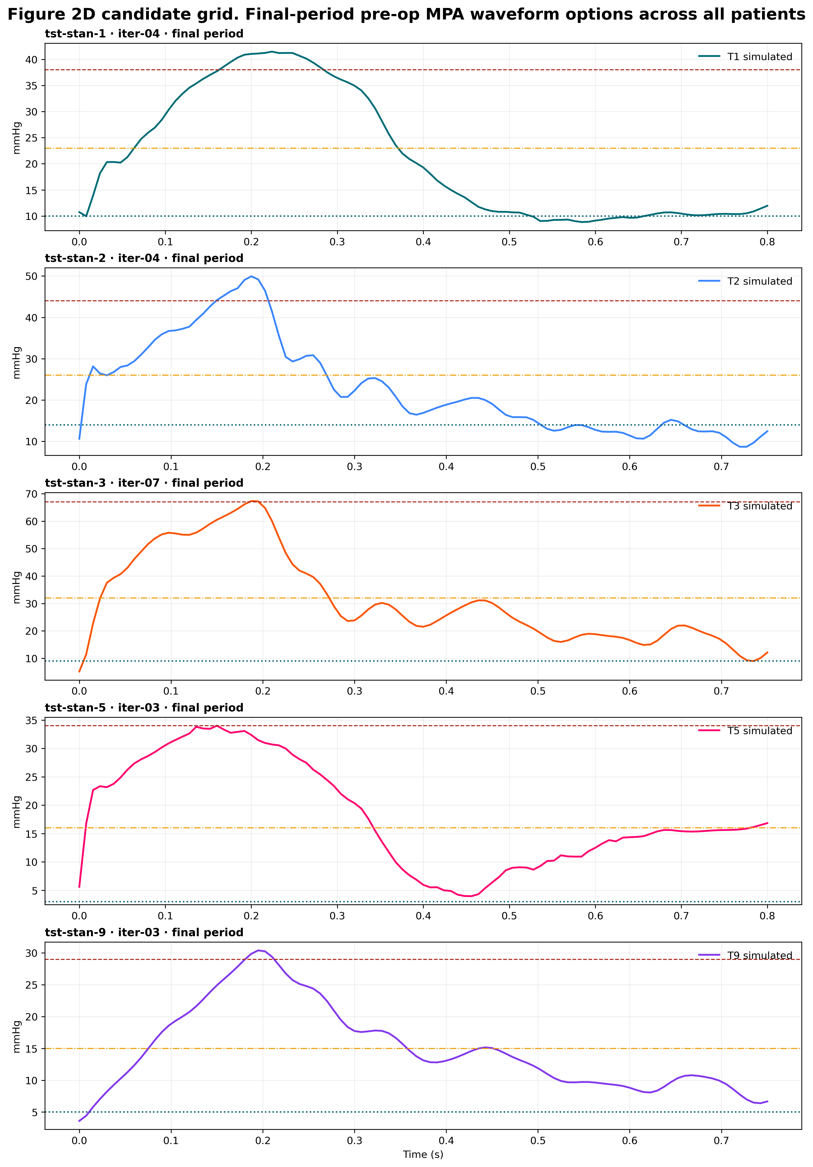
Pre-operative MPA waveforms across the cohort
1 Inputs
2 BC Tuning
3 Pre-op Sim
4 Post-op Sim
5 Adaptation
6 Adapted Sim
7 Metrics
ARCHIVED
What matches well
• Cycle-mean pressure
• RPA / LPA flow split
• Overall waveform morphology
What does not
IN DEVELOPMENT
• Systolic peak in patients with a large proximal pressure drop
• In TST-STAN-1 and -5 no parameter set satisfies systolic and diastolic targets at once
• This observation is what motivated moving the whole pipeline to deformable-wall CMM
Final-period MPA pressure waveforms, all patients (historical RRI-era BCs)
Archived 2026-10-22. Replaced by: Iteration 1: 3D pulse pressure against the catheter. Reason: RRI-era waveforms, two steps back.
Notes:
Archived 2026-10-22. Replaced by: Iteration 1: 3D pulse pressure against the catheter. Reason: RRI-era waveforms, two steps back.

Slide 74
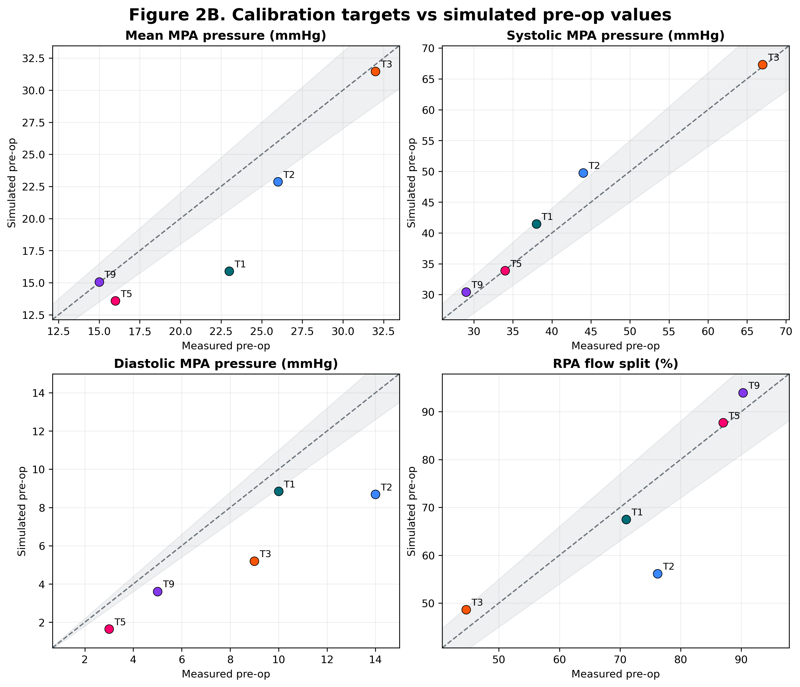
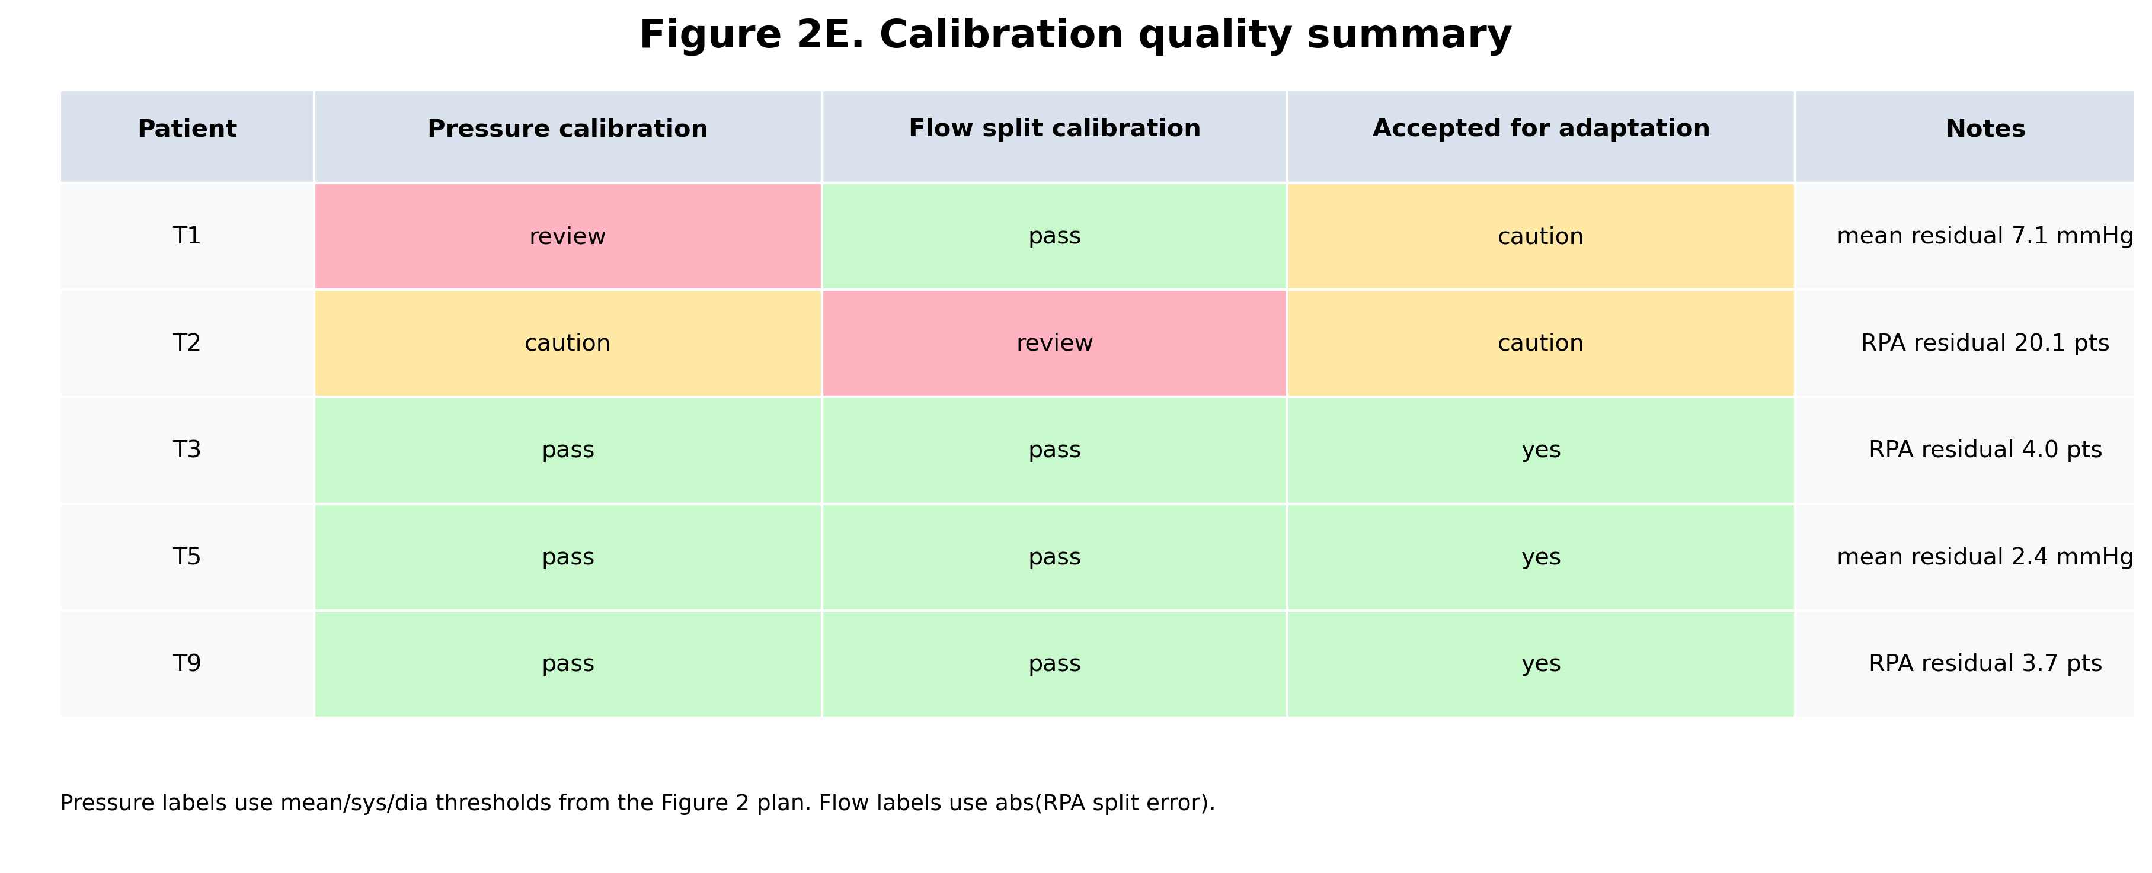
Tuned BCs reproduce the pre-operative targets
1 Inputs
2 BC Tuning
3 Pre-op Sim
4 Post-op Sim
5 Adaptation
6 Adapted Sim
7 Metrics
ARCHIVED
Calibration quality summary by patient
Reading the result
systolic pressure calibrates reliably
mean pressure needs improvement across the board
RPA flow split mismatch in patient 2 only
Calibration targets vs. simulated pre-operative values
Four of five patients calibrate; TST-STAN-2 remains open.
Historical: two-branch RRI, k₃ = 0, s = 0.1 BCs. The cohort is being re-tuned with the physiological model (slides 41–43).
Archived 2026-10-22. Replaced by: Iteration 1: 3D pulse pressure against the catheter. Reason: Two-branch RRI results, two steps back.
Notes:
Archived 2026-10-22. Replaced by: Iteration 1: 3D pulse pressure against the catheter. Reason: Two-branch RRI results, two steps back.

Slide 75
Complete tuning pipeline
1 Inputs
2 BC Tuning
3 Pre-op Sim
4 Post-op Sim
5 Adaptation
6 Adapted Sim
7 Metrics
ARCHIVED
Patient inputs
Inner loop · 0D tuning
Outer loop · 3D
3D mesh + centerlines
1 Proximal C on seed vessels
1 3D CMM, wall matched to 0D C
MRI MPA inflow
2 Map caps → 0D outlets (centerline)
2 Centerline postprocess
Cath MPA sys / dia / mean
3 Per-cap Olufsen trees, 1M nodes
3 svZeroDCalibrator refit
RPA split (perfusion)
4 Shared Nelder–Mead on χ², 5 params
4 Promote seed → inner step 1
PCWP, PR grade → Pd policy
5 Per-cap polish (maxfev 100)
5 Pick preop iteration by hand
learnedZeroD seed (it. 1)
6 Published fit + diagnostics
6 → Stages 3–4
Master schematic for Stage 2: keep it in sync with slide 18 and svzt-agent docs/TUNING_MODEL.md.
Archived 2026-10-22. Replaced by: The updated tuning loop runs on the full 0D model. Reason: Duplicate schematic of the loop overview.
Notes:
Native redraw of the Stage 2 master schematic for the full-PA loop. Inputs: mesh and centerlines, MRI inflow, catheter pressures, the perfusion split, PCWP and the clinical regurgitation grade (which select the outlet-pressure policy), and the learnedZeroD seed for iteration 1. Inner loop: proximal compliance, centerline cap mapping, per-cap trees, shared Nelder-Mead on the likelihood, per-cap polish, published scoring. Outer loop: 3D CMM, centerline postprocess, svZeroDCalibrator, promotion of the calibrated seed, and hand selection of the preop iteration.
Original footnote: Replaces the RRI-era schematic. svzt-agent renders tuning.impedance into the Slurm job; svZeroDTrees implements the model (run_impedance_tuning_for_iteration).
Archived 2026-10-22. Replaced by: The updated tuning loop runs on the full 0D model. Reason: Duplicate schematic of the loop overview.

Slide 76
Outer loop: reconciling the 0D model with 3D
1 Inputs
2 BC Tuning
3 Pre-op Sim
4 Post-op Sim
5 Adaptation
6 Adapted Sim
7 Metrics
ARCHIVED
Seed
it. 1: learnedZeroD + C; later: calibrated
Tune trees
χ², shared → per-cap polish
Run 3D CMM
E matched to 0D C; stiffness-scaled damping
Calibrate
centerline postprocess → svZeroDCalibrator
Promote
calibrated model seeds next iteration
repeat up to max_iterations (5)
Gate and iteration choice (decided 6 Oct)
Fixes from the first cohort runs (6–7 Oct)
3.8σ
TST-STAN-5's best diastolic miss (−7.7 mmHg): the per-metric gate cannot pass, so every iteration is not_close
✓
Prestress: mean steady solve added for learned seeds
✓
3D coupler pairs IMPEDANCE BCs to caps via the outlet mapping
✓
RCR BCs named after the cap they map to
svzt preop select --run-id <id> --iteration <n> --reason <text>
✓
pyvista shim removed; mpa_pressure_vs_time.csv written again
• The preop iteration is picked by hand from completed 3D runs
• The gate (or a χ²-based replacement) will be revisited
• Start a fresh run per patient: old runs seed values outside the new bounds
✓
Job preflight exits (code 8) on an outdated svZeroDTrees
--reuse-preop-3d: rerun post-3D steps only (uncommitted)
Each iteration costs one transient 3D run; until the gate is revisited, the preop iteration is chosen by hand.
Archived 2026-10-22. Replaced by: The updated tuning loop runs on the full 0D model. Reason: Duplicate of the loop overview; it listed --reuse-preop-3d as uncommitted (committed in affa866).
Notes:
Replaces the RRI outer loop. Iteration 1 seeds from learnedZeroD with proximal compliance; every later iteration seeds from the svZeroDCalibrator output of the previous one (calibrated_full_pa), whatever the gate decision. The gate works in sigma units, but TST-STAN-5's best fit misses diastolic by 3.8 sigma, so all iterations are not_close and the driver runs to max_iterations. Decision 6 Oct: ignore the gate for now and select the preop iteration by hand with svzt preop select. Fixes from the first cohort runs: generated prestress now runs a mean steady solve when the seed has none, the 3D coupler pairs impedance BCs with caps through the outlet mapping, RCR BCs are named after their mapped cap, and a test shim that shadowed pyvista on Sherlock was removed. --reuse-preop-3d is in the working tree, not yet committed.
Original footnote: svzt-agent TUNING_MODEL.md §4, §8.3–8.4; EXECUTION.md. Commits: svzt-agent 5f0fba9, d054dcb; svZeroDTrees c0f58de, b582e96, d621390.
Archived 2026-10-22. Replaced by: The updated tuning loop runs on the full 0D model. Reason: Duplicate of the loop overview; it listed --reuse-preop-3d as uncommitted (committed in affa866).

Slide 77
Objective: χ² likelihood replaces relative error
1 Inputs
2 BC Tuning
3 Pre-op Sim
4 Post-op Sim
5 Adaptation
6 Adapted Sim
7 Metrics
ARCHIVED
χ² = Σᵢ ( ( yᵢ,model − yᵢ,target ) / σᵢ )²
σ = 2 mmHg for MPA sys / dia / mean (catheter) · 0.02 for the RPA split (MRI)
What changed in the tuner
1
Loss reweighting off
unit weights across restarts keep the loss a χ² statistic
Weight on 1 mmHg of error, relative to systolic (targets 34 / 3 / 16)
2
L2 penalty on θ removed
it biased k₂ / C toward zero and dominated the loss
3
Diastolic target kept below Pd
under regurgitation MPA pressure falls below Pd
4
Gate in σ units
|model − target| ≤ 1σ, not 10% (0.3 mmHg on a 3 mmHg diastolic)
With the relative loss the optimizer traded 20+ mmHg of systolic and mean for diastolic (53–57 / 3 / 24–25 mmHg).
Archived 2026-10-22. Replaced by: Inner loop: shared fit, then a per-cap polish. Reason: Relative-error loss is two steps back; the chi-squared objective is on the loop slides.
Notes:
Replaces the adaptive-reweighting slide. The relative squared error divides each residual by its target, so on TST-STAN-5 one mmHg of diastolic error (target 3) weighs about 128x one mmHg of systolic error (target 34). With proximal compliance this made the optimizer accept 53-57 / 3 / 24-25 mmHg. The Gaussian likelihood weights each target by its measurement error (2 mmHg catheter, 0.02 MRI split), so chi2 is interpretable and each term above 1 is more than 1 sigma off. Under the likelihood the restart reweighting is disabled, the L2 penalty is gone, the diastolic term is kept when its target is below Pd, and the 3D iteration gate and the Nelder-Mead target stop work in sigma units.
Original footnote: objective {type: likelihood, pressure_sigma_mmhg 2, split_sigma 0.02, target_sigma 1}; keep_diastolic_target true. svZeroDTrees 98aef60 (L2 removed); FINDINGS.md v2 vs v2b.
Archived 2026-10-22. Replaced by: Inner loop: shared fit, then a per-cap polish. Reason: Relative-error loss is two steps back; the chi-squared objective is on the loop slides.

Slide 78
The proximal 0D model gets wall compliance
1 Inputs
2 BC Tuning
3 Pre-op Sim
4 Post-op Sim
5 Adaptation
6 Adapted Sim
7 Metrics
ARCHIVED
Raw learnedZeroD seed
R, L folded into junctions; zero-length connectors
Length from centerline
branch length minus split connectors
Junction R, L → connector
negative L clamped to 0
C = 3AL / (2·Eh/r)
Eh/r = s·5×10⁴, recomputed every evaluation
Why each step is there
3D wall matched per patient and iteration
15.64 mL
lumen, 0.626 mL/mmHg at s = 1: reproduces the calibrated seed's geometry on TST-STAN-5
E = matched E·h / h elasticity_modulus: match_proximal_compliance
• E·h = Eh/r · r_eff, r_eff = Σ(ALr)/Σ(AL); follows the tuned s
• r_eff runs 0.47 cm (TST-STAN-1) to 0.98 cm (TST-STAN-9): one shared E left 3D walls up to 1.8× more compliant than 0D
• A fixed numeric E with the tied multiplier raises a config warning
55 / 55
evaluations failed when compliant R = L = 0 connectors sat in front of the impedance outlets
C ∝ scale³
staged (mesh-scaled) seeds: constant Eh/r gives s³, not s⁴, which kept TST-STAN-9's LPA split positive
Caveat At s = 1 the linear wall implies ~120% volume change over a 31 mmHg pulse, beyond CMM small strain. Measured stiffness remains the first future change.
With the tied multiplier every seed vessel's C is recomputed at the tuned s, including C kept from an earlier calibration.
Archived 2026-10-22. Replaced by: Fixed and tuned parameters. Reason: Proximal compliance is now a fixed rule under the tied multiplier.
Notes:
Proximal compliance on the full-PA seed. C = 3AL/(2 Eh/r) on every seed vessel with Eh/r = s x 5e4; since 16 Oct s is tuned and C is recomputed each evaluation (calibrated C is overwritten). The 3D CMM wall now follows the tuned 0D model per patient and iteration through elasticity_modulus: match_proximal_compliance (E = matched_uniform_wall_eh / h); a single shared E left larger-PA patients' 3D walls up to 1.8x more compliant. For mesh-scaled (staged) patients 0D compliance scales with s^3 at constant Eh/r.
Original footnote: svZeroDTrees ef62d2c, da89f60, eac9f53, fb88065, b7ae42a, 1b01fc9; svzt-agent 0dad632 (9 Oct). docs/pulmonary_tuning_model.md §2.4; TUNING_MODEL.md §8 item 1.
Archived 2026-10-22. Replaced by: Fixed and tuned parameters. Reason: Proximal compliance is now a fixed rule under the tied multiplier.

Slide 79
Distributing trees across the outlets
1 Inputs
2 BC Tuning
3 Pre-op Sim
4 Post-op Sim
5 Adaptation
6 Adapted Sim
7 Metrics
ARCHIVED
d_tree = d_mean,side + s · ( d_cap − d_mean,side )
s = 0
OPTIMIZER SURROGATE
s = 0.1
PREVIOUS DEFAULT
s = 1.0
CURRENT: EXPORTED TO 3D
One side-mean tree per side at a conductance-matched diameter, N·G(d_ref) = ΣG(d_i). Used only inside the shared optimizer stage: ~9× cheaper per evaluation.
Trees nudged toward each cap's own diameter for outlet stability. Fit worse than s = 1.0 in every matched comparison.
One tree per cap at its measured diameter d = 2√(A/π). Oversized caps (rpa_2, d 0.854 cm) hit 1M nodes and are flagged; 2M nodes moves diastolic 0.25 mmHg.
Published χ², matched runs: s = 0.1 vs s = 1.0
What changed
• No arbitrary shrinkage toward the side mean: exported geometry is measured geometry
• All per-cap published models in the study converged at the default solver tolerance
• The surrogate's bias (~2.6 mmHg) is removed by the per-cap polish (slide 21)
Exported trees sit at the measured cap diameters; the side-mean tree survives only as the optimizer's surrogate.
Archived 2026-10-22. Replaced by: Fixed and tuned parameters. Reason: One tree per cap at the measured diameter is now a fixed default.
Notes:
s (diameter_scale) is now 1.0: every outlet cap gets its own tree at its measured diameter, and that per-cap model is what is exported to 3D. The side-mean (s = 0) tree is kept only as the optimizer's shared surrogate at a conductance-matched diameter. In matched TST-STAN-5 runs s = 1.0 fit much better than s = 0.1 (chi2 35 vs 56 and 16 vs 49). The oversized rpa_2 cap truncates at 1M nodes and is flagged; doubling the budget moves diastolic 0.25 mmHg.
Original footnote: diameter_scale 1.0, use_mean false; objective_tree_policy {use_mean: true, reference_diameter: conductance_matched}. χ² from FINDINGS.md (v2b, k2free). docs/pulmonary_tuning_model.md §2.8–2.9.
Archived 2026-10-22. Replaced by: Fixed and tuned parameters. Reason: One tree per cap at the measured diameter is now a fixed default.

Slide 80
From tree geometry to an impedance boundary condition
1 Inputs
2 BC Tuning
3 Pre-op Sim
4 Post-op Sim
5 Adaptation
6 Adapted Sim
7 Metrics
ARCHIVED
Linearize
Vessel impedance
Recurse
Inverse FFT
Navier–Stokes in each vessel,
Womersley solution per frequency
Wave speed and impedance
from radius and wall compliance
Combine daughter impedances
up to the tree root
Root impedance returned to the
time domain as an outlet BC
Wall compliance model
3D–0D coupling
• Eh/r₀ = k₁ exp(k₂r₀) + k₃, with pulmonary k₁ = 2.6×10⁵ dyn/cm² and k₂ = −14 cm⁻¹ fixed
• k₃ = s · 10⁵, tied to the proximal wall through one multiplier s ∈ [0.5, 20] (slide 44)
• Sensitivity: proximal wall and outlet pressure move χ² by 11–23; k₃, k₂ and η by ≤ 1
• Impedance BCs are applied through svZeroDSolver coupled to svMultiPhysics
• The coupler retains the flow history over the last cardiac period for the convolution
• Z[0] enters the constant global system, which is what made the coupling robust
The tree is evaluated as a frequency-domain impedance — never as a resolved 0D network at run time.
Archived 2026-10-22. Replaced by: Structured-tree boundary conditions. Reason: Background detail over the Stage 2 budget; the intro slide covers the impedance.
Notes:
Original footnote: Formulation after Olufsen, Ann Biomed Eng (1999, 2000); stiffness values Colebank 2021 / Bartolo 2022; sensitivity from the TST-STAN-5 study (slide 42).
Archived 2026-10-22. Replaced by: Structured-tree boundary conditions. Reason: Background detail over the Stage 2 budget; the intro slide covers the impedance.

Slide 81
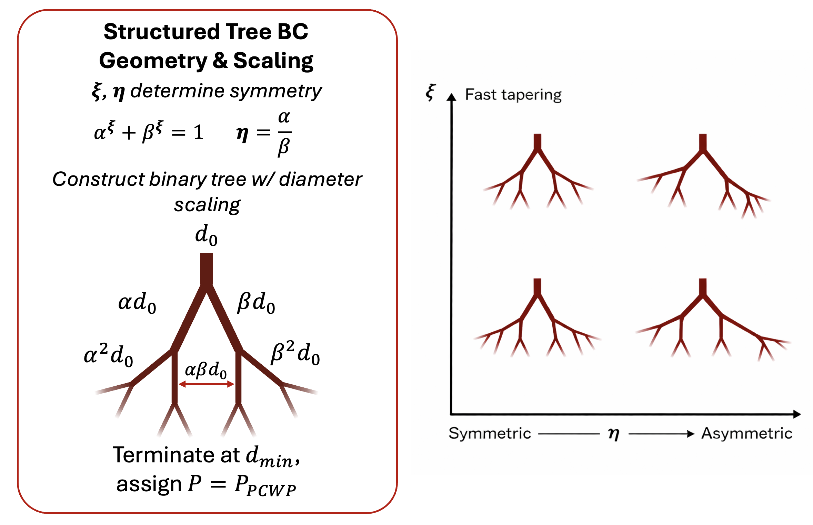
Structured-tree geometry and scaling
1 Inputs
2 BC Tuning
3 Pre-op Sim
4 Post-op Sim
5 Adaptation
6 Adapted Sim
7 Metrics
ARCHIVED
Construction rule
• Each vessel bifurcates into daughters of diameter αd and βd
• ξ sets how fast the tree tapers; η = α/β sets asymmetry
• Recursion stops when diameter falls below d_min
Terminal condition
• Terminal vessels end at a constant outlet pressure Pd, set per patient from PCWP or PA diastolic (slide 43)
• Length of each vessel is set by the length-to-radius ratio l_rr
Two shape parameters per side (ξ, η) plus one stiffness parameter (k₃) describe the entire distal bed.
Archived 2026-10-22. Replaced by: Fixed and tuned parameters. Reason: Background detail over the Stage 2 budget; xi and eta are defined on the parameters slide.
Notes:
Archived 2026-10-22. Replaced by: Fixed and tuned parameters. Reason: Background detail over the Stage 2 budget; xi and eta are defined on the parameters slide.

Slide 82
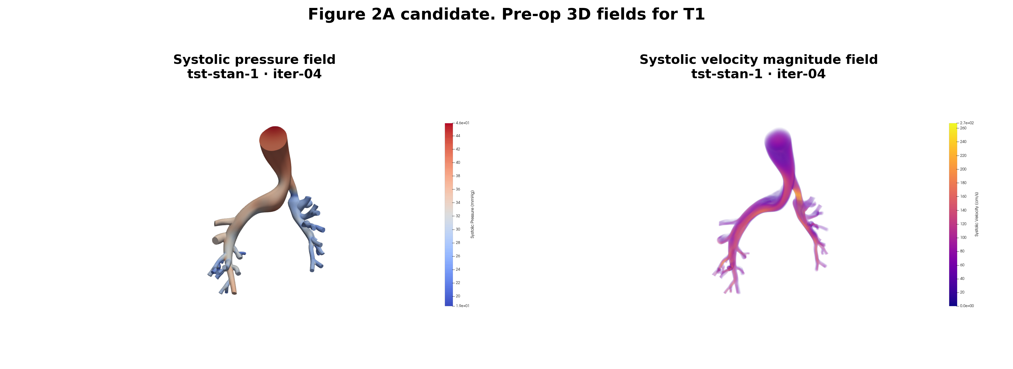
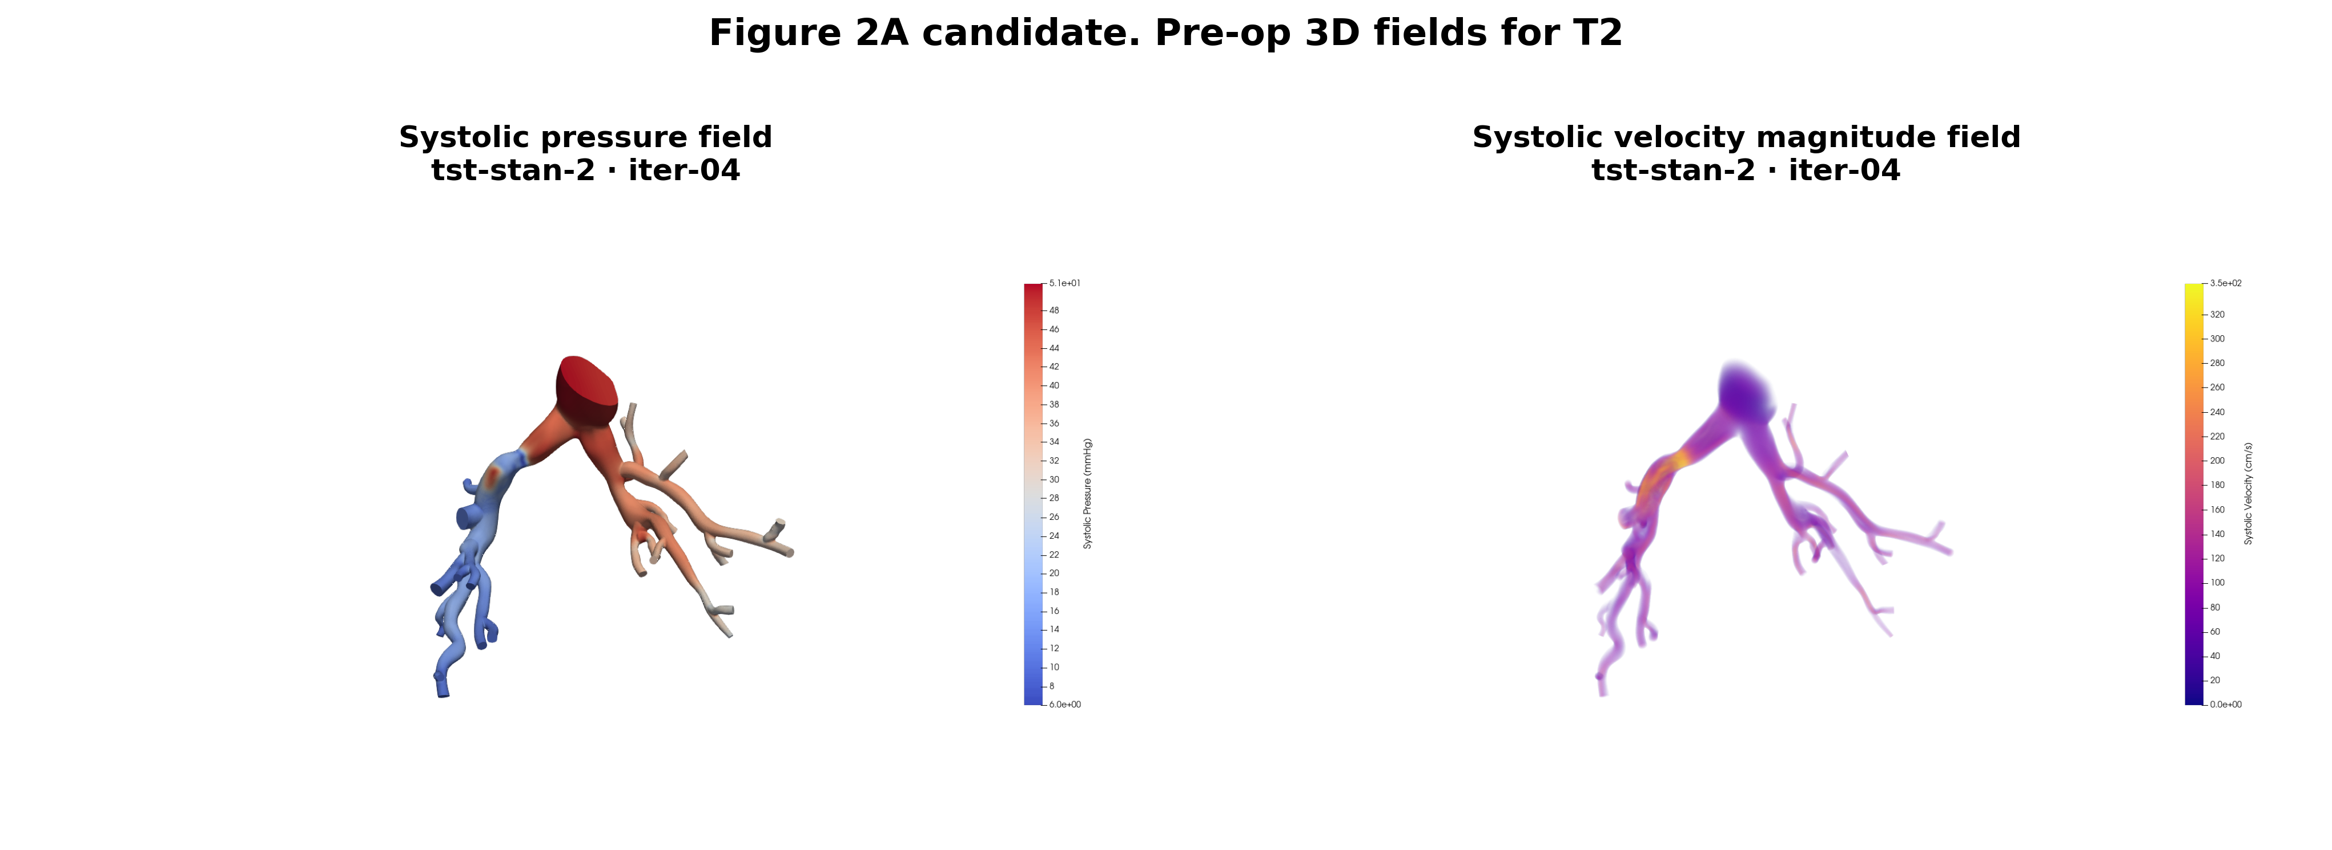
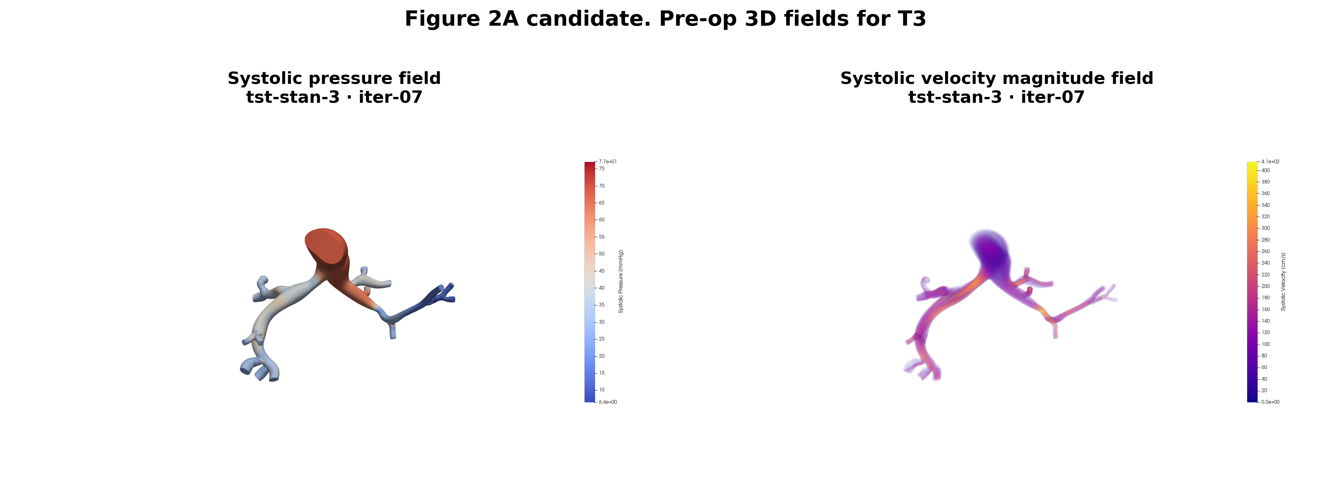
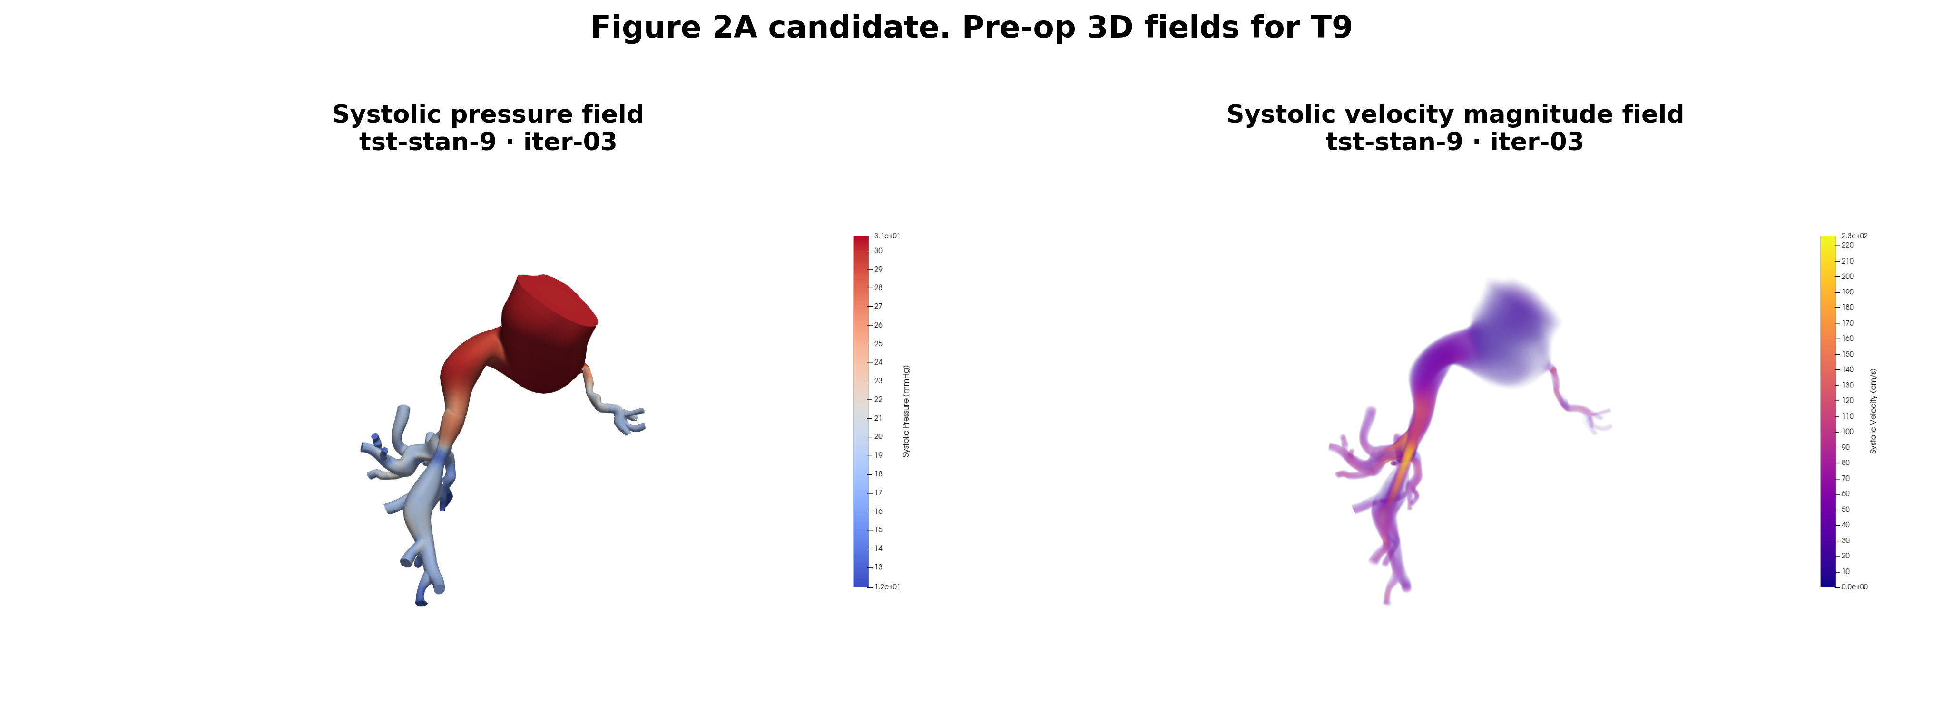
Pre-operative 3D results
1 Inputs
2 BC Tuning
3 Pre-op Sim
4 Post-op Sim
5 Adaptation
6 Adapted Sim
7 Metrics
ARCHIVED
TST-STAN-1
TST-STAN-2
TST-STAN-3
TST-STAN-9
Fields extracted
Missing
IN DEVELOPMENT
• Systolic pressure field and velocity magnitude on the deformed configuration
• TST-STAN-5 pre-operative re-run is still pending after the CMM transition
Pre-operative simulations are complete for four of five patients.
Archived 2026-10-22. Replaced by: Iteration 1: 3D pulse pressure against the catheter. Reason: Renders from the earlier BCs; no pre-op iteration is selected under the current BCs.
Notes:
Archived 2026-10-22. Replaced by: Iteration 1: 3D pulse pressure against the catheter. Reason: Renders from the earlier BCs; no pre-op iteration is selected under the current BCs.

Slide 83
Predicted effect of a 3D / 0D volume correction
1 Inputs
2 BC Tuning
3 Pre-op Sim
4 Post-op Sim
5 Adaptation
6 Adapted Sim
7 Metrics
ARCHIVED
Pulse pressure, systolic − diastolic (mmHg)
Systolic / diastolic and verdict
TST-STAN-1
helps
43.9/4.9 → 40.6/6.6
TST-STAN-2
helps, still high
62.8/11.8 → 55.7/15.3
TST-STAN-3
closes ~½ the gap
77.8/7.6 → 72.6/10.2
TST-STAN-5
−2 to +0.4 mmHg
34.8/2.8 → 34.0/3.2
TST-STAN-9
overshoots
* TST-STAN-5 is already on the scaled damping (c = 3,650); the others are at c = 10⁴. Predictions are model estimates, not 3D runs.
31.6/4.8 → 21.7/9.7
Arrows: 3D now → predicted (volume × r). Targets on slide 12.
The correction narrows the pulse for TST-STAN-1, -2 and -3, is neutral for TST-STAN-5 and overshoots TST-STAN-9.
Archived 2026-10-22. Replaced by: Roadmap: what is changing across the pipeline. Reason: Planned method, not in development; one line on the roadmap and the Stage 3 path.
Notes:
Predicted effect on the 3D result of correcting the mismatch between the 3D lumen volume and the 0D seed volume. Two variants: volume ratio only, and volume x r. Pulse pressure falls toward target for TST-STAN-1 (39.0 -> 34.0 vs 28), TST-STAN-2 (51.0 -> 40.4 vs 30, still well above) and TST-STAN-3 (70.2 -> 62.4 vs 58, about half the gap). TST-STAN-5 (already on the scaled damping) moves between 2 mmHg worse and slightly better. TST-STAN-9 overshoots: pulse 12-16.5 vs 24. Baseline is iteration 1 at c = 1e4 except TST-STAN-3 (iteration 2) and TST-STAN-5 (c = 3650).
Original footnote: Two correction variants: scale by the 3D/0D volume ratio alone, or by volume × r. Prediction relative to each patient's latest 3D run.
Archived 2026-10-22. Replaced by: Roadmap: what is changing across the pipeline. Reason: Planned method, not in development; one line on the roadmap and the Stage 3 path.

Slide 84
3D tuning performance before the damping fix
1 Inputs
2 BC Tuning
3 Pre-op Sim
4 Post-op Sim
5 Adaptation
6 Adapted Sim
7 Metrics
ARCHIVED
3D minus catheter target, last iteration (mmHg), c = 10⁴
Split and calibration by patient
iter.
split 3D / target
calibration
TST-STAN-1
2
0.692 / 0.71
unstable in replay
TST-STAN-2
1 *
0.683 / 0.762
passed (21.2 → 2.4)
TST-STAN-3
2
0.448 / 0.446
gate: no gain (2.5 → 3.6)
TST-STAN-5
2
0.88 / 0.87
gate: no gain (15.5 → 15.6)
TST-STAN-9
1 *
0.875 / 0.903
unstable in replay
Systolic high and diastolic low in all five patients: the 3D pulse is too wide. σ = 2 mmHg.
* not advanced past iteration 1. Only TST-STAN-2's calibration passed; two calibrated models were unstable in replay.
Every patient ran with the aortic damping c = 10⁴; the too-wide 3D pulse motivated the stiffness-scaled damping (next slide).
Archived 2026-10-22. Replaced by: Iteration 1: 3D pulse pressure against the catheter. Reason: Before-damping-fix data moved into the before/after chart.
Notes:
3D tuning performance with the original CMM damping (c = 1e4) at each patient's last iteration. Systolic is above target in every patient (TST-STAN-2 by 18.8, TST-STAN-3 by 10.8 mmHg) and diastolic below target in all five, so the 3D pulse pressure is too wide even where the 0D fit was good. Splits are close except TST-STAN-2 (0.683 vs 0.762). Calibration: TST-STAN-2 passed (21.2 -> 2.4); TST-STAN-3 and -5 failed the improvement-only gate; TST-STAN-1 and -9 calibrated models were unstable in replay. TST-STAN-2 and -9 were not advanced past iteration 1.
Original footnote: 3D preop results at each patient's last completed iteration before 20 Oct 2026; targets from slide 12. Calibration = svZeroDCalibrator improvement-only target gate.
Archived 2026-10-22. Replaced by: Iteration 1: 3D pulse pressure against the catheter. Reason: Before-damping-fix data moved into the before/after chart.

Slide 85
Identifying the gains: calibration and validation design
1 Inputs
2 BC Tuning
3 Pre-op Sim
4 Post-op Sim
5 Adaptation
6 Adapted Sim
7 Metrics
ARCHIVED
The design decision
Fitting objective
• If gains are fit per patient against that patient's own post-operative data, the adapted result is a calibration, not a prediction
• The pipeline is only useful for treatment planning if the gains generalize
• Match the measured post-operative RPA / LPA perfusion split
• Secondary: post-operative MPA pressures
Chosen approach
Reporting requirement
PLANNED
• Fit the gains on three patients and validate on the held-out two
• Or leave-one-out cross-validation across all five, which uses the small cohort more efficiently
• Held-out error must be reported separately from fitted error
• With n = 5, quantify sensitivity to which patients land in the training set
This is the step that decides whether the pipeline predicts or merely describes.
Archived 2026-10-22. Replaced by: Do gains fitted on some patients predict the rest?. Reason: Replaced by the question slide; the gain-fitting design is not settled.
Notes:
Archived 2026-10-22. Replaced by: Do gains fitted on some patients predict the rest?. Reason: Replaced by the question slide; the gain-fitting design is not settled.

Slide 86
Patient-specific adaptation tests
1 Inputs
2 BC Tuning
3 Pre-op Sim
4 Post-op Sim
5 Adaptation
6 Adapted Sim
7 Metrics
ARCHIVED
TST-STAN-1 — pre-op, acute post-op and adapted conditions
TST-STAN-9 — pre-op, acute post-op and adapted conditions
• Adaptation is currently exercised in 0D only; these results have not yet been carried back into a 3D simulation
• Some simulated stents overshoot the measured post-operative flow split — angiographic diameters should be checked against nominal stent size AND THE 0D MODEL NEEDS TO BE IMPROVED TO ADDRESS THIS
Two of five patients have been through the adaptation step; the remaining three follow once tuning closes.
Archived 2026-10-22. Replaced by: Path to publication: Stage 5. Reason: May to June M1 runs on the earlier BCs.
Notes:
Archived 2026-10-22. Replaced by: Path to publication: Stage 5. Reason: May to June M1 runs on the earlier BCs.

Slide 87
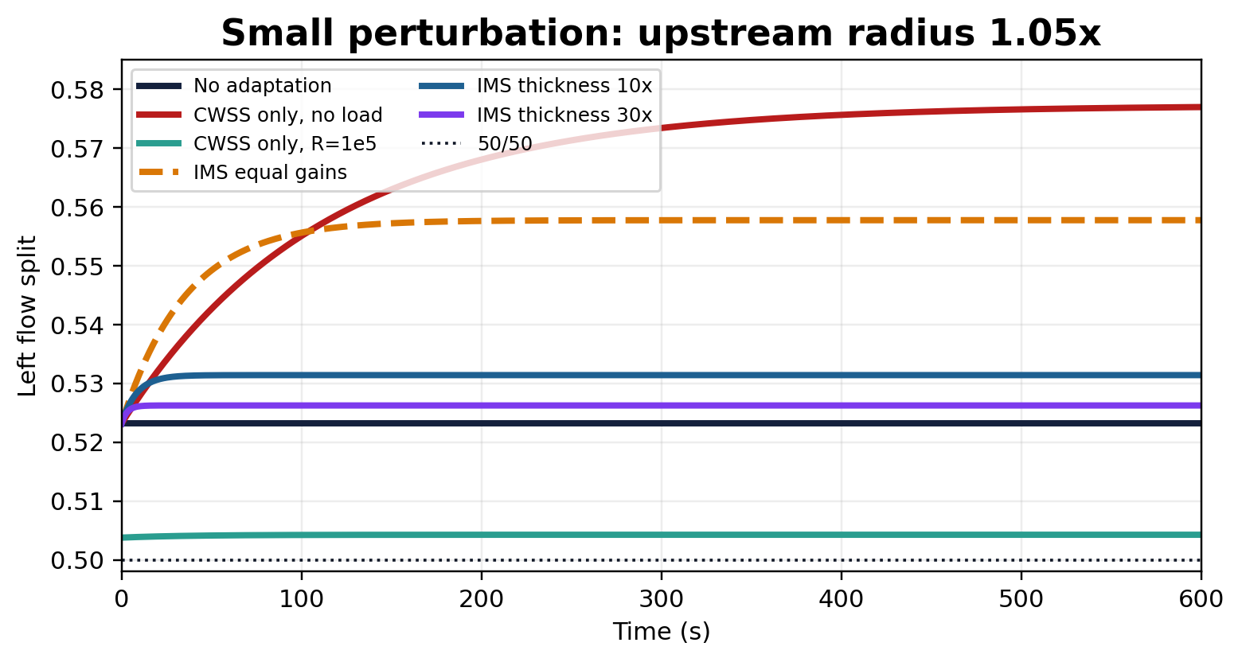
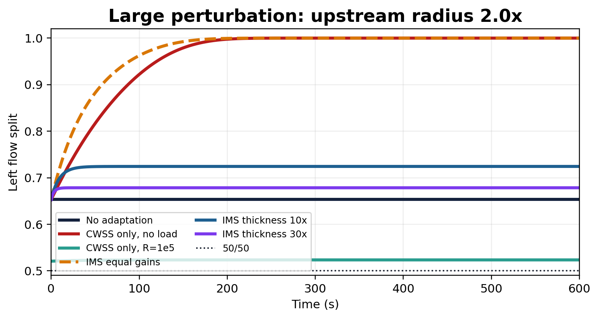
The gains are the lever on adapted flow split
1 Inputs
2 BC Tuning
3 Pre-op Sim
4 Post-op Sim
5 Adaptation
6 Adapted Sim
7 Metrics
ARCHIVED
Small perturbation — upstream radius × 1.05
Large perturbation — upstream radius × 2.0
• A two-branch toy model with adaptive downstream boundary conditions isolates the effect of the gains from patient-specific anatomy
• Varying the thickness gains alone moves the steady adapted flow split across a usable range
• Perturbation magnitude matters for stability: large upstream changes can push the system out of its convergent regime
Thickness gains give a tunable, physically interpretable handle on the adapted split.
Archived 2026-10-22. Replaced by: What changed: one tree per side to per-cap trees. Reason: Two-branch toy study for the earlier formulation.
Notes:
Archived 2026-10-22. Replaced by: What changed: one tree per side to per-cap trees. Reason: Two-branch toy study for the earlier formulation.

Slide 88
Numerical integration
1 Inputs
2 BC Tuning
3 Pre-op Sim
4 Post-op Sim
5 Adaptation
6 Adapted Sim
7 Metrics
ARCHIVED
The cost problem
Integrator comparison
• Evaluating τ and σ requires a hemodynamic solve over the whole tree at every derivative evaluation
• Trees contain 10³–10⁵ vessels, so a naive integration is prohibitive
BDF
Fastest; solves reliably — current default
Radau
Slowest; robust for stiff systems
RK45
Reasonably fast, but intermediate states can yield infeasible 0D resistances
Multirate solution
Practical notes
• The tree is re-simulated only when the accumulated radius change is significant
• Otherwise derivatives are updated from the previous step's radius change
• This is what makes higher-order integrators usable at all
• Intuition-building sweeps use d_min = 0.05 cm rather than the production 0.01 cm
• Vectorized tree construction gave roughly a hundred-fold speed-up in impedance evaluation
Integration is solved; gain identification is the remaining open problem.
Archived 2026-10-22. Replaced by: What changed: one tree per side to per-cap trees. Reason: Integrator notes for M1/M3.
Notes:
Archived 2026-10-22. Replaced by: What changed: one tree per side to per-cap trees. Reason: Integrator notes for M1/M3.

Slide 89
Driving the trees from the 3D result
1 Inputs
2 BC Tuning
3 Pre-op Sim
4 Post-op Sim
5 Adaptation
6 Adapted Sim
7 Metrics
ARCHIVED
The trees never see the 3D field directly. The RRI reduced-order model is the transfer mechanism.
Pre-op 3D
RRI fit
Homeostatic state
Integrate the tree ODEs
from the homeostatic state
under the perturbed
boundary values
→ adapted r_i , h_i
→ adapted tree impedance
Calibrated pre-operative
CFD result
0D model run to reproduce
the pre-operative state
τ_i,0 and σ_i,0 recorded
for every tree vessel
Post-op 3D
RRI fit
Perturbed state
Virtually stented
CFD result
0D model run to reproduce
the post-operative state
New P and Q at each
RRI outlet
• Only the trees adapt — the 3D geometry, the proximal vessels and the RRI parameters are held at their post-operative values
• Because integration is to steady state, the result is independent of how long after the intervention the patient was re-studied
The RRI model is doing double duty: tuning surrogate in Stage 2, adaptation driver in Stage 5.
Archived 2026-10-22. Replaced by: What changed: one tree per side to per-cap trees. Reason: RRI-driven homeostatic and perturbed states, replaced by the M2 territory update.
Notes:
Archived 2026-10-22. Replaced by: What changed: one tree per side to per-cap trees. Reason: RRI-driven homeostatic and perturbed states, replaced by the M2 territory update.

Slide 90
Why constant shear alone is not enough
1 Inputs
2 BC Tuning
3 Pre-op Sim
4 Post-op Sim
5 Adaptation
6 Adapted Sim
7 Metrics
ARCHIVED
Observed failure mode
What the stress term adds
• Applied iteratively across a multi-outlet model, pure CWSS adaptation drove the flow split through wild excursions rather than settling
• Recorded splits across successive iterations swung from 22 / 78 to 86 / 14 with no convergence
• As radius grows at fixed pressure, intramural stress rises and opposes further dilation
• Wall thickening provides a second, slower degree of freedom that relieves stress
• The combined system admits a stable fixed point, which is the state we integrate to
• The trade-off is four gains instead of one, and those gains must be identified
Interpretation
• Shear-only adaptation has positive feedback: dilation raises flow, which raises shear again
• Nothing in the formulation penalizes unbounded radius growth
CWSS-IMS is retained not because it fits better, but because it is the version that converges.
Archived 2026-10-22. Replaced by: What changed: one tree per side to per-cap trees. Reason: Motivation for the M1/M3 formulation, which full-PA runs no longer use.
Notes:
Archived 2026-10-22. Replaced by: What changed: one tree per side to per-cap trees. Reason: Motivation for the M1/M3 formulation, which full-PA runs no longer use.

Slide 91
CWSS-IMS: governing equations
1 Inputs
2 BC Tuning
3 Pre-op Sim
4 Post-op Sim
5 Adaptation
6 Adapted Sim
7 Metrics
ARCHIVED
d ln r_i / dt = k_τ,r · ln( τ_i / τ_i,0 ) + k_σ,r · ln( σ_i / σ_i,0 )
d ln h_i / dt = k_τ,h · ln( τ_i / τ_i,0 ) + k_σ,h · ln( σ_i / σ_i,0 )
τ_i = 4 μ Q_i / ( π r_i³ ) σ_i = P_i r_i / h_i
State and stimuli
Comparison arm
• Each vessel carries a radius and a wall thickness, evolved in log-state form
• Shear and intramural stress are each referenced to their pre-operative homeostatic value
• Four gains: k_τ,r , k_σ,r , k_τ,h , k_σ,h
• CWSS alone, with the terminal resistance swept across a range
• Isolates what the intramural stress term contributes
• Pries and Secomb's seven-parameter scheme is deferred to future work
Integration runs purely to steady state — the adapted result is a long-term asymptote with no physical timescale.
Archived 2026-10-22. Replaced by: What changed: one tree per side to per-cap trees. Reason: M1/M3 formulation (one tree per side) is refused for full-PA runs.
Notes:
Archived 2026-10-22. Replaced by: What changed: one tree per side to per-cap trees. Reason: M1/M3 formulation (one tree per side) is refused for full-PA runs.

Slide 92
The pipeline
ARCHIVED
Inputs
1
BC Tuning
2
Pre-op Sim
3
Post-op Sim
4
Adaptation
5
Adapted Sim
6
Metrics
7
Imaging, segmentation,
clinical targets, inflow
Structured-tree BCs fit
to catheter + LPS targets
svMultiPhysics CMM
deformable-wall 3D CFD
SDF virtual stenting,
pre-op BCs retained
CWSS-IMS integration
of the microvascular trees
3D re-run with the
adapted tree impedances
Pressure, flow split, PVR,
WSS vs. measured post-op
VALIDATED
IN DEVELOPMENT
VALIDATED
VALIDATED
IN DEVELOPMENT
PLANNED
PLANNED
Two feedback loops sit inside the pipeline
Inner loop · Stage 2
Outer loop · Stages 2 ↔ 3
• Tree parameters are tuned against clinical targets on the full branched 0D model (learnedZeroD seed, centerline-mapped outlet BCs)
• svZeroDCalibrator refits the full 0D model to the 3D CFD result; the calibrated model seeds the next tuning iteration
Status key
VALIDATED
established, in use across the cohort
IN DEVELOPMENT
actively being changed this cycle
PLANNED
designed, not yet executed
Archived 2026-10-22. Replaced by: The pipeline. Reason: Duplicate of the next slide; it showed Stage 4 as VALIDATED.
Notes:
Archived 2026-10-22. Replaced by: The pipeline. Reason: Duplicate of the next slide; it showed Stage 4 as VALIDATED.

