Slide 1
Heng Shi University of Bath
Deep Learning
Tutorials

Slide 2
Contents
Workstation
Python and IPython
Basics of Tensorflow
Advances of Tensorflow
Code Example Reading: DRNN

Slide 3
Workstation

Slide 4
Workstation
Hardware platform
Virtualenv - (Tensorflow)
Python 2.7/numpy…
Ubuntu 16.04
Xeon E5-2697
Nvidia m6000
Jupyter Notebook(IDE)
56 cores
24G graphic memory
Notes:
Sometimes, most data wins. So, how to get more data? Even with AMT, often slow and expensive.

Slide 5
Workstation
Software platform
CUDA/Numpy/Pandas/Tensorflow/python/Jupyter Notebook
Tensorflow
Python Interface
CUDA
Numpy
Pandas
Data
CPU
GPU
Jupyter Notebook(Interactive)
Notes:
Sometimes, most data wins. So, how to get more data? Even with AMT, often slow and expensive.

Slide 6
Workstation
1. Login: eepc-0104
2. Terminal: Ctrl + Alt + T
3. Change working directory
4. Initiate TF platform
5. open Jupyter notebook
Useful commonds in Ubuntu
cd /working directory
source activate tensorflow
jupyter notebook
Notes:
Sometimes, most data wins. So, how to get more data? Even with AMT, often slow and expensive.

Slide 7
Python and IPython

Slide 8

Python and IPython
Python vs Matlab ($>$)
1. readable
use tab, no need to use ‘end’
20% short in implementation
2. Beautiful syntax
0-based index
use [] for index, () for function call
3. OOP in python is simple and elegant
4. More efficient, and better parallel and devices support
Notes:
Sometimes, most data wins. So, how to get more data? Even with AMT, often slow and expensive.

Slide 9

Python and IPython
Python vs Matlab ($>$)
5. Free and open-source
debug from source
canopy and anaconda (with N,P,M)
support by any developer
6. Visualizaion
matplotlib academic level 2/3-D graph
QT, Traits, Wx create production level UI Chaco create interactive graph
Notes:
Sometimes, most data wins. So, how to get more data? Even with AMT, often slow and expensive.

Slide 10

Python and IPython
Python vs R ($≈)$
Pro:
Beautiful visualization with ggplot2,ggvis,googlevis and rCharts
Huge ecosystem
Quick to use if package available
No need to learn programming
No OOP, No database, No parallel programming
But, not efficient
Not easy to automate workflow, and reuse code
Notes:
Sometimes, most data wins. So, how to get more data? Even with AMT, often slow and expensive.

Slide 11

Python and IPython
Python vs R ($≈)$
Python:
Ipython Notebook, super readable research notes
Easy to automate workflow, reuse code:
Multi purpose language, can merge differing backgrounp, perfect for team play.
General purpose language, production level quality, easy to test, guarantee the reusable and dependable.
Extendable for DIY algorithms
Much more efficient
Notes:
Sometimes, most data wins. So, how to get more data? Even with AMT, often slow and expensive.

Slide 12
Python and IPython
Suggest:
Result-flow, one-off tasks use R/M
Analyse correlations
Decompose load profiles
Probabilistic distribution fit
Linear regression
Data-flow, complex, multi-stage task, P
Novel and complex algorithms not publically available, such as Deep Learning
Etc…

Slide 13
Python and IPython
Go to IPython Notebook
Jupyter notebook: Interactive programming
Data types
Containers
Functions
Classes
Numpy
Array
Array
…
Matplotlib

Slide 14
Example 1
Python basics with notebook

Slide 15
Basics of Tensorflow

Slide 16
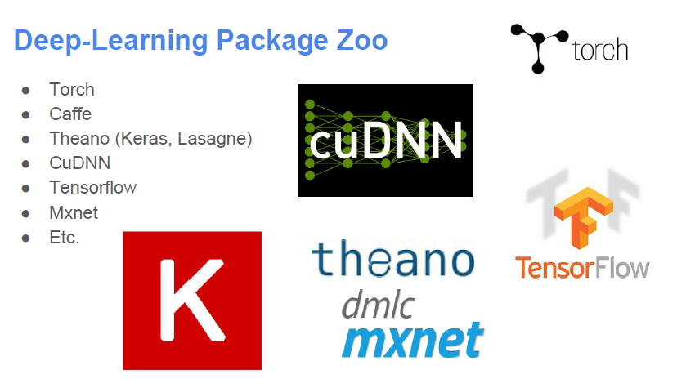
Why Tensorflow
Notes:
Sometimes, most data wins. So, how to get more data? Even with AMT, often slow and expensive.

Slide 17
Why Tensorflow
Features
Model specification:
Configuration files (Caffe, CNTK, etc.)
Generate by program (Torch, Tensorflow, Theano)
Interface Language:
Python: Theano, Tensorflow
Lua: Torch
Java: DL4J
…
Notes:
Sometimes, most data wins. So, how to get more data? Even with AMT, often slow and expensive.

Slide 18
Why Tensorflow
Advantage of Tensorflow
Python (Usain Bolt in Data Science)
Data manipulation packages: numpy,pandas…
More efficient than other script language: R
Glue language, most portable language, most comprehensive.
Support Ipython (interactive programming, easy to record experiments)
GPU support and easy setting.
Graph computing, easy to extend network model
Support by Google team, reliable.
etc
Notes:
Sometimes, most data wins. So, how to get more data? Even with AMT, often slow and expensive.

Slide 19
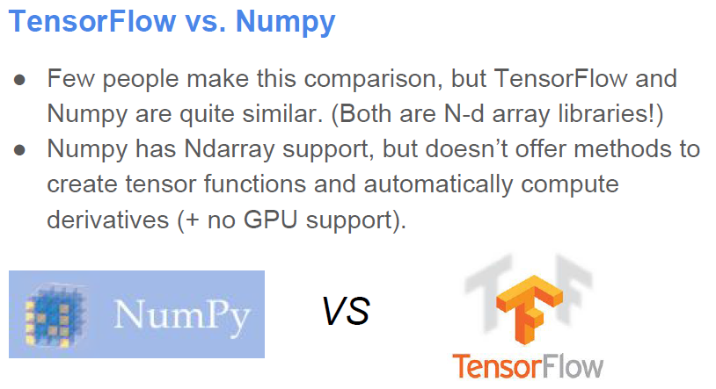
Why Tensorflow
Notes:
Sometimes, most data wins. So, how to get more data? Even with AMT, often slow and expensive.

Slide 20
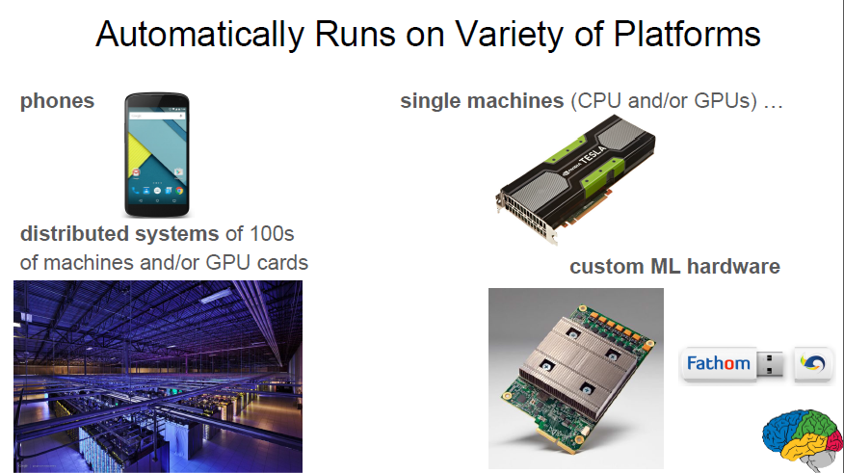
Why Tensorflow
Notes:
Sometimes, most data wins. So, how to get more data? Even with AMT, often slow and expensive.

Slide 21
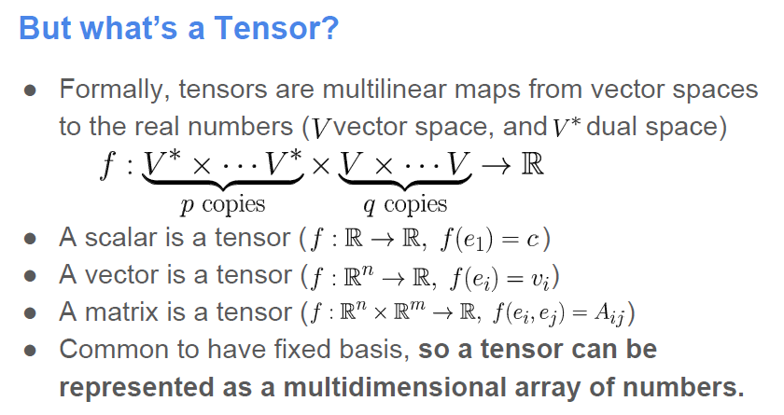
Basics of Tensorflow
Notes:
Sometimes, most data wins. So, how to get more data? Even with AMT, often slow and expensive.

Slide 22
Basics of Tensorflow
Tensors: n-dimensional arrays
Vector: 1-D tensor
Scalar: 0-D tensor
Matrix: 2-D tensor
Deep Learning process →→ flow of tensors
Notes:
Sometimes, most data wins. So, how to get more data? Even with AMT, often slow and expensive.

Slide 23
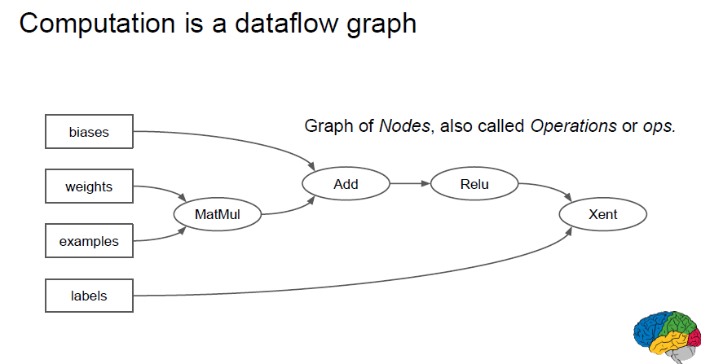
Basics of Tensorflow
Tensors: n-dimensional arrays
Vector: 1-D tensor
Scalar: 0-D tensor
Matrix: 2-D tensor
Deep Learning process →→ flow of tensors
Notes:
Sometimes, most data wins. So, how to get more data? Even with AMT, often slow and expensive.

Slide 24
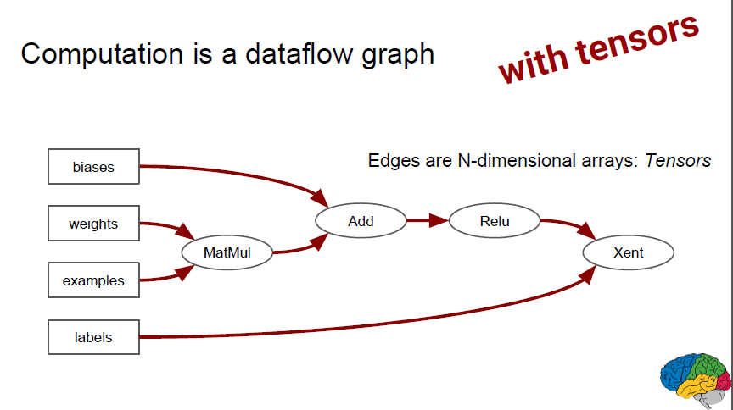
Basics of Tensorflow
Tensors: n-dimensional arrays
Vector: 1-D tensor
Scalar: 0-D tensor
Matrix: 2-D tensor
Deep Learning process →→ flow of tensors
Notes:
Sometimes, most data wins. So, how to get more data? Even with AMT, often slow and expensive.

Slide 25
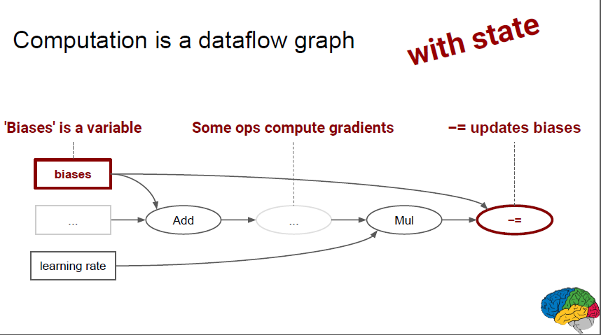
Basics of Tensorflow
Tensors: n-dimensional arrays
Vector: 1-D tensor
Scalar: 0-D tensor
Matrix: 2-D tensor
Deep Learning process →→ flow of tensors
Notes:
Sometimes, most data wins. So, how to get more data? Even with AMT, often slow and expensive.

Slide 26
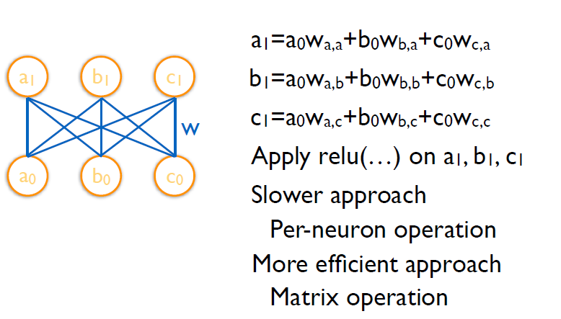
Basics of Tensorflow
Example:
Notes:
Sometimes, most data wins. So, how to get more data? Even with AMT, often slow and expensive.

Slide 27
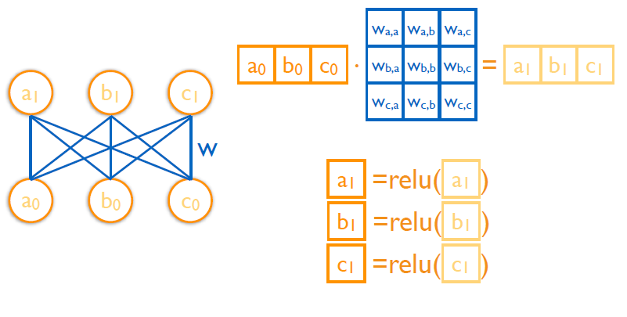
Basics of Tensorflow
Example:
Notes:
Sometimes, most data wins. So, how to get more data? Even with AMT, often slow and expensive.

Slide 28
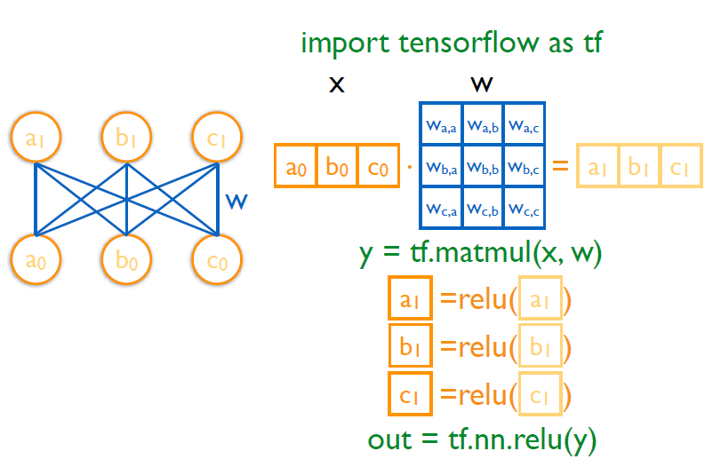
Basics of Tensorflow
Example:
Notes:
Sometimes, most data wins. So, how to get more data? Even with AMT, often slow and expensive.

Slide 29
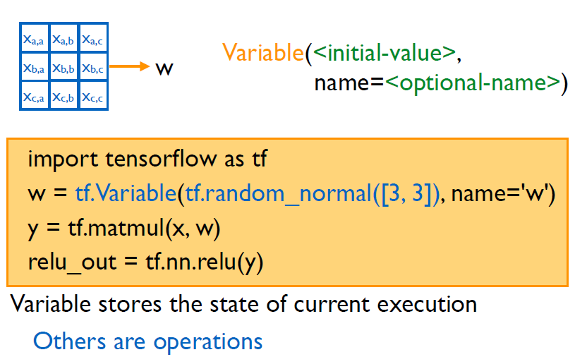
Basics of Tensorflow
Example:
Notes:
Sometimes, most data wins. So, how to get more data? Even with AMT, often slow and expensive.

Slide 30
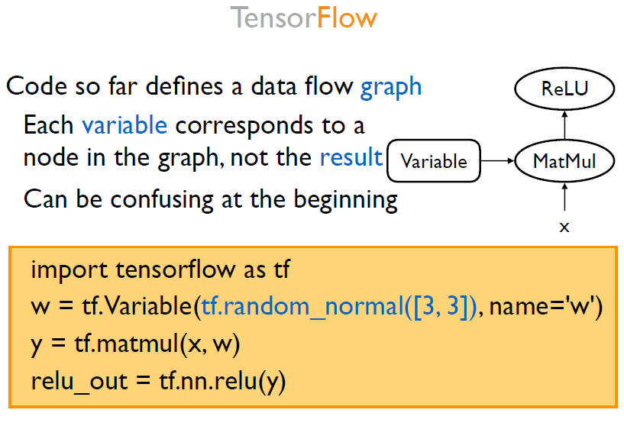
Basics of Tensorflow
Notes:
Sometimes, most data wins. So, how to get more data? Even with AMT, often slow and expensive.

Slide 31
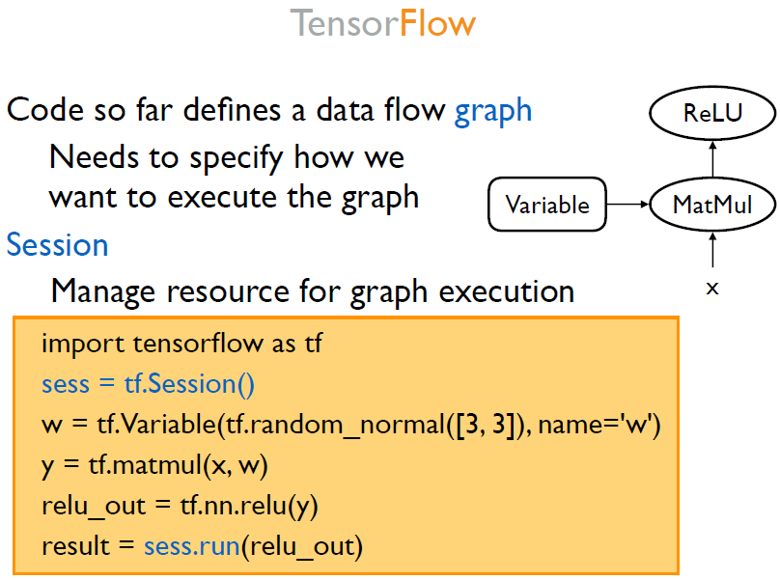
Basics of Tensorflow
Notes:
Sometimes, most data wins. So, how to get more data? Even with AMT, often slow and expensive.

Slide 32
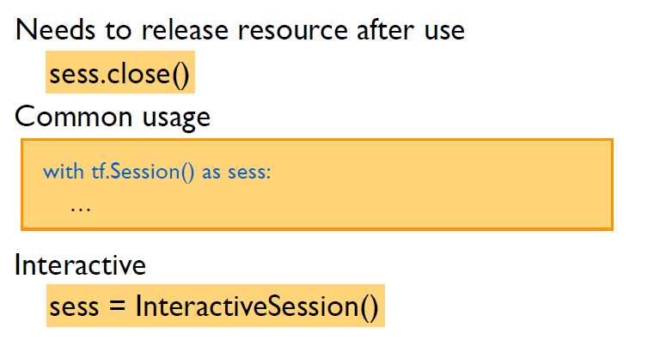
Basics of Tensorflow
Notes:
Sometimes, most data wins. So, how to get more data? Even with AMT, often slow and expensive.

Slide 33
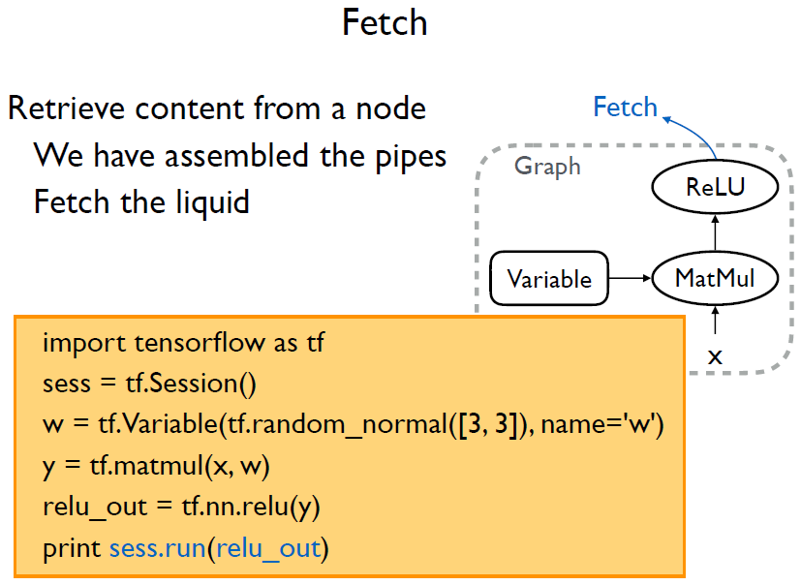
Basics of Tensorflow
Notes:
Sometimes, most data wins. So, how to get more data? Even with AMT, often slow and expensive.

Slide 34
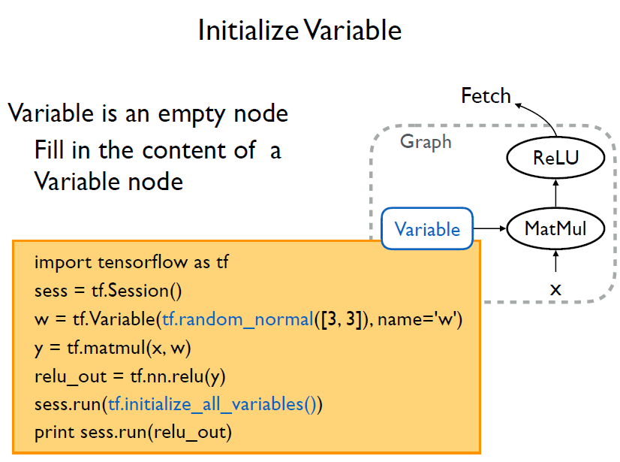
Basics of Tensorflow
Notes:
Sometimes, most data wins. So, how to get more data? Even with AMT, often slow and expensive.

Slide 35
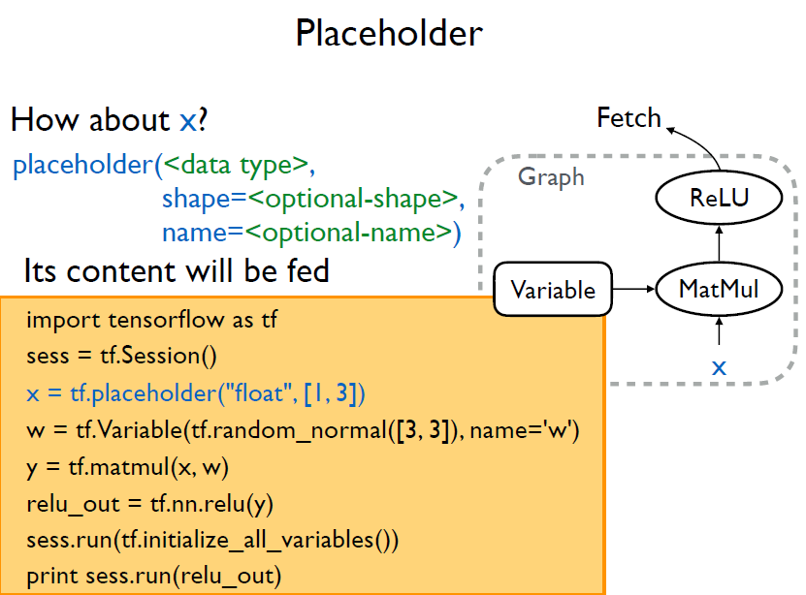
Basics of Tensorflow
Notes:
Sometimes, most data wins. So, how to get more data? Even with AMT, often slow and expensive.

Slide 36
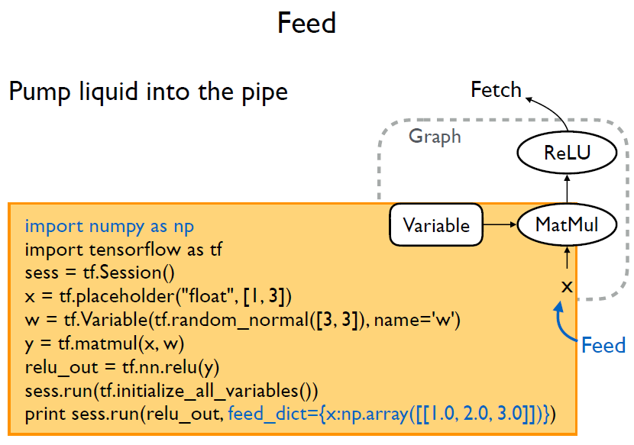
Basics of Tensorflow
Notes:
Sometimes, most data wins. So, how to get more data? Even with AMT, often slow and expensive.

Slide 37
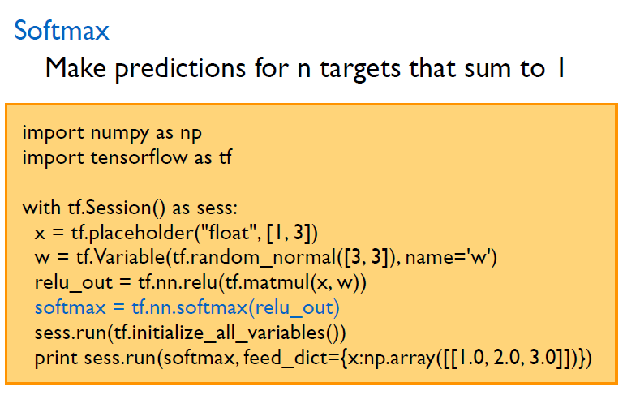
Basics of Tensorflow
Notes:
Sometimes, most data wins. So, how to get more data? Even with AMT, often slow and expensive.

Slide 38
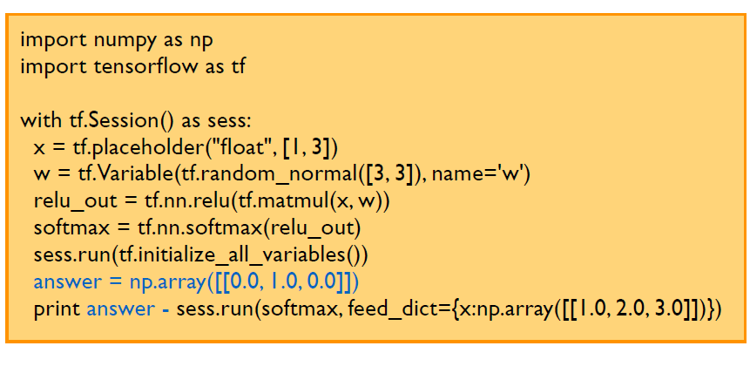
Basics of Tensorflow
Notes:
Sometimes, most data wins. So, how to get more data? Even with AMT, often slow and expensive.

Slide 39
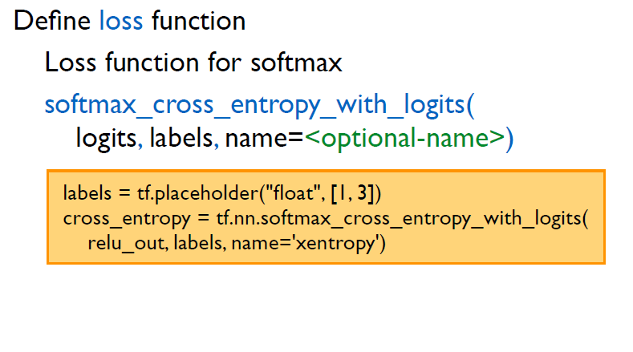
Basics of Tensorflow
Notes:
Sometimes, most data wins. So, how to get more data? Even with AMT, often slow and expensive.

Slide 40
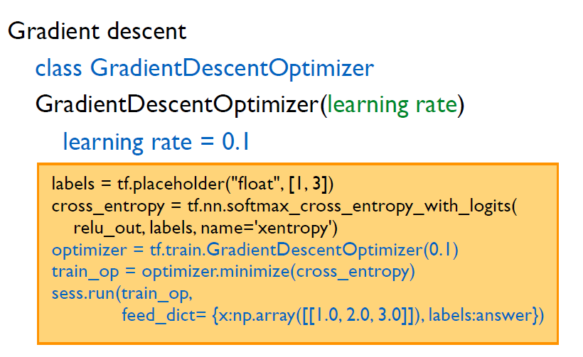
Basics of Tensorflow
Notes:
Sometimes, most data wins. So, how to get more data? Even with AMT, often slow and expensive.

Slide 41
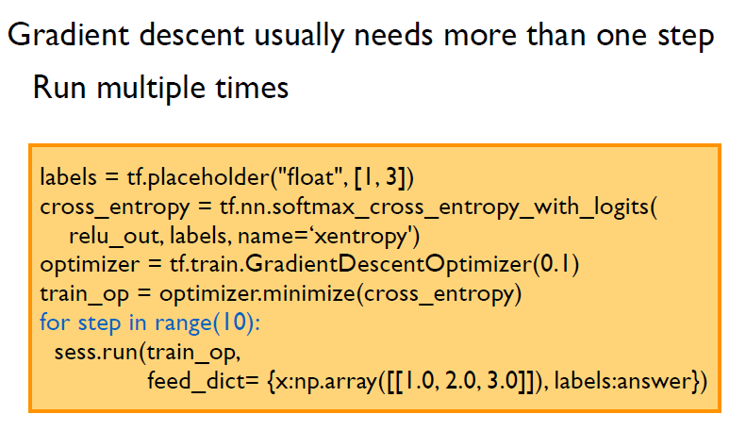
Basics of Tensorflow
Notes:
Sometimes, most data wins. So, how to get more data? Even with AMT, often slow and expensive.

Slide 42
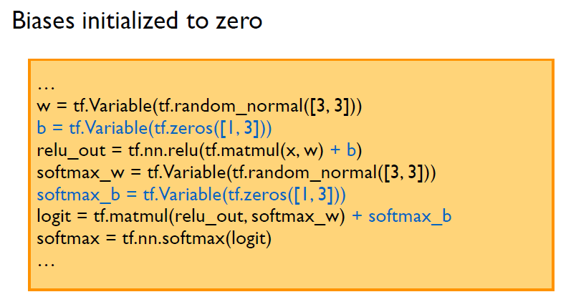
Basics of Tensorflow
Notes:
Sometimes, most data wins. So, how to get more data? Even with AMT, often slow and expensive.

Slide 43
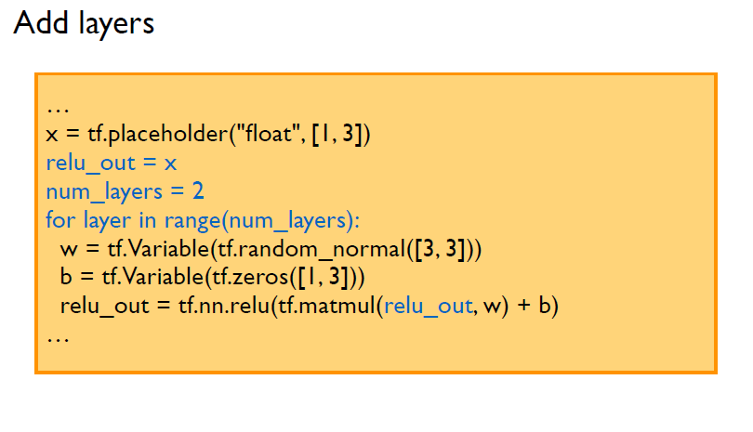
Basics of Tensorflow
Notes:
Sometimes, most data wins. So, how to get more data? Even with AMT, often slow and expensive.

Slide 44
Advances of Tensorflow

Slide 45
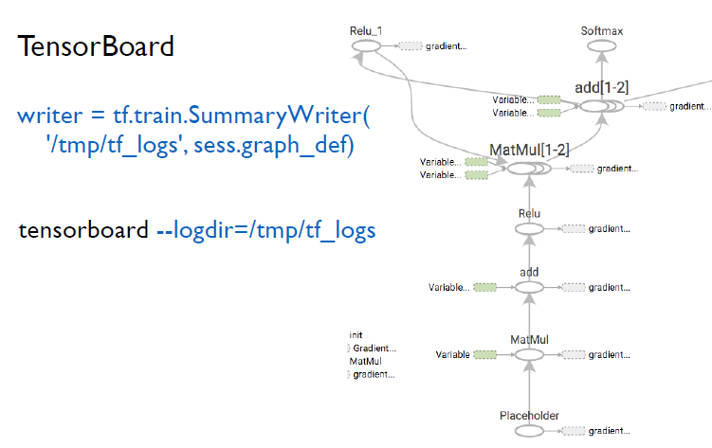
Basics of Tensorflow
Notes:
Sometimes, most data wins. So, how to get more data? Even with AMT, often slow and expensive.

Slide 46
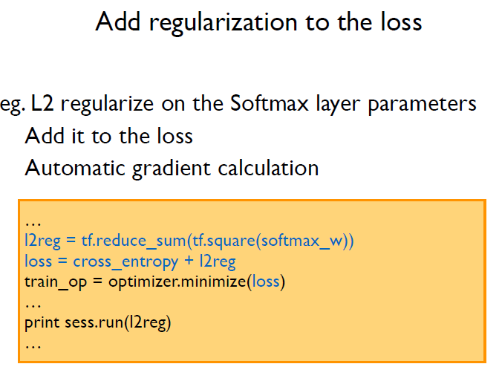
Basics of Tensorflow
Notes:
Sometimes, most data wins. So, how to get more data? Even with AMT, often slow and expensive.

Slide 47
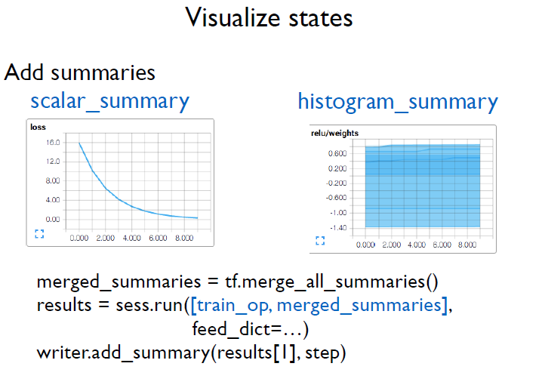
Basics of Tensorflow
Notes:
Sometimes, most data wins. So, how to get more data? Even with AMT, often slow and expensive.

Slide 48
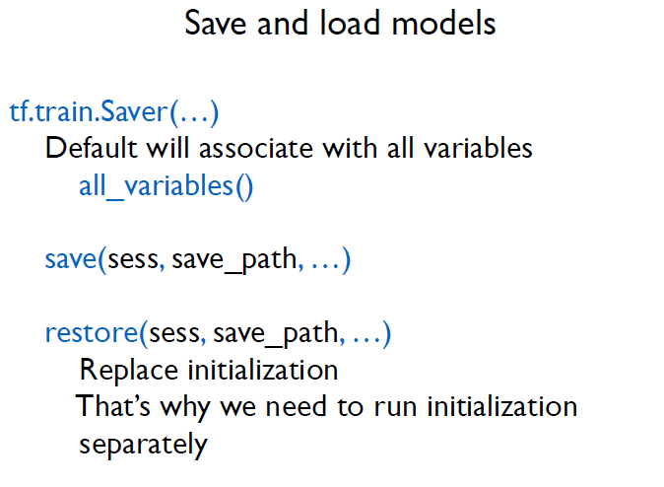
Basics of Tensorflow
Notes:
Sometimes, most data wins. So, how to get more data? Even with AMT, often slow and expensive.

Slide 49
Examples 2
Mnist with 3 version imps.

