Slide 1





Machine Learning with TensorFlow
Harini Gunabalan
@harinigunabalan
harinigunabalan.github.io

Slide 2
What is Machine Learning?
Evolved from pattern recognition and computational learning theory
Subfield of artificial intelligence
Study of algorithms that iteratively learn from data
Make predictions
Finds hidden insights without explicit programming

Slide 3
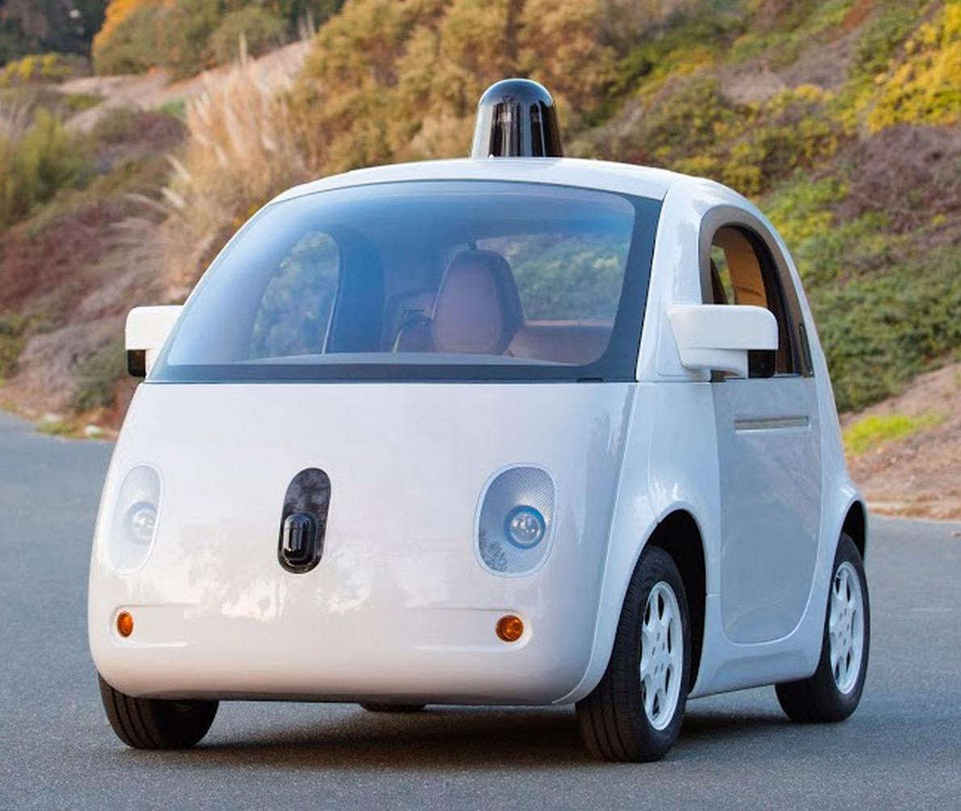
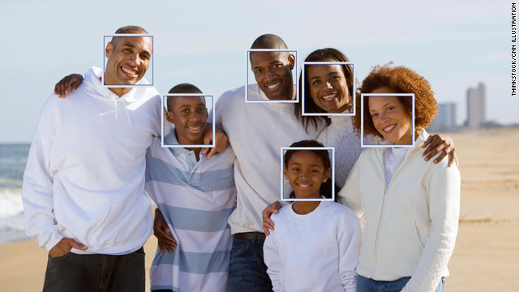
Machine Learning Examples
Applications that cannot be programmed by hand (Machine needs to learn!)
Self-driving cars
Handwriting Recognition, Image Processing, Face Recognition
Computer Vision, Natural Language Processing
http://www.extremetech.com/extreme/197262-its-2015-self-driving-cars-are-more-than-a-promise http://edition.cnn.com/2010/TECH/innovation/07/09/face.recognition.facebook/

Slide 4
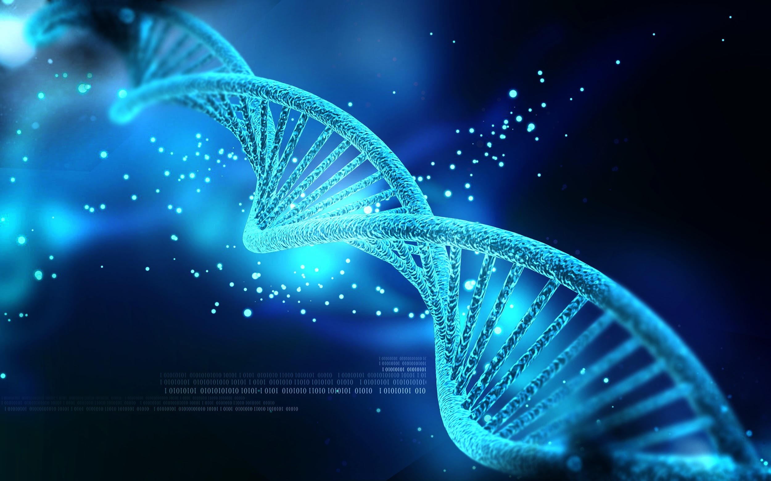
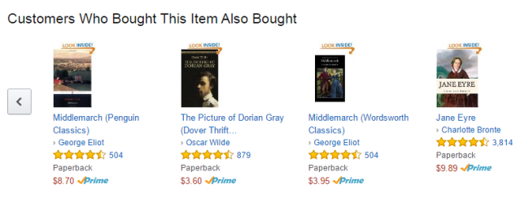
Machine Learning Examples (contd.)
Database Mining
Web Click Data (Clickstreams) from Web Analytics
Medical Records / Biological Data
Self Customizing Programs
Google Ads, Amazon product recommendations
http://www.woothemes.com/2015/05/personalized-product-recommendations/ https://sites.psu.edu/siowfa15/2015/09/02/dna-discovering-who-we-are/

Slide 5
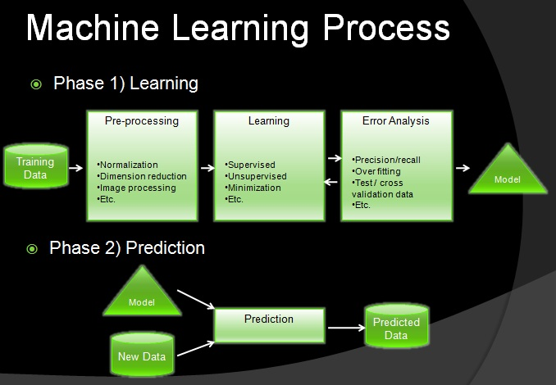
Machine Learning (contd.)
source: https://adnanboz.wordpress.com/

Slide 6
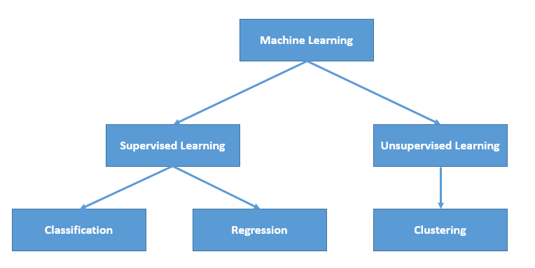
Machine Learning (contd.)
source: https://cuteprogramming.wordpress.com/2015/05/24/machine-learning-in-microsoft-azure/

Slide 7

Supervised Learning
The labelled data (metrics) is already given to the computer
The data points are provided to the machine
Image Label: 5
Solves 2 types of problems
Regression problems: Target variable is continuous
Classification problems: Target variable is categorical

Slide 8
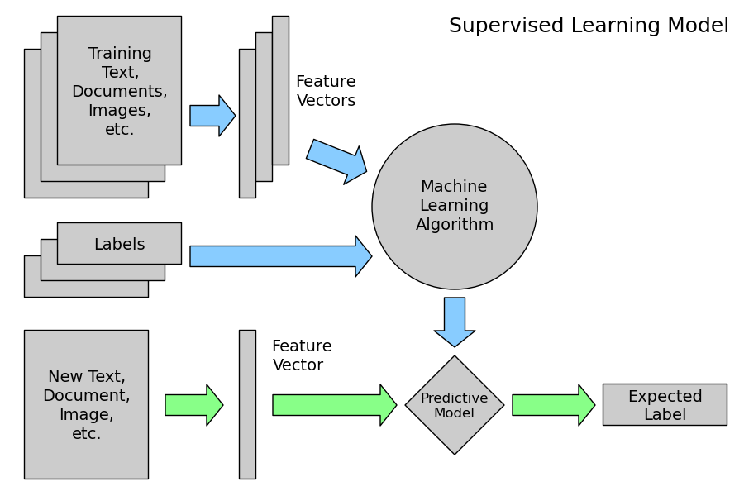
Supervised Learning (contd.)
source: http://www.astroml.org/sklearn_tutorial/general_concepts.html

Slide 9
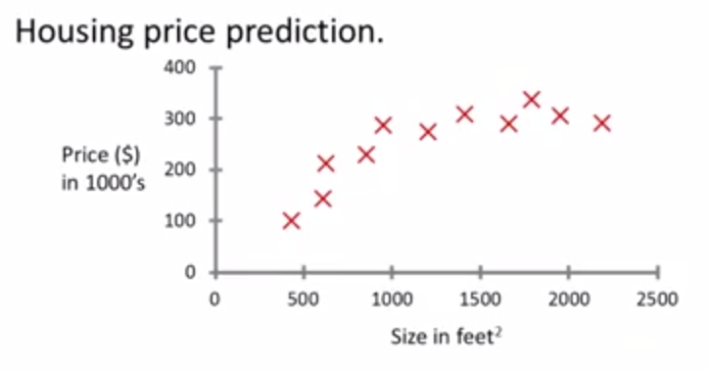
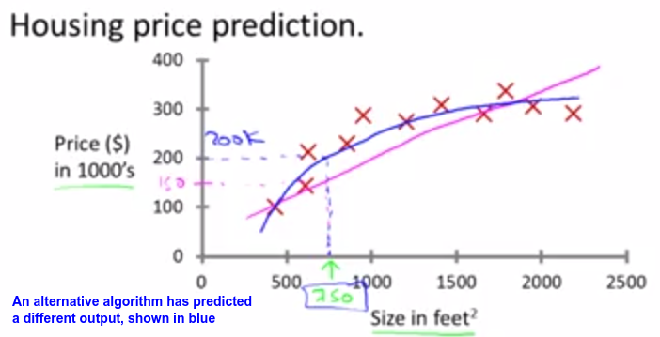
Regression Problem: Housing Price Prediction
source: http://cseav.blogspot.de/2015/04/machine-learning-and-types-of-learning.html

Slide 10

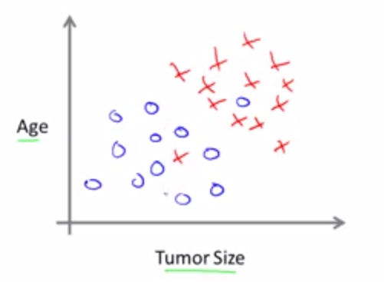
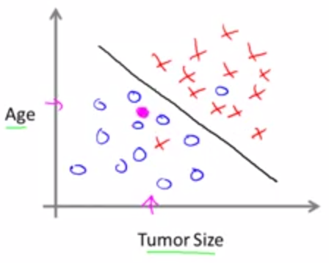
Classification Problem: Cancer Type Prediction
Features for Classification:
Tumor Size
Tumor Size and Age
source: http://cseav.blogspot.de/2015/04/machine-learning-and-types-of-learning.html

Slide 11
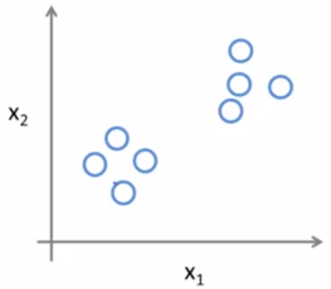
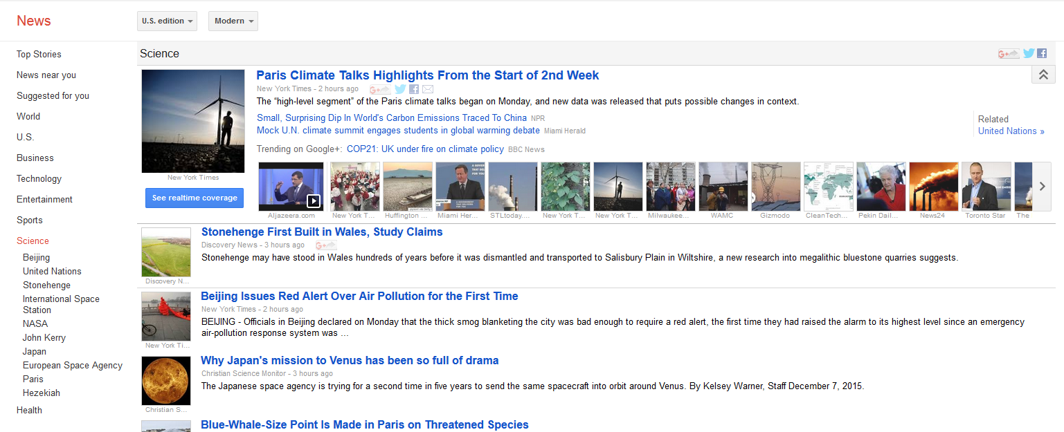
Unsupervised Learning
Finding hidden structures in Datasets without any labels
Data is clustered using several clustering algorithms
Examples: Google News, Social Network Analysis
source: http://news.google.com

Slide 12
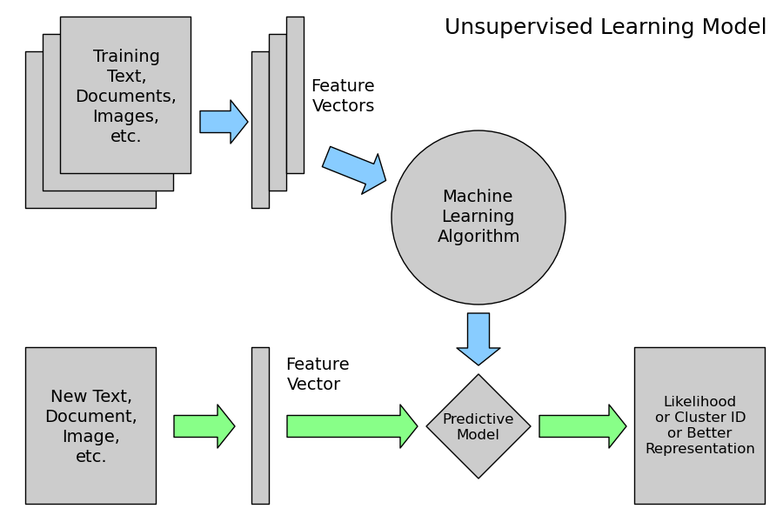
Unsupervised Learning (contd.)
source: http://www.astroml.org/sklearn_tutorial/general_concepts.html

Slide 13
What is TensorFlow?
An Open Source Machine Learning Library
Developed by the Google Brain team, inspired by how the Human Brain works
C++ / Python
Scalable: models run on phones, computers and distributed systems
For numeric computation using Data Flow Graphs

Slide 14
TensorFlow
Tensor (Data)
N Dimensional Array
1-D Vector; 2-D Array Matrix
Example: Image represented as 3D tensor: rows, columns and color
Flow (Operations)
Operations applied to data flowing through
TensorFlow Data Flow Graph:
Nodes: Operations
Edges: Data (Tensors)

Slide 15
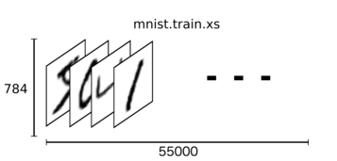
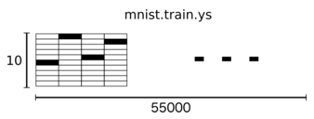
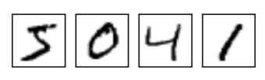
MNIST Example (Predict the Number in the Image)
Download and Import the MNIST DataSet.
The Dataset is split into
Training (55,000)
Testing Data (10,000)
Each dataset has an Image (xs) and a Label (ys)
Image is represented as 28x28 matrix
Matrix flattened: 28*28 = 784
Hence mnist.train.images corresponds to [55000, 784]
And the labels, mnist.train.labels corresponds to [55000,10]

Slide 16
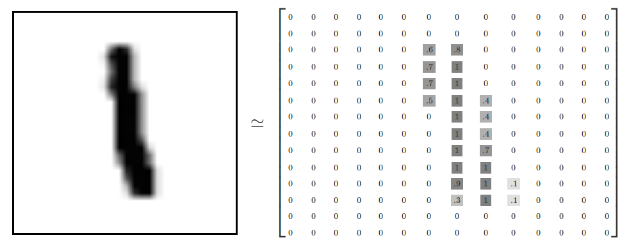
MNIST Example (Predict the Number in the Image)
source: https://www.tensorflow.org/versions/master/tutorials/mnist/beginners/index.html

Slide 17
MNIST Example (contd.)
Softmax Regression:
expressing the output as probabilities for each classification label
Example: Image 8 could be expressed as 80% as 8, 5% as 9 etc.
y = softmax (Wx + b),
where W is the weights and b is the bias
Cross Entropy: Measurement of how bad the model is. Minimize Cross-Entropy.
Cross Entropy = −∑y′log(y) , where y′ is the actual distribution and y is the predicted distribution

Slide 18
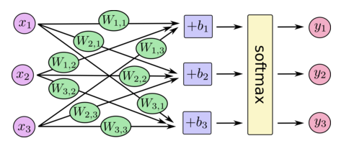
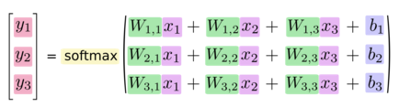
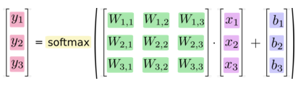
MNIST Example (contd.)
Softmax Regression

Slide 19
TensorFlow Tutorial
Try it yourself on tensorflow.org! :-)
Demo time!

Slide 20
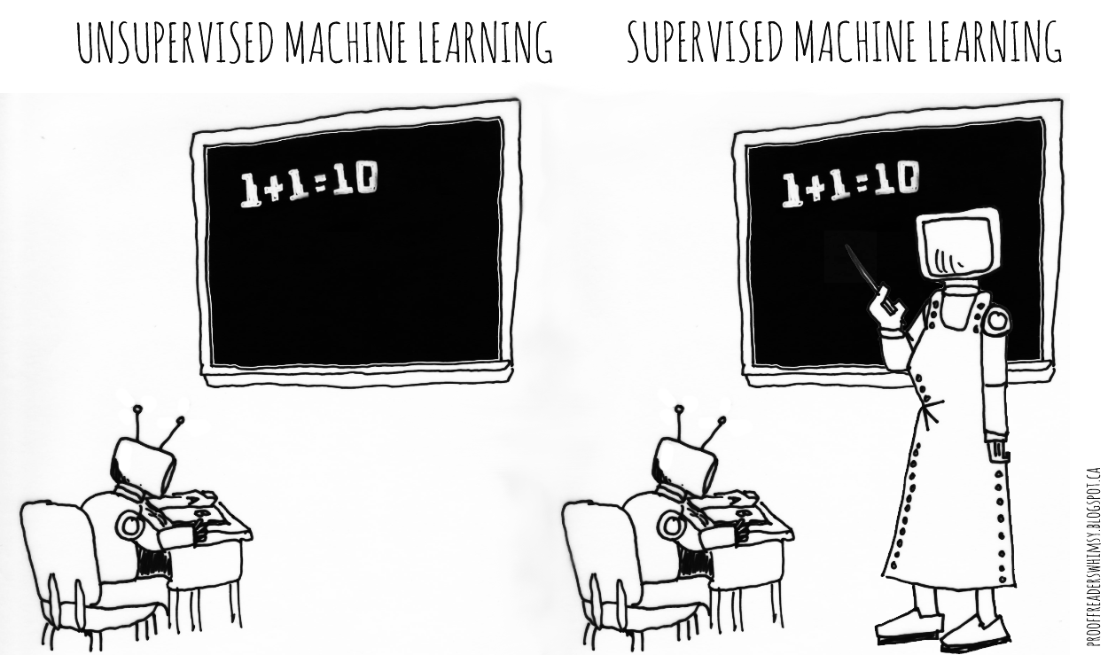
Thank You!
Special thanks to GDG Organizers, Techettes Frankfurt, Verena, Daniela Zimmermann, Jochen Bachmann, Marc Reichelt, Hariharan Gandhi

Slide 21
References
Coursera Machine Learning - https://www.coursera.org/learn/machine-learning
Wikipedia - https://en.wikipedia.org/wiki/Machine_learning
http://static.googleusercontent.com/media/research.google.com/en//people/jeff/BayLearn2015.pdf
https://www.tensorflow.org/

