Slide 1
Heng Shi University of Bath
Deep Learning
Tutorials

Slide 2
Contents
Workstation Guide
Big Data Platform
Basics of Tensorflow
TF advanced Features
Code Example Reading: DRNN

Slide 3
Workstation
Guide

Slide 4
Remote Connection
About remote working
Note 1: desktop only controlled by one person at a time, but programs with multiple users can run as backends, linux version support multiple users with desktop
Note 2: off campus need to connect to VPN first. VPN set up can be found at http://www.bath.ac.uk/bucs/networking/connectfromhome/vpn/
138.38.64.38x
Call out ‘Run’ box: ‘win + R’
Run ‘mstsc’
Hostname: eepc-0104
Windows → Windows (workstation)
Notes:
Sometimes, most data wins. So, how to get more data? Even with AMT, often slow and expensive.

Slide 5
Remote Connection
Windows → Xubuntu (workstation)
Preinstall 1: Xming
Preinstall 2: Kitty (Windows version of Putty)
Run Xlaunch, keep clicking next
Run KiTTy, hostname: eepc-0104, SSH → X11 → enabled
Linux → Xubuntu (workstation)
Preinstall 1: Putty
Sudo apt-get update
Sudo apt-get install putty
Run ‘putty’ at terminal
Notes:
Sometimes, most data wins. So, how to get more data? Even with AMT, often slow and expensive.

Slide 6
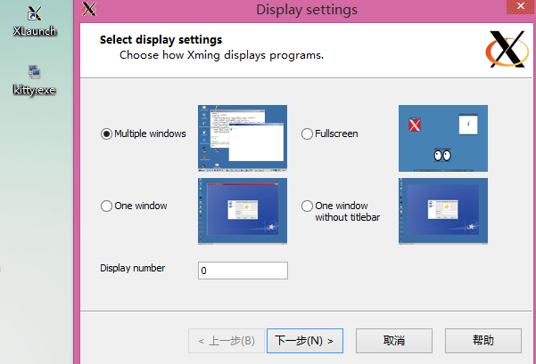
Remote Connection

Slide 7
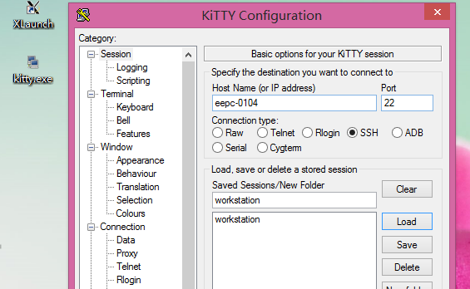
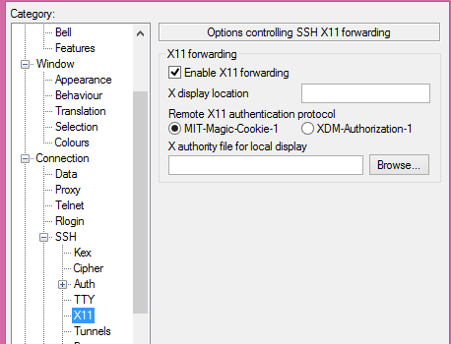
Remote Connection

Slide 8
Big Data Platform
Basic Concepts
Data Analytic Programming Language: python 2.7
Numerical package: Numpy (matlab)
Data management package: Pandas (database)
Data visualization: Matplotlib
Interactive programming IDE: jupyter notebook
Package install manager: conda
Deep learning platform: tensorflow
GPU driver: CUDA
Code version control: git
Notes:
Sometimes, most data wins. So, how to get more data? Even with AMT, often slow and expensive.

Slide 9
Big Data Platform
Hardware platform (Xubuntu)
Virtualenv - (Tensorflow)
Python 2.7/numpy…
xubuntu 14.04
Xeon E5-2697
Nvidia m6000
Jupyter Notebook(IDE)
56 cores
24G graphic memory
Notes:
Sometimes, most data wins. So, how to get more data? Even with AMT, often slow and expensive.

Slide 10
Big Data Platform
Software platform
CUDA/Numpy/Pandas/Tensorflow/python/Jupyter Notebook
Tensorflow
Python Interface
CUDA
Numpy
Pandas
Data
CPU
GPU
Jupyter Notebook(Interactive)
Notes:
Sometimes, most data wins. So, how to get more data? Even with AMT, often slow and expensive.

Slide 11
Start working
1. Either at kitty/putty terminal or open a terminal: ‘Ctrl + Alt + T’
2. Change into shared drive D: ‘cd /mnt/D’ + ‘tab’
3. Change into project directory: ‘cd github/’
4. Initiate TF platform: ‘source activate tensorflow’
5. open Jupyter notebook ‘jupyter notebook’
6. Edit code, SAVE AND EXIT
7. Use git to commit code revision. Log code versions.
Notes:
Sometimes, most data wins. So, how to get more data? Even with AMT, often slow and expensive.

Slide 12

Python and IPython
Python vs Matlab ($>$)
1. readable
use tab, no need to use ‘end’
20% short in implementation
2. Beautiful syntax
0-based index
use [] for index, () for function call
3. OOP in python is simple and elegant
4. More efficient, and better parallel and devices support
Notes:
Sometimes, most data wins. So, how to get more data? Even with AMT, often slow and expensive.

Slide 13

Python and IPython
Python vs Matlab ($>$)
5. Free and open-source
debug from source
canopy and anaconda (with N,P,M)
support by any developer
6. Visualizaion
matplotlib academic level 2/3-D graph
QT, Traits, Wx create production level UI Chaco create interactive graph
Notes:
Sometimes, most data wins. So, how to get more data? Even with AMT, often slow and expensive.

Slide 14

Python and IPython
Python vs R ($≈)$
Pro:
Beautiful visualization with ggplot2,ggvis,googlevis and rCharts
Huge ecosystem
Quick to use if package available
No need to learn programming
No OOP, No database, No parallel programming
But, not efficient
Not easy to automate workflow, and reuse code
Notes:
Sometimes, most data wins. So, how to get more data? Even with AMT, often slow and expensive.

Slide 15

Python and IPython
Python vs R ($≈)$
Python:
Ipython Notebook, super readable research notes
Easy to automate workflow, reuse code:
Multi purpose language, can merge differing backgrounp, perfect for team play.
General purpose language, production level quality, easy to test, guarantee the reusable and dependable.
Extendable for DIY algorithms
Much more efficient
Notes:
Sometimes, most data wins. So, how to get more data? Even with AMT, often slow and expensive.

Slide 16
Python and IPython
Suggest:
Result-flow, one-off tasks use R/M
Analyse correlations
Decompose load profiles
Probabilistic distribution fit
Linear regression
Data-flow, complex, multi-stage task, P
Novel and complex algorithms not publically available, such as Deep Learning
Etc…

Slide 17
GIT new project
Create dir: mkdir test/
cd dir: cd test/
Init git config: git init
Edit code, save files in test/
Track new added file: git add *
Commit code version: git commit –a –m “say sth”
Notes:
Sometimes, most data wins. So, how to get more data? Even with AMT, often slow and expensive.

Slide 18
GIT clone project
Clone from: git clone https://....
Add new code features: git branch feature
Switch to new branch: git checkout feature
git commit –a –m “new feature xx added”
When everything done,
Switch to master branch: git checkout master
Merge changes into master: git merge feature
Delete feature branch: git branch –d feature
Notes:
Sometimes, most data wins. So, how to get more data? Even with AMT, often slow and expensive.

Slide 19
GIT more feature
Look up version history: git log
Cancel code edit, or back to specific version: git revert xxxxxx (6 digits in log)
If project done or want to submit updates into web: git push origin master/feature
Notes:
Sometimes, most data wins. So, how to get more data? Even with AMT, often slow and expensive.

Slide 20
Basics of Tensorflow

Slide 21
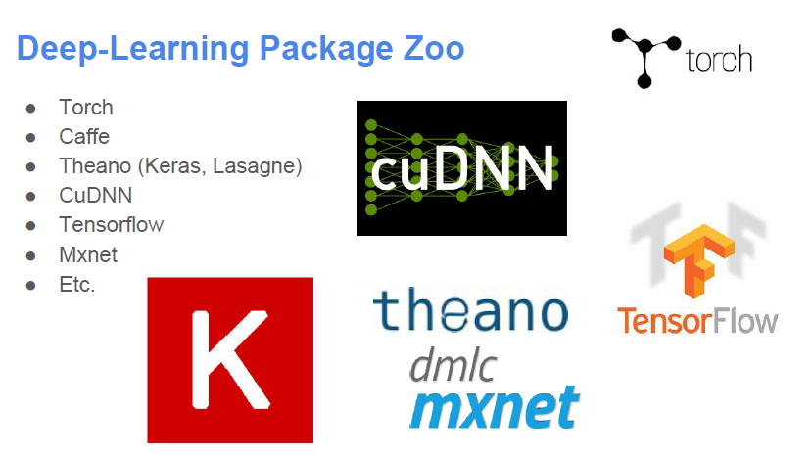
Why Tensorflow
Notes:
Sometimes, most data wins. So, how to get more data? Even with AMT, often slow and expensive.

Slide 22
Why Tensorflow
Features
Model specification:
Configuration files (Caffe, CNTK, etc.)
Generate by program (Torch, Tensorflow, Theano)
Interface Language:
Python: Theano, Tensorflow
Lua: Torch
Java: DL4J
…
Notes:
Sometimes, most data wins. So, how to get more data? Even with AMT, often slow and expensive.

Slide 23
Why Tensorflow
Advantage of Tensorflow
Python (Usain Bolt in Data Science)
Data manipulation packages: numpy,pandas…
More efficient than other script language: R
Glue language, most portable language, most comprehensive.
Support Ipython (interactive programming, easy to record experiments)
GPU support and easy setting.
Graph computing, easy to extend network model
Support by Google team, reliable.
etc
Notes:
Sometimes, most data wins. So, how to get more data? Even with AMT, often slow and expensive.

Slide 24
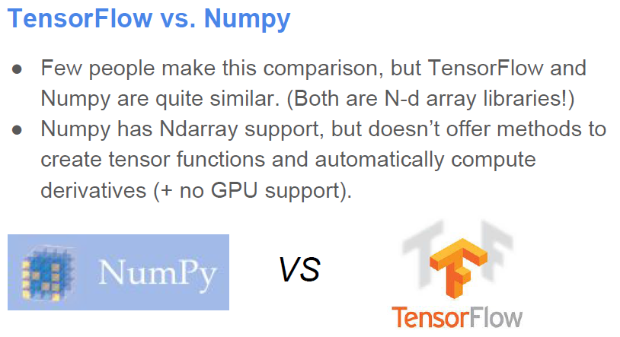
Why Tensorflow
Notes:
Sometimes, most data wins. So, how to get more data? Even with AMT, often slow and expensive.

Slide 25
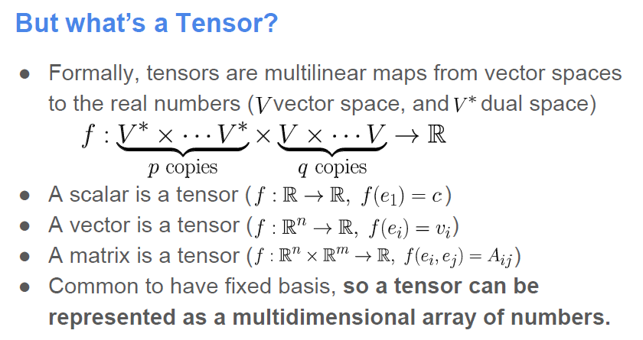
Basics of Tensorflow
Notes:
Sometimes, most data wins. So, how to get more data? Even with AMT, often slow and expensive.

Slide 26
Basics of Tensorflow
Tensors: n-dimensional arrays
Vector: 1-D tensor
Scalar: 0-D tensor
Matrix: 2-D tensor
Deep Learning process →→ flow of tensors
Notes:
Sometimes, most data wins. So, how to get more data? Even with AMT, often slow and expensive.

Slide 27
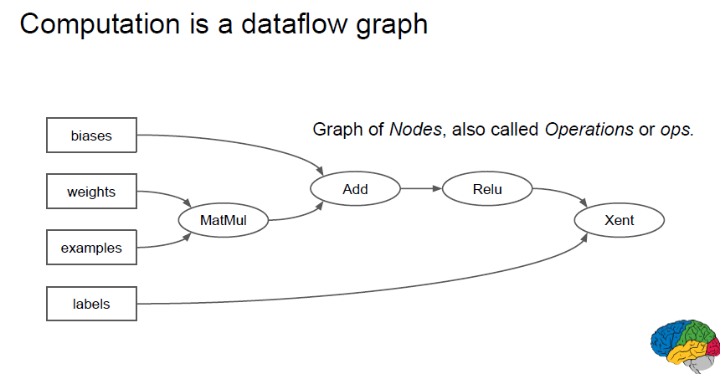
Basics of Tensorflow
Tensors: n-dimensional arrays
Vector: 1-D tensor
Scalar: 0-D tensor
Matrix: 2-D tensor
Deep Learning process →→ flow of tensors
Notes:
Sometimes, most data wins. So, how to get more data? Even with AMT, often slow and expensive.

Slide 28
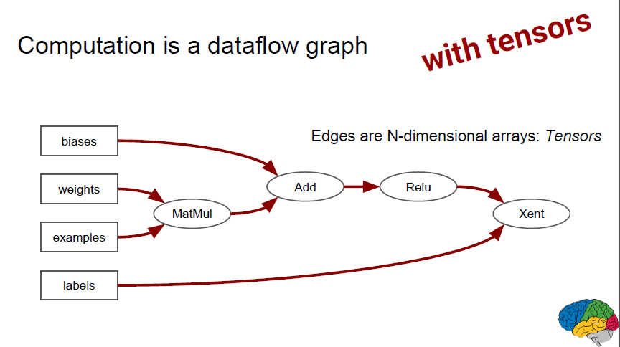
Basics of Tensorflow
Tensors: n-dimensional arrays
Vector: 1-D tensor
Scalar: 0-D tensor
Matrix: 2-D tensor
Deep Learning process →→ flow of tensors
Notes:
Sometimes, most data wins. So, how to get more data? Even with AMT, often slow and expensive.

Slide 29
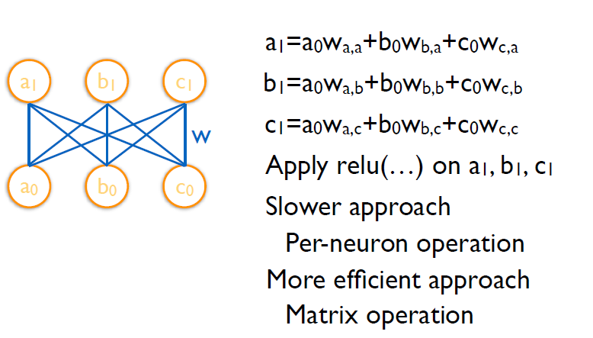
Basics of Tensorflow
Example:
Notes:
Sometimes, most data wins. So, how to get more data? Even with AMT, often slow and expensive.

Slide 30
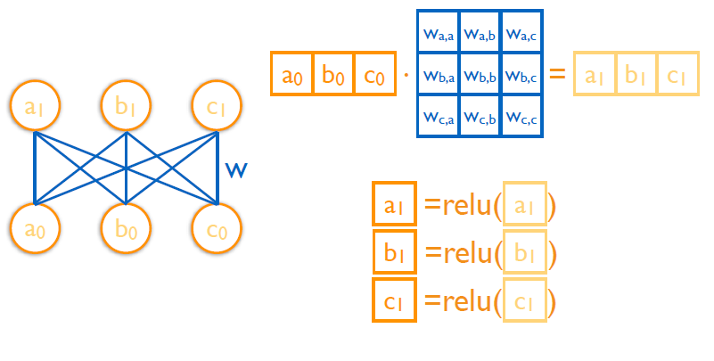
Basics of Tensorflow
Example:
Notes:
Sometimes, most data wins. So, how to get more data? Even with AMT, often slow and expensive.

Slide 31
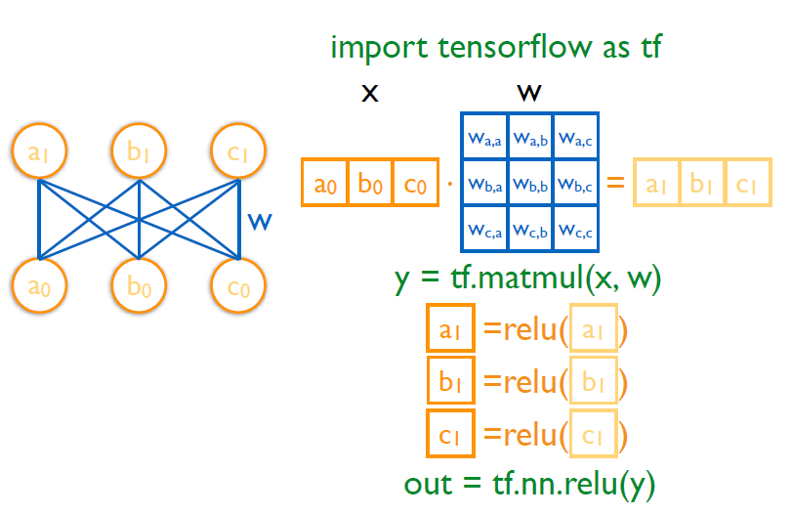
Basics of Tensorflow
Example:
Notes:
Sometimes, most data wins. So, how to get more data? Even with AMT, often slow and expensive.

Slide 32
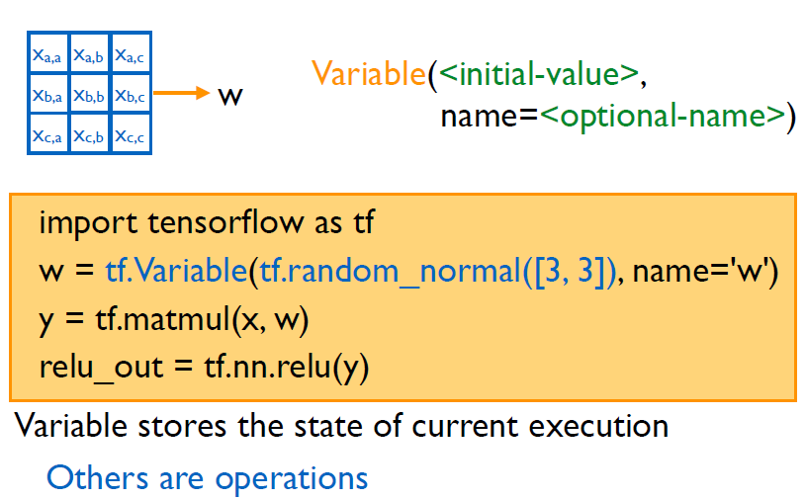
Basics of Tensorflow
Example:
Notes:
Sometimes, most data wins. So, how to get more data? Even with AMT, often slow and expensive.

Slide 33
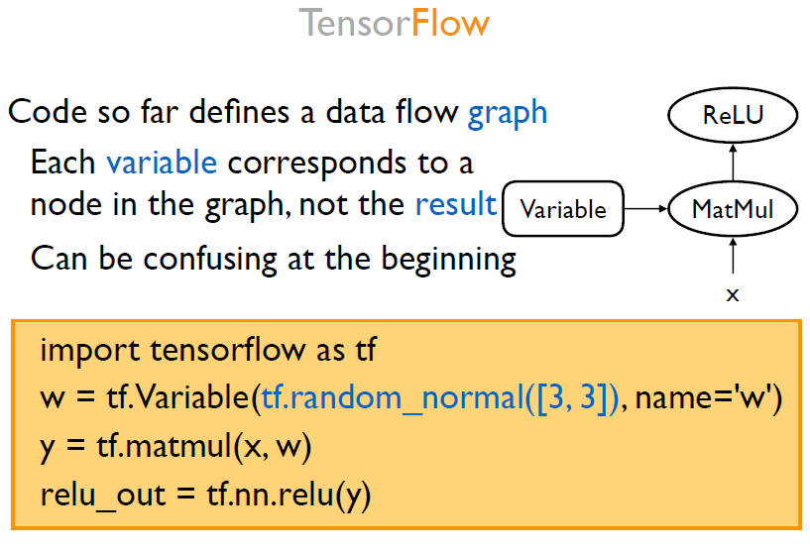
Basics of Tensorflow
Notes:
Sometimes, most data wins. So, how to get more data? Even with AMT, often slow and expensive.

Slide 34
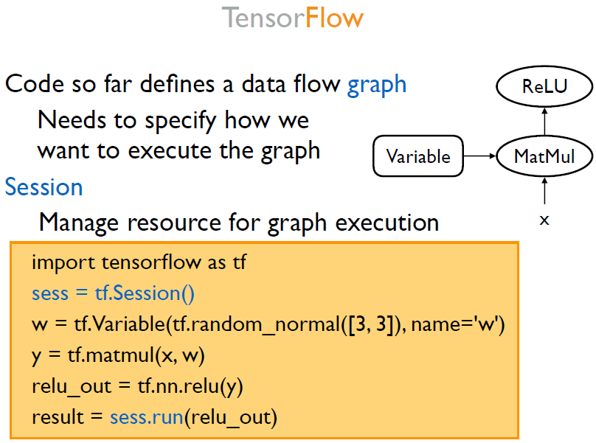
Basics of Tensorflow
Notes:
Sometimes, most data wins. So, how to get more data? Even with AMT, often slow and expensive.

Slide 35
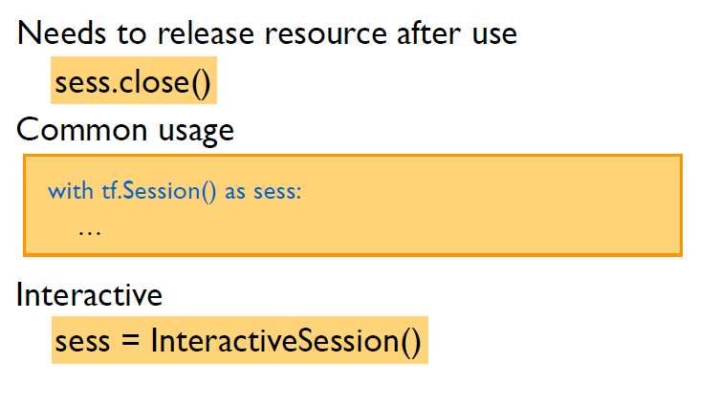
Basics of Tensorflow
Notes:
Sometimes, most data wins. So, how to get more data? Even with AMT, often slow and expensive.

Slide 36
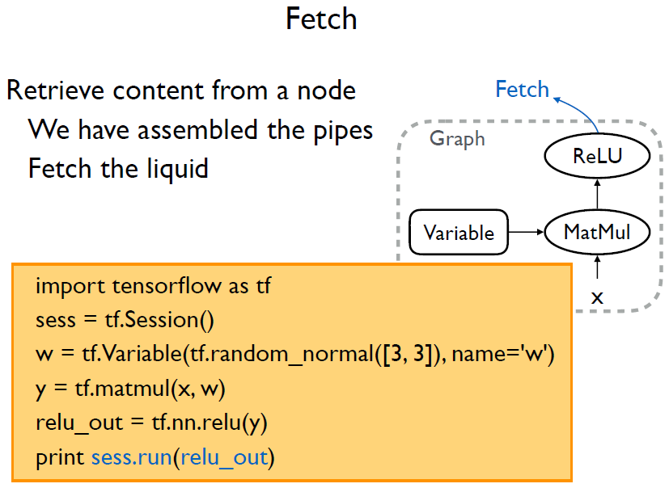
Basics of Tensorflow
Notes:
Sometimes, most data wins. So, how to get more data? Even with AMT, often slow and expensive.

Slide 37
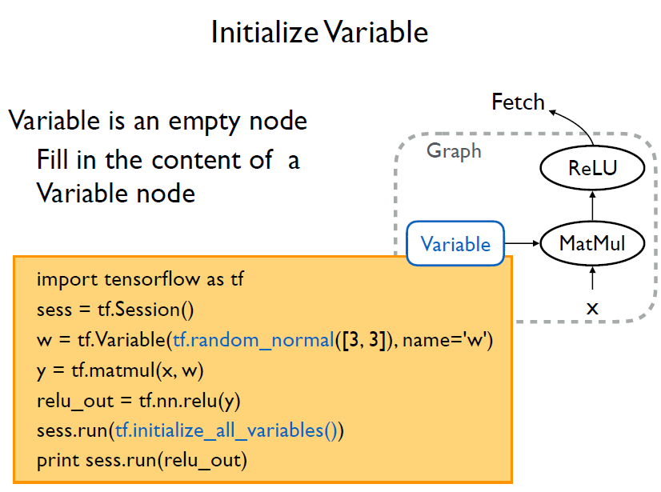
Basics of Tensorflow
Notes:
Sometimes, most data wins. So, how to get more data? Even with AMT, often slow and expensive.

Slide 38
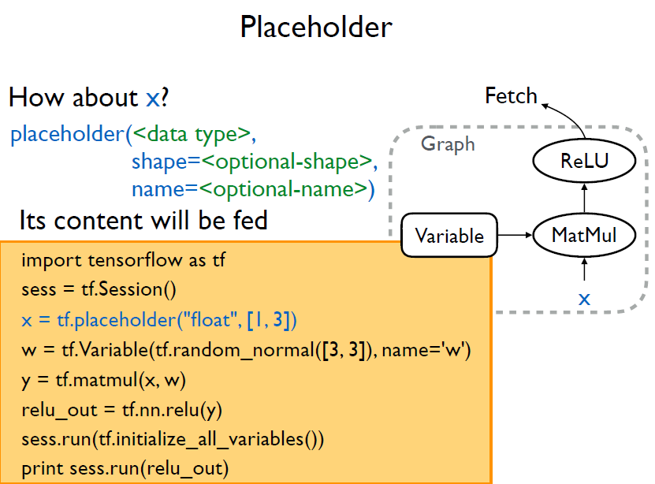
Basics of Tensorflow
Notes:
Sometimes, most data wins. So, how to get more data? Even with AMT, often slow and expensive.

Slide 39
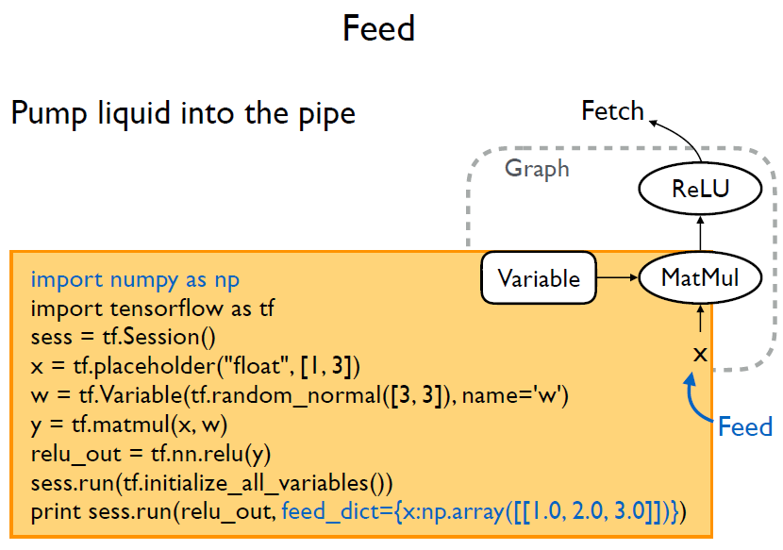
Basics of Tensorflow
Notes:
Sometimes, most data wins. So, how to get more data? Even with AMT, often slow and expensive.

Slide 40
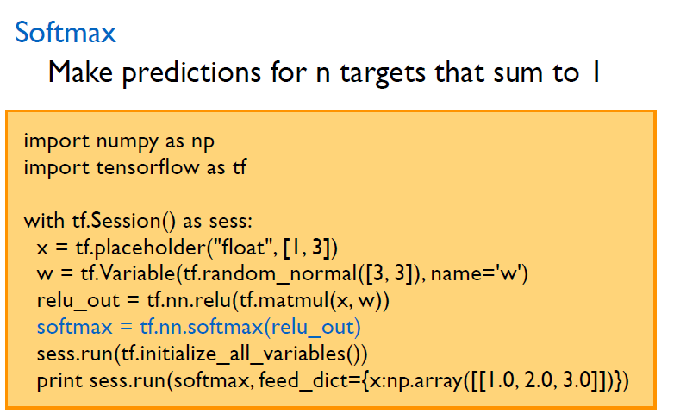
Basics of Tensorflow
Notes:
Sometimes, most data wins. So, how to get more data? Even with AMT, often slow and expensive.

Slide 41
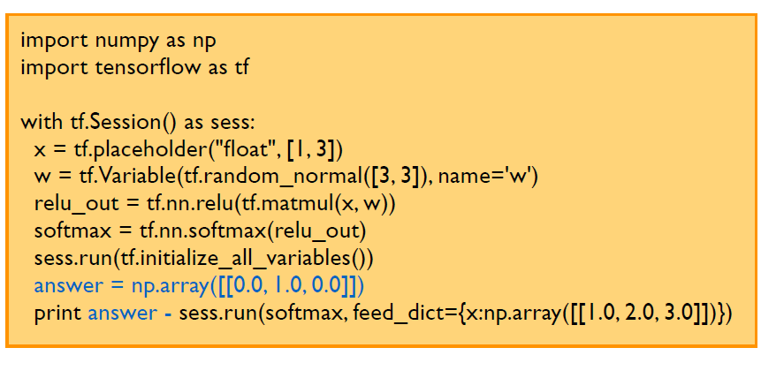
Basics of Tensorflow
Notes:
Sometimes, most data wins. So, how to get more data? Even with AMT, often slow and expensive.

Slide 42
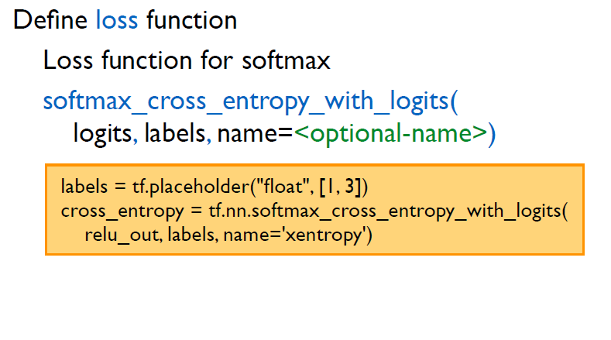
Basics of Tensorflow
Notes:
Sometimes, most data wins. So, how to get more data? Even with AMT, often slow and expensive.

Slide 43
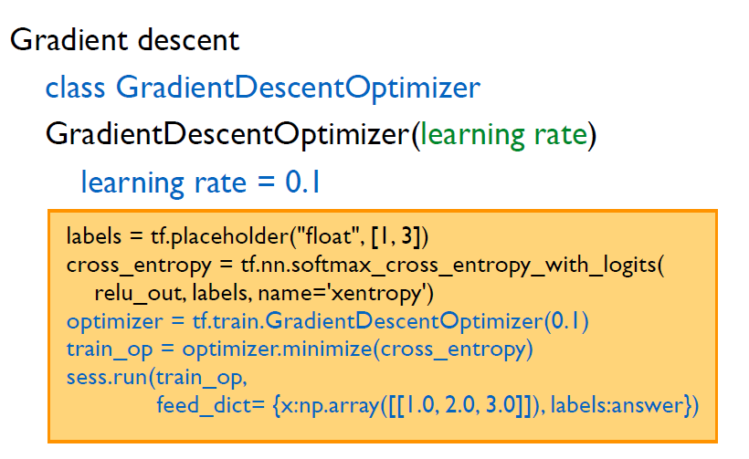
Basics of Tensorflow
Notes:
Sometimes, most data wins. So, how to get more data? Even with AMT, often slow and expensive.

Slide 44
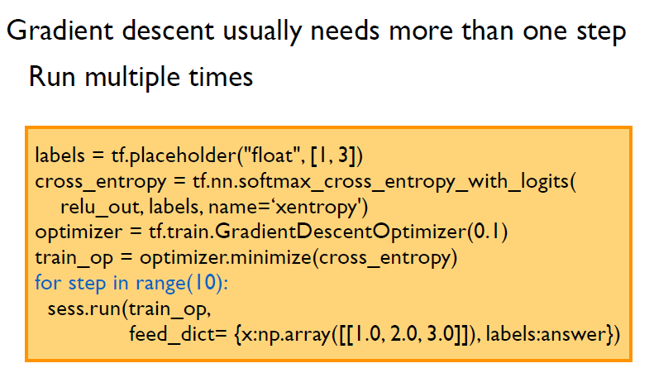
Basics of Tensorflow
Notes:
Sometimes, most data wins. So, how to get more data? Even with AMT, often slow and expensive.

Slide 45
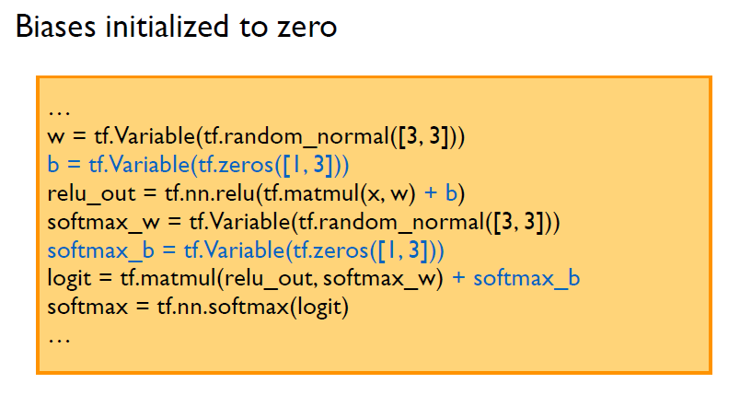
Basics of Tensorflow
Notes:
Sometimes, most data wins. So, how to get more data? Even with AMT, often slow and expensive.

Slide 46
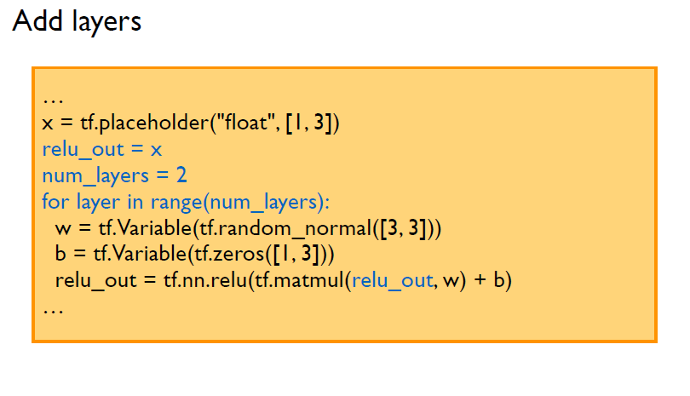
Basics of Tensorflow
Notes:
Sometimes, most data wins. So, how to get more data? Even with AMT, often slow and expensive.

Slide 47
TF advanced Features

Slide 48
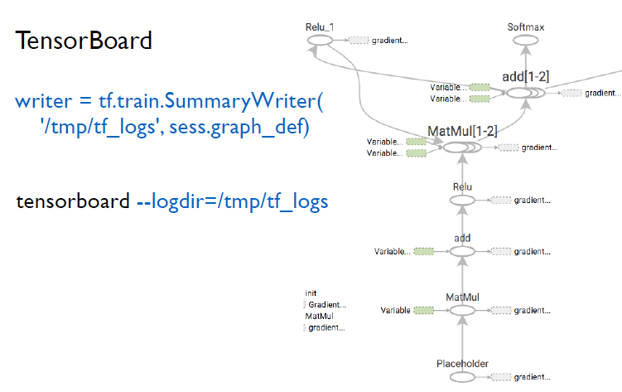
TF advanced Features
Notes:
Sometimes, most data wins. So, how to get more data? Even with AMT, often slow and expensive.

Slide 49
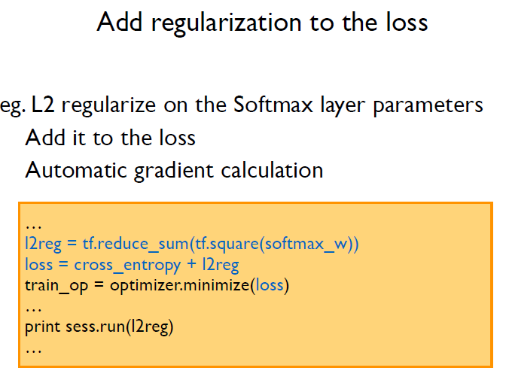
TF advanced Features
Notes:
Sometimes, most data wins. So, how to get more data? Even with AMT, often slow and expensive.

Slide 50
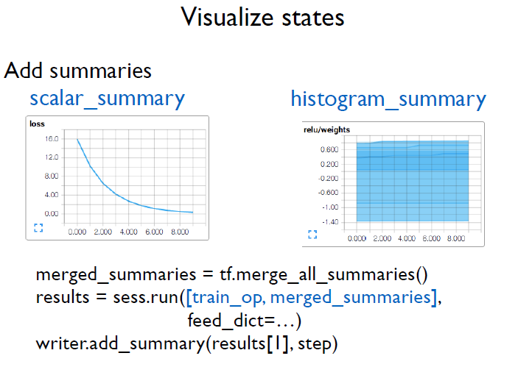
TF advanced Features
Notes:
Sometimes, most data wins. So, how to get more data? Even with AMT, often slow and expensive.

Slide 51
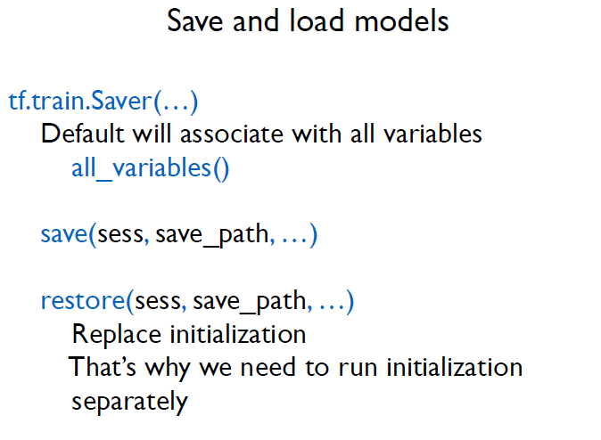
TF advanced Features
Notes:
Sometimes, most data wins. So, how to get more data? Even with AMT, often slow and expensive.

Slide 52
Examples 2
Mnist with 3 version imps.

