Slide 1
Heng Shi University of Bath
Deep Learning
Tutorials

Slide 2
Key words of Tutorial
Big Data Platform in our group
Time Saving = Time spent on worthy things
Notes:
大家好，今天给大家做这个关于大数据和深度学习的tutorial之前，还是想和大家先聊一聊一些闲话，毕竟这次tutorial花了我很多时间准备，我也能预期到将会花你们很多时间去了解、学习、熟悉。所以我希望我们都能明确这次tutorial的目的和意义。那么我主要想聊两点：
第一点就是这次tutorial具体要聊什么内容：
General的知识也没什么好聊的，大家都是大数据组的成员，主要的研究方向就和大数据息息相关，虽然大家在目前对大数据的了解程度和知识储备上各有千秋，有像然哥这样很有经验，也有像王维张弛你们刚刚接触大数据分析。但总体来说，我们组，甚至可以说我们整个电力行业的大数据分析其实才刚刚起步，这个起步意味着在研究方法，研究思想和系统性上都才刚刚起步。那在研究方法、思想上的可上升空间就是大家博士做科研的灵感来源之一，这会在将来很长一段时间里有李老师、有然哥给你们做具体的指导，所以这个我们今天也不聊
那今天聊什么呢? 其实现在的大数据组和我刚读博士时最大的差别就是，我们research开始变得更系统更高效了。
我刚来的时候，组里数据方面刚起步，大数据组基本就是然哥，小明和我三个人，大家做起东西来也是摸着石头过河，研究的模式也是purpose driven的，有了具体要解决的问题，然后才有方法的选择，再然后是工具的选用。那时候就是什么方法效果好，什么工具有这个功能就用什么，大家也都是在做十项全能运动，从数据的获取，分析，代码编写，可视化，论文撰写基本都是一个人来解决。
经过这段时间我，然哥还有小明对这个平台的搭建。现在我们group已经有了自己的workstation，有了自己的大数据平台，各方面的工具选择，各方面的trick都有了很多的经验。特别是在深度学习方面基本形成了流水线式的研究模式。客观来说，我们这套平台硬件软件的积累，在电力系统大数据行业已经是相当的state-of-the-art了，所以作为大数据组成员却不会用这套东西无异于 ‘空有宝山而不入’。
所以今天要聊的第一点，就是让大家了解我们大数据组的这一套东西的原理，使用方式，以及使用技巧。特别是让新生能最快学会这套系统的使用，尽早让我们大数据组进入全民产出论文的阶段。
第二点就是，今天的tutorial具体能带给你们什么：
那就是第二个关键点，time saving=time spent on worthy things
今天不说knowledge，说的主要是两个方面，一个是我们大数据平台的方方面面，二个是方方面面背后的common、uncommon sense、tricks、skills、tools。
这些东西中的相当一部分对在座的各位来说应该都是陌生的，但这些东西又都是数据分析方面最好用的最实用的东西，实用到你们能用完整个博士期间，实用到就算将来做数据方面的工作，在公司里也要用到。
所以我今天tutorial里说的东西相当一部分可能是自己摸索不那么容易接触到的，因为你的精力会集中在科研问题本身，但一旦花时间学会这些tool，skill，就会获得一个长期的收益。而在这些东西上学习花的时间可能前期投入不算小，但整个博士生涯会给你们科研省下很多的时间。正所谓：‘工欲善其事必先利其器’
这两点就是我今天对这个tutorial的期望。下面进入正题

Slide 3
Contents
Workstation Guide
Python and IPython
Basics of Tensorflow
Advances of Tensorflow
Code Example Reading: DRNN

Slide 4
Workstation
Guide

Slide 5
Remote Connection
About remote working
Note 1: desktop only controlled by one person at a time, but programs with multiple users can run as backends, linux version support multiple users with desktop
Note 2: off campus need to connect to VPN first. VPN set up can be found at http://www.bath.ac.uk/bucs/networking/connectfromhome/vpn/
Call out ‘Run’ box: ‘win + x’
Run ‘mstsc’
Hostname: eepc-0104
Windows → Windows (workstation)
Notes:
Sometimes, most data wins. So, how to get more data? Even with AMT, often slow and expensive.

Slide 6
Remote Connection
Windows → Xubuntu (workstation)
Preinstall 1: Xming
Preinstall 2: Kitty (Windows version of Putty)
Preinstall 3: firefox (default explorer at Xubuntu)
Run Xlaunch, keep clicking next
Run KiTTy, hostname: eepc-0104, SSH → X11 → enabled
Linux → Xubuntu (workstation)
Preinstall 1: Putty
Sudo apt-get update
Sudo apt-get install putty
Run ‘putty’ at terminal
Notes:
Sometimes, most data wins. So, how to get more data? Even with AMT, often slow and expensive.

Slide 7
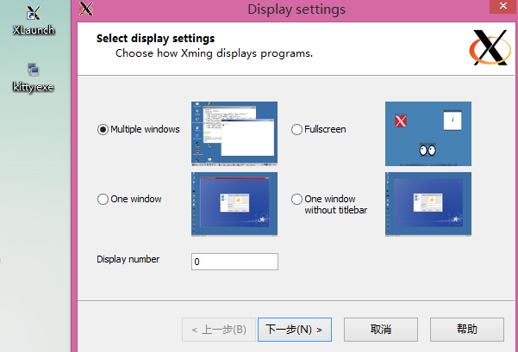
Remote Connection

Slide 8
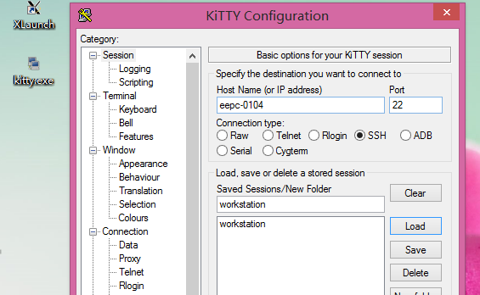
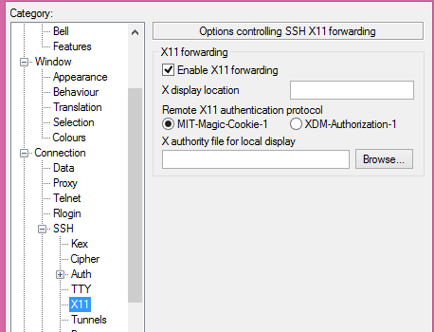
Remote Connection

Slide 9
Start working
1. Either at kitty/putty terminal or open a terminal: ‘Ctrl + Alt + T’
2. Change into shared drive D: ‘cd /mnt/D’ + ‘tab’
3. Change into project directory: ‘cd github/’
4. Initiate TF platform: ‘source activate tensorflow’
5. open Jupyter notebook ‘jupyter notebook’
Notes:
Sometimes, most data wins. So, how to get more data? Even with AMT, often slow and expensive.

Slide 10
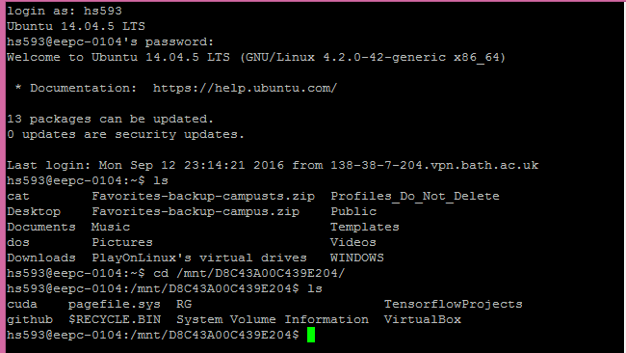
Remote Connection
Changing working directory

Slide 11
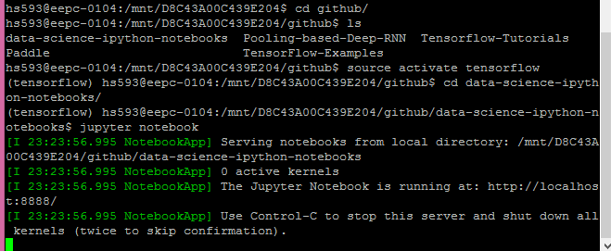
Remote Connection
Open project

Slide 12
Big Data Platform
Basic Concepts
Data Analytic Programming Language: python 2.7
Numerical package: Numpy (matlab)
Data management package: Pandas (database)
Data visualization: Matplotlib
Notes:
Sometimes, most data wins. So, how to get more data? Even with AMT, often slow and expensive.

Slide 13
Big Data Platform
Hardware platform (Xubuntu)
Virtualenv - (Tensorflow)
Python 2.7/numpy…
xubuntu 14.04
Xeon E5-2697
Nvidia m6000
Jupyter Notebook(IDE)
56 cores
24G graphic memory
Notes:
Sometimes, most data wins. So, how to get more data? Even with AMT, often slow and expensive.

Slide 14
Big Data Platform
Software platform
CUDA/Numpy/Pandas/Tensorflow/python/Jupyter Notebook
Tensorflow
Python Interface
CUDA
Numpy
Pandas
Data
CPU
GPU
Jupyter Notebook(Interactive)
Notes:
Sometimes, most data wins. So, how to get more data? Even with AMT, often slow and expensive.

Slide 15
Python and IPython

Slide 16

Python and IPython
Python vs Matlab ($>$)
1. readable
use tab, no need to use ‘end’
20% short in implementation
2. Beautiful syntax
0-based index
use [] for index, () for function call
3. OOP in python is simple and elegant
4. More efficient, and better parallel and devices support
Notes:
Sometimes, most data wins. So, how to get more data? Even with AMT, often slow and expensive.

Slide 17

Python and IPython
Python vs Matlab ($>$)
5. Free and open-source
debug from source
canopy and anaconda (with N,P,M)
support by any developer
6. Visualizaion
matplotlib academic level 2/3-D graph
QT, Traits, Wx create production level UI Chaco create interactive graph
Notes:
Sometimes, most data wins. So, how to get more data? Even with AMT, often slow and expensive.

Slide 18

Python and IPython
Python vs R ($≈)$
Pro:
Beautiful visualization with ggplot2,ggvis,googlevis and rCharts
Huge ecosystem
Quick to use if package available
No need to learn programming
No OOP, No database, No parallel programming
But, not efficient
Not easy to automate workflow, and reuse code
Notes:
Sometimes, most data wins. So, how to get more data? Even with AMT, often slow and expensive.

Slide 19

Python and IPython
Python vs R ($≈)$
Python:
Ipython Notebook, super readable research notes
Easy to automate workflow, reuse code:
Multi purpose language, can merge differing backgrounp, perfect for team play.
General purpose language, production level quality, easy to test, guarantee the reusable and dependable.
Extendable for DIY algorithms
Much more efficient
Notes:
Sometimes, most data wins. So, how to get more data? Even with AMT, often slow and expensive.

Slide 20
Python and IPython
Suggest:
Result-flow, one-off tasks use R/M
Analyse correlations
Decompose load profiles
Probabilistic distribution fit
Linear regression
Data-flow, complex, multi-stage task, P
Novel and complex algorithms not publically available, such as Deep Learning
Etc…

Slide 21
Python and IPython
Go to IPython Notebook
Jupyter notebook: Interactive programming
Data types
Containers
Functions
Classes
Numpy
Array
Array
…
Matplotlib

Slide 22
Example 1
Python basics with notebook

Slide 23
Basics of Tensorflow

Slide 24
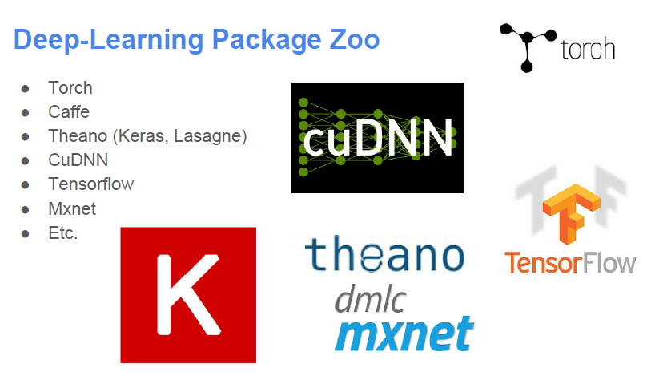
Why Tensorflow
Notes:
Sometimes, most data wins. So, how to get more data? Even with AMT, often slow and expensive.

Slide 25
Why Tensorflow
Features
Model specification:
Configuration files (Caffe, CNTK, etc.)
Generate by program (Torch, Tensorflow, Theano)
Interface Language:
Python: Theano, Tensorflow
Lua: Torch
Java: DL4J
…
Notes:
Sometimes, most data wins. So, how to get more data? Even with AMT, often slow and expensive.

Slide 26
Why Tensorflow
Advantage of Tensorflow
Python (Usain Bolt in Data Science)
Data manipulation packages: numpy,pandas…
More efficient than other script language: R
Glue language, most portable language, most comprehensive.
Support Ipython (interactive programming, easy to record experiments)
GPU support and easy setting.
Graph computing, easy to extend network model
Support by Google team, reliable.
etc
Notes:
Sometimes, most data wins. So, how to get more data? Even with AMT, often slow and expensive.

Slide 27
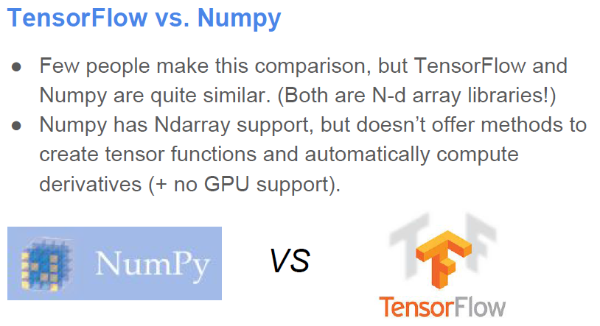
Why Tensorflow
Notes:
Sometimes, most data wins. So, how to get more data? Even with AMT, often slow and expensive.

Slide 28
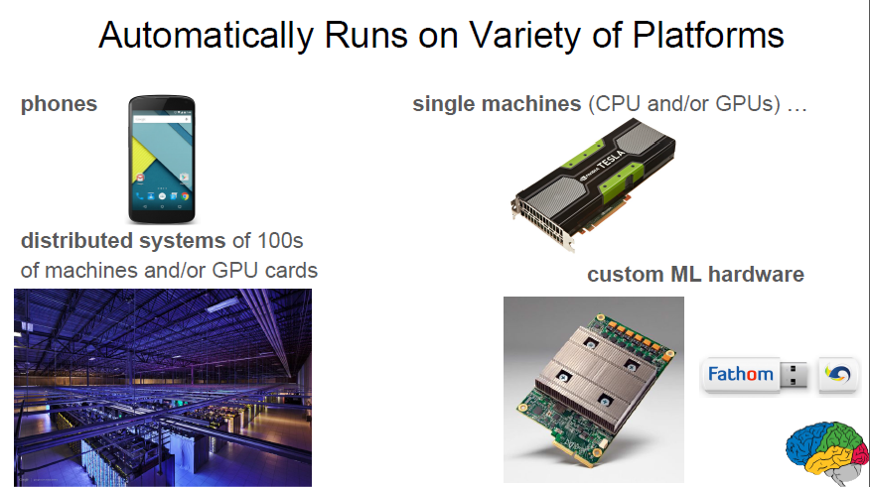
Why Tensorflow
Notes:
Sometimes, most data wins. So, how to get more data? Even with AMT, often slow and expensive.

Slide 29
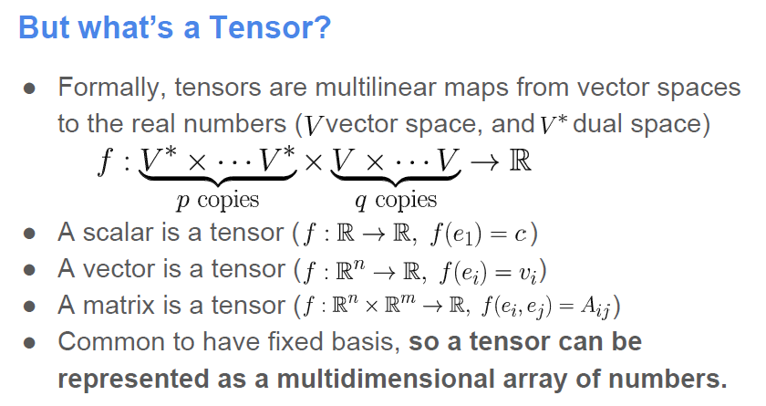
Basics of Tensorflow
Notes:
Sometimes, most data wins. So, how to get more data? Even with AMT, often slow and expensive.

Slide 30
Basics of Tensorflow
Tensors: n-dimensional arrays
Vector: 1-D tensor
Scalar: 0-D tensor
Matrix: 2-D tensor
Deep Learning process →→ flow of tensors
Notes:
Sometimes, most data wins. So, how to get more data? Even with AMT, often slow and expensive.

Slide 31
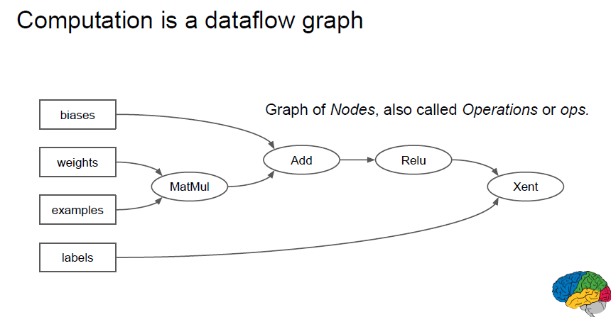
Basics of Tensorflow
Tensors: n-dimensional arrays
Vector: 1-D tensor
Scalar: 0-D tensor
Matrix: 2-D tensor
Deep Learning process →→ flow of tensors
Notes:
Sometimes, most data wins. So, how to get more data? Even with AMT, often slow and expensive.

Slide 32
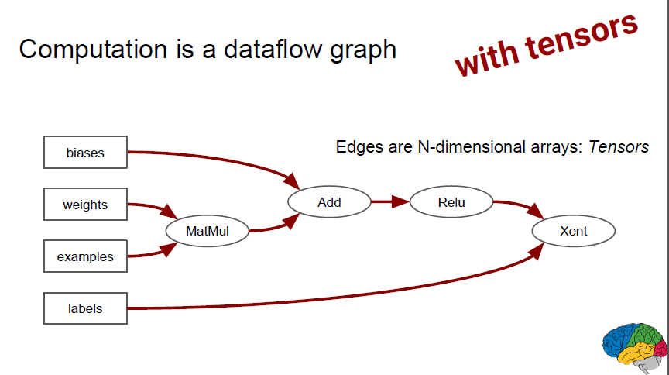
Basics of Tensorflow
Tensors: n-dimensional arrays
Vector: 1-D tensor
Scalar: 0-D tensor
Matrix: 2-D tensor
Deep Learning process →→ flow of tensors
Notes:
Sometimes, most data wins. So, how to get more data? Even with AMT, often slow and expensive.

Slide 33
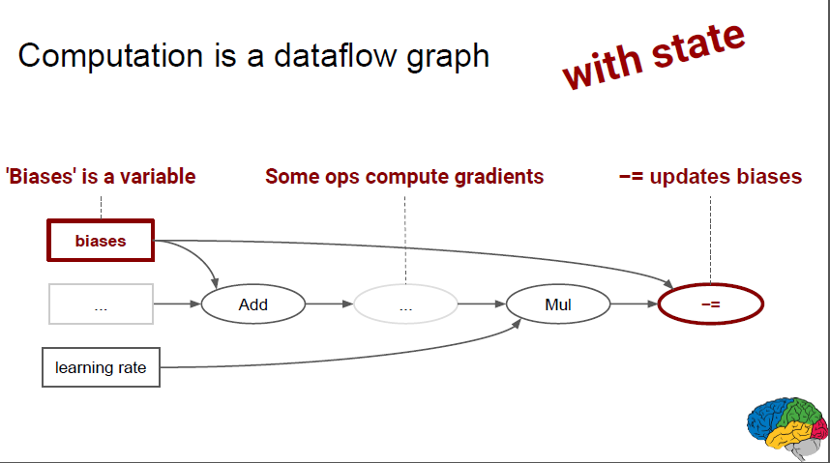
Basics of Tensorflow
Tensors: n-dimensional arrays
Vector: 1-D tensor
Scalar: 0-D tensor
Matrix: 2-D tensor
Deep Learning process →→ flow of tensors
Notes:
Sometimes, most data wins. So, how to get more data? Even with AMT, often slow and expensive.

Slide 34
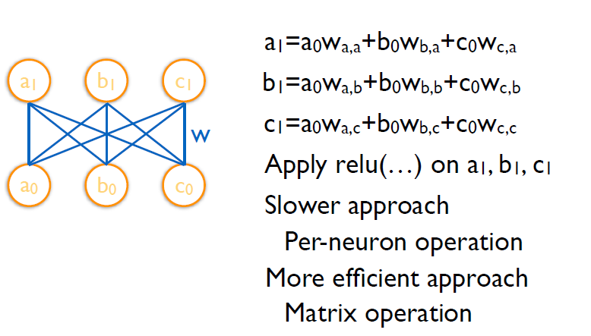
Basics of Tensorflow
Example:
Notes:
Sometimes, most data wins. So, how to get more data? Even with AMT, often slow and expensive.

Slide 35
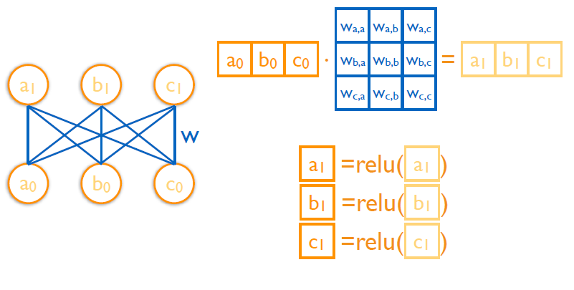
Basics of Tensorflow
Example:
Notes:
Sometimes, most data wins. So, how to get more data? Even with AMT, often slow and expensive.

Slide 36
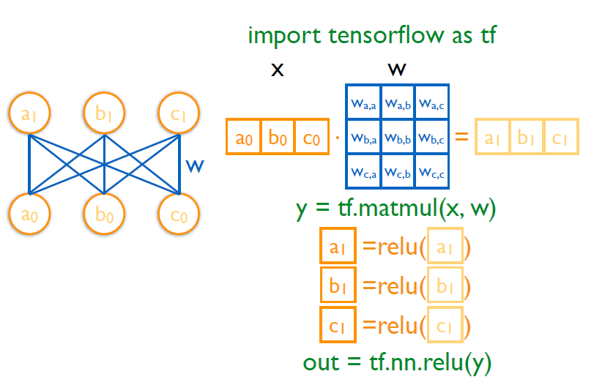
Basics of Tensorflow
Example:
Notes:
Sometimes, most data wins. So, how to get more data? Even with AMT, often slow and expensive.

Slide 37
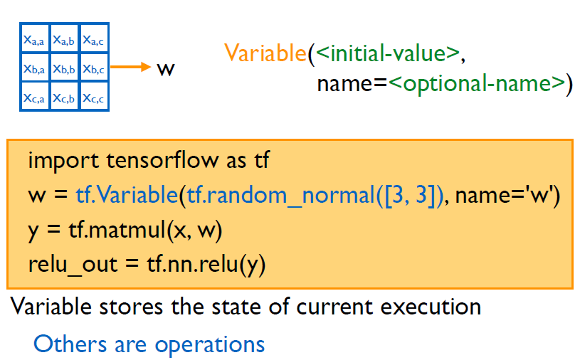
Basics of Tensorflow
Example:
Notes:
Sometimes, most data wins. So, how to get more data? Even with AMT, often slow and expensive.

Slide 38
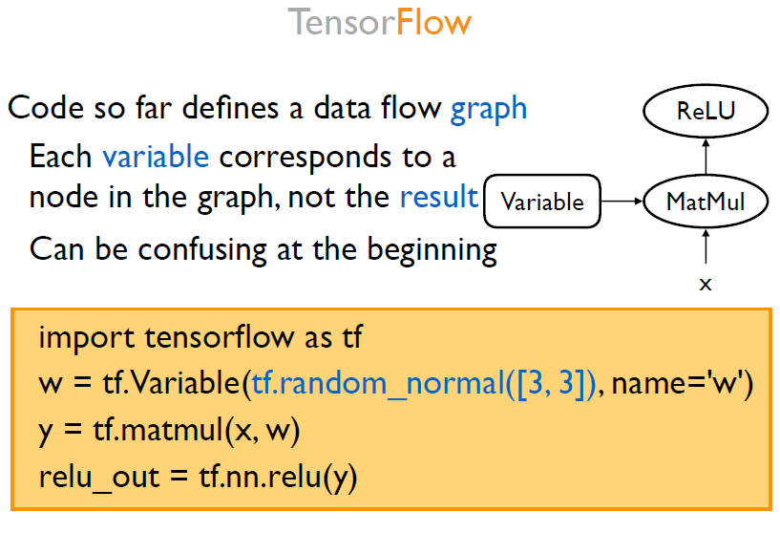
Basics of Tensorflow
Notes:
Sometimes, most data wins. So, how to get more data? Even with AMT, often slow and expensive.

Slide 39
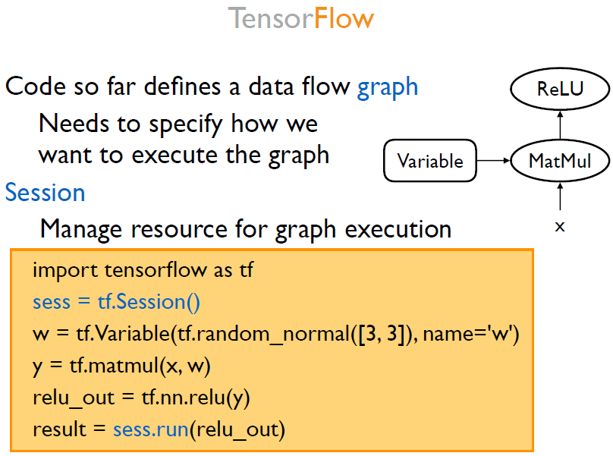
Basics of Tensorflow
Notes:
Sometimes, most data wins. So, how to get more data? Even with AMT, often slow and expensive.

Slide 40
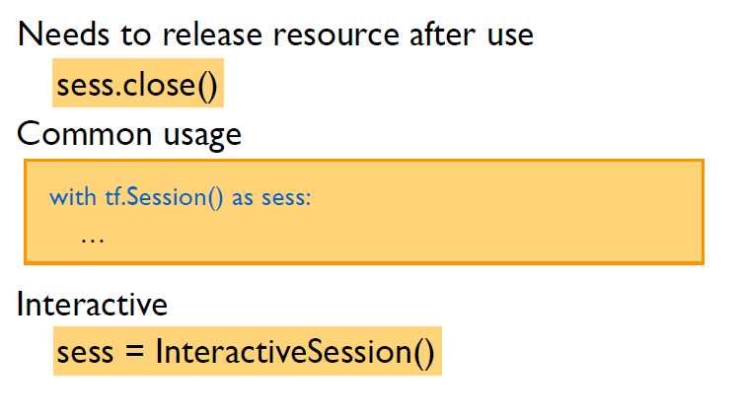
Basics of Tensorflow
Notes:
Sometimes, most data wins. So, how to get more data? Even with AMT, often slow and expensive.

Slide 41
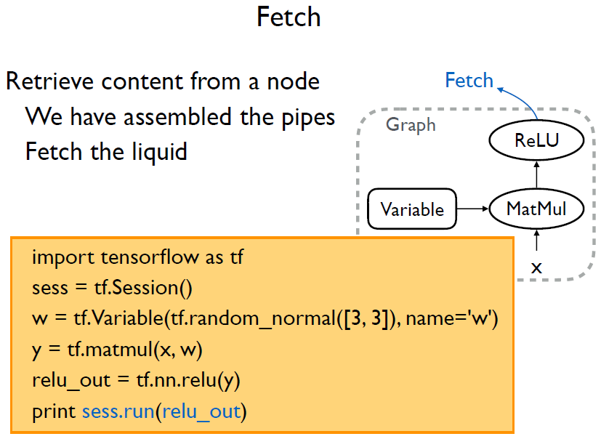
Basics of Tensorflow
Notes:
Sometimes, most data wins. So, how to get more data? Even with AMT, often slow and expensive.

Slide 42
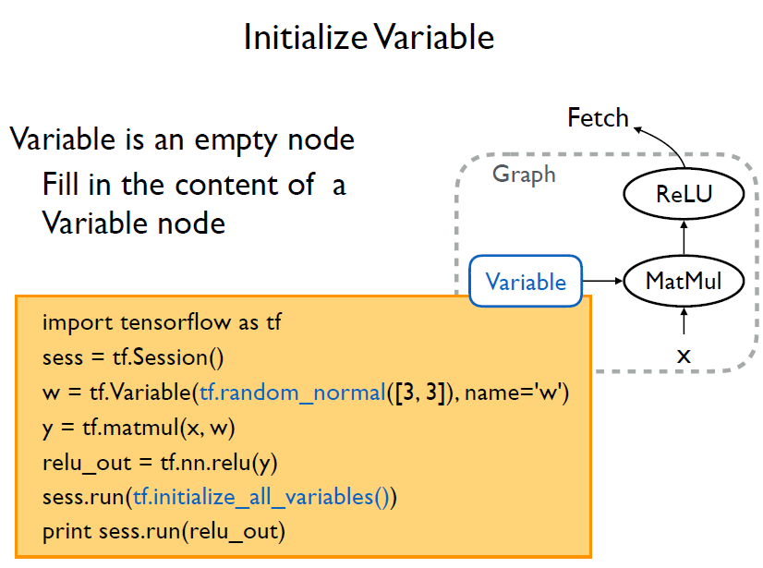
Basics of Tensorflow
Notes:
Sometimes, most data wins. So, how to get more data? Even with AMT, often slow and expensive.

Slide 43
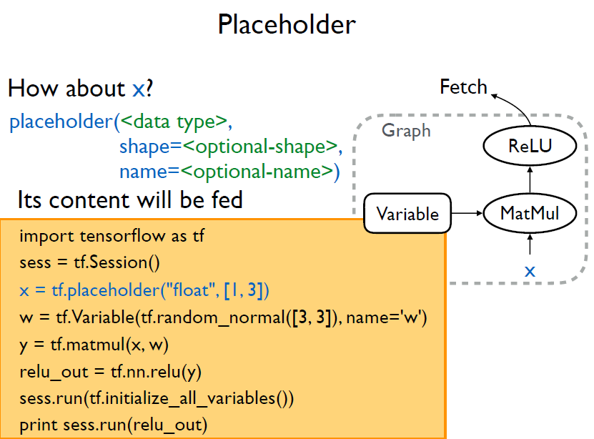
Basics of Tensorflow
Notes:
Sometimes, most data wins. So, how to get more data? Even with AMT, often slow and expensive.

Slide 44
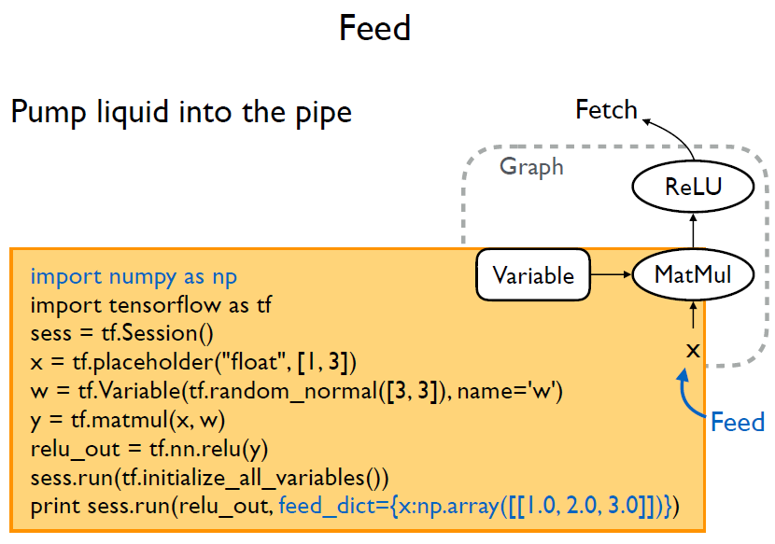
Basics of Tensorflow
Notes:
Sometimes, most data wins. So, how to get more data? Even with AMT, often slow and expensive.

Slide 45
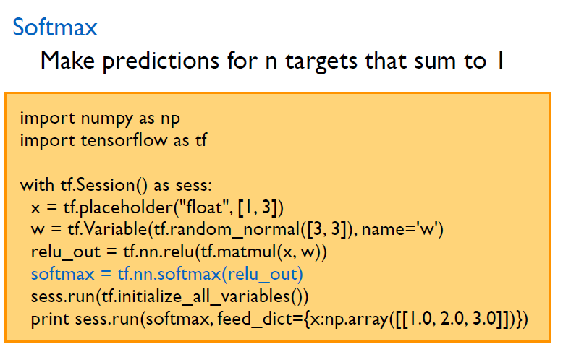
Basics of Tensorflow
Notes:
Sometimes, most data wins. So, how to get more data? Even with AMT, often slow and expensive.

Slide 46
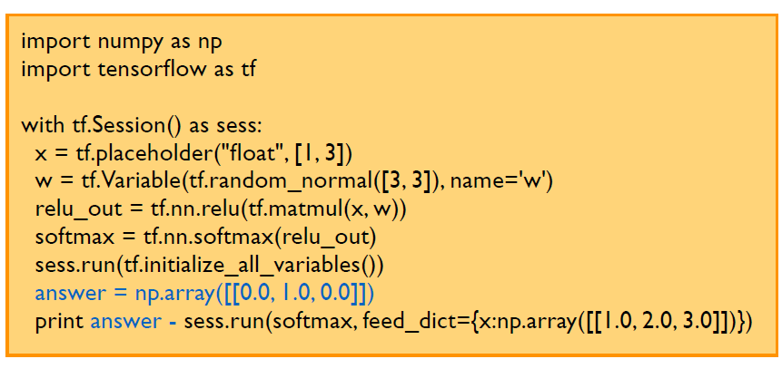
Basics of Tensorflow
Notes:
Sometimes, most data wins. So, how to get more data? Even with AMT, often slow and expensive.

Slide 47
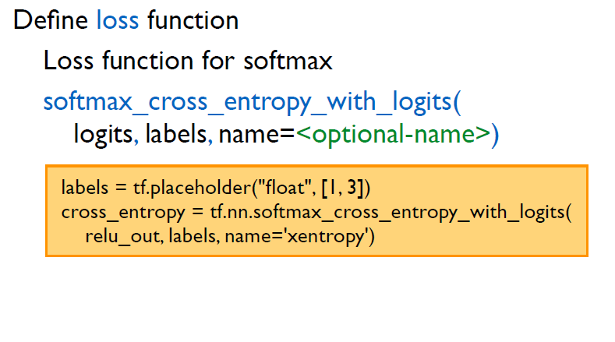
Basics of Tensorflow
Notes:
Sometimes, most data wins. So, how to get more data? Even with AMT, often slow and expensive.

Slide 48
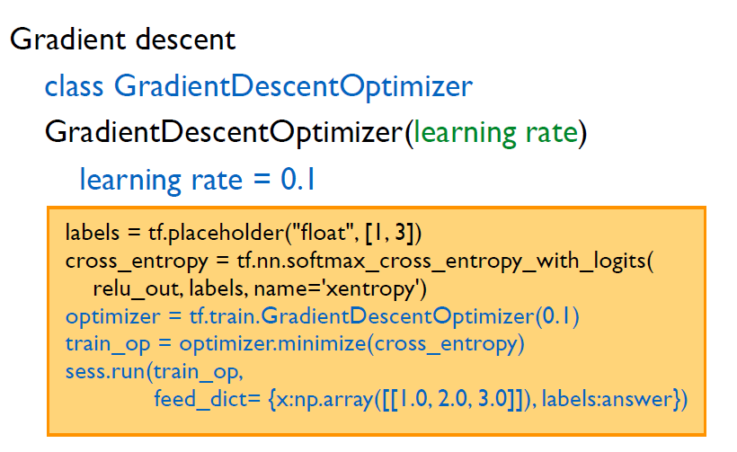
Basics of Tensorflow
Notes:
Sometimes, most data wins. So, how to get more data? Even with AMT, often slow and expensive.

Slide 49
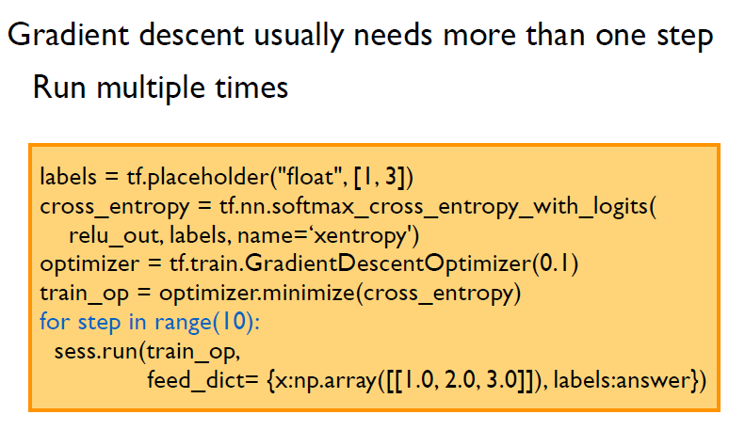
Basics of Tensorflow
Notes:
Sometimes, most data wins. So, how to get more data? Even with AMT, often slow and expensive.

Slide 50
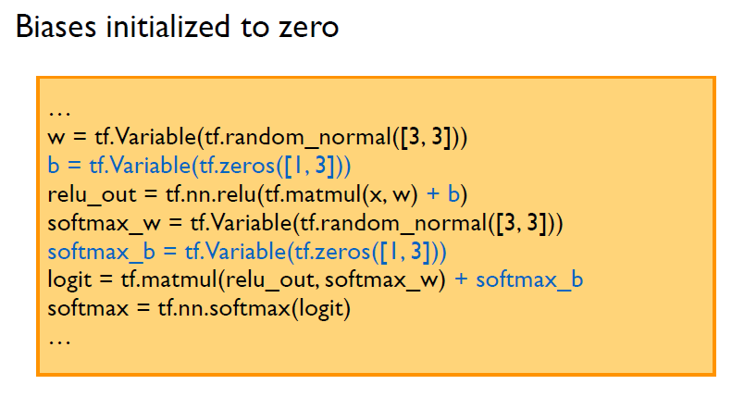
Basics of Tensorflow
Notes:
Sometimes, most data wins. So, how to get more data? Even with AMT, often slow and expensive.

Slide 51
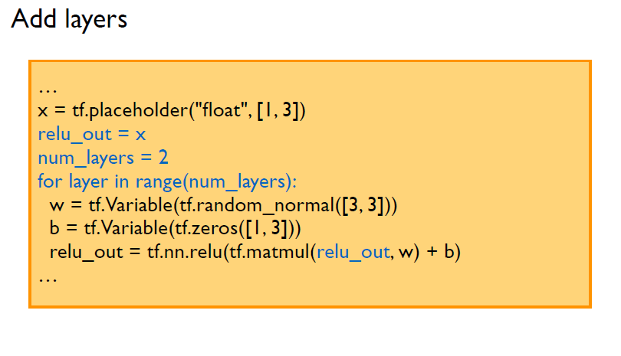
Basics of Tensorflow
Notes:
Sometimes, most data wins. So, how to get more data? Even with AMT, often slow and expensive.

Slide 52
Advances of Tensorflow

Slide 53
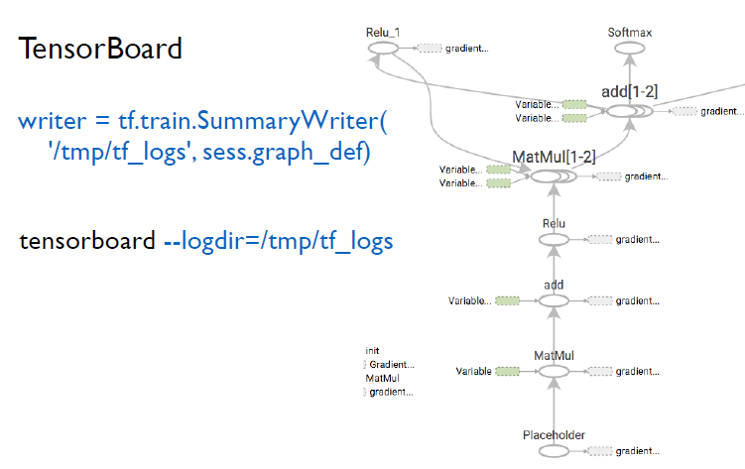
Basics of Tensorflow
Notes:
Sometimes, most data wins. So, how to get more data? Even with AMT, often slow and expensive.

Slide 54
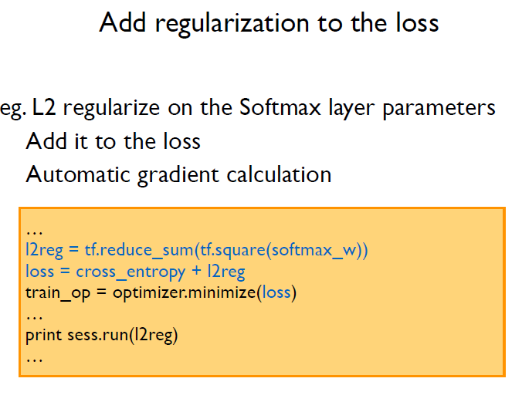
Basics of Tensorflow
Notes:
Sometimes, most data wins. So, how to get more data? Even with AMT, often slow and expensive.

Slide 55
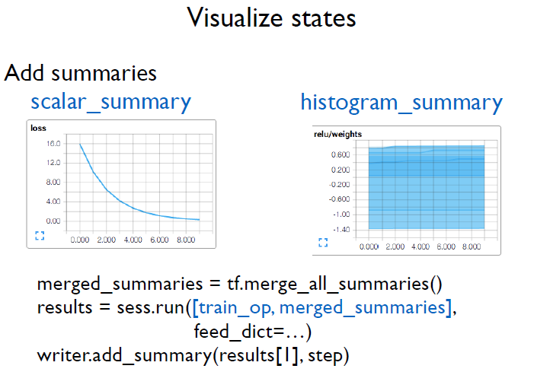
Basics of Tensorflow
Notes:
Sometimes, most data wins. So, how to get more data? Even with AMT, often slow and expensive.

Slide 56
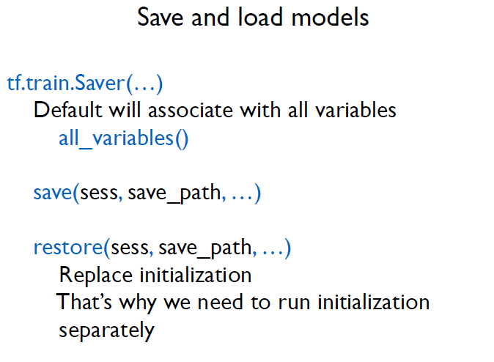
Basics of Tensorflow
Notes:
Sometimes, most data wins. So, how to get more data? Even with AMT, often slow and expensive.

Slide 57
Examples 2
Mnist with 3 version imps.

